Slide 1


1.6T Sian3L LRO Mode Hopping Test Report
2026/10/22

Slide 2
Purpose:
Test Condition:
Conclusion:
Summary

Slide 3
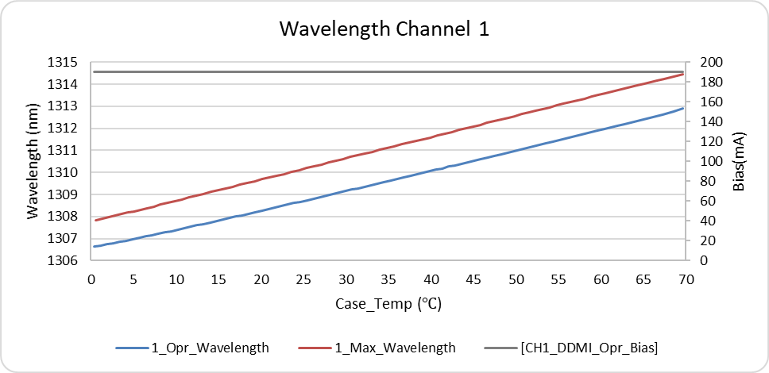
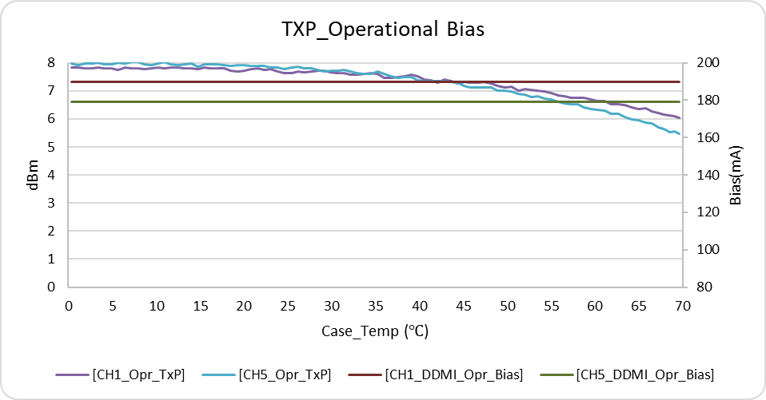
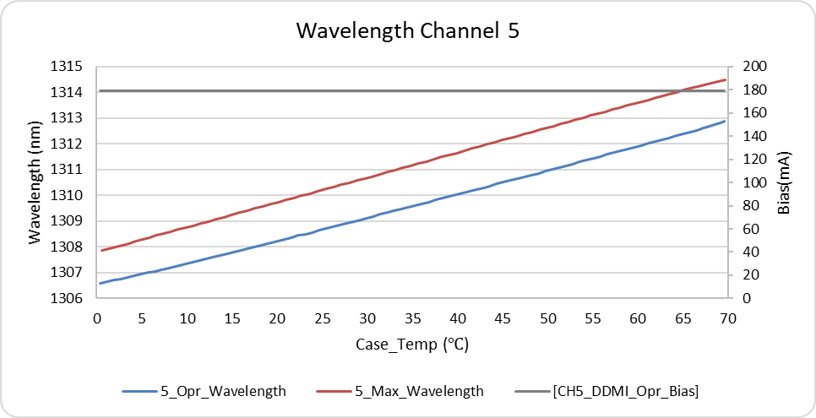
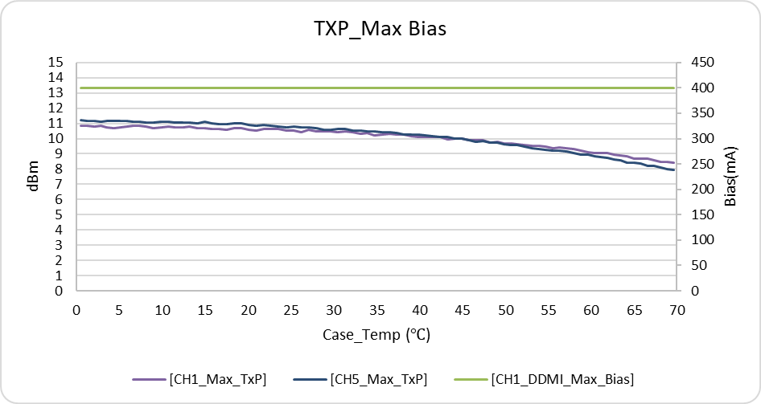
A3_Operational & Maximum Wavelength and TxP
Conclusion:

Slide 4
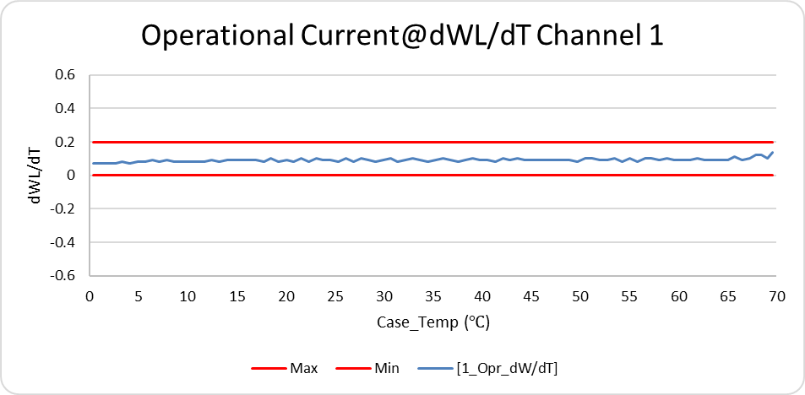
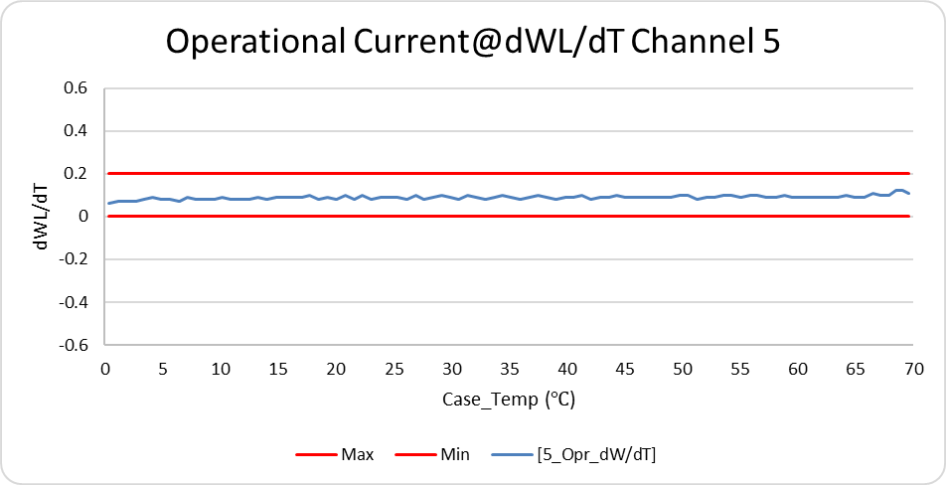
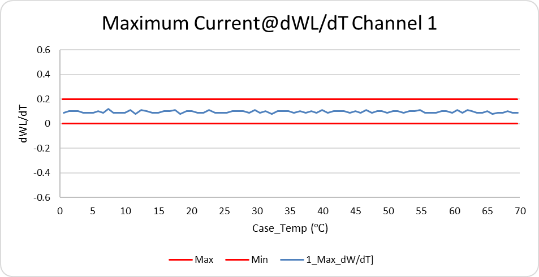
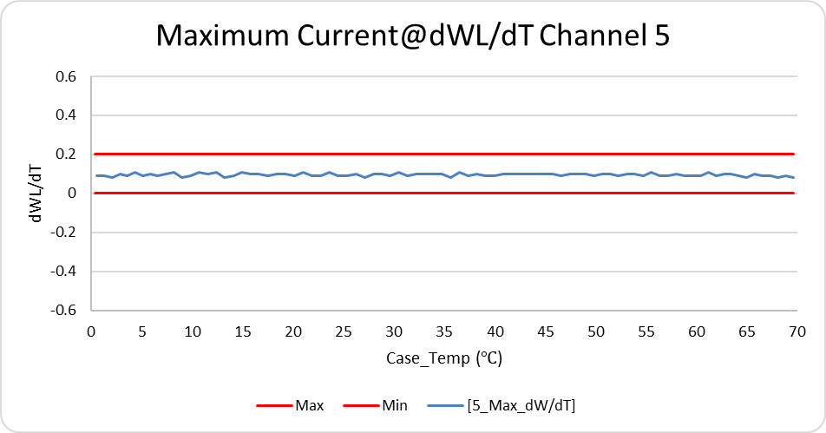
A3_ Operational & Maximum dWL/dT
Conclusion:

