Slide 1
Marketing retail analytics
Great Learning PGDSBA 2022-2023
Presented by: Bhushan Rai

Slide 2
Contents
Problem Statement
Data Pre-processing
Exploratory Data Analysis
Customer Segmentation using RFM Analysis
RFM Inferences and Business Recommendation

Slide 3

Problem Statement
An automobile parts manufacturing company has collected data on transactions for 3 years. They do not have any in-house data science team thus they have hired you as their consultant. Your job is to use your data science skills to find the underlying buying patterns of the customers, provide the company with suitable insights about their customers, and recommend customized marketing strategies for different segments of customers

Slide 4
Data Dictionary:
ORDERNUMBER STATUS
QUANTITYORDERED PRODUCTLINE
PRICEEACH MSRP
ORDERLINENUMBER PRODUCTCODE
SALES CUSTOMERNAME
ORDERDATE PHONE
DAYS_SINCE_LASTORDER COUNTRY
ADDRESSLINE1 CONTACTLASTNAME
CITY CONTACTFIRSTNAME
POSTALCODE DEALSIZE

Slide 5
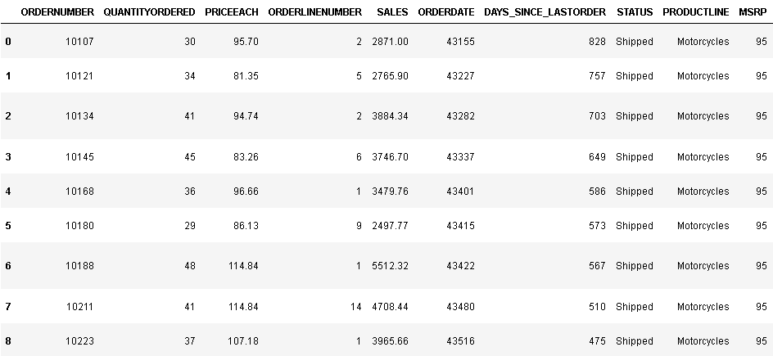
Data Preprocessing: About the data(Info, shape, Summary stats) & Assumptions

Slide 6
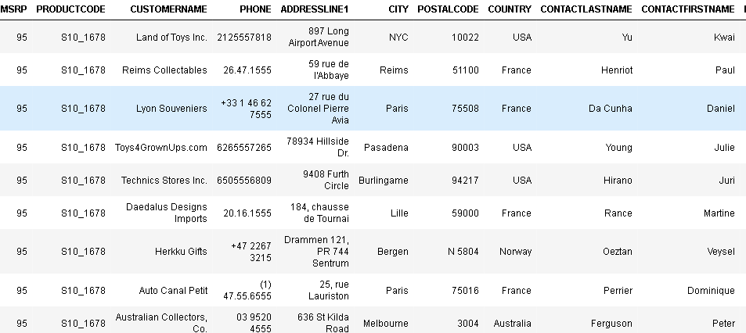

This the second part of dataset

Slide 7
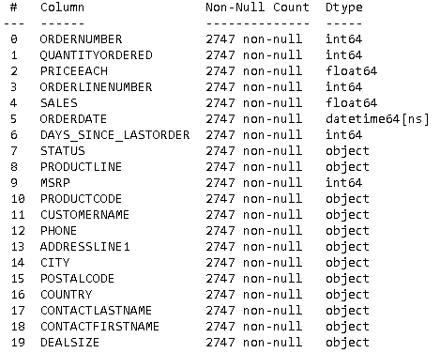
The Dataset contains 2 floats, 6 integer and 12 objects. There are in total of 2747 rows and 20 columns. No missing data found or no duplicates present here.

Slide 8
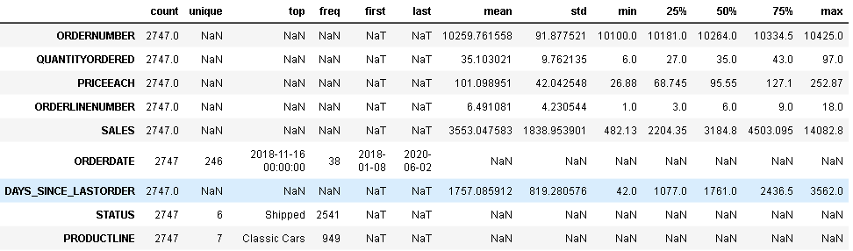
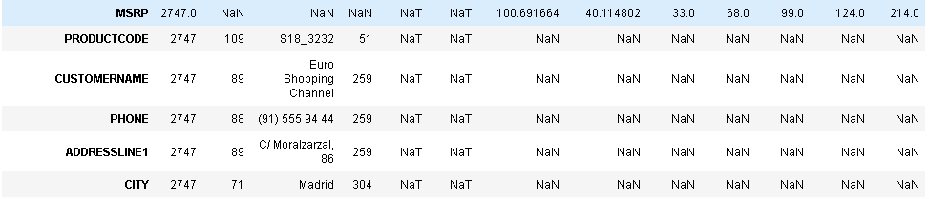
Descriptive Statistics

Slide 9
Assumptions and Findings:
Order Trends: The average order number is around 10260, indicating a significant volume of orders processed. Orders range from 10100 to 10425, suggesting a wide range of transactions.
Product Demand: The average quantity ordered is approximately 35 units per order, with a range from 6 to 97 units. Understanding the demand for different products based on quantity ordered can help in inventory management.
Pricing Strategy: The average price for each item is around 101.10, with prices ranging from 26.88 to 252.87.Analysis of price variations can inform pricing strategies for different product lines.
Order Line Complexity: The average order line number is 6.49, indicating that orders typically consist of multiple lines. Analysing the complexity of order lines can help optimize order fulfilment processes.
Sales Performance: The average sales amount is approximately 3553.05, with a wide range of sales values (from 482.13 to 14082.8).Understanding sales performance and identifying top-performing orders or products can guide sales strategies.

Slide 10
Assumptions and Findings:
Order Timing: The average number of days since the last order is around 1757.09, suggesting a relatively steady flow of orders.
Order Status: The dataset includes various order statuses, with Shipped being the most common (appearing 2541 times).Analysing order statuses can provide insights into order processing efficiency and customer satisfaction.
Product Line Popularity: Classic Cars is the most frequent product line (appearing 949 times), indicating its popularity among customers. Identifying popular product lines can guide marketing and inventory management decisions.
MSRP Analysis: The average Manufacturer's Suggested Retail Price (MSRP) is approximately 100.69. Understanding the relationship between MSRP and actual sales prices can help assess pricing strategies.
Deal Size: Medium deals are the most common (appearing 1349 times).Analysing deal sizes and their impact on sales can guide sales and marketing efforts.

Slide 11
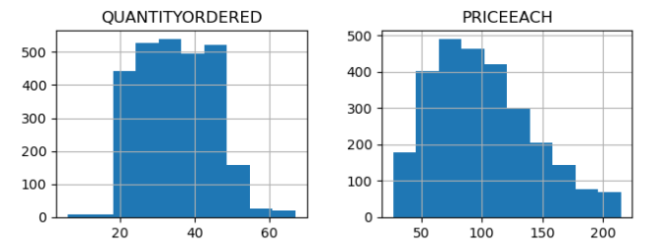
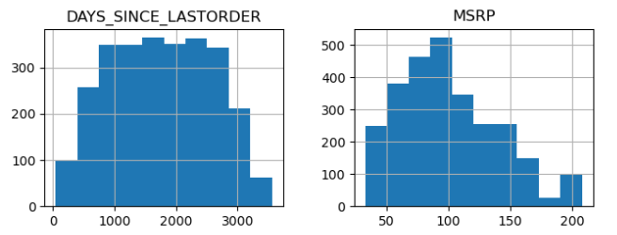
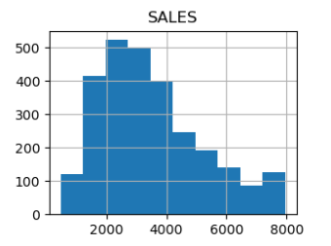
Let’s Perform EDA (Exploratory Data Analysis). This will help us to examine the dataset to summarize the main characteristics and identify patterns undercovering underlying structures, detect outliers and visualize relationships between variables.
Univariate Analysis:

Slide 12
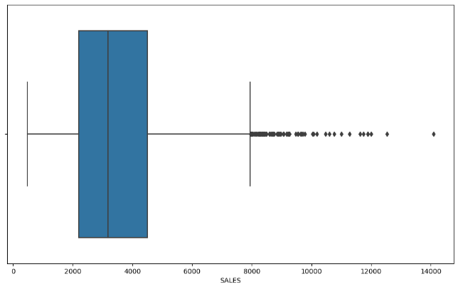
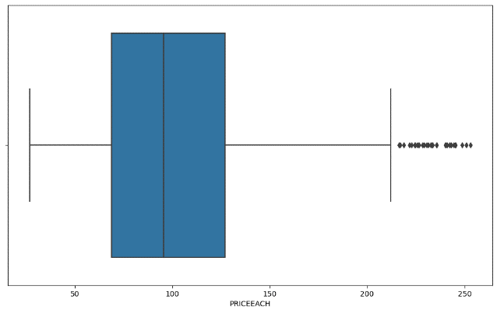
As we see the data is right skewed for variables [Quantity Ordered, Price Each, Sales], there can be a possible outcome of huge delivery as per the demand on the product, so we see a raise in the outliers for these variables however we will still treat them for our analysis. Here in next image, we will see the possible outliers in these variables.

Slide 13
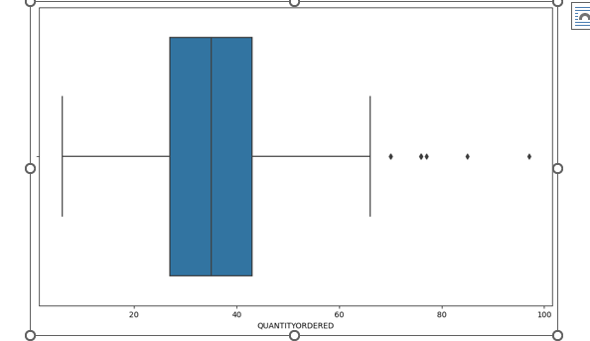
Outliers:

Slide 14
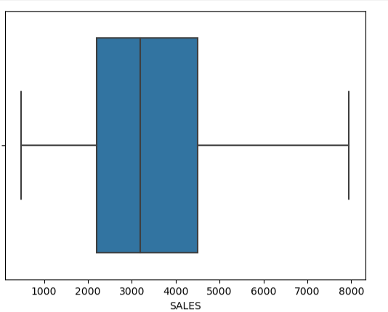
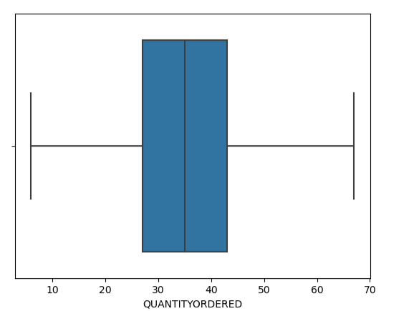
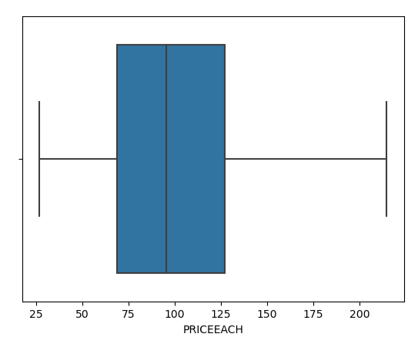
Outliers Treated:

Slide 15
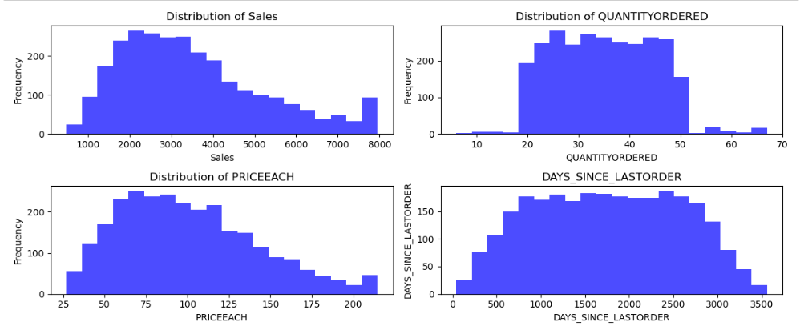
We see here the distribution of sales, Quantity ordered Price Each, Days’s since Last Order, data has a normal distribution.

Slide 16
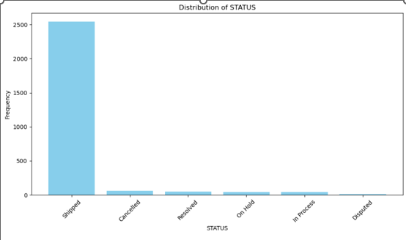
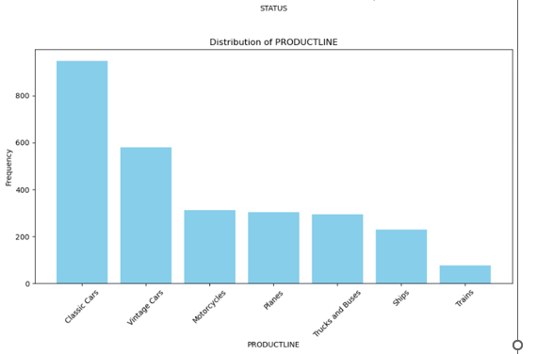
This image shows was a distribution of status variable, shipped is the maximum frequency, followed by the descending order in cancelled, resolved, on-hold, InProgress, disputed. Distribution frequency for product-line shows classic cars has the maximum, followed by vintage cars, motorcycles, planes, trucks& Buses, Ships, trains

Slide 17
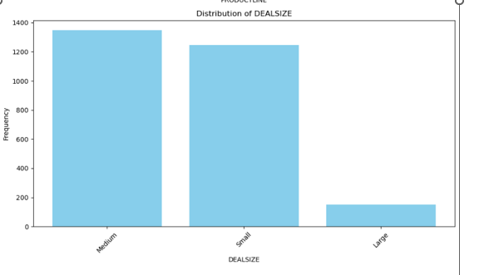
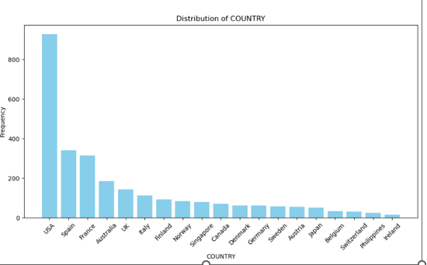
Distribution frequency for deal size is Medium, small and large Distribution frequency for country is USA has the maximum frequency and Ireland has the lowest frequency

Slide 18
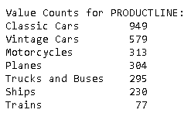
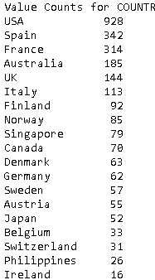
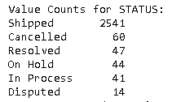

Value counts for Product-line, deal-size, country & Status

Slide 19
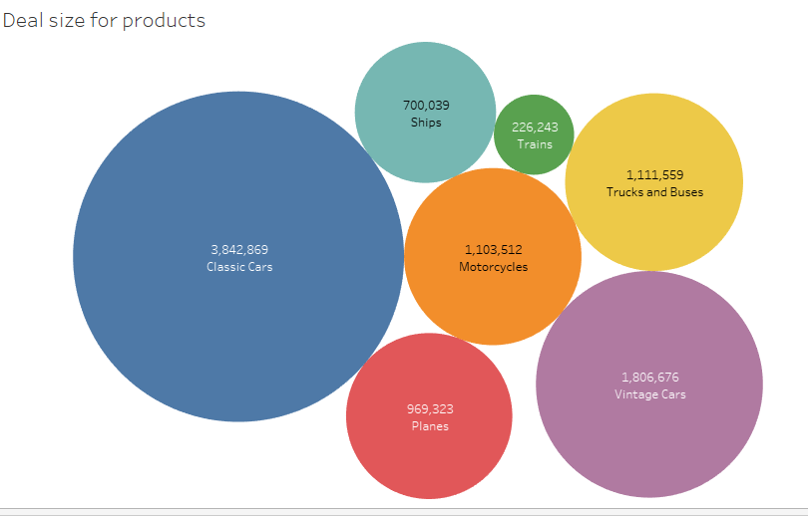
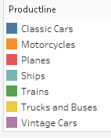
USA has the most sales

Slide 20
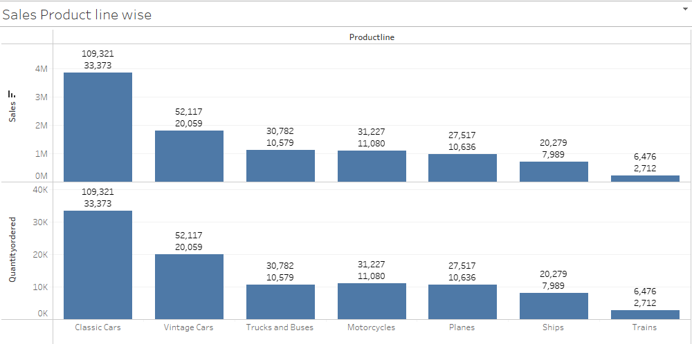
Price Each Data for product line and Quantity ordered

Slide 21
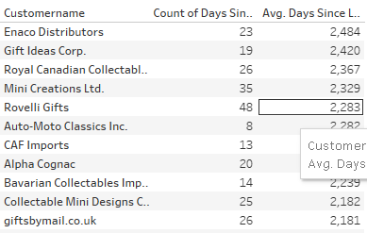
Number of Day Since Last order for TOP 10 customers for most days:

Slide 22
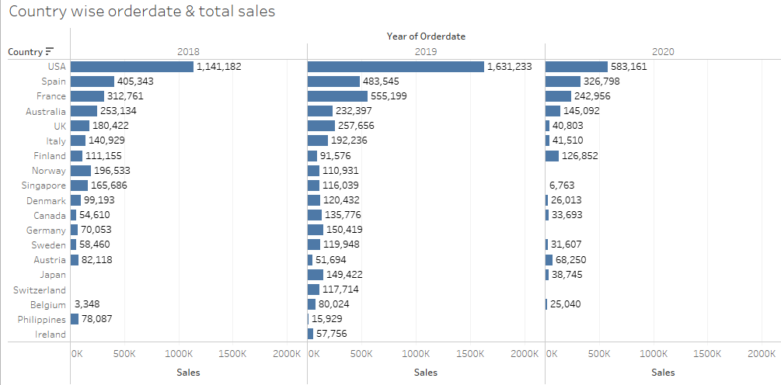
Top countries with most sales yearly data

Slide 23
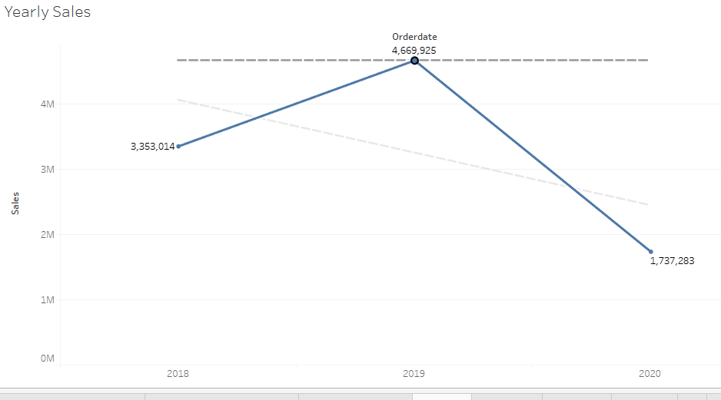
This Graph represents sales frequency as 2019 was a top year

Slide 24
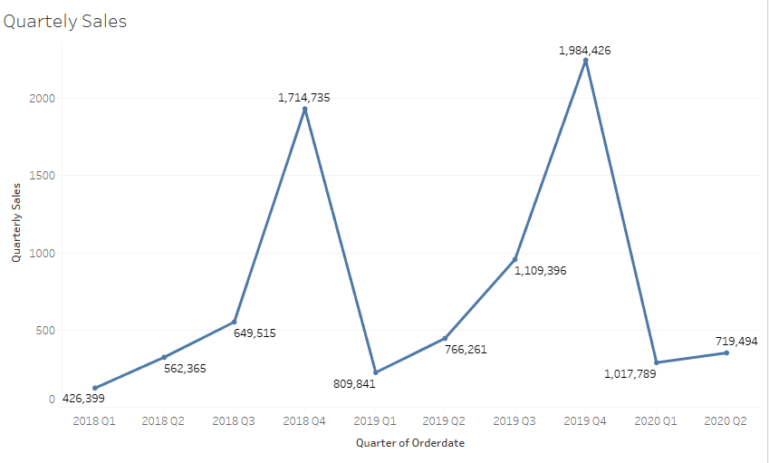

Slide 25
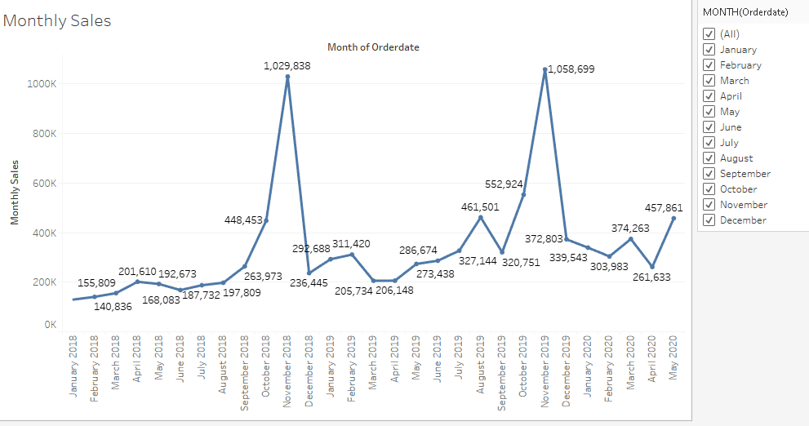
Sales as been constant, however there have been few inconsistencies, but we see a high rise from sep2018 to nov 218, nov 2019, also there is a weekly break up of sales within the same pattern. As we see maximum sales in sep, oct and nov months

Slide 26
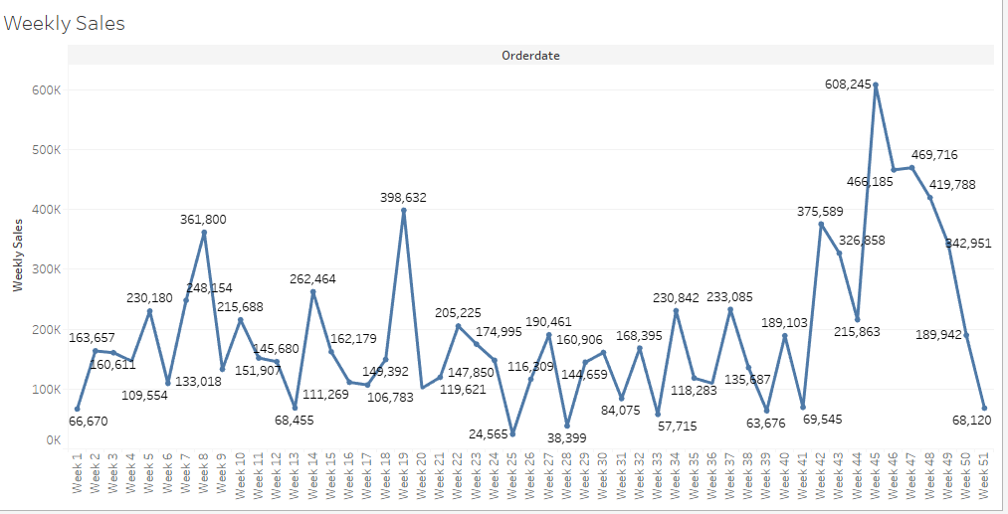

Slide 27
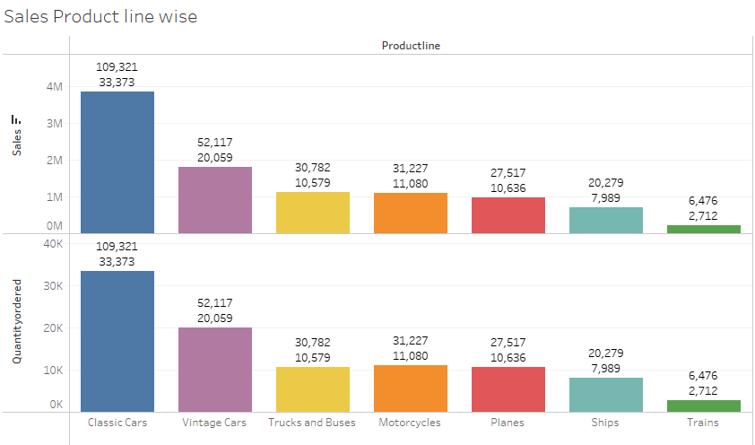
Bivariate Analysis:

Slide 28
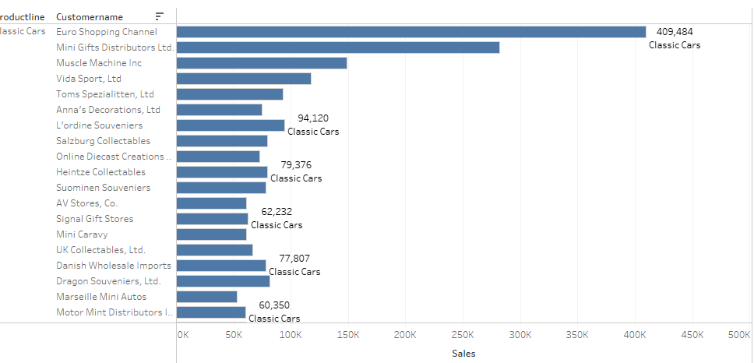
Customer Product-line sales

Slide 29

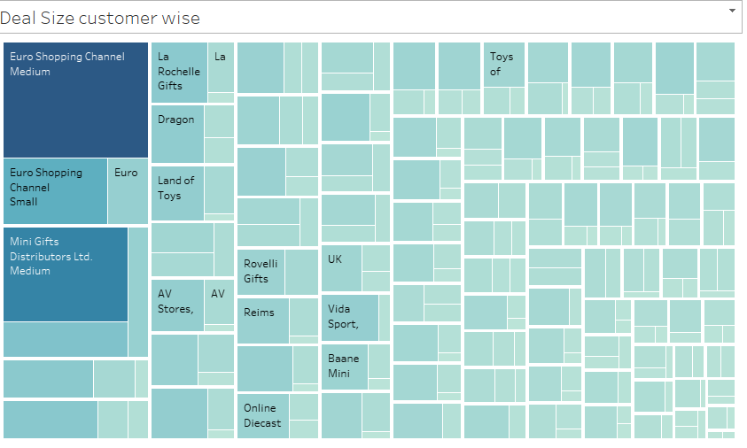

Slide 30
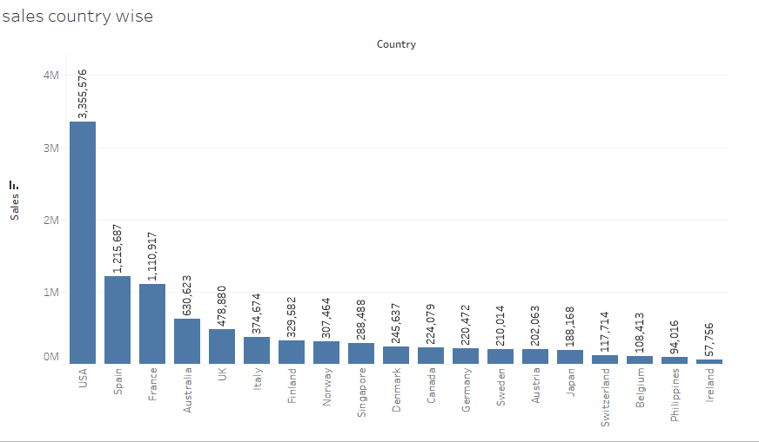
Countries Sales: USA is topping the data with maximum sales and Ireland the least. There is a clear explanation as per the year order date for consecutive 3 years:

Slide 31
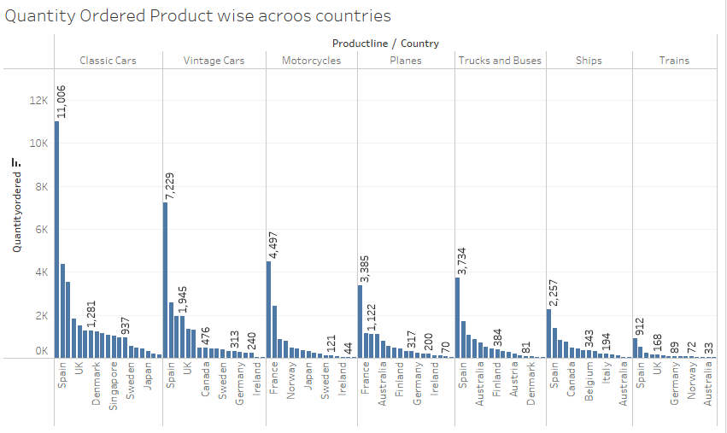

Slide 32
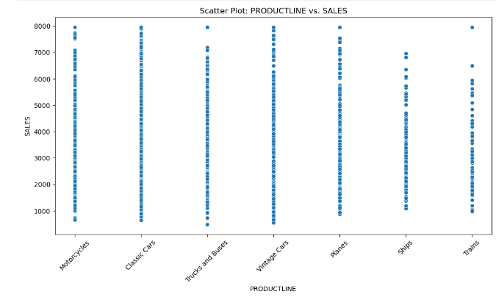
Classic cars has the maximum product popularity.

Slide 33
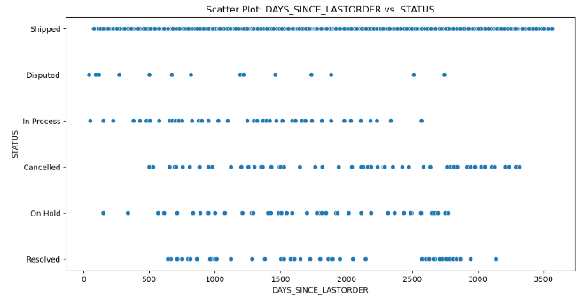
Shipped has the most status

Slide 34
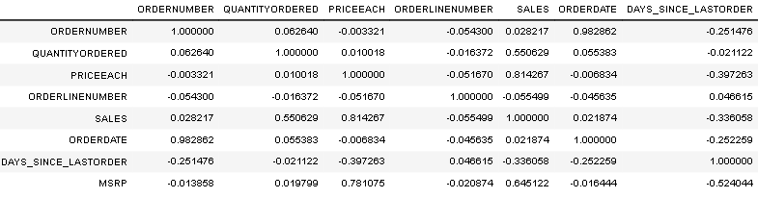


Slide 35
Multivariate Analysis:
Strong Positive Correlation between Price Each and MSRP: The correlation coefficient between Price Each and MSRP is 0.781075, suggesting a strong positive linear relationship. This means that the price at which a product is sold Price Each tends to be positively correlated with its Manufacturer's Suggested Retail Price MSRP.
Strong Positive Correlation between Order Date and Order Number: The correlation coefficient between Order Date and Order Number is 0.982862, indicating a strong positive linear relationship. This suggests that order numbers tend to increase over time, indicating a growth in orders.
Negative Correlation between Days Since Last Order and Sales: The correlation coefficient between Days Since Last Order and Sales is -0.336058, showing a negative correlation. This means that as the number of days since the last order increases, sales tend to decrease, although the correlation is not very strong.

Slide 36
Weak Correlations with Order Line Number: Order Line Number doesn't show strong correlations with other variables, indicating that it may not be strongly related to other aspects of the data
Strong Positive Correlation between Price Each and Sales: The correlation coefficient between Price Eachn and Sales is 0.814267, suggesting a strong positive linear relationship. This means that the price at which a product is sold Price Each is strongly positively correlated with sales.
Negative Correlation between Price Each and Days Since Last Order: The correlation coefficient between Price Each and "Days Since Last Order is -0.397263, indicating a moderate negative linear relationship. This suggests that as the price of a product increases, the number of days since the last order tends to decrease. In other words, higher-priced products may be ordered more frequently.
Negative Correlation between Quantity Ordered and Days Since Last Order: The correlation coefficient between Quantity Ordered" and Days Since Last Order is -0.021122, indicating a weak negative linear relationship. This suggests that there is a slight tendency for the number of days since the last order to increase slightly as the quantity ordered decreases, but the correlation is not strong.

Slide 37
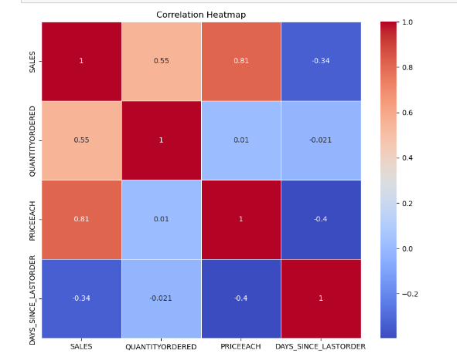

Slide 38
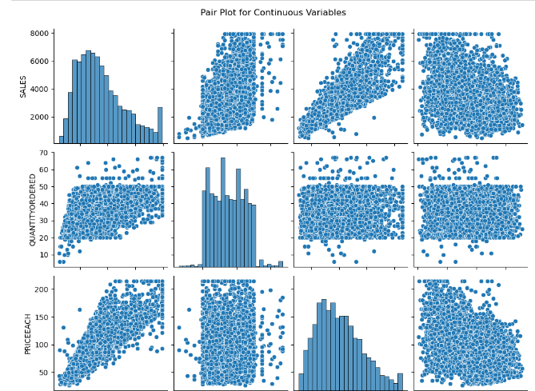
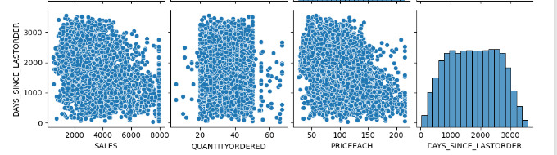

Slide 39
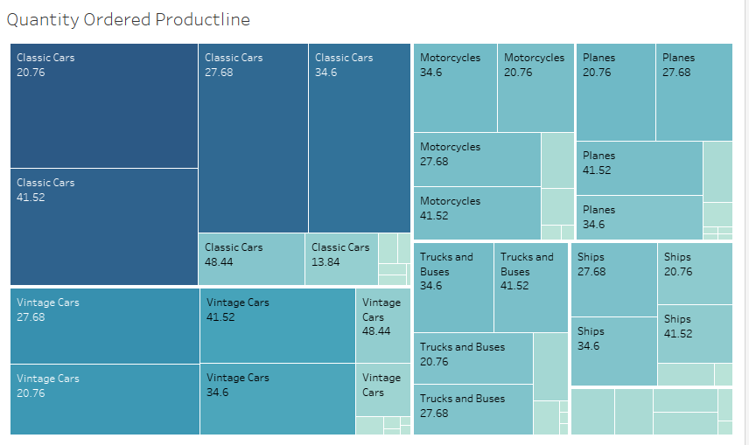

Slide 40
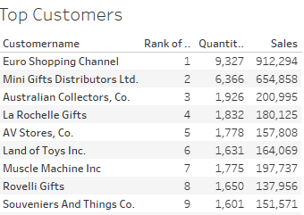
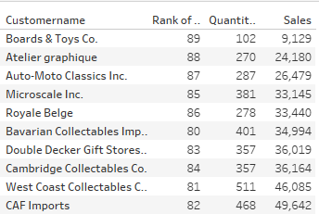
Top and Bottom Customers

Slide 41
Customer Segmentation using RFM
We have use Knime Analytics to segmentate customers based on their RFM analysis.
Parameters used are Quantity Ordered, Sales, order date
For Recency we have calculated present date with order date
Frequency we have taken as Quantity ordered
And Sales for Monetary

Slide 42

RFM stands for Recency, frequency & monetary it’s a technique used in business to segment the customers based on interactions and transactions.
This Photo by Unknown Author is licensed under CC BY-SA

Slide 43
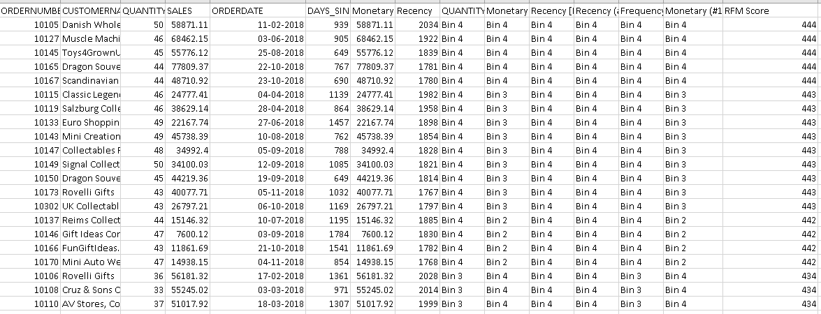

Slide 44
We have successfully segmented the customers the dataset includes columns such as ORDERNUMBER, CUSTOMERNAME, QUANTITYORDERED, SALES, ORDERDATE, DAYS_SINCE_LASTORDER, Monetary, Recency, Frequency, based on customer segments in Bin4 can be valuable customers so we can run exclusive promotions or loyalty programs thorough targeted marketing. Customers who haven't make a purchase from a long time can be offered services to encourage purchasing

Slide 45
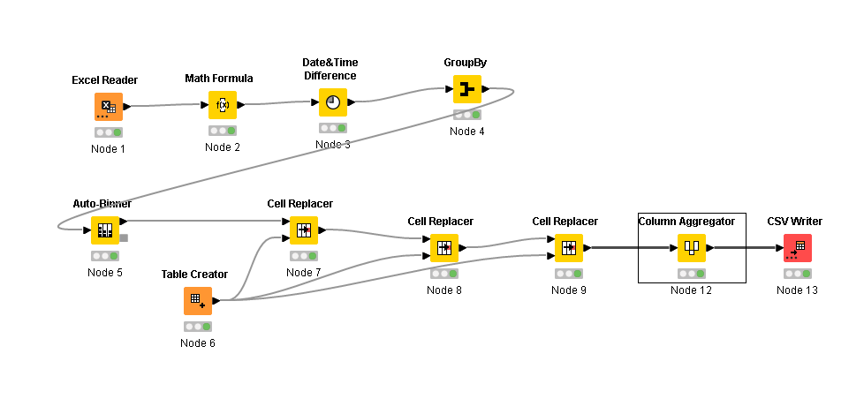
Workflow:

Slide 46
Best 5 customers with RFM Scores:
Danish Wholesale Import RFM score 444
Muscle Machine RFM Score 444
ToysforGrownups.com score 444
Dragon Souvenirs Ltd score 444
Scandinavian Gift Ideas score 44

Slide 47
Customers on verge of churning
Auto Canal Petit RFM score of 142
Australian Collectables, Ltd score of 142
Diecast Classics Inc. score 142
Reims Collectables score 142
Lyon Souvenirs score 142

Slide 48
Lost customers:
Handji Gifts& Co RFM Score of 111
Tokyo Collectables, Ltd score of 111
Petit Auto score of 111
Euro Shopping Channel – Madrid score of 113
Salzburg Collectables score of 114

Slide 49
Loyal customers:
1.Euro Shopping channel RFM Score 443
Mini Gifts and distributors score 434
Australian Collectors, score Co. 432
La Rochelle Gifts score of 334
AV Stores, Co. score 344

Slide 50


