Slide 1
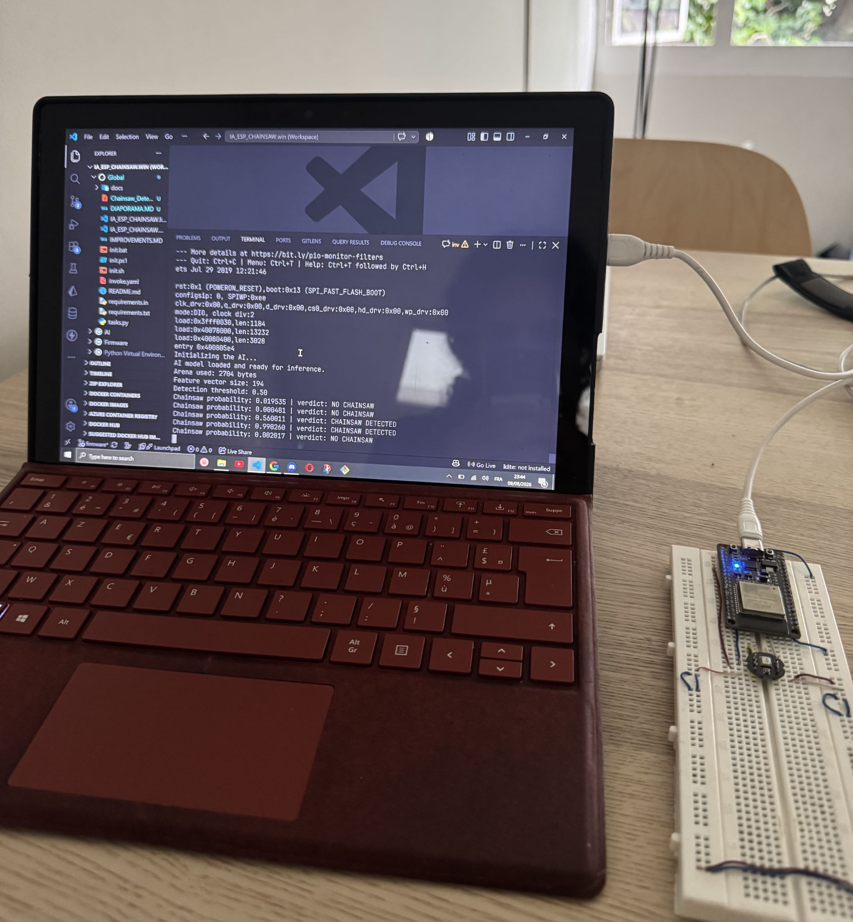
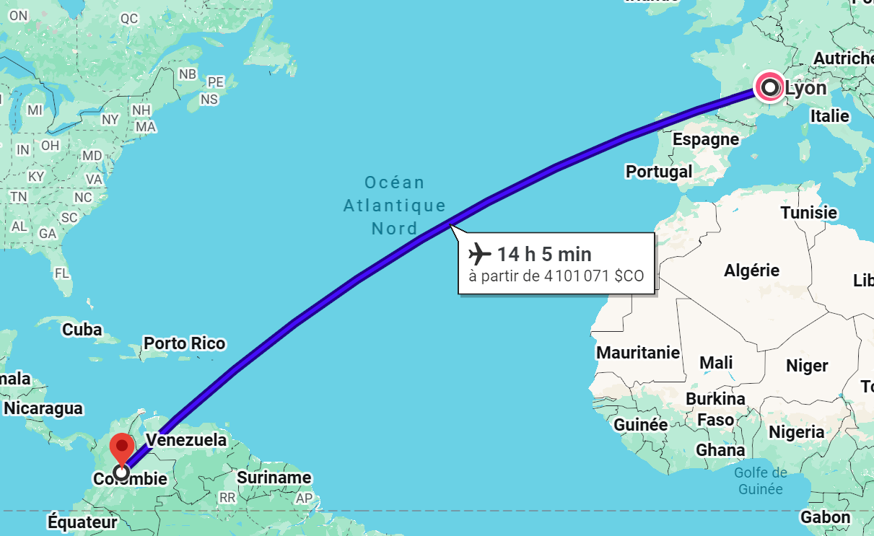



CPE Lyon · Energy Pool · Universidad Militar Nueva Granada
Hearing the forest
Acoustic chainsaw detection on an ESP32
An offline edge-AI node against illegal logging (TensorFlow → TFLite → microcontroller)
PRESENTED BY
Rayane Merlin, Engineering student, CPE Lyon (France)
APPRENTICESHIP
Energy Pool, Lyon - Energy management
INTERNSHIP
Universidad Militar Nueva Granada, Bogotá
PERIOD
15 June 2026 → 14 August 2026
SUPERVISORS
Edward Guillen · Juan Carlos Martínez
1 / 15
Notes:
Good morning everyone, and thank you for having me. My name is Rayan, I come from Lyon, in France, where I study engineering at CPE Lyon. In parallel with my studies I work as an apprentice at Energy Pool, in Lyon, a company operating in the energy-management sector - mostly demand-response and flexibility for electrical grids. For the last two months I have been here in Bogota, at the Universidad Militar Nueva Granada, from the 15th of June to the 14th of August 2026, under the supervision of Edward Guillen and Juan Carlos Martinez, whom I would like to thank for their guidance. The project I am going to present today sits between artificial intelligence and embedded systems: building a small autonomous sensor that can hear a chainsaw in the rainforest and raise an alert - without internet, without GPS, and on a microcontroller that costs a few euros. [~1:00]

Slide 2
DEVELOPER EXPERIENCE
One command to rule them all
1
Bootstrap
2
Locked deps
3
One task runner
init.sh · init.ps1 · init.bat
Creates the Python 3.11 venv and installs everything, on Windows, WSL and Linux.
pip-tools compiles a short, hand-written requirements.in into a fully pinned requirements.txt.
Every action lives in tasks.py as an Invoke task, each with a short alias.
$ inv --list
inv extract-features
e, ef
WAV → feature_dataset.npz
inv build
b
compile with PlatformIO
inv train
t
train the Keras model
inv upload
u, flash
flash the ESP32
inv convert
c, tfl
model.h5 → model.tflite
inv monitor
m
live serial detections
inv validate-tflite
vt
Keras vs TFLite, per threshold
inv dependencies
d
recompile requirements.txt
inv generate-firmware
gf
write the C++ files
inv full-pipeline
fp
extract → … → build
From a fresh dataset to a flashed board: inv full-pipeline → inv upload → inv monitor
2 / 15
Notes:
Before the technical content, one word about developer experience, because it is a real part of the work. The repository ships with init scripts for Windows, WSL and Linux: they create the Python virtual environment and install every dependency, so a new developer is operational in one command. Dependencies are managed with pip-tools - I only maintain a short requirements.in, and the locked requirements.txt is compiled from it, which makes the environment reproducible. Then every single action in the project - feature extraction, training, conversion, validation, firmware generation, compiling and flashing the board - is a task in tasks.py, using the Invoke library, each with a short alias. In practice, going from a fresh dataset to a flashed microcontroller is three commands. [~0:45]

Slide 3
PROJECT OVERVIEW
From a WAV file to a listening device
!
The problem
✓
The idea
Illegal logging is discovered weeks later, from satellite imagery, when the trees are already gone. In remote forest there is no mobile network, no power grid, no infrastructure.
A chainsaw sounds unmistakable: a steady two-stroke engine with a stable harmonic structure, audible far away. Train a network to recognise it, and run that network inside the sensor itself.
THE CHAIN
WAV dataset
→
Keras model
→
TFLite
→
C++ headers
→
ESP32 + INMP441
1,911 labelled files
194 → 128 → 64 → 32 → 1
float32, no quantization
generated by Python
inference on-device
8 kHz sampling
2 s window · 1s hop
194 features
no internet · no GPS · no cloud
Two fully decoupled modules: training/ (Python, on a PC) · firmware/ (C++, on the board)
3 / 15
Notes:
Here is the problem. In remote forest areas, illegal logging is usually discovered weeks later, from satellite imagery, when the trees are already gone. There is no mobile network, no power grid, no infrastructure. But a chainsaw makes a very characteristic noise: a steady two-stroke engine, with a stable harmonic structure, audible over a long distance. So the objective of the project is to train a TensorFlow neural network to recognise that sound, and then to run this network directly inside a microcontroller placed in the forest. The chain is the following: I start from a labelled dataset of WAV files, I train a Keras model on a PC, I convert it to TensorFlow Lite, and I embed it into an ESP32, which listens continuously through an INMP441 digital microphone at 8 kilohertz. Everything runs on-device. The project is split into two completely decoupled modules: the Python training pipeline, and the C++ firmware. [~1:00]

Slide 4
MODULE 1 — TRAINING/
A five-stage pipeline, fully decoupled
01
→
02
→
03
→
04
→
05
extract_features.py
train.py
convert_to_tflite.py
validate_tflite.py
generate_firmware.py
feature_dataset.npz
+ manifest.json
model.h5
+ training_report_NN.json
model.tflite
tflite_report_NN.json
3 C++ files
for the firmware
↻
Re-runnable
#
Cache safety
◔
Diagnostics
Every stage reads the previous stage's output from disk — so any single stage can be re-run alone, without redoing the chain.
Extraction computes a dataset signature — a hash of every raw file's path, size and mtime — so a stale feature cache is detected automatically.
check.py verifies cache and label consistency; chart.py plots learning curves and the metric history across every training run.
check.py and chart.py sit alongside the pipeline, they are diagnostics, not stages of it.
4 / 15
Notes:
Let's start with the training module. It is a five-stage pipeline, and the important design decision is that the stages are decoupled: each one reads the previous stage's output from disk, so I can re-run any stage independently without redoing the whole chain. First, feature extraction turns the WAV folder into a compressed NumPy dataset plus a JSON manifest. Second, training produces the Keras model and a timestamped training report. Third, conversion produces the TensorFlow Lite model. Fourth, validation compares the two models. And fifth, firmware generation writes the C++ files. To avoid working on a stale cache, the extraction step computes a dataset signature - a hash of every raw file's path, size and modification time - so the downstream stages can automatically detect that the dataset changed and re-extract. Alongside the pipeline, two diagnostic tools check the cache and the labels, and plot the learning curves. [~1:00]

Slide 5
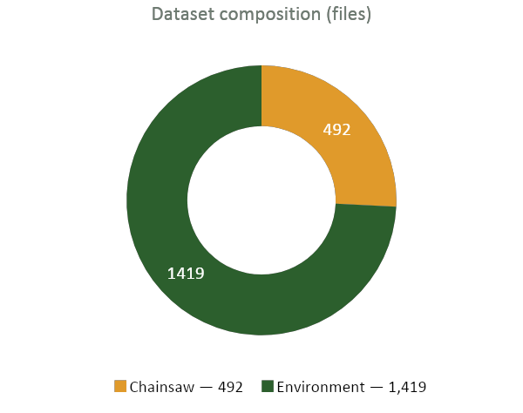
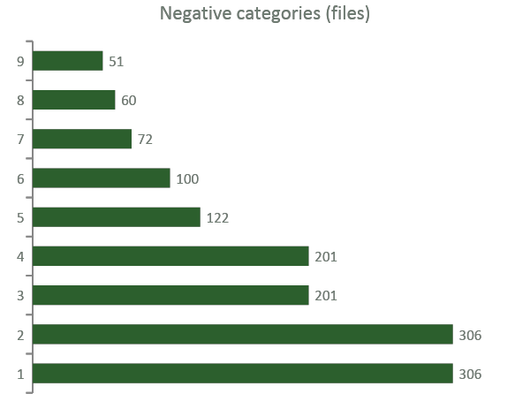
MODULE 1 — TRAINING/
The dataset: 1,911 recordings and 5,963 windows
1,911
5,963
26 %
3,580 / 1,197 / 1,186
WAV files
2s windows
positive windows
train / val / test
Automatic labelling
Derived from the folder path : chainsaw / motosierra → 1, birds / lluvia / jaguar → 0. A file matching no token raises an error, so the folder tree is the single source of truth.
Grouped split
All windows from one recording stay on the same side of the split. Otherwise the model would be tested on windows nearly identical to its training data.
Hard negative
Motocross is deliberately a negative: a two-stroke engine that is not a chainsaw. Class imbalance is handled with weights 0.68 / 1.90.
Positives come from three saw sources (generic, Oregon, Stihl) plus two sets recorded over jungle ambience.
5 / 15
Notes:
Now the data. The dataset contains about 1,900 recordings: roughly 490 chainsaw recordings - from three different sources, including Stihl and Oregon saws, plus two sets where the chainsaw is mixed into jungle ambience - and about 1,400 negative recordings of the environment: birds, monkeys, a jaguar, snakes, rain, tropical rain, rainforest ambience, and motocross. That last one is deliberate: a motocross bike is a two-stroke engine that is not a chainsaw, so it is exactly the kind of hard negative the model must learn to reject. Each file is cut into two-second windows with a one-second hop, which gives almost six thousand feature vectors. Labelling is automatic, derived from the folder path, and a file that matches no known token raises an error - so the folder structure is the single source of truth. One important detail: the split is grouped by source recording, so all windows coming from the same file stay on the same side of the split. Otherwise the model would be evaluated on windows almost identical to those it trained on. [~1:00]

Slide 6
MODULE 1 — TRAINING/
194 numbers describe two seconds of forest
FEATURE VECTOR : per 2s window
MODEL : a small dense network
20 MFCC + Δ + Δ²
Input (194)
♪
timbre, and how the timbre evolves
Normalization — adapted on train
▤
32-band mel spectrogram (dB)
coarse spectral envelope
Dense 128 · ReLU → Dropout
centroid · bandwidth · rolloff
Dense 64 · ReLU → Dropout
◈
where the energy sits in the spectrum
Dense 32 · ReLU
∿
zero-crossing rate · RMS energy
noisiness and loudness
Dense 1 · sigmoid
Each series is reduced to (mean, std) over time → a fixed-size vector of 194 values.
≈ 35,300
Adam
EarlyStopping
parameters
+ binary cross-entropy
+ ReduceLROnPlateau
Single source of truth: the FeatureConfig dataclass — 8 kHz, 2.0 s / 1.0 s, n_mfcc 20, n_mels 32, n_fft 1024, hop 256.
6 / 15
Notes:
How do we describe two seconds of sound to a neural network? Not with raw samples - sixteen thousand samples would be far too much for this microcontroller. Instead I extract a compact acoustic description: twenty MFCC coefficients, which capture the timbre, plus their first and second derivatives, which capture how that timbre evolves; a thirty-two-band mel spectrogram; and five classical spectral descriptors - centroid, bandwidth, rolloff, zero-crossing rate and energy. Each of these is a time series, and I summarise each one by its mean and its standard deviation, which gives a fixed-size vector of one hundred and ninety-four values. The model itself is deliberately small: a dense network, one hundred and ninety-four inputs, three hidden layers, one sigmoid output - about thirty-five thousand parameters. All the signal-processing parameters come from one single dataclass, FeatureConfig, and that will matter a lot in three slides. [~1:00]

Slide 7
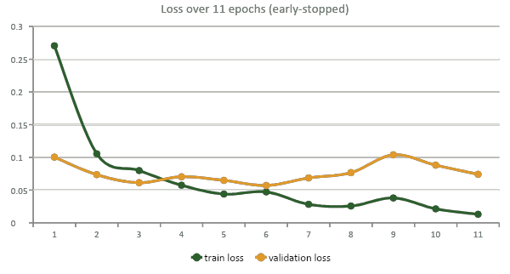
MODULE 1 — TRAINING/
Training results — report #06
TEST SET — 1,186 unseen windows
97.9 %
96.1 %
accuracy
precision
95.8 %
0.995
recall
ROC AUC
Confusion matrix @ threshold 0.5
297
864
12
13
Validation: 98.3 % accuracy · 97.8 % precision · 95.9 % recall · AUC 0.994
TP
TN
FP
FN
The train / validation gap stays small, no visible overfitting on this dataset. These numbers describe the same kind of audio the model was trained on; they do not yet describe a real forest.
7 / 15
Notes:
These are the results of the training run I kept, report number six. Training stops after eleven epochs thanks to early stopping, and the learning-rate scheduler halves the learning rate at the end. On the test set - remember, recordings the model has never seen - accuracy is around ninety-eight percent, precision ninety-six, recall ninety-six, and the area under the ROC curve is 0.995. In absolute numbers, on eleven hundred and eighty-six test windows, the model makes twelve false positives and thirteen false negatives. The gap between training and validation curves stays small, so there is no obvious overfitting on this dataset. I want to be honest about what these numbers mean, though: they are computed on the same kind of audio the model was trained on. They tell us the architecture and the features are appropriate. They do not yet tell us how the device behaves in a real forest - I will come back to that at the end. [~1:15]

Slide 8
MODULE 1 — TRAINING/
The conversion is numerically lossless
validate_tflite.py runs both models on exactly the same validation and test splits, then compares them window by window.
0
5 × 10⁻⁹
8 × 10⁻⁷
prediction mismatches
out of 2,383 windows
mean absolute difference
on the output probability
worst-case difference
observed on any window
That is six orders of magnitude below anything that could change a decision at a 0.5 threshold (pure float32 rounding).
✕
The negative result worth reporting
⌘
Report caching
Enabling Optimize.DEFAULT applies dynamic-range int8 quantization. It works perfectly with the desktop interpreter and produced NaN outputs on TFLite Micro, on the ESP32.
A validation report is only written for a new combination of (reference training report, threshold, SHA-256 of the .tflite file).
→ re-running validation on an unchanged model never produces a redundant, byte-identical report.
→ the exported model stays plain float32.
8 / 15
Notes:
Converting to TensorFlow Lite is not automatically safe, so I built a validation step that runs both models - the Keras one and the converted one - on exactly the same validation and test splits, and compares them window by window. The result is that the conversion is essentially lossless: zero prediction mismatches out of more than two thousand windows, and a mean absolute difference on the output probability of the order of ten to the minus nine. That is pure floating-point rounding. There is one important negative result here. I initially enabled the default optimisation, which applies dynamic-range int8 quantization. It works perfectly with the desktop interpreter, but on the microcontroller, TensorFlow Lite Micro produced NaN outputs. So I deliberately export the model in plain float32, and I documented why - the model is small enough that we can afford it. [~1:00]

Slide 9
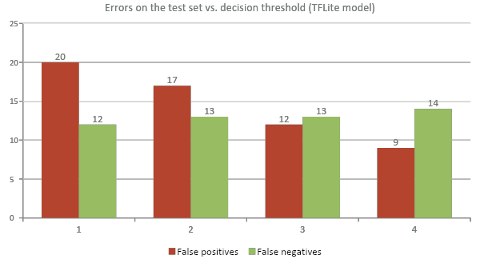
MODULE 1 — TRAINING/
Choosing the threshold: which error do we prefer?
0.30 → 0.60
False positives drop from 20 to 9 : a 55 % reduction for the cost of only two additional false negatives.
THE TWO ERRORS DO NOT COST THE SAME
−
False negative
A chainsaw we did not hear. A tree is cut.
+
False positive
A patrol sent into the jungle for nothing and, worse, a device nobody trusts any more.
Thresholds 0.30 0.40 0.50 0.60
Precision 93.7 % 94.6 % 96.1 % 97.1 %
Recall 96.1 % 95.8 % 95.8 % 95.5 %
F1 score 94.9 % 95.2 % 96.0 % 96.3 %
In the field, alarm fatigue kills a system faster than a missed event → the firmware runs at 0.65
9 / 15
Notes:
Once the model is validated, there is still a free parameter: the decision threshold on the output probability. I generated four validation reports for the same model, at thresholds 0.3, 0.4, 0.5 and 0.6. The trend is clear. At 0.3 we get twenty false positives and twelve false negatives; at 0.6, only nine false positives, and just two more false negatives. In other words, raising the threshold removes more than half of the false alarms at almost no cost in detection. Why does this matter? The two errors do not cost the same thing. A false negative means a chainsaw we did not hear - a tree gets cut. A false positive means a false alarm, and in a real deployment, sending a ranger patrol through the jungle for nothing is extremely expensive; more importantly, a device that cries wolf will simply be ignored, and then it protects nothing. That is why the firmware operates at 0.65 - slightly more conservative than the best offline accuracy point. [~1:15]

Slide 10
THE BRIDGE BETWEEN THE TWO MODULES
Python writes the C++
generate_firmware.py takes the trained model and the feature configuration, and emits three C++ files.
1
generate_feature_config.py
2
generate_dsp_constants.py
3
generate_inference.py
include/app/config.h
src/app/dsp_constants.cpp
src/model/inference.cpp
AUDIO_CONFIG : sample rate, window & hop, n_mfcc, n_mels, FFT and hop length.
The mel filterbank and DCT matrices, precomputed as flat float arrays : the same ones librosa builds internally.
The .tflite bytes as const uint8_t g_model_data[], with a SHA-256 and size comment for traceability.
This is the contract between the two modules.
The Python extractor and the C++ extractor cannot drift apart, because both are derived from the same FeatureConfig object. And the firmware needs no Python, no TensorFlow and no filesystem — everything is compiled in.
⛔ These three files are generated, never hand-edited and any manual change is silently overwritten. Everything that must survive a regeneration (pins, detection thresholds, watchdog timeout) lives in the hand-maintained board_config.h.
10 / 15
Notes:
This slide is, for me, the most important one of the training module. The generation sub-module is the bridge between Python and C++. It writes three files. The first one exports the feature configuration - sample rate, window size, number of MFCCs, FFT size - as a C header. The second precomputes the mel filterbank matrix and the DCT matrix, the same ones librosa builds internally, and writes them as plain float arrays, so the firmware can compute MFCCs without linking any heavy math library. The third embeds the TensorFlow Lite model itself as a byte array, with its SHA-256 for traceability. These three files are generated, never hand-written, and everything that must survive a regeneration - pin numbers, detection thresholds, watchdog timeout - lives in a separate, hand-maintained header. This is what guarantees coherence between the two modules: the Python and the C++ feature extractors cannot drift apart, because both are derived from one single configuration object. [~1:00]

Slide 11
MODULE 2 — FIRMWARE/
A layered C++ application on the ESP32
PlatformIO · Arduino framework · C++17 · board nodemcu-32s (ESP32-WROOM-32)
main.cpp
orchestrator : setup() and loop()
Only two libraries
The TFLite Micro runtime for ESP32, and a small FFT library. Nothing else.
services/
mfcc : feature extraction · watchdog
Compile-time flags
drivers/ · model/
I2S microphone (INMP441) · generated model bytes + TFLite Micro interpreter
A disabled feature costs zero bytes of flash and zero CPU cycles, verbose serial output is off by default.
app/
config.h (generated) · board_config.h (hand-maintained) · flags.h
Fail-safe by design
If a service cannot be initialised, the firmware warns once and keeps running with that feature disabled. On a device meant to sit alone in a forest, never blocking is worth more than being complete.
Generated vs. hand-maintained — the distinction is visible in the file tree itself
GENERATED · config.h · dsp_constants.cpp · inference.cpp HAND-MAINTAINED · board_config.h · flags.h · every driver and service
11 / 15
Notes:
On the embedded side, the firmware is a PlatformIO project, C++17, targeting an ESP32-WROOM-32. It uses only two external libraries: the TensorFlow Lite Micro runtime for the ESP32, and a small FFT library. The code is organised in layers: a driver layer for the I2S microphone; a services layer containing the feature extraction and the watchdog; a model layer with the generated model and the interpreter; and a configuration layer where you can clearly see which files are generated by Python and which ones are hand-maintained. Features are controlled by compile-time flags, so a disabled feature costs literally zero bytes of flash and zero CPU cycles. And the services are written to fail safe: if something cannot be initialised, the firmware logs a warning once and keeps running with that feature disabled, rather than blocking at start-up. On a device meant to sit alone in a forest, never blocking is more valuable than being complete. [~1:00]

Slide 12
MODULE 2 — FIRMWARE/
Re-implementing librosa in C++, exactly
The firmware must compute the same 194 numbers as the Python extractor (without librosa and without NumPy). Any mismatch and the model receives inputs from a distribution it never saw, and fails silently.
1
63 STFT frames
Hann window, reflect padding at the signal edges
!
The bug that cost me the most time
Mel energies
librosa uses two different decibel references: an absolute one (ref = 1.0) inside mfcc(), and a window-relative one (ref = max) for the standalone mel block.
2
MEL_MATRIX, generated by Python
I used the same one for both. The model returned a near-zero probability whatever I played at it — the model was fine, the features were not.
3
20 MFCC
DCT_MATRIX, generated by Python
4
Δ and Δ²
librosa-equivalent Savitzky–Golay coefficients
THE 194-VALUE LAYOUT
[ mfcc µ/σ ×20 ][ Δ ×20 ][ Δ² ×20 ]
[ mel µ/σ ×32 ][ centroid ][ bandwidth ]
[ rolloff ][ zcr ][ rms ]
5
Streaming stats
RunningStats — no full-length buffers kept in RAM
Lesson learned: in embedded machine learning, most bugs are not in the model — they are in feature parity between the training code and the device.
12 / 15
Notes:
This is where most of the engineering time actually went. The firmware has to compute exactly the same one hundred and ninety-four numbers as the Python extractor - otherwise the model receives inputs from a different distribution than the one it was trained on, and it simply fails, silently. So I re-implemented, in C++, the whole chain: sixty-three overlapping FFT frames with a Hann window and reflect padding at the edges, the mel filterbank, the DCT to get the MFCCs, and the delta coefficients with the same convolution kernels librosa uses. Everything is accumulated in a streaming way, so I never keep full-length buffers in memory. And here is the bug that cost me the most time: librosa internally uses two different decibel references - an absolute one inside the MFCC computation, and a window-relative one for the standalone mel block. I was using the same one for both, and the model returned almost zero probability no matter what I played at it. The model was fine. The features were not. [~1:00]

Slide 13
MODULE 2 — FIRMWARE/
The real-time detection loop
SETUP : once
DETECTION BEHAVIOUR : board_config.h
Load the embedded model → build a MicroInterpreter over a 6 KiB tensor arena → AllocateTensors() → init microphone, DSP and watchdog
0.65
kDetectionEnterThreshold
probability needed to start counting
LOOP : roughly once per second, forever
2
kDetectionConsecutiveFrames
1
Sliding window
The first pass records a full 2 s; every pass after that shifts the buffer left by 1 s and only records the newest second.
consecutive windows to confirm
2
Features
16,000 int16 samples → 194 floats → copied into the input tensor.
0.35
kDetectionExitThreshold
probability must fall below this to clear
3
Inference
interpreter->Invoke() → one probability.
10 s
kWatchdogTimeoutSeconds
the board reboots if the loop hangs
4
Decision
The probability goes through a debounce / hysteresis state machine before anything is raised.
Two thresholds, not one: hysteresis stops the verdict from flickering when the signal hovers at the boundary.
Inference every second instead of every two → worst-case detection latency halved.
13 / 15
Notes:
Here is what happens on the device, once per second, forever. At start-up the firmware loads the embedded model and allocates the TensorFlow Lite Micro interpreter in a six-kilobyte tensor arena. Then the loop captures audio into a sliding window: the very first pass blocks for a full two seconds, but after that it shifts the buffer left by one second and only records the newest second. That single optimisation halves the worst-case detection latency, because inference now runs every second instead of every two. The sixteen thousand samples become one hundred and ninety-four features, we run the interpreter, and we get a probability. But a single probability is never enough to raise an alert. It goes through a debounce and hysteresis state machine: two consecutive windows above 0.65 to confirm a detection, and the probability must drop below 0.35 to clear it. Using two different thresholds instead of one prevents the verdict from flickering when the signal hovers around the boundary. And a hardware watchdog reboots the board if the loop ever hangs. [~1:00]

Slide 14
WHERE THE PROJECT STANDS
Excellent on chainsaws, too eager on the rest
✓
What works
!
What does not
On real chainsaw sound the model is reliable : recall ≈ 96 %, detection confirmed in about two seconds.
The whole chain — Keras → TFLite → ESP32 : is validated end to end and runs fully offline.
On sounds that are not chainsaws, the device sometimes fires : false positives are the remaining weakness.
The model is not wrong: it is being asked about sounds it was never taught to reject.
MISSING FROM THE DATASET
Wind on the mic
Insects · cicadas
Human voices
Mic self-noise
Thunder
Brush cutters & generators
△
And one specific mechanism makes it worse
The firmware peak-normalises every 2 s window. In a near-silent window, the microphone's own noise floor is amplified to full scale : and the model has never been shown that pattern labelled as "not a chainsaw".
14 / 15
Notes:
So where does the project stand today? The last dataset gave a model that works very well on real chainsaw sounds - when there is a chainsaw, it is detected, reliably, in about two seconds. The full chain, from Keras to TensorFlow Lite to the ESP32, is validated and runs completely offline. The remaining weakness is the opposite direction: false positives. On sounds that are not chainsaws, the device sometimes fires. And when you look at the dataset, this is not surprising. There is no wind in it - and the microphone has no wind screen. There are no insects, although cicadas are one of the loudest and most constant sounds in a tropical forest. No human voices, no non-chainsaw small engines like brush cutters, which are acoustically the closest thing to a chainsaw. And no recordings of the microphone's own noise floor - which matters, because the firmware peak-normalises every window, so a nearly silent window gets its own hiss amplified to full scale, and the model has simply never been shown that pattern labelled as 'not a chainsaw'. [~1:00]

Slide 15
FUTURE WORK & CONCLUSION
What separates this prototype from a field device
01
02
03
Close the dataset gap
Calibrate the threshold in situ
Then deploy
Record negatives on the deployed hardware itself: microphone self-noise, wind, insects, rain on the enclosure, voices, brush cutters. Then multiply the coverage with augmentation, noise mixed at several SNRs, pitch and time shifts, low-pass filtering to simulate distance.
Today 0.65 comes from an offline study on my own dataset. The right method is to install the node, log its probabilities for several days in the real environment, and pick the operating point that minimises false alarms while keeping recall high. The tooling already exists, every validation run produces a report per threshold.
Target: a node the rangers trust, few enough false alarms that every single alert is acted upon.
The criterion for success is not accuracy on a test set. It is whether a ranger in the Amazon trusts the alert enough to walk into the forest.
Thank you, any questions?
CPE Lyon · Energy Pool · Universidad Militar Nueva Granada
15 / 15
Notes:
To conclude, the most valuable next step is not a bigger model. It is better negative data - and specifically, negatives recorded on the deployed hardware itself: wind, insects, human voices, brush cutters, and the microphone's own noise floor. Data augmentation, mixing noise at several signal-to-noise ratios and low-pass filtering the chainsaw clips to simulate distance, is a cheap way to multiply that coverage. The second step is threshold optimisation based on real field conditions. Today the value 0.65 comes from an offline study on my dataset. The right method is to install the node, log its probabilities for several days in the actual environment, and then choose the operating point that minimises false positives while keeping the detection rate high. The tooling for that already exists - every validation run produces a report per threshold. Because in the end, the criterion for success is not accuracy on a test set. It is whether a ranger in the Amazon trusts the alert enough to walk into the forest. Thank you very much - I'll be happy to take your questions. [~0:45]

