Slide 1
KV Cache Compression
Exploration Phase — Structure, Methods & Benchmarks
TinyLlama 1.1B
Qwen2.5 0.5B
CPU · Exploration · No Hardware Assumptions

Slide 2
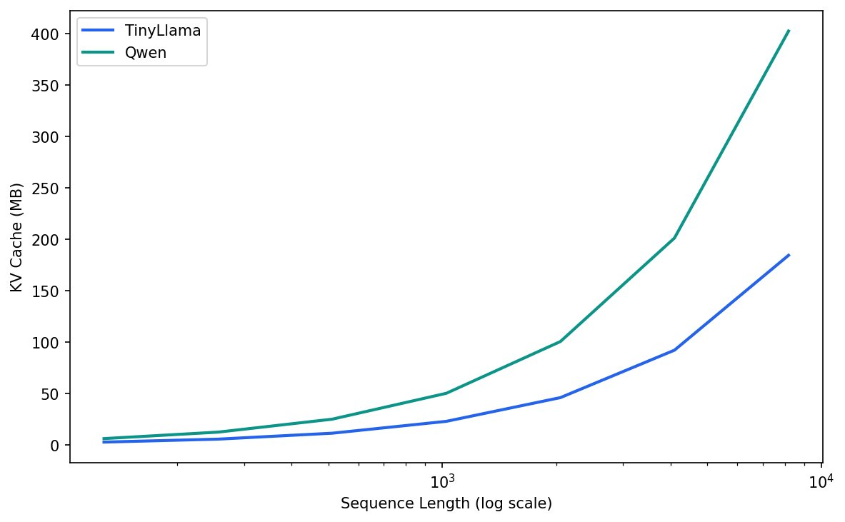
MOTIVATION
KV Cache Grows Linearly with Context
22 layers TinyLlama · n_kv_heads=4, D=64
24 layers Qwen2.5-0.5B · n_kv_heads=8, D=64
Linear Growth with · sequence length

Slide 3
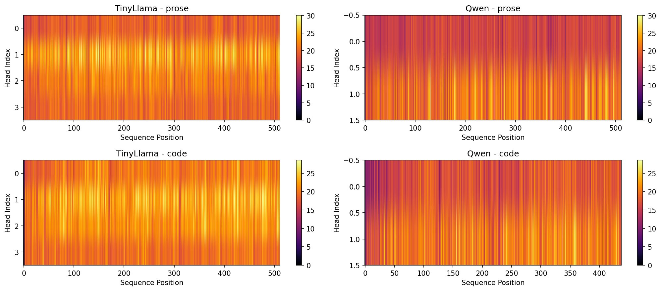
KV CACHE STRUCTURE
Activation Magnitude
Across Token Positions
TinyLlama · Prose
Qwen2.5 · Prose
Cache is non-uniform — certain positions have dramatically higher L2 norm
High-norm positions appear in both prose and code across both models
Pattern holds for all KV heads — a structural property, not head-specific
Colour = key vector L2 norm at each (head, token) position
TinyLlama · Code
Qwen2.5 · Code

Slide 4
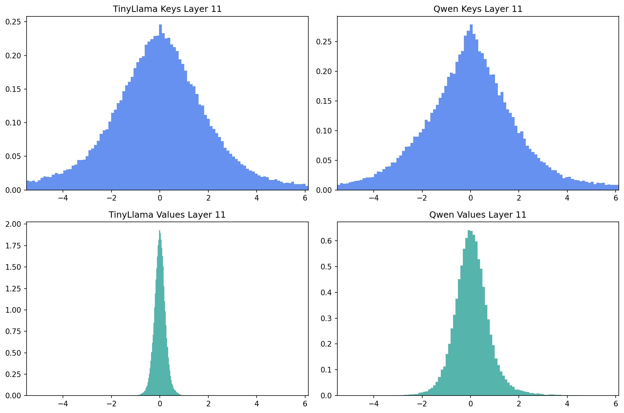
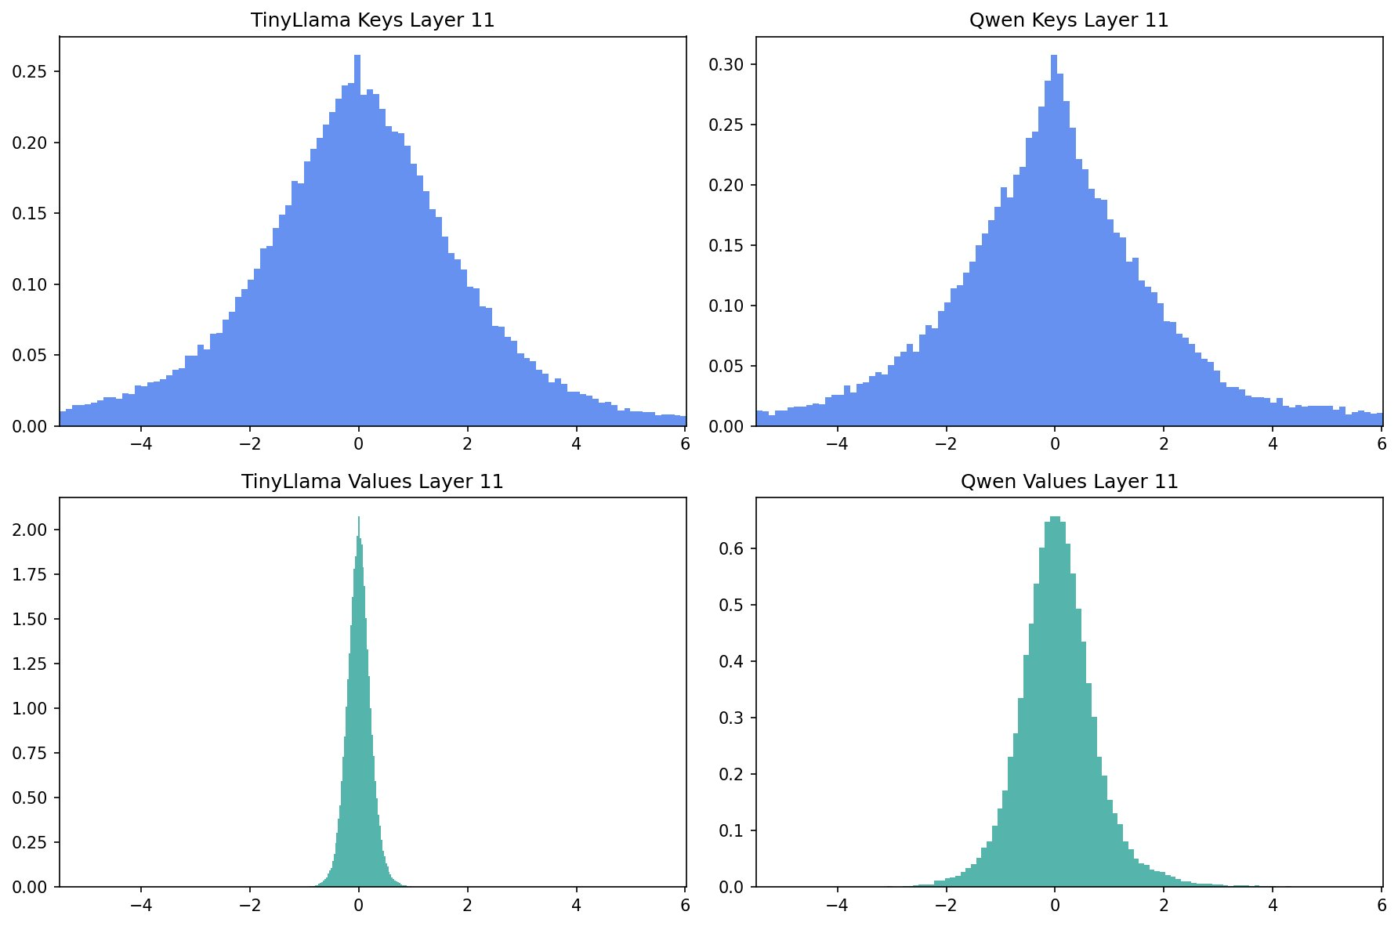
KV CACHE STRUCTURE
Keys and Values Have Different Statistical Profiles
Prose Context
Code Context
Keys: heavier tails, structured outliers Values: sharply peaked, minimal spread — compress differently

Slide 5
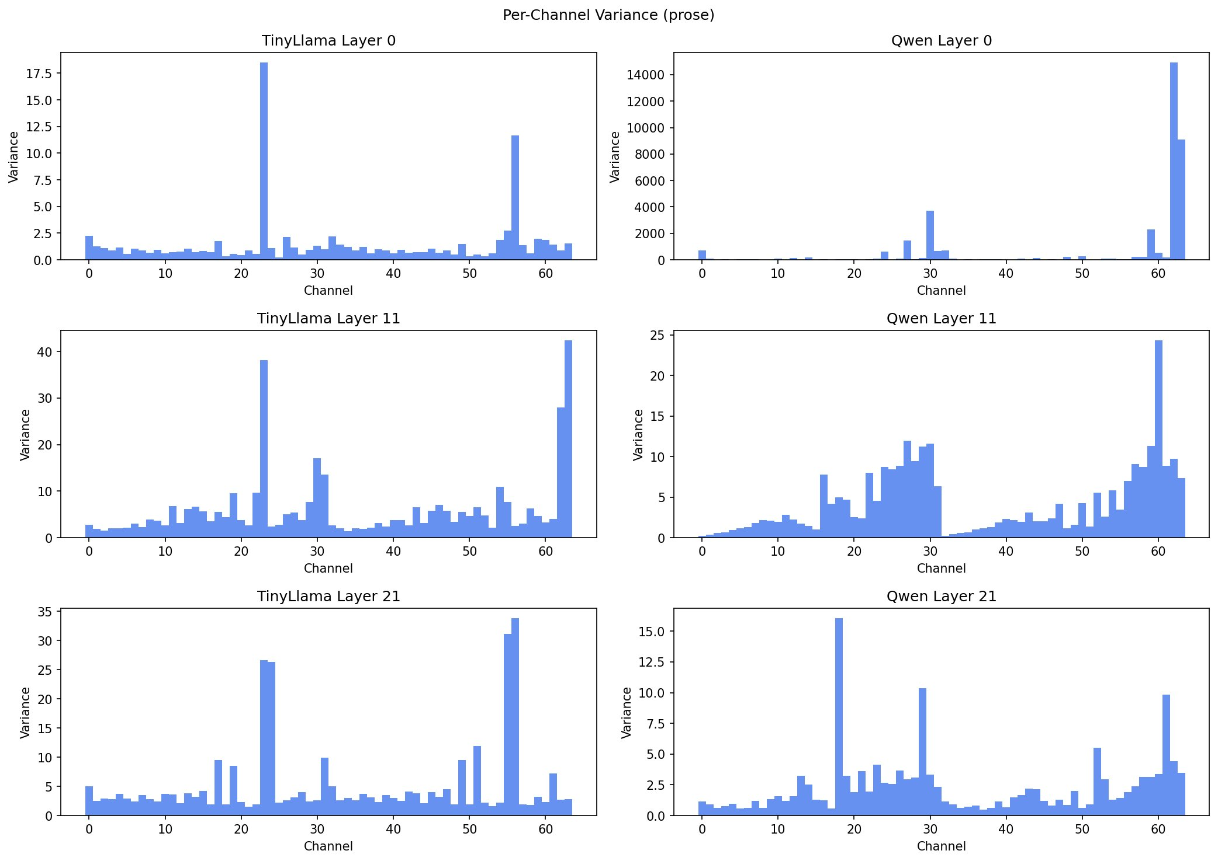
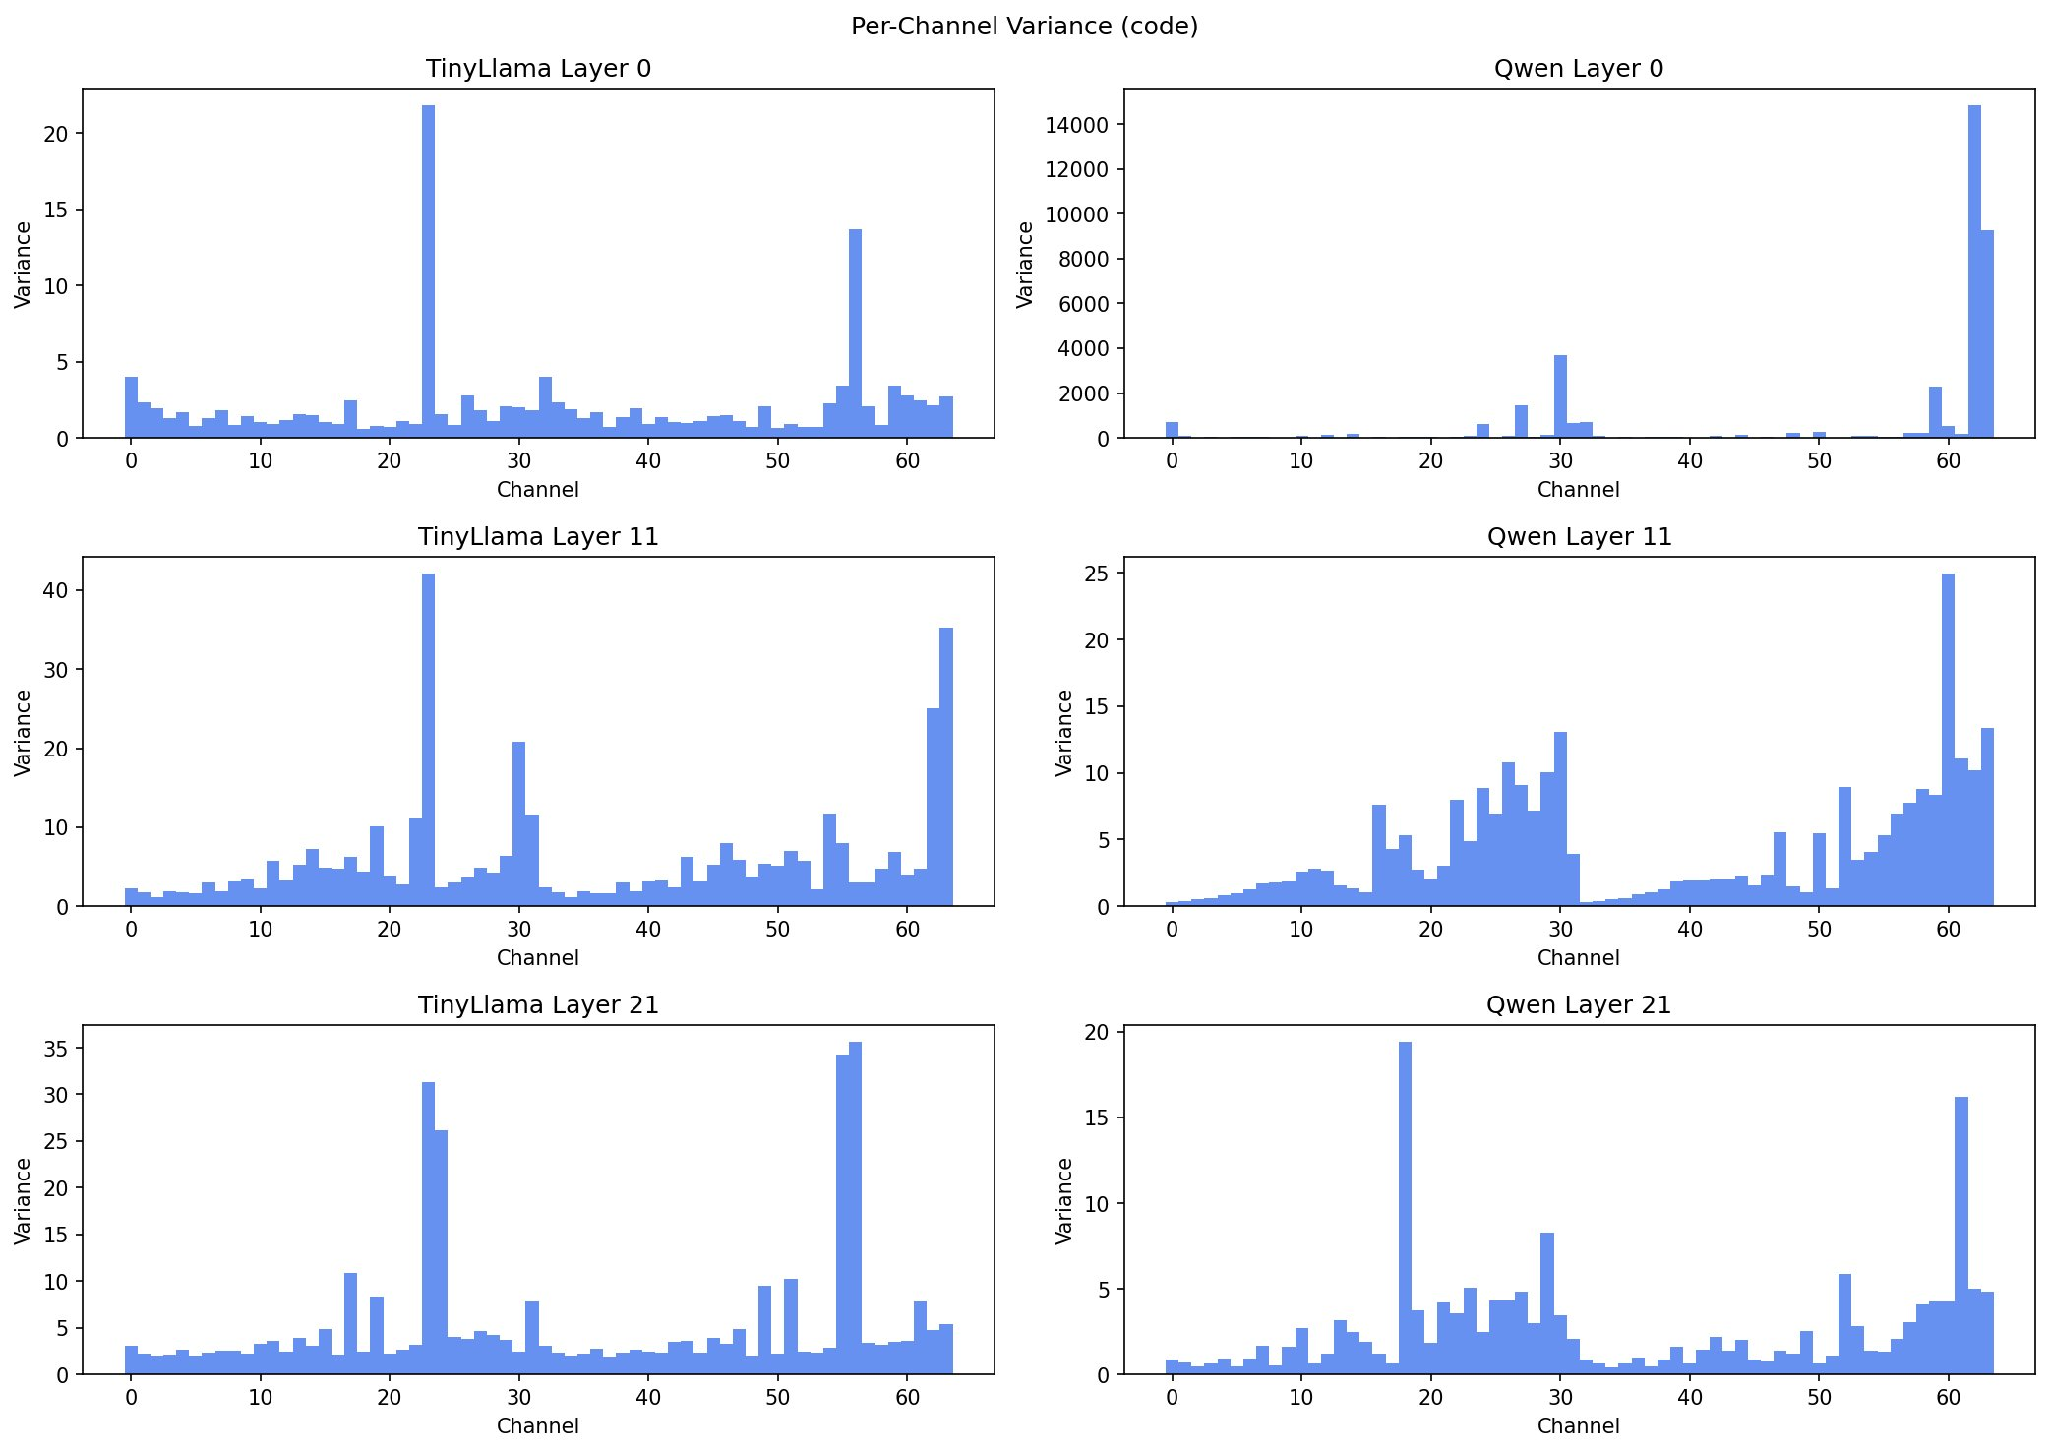
KV CACHE STRUCTURE
Per-Channel Key Variance — Outlier Channels Persist Across Layers
Prose
Code
● A small number of channels dominate variance across all layers
● The same outlier channel indices recur regardless of context type
● Variance concentrates at channels ~23, ~55 in TinyLlama; ~30, ~61 in Qwen

Slide 6
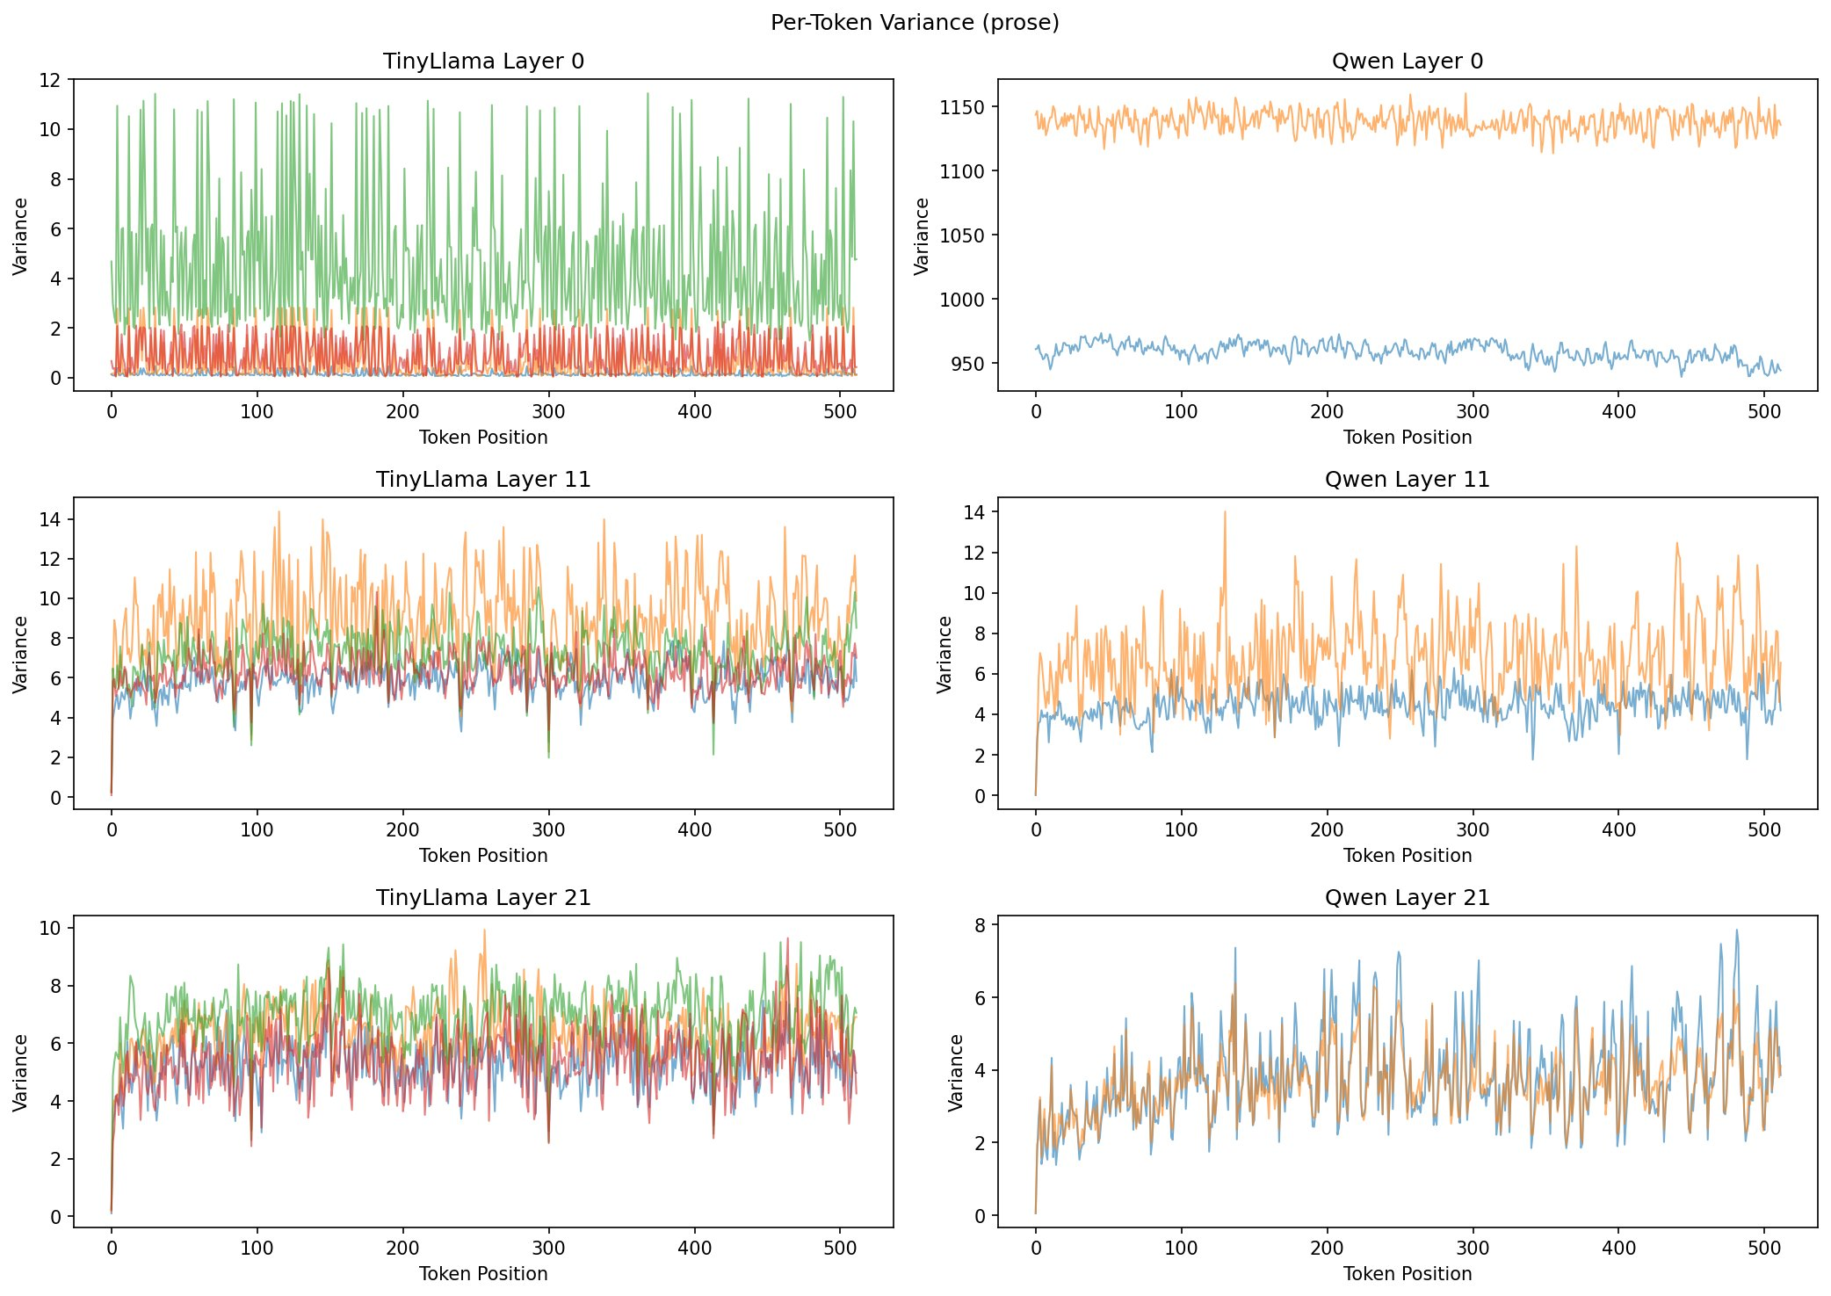
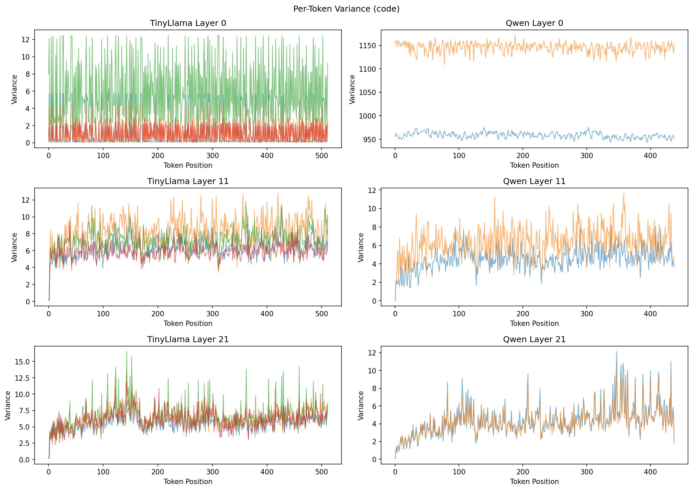
KV CACHE STRUCTURE
Per-Token Key Variance — Code Has More Abrupt Transitions
Prose
Code
Prose: Variance is relatively stable across token positions. Adjacent tokens are similar — the temporal-smoothness assumption holds.
Code: Sharp spikes at syntactic boundaries: brackets, operators, function names. Adjacent tokens differ substantially.

Slide 7
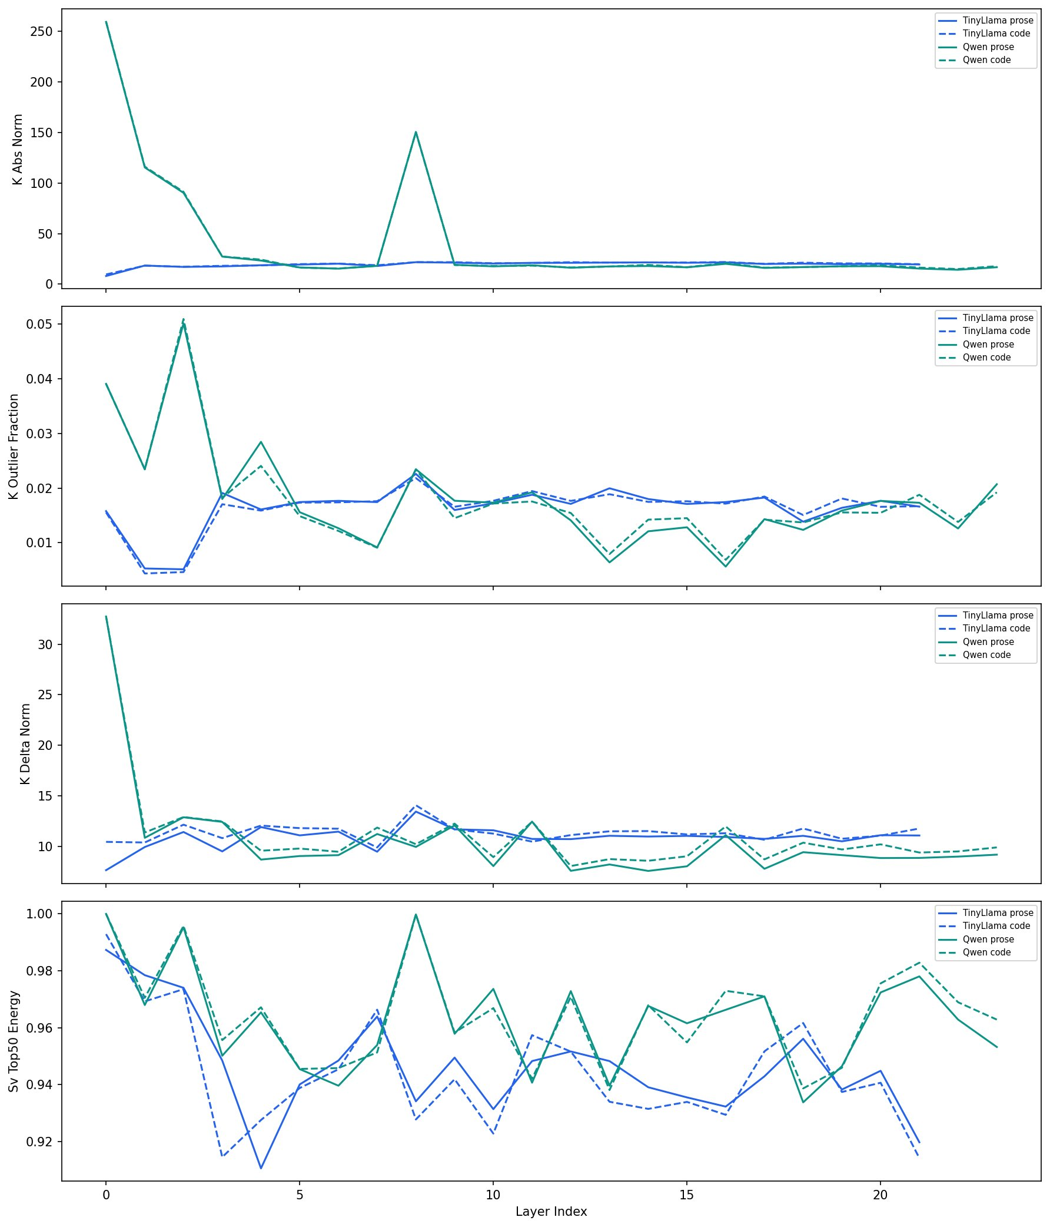
KV CACHE STRUCTURE
Four Metrics
Across Depth
K Abs Norm
Average key vector magnitude
Outlier Fraction
Tokens > 3σ from mean
K Delta Norm
Adjacent-token difference
SV Top-50% Energy
Singular value concentration
Solid = prose · Dashed = code
Blue = TinyLlama · Green = Qwen

Slide 8
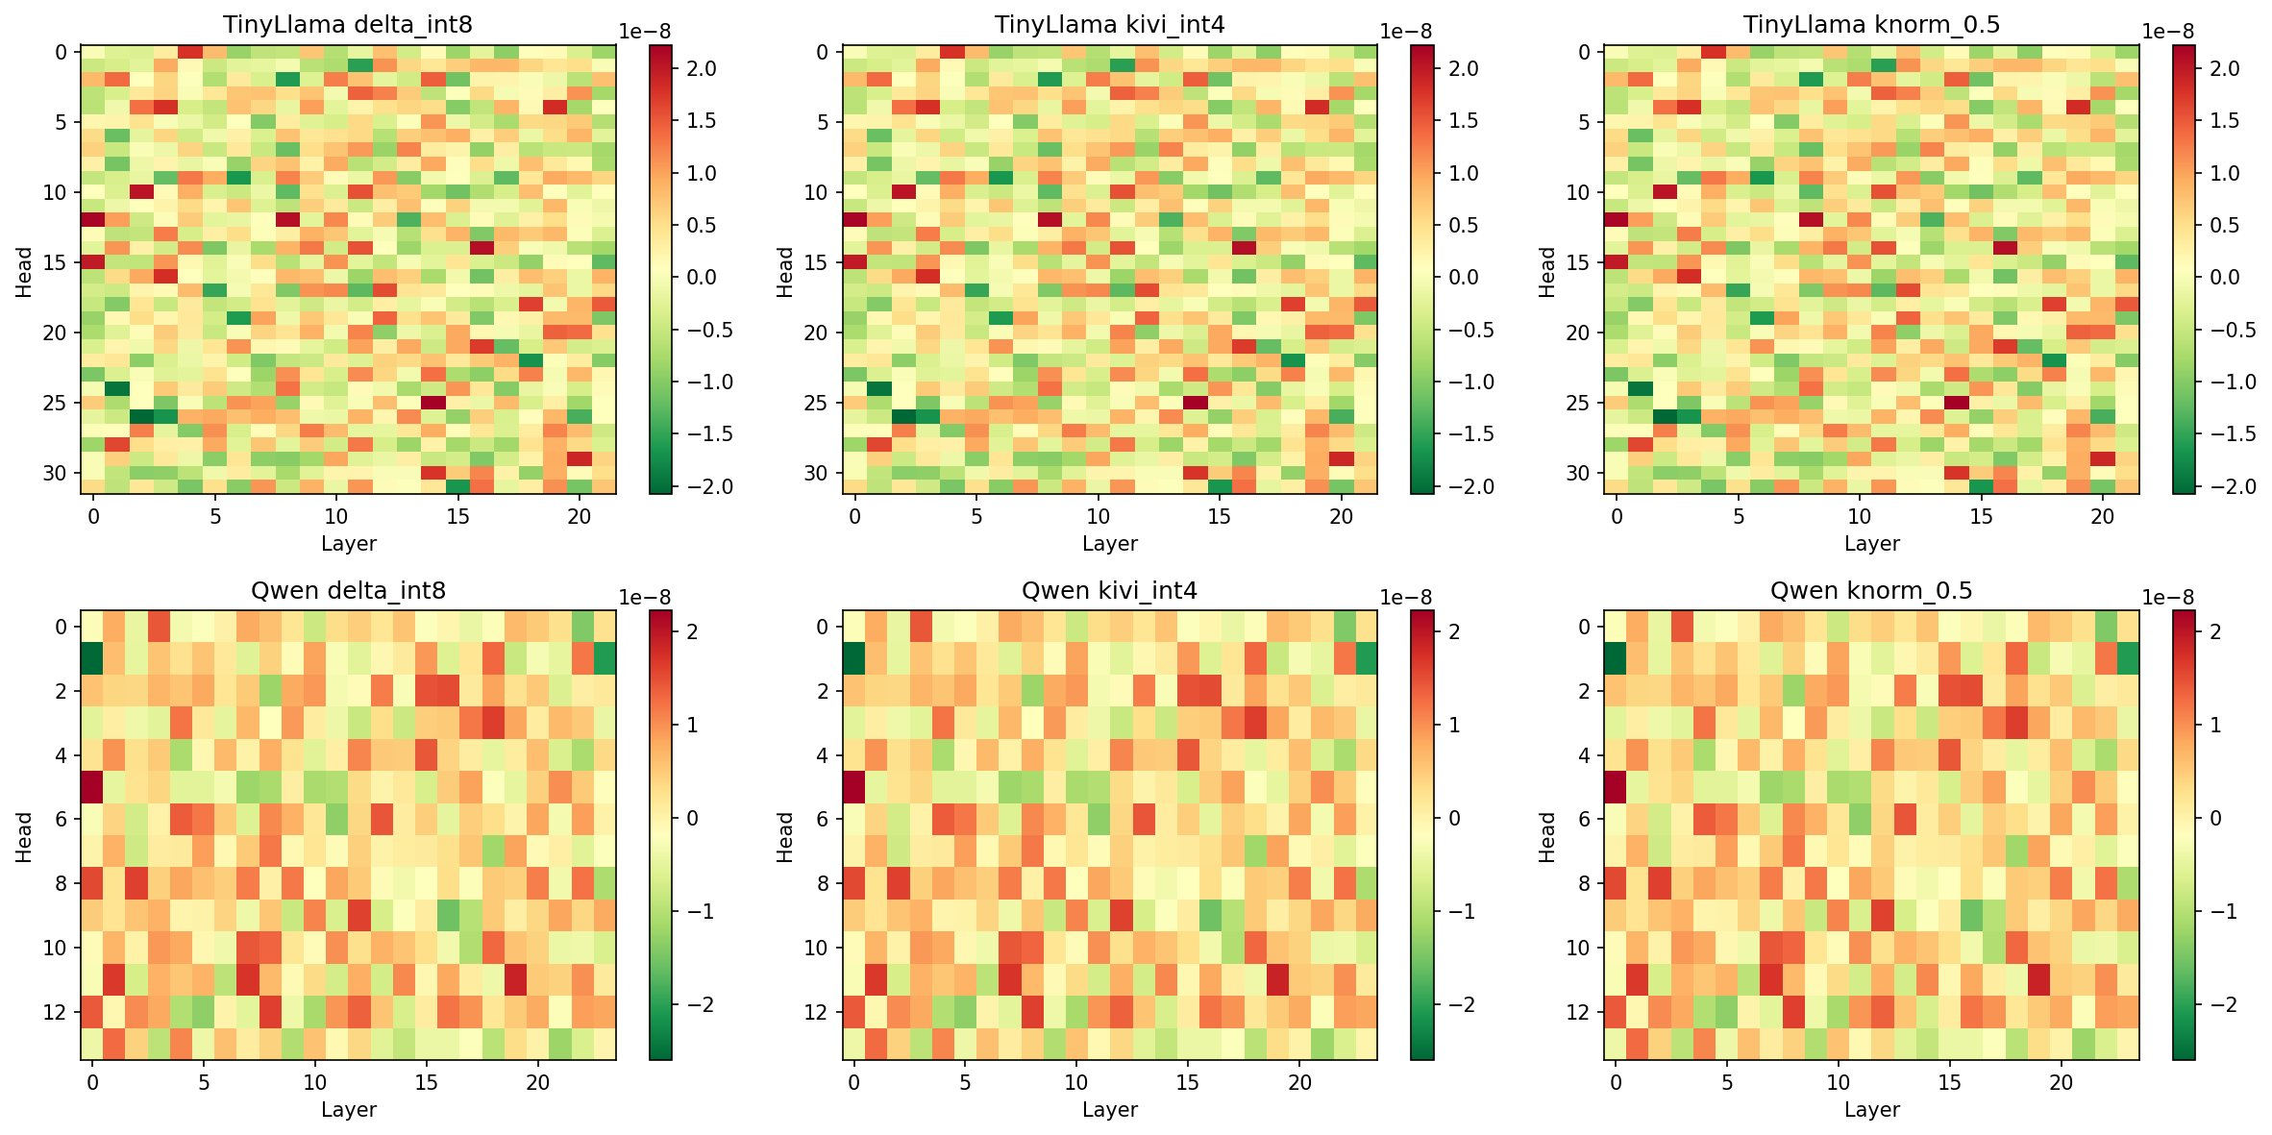
KV CACHE STRUCTURE
Attention Pattern Preservation — KL Divergence from Uncompressed Baseline
delta_int8
kivi_int4
knorm_0.5
TinyLlama
Qwen2.5
Note: Scale is 1×10⁻⁸ — all three methods preserve attention patterns with negligible KL divergence. No method systematically breaks any layer or head.

