Slide 1
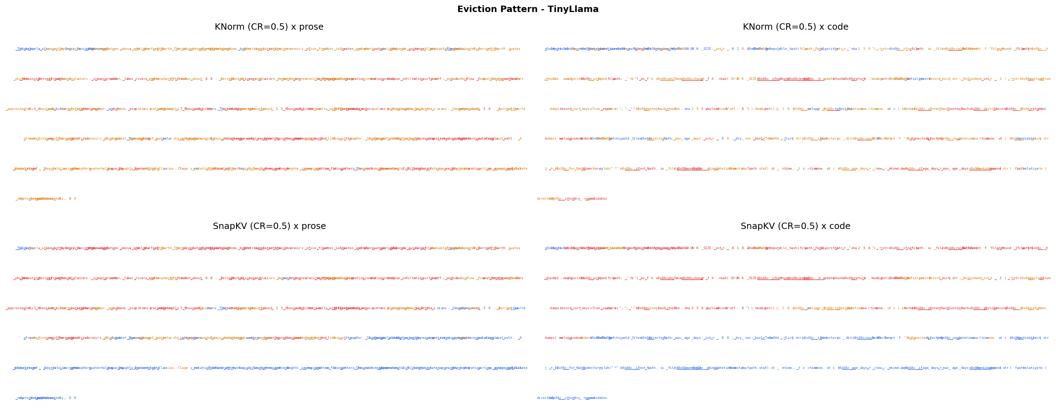
KV CACHE STRUCTURE
Eviction Patterns - Which Tokens Survive Compression?
TinyLlama
Qwen2.5-0.5B
High | Medium | Low retention
Blue=kept, Red=evicted. KNorm retains high-magnitude tokens. SnapKV retains contextually attended tokens. Structural tokens survive.

Slide 2
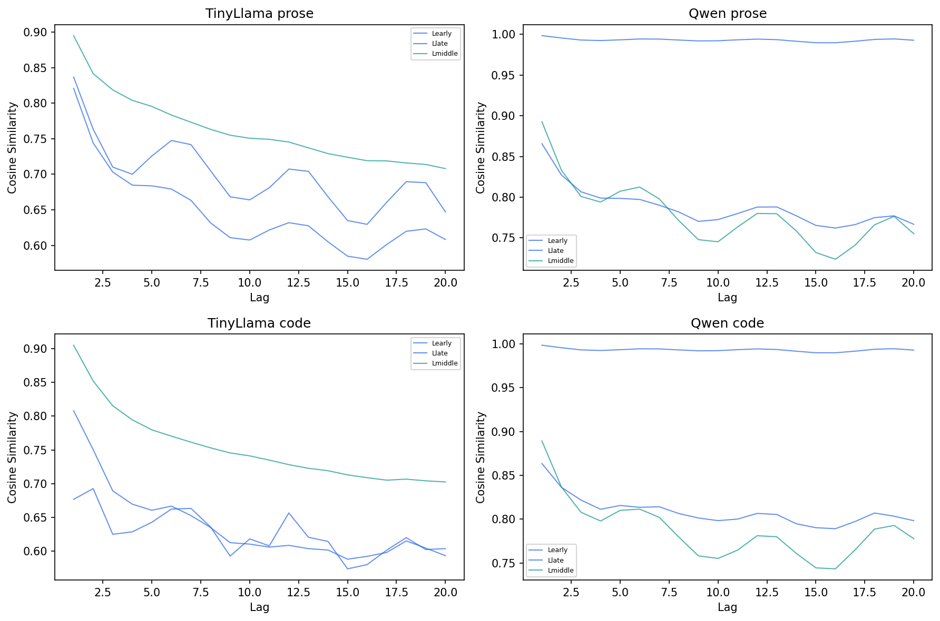
KV CACHE STRUCTURE
Temporal Autocorrelation - How Far Does Token Similarity Extend?
Prose: Cosine similarity >0.6 even at lag 20 - adjacent tokens remain meaningfully similar.
Code: Similarity drops faster with oscillations - syntactic boundaries create sharp transitions.

Slide 3
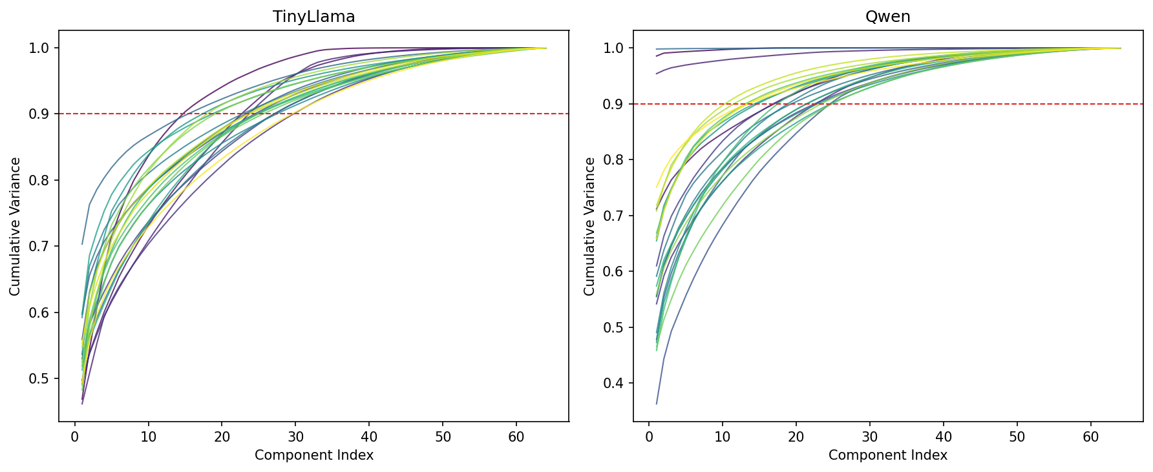
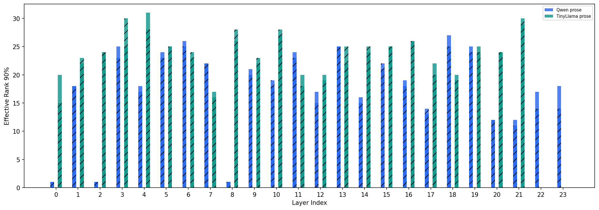
KV CACHE STRUCTURE
Intrinsic Rank Per Layer - How Compressible is the Head Dimension?
Cumulative Variance by Component (Scree)
Effective Rank (90% Variance Threshold) per Layer

Slide 4
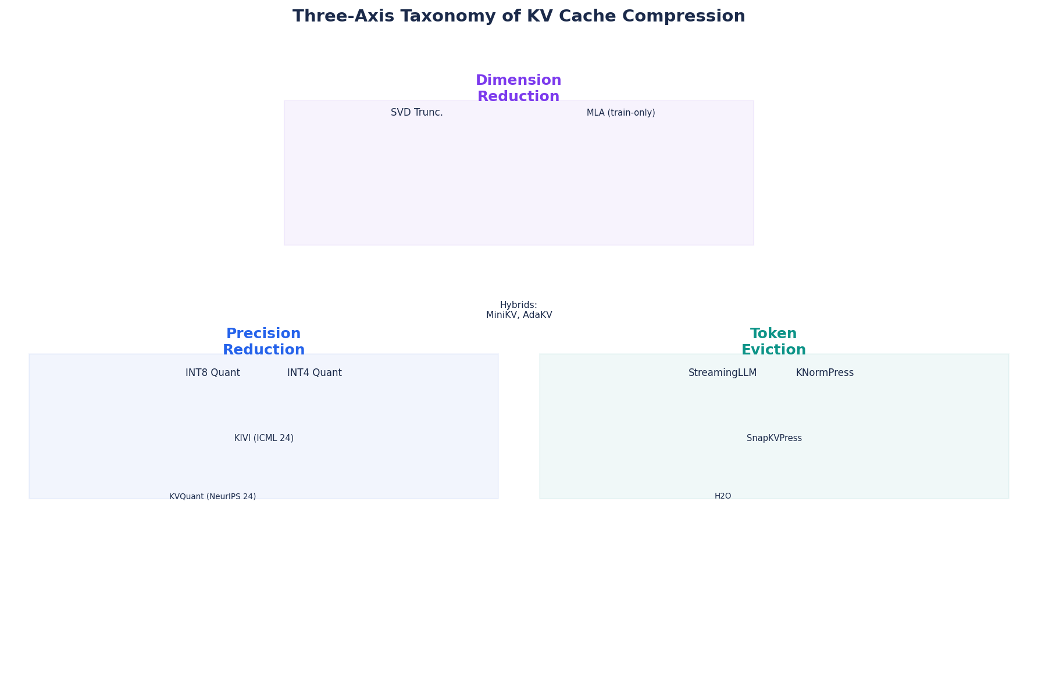
COMPRESSION LANDSCAPE
Three-Axis Taxonomy of KV Cache Compression

Slide 5
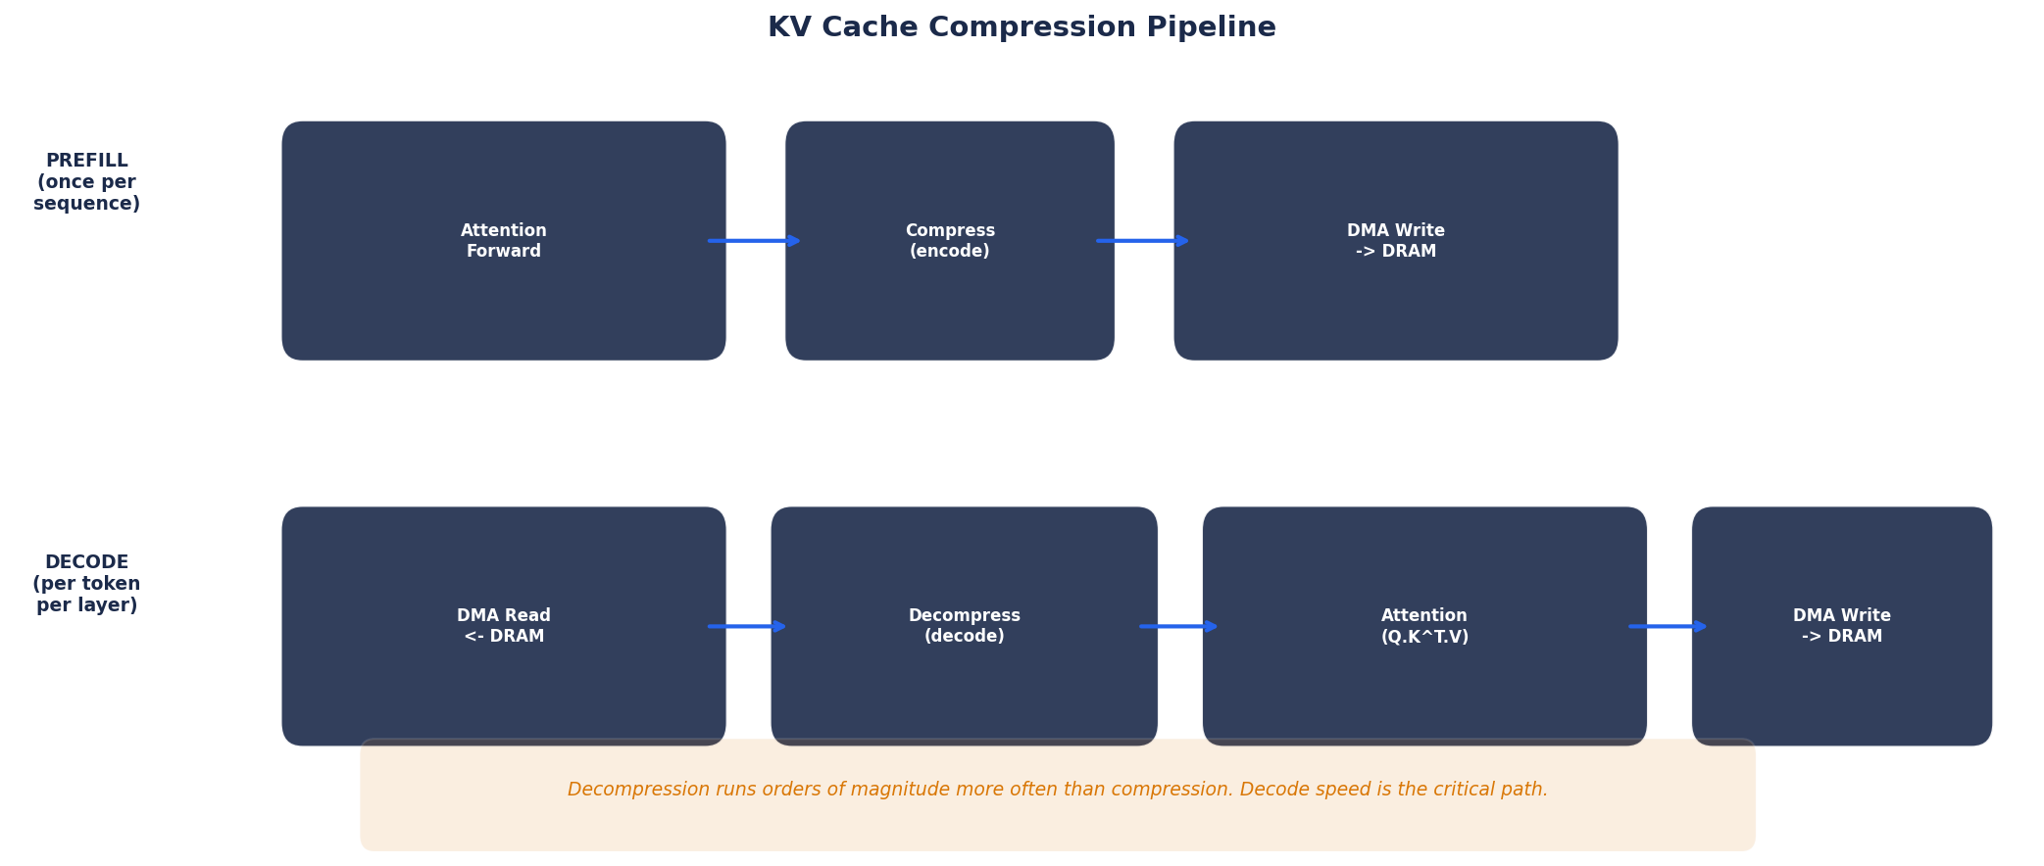
EDGE PIPELINE
KV Cache Compression Lifecycle
Key insight: Decompression runs once per generated token per layer. Decode speed is the critical path.

Slide 6
COMPRESSION LANDSCAPE
Prescribed Deployment Options by Task
Which compression axis fits your workload? Based on structural properties each method preserves.
Task | Memory Concern | Suggested Axis | Reasoning
Long Document QA | Retrieval of specific facts | Eviction (careful) | Pruned tokens cannot be retrieved
Summarisation | Global semantic coherence | Precision reduction | No single token is critical
Code Completion | Local syntactic structure | Precision reduction | Code has low temporal smoothness
Multi-turn Chat | Growing cache across turns | Eviction + Precision | Cache must stay bounded
Structured Data | Exact value preservation | None / High-precision | Numbers/fields are fragile

Slide 7
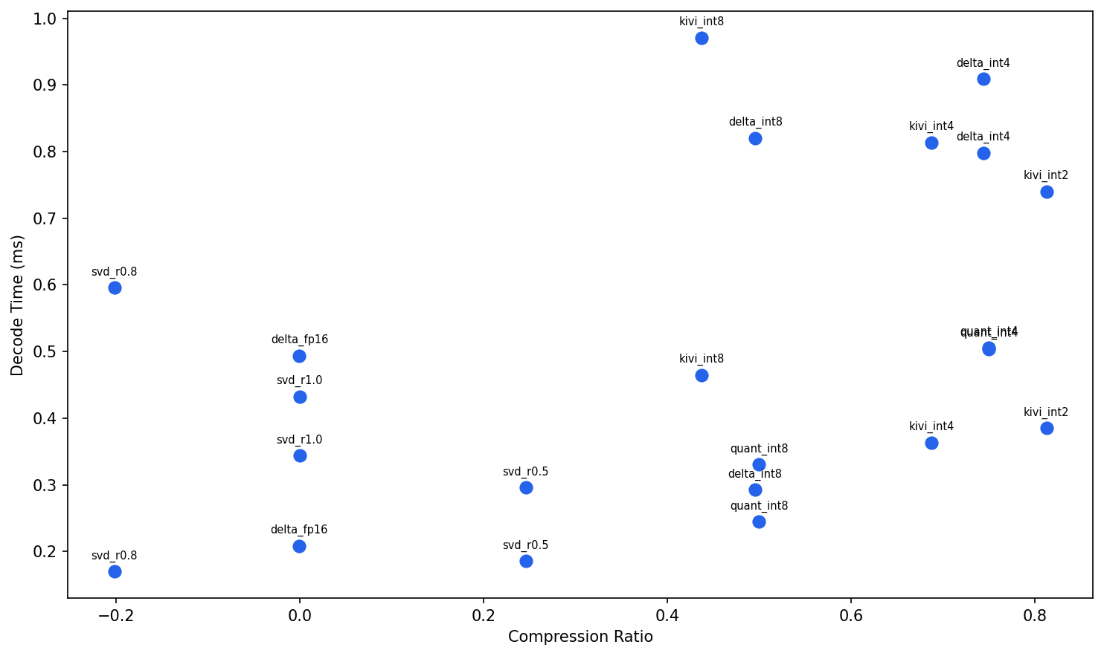
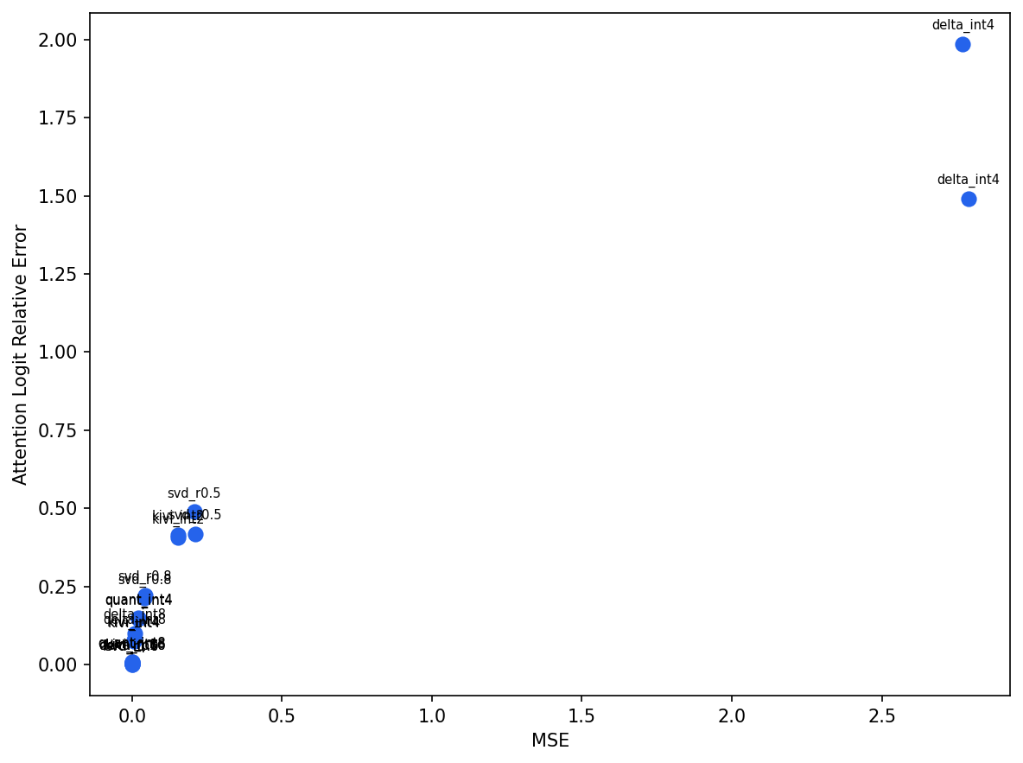
CODEC BENCHMARKS
Codec Speed and Fidelity - No Model Required
Decode Latency vs Compression Ratio
Attn Logit Error vs MSE
delta_int4 is an outlier - high MSE AND high attention logit error. Most codecs cluster near origin with acceptable fidelity.

Slide 8
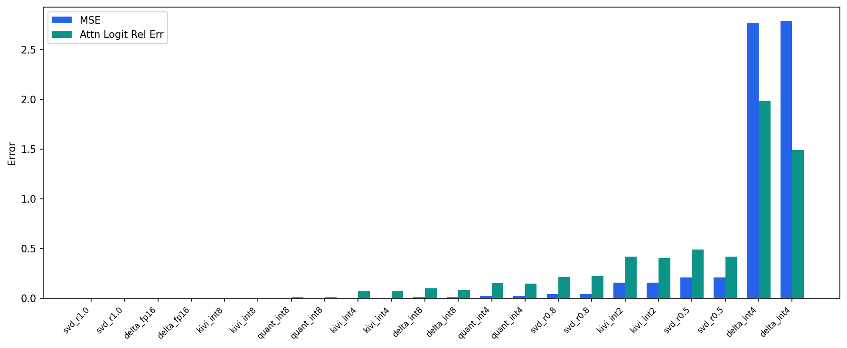
CODEC BENCHMARKS
Reconstruction Quality - MSE and Attention Logit Error per Codec
INT8/FP16: near-zero error
KIVI families: low error at high compression
delta_int4: 10x higher MSE than all other int4

Slide 9
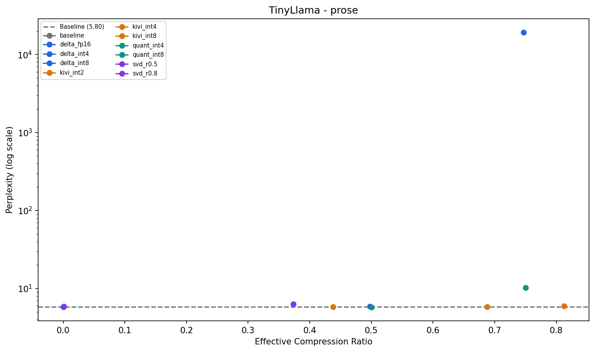
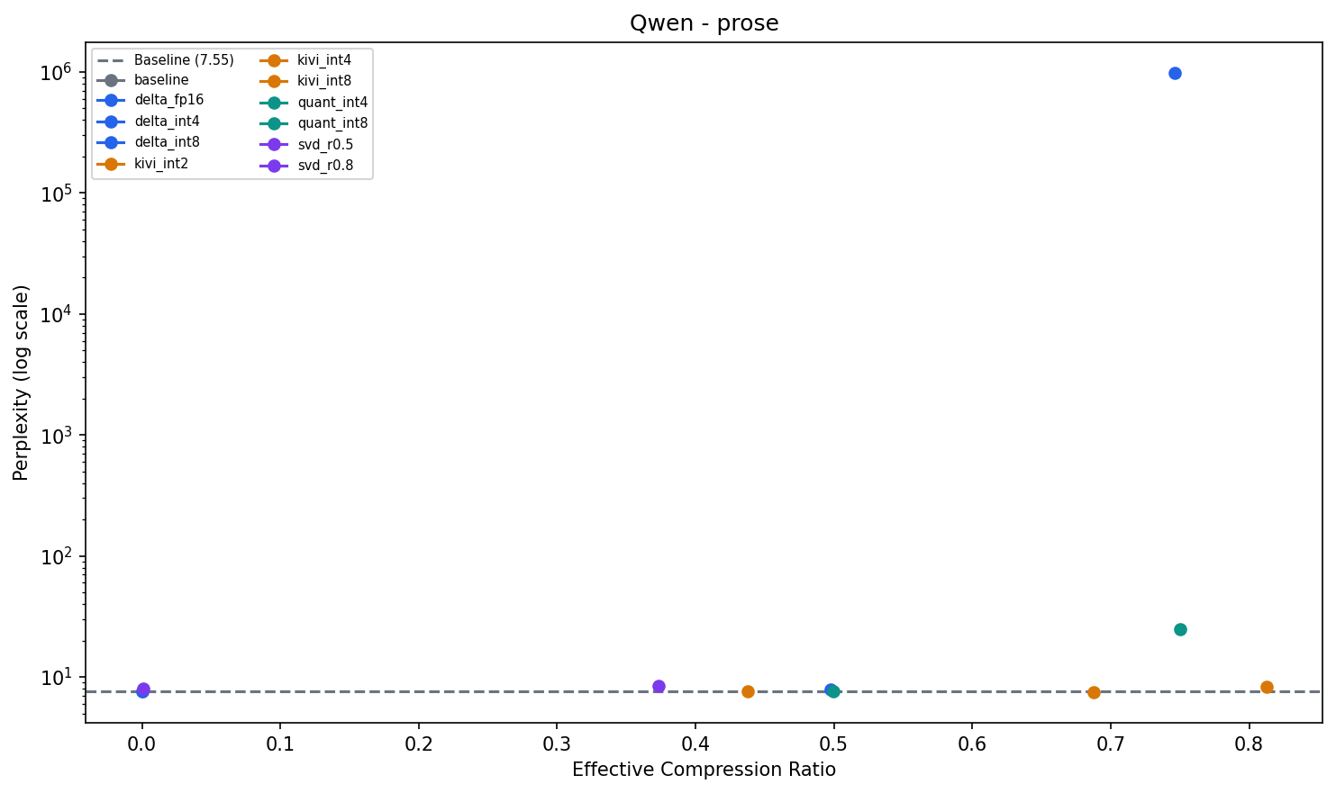
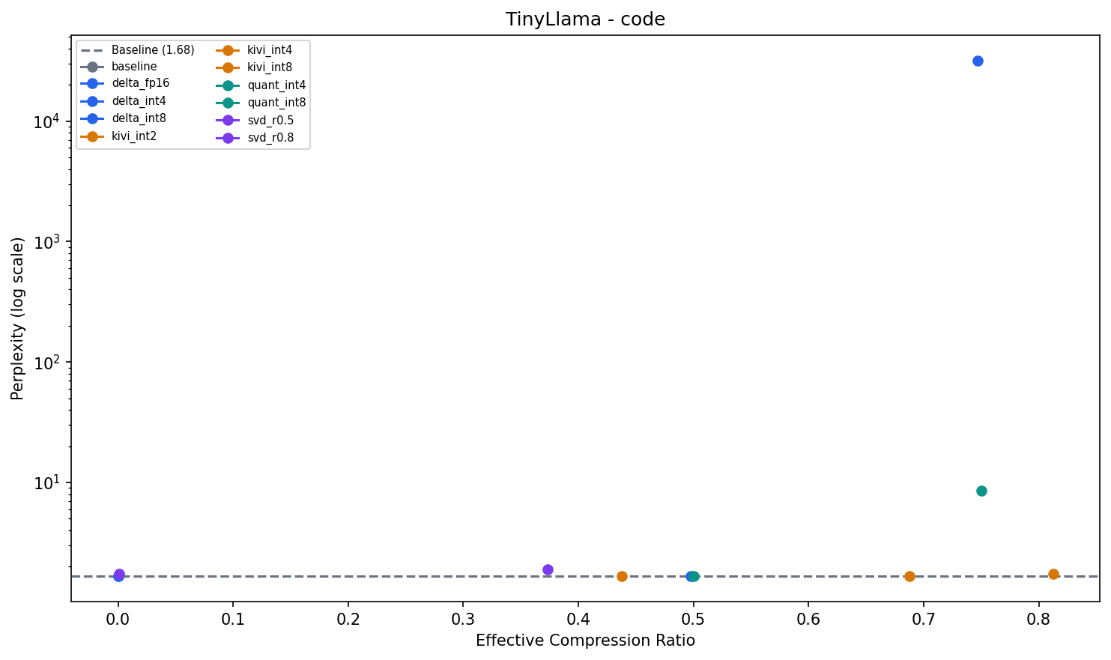
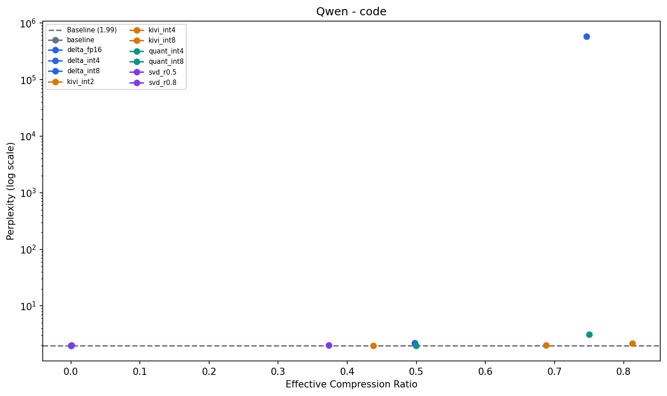
END-TO-END QUALITY
Perplexity vs Compression Ratio - Precision Reduction Codecs
TinyLlama . Prose
Qwen . Prose
TinyLlama . Code
Qwen . Code
KIVI maintains near-baseline PPL at 80% compression. delta_int4 explodes - do not use for quality-sensitive tasks.

Slide 10
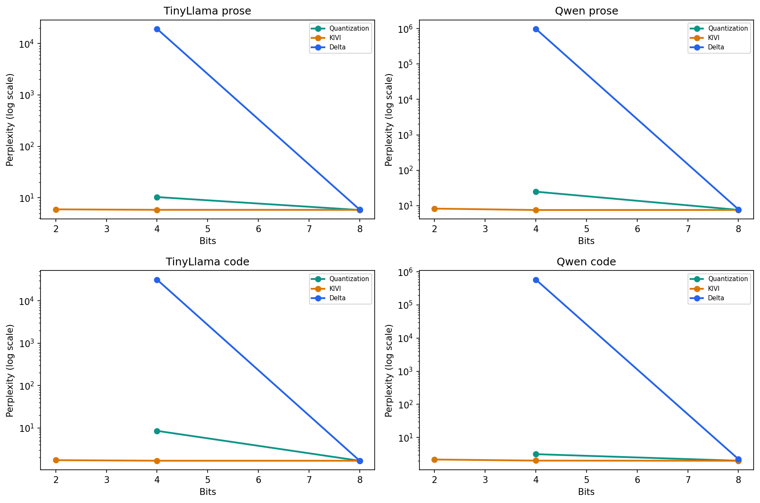
END-TO-END QUALITY
Perplexity vs Quantization Bits - How Low Can We Go?
KIVI (amber) stays flat from 8-bit down to 2-bit. Delta (blue) works at 8-bit but explodes at 4-bit - quantization error compounds in cumulative sum. Quantization (teal) degrades gracefully.

Slide 11
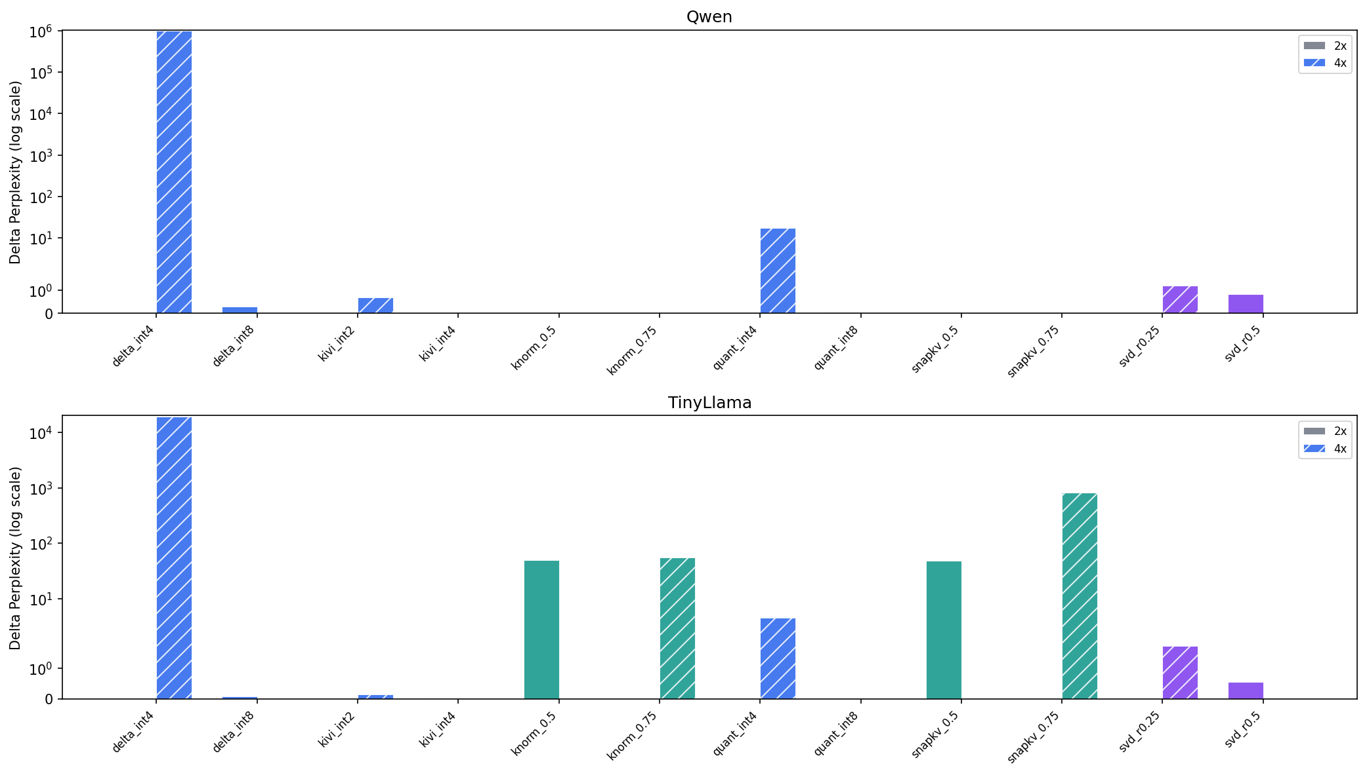
END-TO-END QUALITY
Crossover Comparison - Precision vs Eviction vs Dimension
Precision (blue) dominates at both 2x and 4x targets. Eviction (teal) is 10-50x worse at equal memory budget. Dimension reduction (purple) is moderate. Solid bars=2x, hatched=4x.

