Slide 1
3 Idiots present EYE
The interpreter that visualises

Slide 2
AIM
Create an interpreter for our language similar to C++ to help visualize the implementation of the user’s code
Could be useful as a debugger( mistakes can be visualized directly) and to teach algorithms

Slide 3
PROBLEM STATEMENT
Develop an interpreter for a small rule-based language of your own using python3 and its libraries.
The interpreter must depict, in real time, the execution environment, data structures, variables and memory allocation to give the user a comprehensive overview of the interpreter working and code execution.

Slide 4
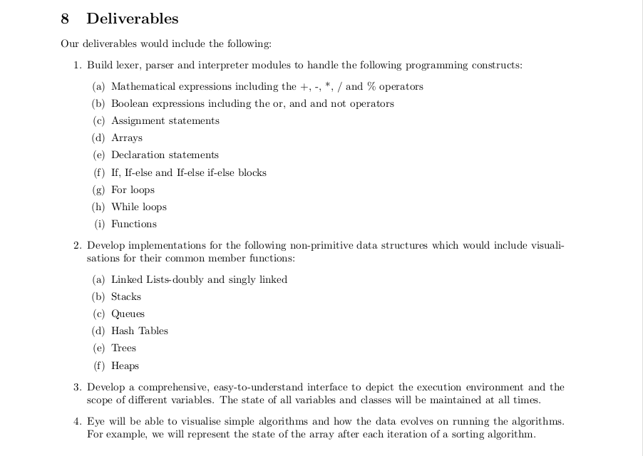
LIST OF DELIVERABLES

Slide 5
Demo 1-MERGE SORT
Buggy code gives undescriptive segmentation faults
Easy to debug using Eye, since one can immediately see that the function with the same arguments is being called.

Slide 6
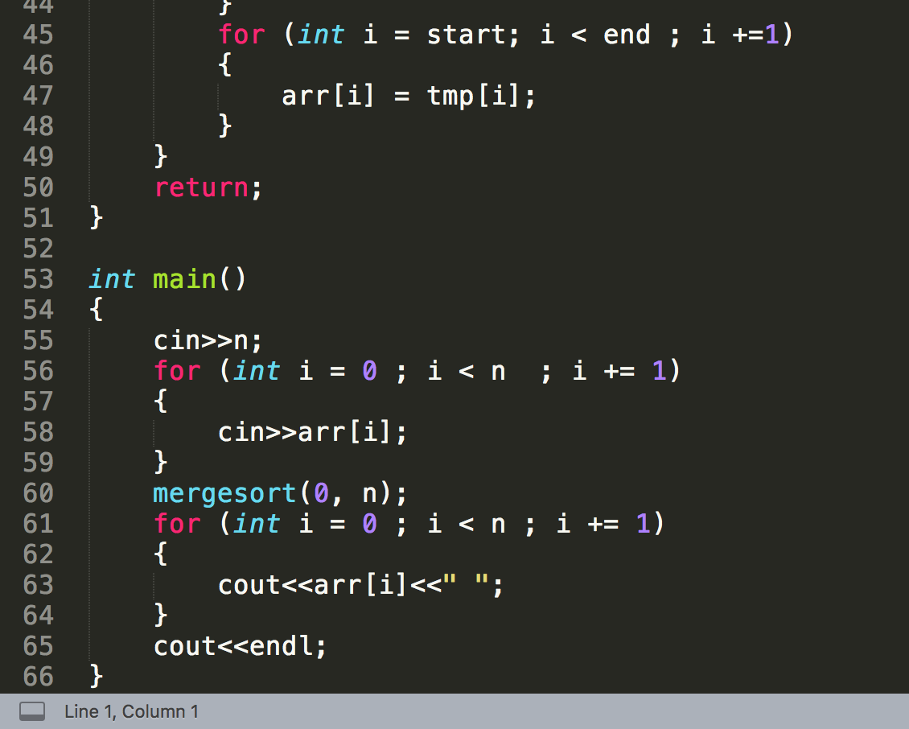

Slide 8
Demo 1-MERGE SORT
Recursion clearly observed and blocks for different loops can be seen
Visible code snippets
Array is global( global variables implemented)
Different Boolean expressions
Cin and cout statements seen

Slide 9
Demo 2- DATA STRUCTURES
A code demonstrating the useful data structures
Basic functions on the data structures implemented
Useful for visualizing them
Performed different operations on stacks, queues, bst, hash table and linkedlist
Do write your own code to try things!!

Slide 10
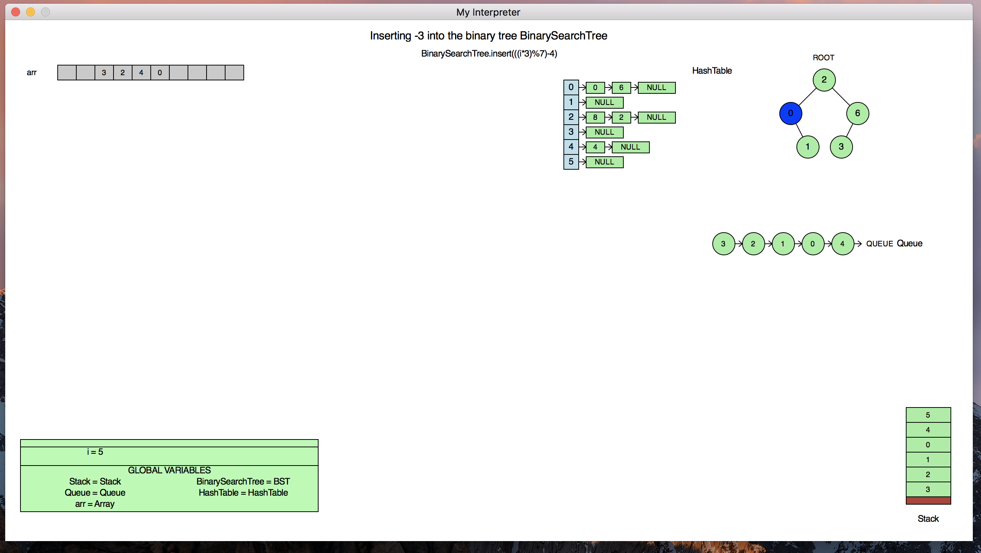

Slide 11
IMPLEMENTED
All the deliverables stated in the abstract have been completed
All mathematical and Boolean expression,assignment statements and declarations can be interpreted
Arrays along with their graphics implemented

Slide 12
IMPLEMENTED
Control-flow statements (if, else-if, else) implemented
Loops like for-loop and while-loop can be visualized
Interpreting of functions also done(all the variables are accessed in an appropriate way)
Recursive functions can be clearly visualized

Slide 13
IMPLEMENTED
Different data structures like stacks, queues, binary search trees , linked lists, hash table can be interpreted
Relevant functions for such data structures implemented
Graphics of such data structures provide a very good way of visualizing common algorithms related to them

Slide 14
IMPLEMENTED
The scoping of variables is clearly visible in the graphics
New block created whenever a new loop or block is started
New stacks are created for functions
Global variables can also be seen and used

Slide 15
IMPLEMENTED
Basic algorithms like sorting can be clearly visualized
Sorting algorithms and algorithms related to common data structures can be clearly seen
Very useful for teaching purposes
Bugs in the program can be caught more easily using the graphics

Slide 16
CHALLENGES
Was quite difficult to understand how a code is interpreted and actually stroring the statements as classes
Understanding the usage of rply library
Implementing the graphics of data structures
Management of the graphics on the screen

Slide 17
SOFTWARE USAGE
Our entire code is in python3
The code has been parsed using rply library
Graphics.py used to display graphics
Extensively used git( private repository)
Used bash scripts to perform different tasks
Used doxygen to generate the documentation of our code
Used latex to create user manual of our language

Slide 18
Reusability
The user has to simply clone our repository and run the file – it gives the user an visualizing environment
An user manual has been created to guide the user(do refer it and run the code)
The libraries required to be in the device are graphics and rply
Could be extended to include all C++ features
As shown, really useful as a debugger and for displaying algorithms and teaching purposes

Slide 19
THANK YOU

