Slide 1
3 Idiots present EYE
The interpreter that visualises

Slide 2
ABSTRACT
Create an Interpreter (for a language syntactically similar to C++)
Give a graphical representation of “behind-the-scene” memory allocation and other processes executed by the interpreter
Develop representations for execution stacks, and common data structures like queues, trees, etc.

Slide 3
MOTIVATION
Chose this project because it can be a great tool to visualise algorithms and common data structures
Difficulties faced in our Algorithms course inspired the idea
Great tool to teach CS 101 -> to give a feel of how a compiler actually executes your code

Slide 4
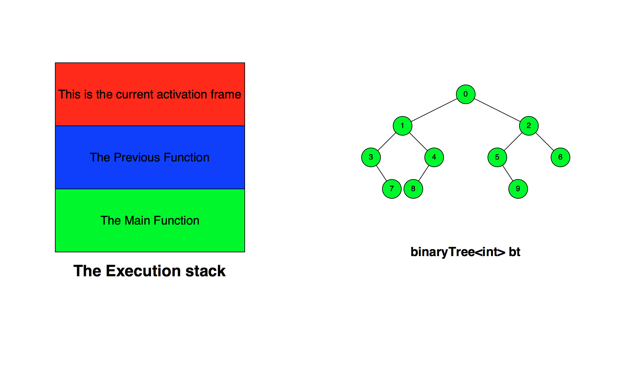
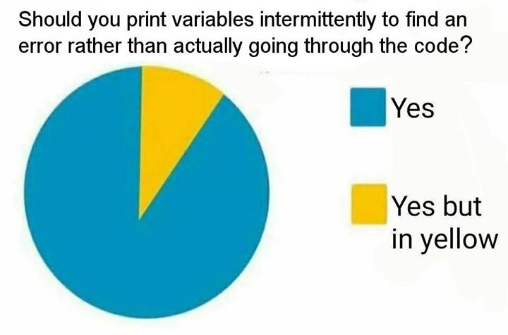


Slide 5
MOTIVATION
Great for debugging!
Convenient to find out logical shortcomings in your algorithms
Very easy to find out where the undescriptive Segmentation Faults arise
Wanted to get under the hood of the compilers we use day in day out
Excitement to create our very own language!

Slide 6
LITERATURE SURVEY
Extensive research has been done on the field of interpreters previously.
Interpreters for the language C++ like Cint, Cling, which inspite of having a lot of functionality are not complete.
Similar attempts to create an visualization environment have been made , though we could not find anything substantial on the internet.

Slide 7
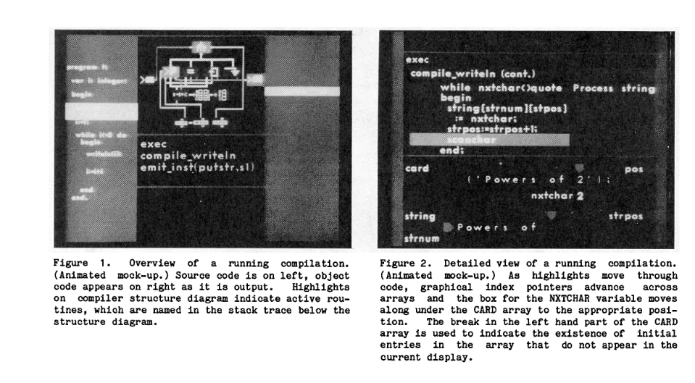

Slide 8
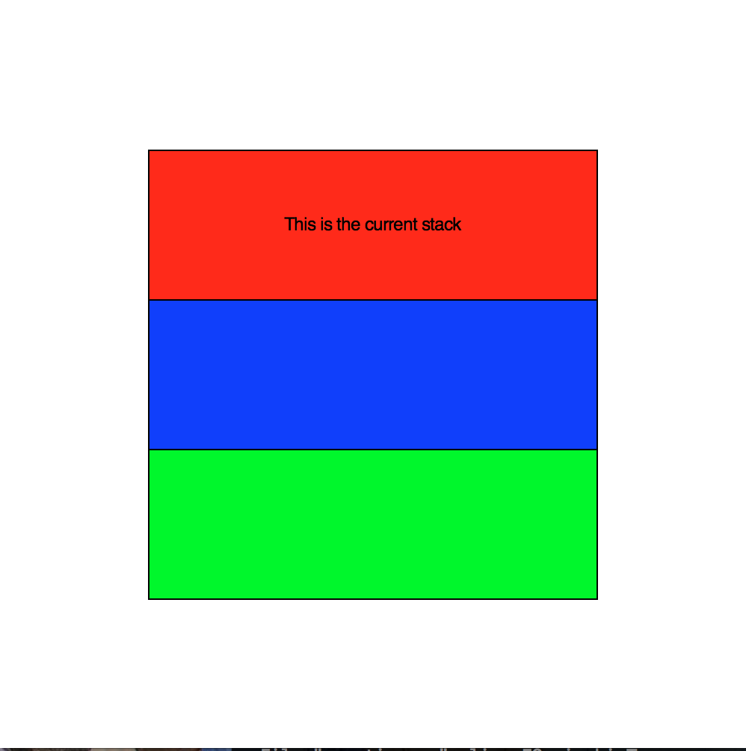

Slide 9
PROBLEM STATEMENT
Develop an interpreter for a small rule-based language of your own using python3 and its libraries.
The interpreter must depict, in real time, the execution environment, data structures, variables and memory allocation to give the user a comprehensive overview of the interpreter working and code execution.

Slide 10
SOFTWARE REQUIREMENTS
Python3 and its (open-source) libraries:
rply:
LexerGenerator – for tokenizing
BaseBox – for abstract syntax trees
ParserGenerator – for, well, parsing
graphics.py
cocos2d along with pyglet
HTML/CSS/JavaScript – to create an interface
Doxygen/Latex – to create a reference manual for our language.

Slide 11
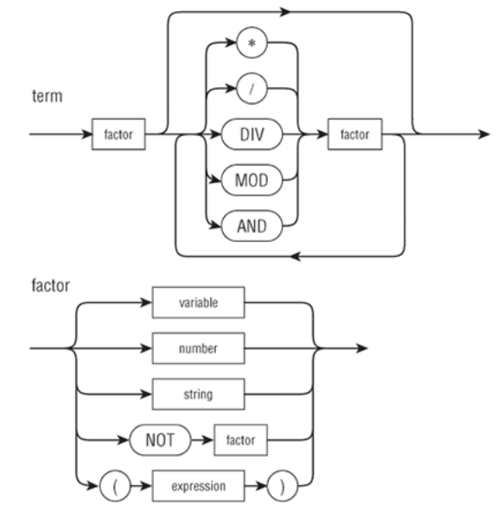
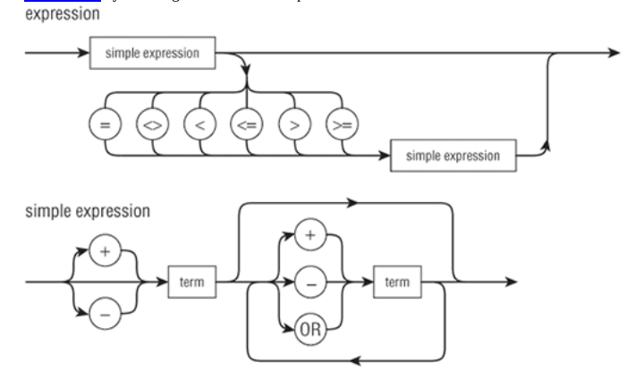

Slide 12
IMPLEMENTATION
First we use a lexer to tokenise each element of the user’s code
We define classes to store all major programming constructs like conditionals, loops and assignments.
The parser, based on Abstract Syntax Trees we define will parse the code and store it into the aforementioned classes.

Slide 13
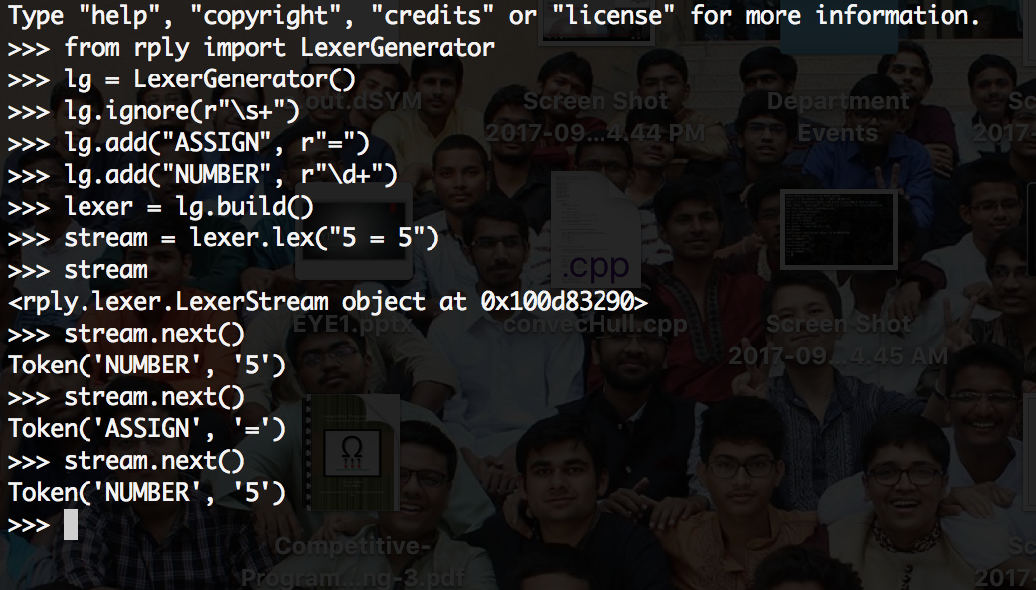

Slide 14
IMPLEMENTATION
PARSER CLASS | WHAT IT WILL CONTAIN | WHAT IT REPRESENTS
Identifier | letter(letter|digit)* | Name of a variable
Variable | identifier|identifier[expression] | Variable or array element
Term | raw data|variables|(expression) | A value
Expression | <unary operator>*term(<binary operator>term)* | Anything that can be evaluated
Statement | declaration|assignment|cout/cin|loops | Constructs of different kinds
Block | statement(statement)* | One or more statements
Assignment | variable and expression | Statements with an “=” sign
Declaration | variable type and assignment type | Variable declarations
Cout/cin | List of expressions/variables | Input and output objects
Conditionals | Expressions for conditions and blocks to execute | If – else if – else constructs
For loop | Intialisation, updation, condtion and block | For loop constructs
While loop | Condition and block | While loop constructs
Functions | Name, argument list and block | Function Declarations
Function Calls | Function name and list of arguments passed | Actual execution of functions

Slide 15
IMPLEMENTATION
Interpreter will maintain a symbol table to store variables (and their scopes) as a list of dictionaries and a dictionary for functions
Finally, when we execute the parsed code, we graphically represent what is being executed.
Common data structures (stacks, queues, etc) will be their own classes with member methods including methods for graphic representations

Slide 16
FEASIBILITY
This program can be used for viewing basic algorithms and for debugging simple programs.
This is also useful for teachers(eg. CS213 and CS101) to demonstrate common problems and algorithms like railroad problem, LPT algorithm in machine scheduling.
However it will be quite difficult to implement it for extensive programs which have a variety of features and also for some basic probems like i++.

Slide 17
TESTING
We will implement and visualise the algorithms and data structures learnt in our course on Data Structures and Algorithms.
We will check each module: namely the lexer, parser, interpreter, graphic generation and data structures, by reviewing the trees generated or output displayed for each stage, for a number of programs.

Slide 18
WORK ALLOCATION AND TIMELINE
About 10-11 days for making lexer for tokenizing and parser for parsing the given tokens. Aman will be working on lexer while Sahil and preey will code the rules for parsing.
About 1 week for developing the interpreter, while preey will be working on how to manage function. Sahil will work on assignment and variable updation. Aman will work on developing the symbol table.
About 1 week for working on graphics implementation of the statements, functions and data structures. Sahil will work on showing variables and current values stored. Aman will work on showing changes in the data structures and updating them and preey will work on showing activation frame and the scoping of variables.
Last week to be kept for debugging, documenting, implementing HTML interface. All three of us will be in debugging and documentation.

Slide 19
THANK YOU!

