Slide 1
3 Idiots present
EYE
The interpreter that visualises

Slide 2
PROBLEM STATEMENT
Develop an interpreter for a small rule-based language of your own using python3 and its libraries.
The interpreter must depict, in real time, the execution environment, data structures, variables and memory allocation to give the user a comprehensive overview of the interpreter working and code execution.

Slide 3
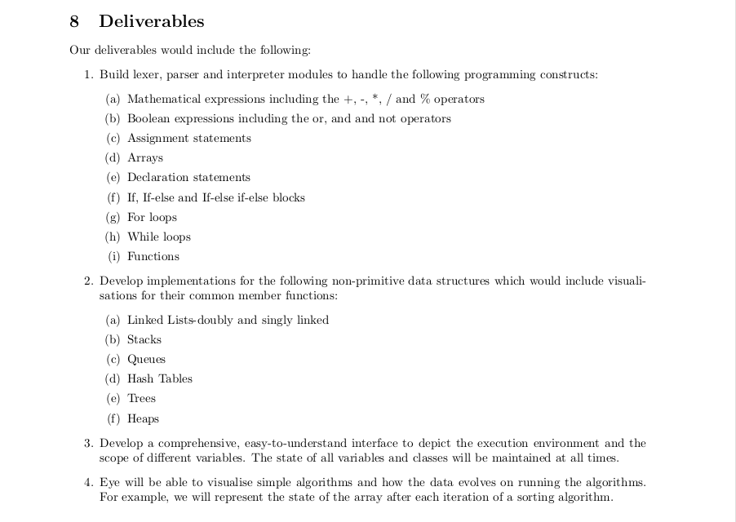
LIST OF DELIVERABLES

Slide 4
IMPLEMENTED
All the deliverables stated in the abstract have been completed
Concepts of scope and shadowing can be clearly seen
All mathematical and Boolean expressions implemented
Functions and global variables implemented( recursion can be clearly seen)

Slide 5
IMPLEMENTED
Loops and control-flow statement can also be visualized(with scope)
Data structures useful in algorithms like binary search trees, stacks , queues, linkedlists ,hash table can be visualized
Code snippet which is currently in execution being displayed

Slide 6
Demo 1-MERGE SORT
Buggy code gives undescriptive segmentation faults
Easy to debug using Eye
Recursion clearly observed
Visible code snippets
Array is global( global variables implemented)
Different Boolean expressions
Cin and cout statements seen

Slide 7
Data Structures
A code demonstrating the useful data structures
Basic functions on the data structures implemented
Useful for visualizing them
Performed different operations on stacks, queues, bst, hash table and linkedlist
Do write your own code to try things!!

Slide 8
SOFTWARE USAGE
Our entire code is in python3
The code has been parsed using rply library
Used doxygen to generate the documentation of our code
Used latex to create user manual of our language
Extensively used git( private repository)
Used bash scripts to perform different tasks
Graphics.py used to display graphics

Slide 9
Reusability
The user has to clone our repository and run the file – it gives the user an visualizing environment
An user manual has been created to guide the user
The libraries required to be in the device are python3 and rply
Could be improvised to include most C++ features
As shown, really useful as a debugger and for displaying algorithms and teaching purposes

Slide 10
THANK YOU

