Slide 1
DataSys Coin (DSC): Simplifying Blockchain Technology
A Java-based Blockchain Project
by
Team Hackstr

Slide 2
Introduction to DSC Coin
"DSC Coin is a simplified blockchain model, developed as a Java program."
"This project aims to provide a foundational understanding of blockchain technology, focusing on its application in distributed systems."
"While drawing inspiration from Bitcoin and Ethereum, DSC Coin is designed to be more straightforward, making it ideal for educational purposes."

Slide 3
Fundamentals of Blockchain in DSC Coin
"Blockchain is a decentralized ledger technology."
"It ensures secure, transparent, and tamper-proof transactions."
"Distributed systems are crucial in blockchain for scalability and reliability."

Slide 4
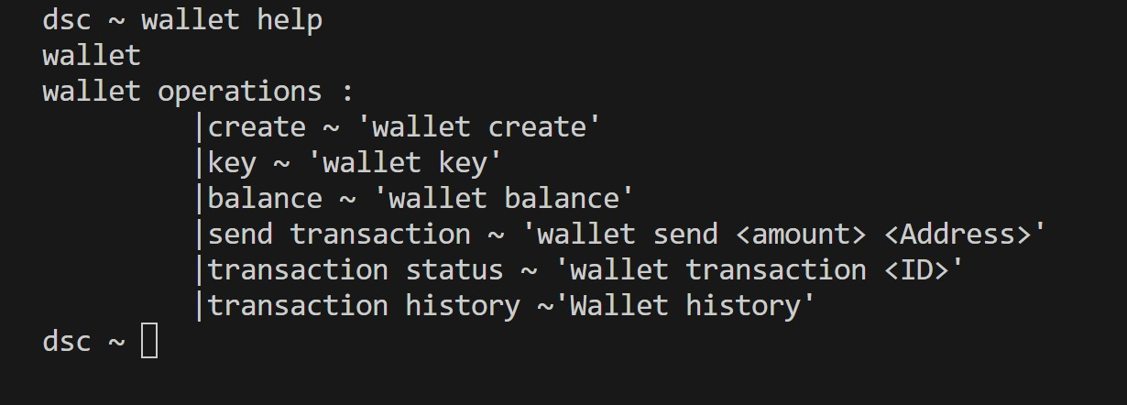
Core Components of DSC Coin
"DSC Coin comprises several key Java classes, each serving a specific function."
"Classes include Block, BlockChain, Transaction, Validator, WalletGenerator, Metronome, Pool, and Main."

Slide 5
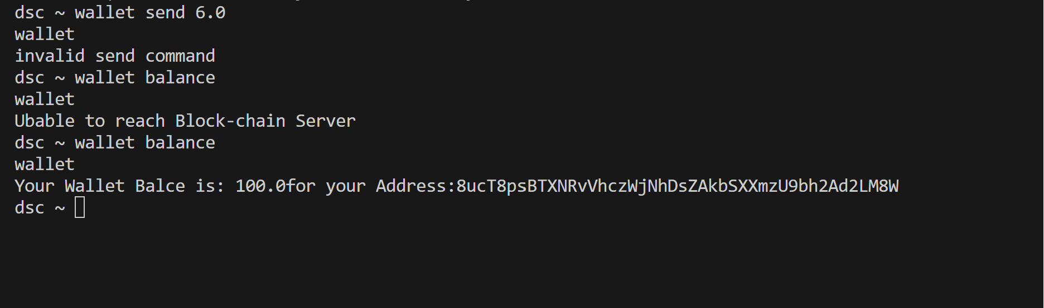
Error Handling

Slide 6
Key Implementations in Java
"The Block class represents individual records in the blockchain."
"The BlockChain class manages the chain of blocks, ensuring integrity."
"Transactions are created and processed using the Transaction class."
"Validation of transactions is handled by the Validator class."
[Add brief descriptions for Metronome, and Pool]

Slide 7
BlockChain
It manages the chain of blocks that constitutes the blockchain.
Functionality: -
. Chain Management
. Integrity Checks
. Transaction Processing
Acts as the ledger that records all transactions and blocks, maintaining the state and continuity of the blockchain.

Slide 8
Metronome
The `Metronome` class simulates the timing mechanism in the blockchain and simulates the timing of block creation
Functionality: -
. Block Timing
. Synchronization
Essential for the simulated mining process, maintaining a steady and controlled addition of blocks to the blockchain.

Slide 9
Validator
Validates transactions and creates new blocks.
Functionality: -
. Transaction Validation
. Block Verification
Acts as a safeguard for the blockchain, preventing fraudulent or invalid transactions and blocks from being recorded.

Slide 10
Pool
Manages unprocessed and unconfirmed transactions.
Functionality: -
. Transaction Storage
. Transaction Selection
Functions as a holding area for transactions, streamlining the process of adding them to the blockchain.

Slide 11
Security and Integrity Measures
Cryptographic Hashing with Blake3:
Chained Block Hashes for Security:
Blocks contain their own hash and the hash of the previous block.
This chaining secures the entire blockchain against data tampering.
Transaction Integrity and Non-repudiation:
Transactions are cryptographically secured in the Transaction class.
Once recorded, transactions cannot be altered, ensuring trust in the system.
Resilience Against Attacks:
The system is designed to prevent common blockchain attacks.
The Validator class plays a crucial role in maintaining a robust consensus mechanism.
Continuity and Consistency:
Distributed architecture ensures every node has an up-to-date blockchain copy.
Consensus algorithms keep the blockchain consistent across all nodes.
Utilizing the Blake3 algorithm for secure and fast hashing.
Each block in our chain contains a unique hash based on its data, ensuring data integrity.

Slide 12
Demonstration
"A live demonstration of DSC Coin in action."
"Illustration of how transactions are created, validated, and added to the blockchain."

Slide 13

Conclusion
"DSC Coin provides a basic yet comprehensive understanding of blockchain technology."
"It demonstrates the potential and challenges of implementing distributed ledger systems."

