Slide 1
Disaster Donation Management System
INFO 5100 Final Project Presentation
Group Members:
Eshanee Thakur
Shailly Jain
Tasleem Rayali

Slide 2
Problem Statement
There have been many natural and man made disasters, which have been occurring at an alarming rate
During these times, donations usually start flowing in the disaster area immediately. It is imperative that efforts are made to coordinate and tackle the problems faced and prevent any further difficulties
No proper requirement tracking and management of the donations leads to chaos and wastage of time and resources

Slide 3
Proposed Solution
We propose “Disaster Donation Management System” application. This application would primarily track the actual needs of goods and medicines in the affected area and all the goods donated by the people around the world
It would record the shipment of these goods based on the affected area needs for its distribution. The application would also track the inflow of cash donations
With this project, we aim to provide an end to end system, where the admin can keep track of the donations and distribute it according to the requirement of the affected area in order to avoid the wastage of resources

Slide 4
Approach
Planning
Design
Specification
Development
Organizations & directories
Enterprises
Db4o setup
Organizations & directories
UI
Human Resources
NGO
Relief Funding organization
Pharmacist Organization
Logistics
Good Management Organization
Transport Organization

Slide 5
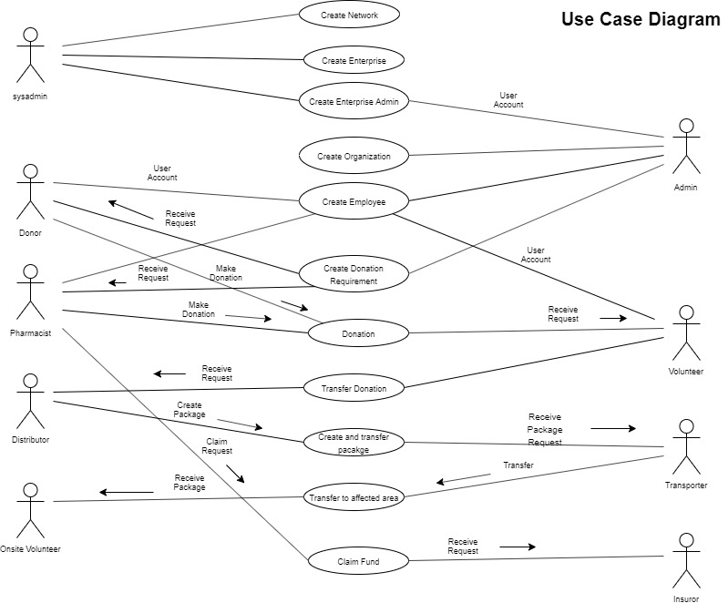
Use Case

Slide 6
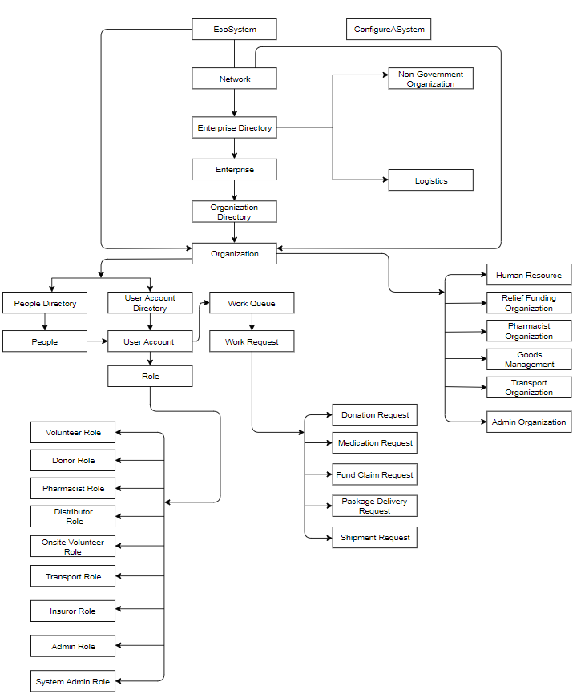
Object Model

Slide 7
Pharmacist workflow
Start
Donation
Requirements
No
Medicines
End
yes
Make Donation
On Site Volunteer
Volunteer
Collects Donations
Transporter
Transfers packages
Distributor
Creates Packages

Slide 8
Donor workflow
Start
Donation
Requirements
No
Food, Clothes and Money
Yes
End
Make Donation
Money
Money or Goods?
On Site Volunteer
Goods
Volunteer
Collects Donations
Transporter
Transfers packages
Distributor
Creates Packages

Slide 9
Claim work Flow
Start
Pharmacist
No
Request Completed?
yes
Insurors
Validate claim Request
Approve
Receive Money
Approve or reject?
Reject
End

Slide 10
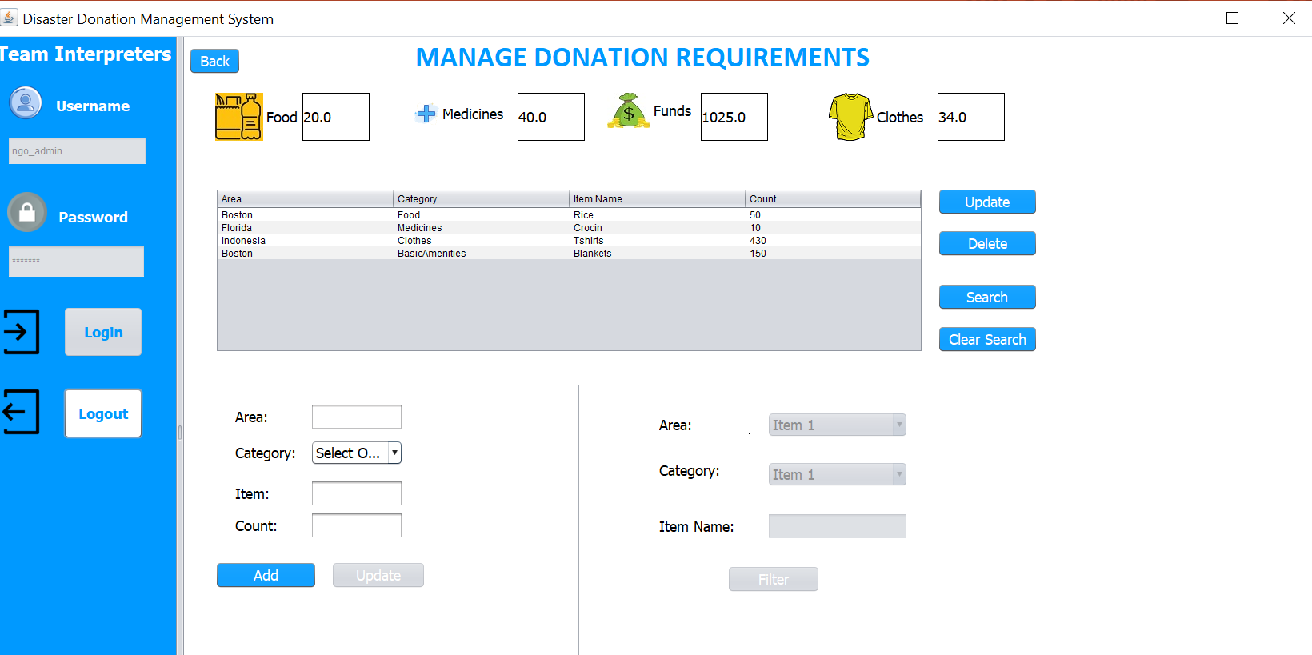
Screenshots

Slide 11
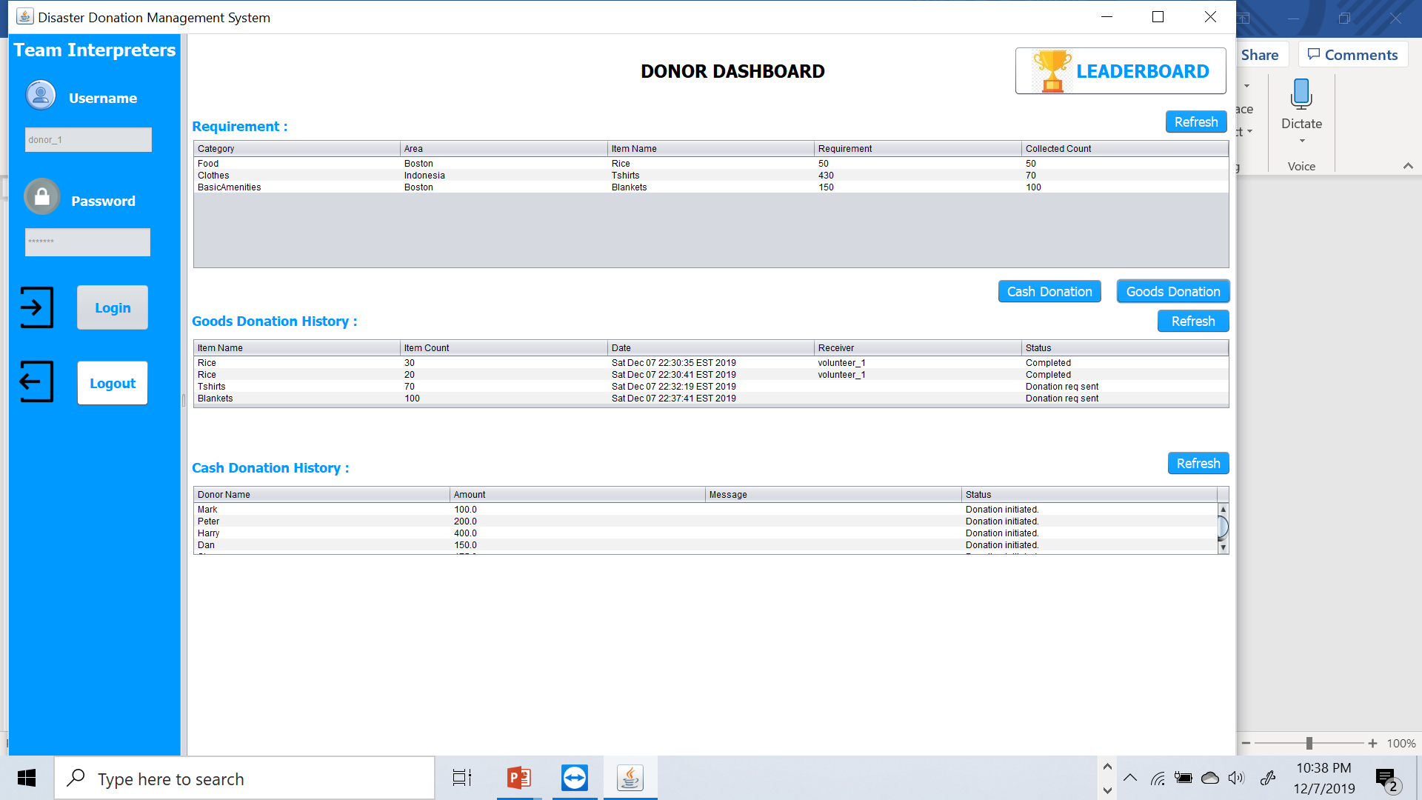

Slide 12
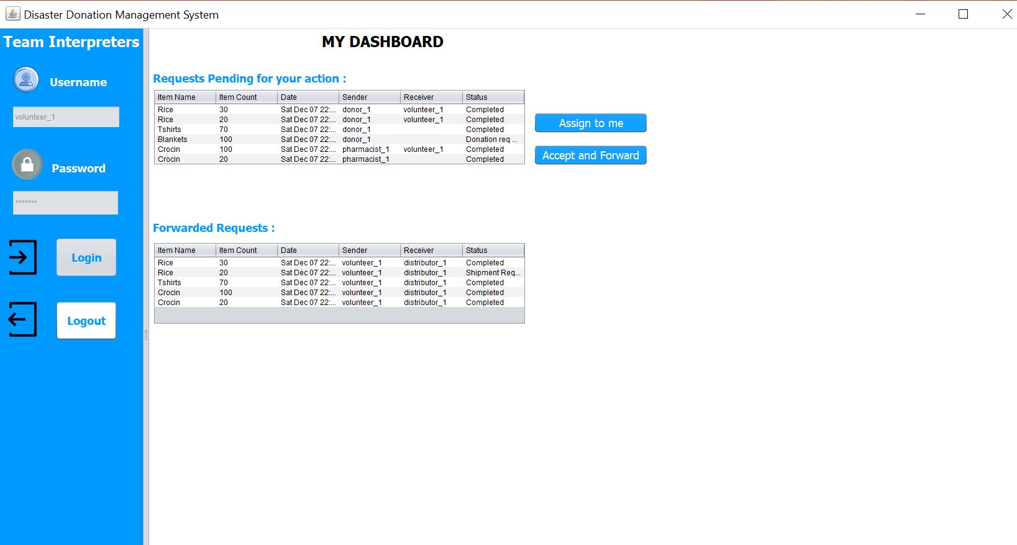
VOLUNTEER DASHBOARD

Slide 13
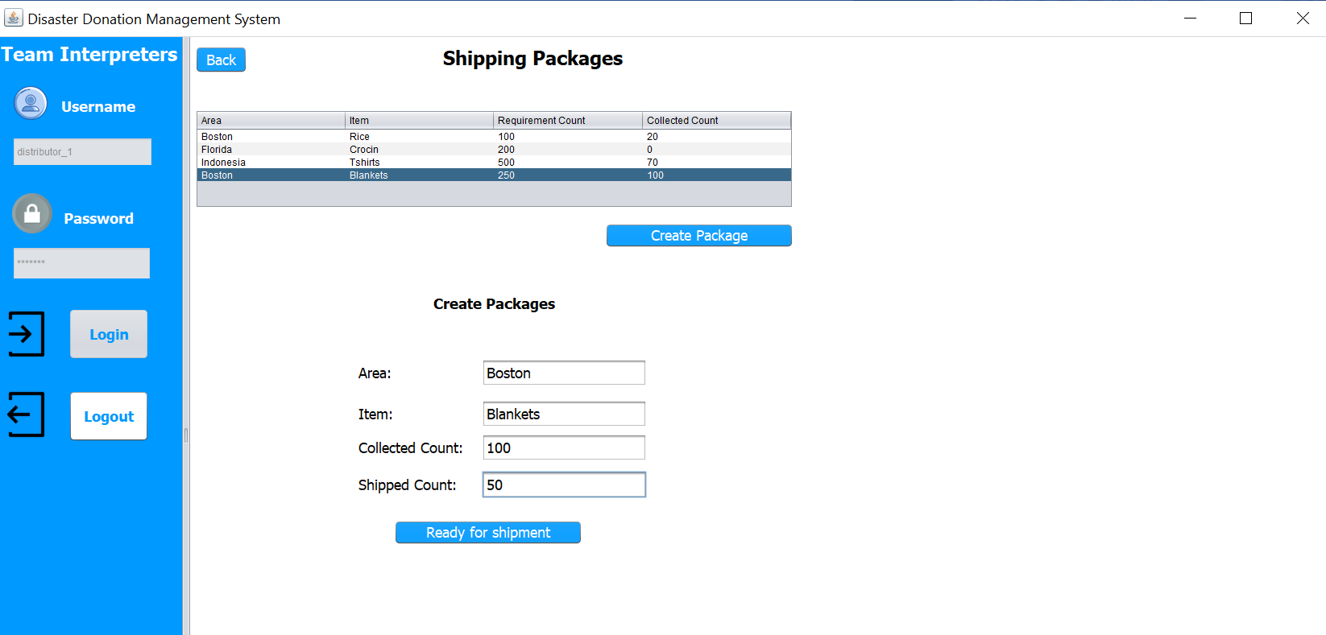

Slide 14
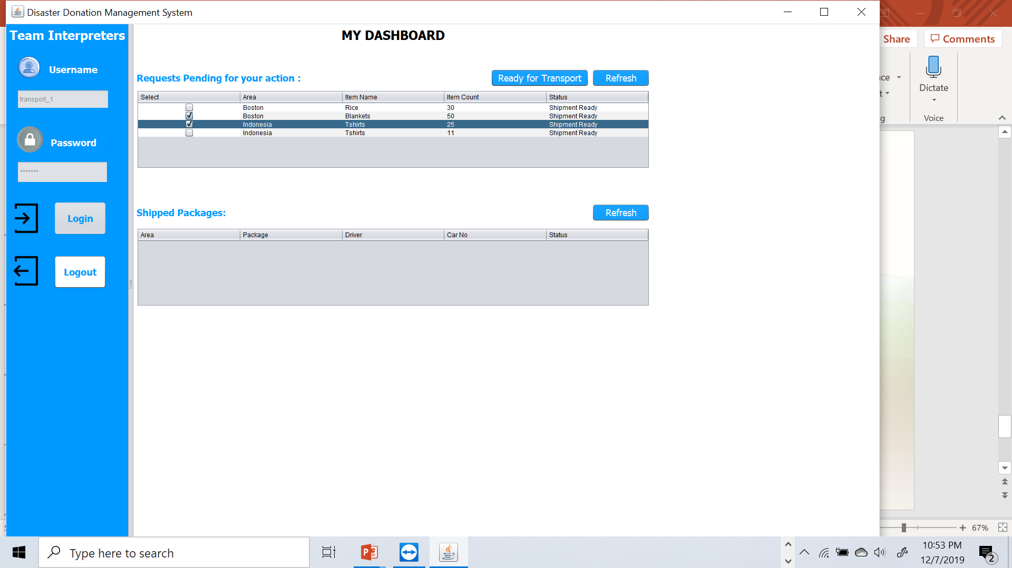

Slide 15
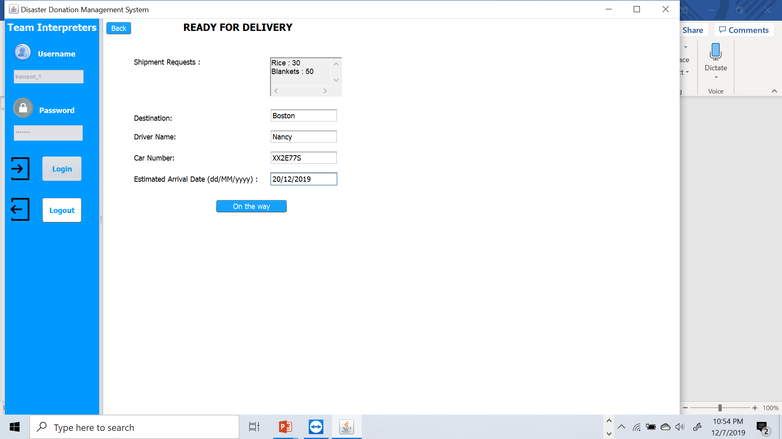

Slide 16
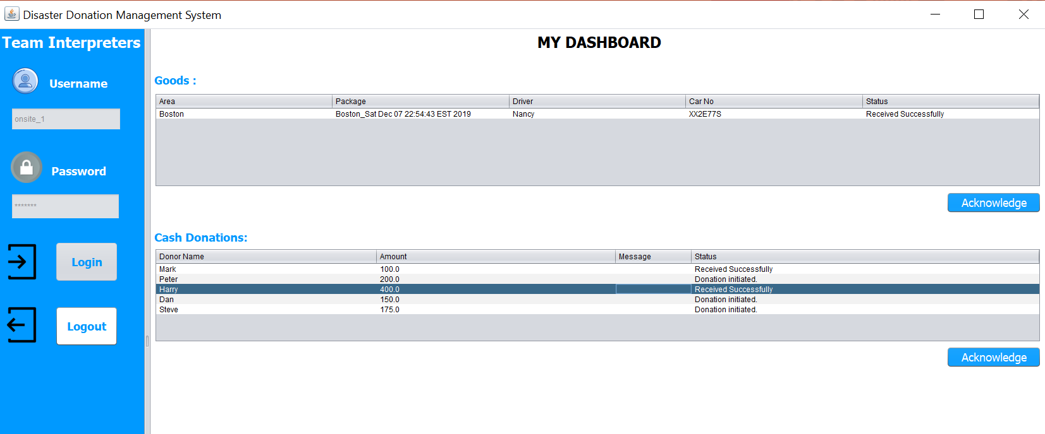

Slide 17
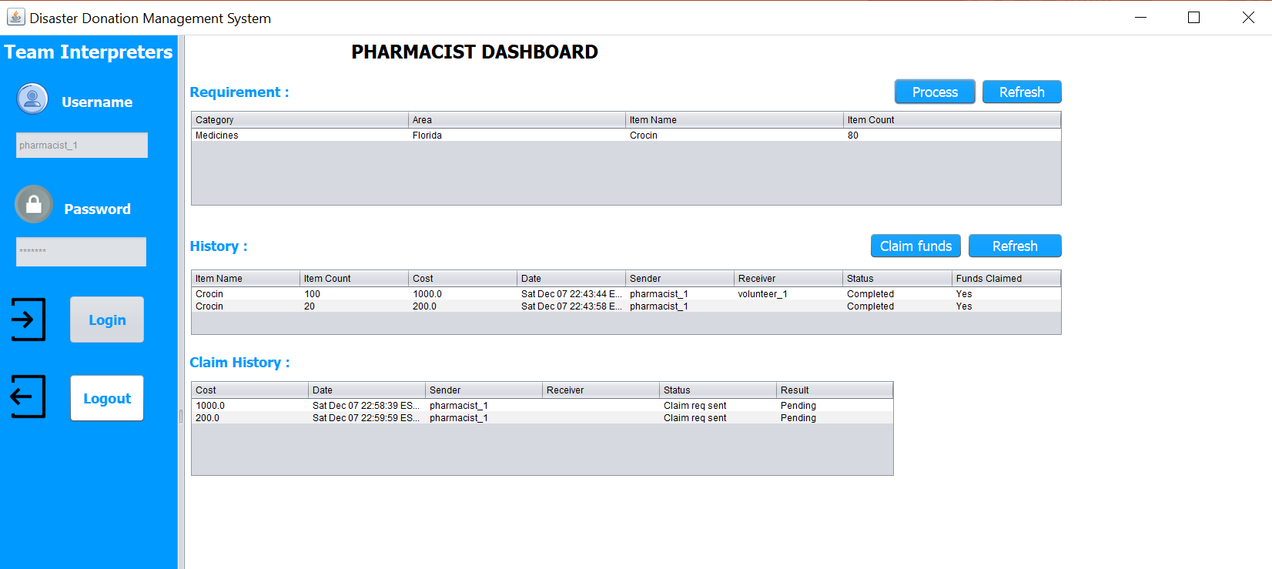

Slide 18
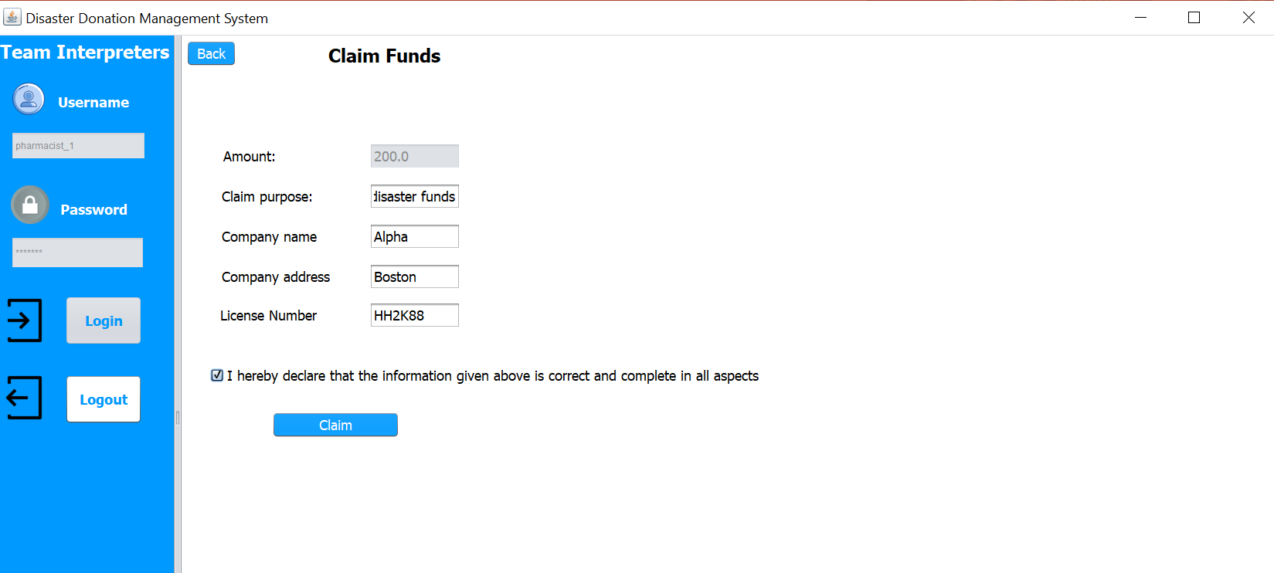

Slide 19
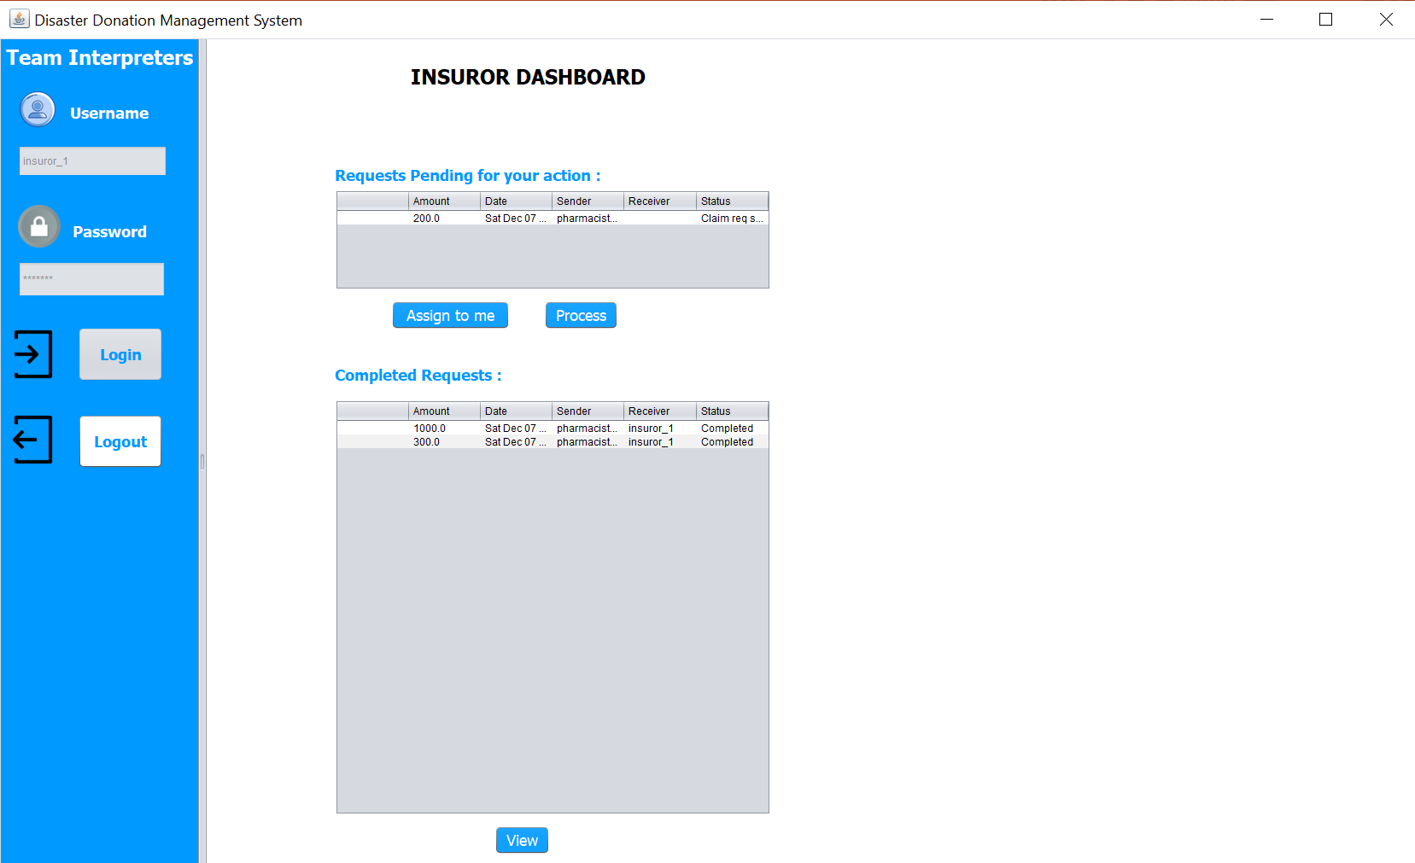

Slide 20
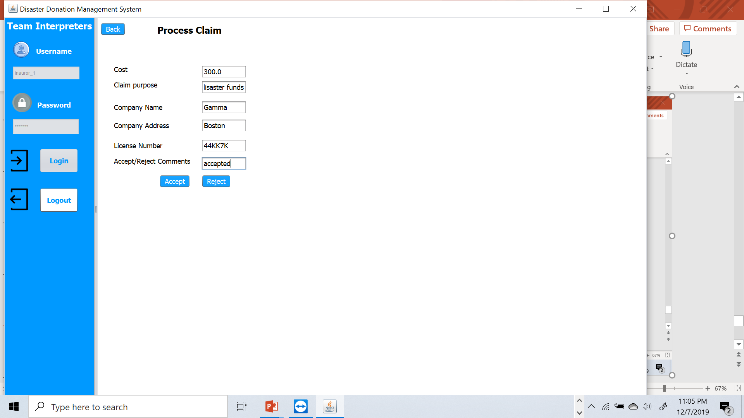

Slide 21
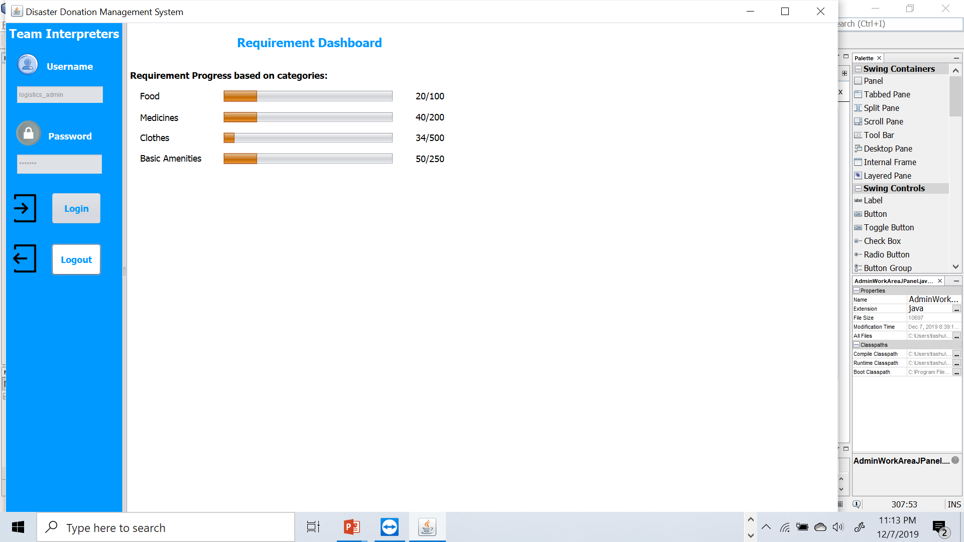

Slide 22
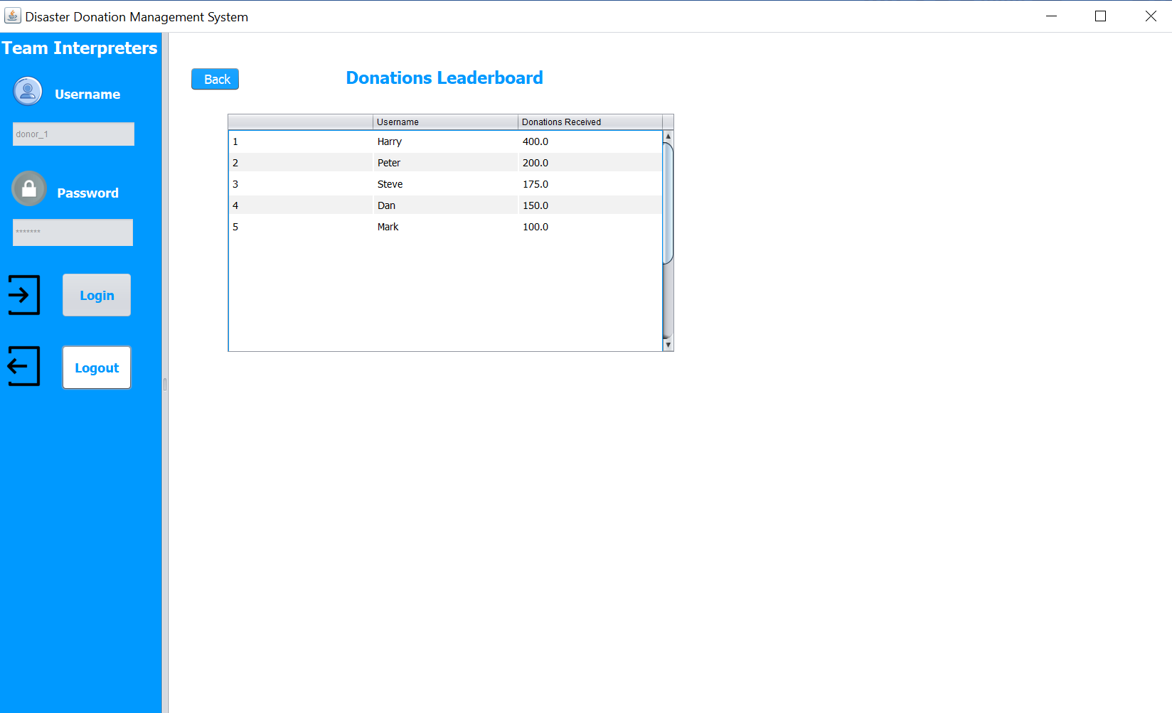

Slide 23
Thank you

