Slide 1
NEPAL
THE LAND OF HIMALAYAS
Founded
1768 AD
🏙 Capital
Kathmandu
👥 Population
~31 Million
🏔 Highest Peak
Mt. Everest 8,849m
Nepal • Country Presentation Designed By Rayamajhi Ajay

Slide 2
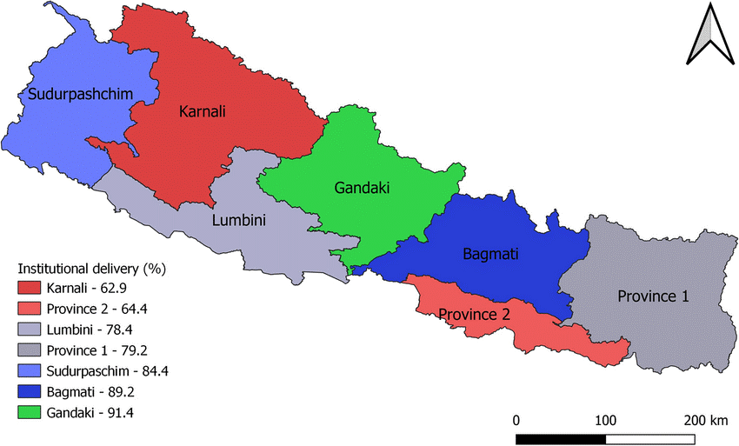
OVERVIEW OF NEPAL
MAP OF NEPAL
Official Name: Federal Democratic Republic of Nepal
Year of Unification: 1768 (Gorkha Kingdom)
Current Republic: 2008 (abolished monarchy)
Constitution: 2015 (Federal Parliamentary Republic)
Area: 147,516 km²
Nepal lies between China (north)
and India (south, east, west)
Location: South Asia — landlocked in the Himalayas
Nepal • Country Presentation Designed By Rayamajhi Ajay

Slide 3
POPULATION & ETHNIC GROUPS
~31
Million
Total Population (2025)
125+
Ethnic Groups
& 123 Languages
1.85%
Annual Growth Rate
48th most populous country
Major Ethnic Groups
Chhettri
16.6% of population
Brahman-Hill
12.2% of population
Magar
7.1% of population
Tharu
6.6% of population
Tamang
5.8% of population
Newar
5.0% of population
Nepal • Country Presentation Designed By Rayamajhi Ajay

Slide 4
MAJOR RELIGIONS IN NEPAL
Hindu 81.3%
Buddhist 9%
Muslim 4.4%
Kirant 3.1%
Other 2.2%
Nepal • Country Presentation Designed By Rayamajhi Ajay

Slide 5
TOP 5 CITIES BY POPULATION
TOP 5 CITIES BY POPULATION
Kathmandu
Capital & largest city. Hub of politics, culture & commerce.
1
Pokhara
Gateway to Annapurna. Nepal's tourism capital.
2
Bharatpur
Fast-growing; gateway to Chitwan National Park.
3
Biratnagar
Industrial & trade hub in Eastern Nepal.
4
Lalitpur (Patan)
Ancient Newari architecture; arts & culture capital.
5
Nepal • Country Presentation Designed By Rayamajhi Ajay

Slide 6
AVERAGE TEMPERATURE BY MONTH — KATHMANDU
Coldest Month
January — avg 10°C (50°F)
Hottest Month
June — avg 24°C (75°F)
Best Seasons
Spring (Mar–May) &
Autumn (Oct–Nov)
Monsoon Season
June to September
(heavy rainfall)
Climate Type
Humid subtropical
(Cwa Köppen class)
Nepal • Country Presentation Designed By Rayamajhi Ajay

Slide 7
AVERAGE RAINFALL BY MONTH — KATHMANDU
Total Annual
~1,455 mm (57")
Wettest Month
July — 363 mm
Driest Month
December — 6 mm
Monsoon Period
June–September
Rainfall Days/yr
~110 days
Nepal • Country Presentation Designed By Rayamajhi Ajay

Slide 8
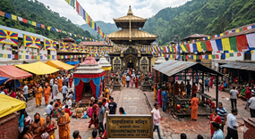
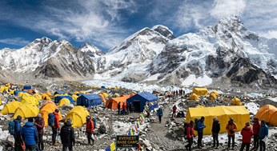
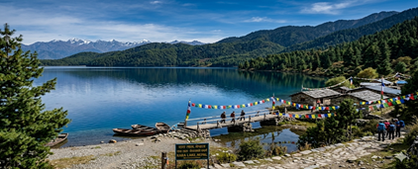
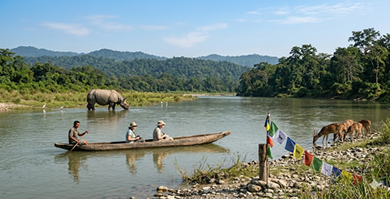
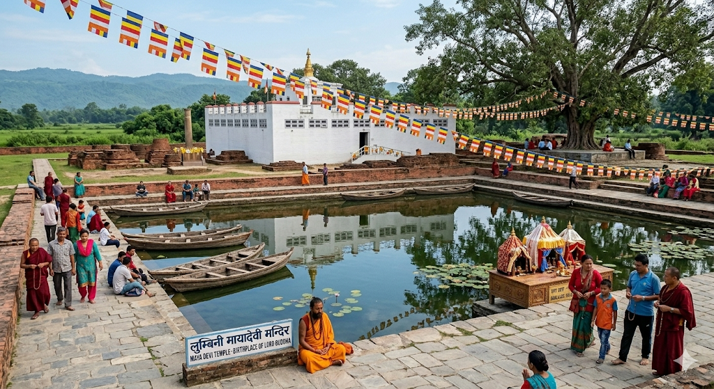
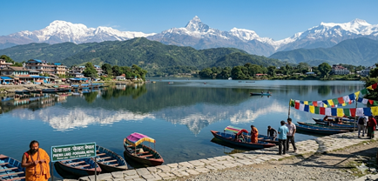
MUST-SEE TOURIST ATTRACTIONS
🏔 Mount Everest Base Camp
🛕 Pashupatinath Temple
🏞️ Rara Lake
Trek to the foot of the world's highest peak (8,849m). A once-in-a-lifetime adventure through Sherpa villages.
Kathmandu's most sacred Hindu temple on the Bagmati River — a UNESCO World Heritage Site.
Nepal’s largest freshwater lake is famous for its crystal-clear blue water, peaceful surroundings, and breathtaking Himalayan scenery.
🏞 Pokhara & Phewa Lake
🐆 Chitwan National Park
☮ Lumbini — Birthplace of Buddha
Nepal's tourism hub with stunning Himalayan reflections, paragliding, and gateway to Annapurna treks.
UNESCO-listed park famous for one-horned rhinos, Bengal tigers, and jungle safaris.
UNESCO World Heritage Site: the sacred birth-place of Siddhartha Gautama (Lord Buddha).
Nepal • Country Presentation Designed By Rayamajhi Ajay

Slide 9
MOST POPULAR FOODS & DRINKS
Dal Bhat
The national dish — lentil soup served with steamed rice, vegetables & pickles. Eaten twice daily by most Nepalis.
Momo
Steamed or fried dumplings filled with meat or vegetables — Nepal's most beloved street food.
🍛
🥟
Thukpa
Hearty noodle soup with vegetables & meat, popular in the mountain regions.
Sel Roti
Sweet, ring-shaped rice bread fried until crispy — a festive Nepali treat.
🍲
🥙
Chiya (Masala Tea)
Spiced milk tea brewed with cardamom, ginger & cinnamon — the national beverage.
Raksi & Tongba
Traditional alcohol: Raksi (rice/millet spirit) and Tongba (hot millet beer) from mountain communities.
☕
🍺
Nepal • Country Presentation Designed By Rayamajhi Ajay

Slide 10
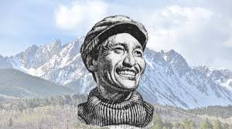
FAMOUS
PERSON
The Man Who Conquered Everest
🏔 Historic Achievement
On May 29, 1953, Tenzing Norgay and Sir Edmund Hillary became the first confirmed people to reach the summit of Mount Everest (8,849m), the world's highest peak.
Tenzing
Norgay
🌍 Global Recognition
Time magazine named him one of the 100 Most Influential People of the 20th Century. He received Nepal's Order of the Star (Nepal Tara) and Britain's George Medal.
Sherpa Mountaineer
1914 – 1986
🎒 Sherpa Legacy
Born in the Khumbu region of Nepal, Tenzing opened the world's eyes to Sherpa skill and culture. He later founded Tenzing Norgay Adventures (1978) to share Himalayan trekking.
Summit: May 29, 1953
📖 Life After Everest
He served as Director of Field Training at the Himalayan Mountaineering Institute in Darjeeling, inspiring generations of climbers across Asia.
Nepal • Country Presentation Designed By Rayamajhi Ajay

Slide 11
NATIONAL PARK & NATIonal ANIMAL
🌿 Chitwan National Park
🐄 Cow (National Animal)
Established: 1973 — Nepal's first national park.
Scientific Name : Bos Taurus.
UNESCO Status: World Heritage Site since 1984.
Status: Domesticated and abundant.
Area: 932 km² in the Terai lowlands
Size: 1.2 to 1.5 meters height and 400 to 800 kg weight
Famous For: One-horned rhinoceros, Bengal tigers, gharials, and Asian elephants
Habitat: Pastures and farms.
Activities: Jeep safari, elephant safari, bird watching, canoe rides
Diet: Grasses and hay.
Wildlife: 700+ species of wildlife, 600+ birds, 56 mammal species.
Found In Nepal: Within Nepal, distinct local cattle breeds are found from the lowlands to the high-altitude hills.
Location: Chitwan District, southern Nepal.
Significance: National, sacred animal
Nepal • Country Presentation Designed By Rayamajhi Ajay

Slide 12
GEOGRAPHY HIGHLIGHTS
🏔
🌊
💧
Highest Mountain
Longest River
Biggest Lake
Mount Everest
Karnali River
Rara Lake
8,849 m (29,032 ft) above sea level
507 km — Nepal's longest river
Area: 10.8 km² — Nepal's largest lake
▸ World's highest peak above mean sea level
▸ Originates in Tibet near Lake Manasarovar
▸ Located in Mugu District, remote northwest Nepal
▸ Located on the Nepal–China (Tibet) border
▸ Flows through western Nepal into India's Ghaghra
▸ Elevation: 2,990 m (9,810 ft)
▸ Known as Sagarmatha in Nepali & Chomolungma in Tibetan
▸ Wild rafting destination — world-class rapids
▸ Crystal-clear sapphire waters year-round
▸ First summited May 29, 1953 by Hillary & Norgay
▸ Passes through Shey Phoksundo & Bardiya National Parks
▸ Surrounded by Rara National Park
▸ ~700 climbers attempt the summit each year
▸ Feeds the Karnali Province of western Nepal
▸ Deep blue color visible from the air — nicknamed 'Queen of Lakes'
Nepal • Country Presentation Designed By Rayamajhi Ajay

Slide 13
Thank You!
Nepal — Incredible. Inspiring. Eternal.
🌍 Home to 8 of the world's 10 highest peaks
🙏 Birthplace of Siddhartha Gautama — the Lord Buddha
🏆 Site of the first-ever Everest summit (1953)
🌿 Rich in biodiversity: 185 mammal species, 900+ birds
🎭 Incredible cultural diversity: 125+ ethnic groups
Nepal • Country Presentation Designed By Rayamajhi Ajay

