Slide 1

FUNCTIONAL · AESTHETIC · REGENERATIVE GYNAECOLOGY
Tissue-Specific
Intimate Medicine
Indication-driven. Biologically rational.
DR. NADEEN KABBOURA
Obstetrics & Gynaecology · Aesthetic and Regenerative Medicine
CONFERENCE · SESSION · DATE
Notes:
Open on the single claim the whole lecture defends: intimate treatment must be tissue-specific, indication-driven and biologically rational — not product- or device-driven.
Fourteen slides, ten minutes of core material. Signpost the five movements: premise and anatomy, pigment and inflammation, energy and hierarchy, regeneration and evidence, framework and conclusion.
Timing: 20 seconds. Do not read the title.

Slide 2
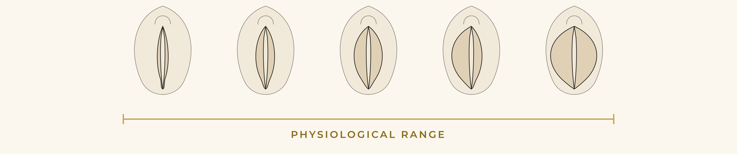
THE CLINICAL PREMISE
Variation is not pathology.
Treat indication — not expectation.
Lloyd et al. BJOG 2005;112:643–6 · ACOG Committee Opinion 795, 2020
ESTABLISHED EVIDENCE
02
Notes:
Labial dimensions in unselected women span a wide range — Lloyd's series recorded labia minora width from a few millimetres to roughly five centimetres, with marked asymmetry common and unrelated to symptoms.
The clinical consequence: an appearance outside a patient's expectation is not, by itself, an indication. ACOG Committee Opinion 795 is explicit that counselling on normal variation precedes any discussion of intervention.
Say plainly: we treat symptoms, function and disease. We do not treat a photograph. Timing: 45 seconds.

Slide 3
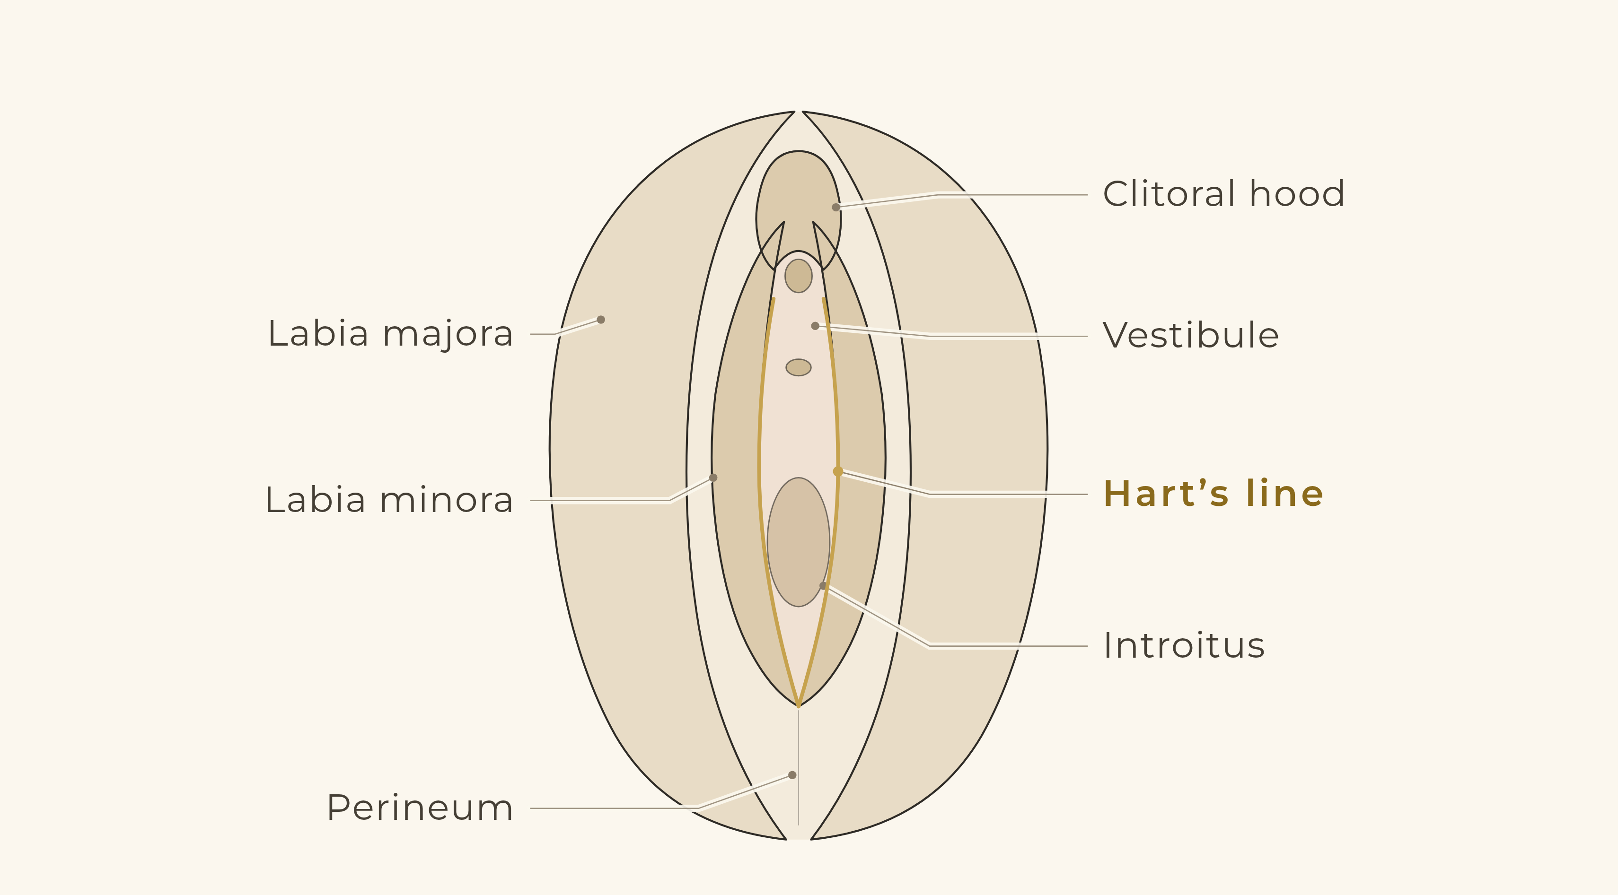
TISSUE-SPECIFIC ANATOMY
One region. Distinct tissue biology.
Keratinised skin laterally
Non-keratinised mucosa medially
Hart’s line is the boundary
Yeung & Pauls, Obstet Gynecol Clin North Am 2016;43:27–44
ESTABLISHED EVIDENCE
03
Notes:
Click once: Hart’s line traces in gold. Let it draw before speaking over it.
Hart’s line runs along the medial aspect of the labia minora and marks the boundary between keratinised, ectodermally derived skin and the non-keratinised vestibular mucosa of urogenital-sinus origin. It is the most clinically useful landmark on the vulva and it is almost never drawn on an aesthetic consent form.
Everything that follows — what you can apply, what you can inject, what energy you can deliver — changes when you cross that line. Name the tissue before you name the treatment. Timing: 50 seconds.

Slide 4
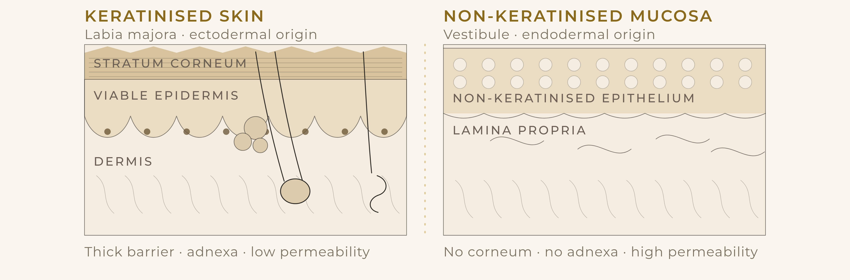
THE CUTANEOUS–MUCOSAL INTERFACE
Mucosa ≠ facial skin
No stratum corneum · no adnexa · percutaneous absorption several-fold higher than forearm
Oriba, Bucks & Maibach, Br J Dermatol 1996;134:229–33 · Farage & Maibach, Arch Gynecol Obstet 2006;273:195–202
ESTABLISHED EVIDENCE
04
Notes:
Left: labia majora — thick stratum corneum, deep rete ridges, follicles, sebaceous and apocrine glands, a competent barrier. Right: vestibule — non-keratinised, glycogen-rich, no corneum, no adnexa, superficial capillary loops.
Oriba and Maibach measured percutaneous absorption of hydrocortisone and testosterone across vulvar versus forearm skin and found it substantially higher at the vulva. The practical reading: a concentration that is well tolerated on the face is not the same exposure here, and the absence of adnexa removes the reservoir and the re-epithelialisation source that facial resurfacing relies on.
This is why facial protocols transplanted unchanged are the commonest source of iatrogenic injury in this field. Timing: 60 seconds.

Slide 5
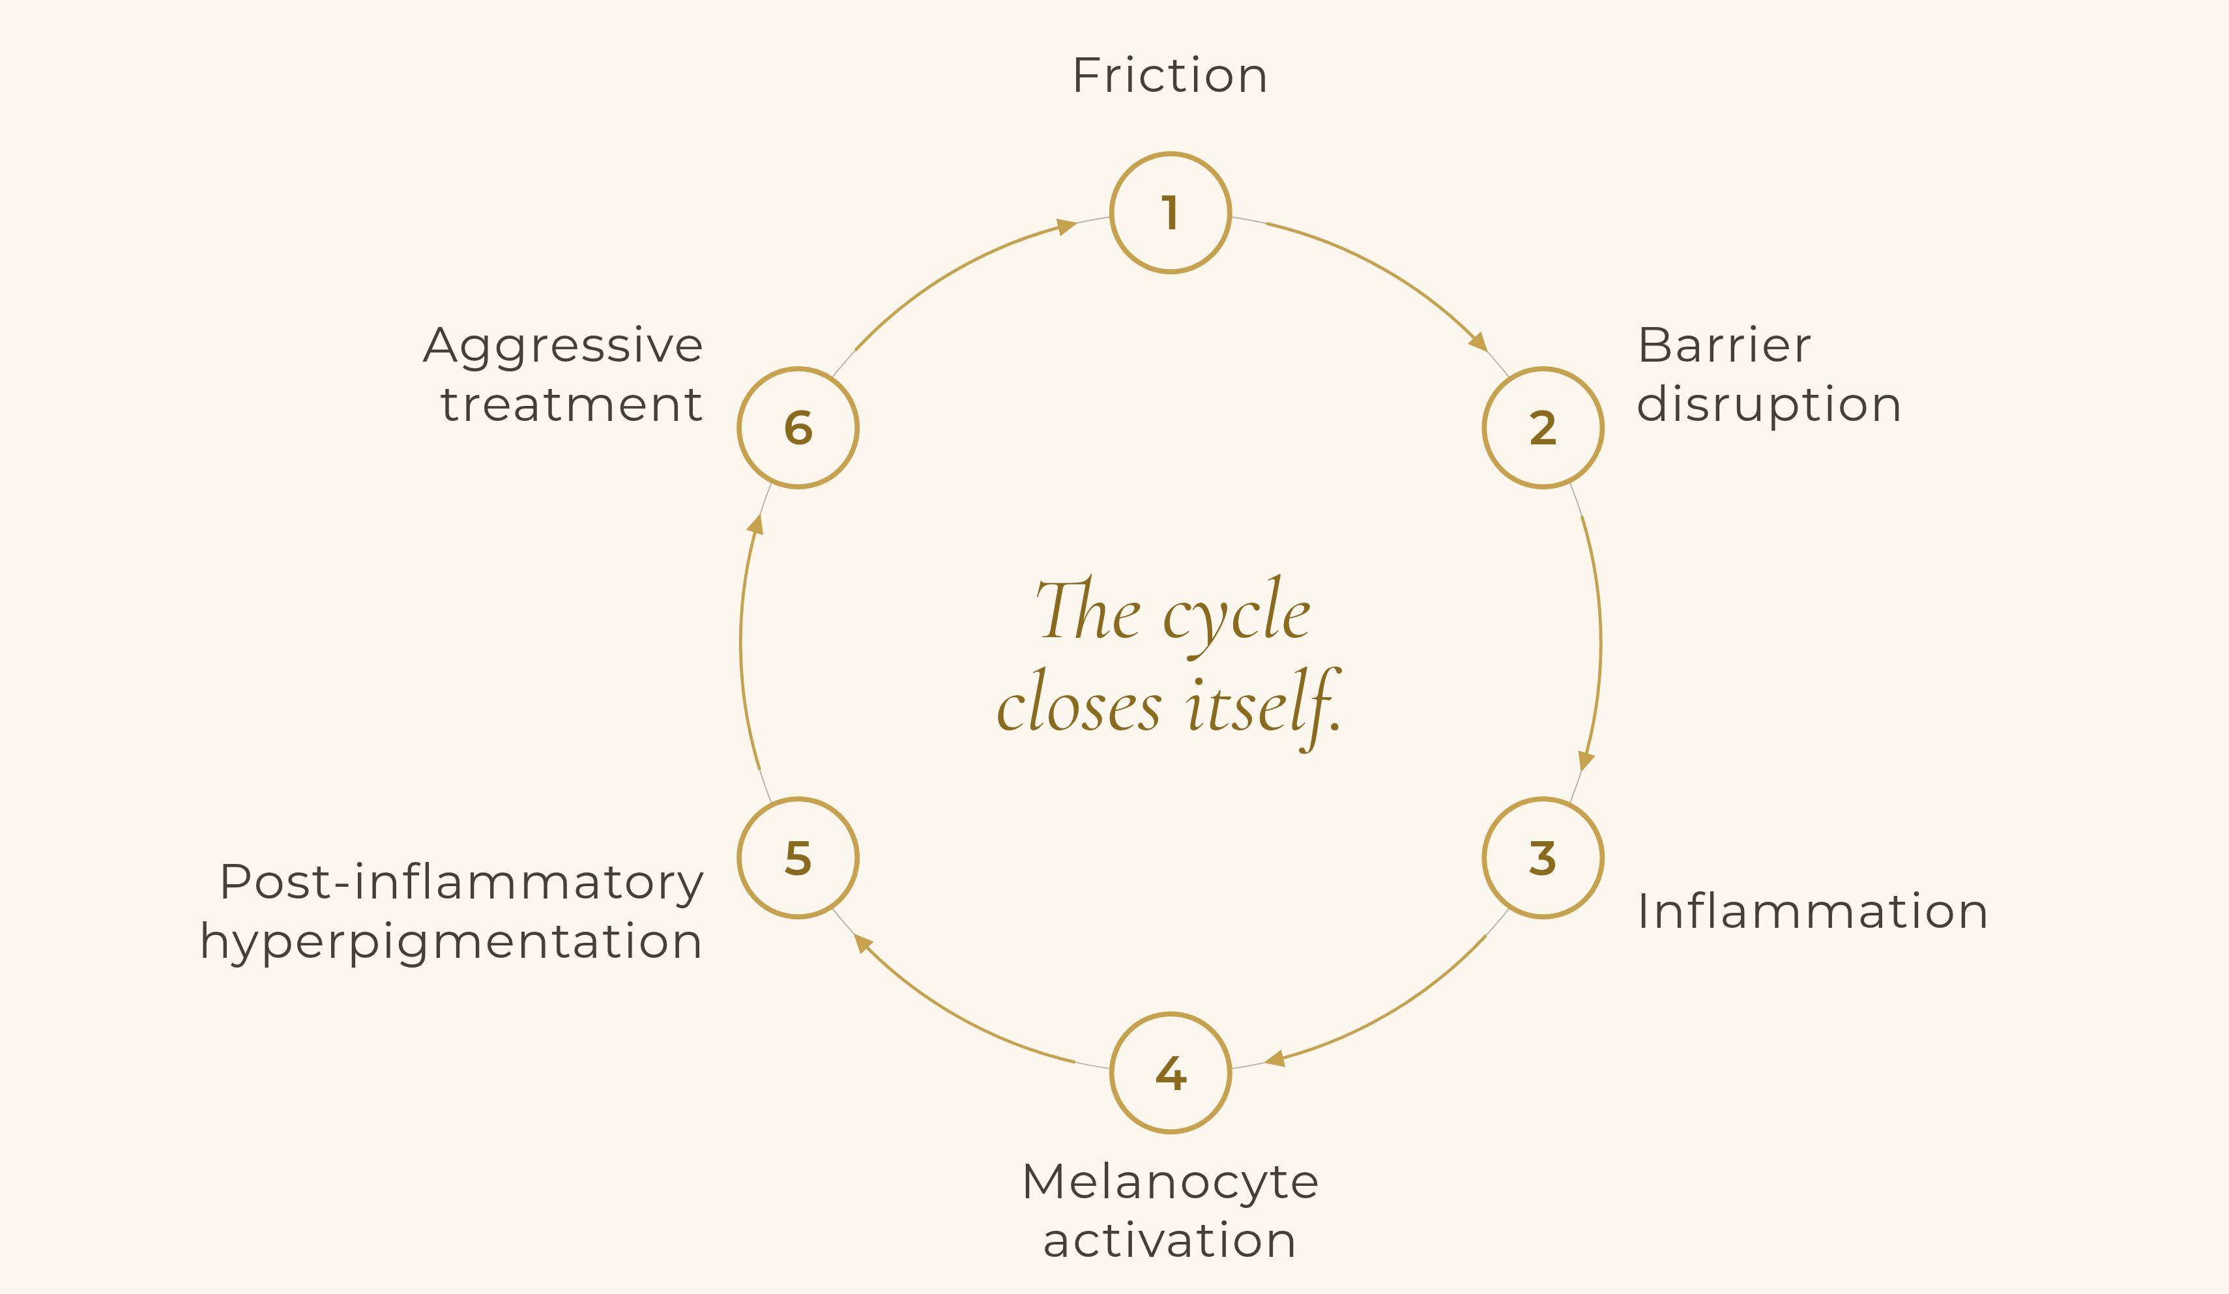
MECHANISM
The inflammation–pigment cycle
Escalation feeds
the cycle.
Correct the driver first. Pigment is the readout, not the disease.
Davis & Callender, J Clin Aesthet Dermatol 2010;3(7):20–31
MECHANISM ESTABLISHED · SITE EXTRAPOLATED
05
Notes:
Build it one click at a time; seven clicks in total. Do not rush — this is the slide the room should remember.
Friction and occlusion disrupt an already thin barrier. Barrier disruption drives low-grade inflammation. Inflammatory mediators — prostaglandins, leukotrienes, endothelin-1, stem cell factor — upregulate melanocyte activity. Melanin is transferred and, where the basement membrane is breached, dropped into the dermis. The visible result is post-inflammatory hyperpigmentation.
The sixth node is the one we contribute: aggressive treatment aimed at the pigment re-injures the barrier and re-enters the loop at step two. Every escalation taken against an inflamed field buys a darker result.
Timing: 90 seconds — the longest single slide.

Slide 6
ASSESSMENT
Assess before you treat
Is pathology present?
YES
NO
Biopsy or treat the disease
Identify the driver
— Lichen sclerosus
— Physiological variation
— Differentiated VIN
— Friction or mechanical trauma
— Vulvar melanoma
— Post-inflammatory pigment
— Infection or dermatosis
— Hormonal influence
— Previous procedural injury
Lewis et al. BAD guidelines, Br J Dermatol 2018;178:839–53
EXPERT CLINICAL FRAMEWORK
06
Notes:
Two clicks. The left arm first, deliberately — it is the arm that ends careers.
Any fixed, indurated, ulcerated, eroded or changing lesion is biopsied before a single aesthetic intervention. ABCDE criteria perform poorly on mucosal melanoma; a benign clinical impression is not a substitute for histology. Lichen sclerosus and differentiated VIN both carry malignant potential and both are routinely mistaken for pigmentary or textural complaints.
The right arm is where most consultations actually sit — and even there, naming the driver comes before choosing a modality. If you cannot name the driver, you are not ready to treat. Timing: 60 seconds.

Slide 7
PIGMENT
Target the mechanism, not the shade
Trigger
Inflammatory
signalling
Melanocyte
activation
Tyrosinase
activity
Melanin
synthesis
Melanosome
transfer
Visible
pigmentation
Tranexamic acid
Azelaic acid
Niacinamide
Hydroquinone*
Retinoids
Dermatological evidence is established · vulvar application is anatomical extrapolation
* prescription-only in several jurisdictions · exogenous ochronosis risk
Bala et al. Dermatol Surg 2018;44:814–25 · Hakozaki et al. Br J Dermatol 2002;147:20–31
EXTRAPOLATED EVIDENCE
07
Notes:
One click reveals where each agent class acts. The point of the slide is that a clinician who knows the pathway can reason about any product, including the ones that do not exist yet.
Tranexamic acid acts upstream, on plasmin-mediated inflammatory signalling — which is why it outperforms pure tyrosinase inhibitors where inflammation is the driver. Azelaic acid and hydroquinone inhibit tyrosinase, the rate-limiting enzyme. Niacinamide reduces melanosome transfer to keratinocytes; retinoids act on transfer and on epidermal turnover.
Be explicit about the evidence class: these data come from facial melasma and post-inflammatory hyperpigmentation trials. Vulvar use is extrapolation by mechanism, not by trial — and on non-keratinised mucosa the irritant potential of retinoids and acids is higher. Timing: 60 seconds.

Slide 8
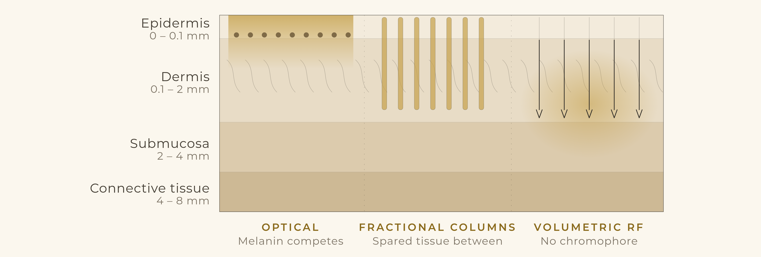
ENERGY
Select energy by tissue target
Melanin is a competing chromophore — optical risk rises steeply in Fitzpatrick IV–VI
FDA Safety Communication, 30 July 2018 · Li et al. JAMA 2021;326:1381–9
EVIDENCE REMAINS LIMITED
08
Notes:
Three clicks, one modality class at a time. Deliberately no devices, no brands — the variable that matters is depth and chromophore, not the badge on the handpiece.
Optical energy deposits superficially and is absorbed by melanin as well as by water; in richly pigmented skin the epidermis competes for the energy you intended for the dermis. Fractional delivery spares intervening tissue and relies on those islands for repair. Volumetric radiofrequency heats resistively, has no chromophore dependence, and can reach dermis and submucosa while the epidermis is comparatively spared.
Hold the evidence honestly: the FDA's 2018 communication warned against energy devices marketed for vaginal ‘rejuvenation’, and Li's sham-controlled trial found fractional CO₂ no better than sham for postmenopausal vaginal symptoms at 12 months. Local oestrogen remains better evidenced for genitourinary syndrome of menopause. Timing: 60 seconds.

Slide 9
SEQUENCE
Therapeutic hierarchy
MAINTENANCE
Prevention · reassessment
REGENERATION
Tissue quality · biostimulation
STRUCTURE
Volume · laxity · scars
CORRECTION
Pigment · texture · hair
FOUNDATION
Barrier · inflammation · friction
An inflamed foundation cannot support escalation.
EXPERT CLINICAL FRAMEWORK
09
Notes:
Six clicks, building from the base upward — the order of the build is the argument.
Foundation is barrier repair, inflammation control and friction elimination: bland emollients, pH-appropriate cleansing, breathable fabrics, reconsidered hair removal. Correction addresses surface — pigment, texture, hair. Structure addresses volume, laxity and scar. Regeneration addresses tissue quality. Maintenance is prevention and scheduled reassessment, not a repeat sale.
The rule that governs the whole pyramid: you may not skip a tier because a patient has asked for a higher one. An inflamed, friction-driven field treated with energy or injectables returns darker, not lighter. Timing: 50 seconds.

Slide 10
TISSUE REGENERATION · BIOSTIMULATION · ECM REMODELLING
The cascade, not the product
Stimulus
Cellular signalling
Fibroblast activity
Extracellular-matrix remodelling
Collagen and elastin synthesis
Improved tissue quality
AUTOLOGOUS
NUCLEOTIDE
SCAFFOLD
STIMULATOR
Platelet concentrates (PRP / PRF)
Polynucleotides (PN / PDRN)
Hyaluronic-acid biostimulation
Collagen-stimulating injectables
Evidence varies by indication and anatomical site.
Squadrito et al. Front Pharmacol 2017;8:224
EMERGING EVIDENCE
10
Notes:
Three clicks: the cascade, then the therapeutic categories, then the caveat.
Every regenerative approach in this field claims the same pathway: a stimulus produces cellular signalling, fibroblasts are recruited and activated, the extracellular matrix is remodelled, collagen and elastin are synthesised, and tissue quality improves. Polydeoxyribonucleotide acts partly through adenosine A2A receptor agonism with anti-inflammatory and pro-angiogenic effects; platelet concentrates deliver autologous growth factors; hyaluronic-acid and collagen-stimulating injectables act as scaffold and stimulus.
Present these as categories with proposed mechanisms, not as products. The cascade is plausible and partly demonstrated in vitro and at other sites; the site-specific clinical evidence at the vulva is thin and heterogeneous, and one indication does not license another. Timing: 60 seconds.

Slide 11
EVIDENCE
Where the evidence actually sits
Autologous platelet
concentrates (PRP)
Collagen-stimulating
injectables
NAD⁺-related
interventions
MORE ESTABLISHED
MORE EXPERIMENTAL
Polynucleotides
(PN / PDRN)
Extracellular vesicles
/ exosomes
Biological rationale does not equal clinical validation.
Goldstein et al. J Am Acad Dermatol 2019;80:1788–9 · FDA Public Safety Notification on exosome products, 2019
EMERGING · EXPERIMENTAL
11
Notes:
Five clicks place the categories, the sixth delivers the line. Resist the urge to move anything leftward for the room’s comfort.
Autologous platelet concentrates have the largest genital literature and it is still small — Goldstein’s randomised, double-blind trial in vulvar lichen sclerosus found no significant benefit over placebo, which is exactly the kind of result that should temper enthusiasm. Polynucleotides have a coherent mechanism and mostly uncontrolled genital data. Collagen-stimulating injectables are extrapolated from facial and body use, and carry nodule risk if placed in the wrong plane.
Extracellular vesicles and NAD⁺-related interventions are, at this site, pre-clinical rationale with active marketing. There is no FDA-approved exosome product and standing safety notifications exist. Naming that from the podium is part of the job. Timing: 70 seconds.

Slide 12
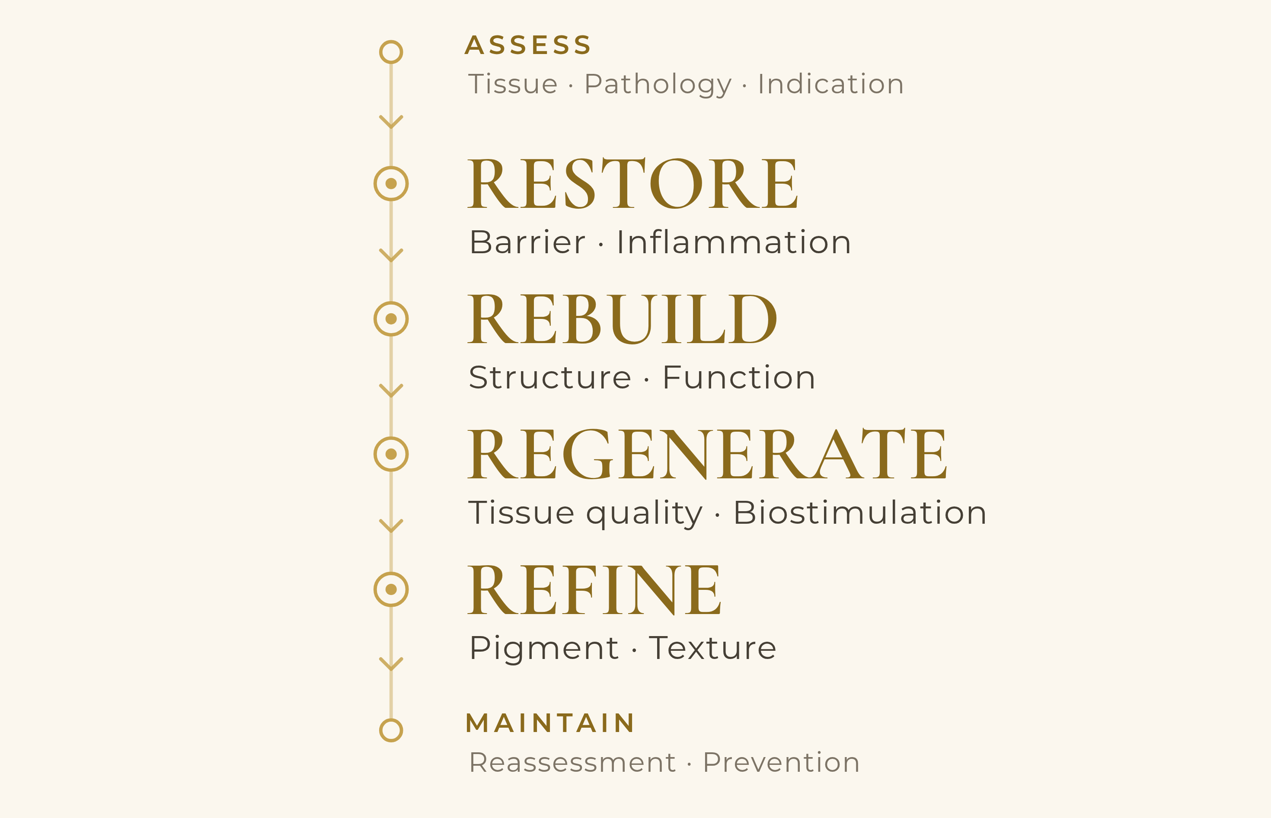
EXPERT CLINICAL FRAMEWORK — NOT A VALIDATED GUIDELINE
The Kabboura Clinical Framework
Escalate only from
a quiet foundation.
Stage-gated and indication-led. Each stage is re-assessed before the next is entered.
An organising heuristic — not a validated protocol.
EXPERT CLINICAL FRAMEWORK
12
Notes:
Six clicks, one stage each. Let RESTORE, REBUILD, REGENERATE and REFINE carry the visual weight — those four words are the deck’s takeaway.
Assess: tissue, pathology, indication. Restore: barrier and inflammation — nothing above this stage is attempted until the field is quiet. Rebuild: structure and function. Regenerate: tissue quality through biostimulation and extracellular-matrix remodelling. Refine: pigment and texture, deliberately last, because pigment is the readout of everything beneath it. Maintain: reassessment and prevention.
State the epistemic status out loud: this is an expert clinical framework, offered as an organising heuristic. It is not a guideline and it has not been validated prospectively. Timing: 60 seconds.

Slide 13
CONCLUSION
Clinical take-home
01
Diagnose before treating
02
Match treatment to tissue
03
Escalate according to evidence
Treat biology — not trends.
13
Notes:
Four clicks. Say each line once and stop — do not gloss them.
Diagnose before treating: the biopsy threshold is low and the cost of missing differentiated VIN or mucosal melanoma is absolute. Match treatment to tissue: Hart’s line changes what is safe on either side of it. Escalate according to evidence: name the evidence class — established, extrapolated, emerging, or expert framework — every time you offer something.
Close on the final line and let it sit. Timing: 40 seconds.

Slide 14


THANK YOU
Dr. Nadeen Kabboura
Obstetrics & Gynaecology · Aesthetic and Regenerative Medicine
@drnadeenkabbouraofficial · nadeenkabboura@gmail.com
FULL BIBLIOGRAPHY
LECTURE RESOURCES
rayan-debug.github.io/nadine-/deck/references.html
rayan-debug.github.io/nadine-/
14
Notes:
Leave this slide up through questions. The left code opens the full reference list for every claim made in the lecture; the right opens the longer teaching resource.
If time has run short, the three slides worth returning to in discussion are Hart’s line, the inflammation–pigment cycle and the evidence spectrum.

