Slide 1


HUMAN-IN-THE-LOOP ANOMALY DETECTION FOR AI SYSTEM
Author: Rayan Tanzeem

Slide 2
PROJECT OVERVIEW
  Human-in-the-Loop Anomaly Detection for AI Responses
  Focus: deciding when human review is required, not judging AI with more AI
  Implemented as a REST API with a lightweight UI
  Emphasis on control, explainability, and trust

Slide 3
PROBLEM STATEMENT
  AI systems can hallucinate, give unsafe advice, or violate policies
  Manual review of every AI response does not scale
  Fully automated moderation lacks accountability
  Need a system to selectively involve humans in risky cases

Slide 4
ANOMALY DETECTION LOGIC
  AI generates response normally
  System infers intent (e.g. general, medical, future event)
  Explicit risk signals are detected (rule-based)
  future claims
  medical domain
  missing disclaimers
  Signals are weighted and compared against policy thresholds

Slide 5
RESULTS & IMPACT
  Demonstrates scalable Human-in-the-Loop control
  Most safe queries are auto-approved
  Only high-risk outputs are escalated
  Decisions are explainable and auditable
  Clear separation between AI generation and governance

Slide 6
CHALLENGES FACED
  Avoiding “AI judging AI” anti-pattern
  Designing escalation logic without overengineering
  Balancing simplicity with meaningful safety signals
  Keeping policy logic transparent and judge-explainable

Slide 7
FUTURE WORK
  Automate policy updates using accumulated human feedback
  Active learning to refine signal thresholds
  Vector search for identifying similar past reviewed cases
  Role-based admin dashboard for reviewers
  Offline fine-tuning or reward modeling (out of hackathon scope)

Slide 8
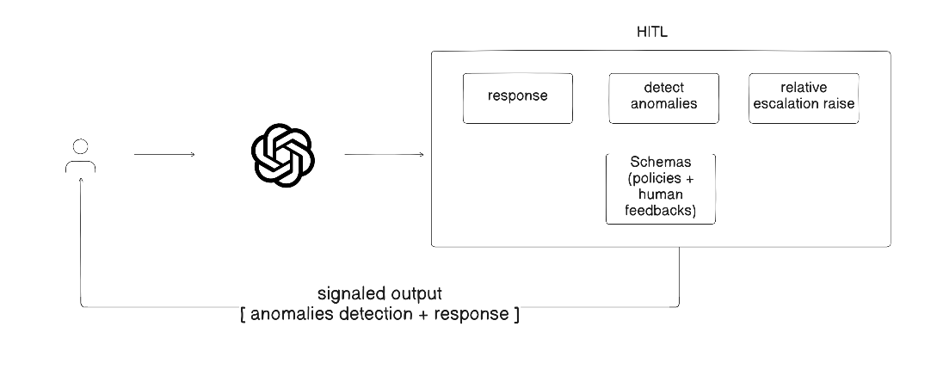
METHODOLOGY

Slide 9
THANK YOU!
FOR YOUR ATTENTION
Author: Rayan Tanzeem

