Slide 1
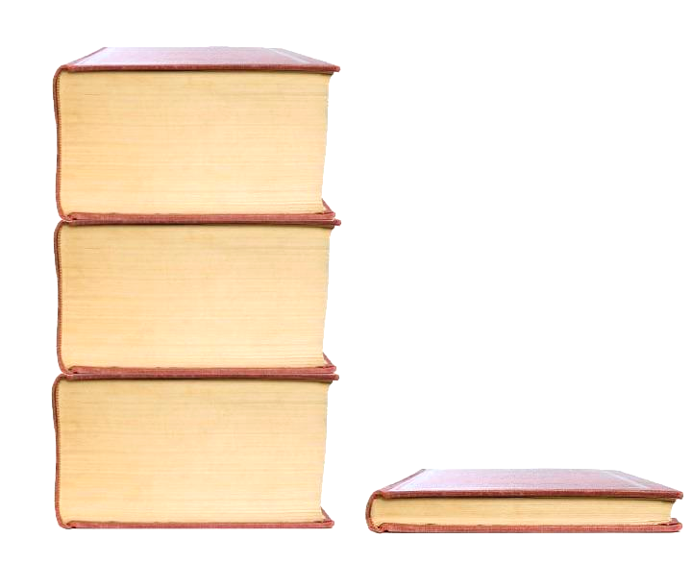
Extractive Text Summarization Using TF-IDF
CSE 318 - Artificial Intelligence Laboratory

Slide 2
Team members
Hasibul Hossain (210401020 2173)
Samiyan Rashid (210401020 2168)
Rayanul Kader Chowdhury (210401020 2162)

Slide 3
Contents
Introduction
Motivation
Objective
Relative work
Methodology
Implementation
Performance evaluation
Future work
Conclusion

Slide 4
What is summarization?
Introduction

Slide 5
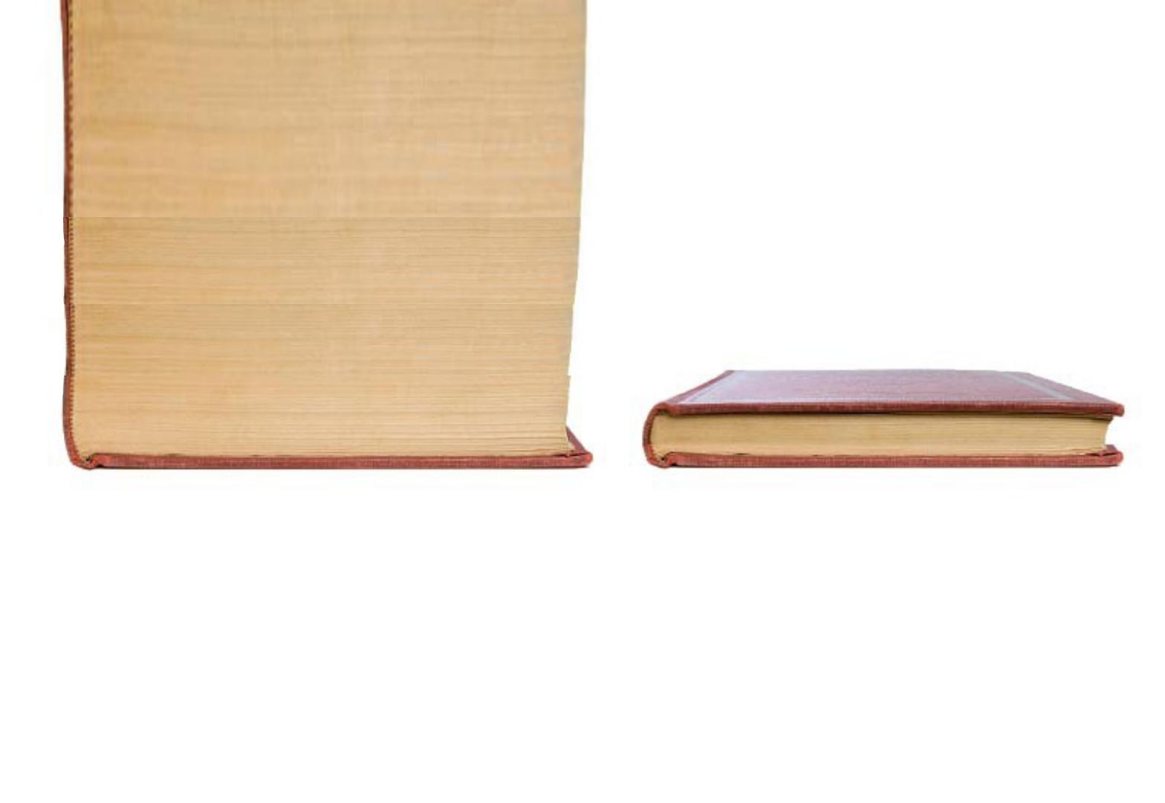

Holidays are the most joyous time for every student. Everyone loves holidays, whether they are for one day or one month! Students especially look forward to their annual school vacation. They love that they don’t need to get up early for school and can get extra sleep hours. It’s a healthy break from a routine. Kids plan so many things for their holidays; some want to spend it with their cousins in their grandparent’s or relatives’ house. Some plan for a family holiday where they visit and explore new places. It is also a good time to learn new things or pursue new hobbies. Holidays are magical days full of fun and enjoyment.
Holidays are the most joyous time for every student. Students especially look forward to their annual school vacation. Holidays are magical days full of fun and enjoyment.
Large Text Body
Summarized text

Slide 6
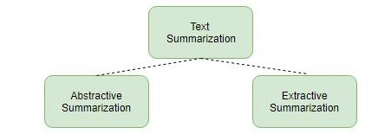
There are 2 types of summarization

Slide 7
But what is extractive summarization?
Extractive Summarization
" It simply takes out the important sentences or highest scoring sentences from the original text and joins them to form a summary. "

Slide 8
Holidays are the most joyous time for every student. Everyone loves holidays, whether they are for one day or one month! Students especially look forward to their annual school vacation. They love that they don’t need to get up early for school and can get extra sleep hours. It’s a healthy break from a routine. Kids plan so many things for their holidays; some want to spend it with their cousins in their grandparent’s or relatives’ house. Some plan for a family holiday where they visit and explore new places. It is also a good time to learn new things or pursue new hobbies. Holidays are magical days full of fun and enjoyment.
Holidays are the most joyous time for every student. Students especially look forward to their annual school vacation. Holidays are magical days full of fun and enjoyment.
Large Text Body
Extractive Text Summarization

Slide 9
Holidays are the most joyous time for every student. Everyone loves holidays, whether they are for one day or one month! Students especially look forward to their annual school vacation. They love that they don’t need to get up early for school and can get extra sleep hours. It’s a healthy break from a routine. Kids plan so many things for their holidays; some want to spend it with their cousins in their grandparent’s or relatives’ house. Some plan for a family holiday where they visit and explore new places. It is also a good time to learn new things or pursue new hobbies. Holidays are magical days full of fun and enjoyment.
Holidays are the most joyous time for every student. Students especially look forward to their annual school vacation. Holidays are magical days full of fun and enjoyment.
Large Text Body
Extractive Text Summarization

Slide 10
Holidays are the most joyous time for every student. Everyone loves holidays, whether they are for one day or one month! Students especially look forward to their annual school vacation. They love that they don’t need to get up early for school and can get extra sleep hours. It’s a healthy break from a routine. Kids plan so many things for their holidays; some want to spend it with their cousins in their grandparent’s or relatives’ house. Some plan for a family holiday where they visit and explore new places. It is also a good time to learn new things or pursue new hobbies. Holidays are magical days full of fun and enjoyment.
Holidays are the most joyous time for every student. Students especially look forward to their annual school vacation. Holidays are magical days full of fun and enjoyment.
Large Text Body
Extractive Text Summarization

Slide 11
Holidays are the most joyous time for every student. Everyone loves holidays, whether they are for one day or one month! Students especially look forward to their annual school vacation. They love that they don’t need to get up early for school and can get extra sleep hours. It’s a healthy break from a routine. Kids plan so many things for their holidays; some want to spend it with their cousins in their grandparent’s or relatives’ house. Some plan for a family holiday where they visit and explore new places. It is also a good time to learn new things or pursue new hobbies. Holidays are magical days full of fun and enjoyment.
Holidays are the most joyous time for every student. Students especially look forward to their annual school vacation. Holidays are magical days full of fun and enjoyment.
Large Text Body
Extractive Text Summarization

Slide 12
But question is, exactly on what basis are those sentences "important"? Or how we measure the "score"?
Answer: TF-IDF

Slide 13
But why?

Slide 14
So what is TF-IDF (Term Frequency - Inverse Document Frequency)?

Slide 15
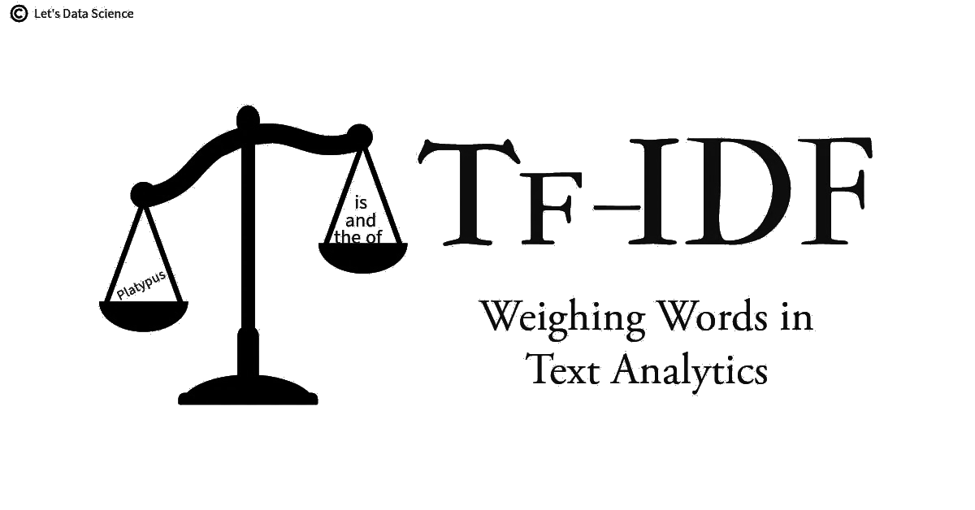

Slide 16
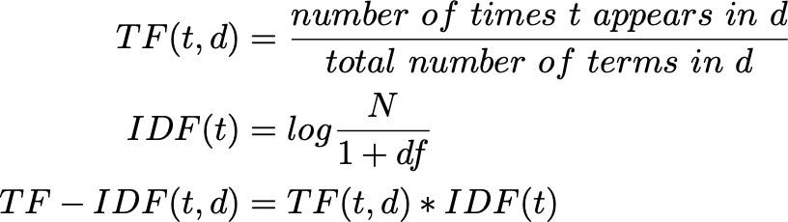
By using this formula!
Where,
df = document frequency

Slide 17
2. Motivation
Information Overload.
Efficiency.
Improving Content Consumption.
Short attention span.
Learning and implementing NLP, statistical method.

Slide 18
3. Objective
Implement TF-IDF for Extractive Summarization
Develop a Method for Sentence Scoring
Enhance Data Pre-processing Techniques
Ensure Flexibility in Summary Length
Evaluate the Quality of Generated Summaries

Slide 19
4. Relative work

Slide 20
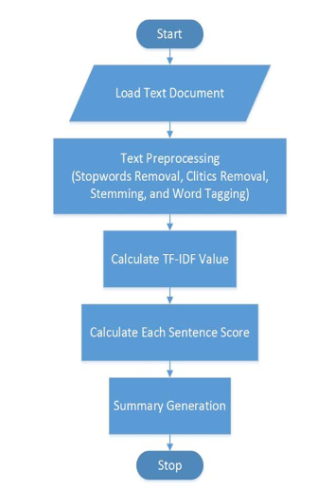
" Single Document Automatic Text Summarization Using Term Frequency-Inverse Document Frequency (TF-IDF)." Written By Hans Christian1, Mikhael Pramodana Agus, Derwin Suhartono Published By ComTech: Computer, Mathematics and Engineering Applications, volume 7, p. 285

Slide 21
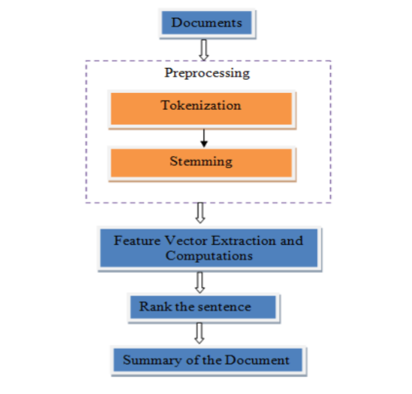
"TFIDF Model based Text Summarization." Written By Dr. Geetha C Megharaj, Varsha Jituri Published By INTERNATIONAL JOURNAL OF ENGINEERING RESEARCH & TECHNOLOGY (IJERT) RTCSIT – 2022 (Volume 10 – Issue 12)"

Slide 22
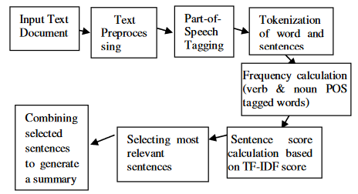
"Comparative Assessment of Extractive Summarization: TextRank, TF-IDF and LDA." Written By Ujjwal Rani Karambir Bidhan Published By Journal of Scientific Research Volume 65, Issue 1

Slide 23
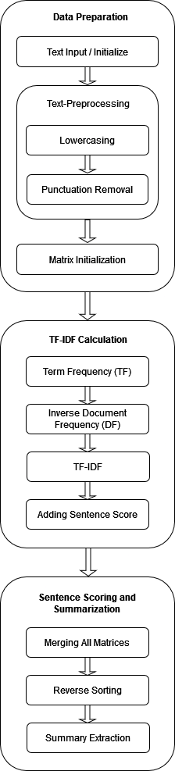
5. Methodology
Data Preparation
Text Input / Initialization
Preprocessing
Lowercasing
Punctuation Removal
Matrix Initialization
TF-IDF Calculation
Term Frequency (TF)
Inverse Document Frequency (IDF)
TF-IDF Score Calculation
Adding Sentence Score
Sentence Scoring and Summary Extraction
Merging All Matrices
Reverse Sorting
Summary Extraction

Slide 24
6. Implementation
Initializing Documents
Text Pre-Processing
Matrix Initialization
TF-IDF Calculation
Sentence Scoring and Summarization

Slide 25
Initializing Documents
Text Pre-Processing
Matrix Initialization
TF-IDF Calculation
Sentence Scoring and Summarization
Document_1 : A breed of venomous snake considered an endangered species in Bangladesh even a...
Document_2 : A series of stories have been making rounds on social media, of people dying in...
Document_3 : All health centeres and hospitals in Bangladesh have been ordered to stock anti-venom after reports of a surge in snake...
Document_4 : One of the deadliest snakes on the Indian subcontinent is growing increasingly common in Bangladesh, spurring questions...
Document_5 : The deaths caused by the bites of the deadly venomous Russell's Viper, commonly known as 'Chandrabora' in Bangla, are increasing alarmingly...

Slide 26
Initializing Documents
Text Pre-Processing
Matrix Initialization
TF-IDF Calculation
Sentence Scoring and Summarization
Lower
casing
Punctuation
remove
Before:
Document_5 :The deaths caused by the bites of the deadly venomous Russell's Viper, commonly known as 'Chandrabora' in Bangla, are increasing alarmingly...
After:
Document_5 :the deaths caused by the bites of the deadly venomous russell's viper, commonly known as 'chandrabora' in bangla, are increasing alarmingly...

Slide 27
Initializing Documents
Text Pre-Processing
Matrix Initialization
TF-IDF Calculation
Sentence Scoring and Summarization
Lower
casing
Punctuation
remove
Before:
Document_5 : the deaths caused by the bites of the deadly venomous russell's viper, commonly known as 'chandrabora' in bangla, are increasing alarmingly...
After:
Document_5 : the deaths caused by the bites of the deadly venomous russells viper commonly known as chandrabora in bangla are increasing alarmingly...

Slide 28
Initializing Documents
Text Pre-Processing
Matrix Initialization
TF-IDF Calculation
Sentence Scoring and Summarization
Lower
casing
Punctuation
remove
Not Removed in this step
Full stop ( . )

Slide 29
Initializing Documents
Text Pre-Processing
Matrix Initialization
TF-IDF Calculation
Sentence Scoring and Summarization
Document_1 : A breed of venomous snake considered an endangered species in...
Sentences
Score
'a breed of venomous snake considered... '
0.000000
'the snake russell’s viper or ... '
0.000000
'a viper’s bite can spread poison ... '
0.000000
Document_1 =
.
.
'dr md abdul washed chowdhury ... '
0.000000

Slide 30
Initializing Documents
Text Pre-Processing
Matrix Initialization
TF-IDF Calculation
Sentence Scoring and Summarization
TF-IDF Score of words
'a breed of venomous snake considered... '
0.20158723658609567
0.1673347185366257
0.20158723658609567
0.20158723658609567
0.20158723658609567
Total sum of all word's TF-IDF score : 4.493617094402984

Slide 31
Initializing Documents
Text Pre-Processing
Matrix Initialization
TF-IDF Calculation
Sentence Scoring and Summarization
Sentences
Score
'a breed of venomous snake considered... '
5.24743307
'the snake russell’s viper or ... '
3.51710781
'a viper’s bite can spread poison ... '
4.95604068
Document_1 =
.
.
'dr md abdul washed chowdhury ... '
4.94899731

Slide 32
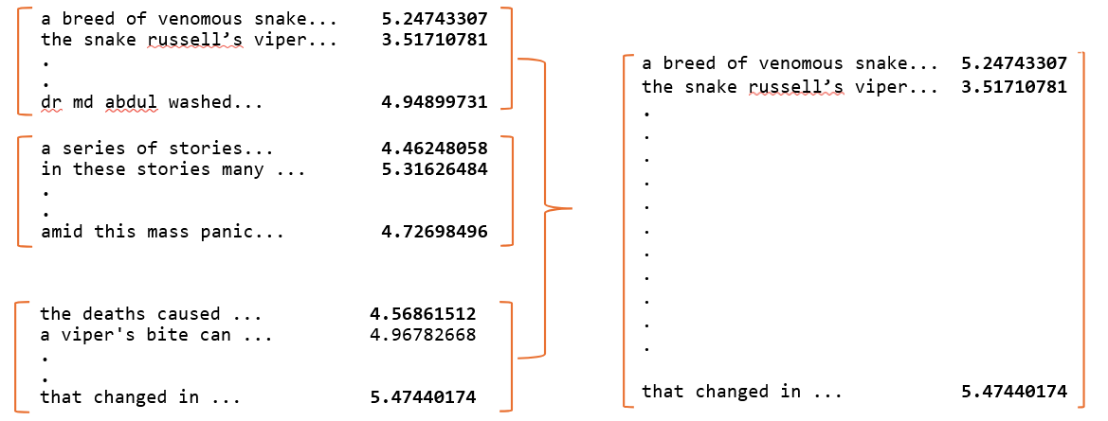
Initializing Documents
Text Pre-Processing
Matrix Initialization
TF-IDF Calculation
Sentence Scoring and Summarization
I/O
Reverse
Sort
Merging
All Matrix

Slide 33
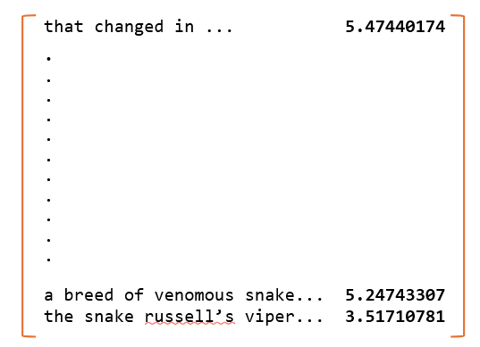
Initializing Documents
Text Pre-Processing
Matrix Initialization
TF-IDF Calculation
Sentence Scoring and Summarization
I/O
Reverse
Sort
Merging
All Matrix

Slide 34
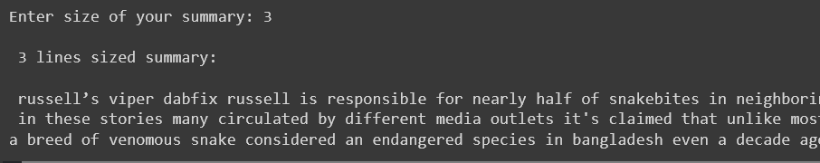
Initializing Documents
Text Pre-Processing
Matrix Initialization
TF-IDF Calculation
Sentence Scoring and Summarization
I/O
Reverse
Sort
Merging
All Matrix
Takes the summary size from user and prints summary.

Slide 35
7. Future Work
Removing Stop-words
Text Formatting
Software System
Combining extractive with abstractive methods

Slide 36
8. Conclusion
TF-IDF can significantly reduce the time and effort
Boosts information accessibility, aids quick decision-making, and improves content consumption
Face challenges in handling nuanced information and maintaining coherence and context.
Combining extractive with abstractive methods holds potential.

Slide 37
Thank you!

