Slide 1
1. Text
TaskLens PowerPoint audit. Plain text in Calibri, 28 pt.
Notes:
Speaker note on slide 1: check whether notes survive.

Slide 2
2. Multiple fonts
Calibri 28 pt — The quick brown fox 0123456789
Times New Roman 28 pt — The quick brown fox 0123456789
Courier New 24 pt — The quick brown fox 0123456789
Arial Black 26 pt — The quick brown fox 0123456789
Georgia 30 pt — The quick brown fox 0123456789
Helvetica Neue 28 pt — The quick brown fox 0123456789

Slide 3

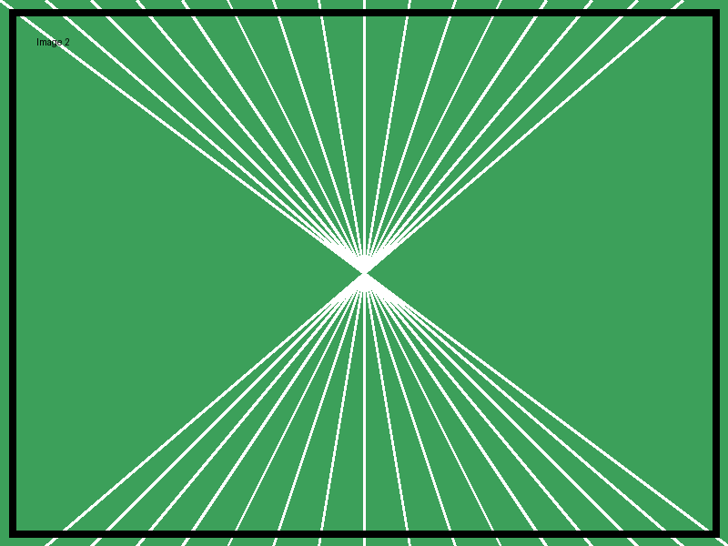
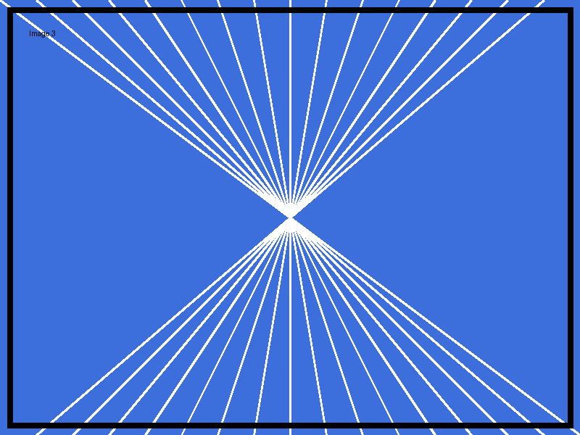
3. Images

Slide 4
4. Shapes
RECTANGLE
OVAL
ROUNDED_RECTANGLE
ISOSCELES_TRIANGLE
RIGHT_ARROW
STAR_5_POINT

Slide 5
5. Table
Item | Q1 | Q2 | Q3
Row 1 | 11 | 12 | 13
Row 2 | 21 | 22 | 23
Row 3 | 31 | 32 | 33
Row 4 | 41 | 42 | 43

Slide 6
6. Chart

Slide 7
7. Dark background, white text

Slide 8
8. Title and Content layout
Bullet one
Bullet two
  Bullet three (level 2)

Slide 9
٩. نص عربي
مرحباً بكم في تطبيق TaskLens. هذه شريحة لاختبار تشكيل الحروف العربية والاتجاه من اليمين إلى اليسار، مع علامات الترقيم: «اقتباس»، وسؤال؟ وفاصلة، ونقطة.
الأرقام: ١٢٣٤٥٦٧٨٩٠ و 1234567890

Slide 10
10. Mixed Arabic + English
اجتماع الفريق يوم Monday الساعة 10:30 AM في غرفة Meeting Room B، والميزانية 25,000 SAR.
The report «التقرير السنوي» is due on 15 March (١٥ مارس).
Link: https://example.com

Slide 11
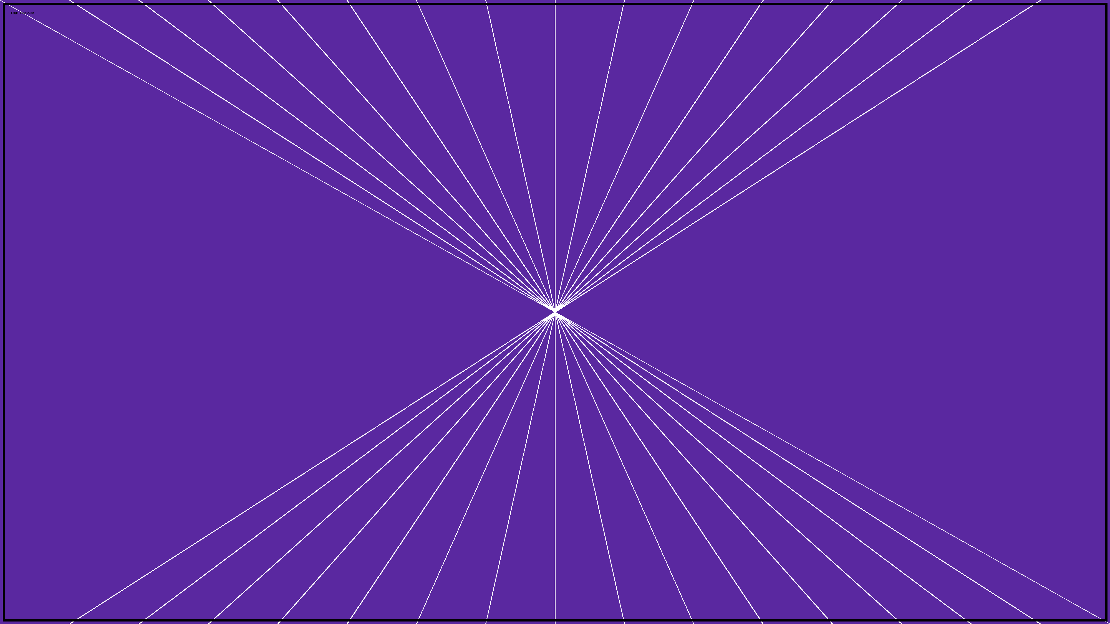
11. Large image (4000 × 2250)

Slide 12
12. Long text
Long paragraph to test wrapping and overflow. Long paragraph to test wrapping and overflow. Long paragraph to test wrapping and overflow. Long paragraph to test wrapping and overflow. Long paragraph to test wrapping and overflow. Long paragraph to test wrapping and overflow. Long paragraph to test wrapping and overflow. Long paragraph to test wrapping and overflow. Long paragraph to test wrapping and overflow. Long paragraph to test wrapping and overflow. Long paragraph to test wrapping and overflow. Long paragraph to test wrapping and overflow. Long paragraph to test wrapping and overflow. Long paragraph to test wrapping and overflow. Long paragraph to test wrapping and overflow. Long paragraph to test wrapping and overflow. Long paragraph to test wrapping and overflow. Long paragraph to test wrapping and overflow. Long paragraph to test wrapping and overflow. Long paragraph to test wrapping and overflow. Long paragraph to test wrapping and overflow. Long paragraph to test wrapping and overflow.
Notes:
Speaker note on slide 12. ملاحظة المتحدث بالعربية.

Slide 13
13. Multiple objects
1
2
3
4
5
6
7
8
9
10
11
12
13
14
15
16
17
18
19
20
21
22
23
24
25
26
27
28
29
30
31
32
33
34
35
36
37
38
39
40

Slide 14
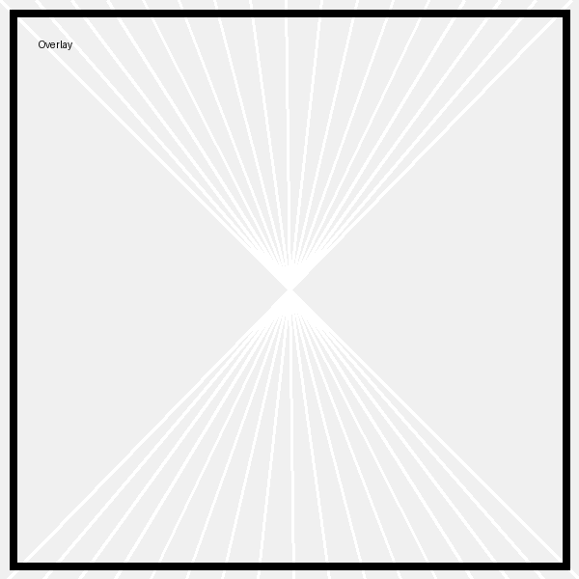
14. Complex layout
Layer 1 — طبقة 1
Layer 2 — طبقة 2
Layer 3 — طبقة 3
Layer 4 — طبقة 4
Layer 5 — طبقة 5
Layer 6 — طبقة 6

Slide 15
15. Final slide — الشريحة الأخيرة

