Slide 1

Large deck slide 1 of 80

Slide 2
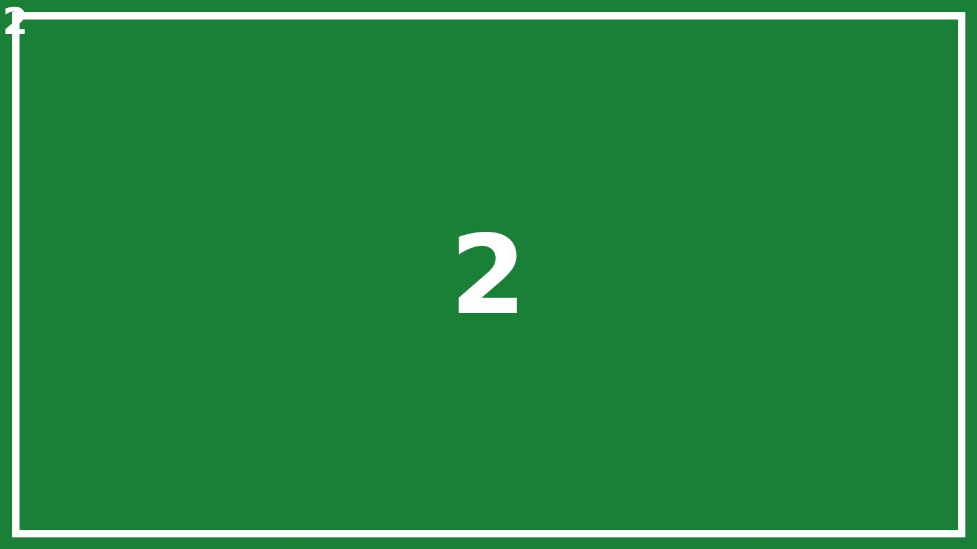
Large deck slide 2 of 80

Slide 3
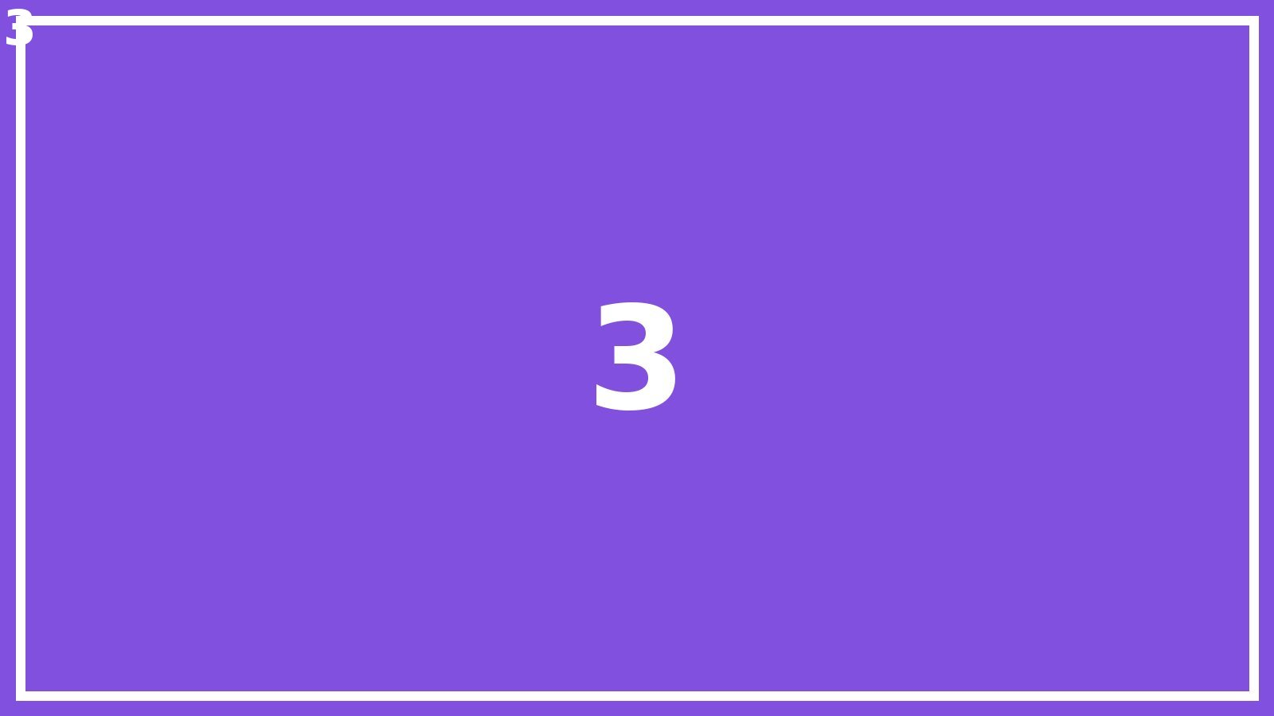
Large deck slide 3 of 80

Slide 4

Large deck slide 4 of 80

Slide 5

Large deck slide 5 of 80

Slide 6
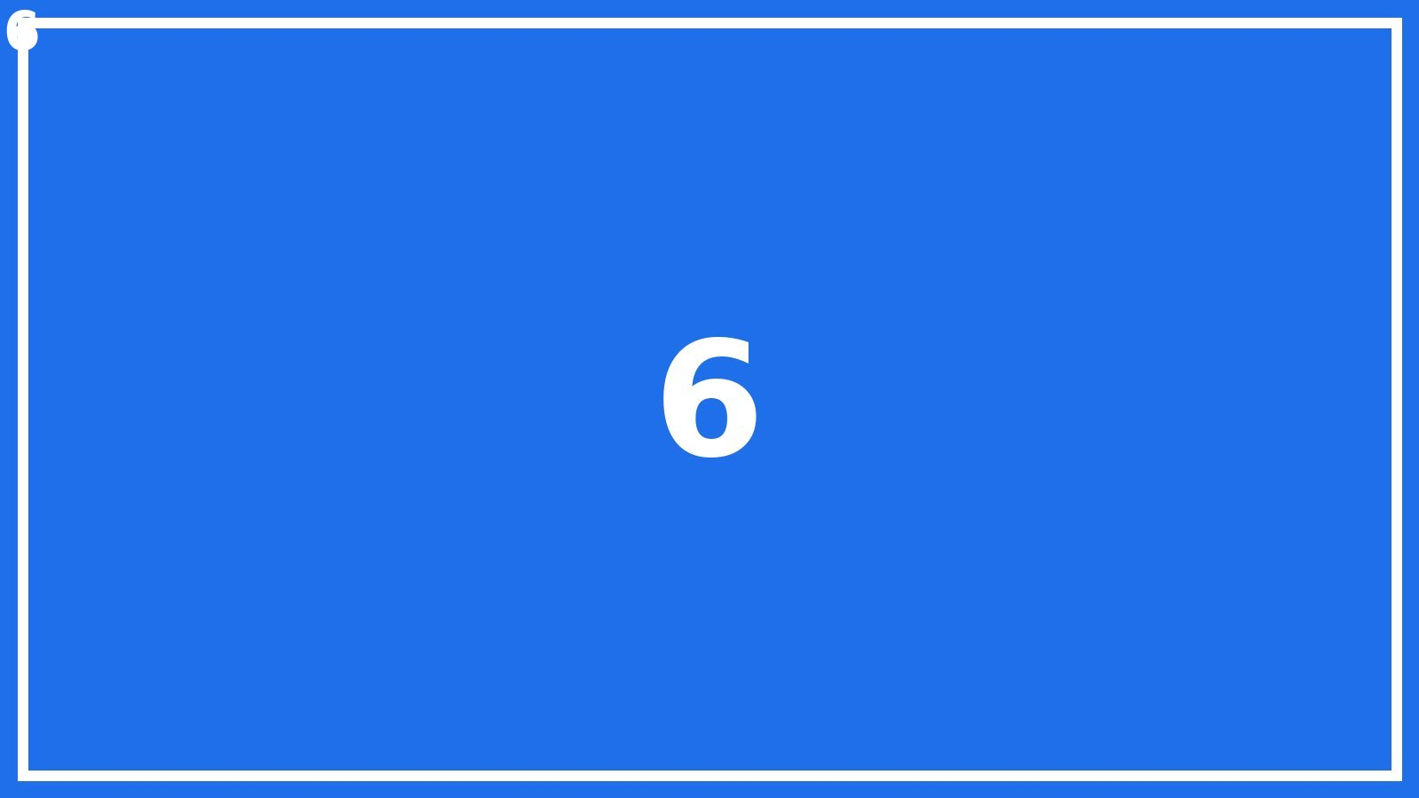
Large deck slide 6 of 80

Slide 7
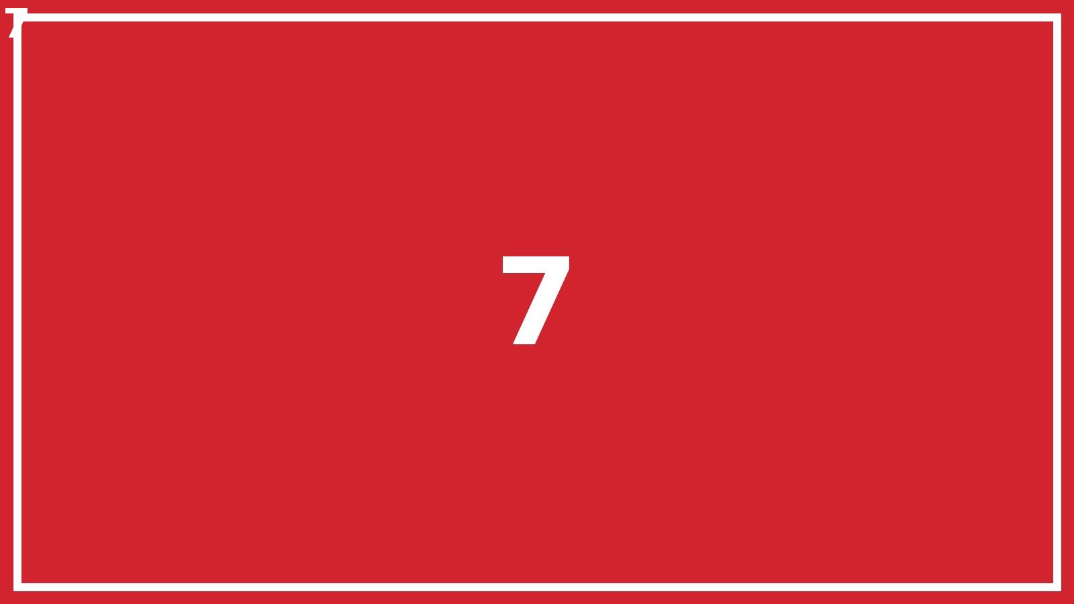
Large deck slide 7 of 80

Slide 8
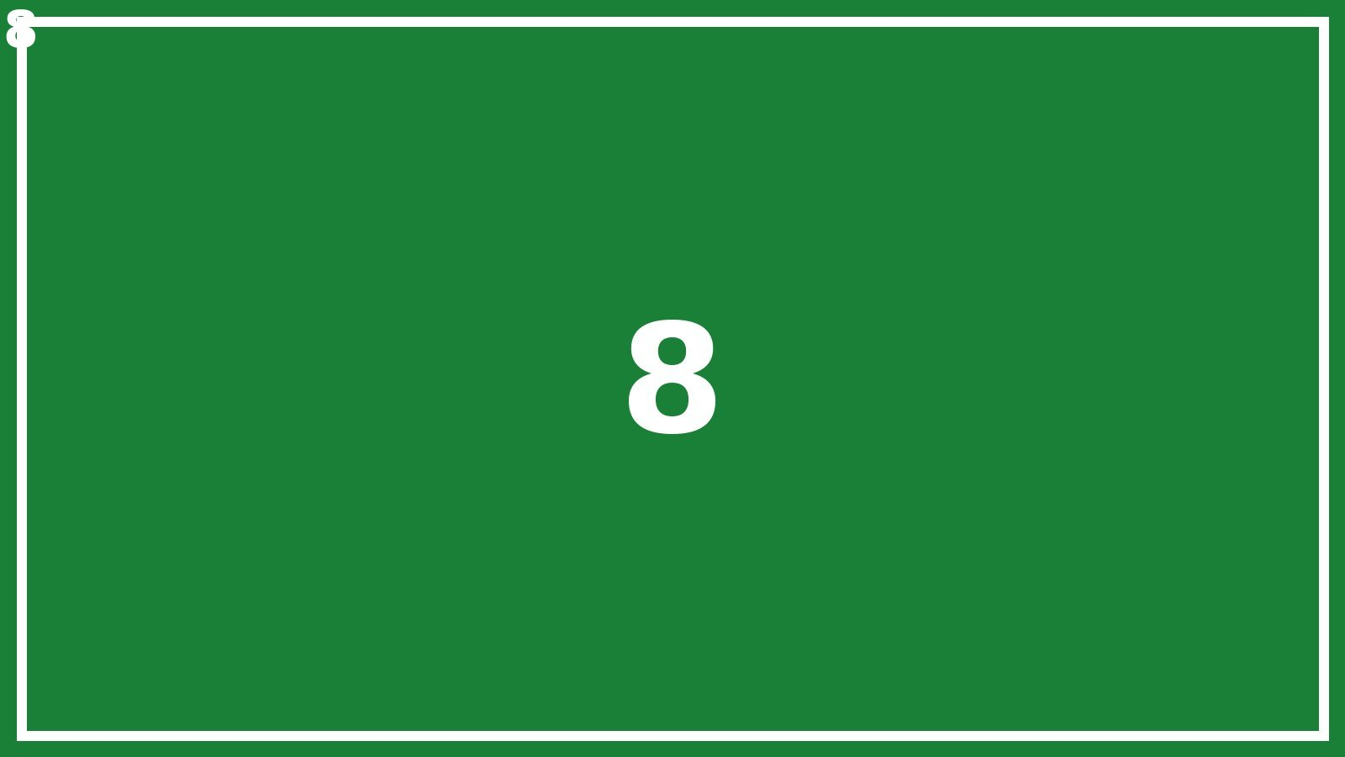
Large deck slide 8 of 80

Slide 9
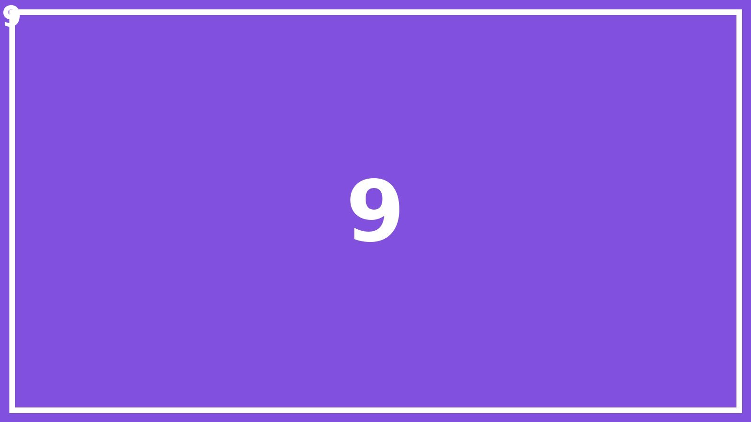
Large deck slide 9 of 80

Slide 10
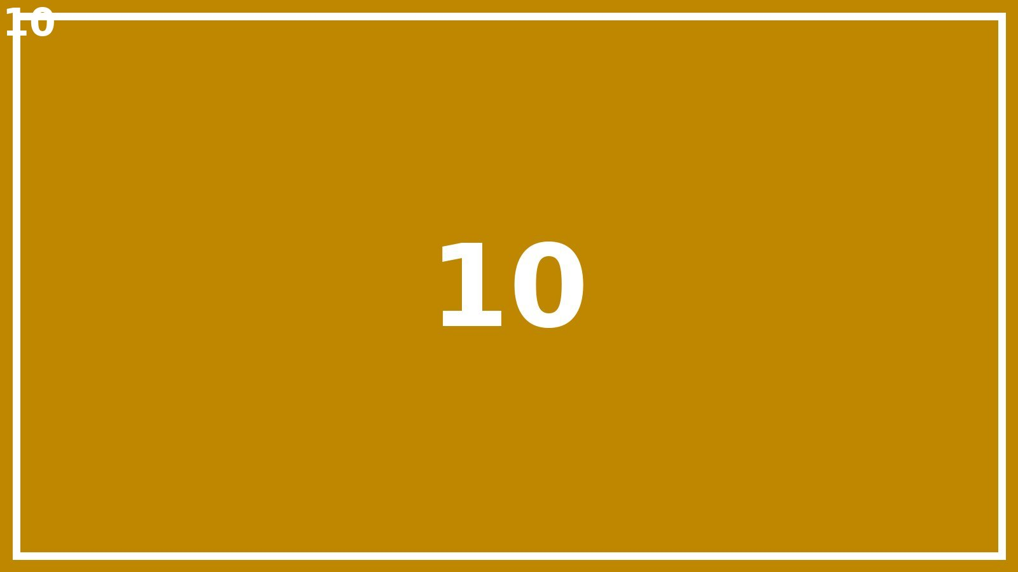
Large deck slide 10 of 80

Slide 11
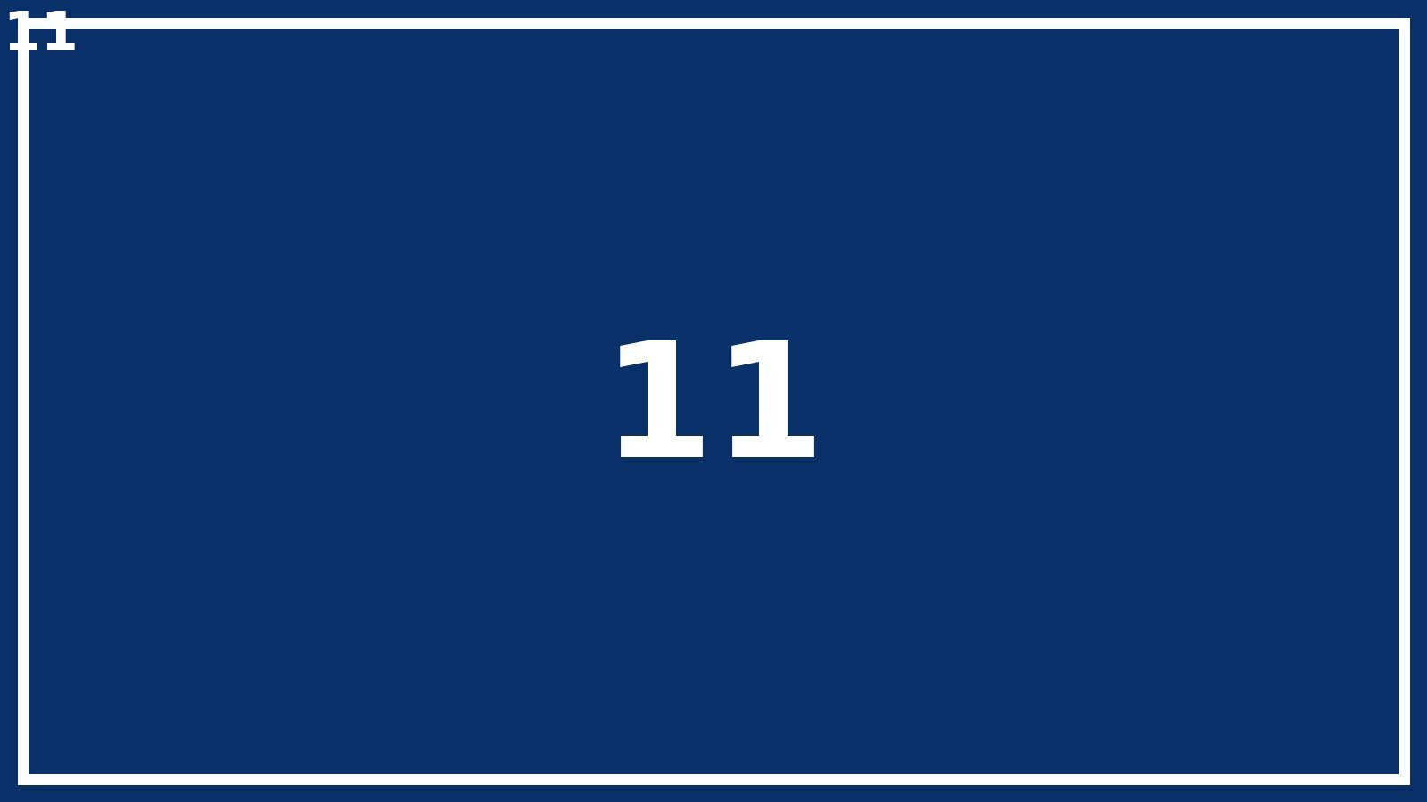
Large deck slide 11 of 80

Slide 12
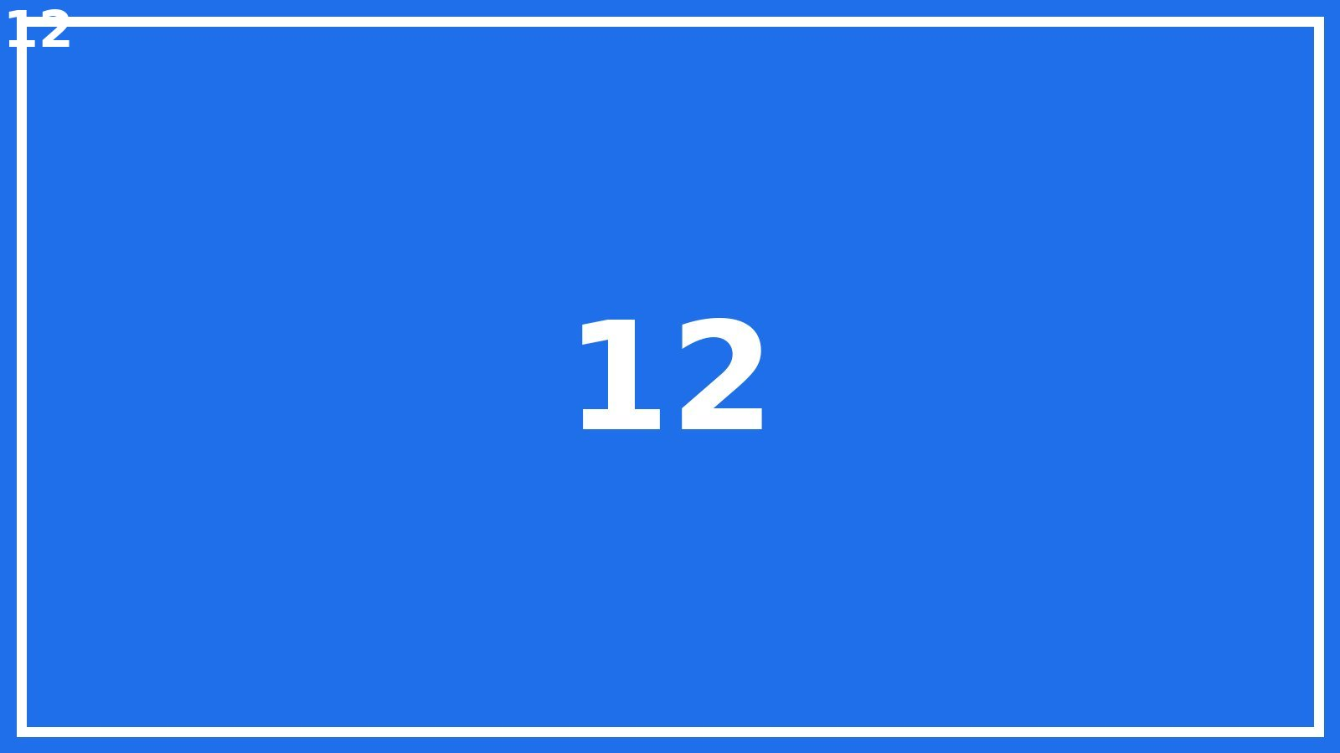
Large deck slide 12 of 80

Slide 13
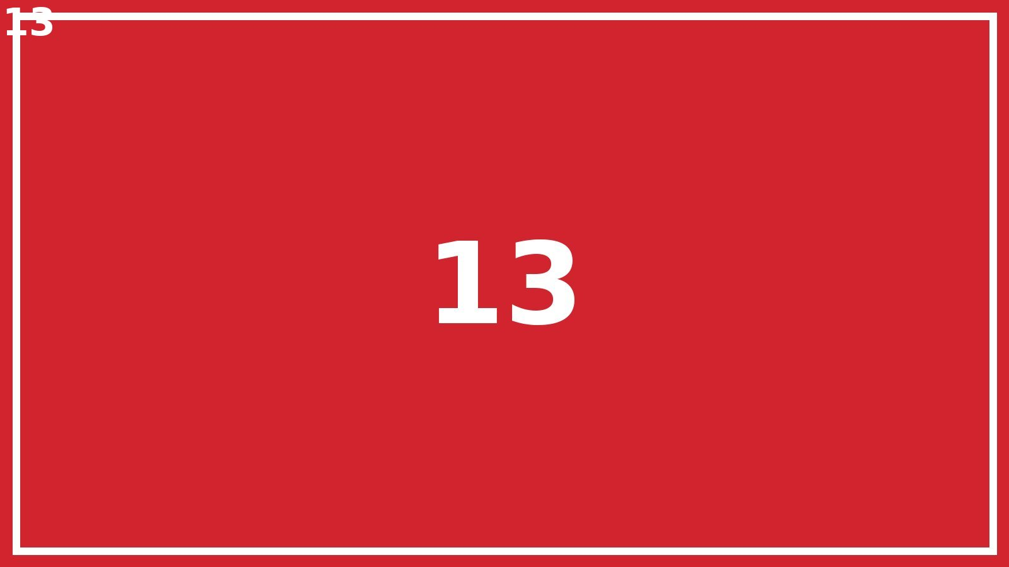
Large deck slide 13 of 80

Slide 14
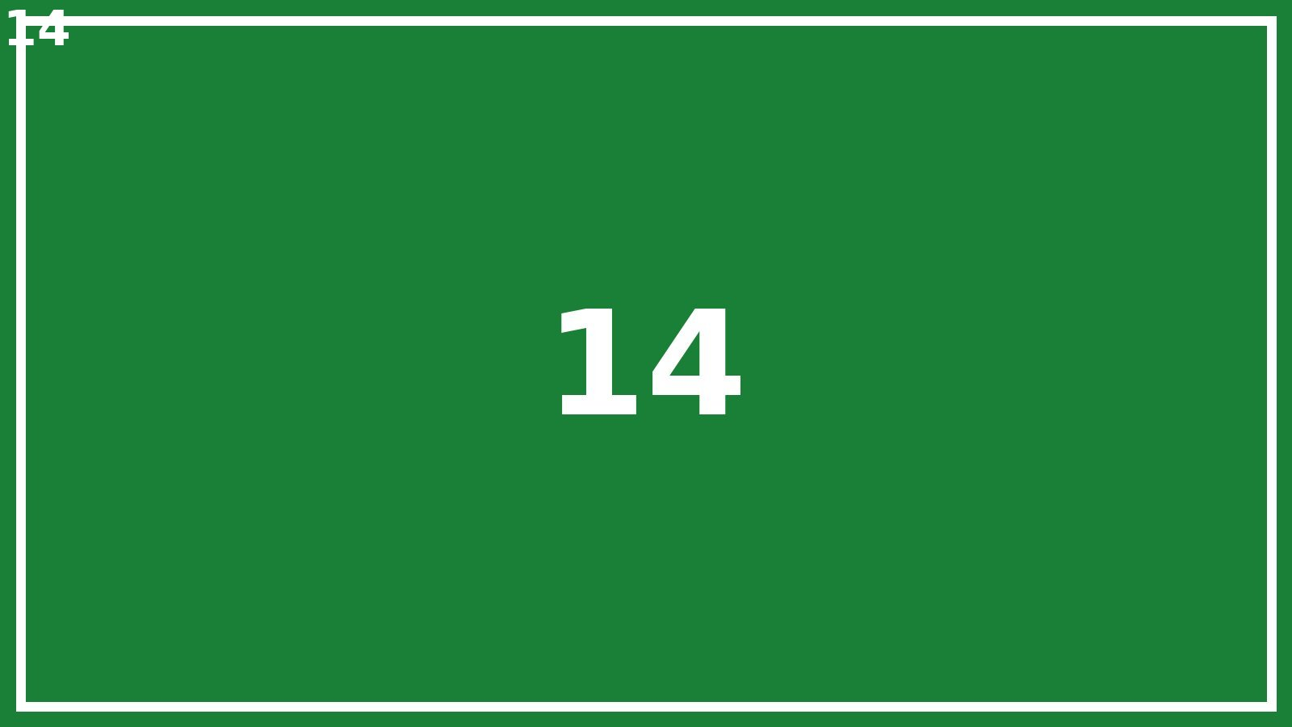
Large deck slide 14 of 80

Slide 15
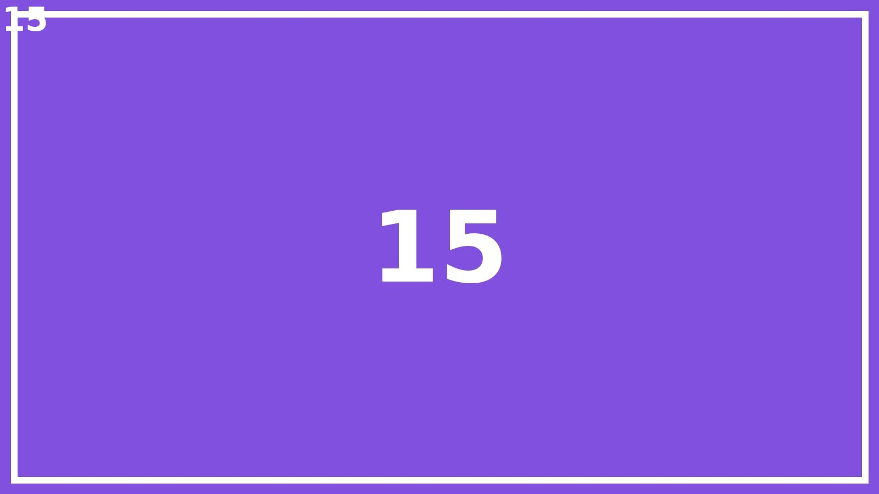
Large deck slide 15 of 80

Slide 16
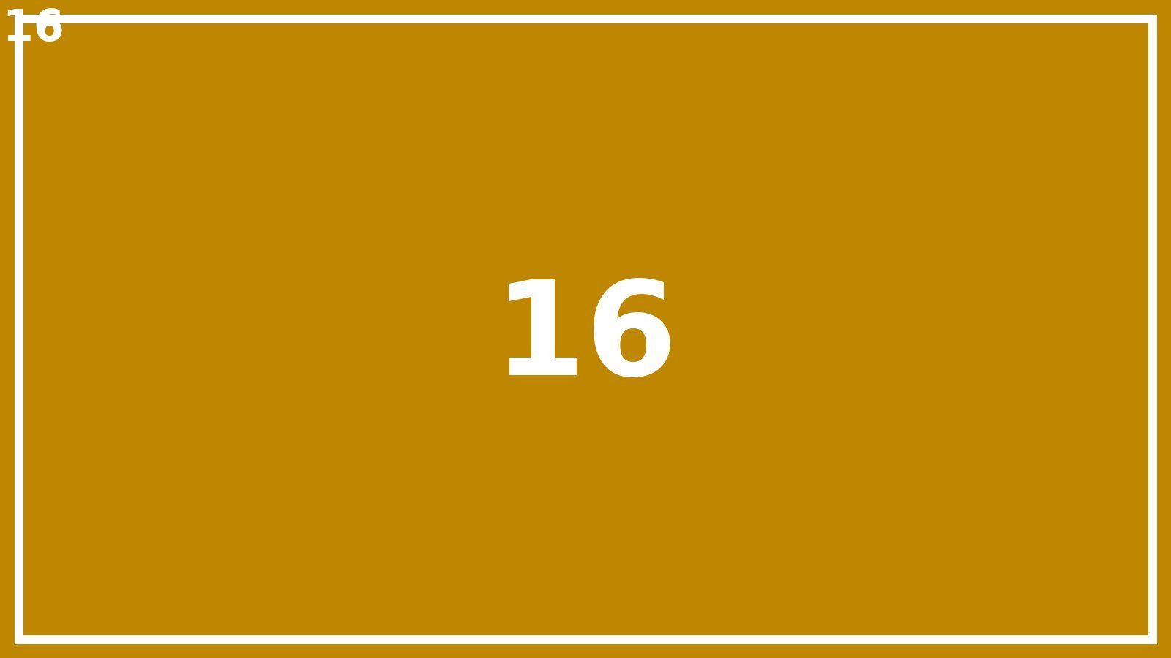
Large deck slide 16 of 80

Slide 17
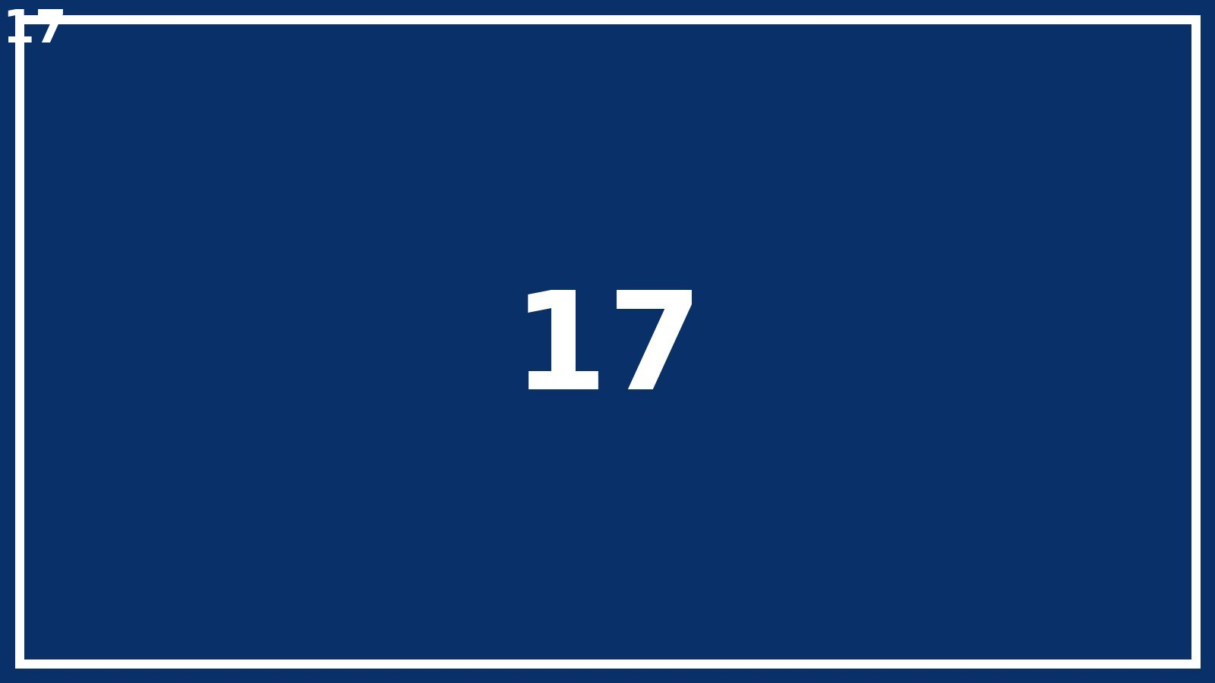
Large deck slide 17 of 80

Slide 18
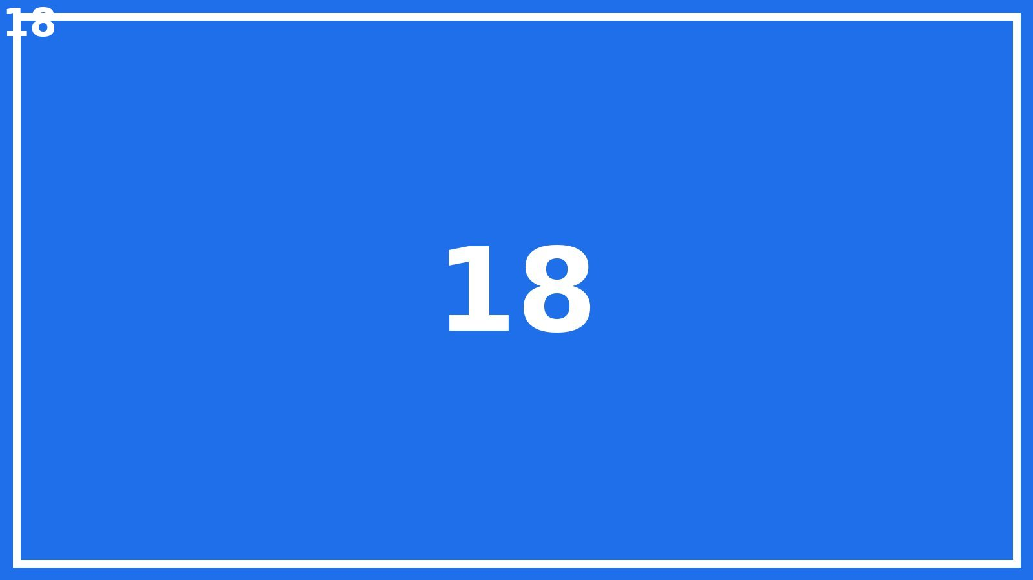
Large deck slide 18 of 80

Slide 19
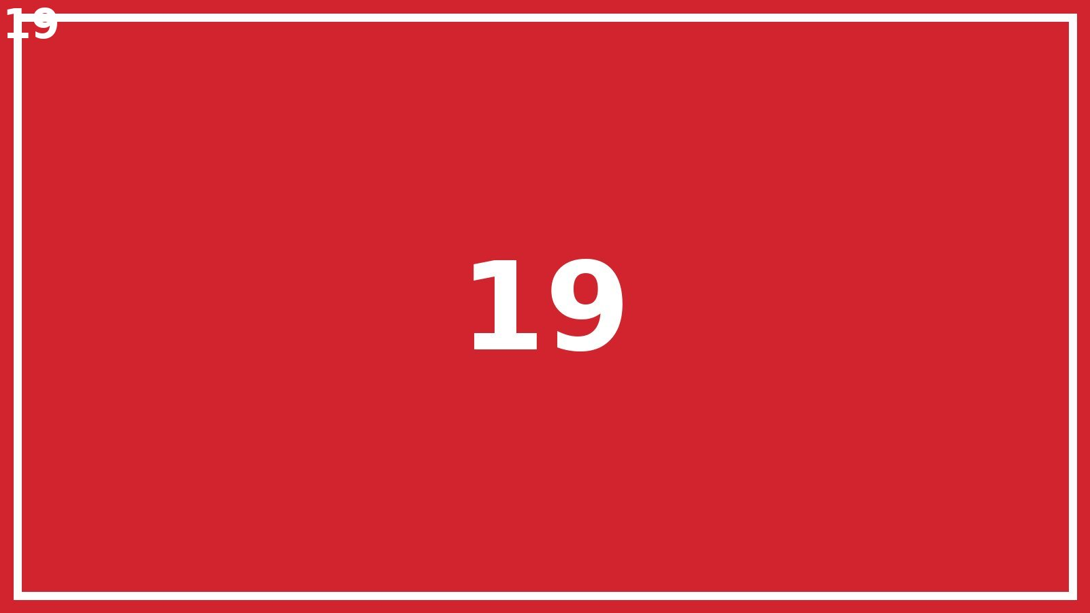
Large deck slide 19 of 80

Slide 20
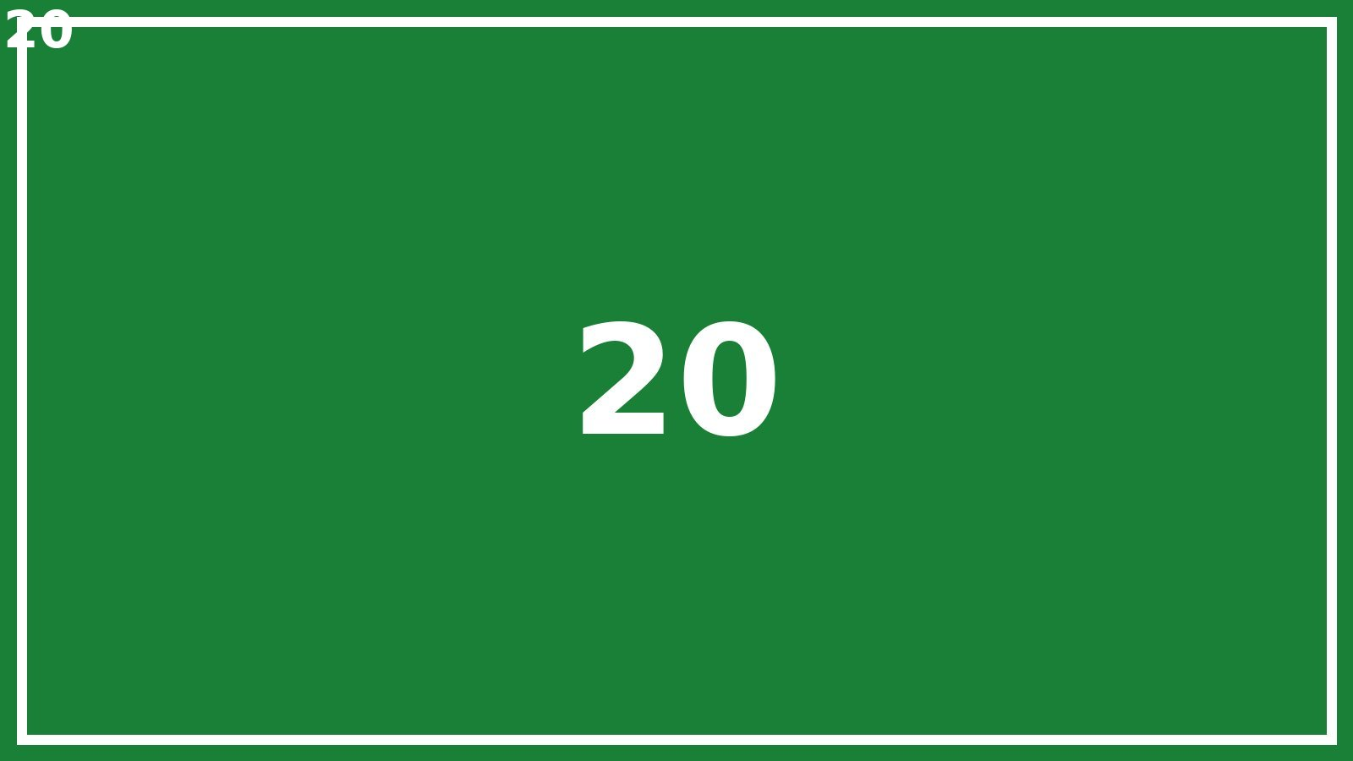
Large deck slide 20 of 80

Slide 21
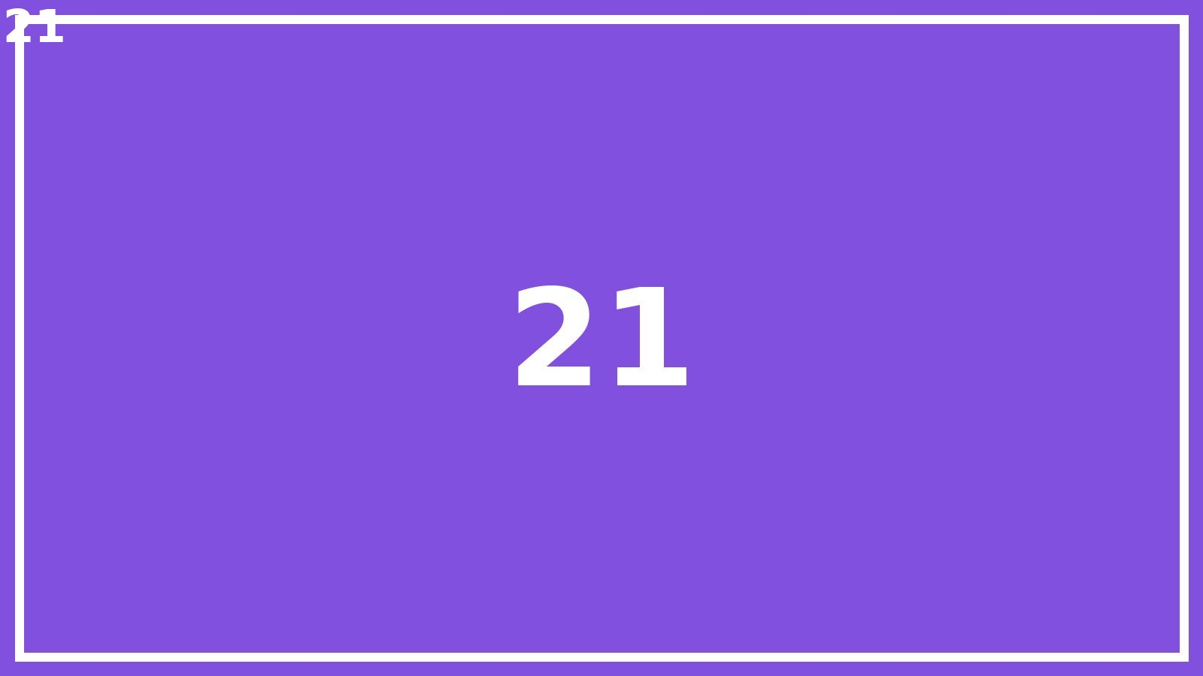
Large deck slide 21 of 80

Slide 22
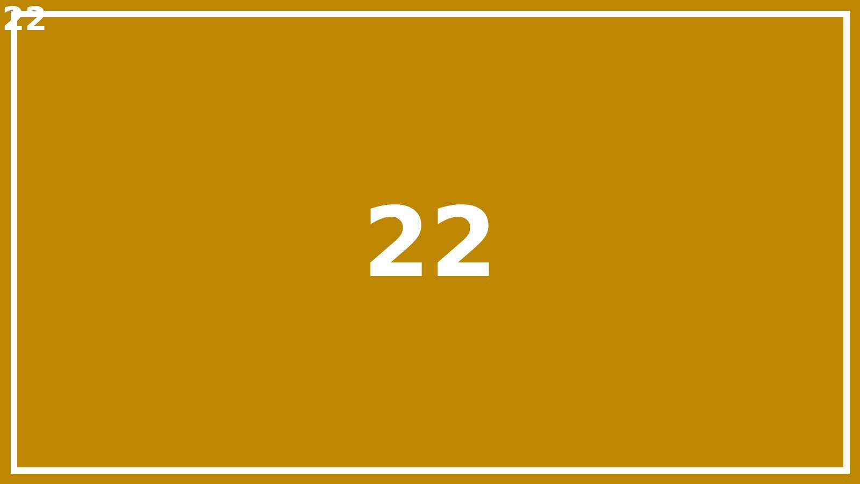
Large deck slide 22 of 80

Slide 23
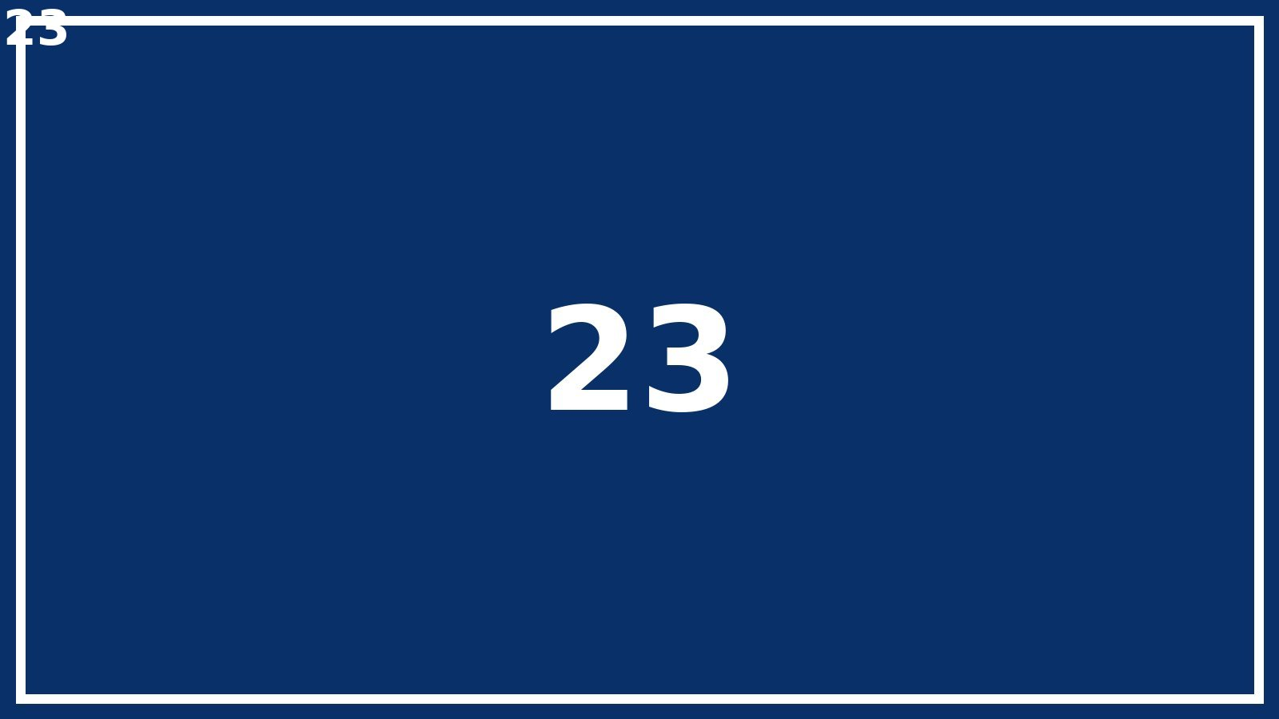
Large deck slide 23 of 80

Slide 24
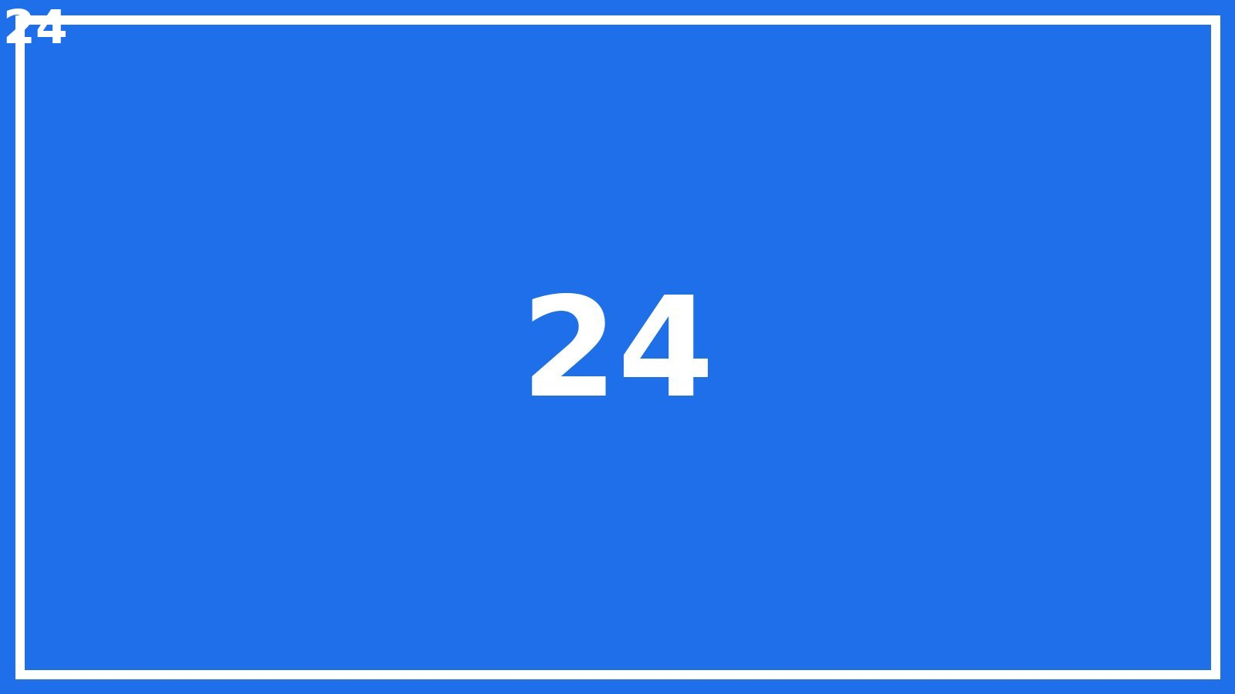
Large deck slide 24 of 80

Slide 25
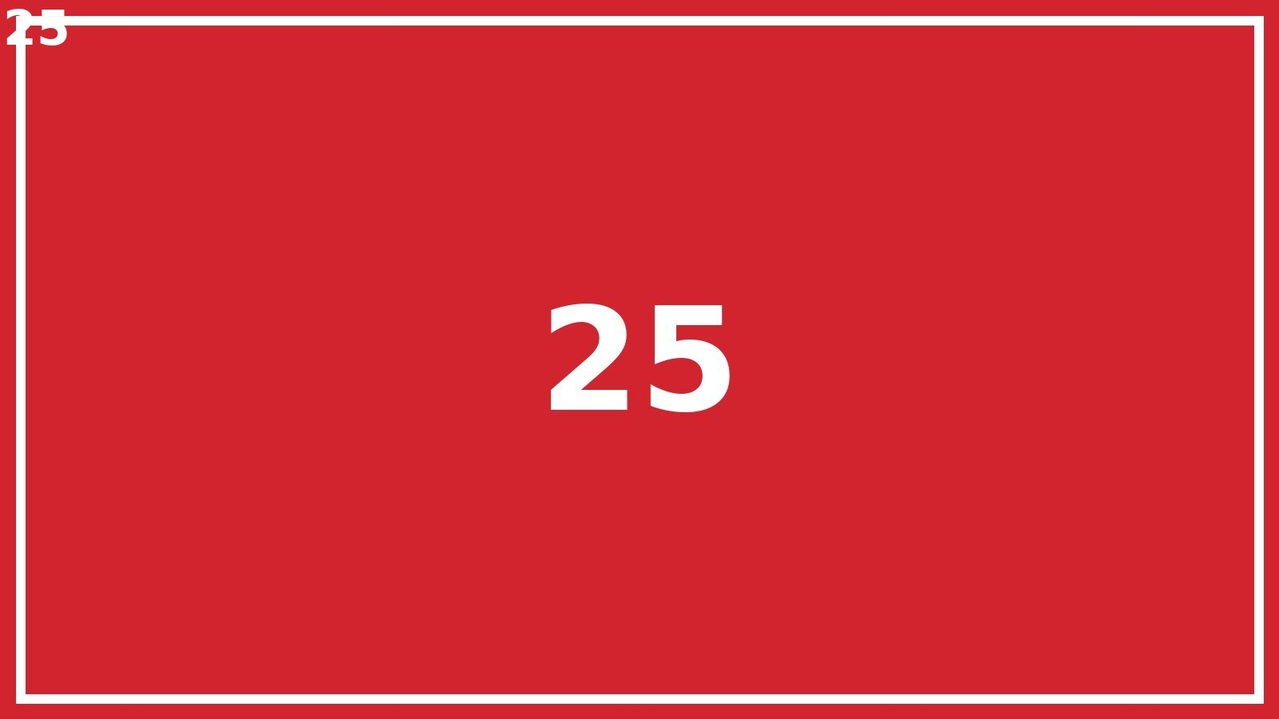
Large deck slide 25 of 80

Slide 26
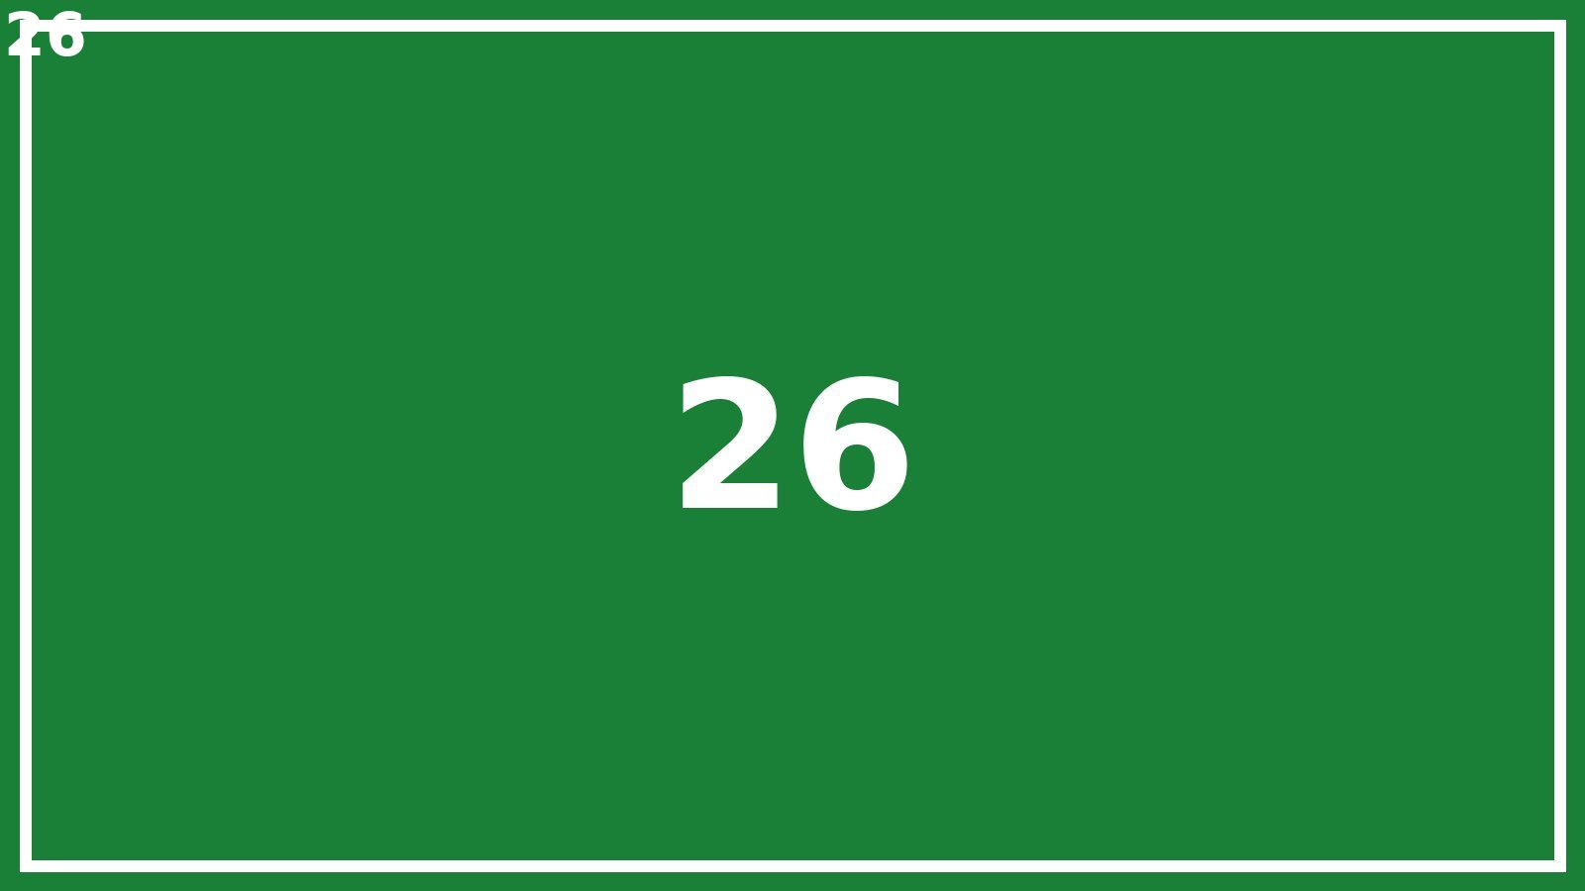
Large deck slide 26 of 80

Slide 27
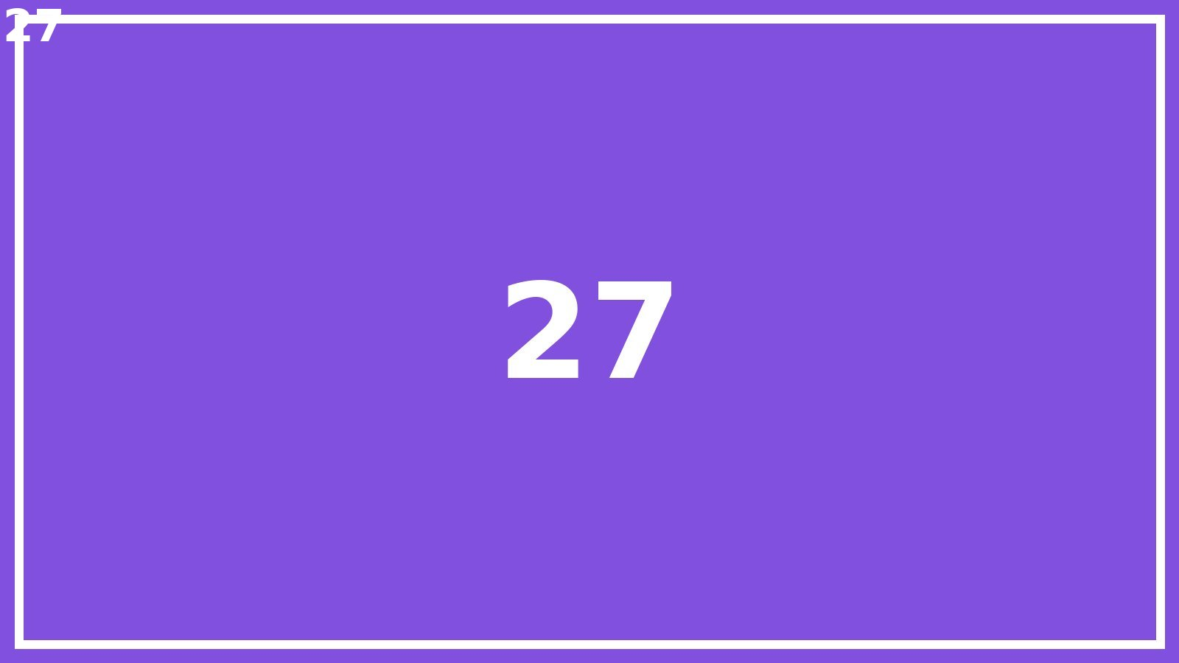
Large deck slide 27 of 80

Slide 28
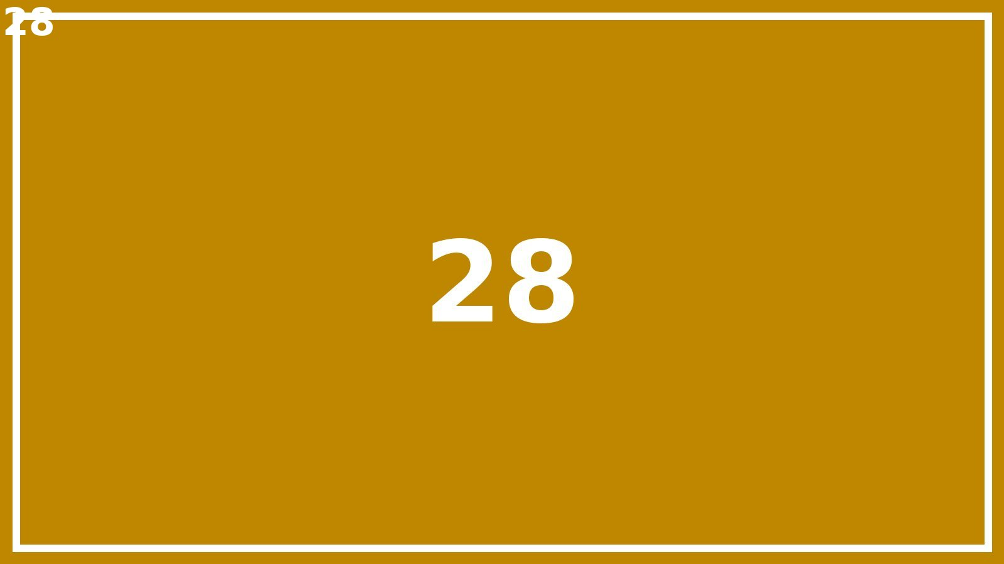
Large deck slide 28 of 80

Slide 29
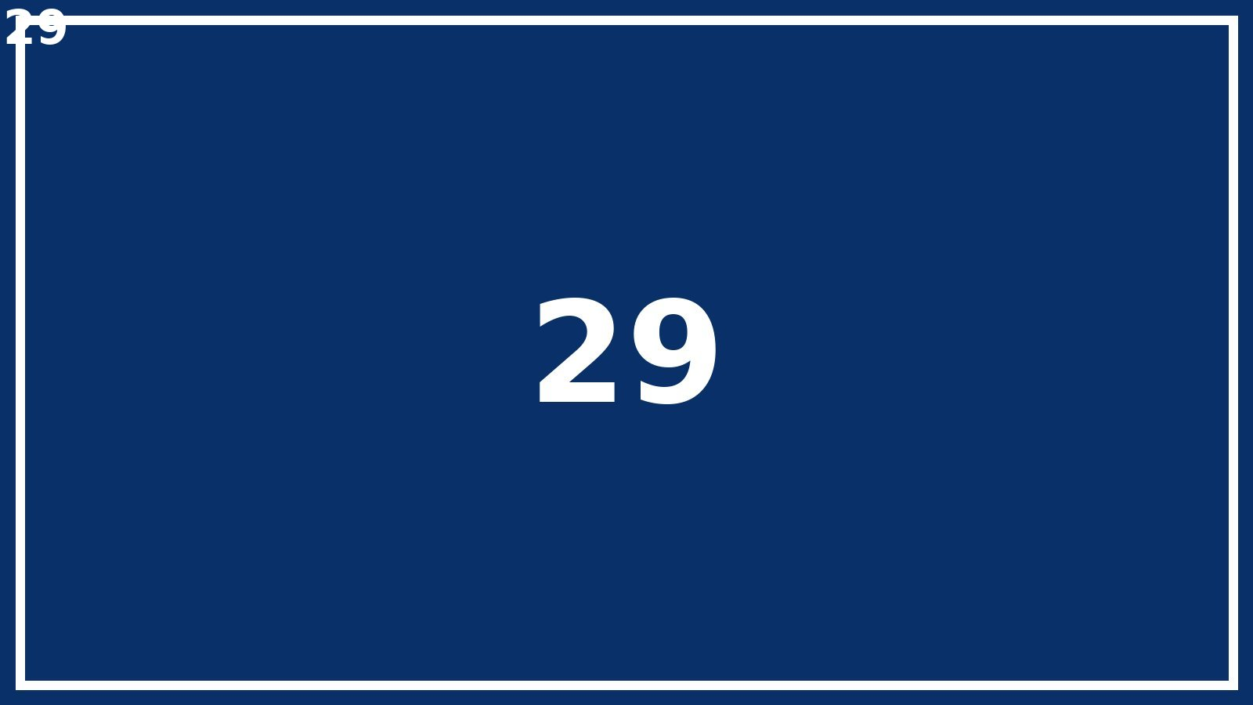
Large deck slide 29 of 80

Slide 30
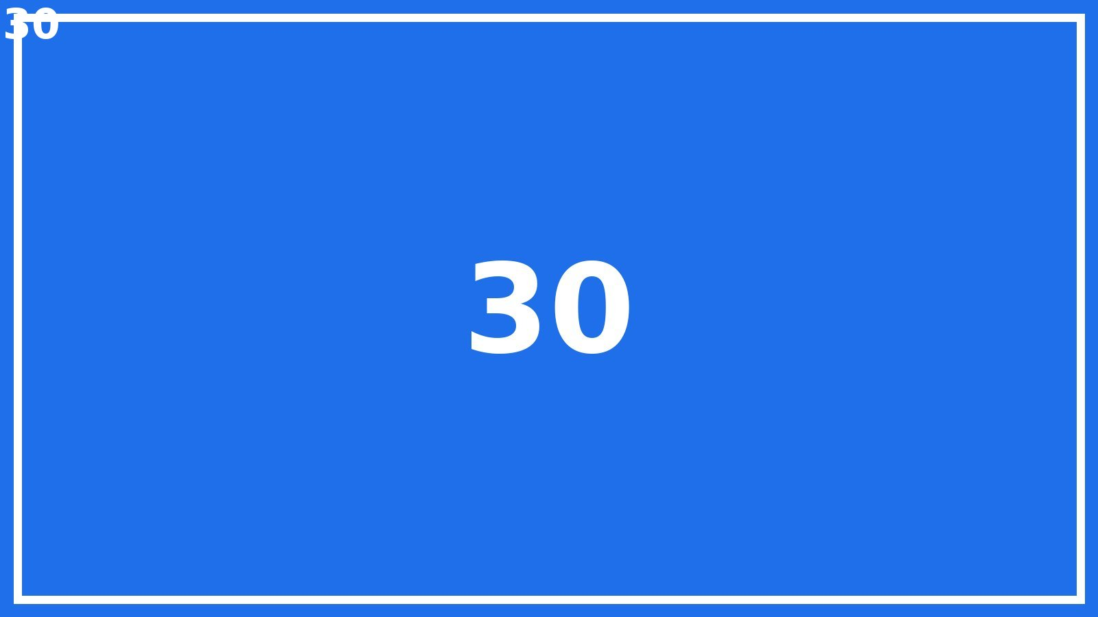
Large deck slide 30 of 80

Slide 31
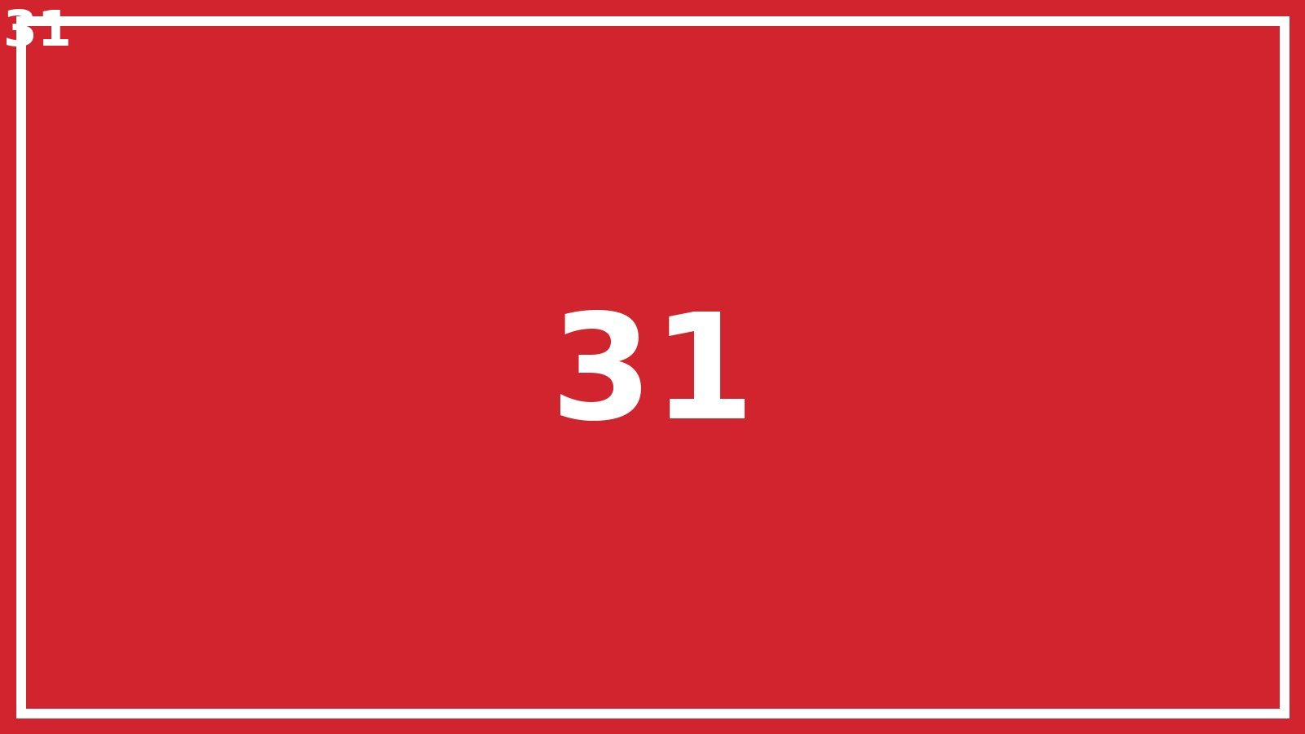
Large deck slide 31 of 80

Slide 32
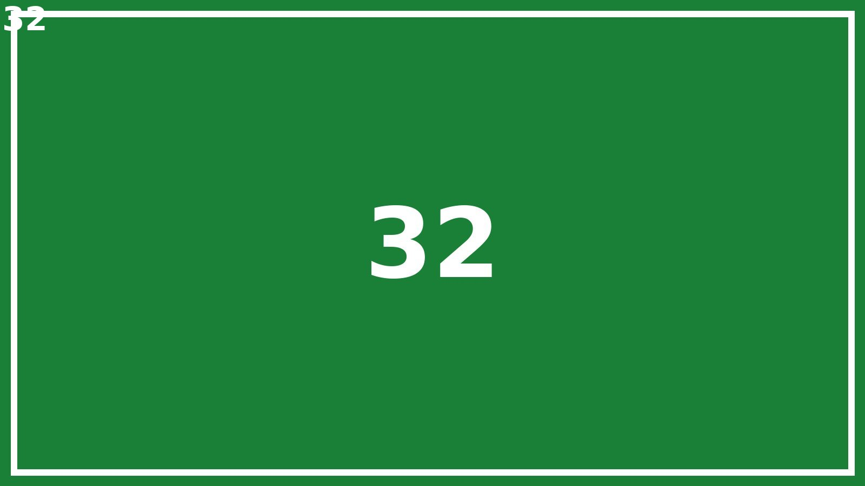
Large deck slide 32 of 80

Slide 33
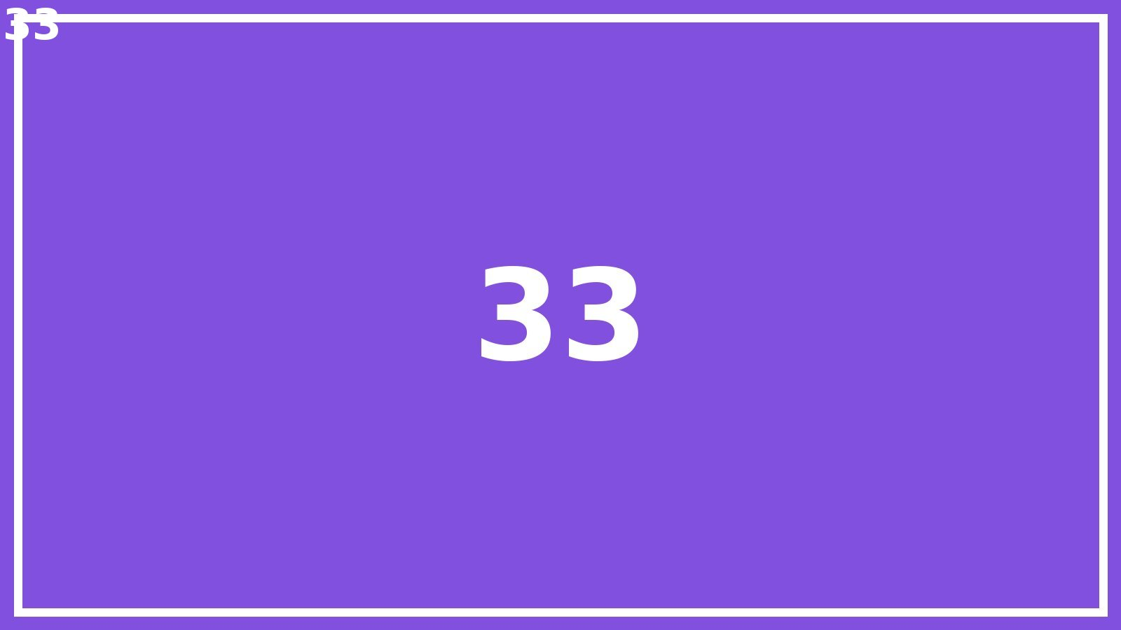
Large deck slide 33 of 80

Slide 34
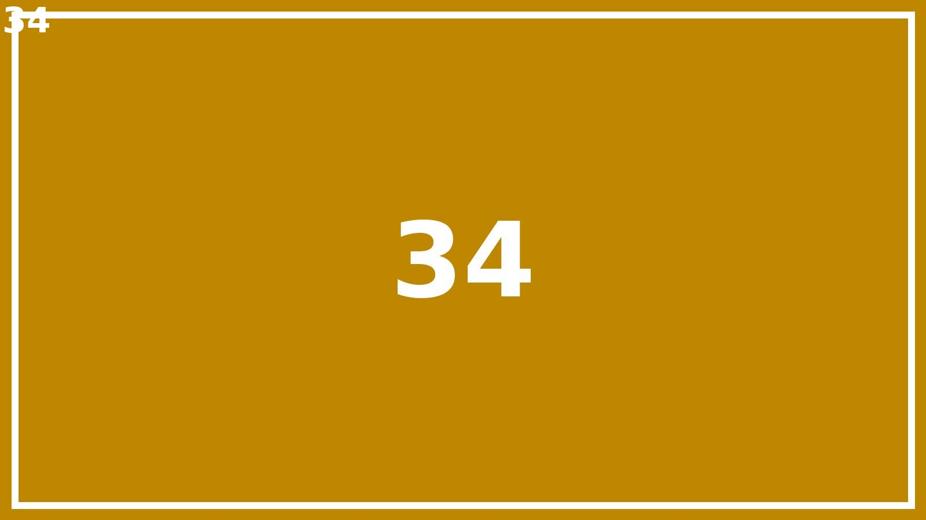
Large deck slide 34 of 80

Slide 35
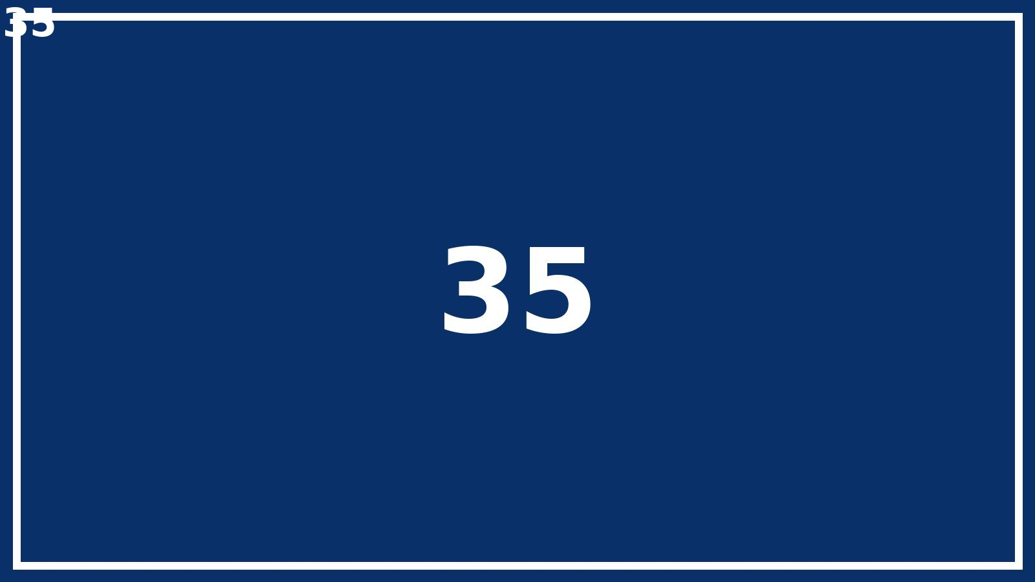
Large deck slide 35 of 80

Slide 36
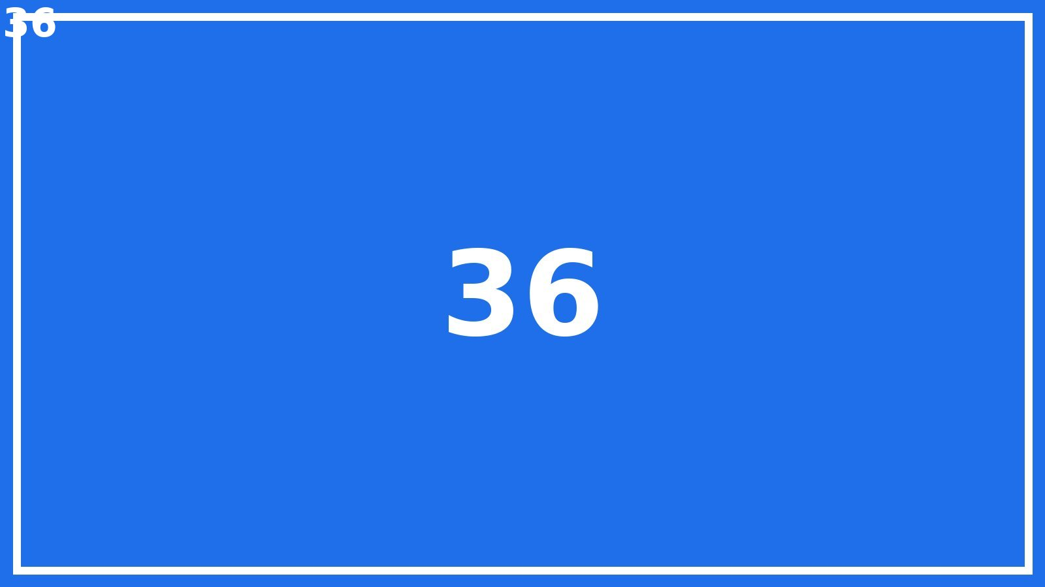
Large deck slide 36 of 80

Slide 37
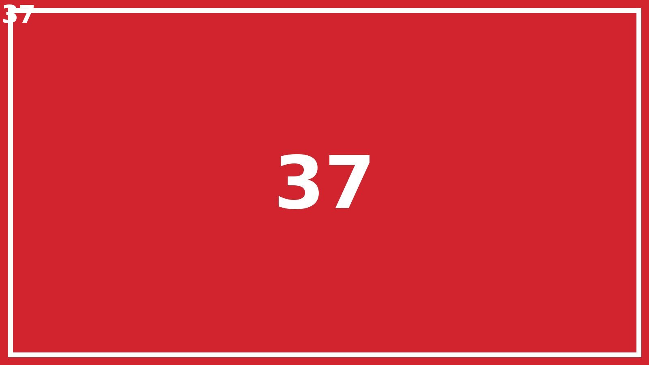
Large deck slide 37 of 80

Slide 38
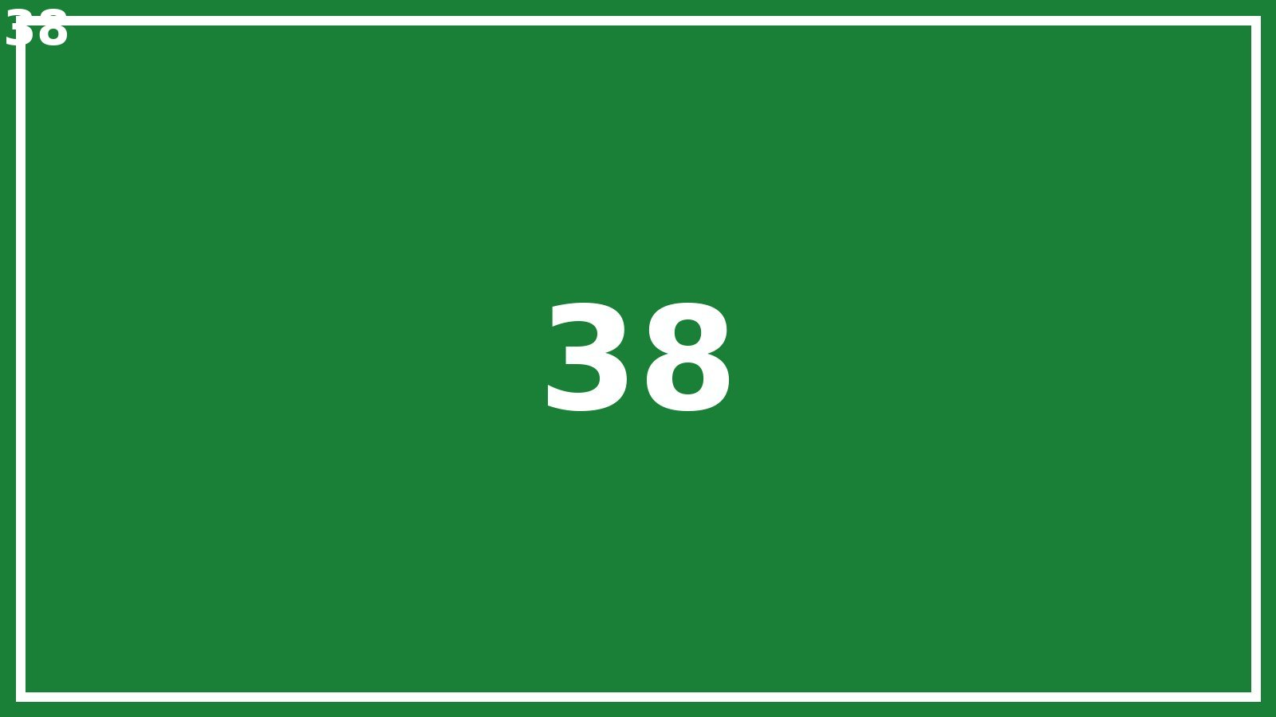
Large deck slide 38 of 80

Slide 39
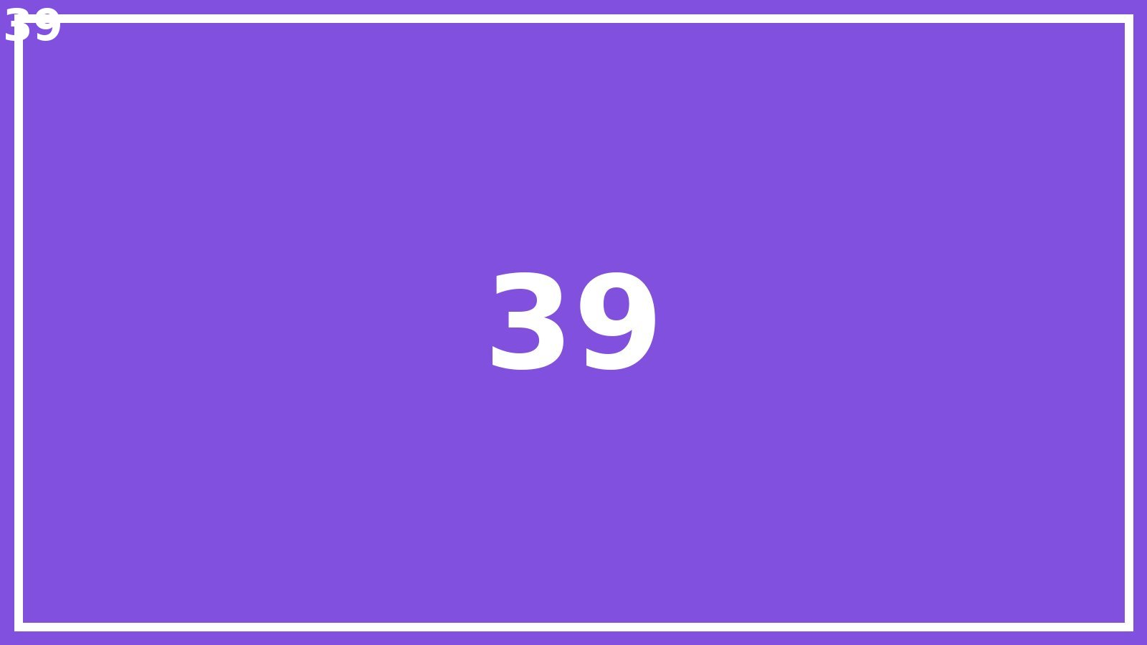
Large deck slide 39 of 80

Slide 40
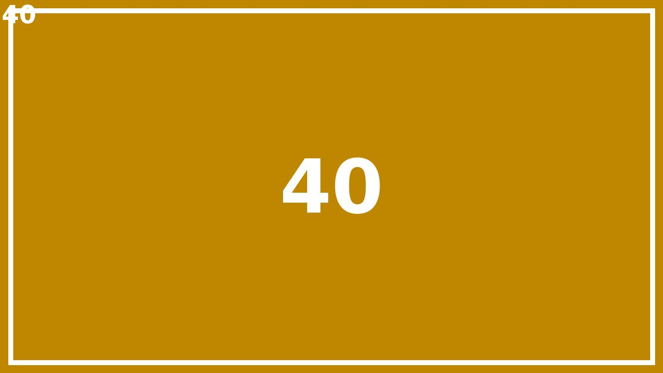
Large deck slide 40 of 80

Slide 41
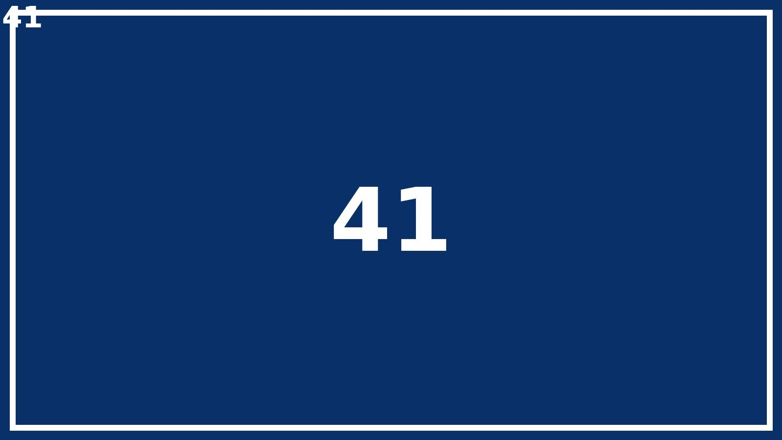
Large deck slide 41 of 80

Slide 42
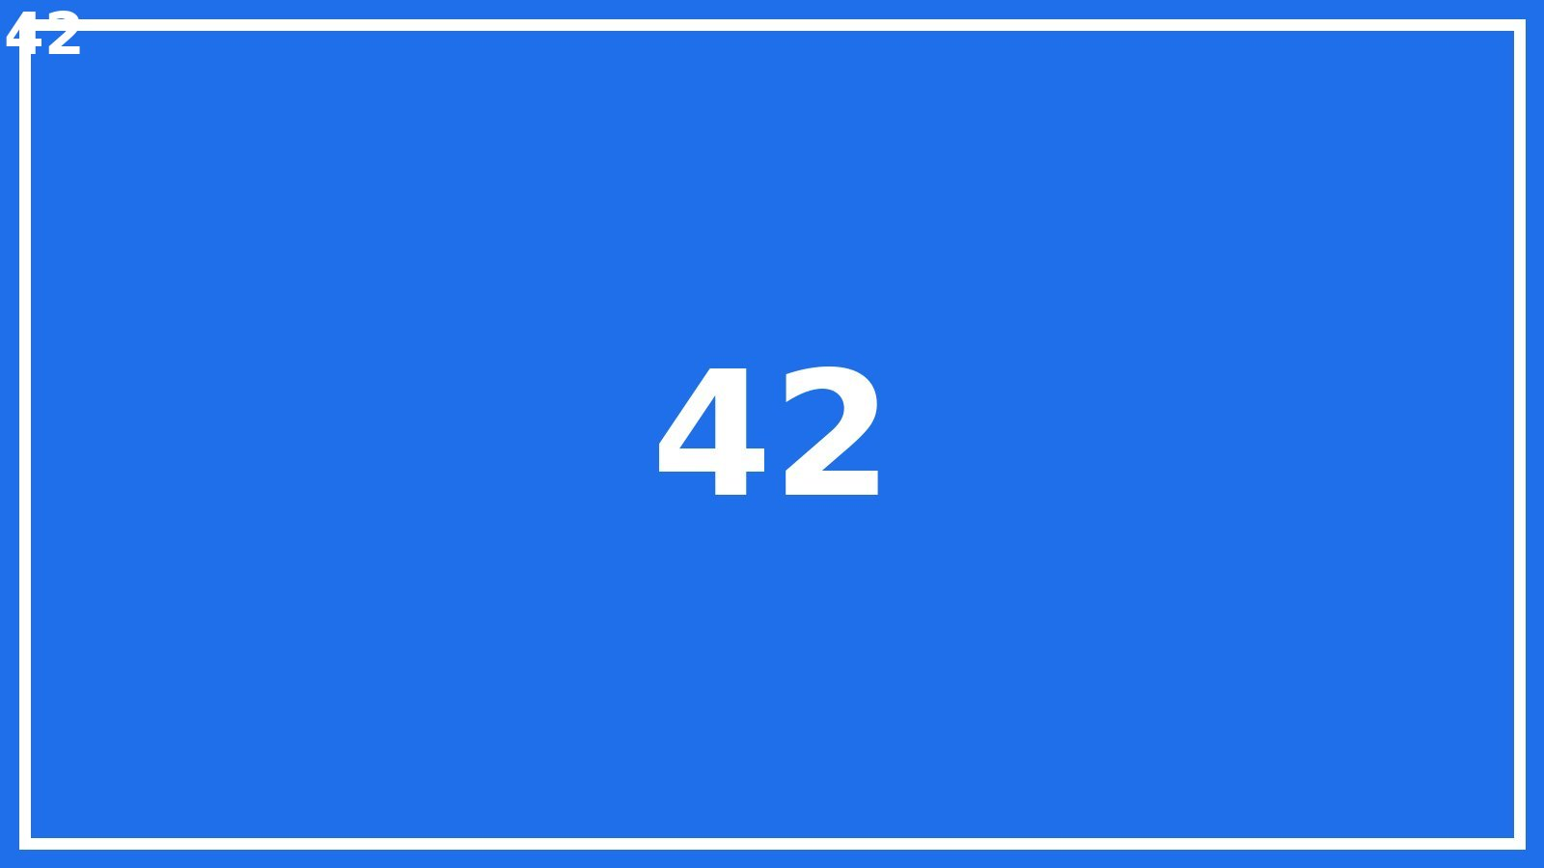
Large deck slide 42 of 80

Slide 43
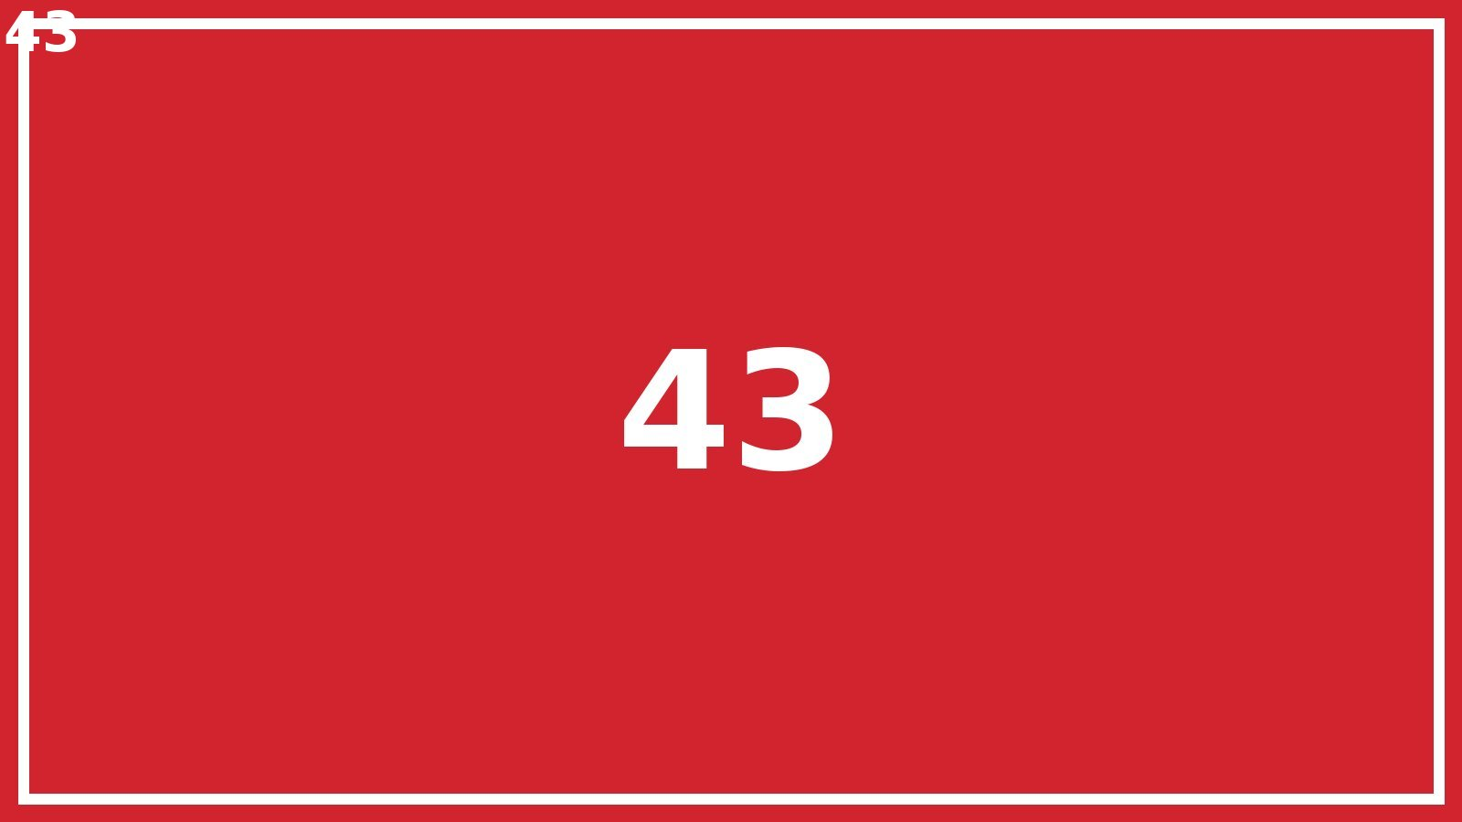
Large deck slide 43 of 80

Slide 44
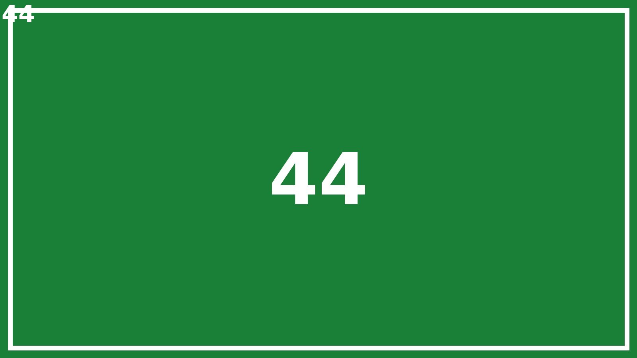
Large deck slide 44 of 80

Slide 45
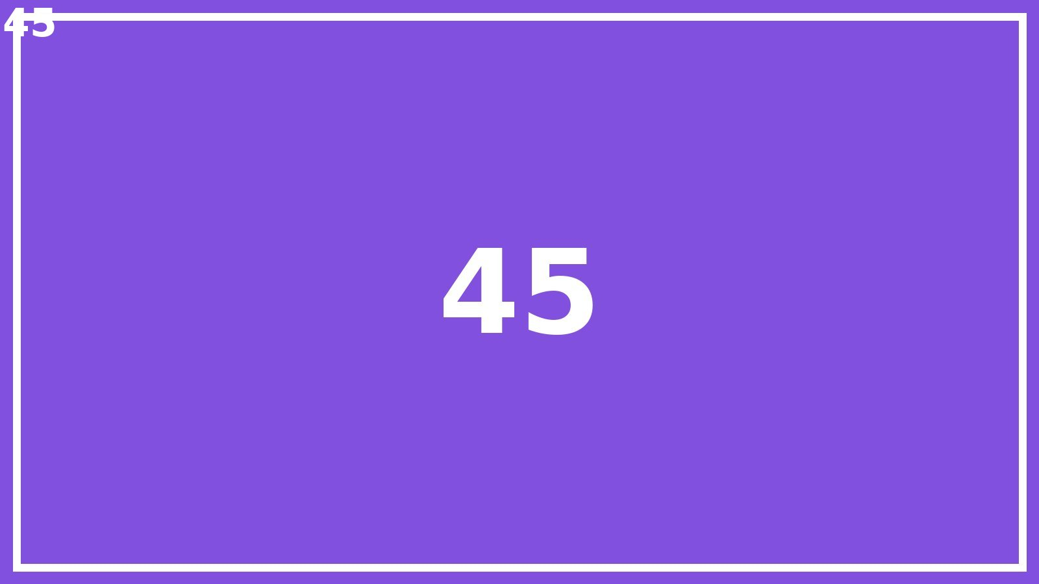
Large deck slide 45 of 80

Slide 46
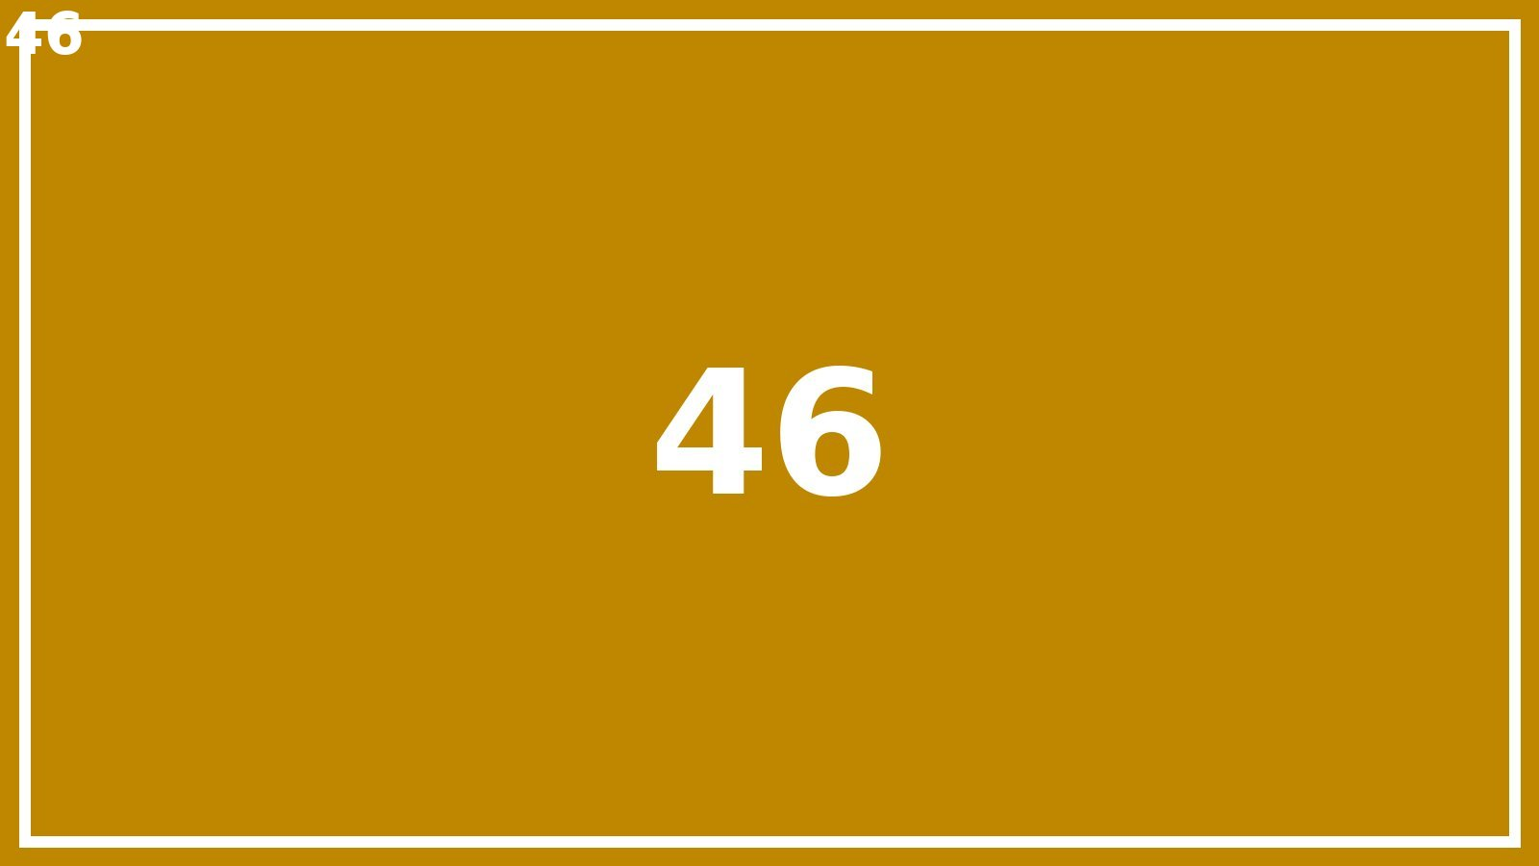
Large deck slide 46 of 80

Slide 47
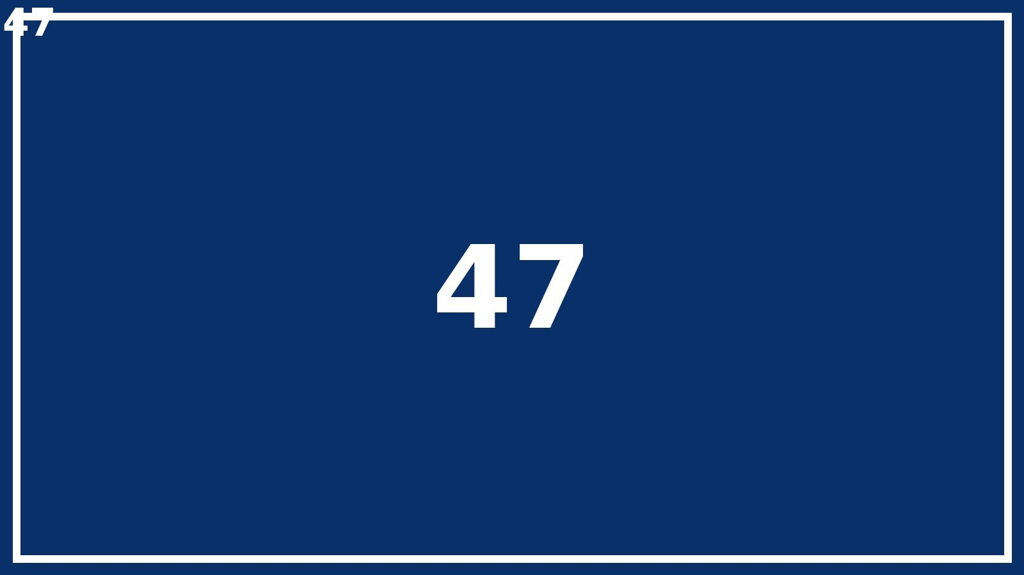
Large deck slide 47 of 80

Slide 48
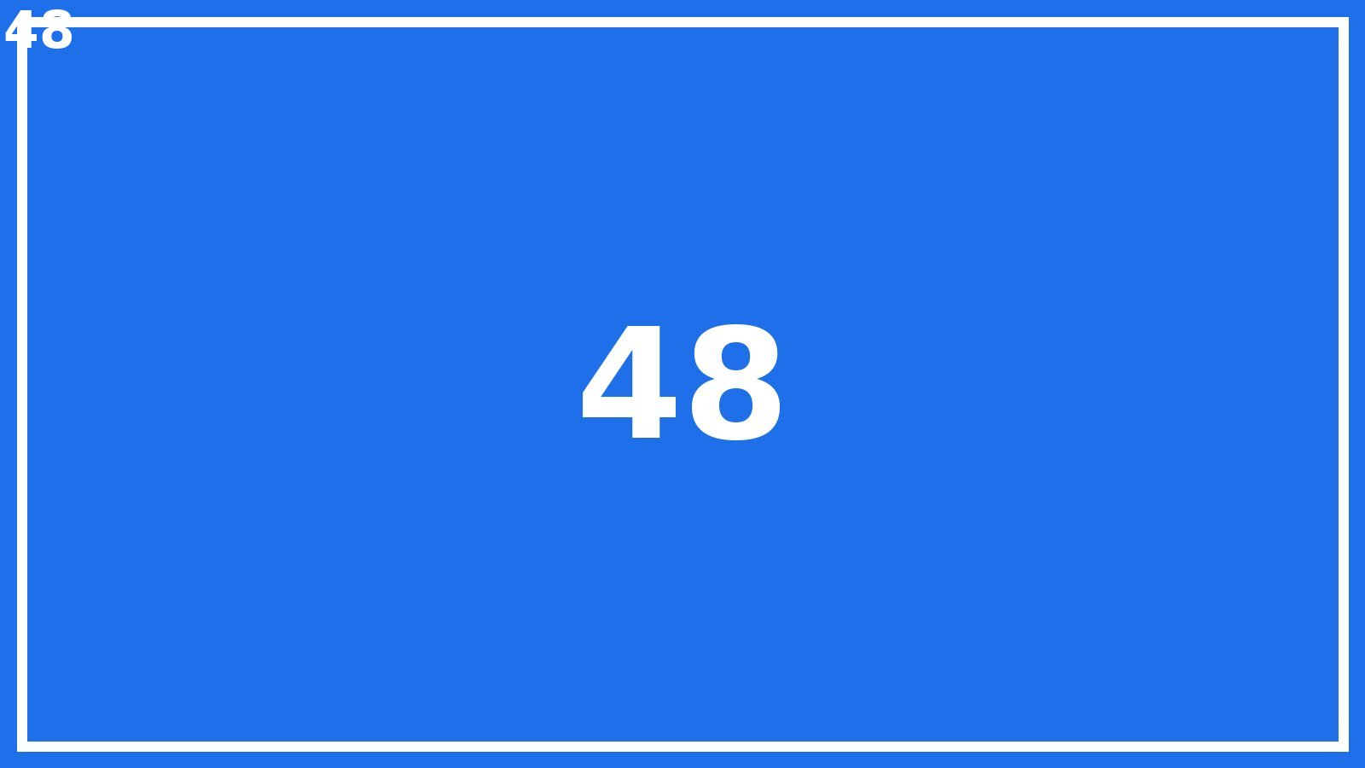
Large deck slide 48 of 80

Slide 49
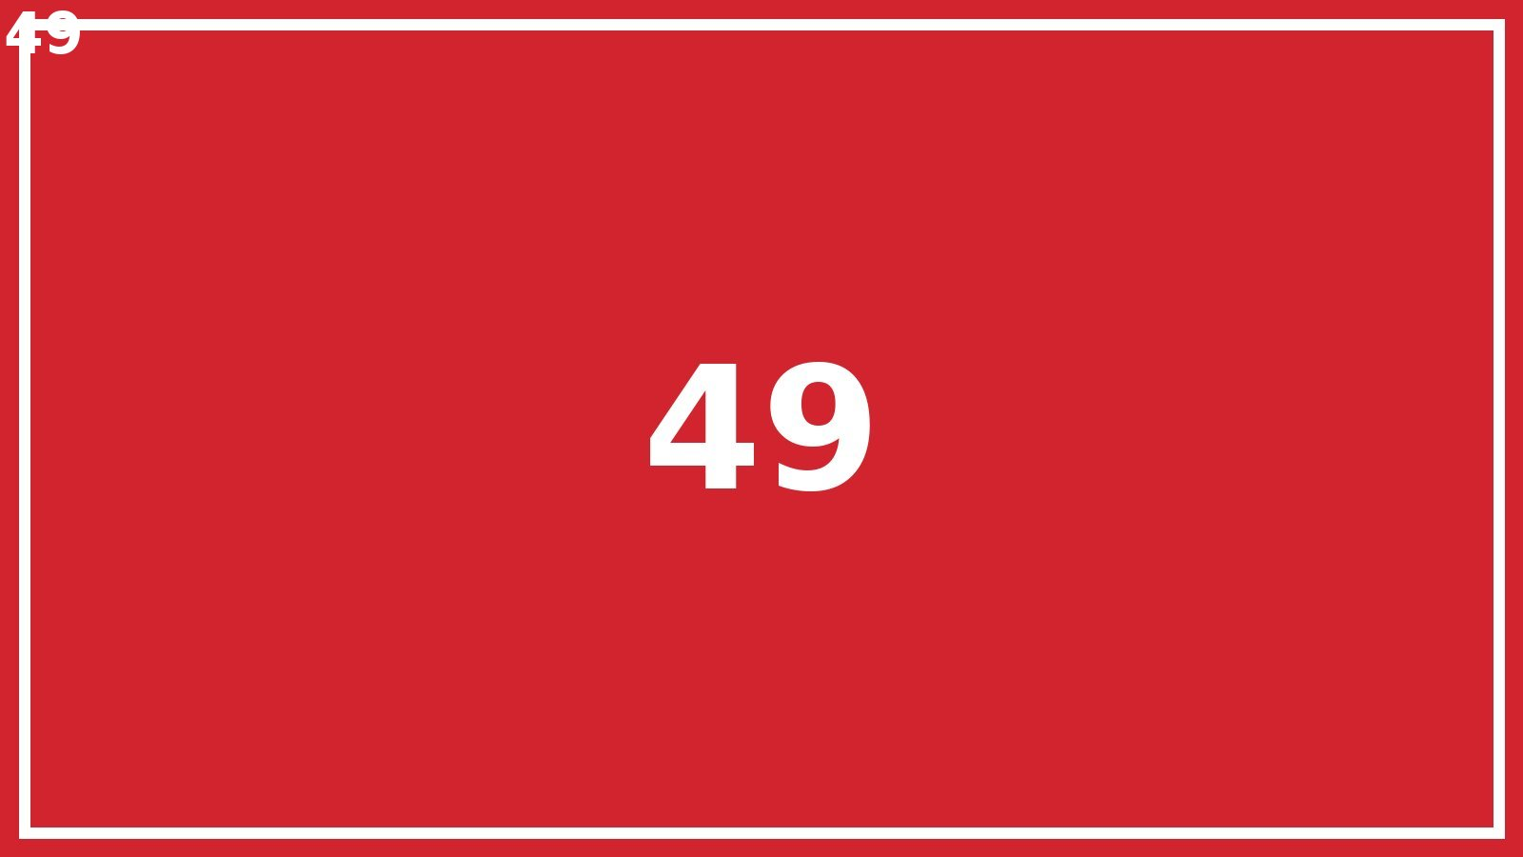
Large deck slide 49 of 80

Slide 50
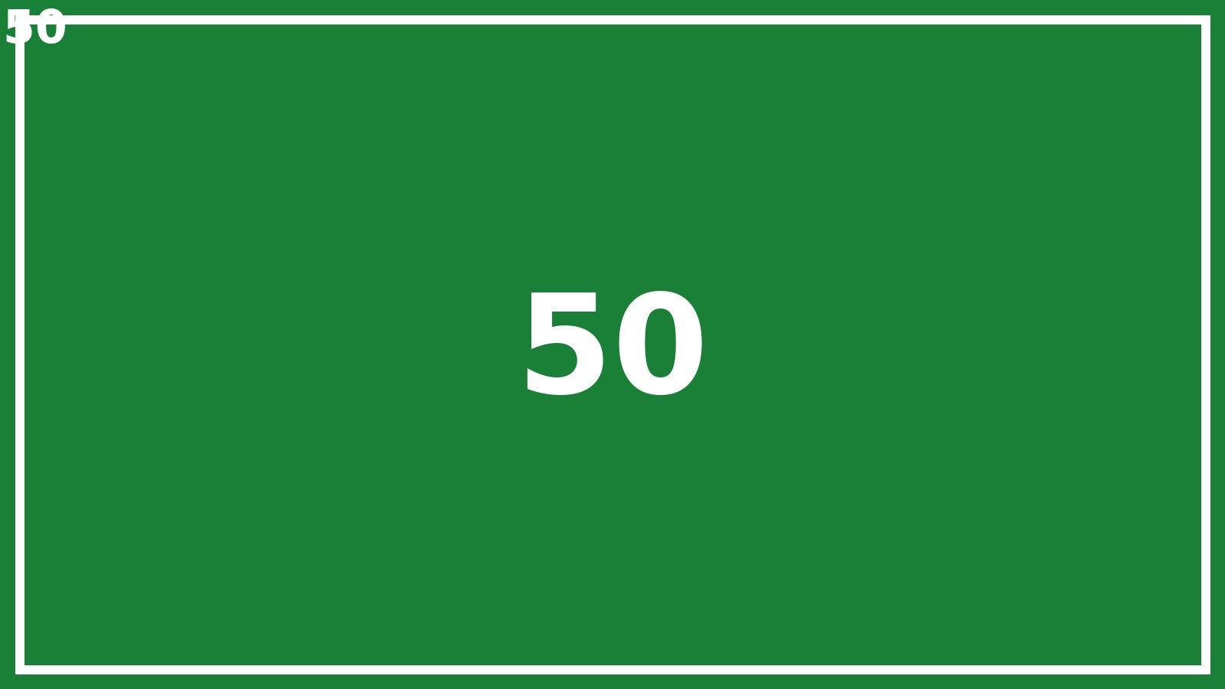
Large deck slide 50 of 80

Slide 51
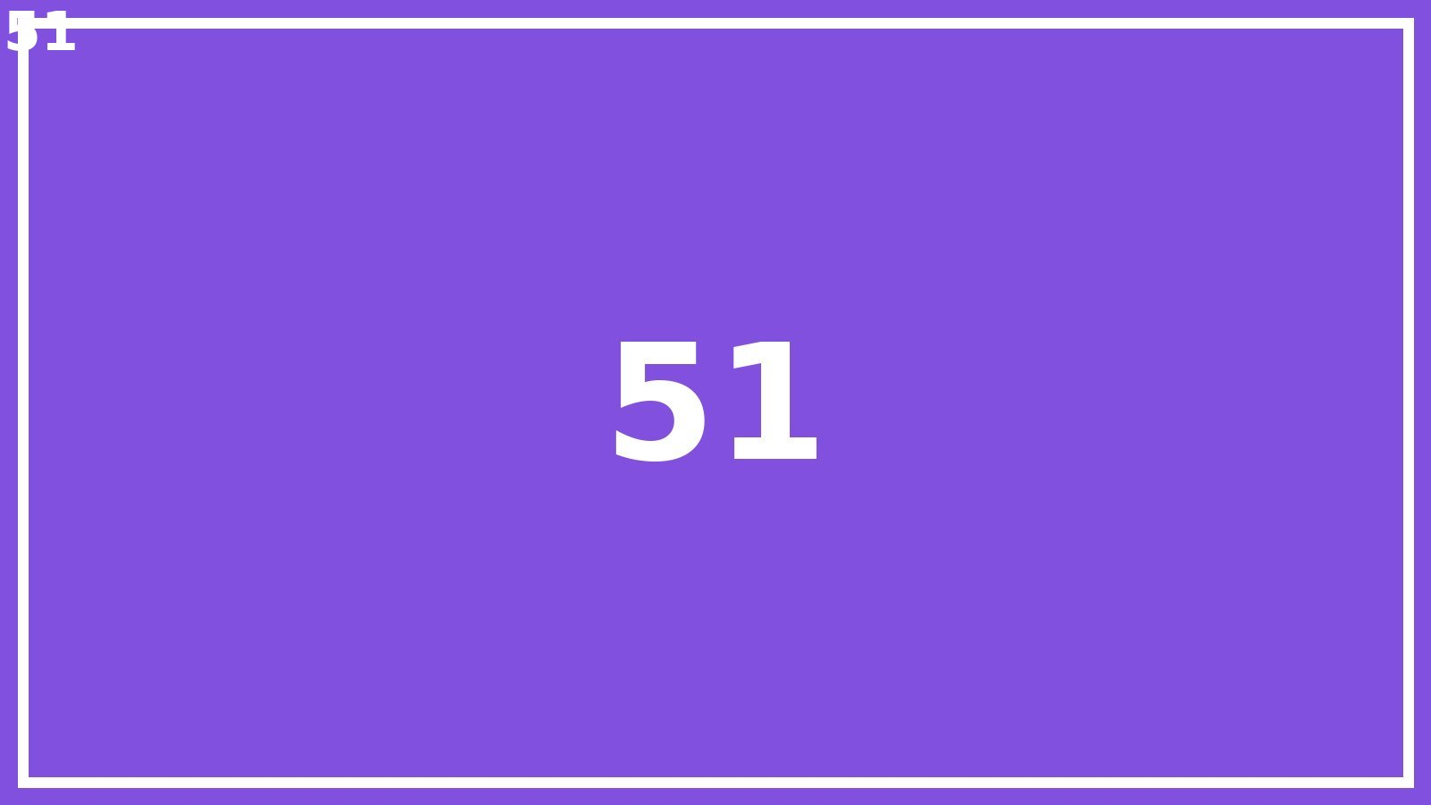
Large deck slide 51 of 80

Slide 52
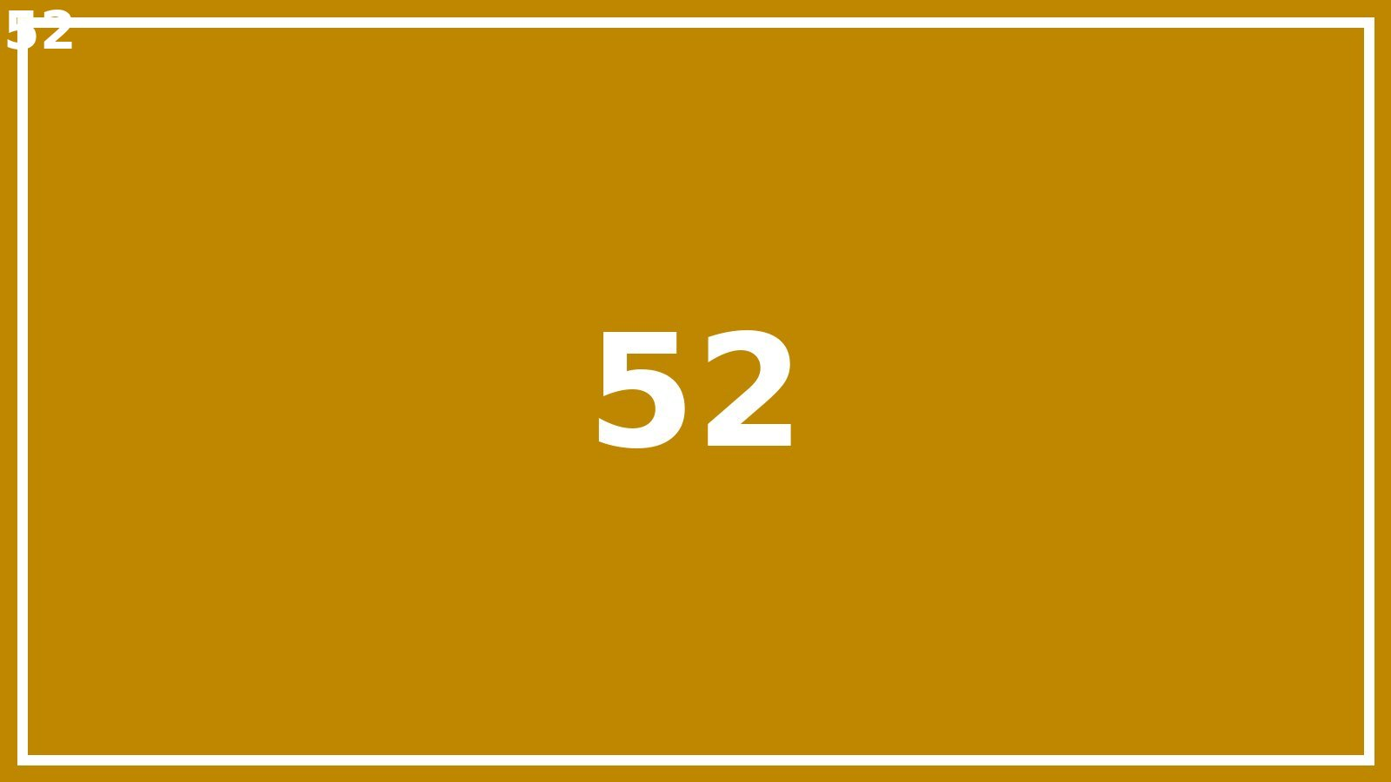
Large deck slide 52 of 80

Slide 53
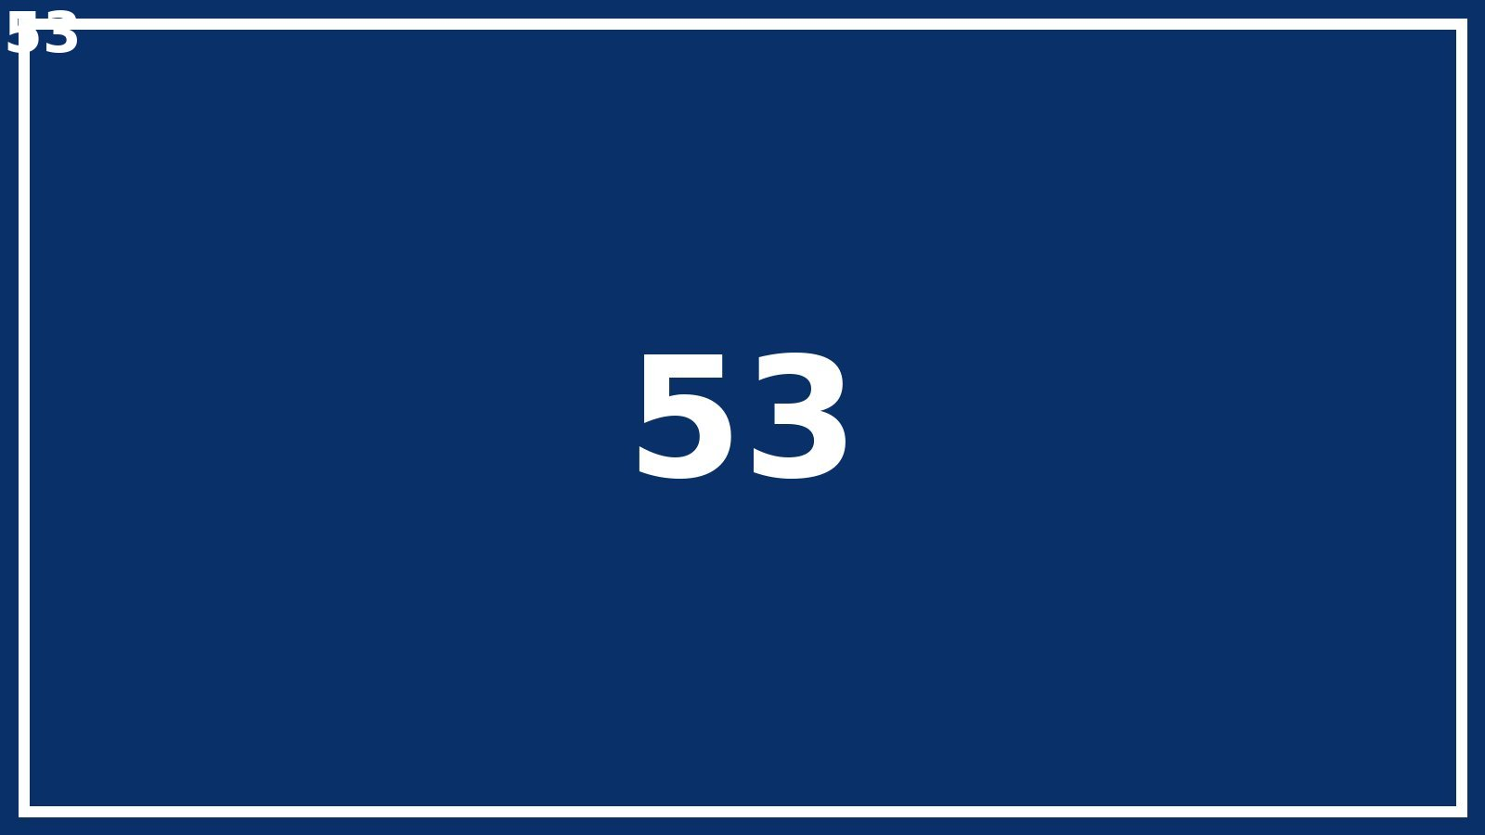
Large deck slide 53 of 80

Slide 54

Large deck slide 54 of 80

Slide 55

Large deck slide 55 of 80

Slide 56

Large deck slide 56 of 80

Slide 57

Large deck slide 57 of 80

Slide 58

Large deck slide 58 of 80

Slide 59

Large deck slide 59 of 80

Slide 60

Large deck slide 60 of 80

Slide 61

Large deck slide 61 of 80

Slide 62

Large deck slide 62 of 80

Slide 63

Large deck slide 63 of 80

Slide 64

Large deck slide 64 of 80

Slide 65

Large deck slide 65 of 80

Slide 66

Large deck slide 66 of 80

Slide 67

Large deck slide 67 of 80

Slide 68

Large deck slide 68 of 80

Slide 69

Large deck slide 69 of 80

Slide 70

Large deck slide 70 of 80

Slide 71

Large deck slide 71 of 80

Slide 72

Large deck slide 72 of 80

Slide 73

Large deck slide 73 of 80

Slide 74

Large deck slide 74 of 80

Slide 75

Large deck slide 75 of 80

Slide 76

Large deck slide 76 of 80

Slide 77

Large deck slide 77 of 80

Slide 78

Large deck slide 78 of 80

Slide 79

Large deck slide 79 of 80

Slide 80

Large deck slide 80 of 80

