Slide 1
OVGU - COMSYS - Seminar SS2026
Proactive Routing Using OLSR in Wireless Networks
Seminar: Hot Topics in Communication Systems and Internet of Things
Rayan Brigui | OVGU COMSYS | SS2026

Slide 2
PAPER STRUCTURE
Structure of the Presentation
Introduction: motivation, routing problem, and aim of the paper.
Proactive routing: definition, route maintenance, advantages, and limitations.
OLSR protocol: HELLO messages, TC messages, and route calculation.
Multipoint Relays: selection process and overhead reduction.
Discussion and conclusion: suitability, main findings, and limitations.
02

Slide 3
INTRODUCTION
INTRODUCTION
Introduction and Motivation
Why this topic is important
Example situations
Wireless networks are used to connect devices without cables.
Emergency and rescue operations
Usually, wireless networks depend on fixed infrastructure, such as routers or base stations.
Military communication
But in some situations, this infrastructure is not available.
Temporary events
Main idea
Problem
In these cases, devices must communicate directly with each other.
Because nodes can move, the network topology changes often.
They may also forward data for other devices.
Therefore, routing becomes difficult.
This creates a Mobile Ad Hoc Network, or MANET.
03

Slide 4
PROACTIVE ROUTING
PROACTIVE ROUTING
Proactive Routing
Also called:
Proactive routing is also called table-driven routing.
Definition:
Proactive routing means that each node keeps routes to other nodes ready all the time.
The routes are stored in a routing table.
Main idea:
When a node wants to send data, it does not need to search for a route first.
It can use an already known route immediately.
Main benefit:
It reduces the delay before data transmission starts.
Main cost:
Nodes must exchange control messages regularly to keep routing tables updated.
06

Slide 5
PROACTIVE ROUTING
PROACTIVE ROUTING
Advantages and Limitations
Advantages
Limitations
Routes are already available before data transmition starts.
Nodes must send control messages regularly to keep routes updated.
Nodes can send data immediately without waiting for route discovery.
Routing updates use bandwidth even when no real data is transmitted.
Proactive routing is useful for frequent and time-sensitive communication.
Proactive routing becomes less efficient when the network is large or highly mobile.
07

Slide 6
COMPARISON
COMPARISON
Proactive vs Reactive Routing
Feature
Proactive routing
Reactive routing
Route availability
Prepared in advance
Created on demand
Initial delay
Low
Higher because discovery is needed
Control overhead
Higher due to periodic updates
Lower when traffic is low
Best use case
Frequent communication
Low traffic or occasional communication
Examples
OLSR, DSDV
AODV, DSR
08

Slide 7
OLSR
OLSR
OLSR Routing Definition
OLSR stands for Optimized Link State Routing.
It is a proactive routing protocol for wireless ad hoc networks, especially MANETs.
The main optimization is the use of Multipoint Relays to reduce unnecessary forwarding.
OLSR mainly uses HELLO messages and Topology Control (TC) messages to maintain routing information.
09

Slide 8
PROCESS OVERVIEW
PROCESS OVERVIEW
OLSR Routing Process
1
2
3
4
Neighbor discovery starts with HELLO messages.
Based on this information, nodes select Multipoint Relays (MPRs)
TC messages share topology information across the network.
Each node updates its routing table and chooses the next hop.
10

Slide 9
OLSR MECHANICS
OLSR MECHANICS
Neighbor Discovery with HELLO Messages
HELLO messages are local and are not forwarded through the whole network.
They identify one-hop neighbors that can be reached directly.
HELLO
HELLO
A
B
C
They also reveal two-hop neighbors reachable through an intermediate node.
Missing HELLO messages can indicate a broken or unavailable link.
B is A's one-hop neighbor
C is A's two-hop neighbor
through B
11

Slide 10
OLSR MECHANICS
OLSR MECHANICS
Topology Control and Route Calculation
TC messages distribute topology information beyond the local neighborhood.
They mainly advertise links related to nodes that selected the sender as an MPR.
Each node independently builds its topology table and routing table.
Routes are usually chosen by shortest hop count and updated after topology changes.
12

Slide 11
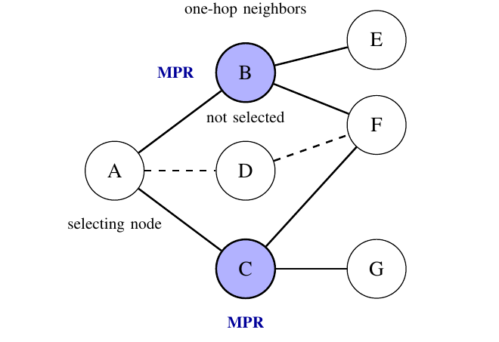
MULTIPOINT RELAYS
MULTIPOINT RELAYS
MPR Definition and Selection
MPRs are selected one-hop neighbors responsible for forwarding control messages.
B
Each node chooses its own MPR set; no central router makes the decision.
The goal is to cover all two-hop neighbors with as few MPRs as possible.
The MPR set changes when mobility or link changes alter the neighborhood.
13

Slide 12
MULTIPOINT RELAYS
MULTIPOINT RELAYS
How MPRs Reduce Routing Overhead
Without MPRs
With MPRs
Many nodes retransmit the same control message
Only selected relay nodes retransmit
Duplicate transmissions waste bandwidth
Control traffic becomes smaller
Dense networks suffer especially from repeated flooding
Topology information still reaches the network
MPRs do not remove overhead completely, but they make proactive routing more efficient.
14

Slide 13
DISCUSSION
DISCUSSION
Advantages and Limitations of OLSR
Advantage: routes are already available, so initial delay is low.
Advantage: MPRs reduce unnecessary retransmissions compared with normal flooding.
Limitation: periodic control messages still consume bandwidth and energy.
Limitation: very high mobility or very limited energy can reduce performance.
15

Slide 14
CONCLUSION
CONCLUSION
Main Findings and Limitations
MAIN FINDINGS
LIMITATIONS / FUTURE WORK
OLSR combines link-state routing with MPR-based optimization.
Periodic control messages still consume bandwidth and energy.
HELLO messages discover local neighbors; TC messages spread topology information.
Large or highly mobile networks can increase overhead.
Routes are available before transmission, reducing initial delay.
OLSR is important, but not the best solution for every wireless network.
16

