Slide 1
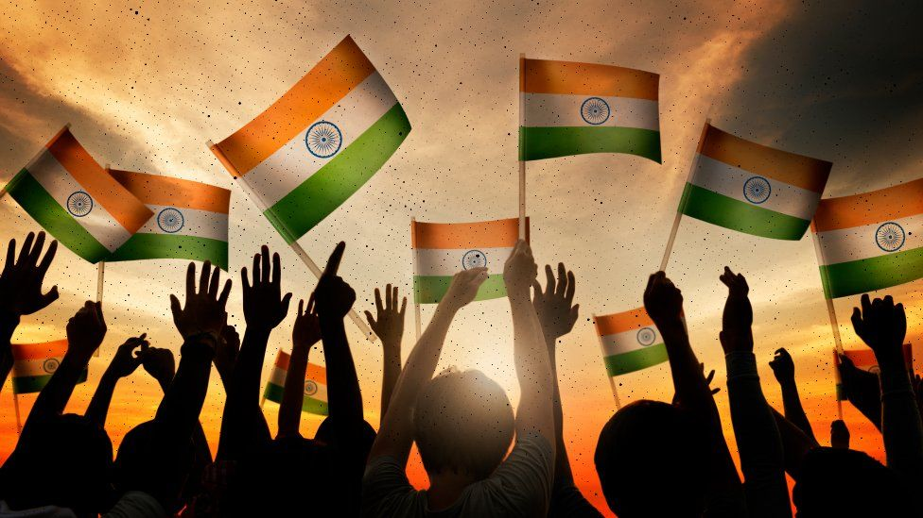
How did Indians vote in 2019 and 2024?
A research project by Aryadev

Slide 2
CONTENTS
Introduction to the Analysis
Presenting a view before going into analysis
State and constituency level analysis
What is the distribution of Constituencies over all the states?
Party level Analysis
Which Parties have been present in most constituencies and States?
What has been the performance of the Parties State-wise?
Which party has won the most constituencies?
What has been the general Win vs Loss relationship for the Parties in 2019 vs 2024?
Which Party has the most candidates with criminal history?
Politician Level Analytics(2019)
What is the Gender Ratio of the Contestants? Also the Gender Ratio of the Winners?
What is the Educational Qualification of our politicians?
What is the relationship of Age and Politics?
What relation does the Politician category have with the election results?
Summary

Slide 3
Introduction to the Analysis
India is a country, divided into states and union territories, with a parliamentary system governed under the Constitution of India, which defines the power distribution among the federal government and the states. Election Commission is a federal body, enacted under the provisions of the Constitution, responsible for monitoring and administering all the electoral processes of India. This body is responsible for ensuring elections are free and fair, without any bias.
The Analysis here is based on the election to Lok Sabha (The General Elections) for the year 2019 vs 2024 Members of Lok Sabha (House of the People) or the lower house of India's Parliament are elected by being voted upon by all adult citizens of India, from a set of candidates who stand in their respective constituencies. Every adult citizen of India can vote only in their constituency. Candidates who win the Lok Sabha elections are called 'Member of Parliament' and hold their seats for five years or until the body is dissolved by the President on the advice of the council of ministers. The house meets in the Lok Sabha Chambers of the Sansad Bhavan in New Delhi, on matters relating to creation of new laws, removing or improving the existing laws that affect all citizens of India.

Slide 4
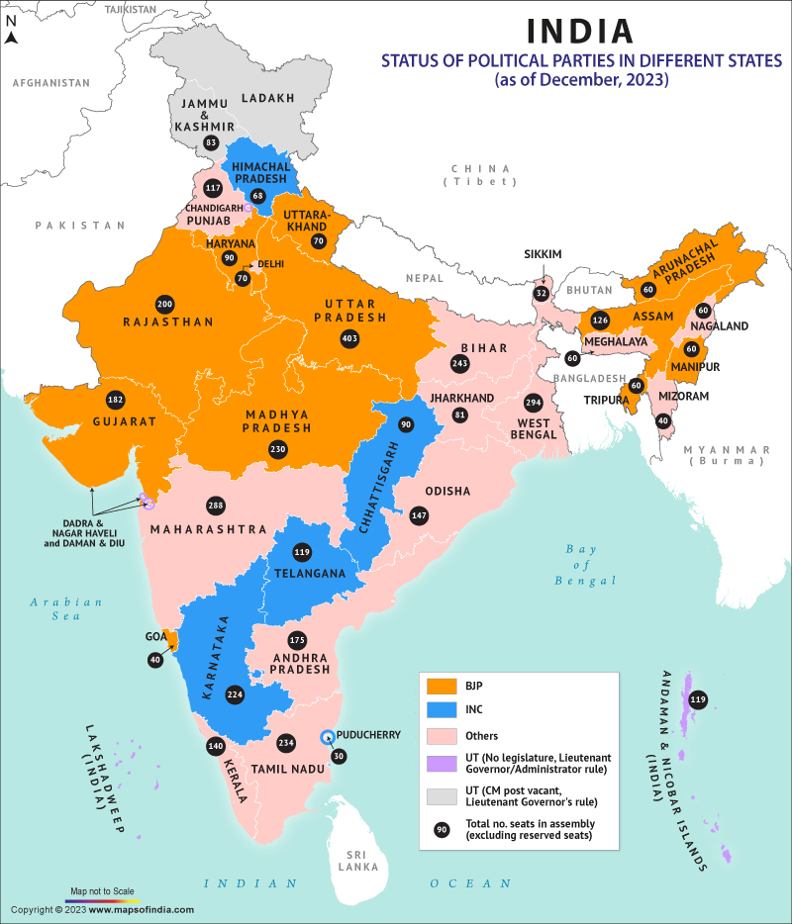
Presenting a view before going into Analysis

Slide 5
State and Constituency Level Analysis
What is the distribution of Constituencies over all the states?
Observation Uttar Pradesh, Maharashtra and West Bengal- These states have the most number of constituencies. There exists a direct relationship of count of constituencies and population- The constituencies are divided based on the population of 1971- and this shall remain till the year 2026. Although currently Bihar has a higher population, West Bengal has the 3rd highest constituency count based on the above fact.

Slide 6
Party Level Analysis
Which Parties have been present in most constituencies and States?
Observation The Bharatiya Janata Party (BJP) and Indian National Congress (INC) have participated in the most number of constituencies in 2019 elections all over India. While in 2024 elections Bahujan Samaj Party (BSP) was leading in the number of constituency contested, even surpassing BJP and INC, but INC wins in terms of the number of States. While these are the major parties to contest almost all over India, we see the rest of the parties have restricted themselves to a handfull of states.

Slide 7
Party Level Analysis
What has been the performance of the Parties State-wise?
Observation The Bharatiya Janata Party (BJP) has been showing high performance since 2019, when they won the highest number of seats in multiple states where the other parties underperformed. Even though BJP did dominate in the 2024 elections as well, they were unable to retain their lead in some states like UP. In Uttar Pradesh where Samajwadi Party has shown great improvement in 2024 winning the most number of seats, in West Bengal All India Trinamool Congress (AITMC) has won the major share of votes standing out in the state-wise performance.

Slide 8
Party Level Analysis
Which party has won the most constituencies?
Observation As seen from the data, In 2019 and 2024, BJP has won the maximum constituencies all over India. INC, who stood 2nd in the number of victories had only 52 seats in 2019 elections, which is practically 1/6th of the constituencies won by BJP. Although, in 2024 elections Indian National Congress (INC) did show a high jump in number of winning seats with 99 seats. However it is still practically less than half of the constituencies won by BJP who won 240 seats in 2024 elections.

Slide 9
Party Level Analysis
What has been the general Win vs Loss relationship for the Parties?
Observation As seen in the above chart, the 2019 elections have been extremely lucky for parties like BJP,SHS or DMK. However in 2024 elections BJP could win just above 50% of the seats contested and 2024 elections has been extremely lucky for parties like DMK, AITMC, Telegu Desam, JDU, Lok Janatashakti Party (LJP). But it has been a major failure for the rest of the parties, where they have lost more than they won.

Slide 10
Party Level Analysis
Which Party has the most candidates with criminal history?
Observations As the data suggests, many politicians have been associated with criminal activities, highest number of candidates coming from parties like BJP and INC. Always these cases pressed need not be genuine, but obviously, when its multiple for a single individual- this is a serious issue. We must take the responsibility while voting, as its our duty to choose the right person- as a duty towards the nation.

Slide 11
Politician Level Analytics(2019)
What is the Gender Ratio of the Contestants? Also the Gender Ratio of the Winners?
Observation Out of the total list of participants only 12.78% (258 out of 2018) are female politicians, while 87.21% (1760 out of 2018) are male. Upon considering the winners, 14.1% (76 out of 463) are female politicians, while 85.9% are male politicians. The Gender ratio is not very well distributed as can be seen from the above presentation.

Slide 12
Politician Level Analytics(2019)
What is the relationship of Age and Politics?
Observation Most Number of female politicians have their average age between 40-50, while for male politician, it ranges from 50-60 range. The average age of male politians is more as compared to female politicians contesting for the Lok Sabha elections.

Slide 13
Politician Level Analytics(2019)
What is the Educational Qualification of our politicians?
Observation The total percentage of Graduate+ educated people contesting in the election is 67.12%, which has increased to 72.17% of the winners. This is actually a positive sign, as educated politicians are a very big factor towards a country's development. But still around 28% of the politicians have received no professional degree. Hope with passing time, we improve upon this factor, and consider the educational qualification as a primary requirement while voting!

Slide 14
Politician Level Analytics(2019)
What relation does the Politician category have with the election results?
Observation The Category participation of General-SC-ST have been in the ratio of 68.97:18.97:12.04- while as of the winners, the ratios have been modified to 74.02:15.76:10:20

Slide 15
Summary
After analyzing the voting pattern of Indians, we have come upon multiple conclusions. Let us look at them in the below points:
In 2019 & 2024, the Bharatiya Janata Party (BJP) has claimed the most number of seats all over India- dominating clearly over all the national and the state specific parties. The outreach created by them has really made them claim their position in the Lok Sabha. However, it should not go unsaid that some parties like INC, BSP and AITMC came back stronger in the 2024 elections as compared to the 2019 elections.
Generally, education is regarded as a significant factor while voting. Around 72%+ of the winners are having a graduate + degree. This is a significant factor for a developing nation like India- where we need educated politicians to lead the nation.
The general participation of Female politicians is much less than the male politicians. A balanced gander ratio would be good enough- as people from all sectors would be able to contribute to the progress of the society.
The average age of politicians is high. It might be an advantage if younger politicians contest and are able to lead the nation. Although it is never a parameter to think that the older politicians wouldn't be able to perform their tasks well- but it comes with the risk of health and age related issues.
Criminal activities is a serious concern- as the people who are elected by us- indirectly are the face of the nation. They should be more of a role model-rather than someone who is not respected.

Slide 16
Thank You

