Slide 1
LectureLens
Offline lecture search with links back to the source
Snapdragon AI Lab Build & Present Challenge
Notes:
Prototype developed for the Snapdragon AI Lab Build & Present Challenge. Project code and demo materials are original work in this repository.

Slide 2
The problem
A useful explanation can be buried inside a long recording.
Students need the moment the lecturer spoke and the slide shown at that point. A transcript alone makes those sources hard to connect.
LectureLens keeps both sources searchable in one local timeline.
LECTURELENS 02
Notes:
The problem statement is a product hypothesis, not a measured study result.

Slide 3
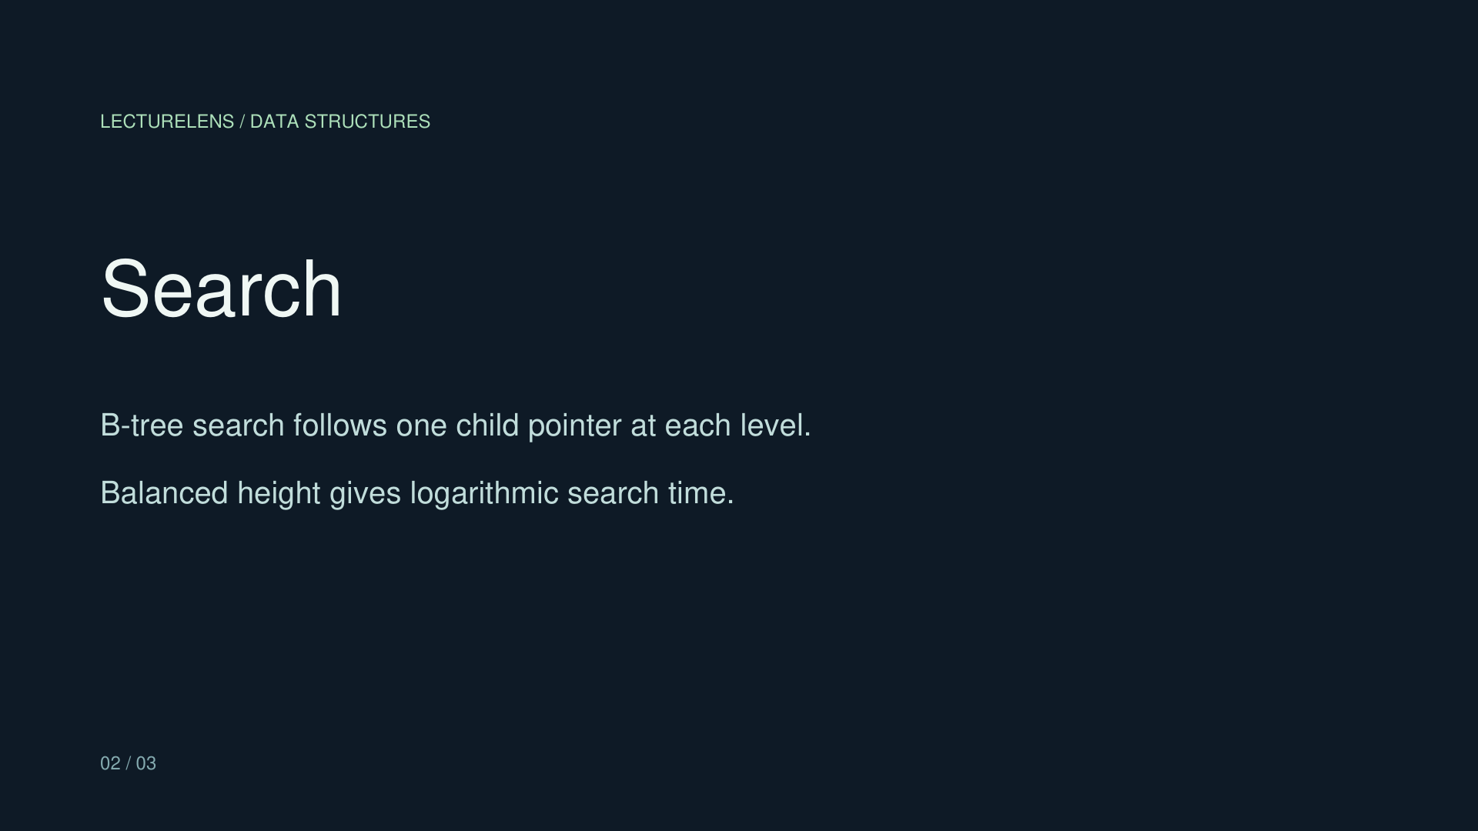
A search result opens the source
1 Import a recording, transcript, and slides
2 Search a concept across spoken and slide text
3 Open the audio time and linked page
Sample: “logarithmic” returns the transcript at 0:18 and slide 2.
LECTURELENS 03
Notes:
Illustrative sample authored for this project. Search output verified in the local prototype. No external image source.

Slide 4
Local architecture
Recording
Search + timeline
SRT / VTT transcript
Python local server
Browser UI
PDF slides
Optional Qualcomm Whisper adapter for WAV transcription
NPU execution needs validation on the target laptop
LECTURELENS 04
Notes:
Architecture reflects the prototype implementation in lecturelens/core.py and lecturelens/server.py. Qualcomm sample reference: https://github.com/qualcomm/ai-hub-apps/blob/main/apps/whisper_windows_py/README.md . QNN path is implemented as an adapter but has not been run on the user device.

Slide 5
Prototype status
Working today
Still to validate
Local import and storage
PDF text extraction and slide preview
Timestamped transcript search
Audio seek and manual slide links
Qualcomm Whisper assets on the target PC
Actual QNN execution provider
Latency and battery measurements
ARM64 installer
LECTURELENS 05
Notes:
The working features were exercised with a five-passage, three-slide original sample. The Qualcomm QNN adapter is code-complete but lacks target-device validation. No speed or battery values are asserted.

Slide 6
Snapdragon validation plan
Target: Windows 11 on a Snapdragon-powered HP PC
1 Run Qualcomm’s Whisper sample with matching AI Hub assets
2 Confirm the actual execution provider on the device
3 Compare transcription time on the same audio clip
4 Package and document the ARM64 app after validation
LECTURELENS 06
Notes:
Qualcomm AI Hub model card: https://aihub.qualcomm.com/compute/models/whisper_base . Official Windows sample: https://github.com/qualcomm/ai-hub-apps/blob/main/apps/whisper_windows_py/README.md . The challenge target requirement is in https://unstop.com/competitions/1748893 .

