Slide 1

Pompa
Every litre counted. Every dinar accounted for.
Managing your service station — simple, beautiful and in your pocket.
Version 1.0.0

Slide 2
Daily life in a station
⚠ Cash gaps that nobody can explain
⚠ Fuel that vanishes between the delivery and the pump
⚠ Deliveries never checked: invoiced or really received?
⚠ Oil and filter stock counted “by eye”
⚠ No visibility when the manager is away
Pompa · Version 1.0.0 · © 2026 JawlaDev
2

Slide 3
Pompa: everything under control
⏱️ Attendant shifts
🛢️ Tanks under control
🚚 Checked deliveries
Start and end index of every nozzle, money handed in (cash, card, coupons): the cash gap is calculated automatically.
Theoretical stock, real gauging, an alert as soon as a gap or a low level appears.
Delivery note, invoiced volume compared with received volume, supplier debts.
📦 Small stock
📈 Clear figures
📱 On your phone
Oils, filters, consumables: counter sales tied to the shift, low stock alerts.
Litres, takings, losses, estimated margin, by attendant and by fuel; Excel export.
Installable like an app, in French, Arabic and English.
Pompa · Version 1.0.0 · © 2026 JawlaDev
3

Slide 4
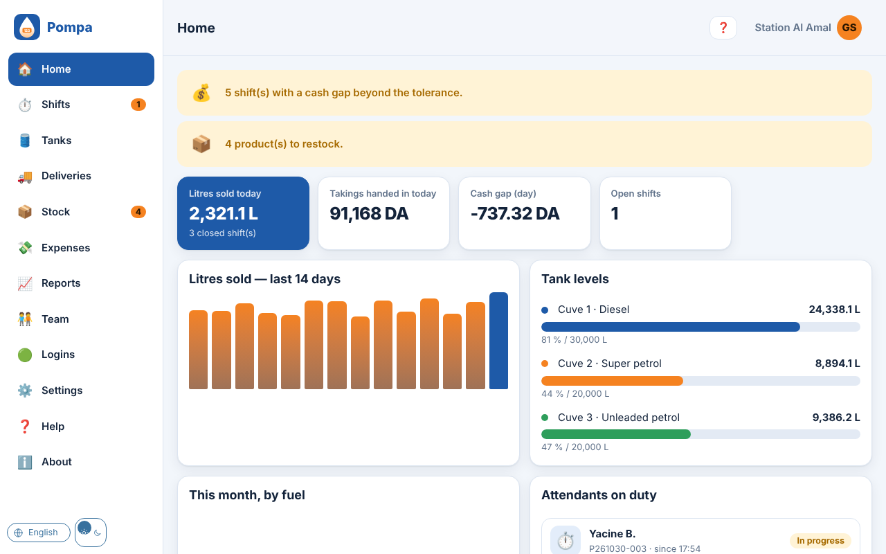
The manager sees everything at a glance
Start and end index of every nozzle, money handed in (cash, card, coupons): the cash gap is calculated automatically.
Theoretical stock, real gauging, an alert as soon as a gap or a low level appears.
Pompa · Version 1.0.0 · © 2026 JawlaDev
4

Slide 5
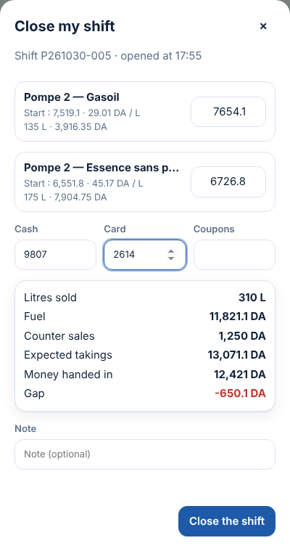
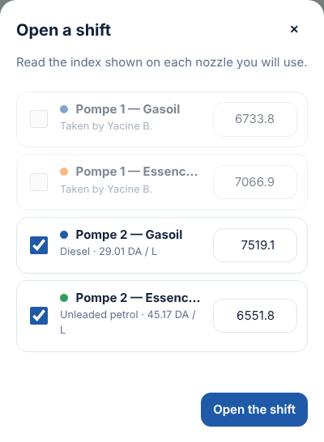
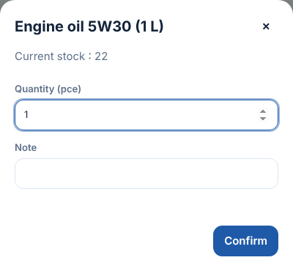
The attendant: 2 minutes, everything guided
Opens the shift, reads the indexes, sells at the counter, closes: everything is guided, in 2 minutes.
Pompa · Version 1.0.0 · © 2026 JawlaDev
5

Slide 6
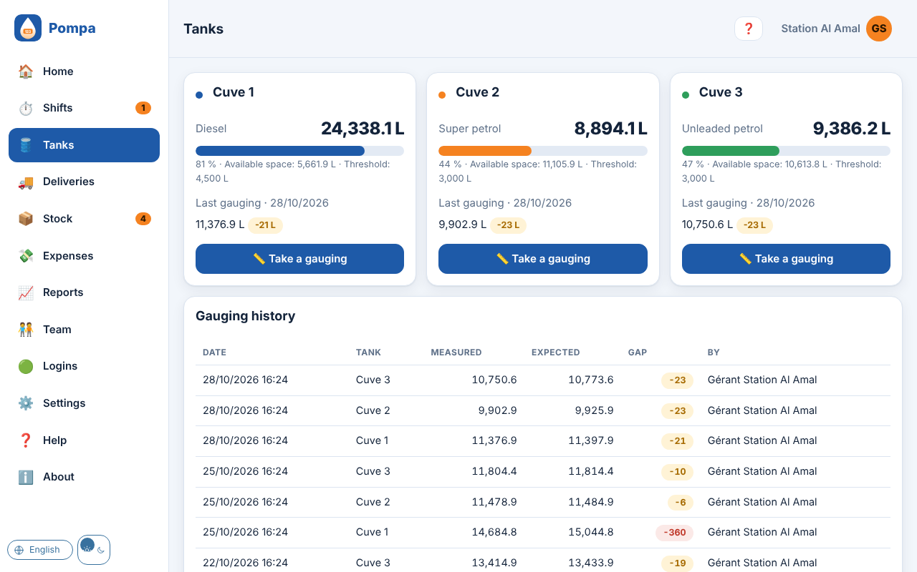
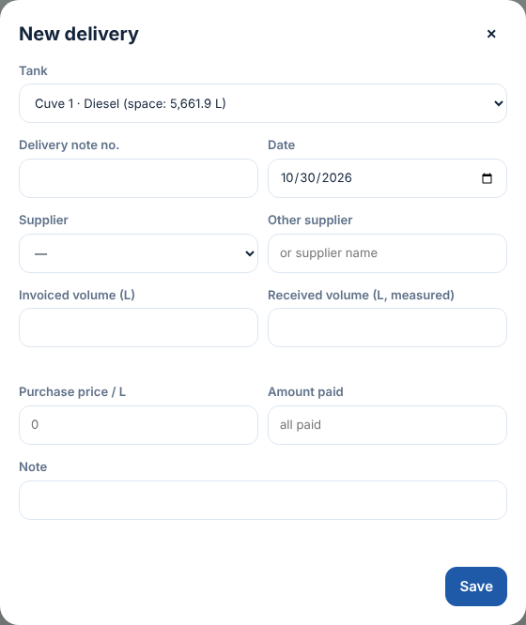
Tanks and deliveries under control
Theoretical stock, real gauging, an alert as soon as a gap or a low level appears.
Pompa · Version 1.0.0 · © 2026 JawlaDev
6

Slide 7
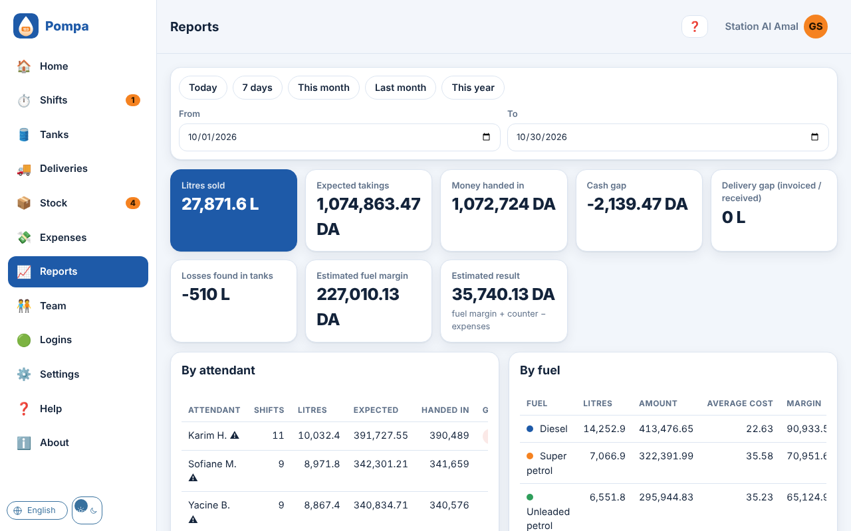
Clear figures, by attendant and by fuel
Litres, takings, losses, estimated margin, by attendant and by fuel; Excel export.
Oils, filters, consumables: counter sales tied to the shift, low stock alerts.
Pompa · Version 1.0.0 · © 2026 JawlaDev
7

Slide 8
Everyone sees what concerns them
The attendant
The supervisor
The manager
Opens the shift, reads the indexes, sells at the counter, closes: everything is guided, in 2 minutes.
Follows the shifts, takes the gaugings, records the deliveries, manages the stock.
Sees everything, sets the prices, creates the team, reads the reports, wherever they are.
Pompa · Version 1.0.0 · © 2026 JawlaDev
8

Slide 9
Two ways to host it
Google version
PHP / MySQL version
Free to host: Google Apps Script and Google Sheets. Nothing to install on a server.
On the hosting of your choice: your data stays with you.
Automatic updates · Your data stays yours
Pompa · Version 1.0.0 · © 2026 JawlaDev
9

Slide 10
Why Pompa?
✔ Designed with station managers
✔ No long training: the help is inside the app
✔ Your data stays yours
✔ Automatic updates
Pompa · Version 1.0.0 · © 2026 JawlaDev
10

Slide 11

Free trial: we set up your station within 24 h
https://rayanem-dev.github.io/pompa/
Rayane Redha Madani — Rayane M. · ☎ 0670779792 · ✉ rayanem@gmail.com

