Slide 1

Boutika
Run your shop simply and beautifully
Checkout · stock · delivery · customer credit · figures
Kiosk · Cosmetics · Food & grocery — in French, Arabic and English
Notes:
Boutika presentation to shop owners (about 12 minutes), live demo at the end.

Slide 2
Today, shops are run “by hand”
1
A notebook for sales
2
Stock “in your head”
Hand calculations, till errors, no view of profit
Stock-outs found too late, expired products thrown away
3
Deliveries by phone
4
Forgotten credit
Drivers' cash hard to track, addresses lost
Who owes what, since when? No reminders
Result: lost time, lost money and lost goods.
Boutika
2

Slide 3
Boutika: one space for the whole shop
G
R
V
L
Manager
Supervisor
Seller
Driver
Sees everything: figures, stock, team, settings
Stock, purchases, expenses and reports
Checkout, customers, own sales — without seeing margins
His runs: call, directions, collect, report a failure
Everyone signs in with their own account and only sees what concerns them. Installable on phone, tablet and computer — no hardware to buy.
Boutika
3

Slide 4
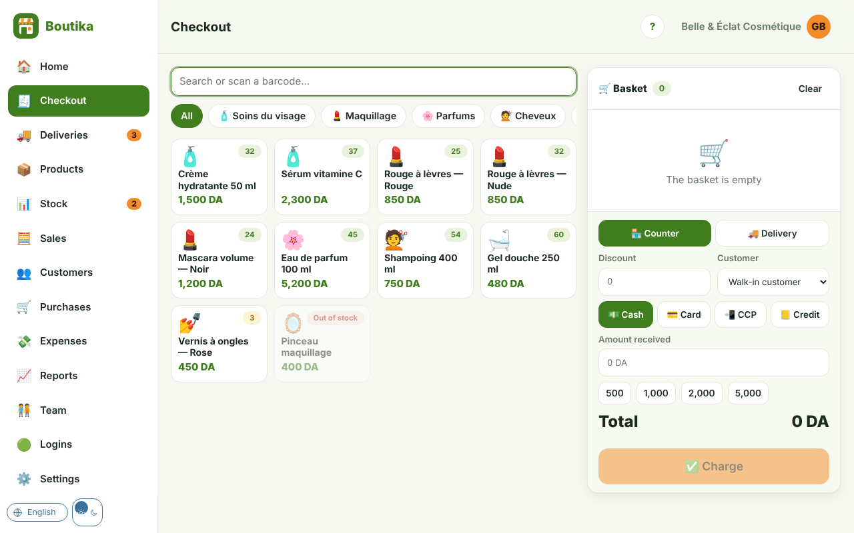
A fast touch checkout that scans
✓
Tap or scan
USB reader or phone camera
✓
Cash, card, CCP or credit
automatic change
✓
Sold by weight
kg, g, litres: 2.5 kg in one tap
✓
Printable receipt
80 mm, with VAT if needed
Boutika
4

Slide 5
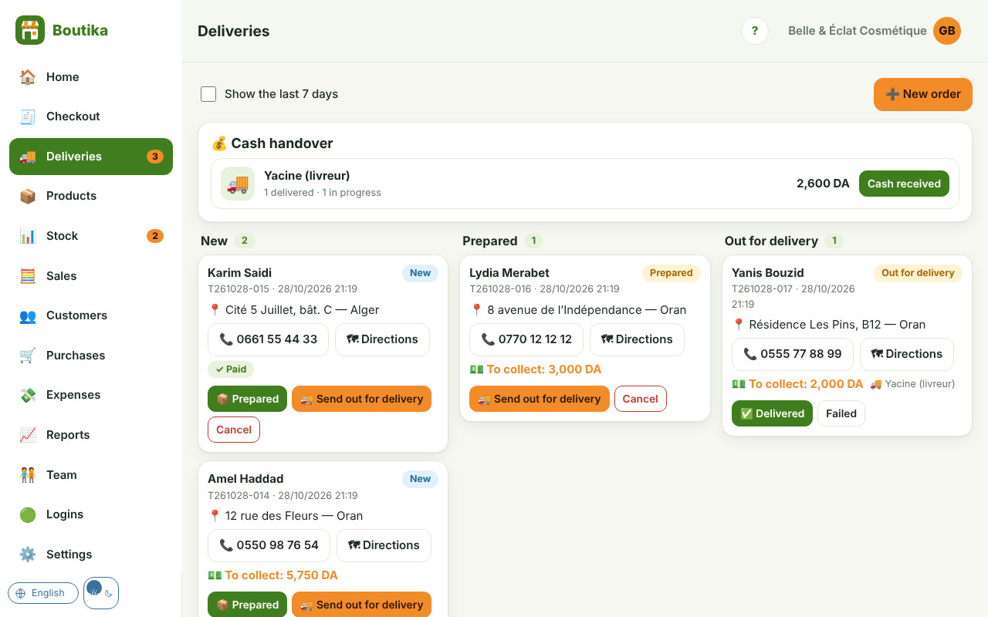
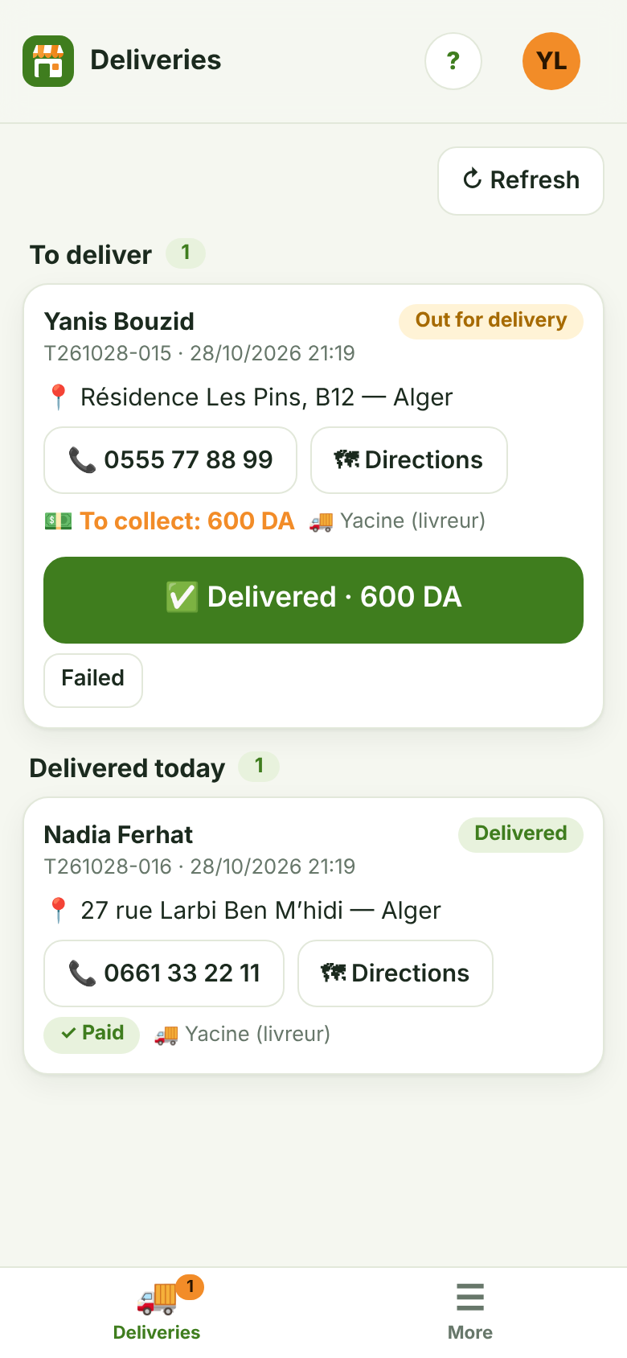
Delivery, from basket to cash received
Fees per wilaya, free delivery above an amount
Cash on delivery or already paid (CCP, card)
Cash handover: know how much each driver owes
Boutika
5

Slide 6
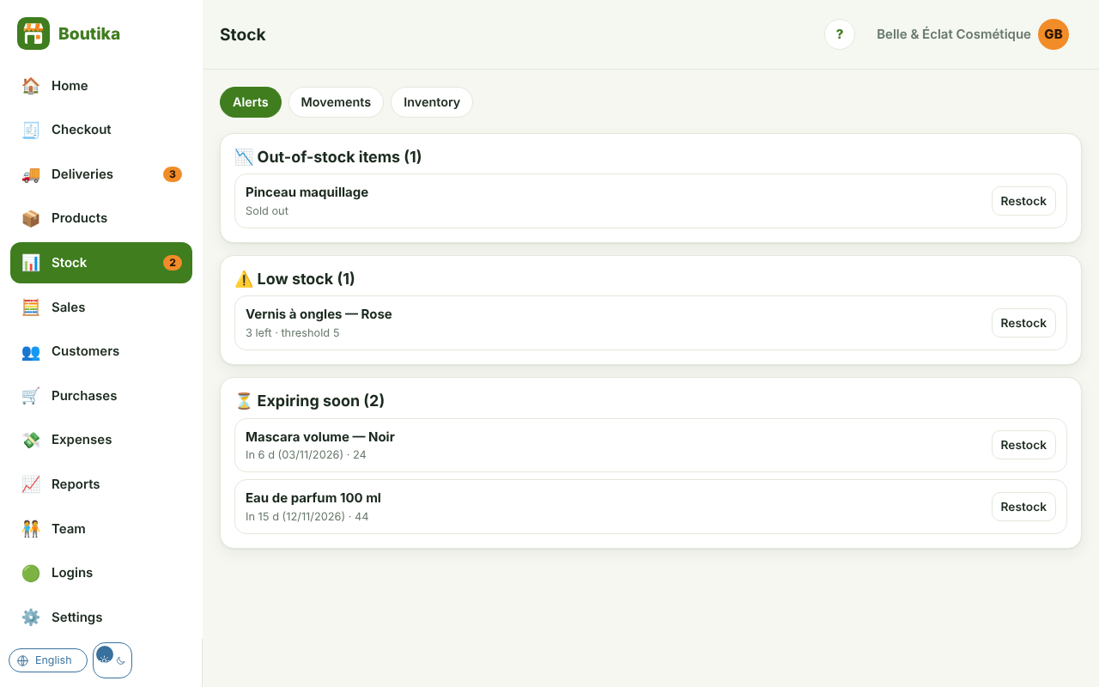
Stock under control, no waste
✓
Automatic alerts
out of stock, low stock, expiring soon
✓
Inventory in minutes
only differences are recorded
✓
Purchases and suppliers
average cost, debts tracked
✓
Movement log
who did what, when
Boutika
6

Slide 7
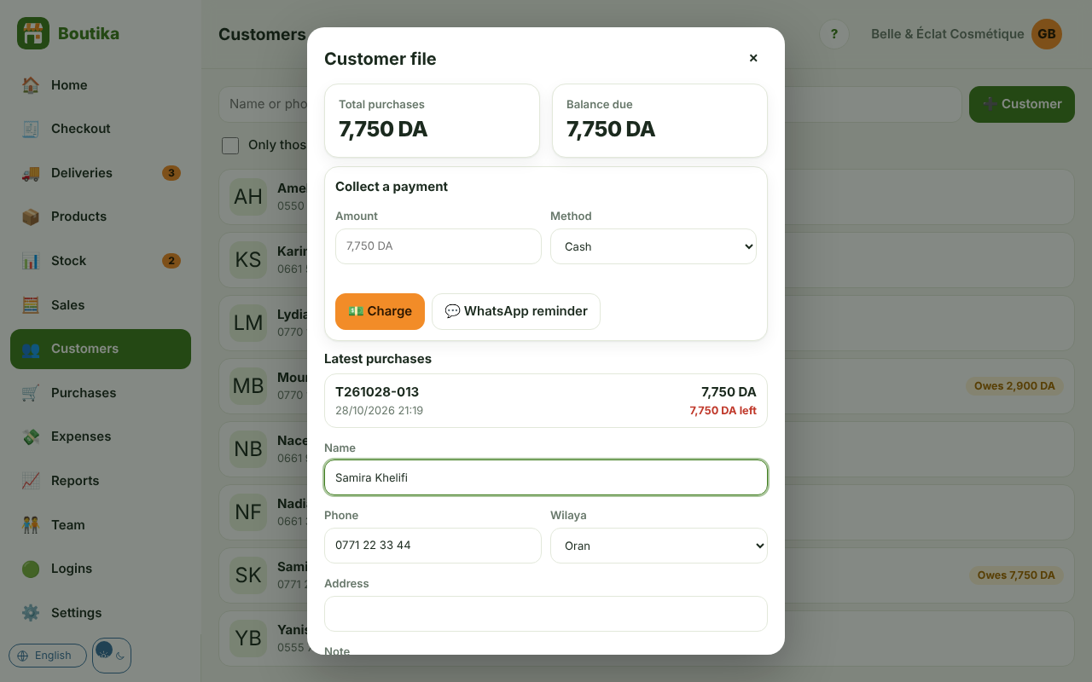
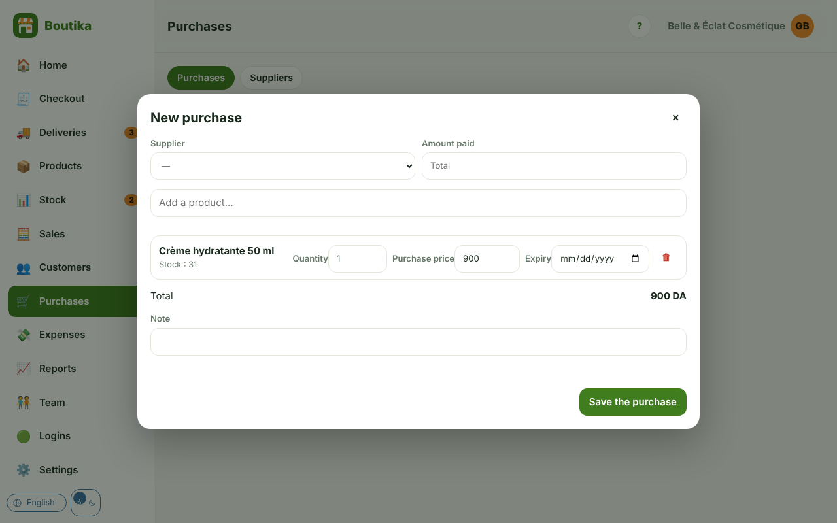
Customer credit and suppliers under control
Customer file: purchases, balance due, payments
WhatsApp reminder in one tap
Purchase: stock and cost updated
Supplier debts visible and payable
Boutika
7

Slide 8
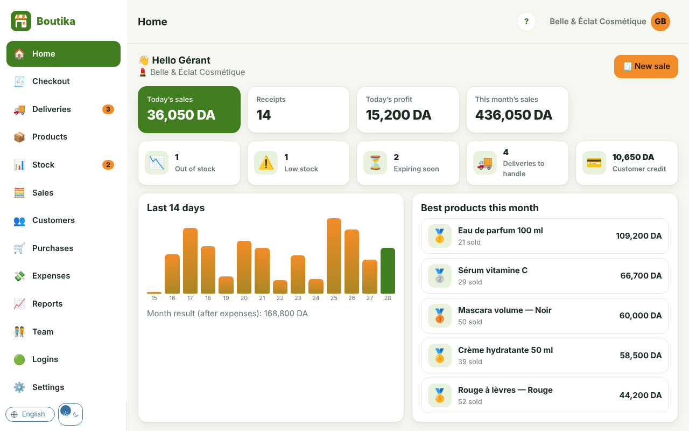
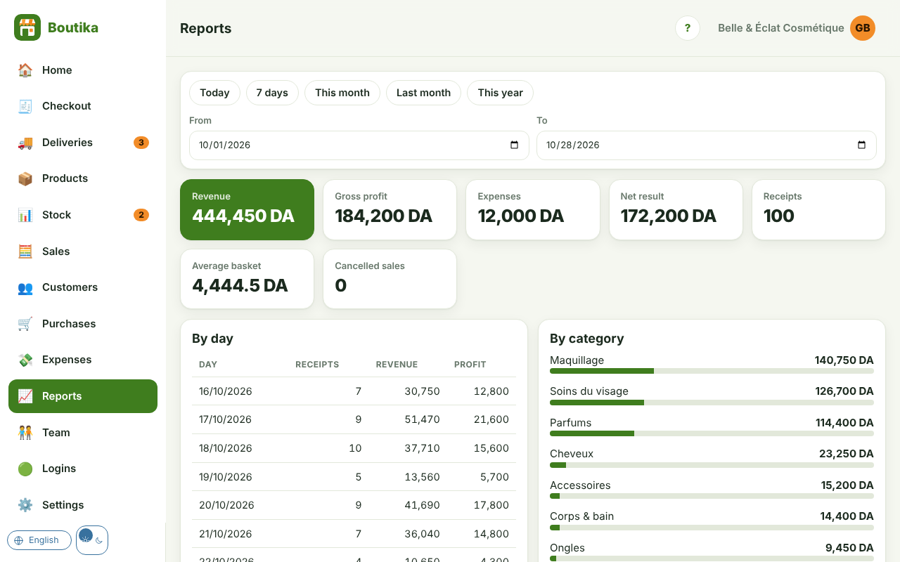
Clear figures, day after day
Sales and profit for the day and the month
Best products, result after expenses
Reports by day, category, seller, payment method
CSV export for Excel
Boutika
8

Slide 9
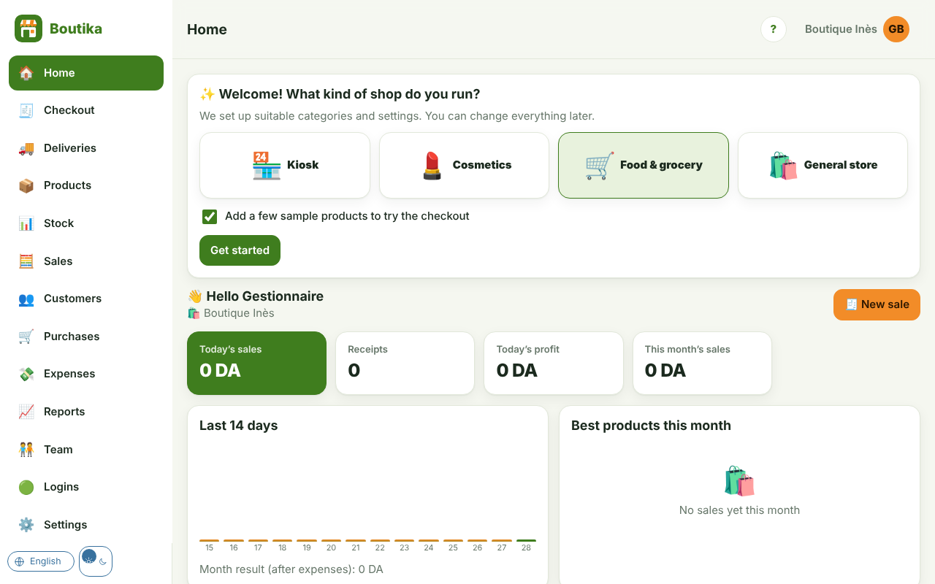
Universal: a template for every business
🏪
💄
🛒
🛍️
Kiosk
Cosmetics
Food & grocery
General store
Drinks, snacks, top-ups, press
Shades, variants, expiry
Sold by weight, expiry dates
Any other retail business
At first launch, one choice is enough: categories, options and sample products are prepared.
Everything remains editable afterwards.
Boutika
9

Slide 10
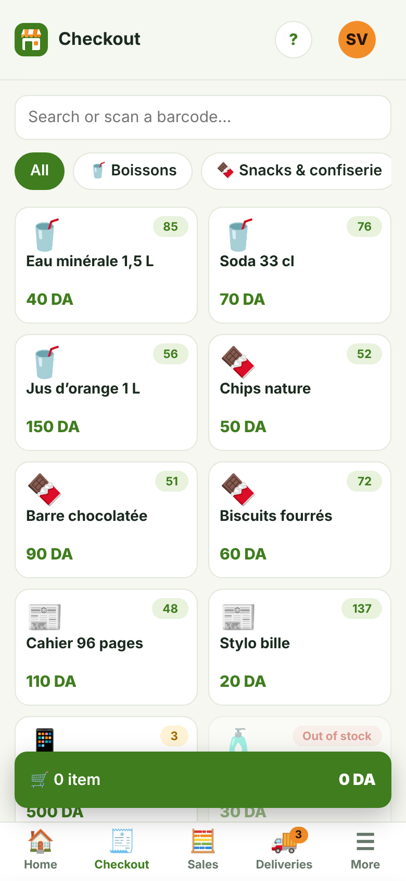
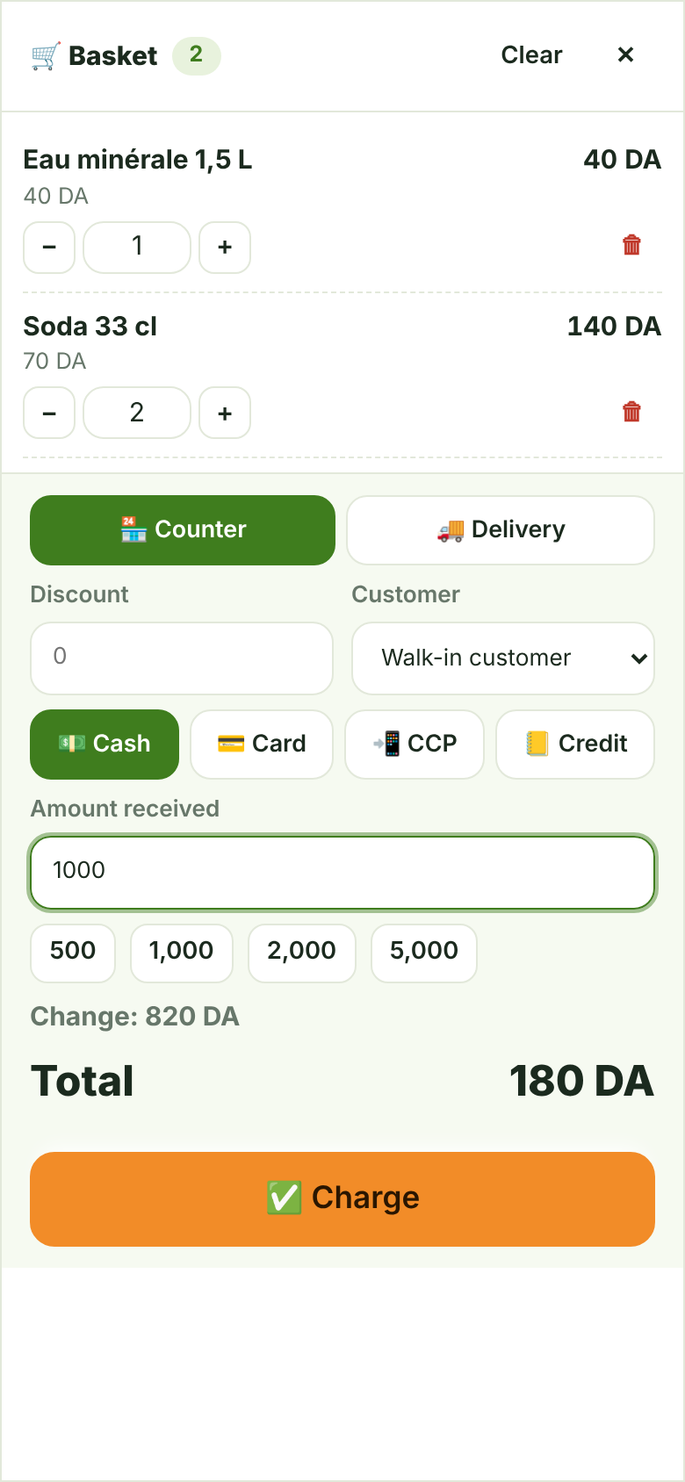
On the phone, like a real app
✓
Installable in one tap
✓
Checkout and camera scanning
✓
Thumb-friendly bottom menu
✓
Dark mode, right-to-left Arabic
Boutika
10

Slide 11
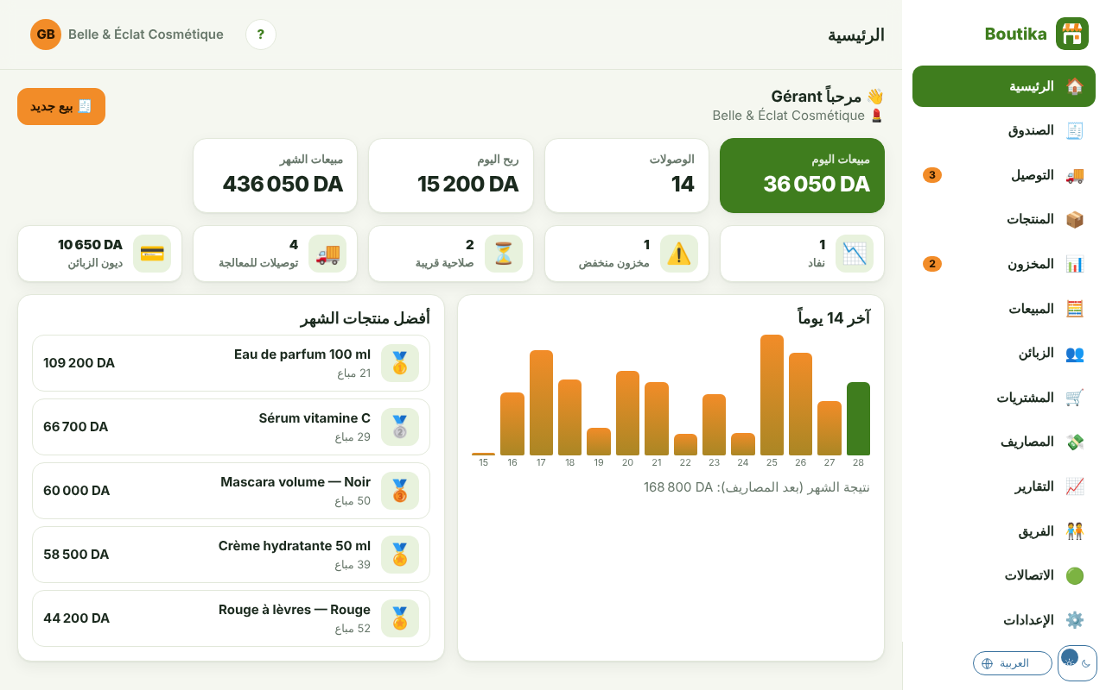
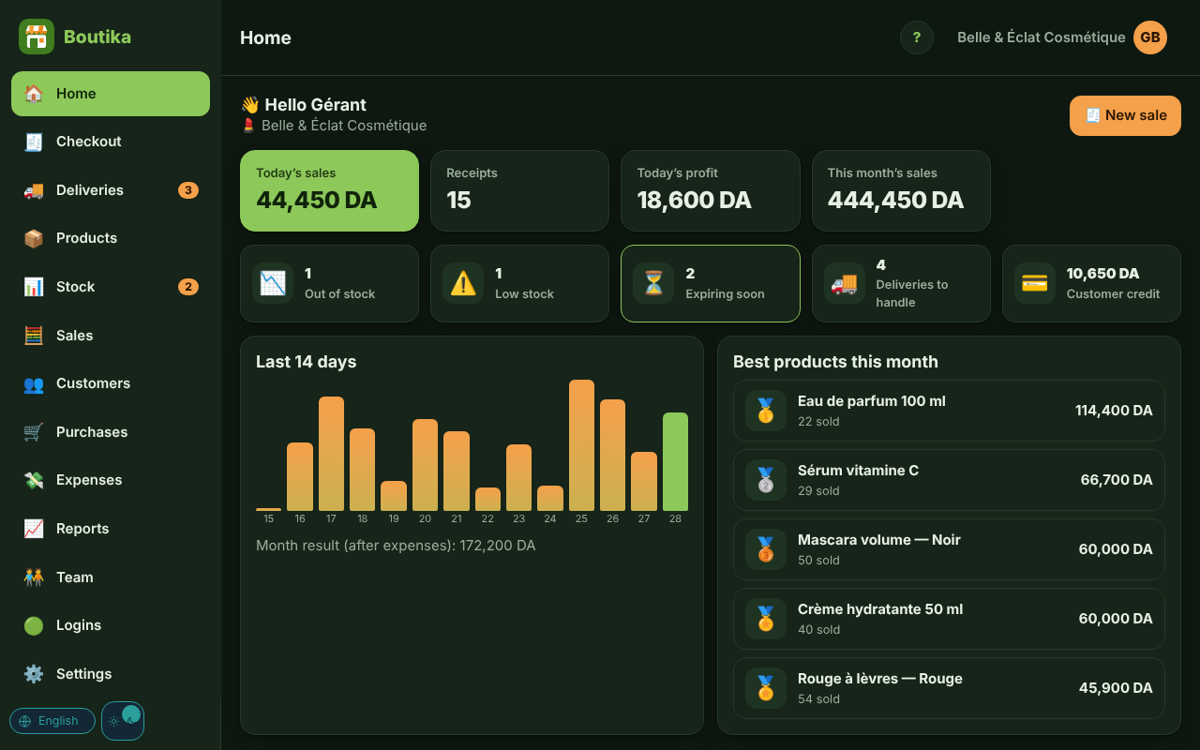
French, Arabic, English — on every screen
Right-to-left Arabic, matching numbers and dates
Light or dark mode, each person's choice
Boutika
11

Slide 12
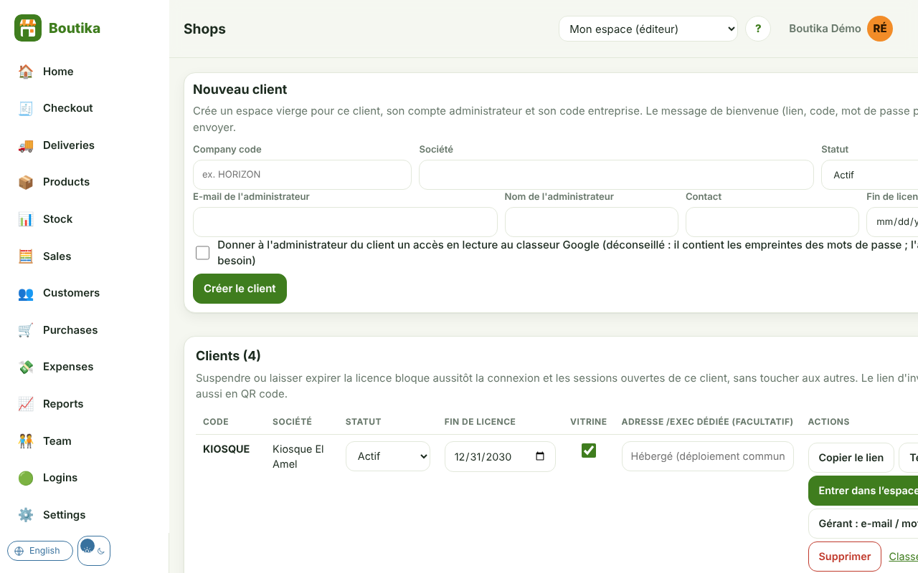
For the publisher: sell to many shops
✓
One shop = one separate space
company code, manager, welcome message
✓
Licence and status
trial, active, suspended — immediate effect
✓
Free trials
requests received and converted in one click
✓
Remote support
enter a shop, logged
Boutika
12

Slide 13
Your data is protected
One space per shop
Rights per role
Protected passwords
No data mixed between shops
Everyone only sees their own scope
Salted hash, lock after repeated attempts
Logged support access
Hosting of your choice
Exportable data
Never with publisher rights
Google Apps Script or PHP / MySQL
CSV, database backup at any time
Boutika
13

Slide 14
Start in three steps
1
2
3
Request your trial
We prepare your shop
You sell, we follow up
A form on the Boutika home page
Accounts, categories, products: we guide you
In-app help and support
Plans: monthly · yearly · one-time payment — prices on request
Free trial with no commitment: every feature, with your real data.
Boutika
14

Slide 15
Try Boutika in your shop
Home page and trial request: rayanem-dev.github.io/boutika
Rayane Redha Madani — Rayane M., publisher of Boutika
0670779792 · rayanem@gmail.com
Boutika — your shop, simple and beautiful
Boutika
15
Notes:
Offer a live demo, then open the trial request with the shop owner.

