Slide 1
PhysTech
Damir Safin, Airat Valiullin
hackaTUM 2022, Microwave Imaging

Slide 2
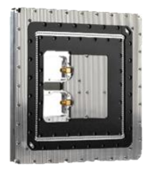
Problem definition

Slide 3
Voxel data

Slide 4
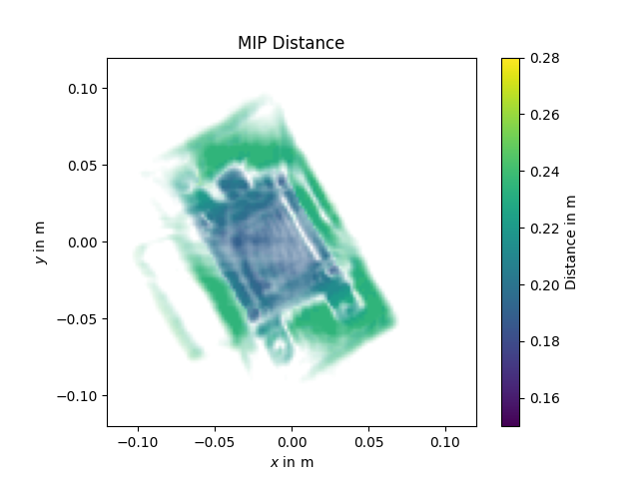
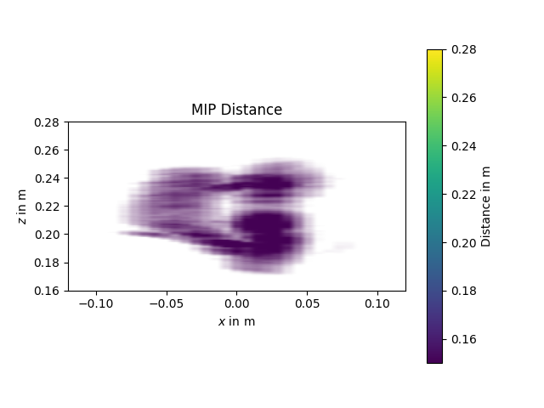
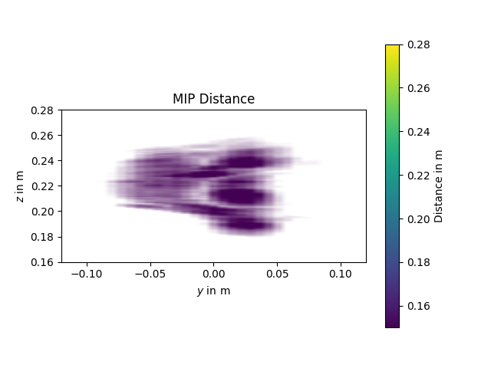
Reduction to MIP

