Slide 1



NPCI Hackathon
Team Hucker

Slide 2
Team Members
Rayan Halder
Suraj Khot
Saransh Yadav
Krish Agarwal

Slide 3
Problem Statement
Unified Reward Systems
Many apps and shops offer reward points to loyal customers. These points can only be used at those respective shops / apps. From the customer point of view, it would be beneficial to merge reward points or use them across sellers, but from the seller’s point of view, this could lead to losses.
Come up with a unified rewards system that would incentivize the shopkeepers to join this system.

Slide 4
Our Proposed Solution
Did we succeed?
Our solution makes sure that customers are satisfied while also ensuring that businesses receive a new way to expand their horizons. In the end, both parties stand to gain from our idea.
Sellers and Reward Points
Sellers will buy reward points from us at a fixed rate and provide it to their customers as a percentage basis of transaction value. For big stores we can allow sellers to give reward points on an item to item basis rather than on a single metric of transaction value for even more fine grained control over the reward points.
05
01
04
Gaining Reward Points
Upon choosing to gain reward points, the customers will directly gain reward points ( if the seller has bought any reward points ). The seller only needs to verify if the transaction is an actual one or not on their app to approve the remittance of the reward point.
The Transaction
Customers upon completing a transaction can go to our app and register their transaction. They can then either gain reward points for the transaction or use their existing reward points to apply a discount on the transaction.
02
03
Using as a Discount
When the customers select to use their existing reward points to avail a discount on the purchase, a notification will go to the seller to approve the discount to prevent fraudulent transactions. If at any point the seller denies the redeem request, grievance channels will be available for the customers to complain.

Slide 5
Problems we are solving
What do our reward points mean? What are their uses?
Why will sellers join the Unified Rewards System?
Why will sellers allow reward points earned at some other store to be used at theirs?
Why will stores use our reward system if they already have a pre-existing system in place?
What if a customer shops consistently at big stores and uses the reward points on small stores? Will the big stores face a loss?

Slide 6
Reward Points
Sellers will be buying reward points @Rupees 1 /- for 100 Reward Points.
Customers will be redeeming the reward points @ Rupees 1/- for 110* Reward Points.
After a transaction, a customer will be either be able to gain reward points or use them to cash out a discount from the transaction.
The Reward Points will expire within 1 year of acquisition of such, to make the customers spend them as much as they can and not horde reward points.
* -> This value of 110 is subject to change depending on the requirements of the model

Slide 7
What if a customer shops consistently at big stores and uses the reward points on small stores? Will the big stores face a loss?
Although a big store will be giving out more reward points, they will build a larger base of loyal customers than otherwise. Because of this, although they may earn slightly less per product sold, the overall volume sale will increase. The larger amount of exchange offsets the costs of giving out reward points, making the store more profitable.

Slide 8
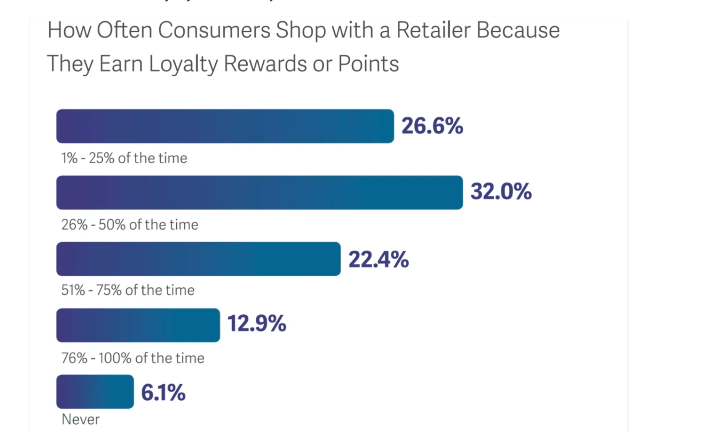
This graph shows that consumer loyalty increases when retailers give reward points. For this reason, a reward-system based platform will have a high customer retention.
Source : https://mirasvit.com/blog/loyalty-reward-points.html

Slide 9
Why will sellers join the Unified Rewards System even though it may (or may not) reduce the footfall at their stores?
More chances of attracting customers. Customers will feel rewarded on any sale having a reward point attached to it
Sellers will be able to attract customers by increasing reward points offered on a certain day. Customers will be notified about the hottest deals being offered, which boosts sales.
They do not need to manage their own rewards system and challenge
Notes:
Hottest deals:- sellers can buy more reward points, the customers will be compelled to rush to that store and buy shit before the reward points of that shop die in a pit of glory and money

Slide 10
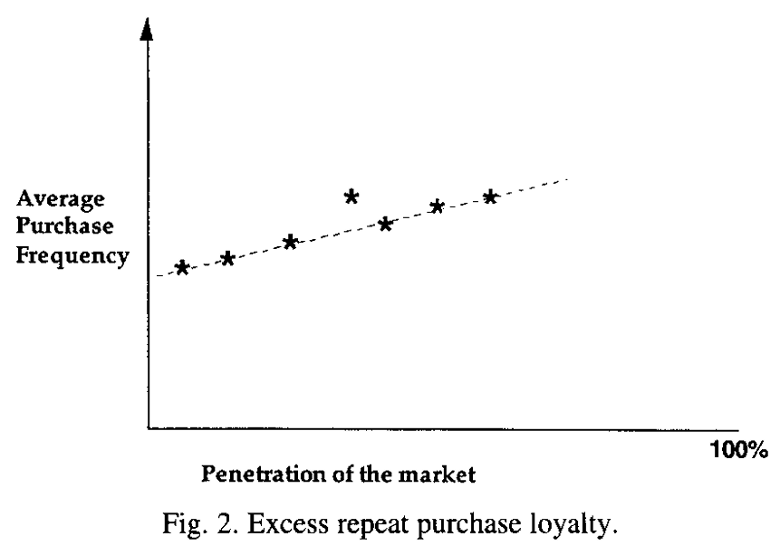
The graph clearly demonstrates that consumers are more likely to make purchases when incentivized with rewards. Implementing a unified reward system motivates consumers to buy more, ultimately increasing profits for shopkeepers.
Source: Byron Sharp, Anne Sharp, Loyalty programs and their impact on repeat-purchase loyalty patterns,International Journal of Research in Marketing,
Pages 473-486, (https://www.sciencedirect.com/science/article/pii/S0167811697000220)

Slide 11
Why will sellers allow reward points earned at some other store to be used at theirs?
They can cash-in their reward points for compensation, so there is no loss of money.
A customer using the app will give preferential treatment to those sellers who allow reward points to be redeemed rather than to those who do not allow it.
Notes:
Compensation:-

Slide 12
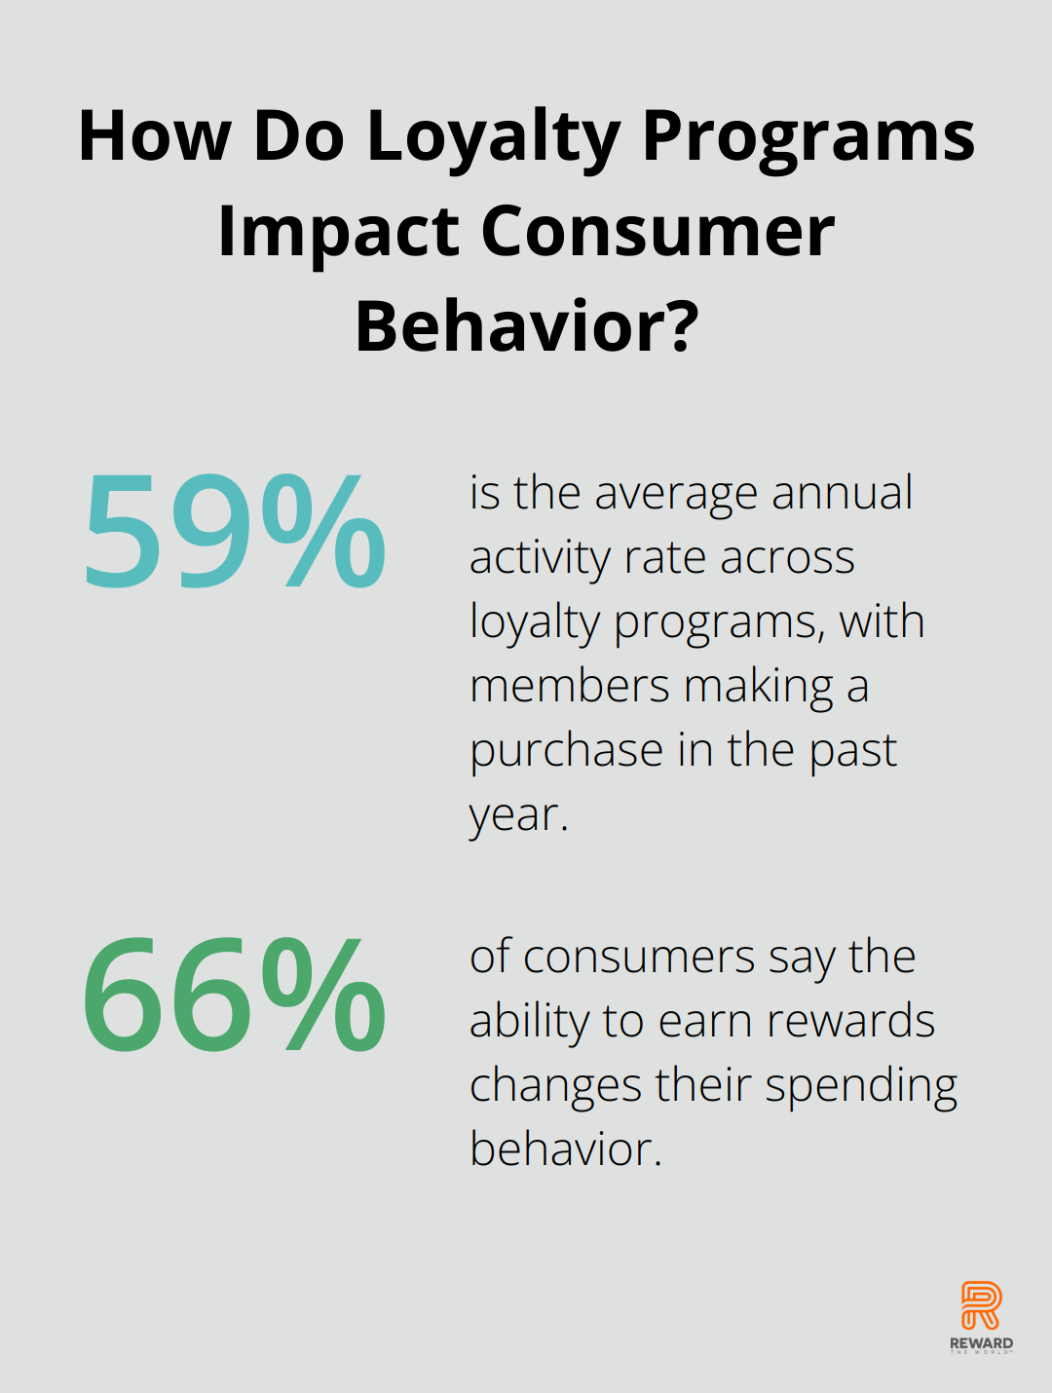
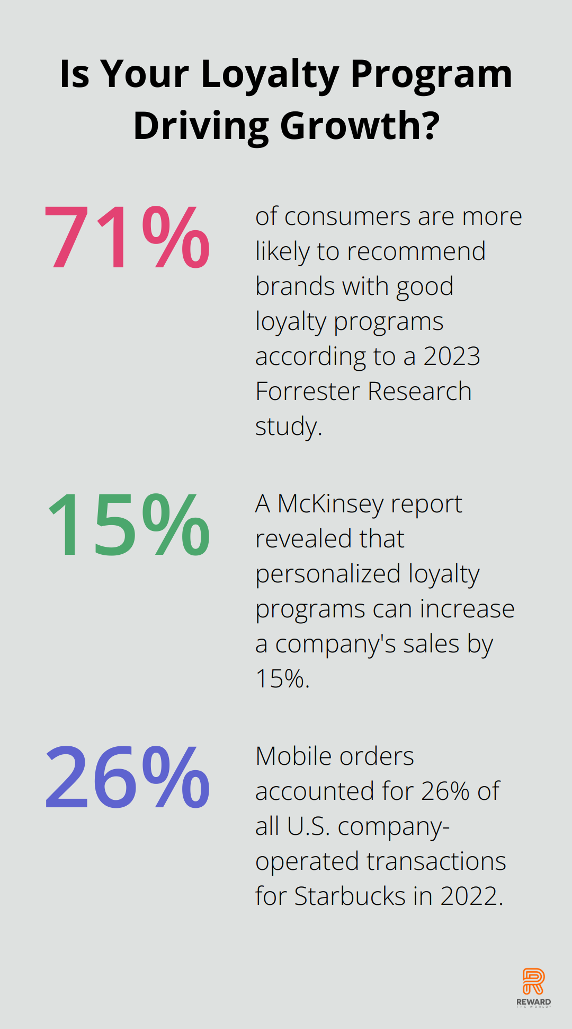
A good loyalty program enforces consumer spending, which leads to an increased to a greater volume of trade. This is ultimately beneficial for the businesses.
Source: https://rewardtheworld.net/loyalty-programs-impact-on-customer-purchase-behavior/

Slide 13
Why will stores use our reward system if they already have a pre-existing system in place?
By registering into this system, each shop gains access to a much larger pool of customers than they could reach on their own.
They will also get exposure to non-regular customers who approach store to redeem reward points.
This directly leads to more sales, and hence more profit.

Slide 14
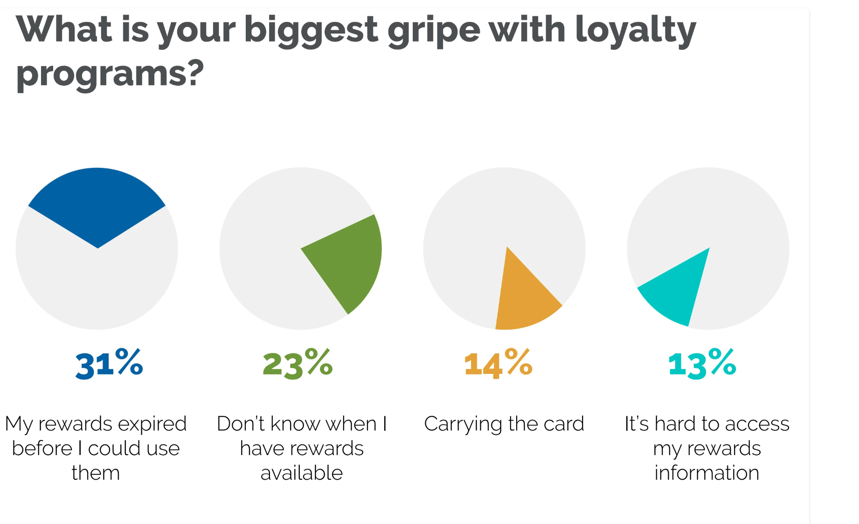
An app-based solution that sends notifications and reminders about deals with a clean interface can remedy all the common issues that normal loyalty programs suffer from.
Source : https://mirasvit.com/blog/loyalty-reward-points.html

Slide 15
TECHNICAL CHALLENGES

Slide 16
Are we dealing with real money?
Our Database
Authentication
Security Concerns
Who will be managing the finances?

Slide 17
Are we dealing with real money?
Yes, we are dealing with actual funds, but only on the sellers’ side.
A customer will not be ever feeling that he/she is dealing with real money and will only think of the reward points as actual rewards that can be redeemed.
This will help reinforce the concept of reward points in the minds of the customer which in turn boosts the frequency of usage of these reward points by the customer.

Slide 18
Our Database?
The Database will be an SQL database which provides better maintainability than NoSQL counterparts. The database can be hosted on the VM platform on which we are hosting our servers or any Database provider.
Postgres is an excellent choice for our use case as it is an SQL database, low latency and atomic transactions.
A Database provider is much more preferred than hosting it on our own as it allows us to not worry about backups and availability of our database, and also allows us to horizontally scale faster.
The database will contain few tables, namely, sellers, customers and transactions, all of which are self explanatory on their use case.

Slide 19
Authentication
Customer authentication can be done simply by allowing them to register through their Gmail account using OAuth2.
Seller Authentication can also be done using OAuth2 albeit taking some extra data from them to properly identify them.

Slide 20
Security Concerns
The banking part of the service can be shifted to proper 3rd party providers like RazorPay or Stripe or GPay / ApplePay so that we do not have to deal with security issues on our side as any mistake can hamper our relationship with the sellers.
Using these 3rd Party services or Aggregators will prove to be quite beneficial as instead of focusing our concern with security issues related to banking, we can utilise our time on improving the experience for the customers and the sellers.

Slide 21
Who will be managing the finances?
The finances will be managed through a central account registered under the name of the business or organization, ensuring streamlined control and oversight of funds.
A current banking account will be required to handle the frequency of transactions on our end. Considering the volume our service might receive on successful penetration into the market ecosystem, we will need to make proper arrangements with the banking authorities to properly handle the sheer volume of transactions.

Slide 22
How will we host our servers and offset its costs?
Servers can be hosted on any Virtual machine provider like AWS, GCP, Azure or Linode. The costs will be offset by charging the sellers at a higher rate for giving the redeem points than the amount that can be redeemed by the customers using those redeem points.
This differential will allow us to maintain our costs.

Slide 23
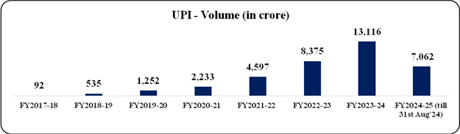
Considering the high trade volume occurring over UPI, even a small margin between the rates we charge the businesses for providing their customers with reward points and the rates at which customers redeem their rewards points allows us to make enough to accommodate the cost of the services we are providing.
Source: https://pib.gov.in/PressReleaseIframePage.aspx?PRID=2057013#:~:text=UPI%20has%20revolutionised%20digital%20payments,volume%20has%20reached%207%2C062%20crore.

Slide 24
Sellers and Us
We will be providing a proper onboarding for the sellers upon successful registration on our service.
This will allow the sellers to properly learn about the system and the ins and outs of it. The sellers will not be altering their workflow much by participating in the rewards system.
The major part of the hassle will be on the customer side, thus offloading the work required from the sellers to the customers.
The sellers will only be required to confirm each transaction.
# Read more about the way we can integrate this with UPI to provide an even more seamless experience for both the sellers and the customers at the end of our slides.

Slide 25
Customer and Sellers’ Grievances
We will be providing two grievances channel, one for the customers and one for the sellers, individually to properly address their concerns in a timely manner.
They will be able to contact us primarily through mail and later by a contact number when we can manage the manpower for it.
This will allow us to always be available for the consumers of our service and help them through our service.

Slide 26
About Initial Capital
A starting initial capital will help us to lure in customers by enticing them with starter reward points and will also allow us to offset the cost for the sellers at the start so they can test out the system and see if they can benefit from it, which they absolutely will allowing us to make them our paying sellers.

Slide 27
Our plans on Integration with UPI
Our solution can be implemented along with UPI to provide an even more seamless experience. We can get the customer and seller data directly from the UPI transaction and provide the reward points or compensation accordingly.
UPI Data will also allow us to handle fraudulent transactions easily as a seller to merchant transaction or vice versa cannot be easily spoofed. The customers can also be moved away from actual money by directly applying the discount on their transaction, thus completing the entire transaction in one sweep go.

Slide 28
Summary
Our solution to the unifying reward points across many businesses involves selling reward points to businesses, which lets them set up their own methods of distributing these points to consumers. The manner in which they distribute these points can boost their customer base and loyalty as these customers will be inclined to shop at businesses that provide better rewards. Together with a robust UPI integration, that guarantees a seamless experience and addresses safety concerns, our app provides a modern paradigm of online shopping.

