Slide 1

Rental Car System
By :
Rayan Essam Taj
Faisal Faiz Saharti
Abdul-Rahman Hani Al-Johani
1740377
1741977
1741977

Slide 2
Project Description
“Rental Car System” is a system that allows the customer to rent a vehicle.
Can search through a variety of filters.
Must decide the number of days.
Must choose a pickup/drop off location.

Slide 3
Feasibility Study
Serial No. | Feasibility Concern | Status | Reasons
1 | Economical | Satisfied | Our System will not cost a lot of money. The only thing that the system will need is a database in order to keep everything synchronized through all the branches.
2 | Technical | Satisfied | We are going to need to draw the customers in order to tell them why they should use this website, because it is simple, easy to learn and use for all types of users as it caters to universal usability.
3 | Organizational | Satisfied | it will be very convenient for the customer to find what he wants so easily and quickly. They will be only a few checks away from renting the car that they need.

Slide 4
Class Diagram : Overview

Slide 5
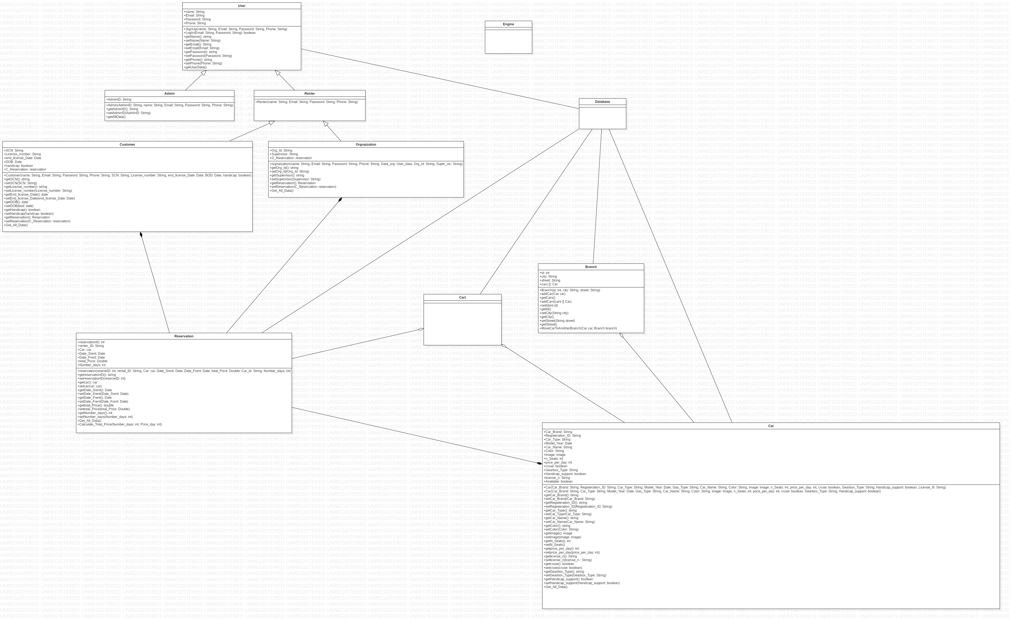
User

Slide 6
Renter extends User
Admin extends User

Slide 7
Customer extends Renter
Organization extends Renter

Slide 8
Branch

Slide 9
Car
Car

Slide 10
Reservation

Slide 11
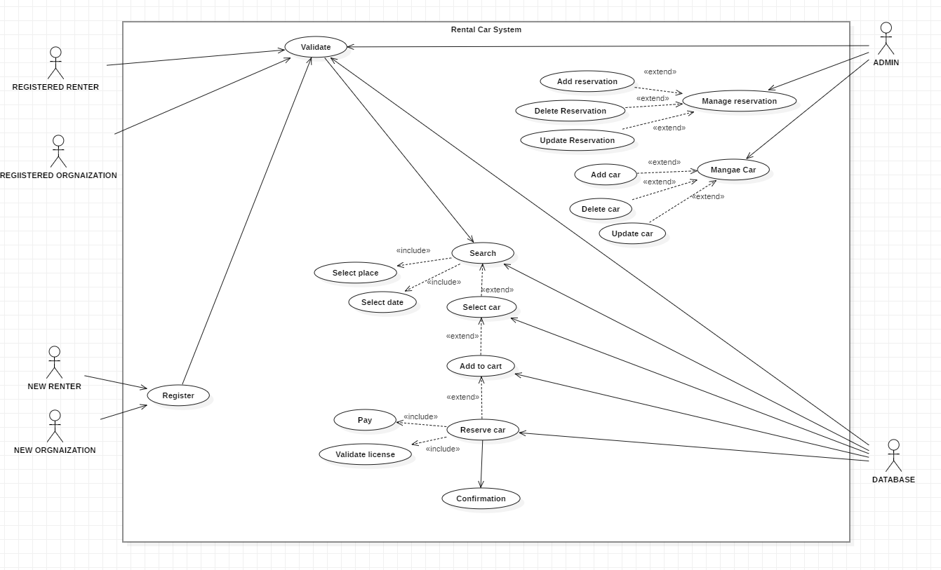
Use Case Diagram : Overview

Slide 12
THE END

