Slide 1
OpenCritic analysis
This project scrapes 10,000 video game reviews from OpenCritic.com to analyze patterns in critical reception. It uses Selenium for web scraping, pandas for data cleaning, matplotlib for visualization, and scikit-learn for modeling.

Slide 2
Data Collection
Data collection starts at opencritic.com/browse/all
500 index pages are scraped
10,000 item pages are scraped
From the index pages: rank, url, genre(s), release date
From the item pages: name, top critic average, critics recommend percentage, creator(s), platform(s), number of reviews
Stored as a JSON Lines file

Slide 3
Data Description
Final cleaned dataset: 9,317 games with a valid top critic average
10 features per game
Top critic average (0-100)
Critics recommend percentage (0-100%)
Number of reviews (3-255)
Creator(s) (5,855 unique studios/developers)
Platform(s) (14 platforms)
Genre(s) (23 distinct genres)

Slide 4
Key Statistics
Average top critic score: 71.28
Highest: Super Mario Odyssey (93)
Lowest: The Day Before (12)
Most common platform: PC
Most common genres: Action, Adventure
Most prolific creator: Nintendo

Slide 5
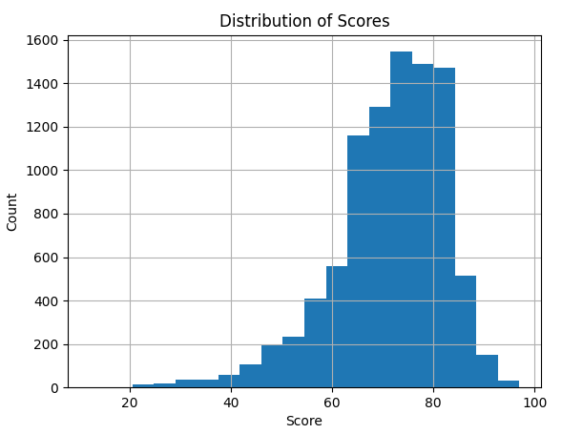
Visuals

Slide 6
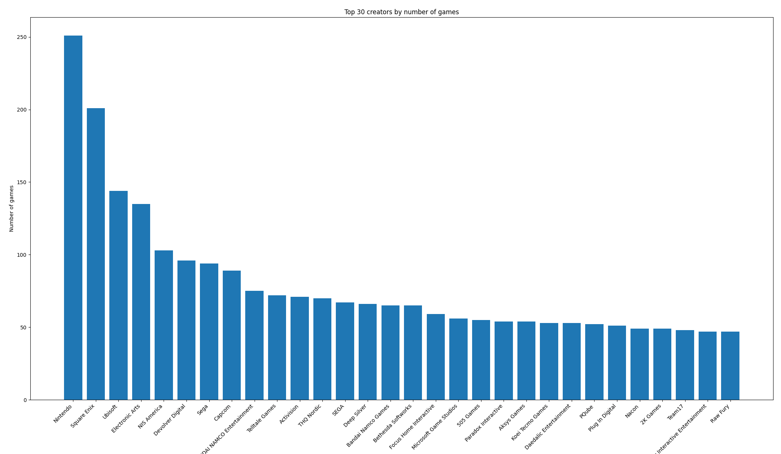

Slide 7
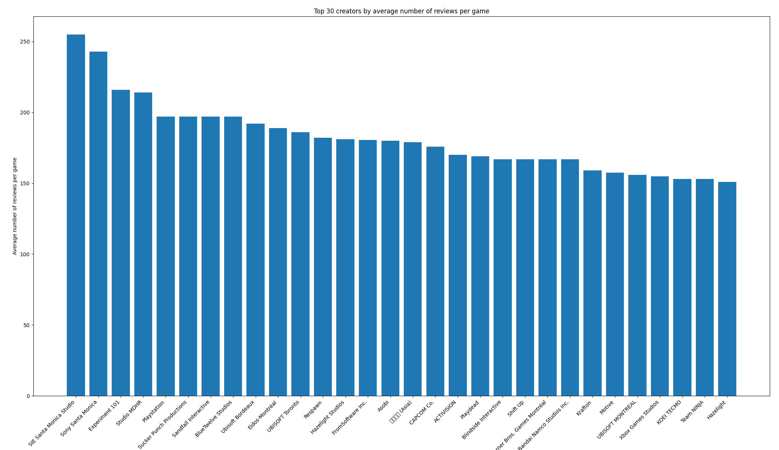

Slide 8
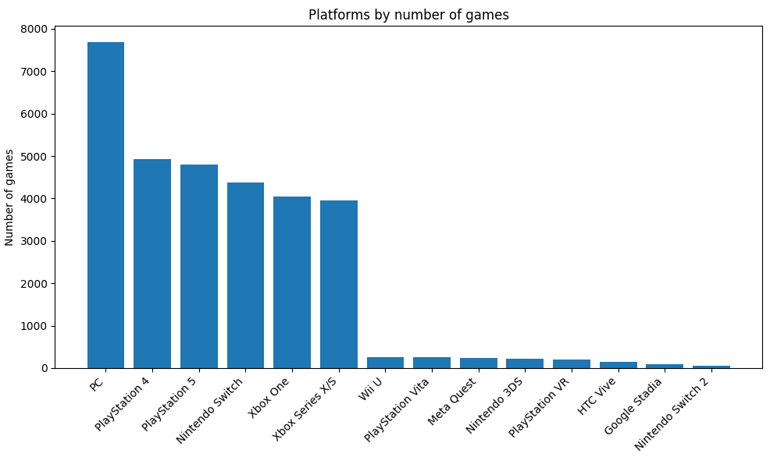

Slide 9
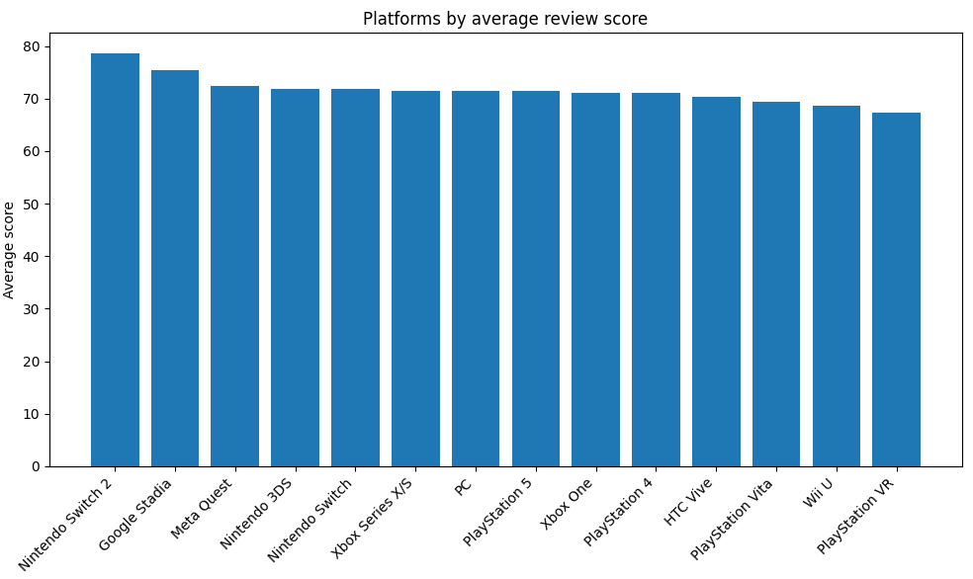

Slide 10
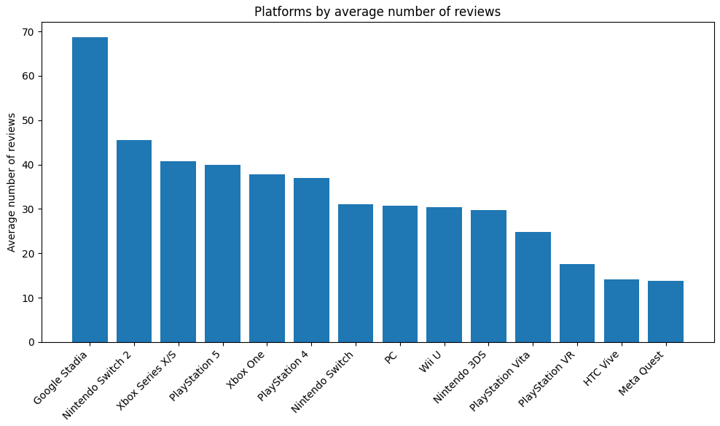

Slide 11
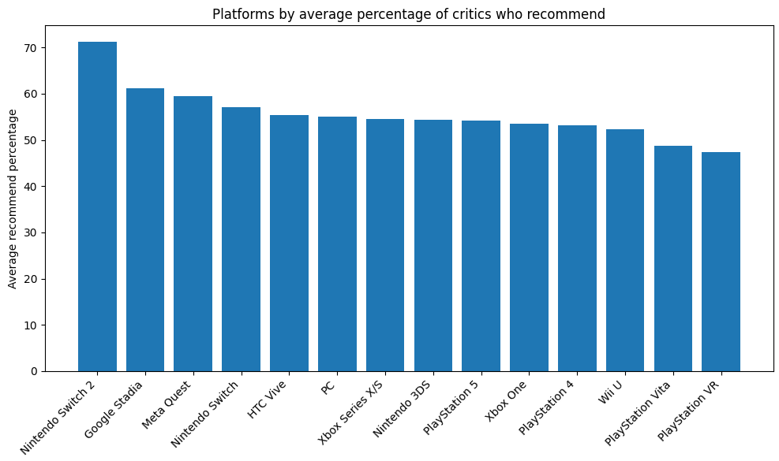

Slide 12
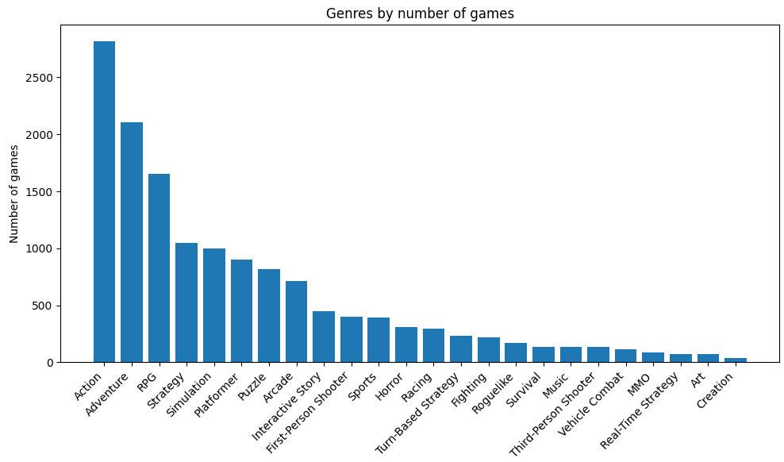

Slide 13
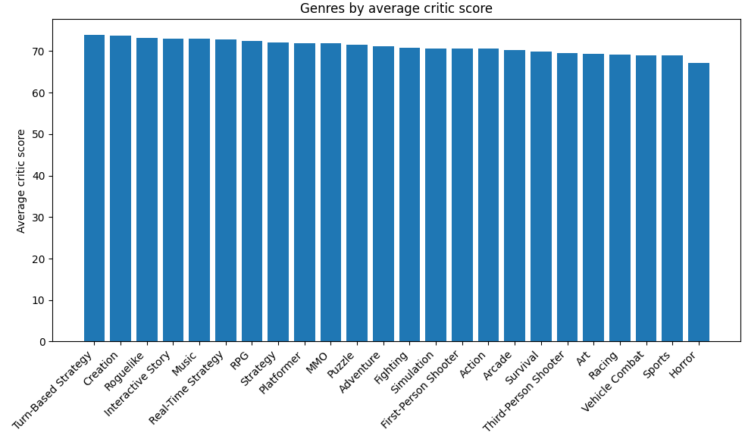

Slide 14
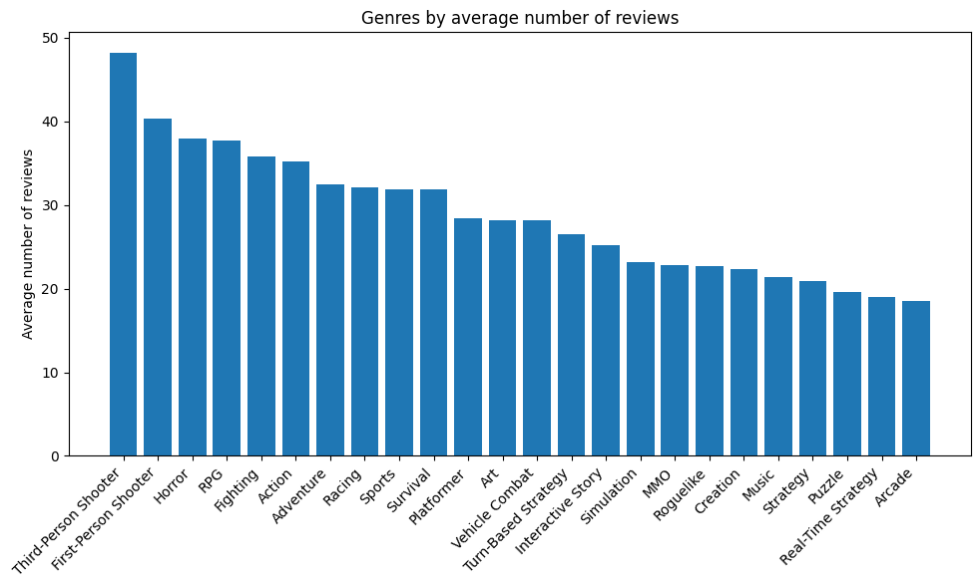

Slide 15
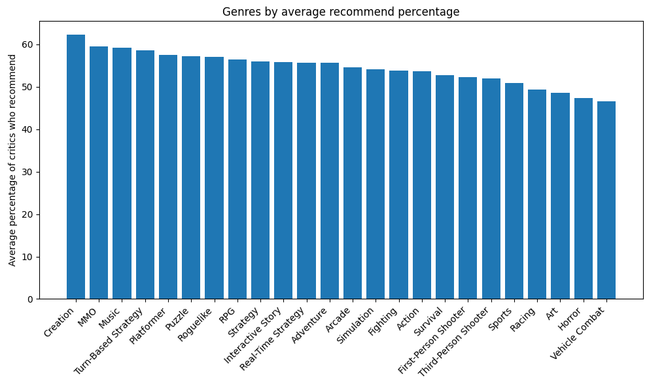

Slide 16
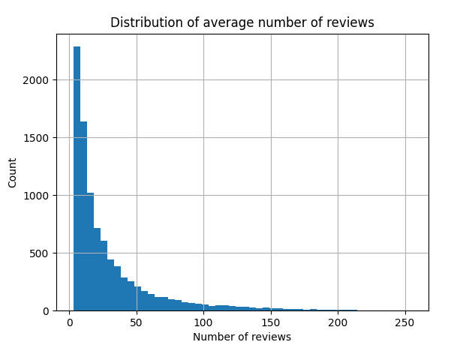

Slide 17
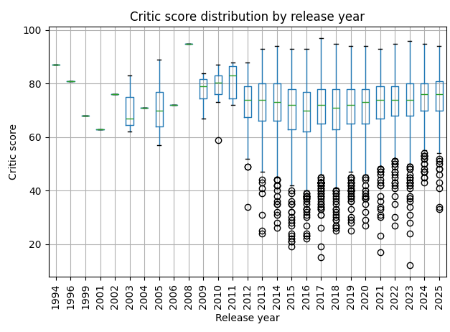

Slide 18
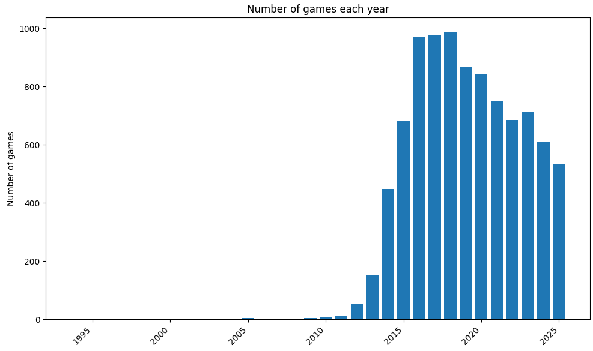

Slide 19
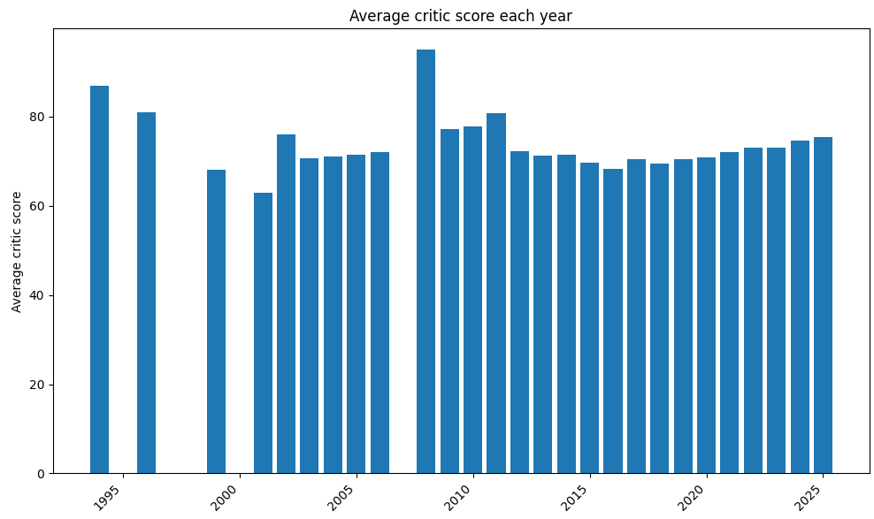

Slide 20
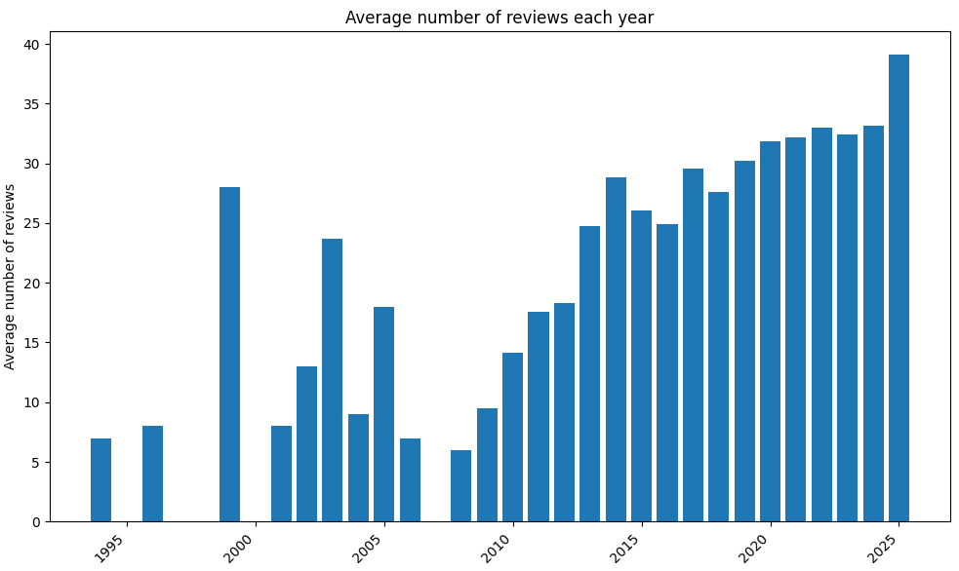

Slide 21
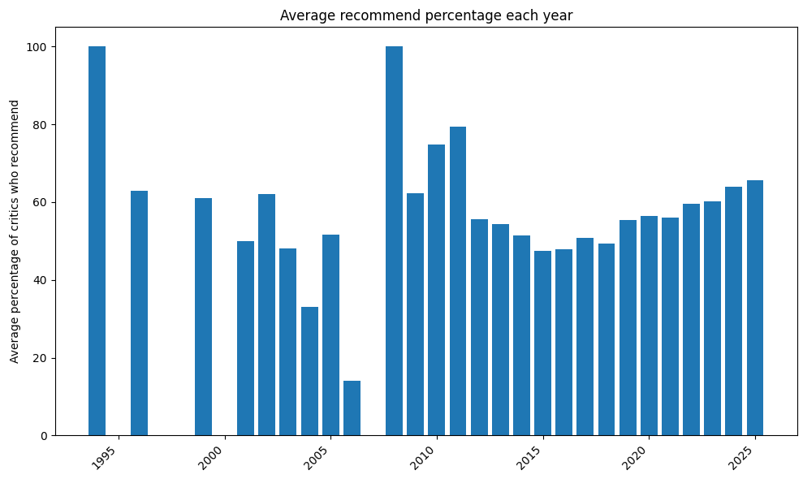

Slide 22
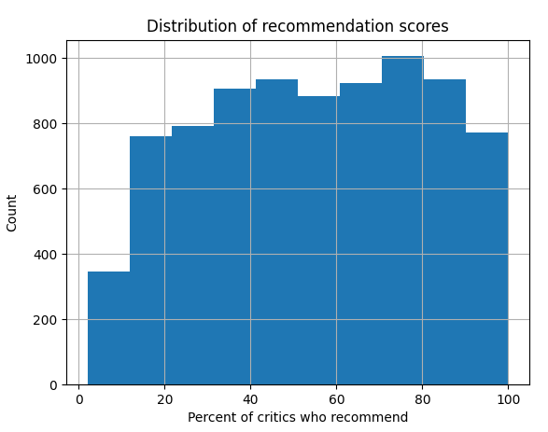

Slide 23
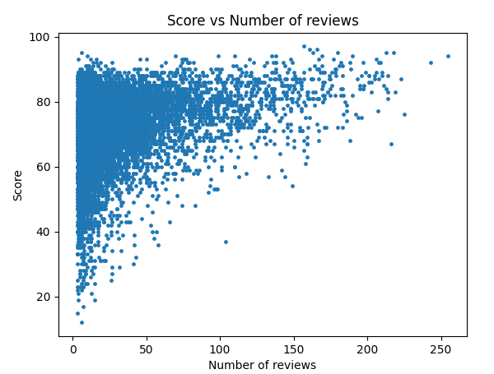

Slide 24
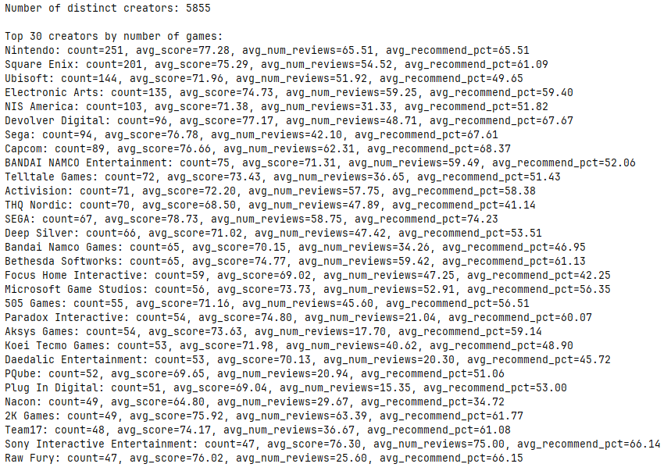

Slide 25
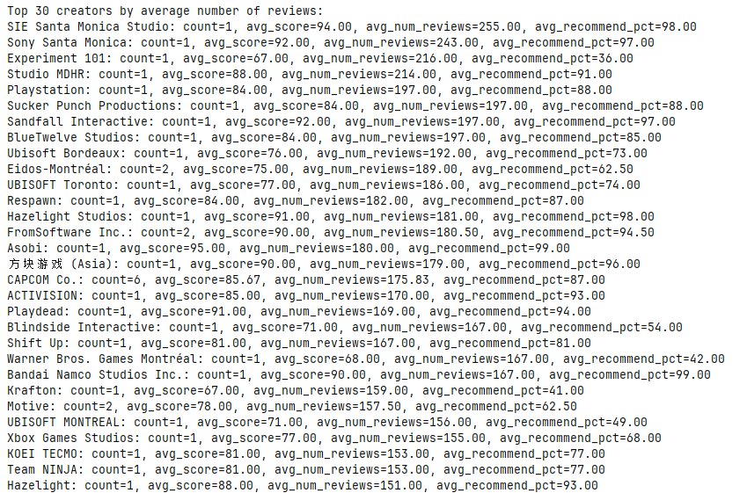

Slide 26
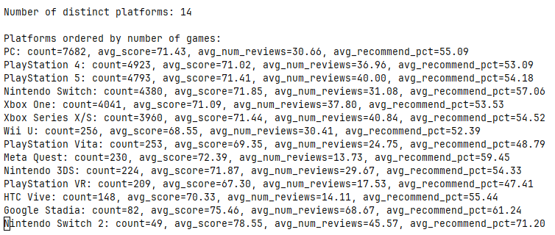

Slide 27
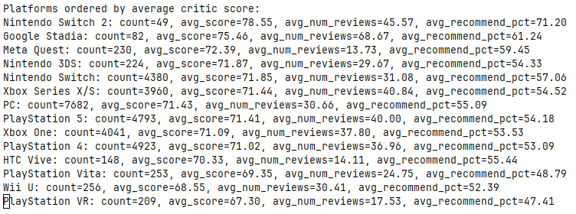

Slide 28
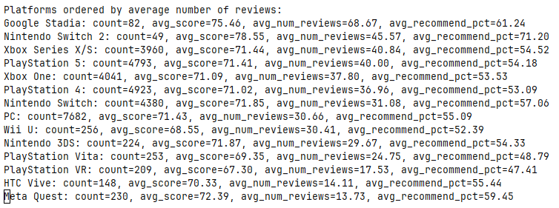

Slide 29
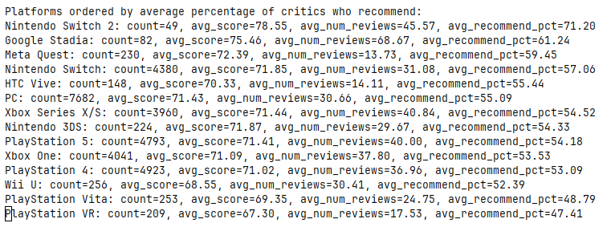

Slide 30
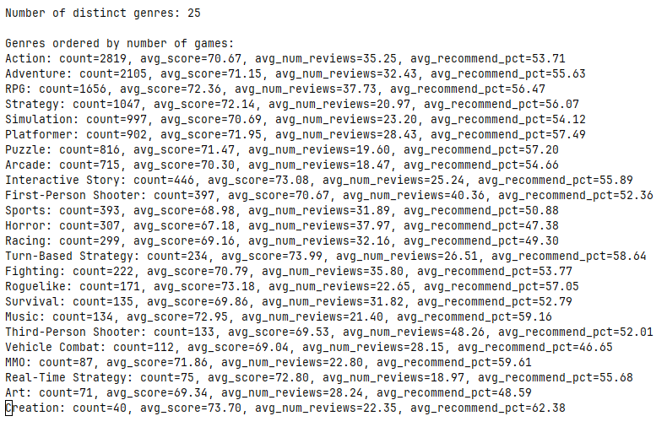

Slide 31
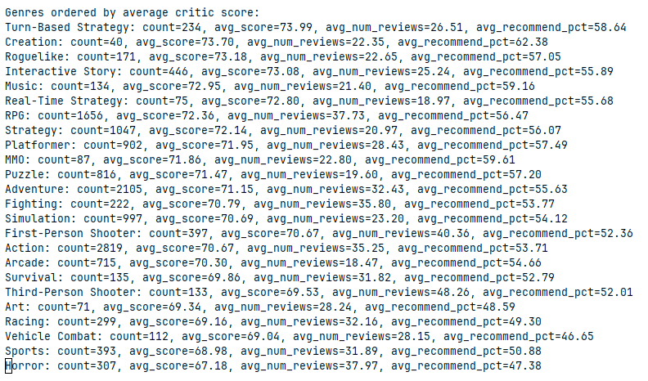

Slide 32
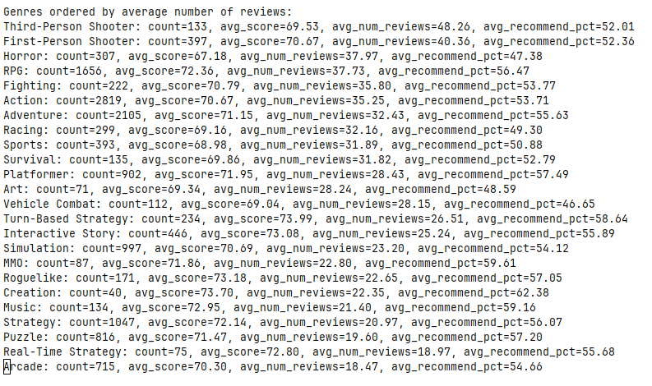

Slide 33
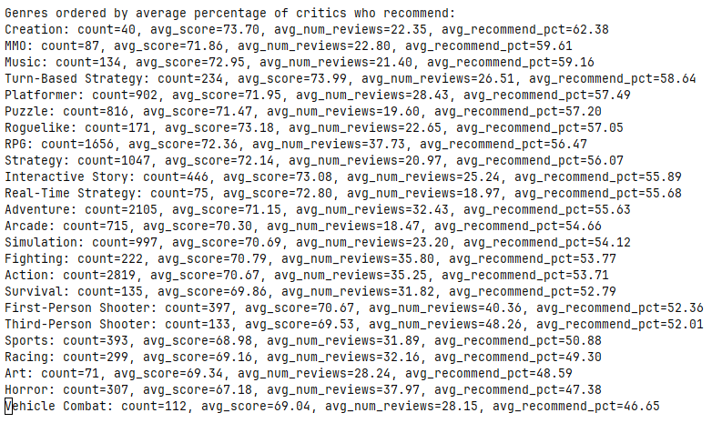

Slide 34
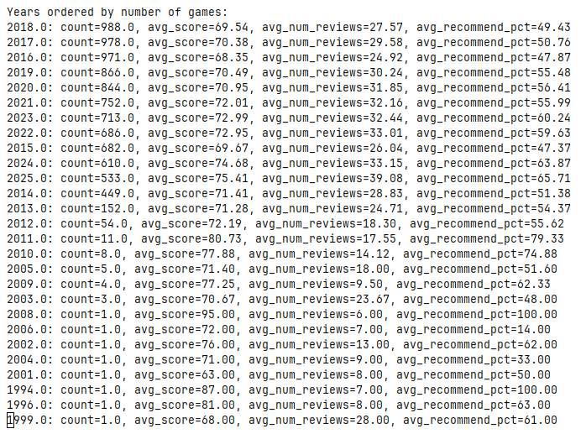

Slide 35
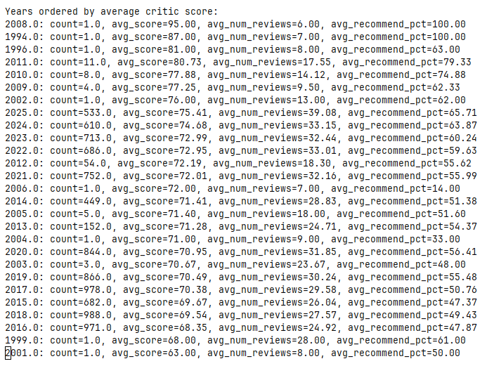

Slide 36
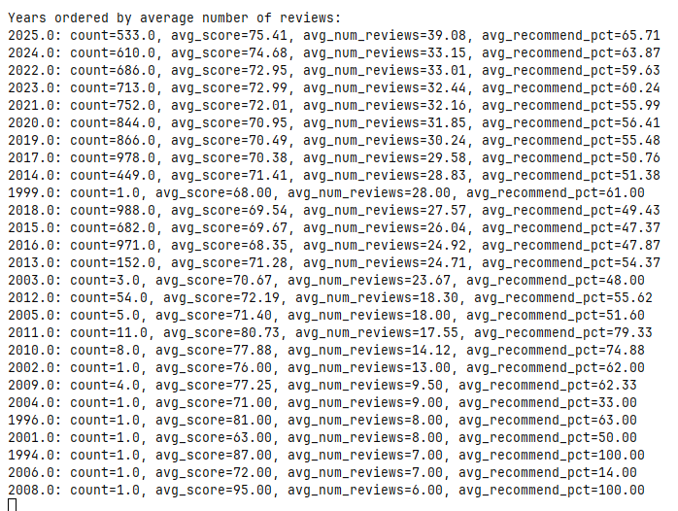

Slide 37
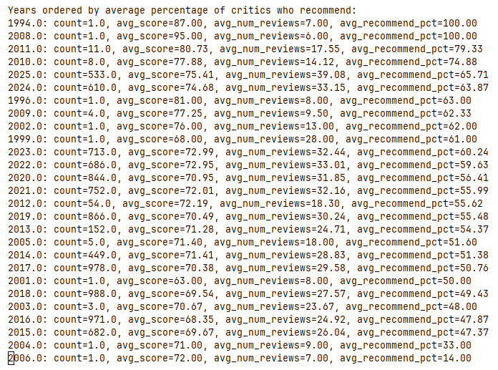

Slide 38
Modeling
Only had time for a few linear regression models
Top critic average variance explained by number of reviews: 8%
Variance explained by release year: 1%
Variance explained by critic recommend percentage: 74%
Variance explained by all 3 of these, using multiple linear regression model: 75%

