Slide 1


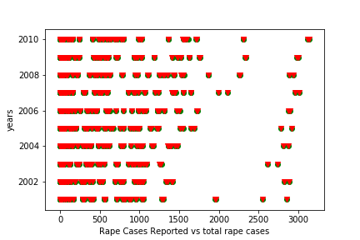
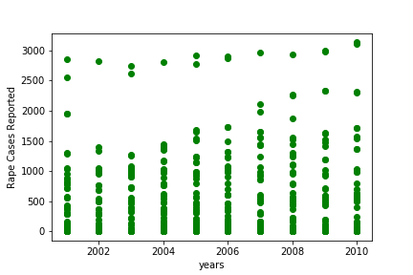

Crime Analysis in India
Rayaan Ahmed
School of Computer Science and Information Systems, Northwest Missouri State University
Introduction
Results
Conclusion
India is going through an enormous increase in the crime in the recent past, the data which I am going to work on is going to analyze the crime rates in a particular place and predict the safest cities and places around. I can even say that where the security and police protection should be there. These analysis and predictions will help police department to focus on the current crime rates and change the punishment sections.
Evaluation of Crime rate in India for particular years.
Predicts average increase in crime rate every year.
Provides the graphical representation of crime increase every year and represents number of cases has been reported every year.
Crime reporting statement:
The graph on the right represents total rape cases reported every year.
The rape cases reported are not same as total rape cases.
Materials/Methods
Features:
Age of the victims
Number of cases reported
Years
Performed Linear regression to train the model.
Used Decision Tree Classifier to implicitly perform feature selection.
Evaluate
Crime increase statement:
The graph on the right represents total rape case increased every year.
The graph clearly states rape cases has been increased every year.
Additional Resources
Acknowledgements
Poster Repository
https://www.kaggle.com/rajanand/crime-in-india#20 Victims of rape.csv
https://scikit-learn.org/stable/modules/generated/sklearn.tree.DecisionTreeClassifier.html
Mentor: Dr. Charles Hoot
https://github.com/raybox94/ML_Project_Poster

