Slide 1
Storm
Team 04

Slide 2




Team members
Rayaan Ahmed
Gopi Krishna Amara
Vinay Linginedi
Lakshmi Vancha

Slide 3
Agenda
Introduction
Types of processing big data
Possible areas of using storm
Storm components
Architecture
HandsOn

Slide 4


Slide 5
Introduction to Storm
Storm is an open source software
Currently being incubated at the Apache software foundation
Many Industries choose it because its distributed, real-time, data processing platform
Storm is unbelievably fast because it has enormous power of processing the data
Vinay Linginedi

Slide 6
Types of processing of Big Data
Batch Processing:
Takes large amount of data at a time, analyzes it and produces a large output
Real Time Processing:
Collects, analyzes and produces output in Real time.
Vinay Linginedi

Slide 7
Possible areas of using storm
Continuous computation: Storm can do continuous computation on data streams and stream the results into clients in real time
Real- time analytics: Storm can analyze and respond to data that comes from different data sources as they happen in real time.
Stream processing: Storm is used to process a stream of data and update a variety of databases in real time.
Vinay Linginedi

Slide 8
Storm | Hadoop
Master/Slave architecture with Zookeeper based coordination. The master node is called nimbus and slaves are called supervisors. | Master/slave architecture with Zookeeper based coordination. The master node is called job tracker and slave node is task tracker.
A Storm streaming process can access tens of thousands messages per second on cluster | HDFS uses MapReduce framework to process vast amount of data that takes minutes or hours
If nimbus/supervisor dies, restarting makes it continue from where it stopped, hence nothing gets affected. | If the jobtracker dies, all the running jobs are lost
Vinay Linginedi

Slide 9
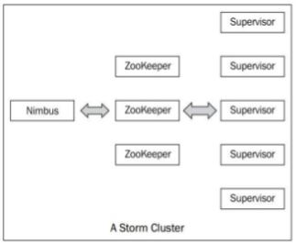
Storm Components
A storm cluster follows a master-slave model where the master and slave processes are coordinated through Zookeeper
Zookeeper is a distributed coordination service to manage large set of hosts
Lakshmi Vancha

Slide 10
Storm Components: Nimbus
It is the central component of Storm cluster.
It is responsible for:
Distributing application code across various worker nodes.
Assigning tasks to different machines.
Monitoring tasks for any failures.
Restarting them when required.
Lakshmi Vancha
Notes:
It is stateless
Stores its data in zookeeper
Only one nimbus data in one storm cluster
It can be restarted without interuppting any other tasks that are running.

Slide 11
Storm Components: Supervisor nodes
The nodes that follow instructions given by the nimbus are called as Supervisors.
These are the worker nodes in the Storm cluster.
Each Supervisor node runs Supervisor daemon:
Creating, Starting and Stopping the worker processes to execute the tasks assigned to that node.
Lakshmi Vancha
Notes:
Like nimbus the supervisor is also a fail-fast where it stores all of its state in zoo keeper so that it can start without any loss

Slide 12
Storm Component: Zoo Keeper
ZooKeeper helps the supervisor to interact with the nimbus. It is responsible to maintain the state of nimbus and supervisor.
Storm also uses a Zookeeper cluster to coordinate various processes.
As all data are stored in ZooKeeper, so any time we can kill Nimbus or Supervisor daemons without affecting cluster.
Lakshmi Vancha

Slide 13


Slide 14
The Storm model
Basic unit of data that can be processed by a storm application is tuple
Each tuple consists of a predefined list of fields
A tuple is dynamically typed, that is, you just need to define the names of the fields in a tuple and not their data type
Fields in a tuple can be accessed by its name getValueByField(String) or its positional index getValue(int)
Rayaan Ahmed

Slide 15
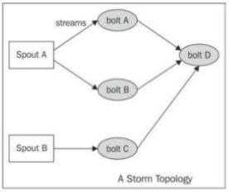
Storm topology
We create a storm topology and deploy it on a storm cluster to process the data
Rayaan Ahmed

Slide 16
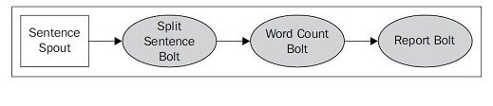
For a word count task how the processing will undergo in storm is given thru below example
Rayaan Ahmed

Slide 17


Slide 18
Resources
https://engineering.cerner.com/blog/structure-matters-how-cerner-handled-too-much-health-data-in-hbase/
https://www.tutorialspoint.com/apache_storm/apache_storm_cluster_architecture.htm
https://www.slideshare.net/hemelaiub/1-stormintro-47836334

Slide 19


