Slide 1

WELCOME TO
SOS CHILDREN’S
VILLAGES
Notes:
www.soschildrensvillages.org.uk

Slide 2
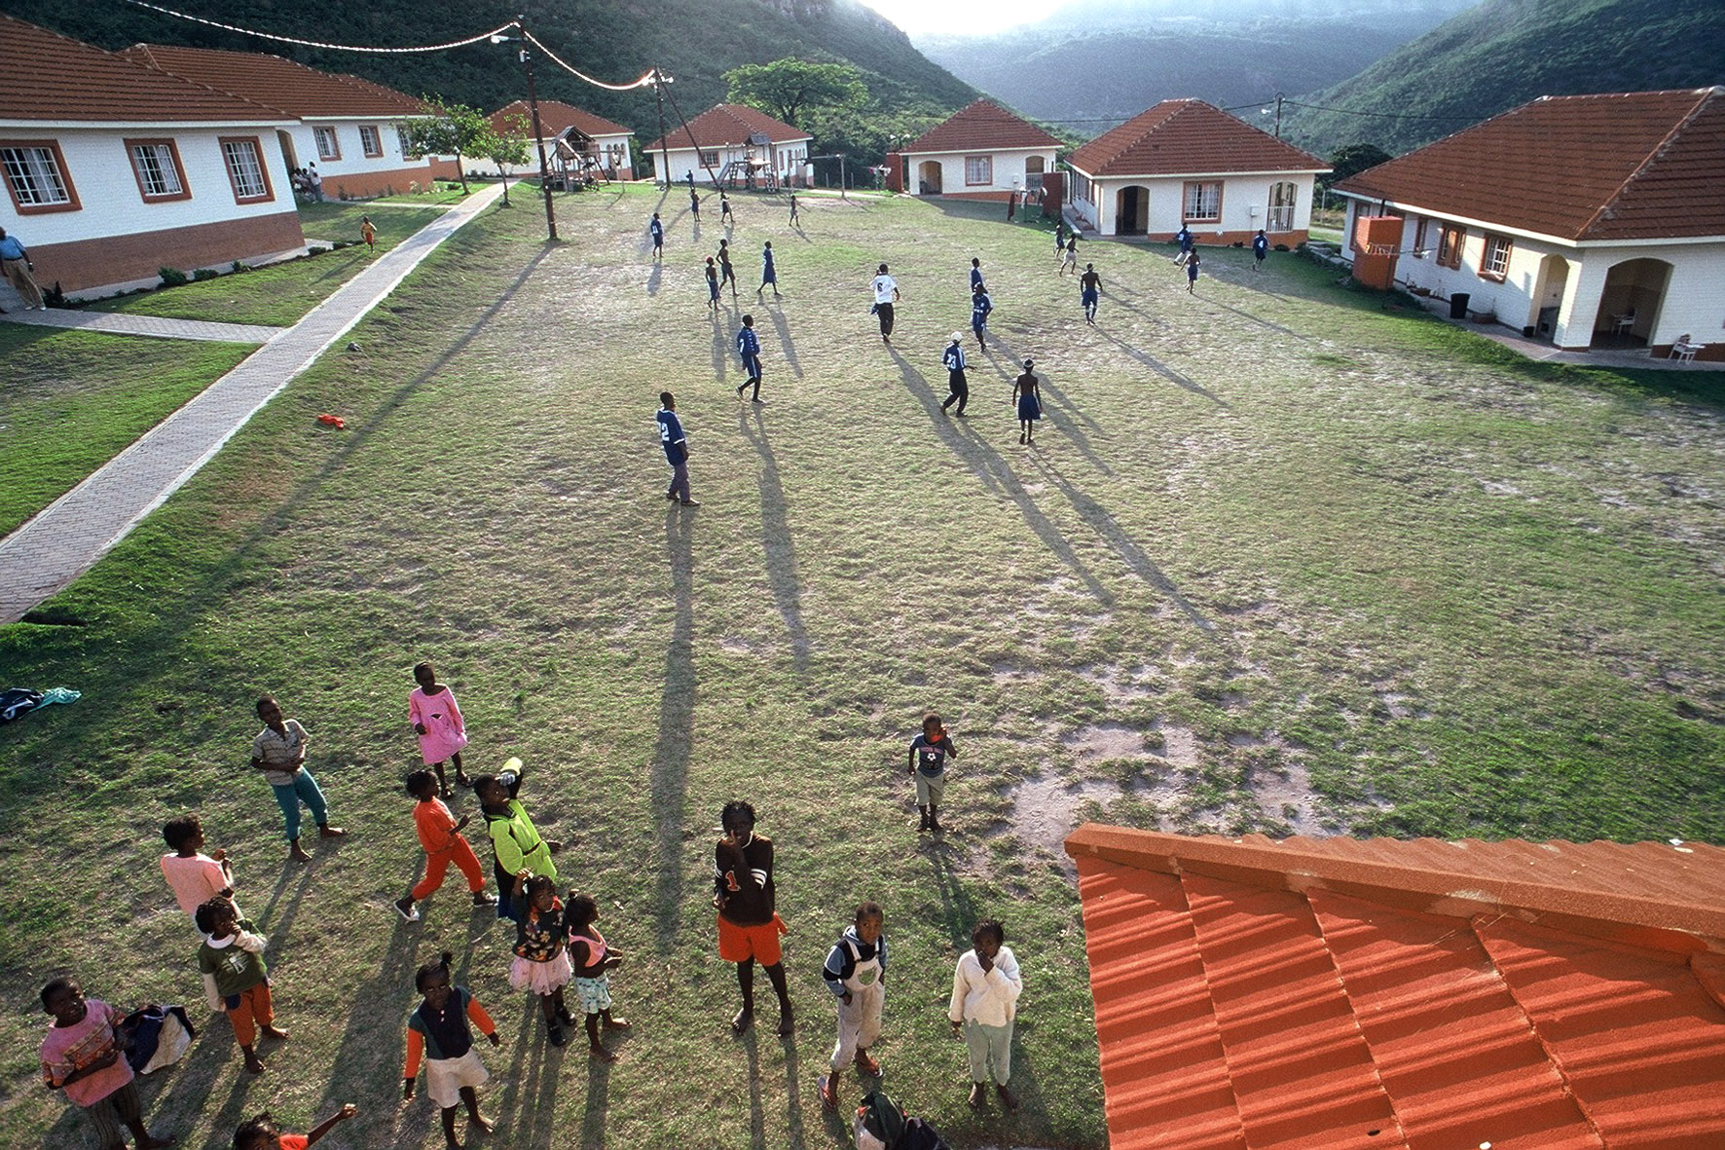
Notes:
www.soschildrensvillages.org.uk

