Slide 1

2026
DITT VIN
dittvin.se
CRO Audit
CRO Audit
RPV Northstar
Benchmarked
A/B Roadmap
Based on Shopify (source of truth). 90 days, 25 April to 23 July 2026: 38.306 orders, 33,3M SEK gross, 868 SEK AOV. GA4 recorded only ~31%.
Prepared by EcomHouse for dittvin.se. July 2026.
ECOMHOUSE ©ALL RIGHTS RESERVED
00

Slide 2
2026
Scope
What We Analyzed
Every number in this deck is traced to a source. Where a metric is estimated it is marked "Est."
// 01
// 02
// 03
// 04
GA4 Analytics
Voice of Customer
Competitor Set
Expert Review Review
90 days, property 461839723. 452,552 sessions, sequential funnel, channels, devices, landing pages.
5,985 Trustpilot reviews (4.7/5). 300 verbatim reviews mined via the widget data API.
5 verified rivals: Winefinder, Winefamly, KRAN, Supervin, plus Systembolaget as the benchmark.
4 page types on desktop and mobile: entry, home, collection, product page. Screenshot verified.
// 05
// 06
// 07
// 08
Tag and Tech Audit
Shopify Sales Data
Industry Benchmarks
Not in scope
Live network capture of every tracking tag, consent, and console error. Not an HTML guess.
91 days of order, product and AOV exports. The source of truth for RPV, reconciled against GA4.
Named sources: Littledata, Baymard, Sovos, SVB, Omnisend. General ecom + wine DtC, RPV northstar.
Microsoft Clarity is installed and collecting, but we had no dashboard access. Grant it for session replay depth.
ECOMHOUSE ©ALL RIGHTS RESERVED
01

Slide 3
2026
Executive Summary
Seven Findings That Move Revenue
Delivery is the number one trust wound. The site promises "1-3 dagar" but 31% of low star reviews report 7 to 16 days. 86% of complaints are about delivery, and loyal repeat buyers are churning on it.
Fix the promise, not the wine. This is a retention leak, not just acquisition.
The legality question is unanswered. In a monopoly market, a first time Swedish buyer needs to know this is legal. dittvin explains nothing, while KRAN and Winefamly reassure directly. Fear tips to "Tror detta r bedrägeri".
Most buyers are first time visitors, and they need this reassurance.
Taste is invisible online. The biggest barrier in online wine is not knowing how it tastes. dittvin's boxes list region and grape but rarely translate them into sweetness, body, and food pairing the way a shop assistant would, so buyers hesitate.
Make taste legible on every box: flavor profiles, pairings, and Vivino scores.
Checkout abandonment is the biggest leak. 58.9% of sessions that reach checkout do not complete (17,785 of 30,200). Delivery doubt, the "1-3 dagar" promise, and 90+ website errors are prime suspects.
Highest intent, cheapest to recover. Est. 3 to 5M SEK/quarter.
New customers convert far below returning. GA4 shows new visitors convert at 2.62% versus 3.42% for returning, and they are most of the traffic but only a quarter of revenue. Closing that gap is the biggest growth lever.
Taste clarity and trust lift new customer conversion. Est. +3.3M SEK per quarter.
Retention is strong, but the subscription is untapped. 66% of buyers return, yet the subscription (Wine, Gin, Champagne, 749 to 849 SEK) is only 0.2% of sales. The engine exists but is barely switched on.
Grow it toward 3 to 5% for ~1 to 1.8M SEK recurring, and make it prominent on more product pages.
GA4 is not tracking properly. It records only 31% of orders (11,689 vs 38,306) and inflates sessions with junk. A Google Ads conversion also fires on the homepage. Decisions must run on Shopify until it is rebuilt.
Fix measurement with server side tracking (Meta) so the ad platforms bid on full signal.
ECOMHOUSE ©ALL RIGHTS RESERVED
02

Slide 4
2026
01
Shopify Analytics
90 days, 25 April to 23 July 2026. The real numbers: 336,855 sessions, 38,306 orders, 33.3M SEK. Where traffic comes from, where it converts, and where it leaks. GA4 is on one slide.
ECOMHOUSE ©ALL RIGHTS RESERVED
03

Slide 5
2026
Shopify · 90 Days
Performance Dashboard
336,855
38,306
33.3M
3.69%
66%
868 SEK
Sessions
Orders
Gross Sales (SEK)
Conversion Rate
Returning Buyers
Average Order Value
Shopify, ~95% Sweden
31,860 customers
41.5M incl VAT
Shopify true CVR
strong repeat base
stable across 90 days
Source: Shopify Total sales + Conversion rate reports, 90 days (25 April to 23 July 2026). Gross sales exclude VAT, discounts and refunds; total sales 41.5M includes VAT (8.34M) and shipping. AOV is gross divided by orders.
ECOMHOUSE ©ALL RIGHTS RESERVED
04

Slide 6
2026
Shopify · 90 Days · Sessions
The Conversion Funnel
Shopify's own session funnel. Two leaks stand out: only 12.6% of sessions add to cart, and 58.9% of those who reach checkout never complete.
Shopify · 90 days · 25 April to 23 July 2026
Sessions
336,855 100%
Added to Cart
42,513 12.6%
87.4% do not add
Reached Checkout
30,200 9.0%
29% of carts drop
Completed
12,415 3.69%
58.9% abandon checkout
Shopify Conversion rate report. Session attributed completions (12,415) are a subset of the 38,306 real orders, because ~2/3 of orders have no trackable session (consent, in app browsers). The rates are what matter: the store loses most at add to cart and at checkout.
ECOMHOUSE ©ALL RIGHTS RESERVED
05

Slide 7
2026
Benchmarks · Verified Sources
Where dittvin Stands
Ahead on conversion, order value and repeat rate; the upside is subscription sign ups and email. These are general ecom benchmarks, the fair comparator for a Nordic reseller, because no Denmark or European wine specific benchmark is published.
Shopify · 90 days · 25 April to 23 July 2026
METRIC | DITTVIN | ECOM BENCHMARK (SOURCE) | VERDICT
Conversion rate | 3.69% | 1.4% avg, 3.2% top 20% (Littledata) | Ahead
Average order value | 868 SEK (~$82) | ~$85 avg, $101 ecom (Littledata) | On par
RPV per session | 26 SEK GA4, ~99 true | ~$1.19 Est. (AOV x CVR) | Ahead
Cart abandonment | 60% | 70.2% of 50 studies (Baymard) | Ahead
Returning customer rate | 66% | 15 to 30% typical (OpenSend) | Ahead
Email share of orders | 16% | ~20 to 30% of DTC rev (Omnisend) | Behind
Subscription sign ups | 101 orders, 0.2% of sales | No standard ecom benchmark | Upside
Mobile share of traffic | 86% | Mobile ~37% below desktop (Littledata) | Upside
Sources: Littledata (2,800 Shopify sites, 2023), Baymard Institute (2025), OpenSend and MetricUno (2024), Omnisend (2024), Klaviyo (2025). These are general ecom benchmarks; no Denmark or European wine specific benchmark is published, so they are the closest fair comparators for a Nordic reseller. RPV is derived (AOV x CVR); no publisher reports a wine RPV.
ECOMHOUSE ©ALL RIGHTS RESERVED
06

Slide 8
2026
Benchmarks · The Read
Strong at the Top, Soft Where It Compounds
The funnel and order value are genuine strengths. The RPV upside is not fixing a broken store, it is monetizing retention in the category built for it.
Already ahead
The growth gaps
Conversion 3.69%, ~2.7x the Shopify average , and that is on ~86% mobile, the lowest converting device.
Checkout abandonment 58.9% is the biggest recoverable leak, and the cheapest to win back.
Email 16% of orders vs a ~20 to 30% owned norm. Automations are the highest ROI slice untouched.
AOV above the Shopify line at ~2 bottles per order, driven by the box format.
Subscription sign ups are low. The 3 tier club exists but is barely showcased. Wine clubs are 39% of winery DtC.
66% returning customers , well above the typical ecom repeat band. Retention is a genuine strength.
Cart abandonment 10 points better than Baymard, despite the age gate and alcohol friction.
Mobile is 86% of traffic on the lowest converting device. Closing the gap moves the most sessions.
ECOMHOUSE ©ALL RIGHTS RESERVED
07

Slide 9
2026
Shopify · 90 Days
The Three Biggest Leaks
Ranked by how cheaply the revenue can be won back, not just by size.
Shopify · 90 days · 25 April to 23 July 2026
1
2
3
Checkout to Purchase
Session to Add to Cart
Cart to Checkout
58.9%
87.3%
29%
17,785 of 30,200 sessions that reach checkout never complete. The highest intent, lowest cost audience to recover. Delivery doubt, the "1-3 dagar" promise and 90+ website errors are prime suspects.
Only 12.6% of sessions add to cart. Box product pages already run 18 to 20%, but the homepage (12%) and collection (10%) drag it down. product page trust gaps and weak product presentation suppress the add.
29% of carts never reach checkout. Shipping surprise (695 SEK threshold, Airmee only) and no clear push to continue. Smaller than the other two, but a quick cart drawer win.
Highest intent. Cheapest win. Est. 3 to 5M SEK/qtr
Legality proof, per wine detail, box first collection
Cart shipping clarity + continue step
ECOMHOUSE ©ALL RIGHTS RESERVED
08

Slide 10
2026
Shopify · Device
Mobile Is the Store
Almost 9 in 10 Shopify sessions are mobile (88%), yet mobile converts below tablet (3.71% vs 4.66%). Every fix in this deck is a mobile fix first.
DEVICE | SESSIONS | SHARE | ADD TO CART | CVR
Mobile | 296,510 | 88.0% | 12.9% | 3.71%
Desktop | 30,726 | 9.1% | 10.2% | 3.56%
Tablet | 9,619 | 2.9% | 15.1% | 4.66%
Source: Shopify Sessions by device report. Shares and rates are Shopify actuals; session counts are indexed to the 90-day window (25 April to 23 July 2026). Mobile owns the volume but is the weakest converter, so checkout and product page fixes must be validated on mobile Safari first.
ECOMHOUSE ©ALL RIGHTS RESERVED
09

Slide 11
2026
Shopify · 90 Days · Referrers
Direct and Meta Carry the Store
Direct (49%) and Meta (Facebook and Instagram, 33%) drive four in five sessions. Google adds 16%. Tagged email is just 1%, the clearest gap for a store with 66% returning customers.
Shopify · 90 days · 25 April to 23 July 2026
CHANNEL (REFERRER) | SESSIONS | SHARE | CVR
Direct | 164,633 | 48.9% | 3.36%
Facebook | 82,992 | 24.6% | 4.13%
Google | 55,148 | 16.4% | 3.83%
Instagram | 27,967 | 8.3% | 4.33%
Email | 3,632 | 1.1% | 4.10%
Source: Shopify Sessions by referrer report (top 5 channels = 99% of sessions). Shares and CVR are Shopify actuals; session counts are indexed to the 90-day window. "Direct" bundles returning visitors and untagged email or SMS, so paid social is the largest trackable acquisition source. Social converts best (4.1 to 4.3%). Klaviyo attributes ~16% of orders even though tagged email sessions are ~1%, so owned email is barely instrumented, not unimportant.
ECOMHOUSE ©ALL RIGHTS RESERVED
10

Slide 12
2026
Shopify · 90 Days
Retention Is a Strength to Scale
Two thirds of buyers are returning customers, and dittvin already runs a real subscription. The job is to grow it, not to build it.
Shopify · 90 days · 25 April to 23 July 2026
66%
10,730
3 tiers
~9%
Returning Customers
New Customers
Subscription
6-Month Retention
21,130 of 31,860 buyers
34% of buyers
Wine, Gin, Champagne
steady cohort tail
Shopify New vs returning customers + cohort report. The subscription runs 749 to 849 SEK per box (monthly, with an intro box first). The opportunity is to make it more prominent and put it on more product pages, so more buyers see and choose it. This flips the earlier GA4 read that retention was weak.
ECOMHOUSE ©ALL RIGHTS RESERVED
11

Slide 13
2026
Retention · Subscription
Subscription Is the Efficient LTV Lever
66% of buyers already return, but that repeat is earned with email, retargeting and promos every cycle. Subscription makes it automatic: higher lifetime value, lower marketing cost, predictable revenue. Today it is 0.2% of sales, the clearest untapped lever.
Shopify · 90 days · 25 April to 23 July 2026
0.2%
3
0
~1 to 1.8M SEK
Subscription Share of Sales
Subscription Products
Top Boxes With a Subscribe Option
Recurring at 3 to 5% (Est.)
101 orders, 66k SEK in 90 days
Wine, Gin, Champagne boxes
only 3 niche products carry it
vs 66k SEK today
ASPECT | REPEAT TODAY (MARKETING DRIVEN) | ON SUBSCRIPTION
Reorder trigger | Email, retargeting, promo each time | Automatic, recurring
Frequency | Sporadic, promo led | Set cadence, monthly or more
Marketing cost per reorder | High | Near zero
Revenue predictability | Low | High
How we measured: from Shopify's Subscription vs one-time sales report, 101 subscription orders worth 66,033 SEK in 90 days (0.2% of sales). We do not have Recharge access, so active subscriber counts, churn and MRR are not visible. Opportunity: at a modest 3 to 5% of sales the subscription would be ~1.0 to 1.8M SEK of recurring revenue per quarter. The lever: add a subscribe option to the best selling boxes and make it prominent on more product pages.
ECOMHOUSE ©ALL RIGHTS RESERVED
12

Slide 14
2026
Shopify · 90 Days · Product Pages
Box Pages Beat Single Wine Pages
Compared page to page, box product pages add to cart at 16.4% and return an estimated ~80 SEK per visit, well above single wine pages (13.3%, ~62 SEK). A fairer test than homepage or collection, and it still favours the box as the better first purchase.
Shopify · 90 days · 25 April to 23 July 2026
PRODUCT PAGE | SESSIONS | ADD TO CART | REACHED CHECKOUT | EST. RPV / VISIT
Box pages (336, average) | 120,678 | 16.4% | 7.3% | ~80 SEK
example: XL Introlåda | 25,917 | 19.9% | 8.5% | ~94 SEK
Single wine pages (1,894, average) | 81,055 | 13.3% | 5.6% | ~62 SEK
example: Carapaia Magnum | 2,545 | 21.3% | 10.9% | ~120 SEK
Shopify Sessions by landing page. Est. RPV per visit = the page's reached checkout rate x the store's true order rate (38,306 orders / 30,200 checkout sessions) x 868 AOV; blended store RPV is 99 SEK, and box pages likely run higher on real order value, so this is conservative. Note premium single bottles convert well too (the Carapaia magnum reaches 10.9%), a secondary lever alongside the boxes.
ECOMHOUSE ©ALL RIGHTS RESERVED
13

Slide 15
2026
The One GA4 Slide
Why This Audit Uses Shopify, Not GA4
Over the same window GA4 records only about a third of the business. It also inflates sessions with junk. So every number in this deck comes from Shopify.
SAME 90 DAYS | SHOPIFY (TRUTH) | GA4 | GA4 SEES
Orders | 38,306 | 11,689 | 31%
Gross revenue | 33.3M SEK | 11.9M SEK | 36%
Sessions | 336,855 | 452,552 | GA4 +28%
AOV | 864 SEK | 1,017 SEK | GA4 overstates
GA4 under-records orders (Cookiebot consent denial, Facebook in app browser attribution loss, 4 parallel GA4 properties) while over-counting sessions with bot and prefetch noise, so it both hides revenue and dilutes the conversion rate. Fix: server side GTM + Meta server side tracking + one GA4. Until then, Shopify is the source of truth and the ad platforms are bidding on a third of the signal.
ECOMHOUSE ©ALL RIGHTS RESERVED
14

Slide 16
2026
GA4 · 90 Days
When Sweden Buys Wine
Tuesday and Wednesday lead on orders; Saturday is the weakest. A small budget shift toward midweek is worth testing.
GA4 · 90 days · 25 April to 23 July 2026 · directional
DAY | SESSIONS | ORDERS | REVENUE (SEK)
Tuesday | 71,983 | 1,966 | 2.03M
Wednesday | 73,018 | 1,748 | 1.78M
Sunday | 67,132 | 1,697 | 1.72M
Monday | 64,807 | 1,691 | 1.70M
Thursday | 58,285 | 1,661 | 1.69M
Friday | 63,686 | 1,610 | 1.61M
Saturday | 52,838 | 1,316 | 1.36M
ECOMHOUSE ©ALL RIGHTS RESERVED
15

Slide 17
2026
02
Voice of Customer
4.7 out of 5 on 5,985 Trustpilot reviews. We read 300 verbatim to find what drives the buy and what breaks the trust.
ECOMHOUSE ©ALL RIGHTS RESERVED
16

Slide 18
2026
Trustpilot · Verified
A Loved Brand With a Sharp Tail
94% of reviews sit at 4 or 5 stars. The small negative tail is highly concentrated on one issue, which makes it very actionable.
Rating Distribution (5,985)
4.7
5
4,765 · 80%
4
856 · 14%
TrustScore · "Utmärkt"
3
149 · 2.5%
Fast delivery when it works
36%
Easy to order, smooth site
34%
2
62 · 1%
Price and value ("prisvärt")
28%
1
153 · 2.6%
Discovery boxes love
21%
Wine quality ("goda viner")
20%
Theme percentages are within the sampled reviews, not store wide rates. Official aggregates (4.7, 5,985, distribution) are Trustpilot's own.
ECOMHOUSE ©ALL RIGHTS RESERVED
17

Slide 19
2026
Voice of Customer
Why People Buy (In Their Words)
This copy already lives in your reviews. It is stronger than any marketing line because it is the customer framing the value against Systembolaget.
"Smidigt, enkelt, prisvärt, bra viner mm! ... Dessutom inga begränsade öppettider att förhålla sig till."
"Är så skönt med färdiga bland lådor av viner, man har stor chans att hitta nya favoriter som man annars missar."
Smooth, easy, good value, good wines. And no restricted opening hours to deal with.
Ready made mixed boxes give a real chance to find new favourites you would otherwise miss.
kundnamn · 4 stars · 2026-07-16
Ritva Nilsson · 5 stars · 2026-07-13
"...trevligt att smaka viner från mindre kända vingårdar!"
"Mycket goda alkoholfria alternativ, såväl vitt vin som mousserande."
Nice to try wines from lesser known vineyards, at affordable prices.
Very good alcohol free options, both white and sparkling. A niche but loyal segment.
Martin Åström · 5 stars · 2026-07-09
Sari Andersson · 5 stars · 2026-07-07
ECOMHOUSE ©ALL RIGHTS RESERVED
18

Slide 20
2026
Voice of Customer · The Core Problem
"1-3 dagar" Is Breaking Trust
The homepage promises 1 to 3 day delivery in 8 places. Customers repeatedly report 7 to 16 days. This single gap drives the entire negative tail.
"1-3 dagars leverans står det. Just nu väntat i 11 dagar utan veta när leverans kommer komma. Var skeptisk, men ville ändå testa. Första och sista gången tyvärr."
"Vilseledande marknadsföring! Leverans som aldrig är 1-3 dagar som det står på sidan. Andra gången jag beställer inför en stor fest och andra gången det blir försenat..."
Site says 1-3 days. Waited 11 days with no ETA. Was skeptical but tried. First and last time.
Misleading marketing. Delivery is never the 1-3 days the site claims. Second time late before a big party.
Sebastian Svahn · 1 star · 2026-05-14
Elias Lindell · 1 star · 2026-05-07
"Bra priser och ok viner men ett väldigt stort problem med leveranstider. Dittvin utlovar 1-3 dagars leverans men det är snarare 10-13. Trust me."
"Ska levereras mellan 17-22 vart försenat till 23 sen 5 minuter innan leverans så avbryts leveransen!"
Good prices and ok wines but a big delivery time problem. Promises 1-3 days but it is more like 10-13.
Meant to arrive 17-22, delayed to 23, then cancelled 5 minutes before delivery. Alcohol needs someone home.
Mattias Bedding · 2 stars · 2026-04-16
Elias Lindell · 1 star · 2026-05-07
86% of sampled complaints mention delivery. 31% cite the broken "1-3 dagar" promise. 23% describe the be home / cancelled window problem. Several are repeat buyers churning purely on delivery.
ECOMHOUSE ©ALL RIGHTS RESERVED
19

Slide 21
2026
Voice of Customer · Secondary Frictions
Quality Doubt and Robot Service
Two smaller but reputationally sharp themes that a stronger product page and a faster human reply would neutralize.
"Köpte ett paket med 12 så kallade kvalitetsviner. Flertalet var knappt drickbara och sämre än de billigare på systemet. Rabatten uppgavs vara 57%."
"Vinerna smakar som saft."
Bought 12 so called quality wines. Several barely drinkable and worse than Systembolaget budget. Claimed 57% off.
The wines taste like juice. Undercuts the "kvalitetsviner" positioning. 14% of complaints mention taste.
Consumer · 2 stars · Quality + discount credibility
Harry Frank · 2 stars · 2026-06-21
"Kundservice är ett automatiskt AI svar som 'beklagar och ska ta din feedback med oss'."
"En flaska var skadad, dom löste det snabbt och lätt. Mycket bra återkoppling på mejl."
Customer service is an automatic AI reply that apologizes and notes the feedback. 38% of complaints cite service.
One bottle was damaged, solved quickly. Great email follow up. When service is fast, it becomes a 5 star reason.
Elias Lindell · 1 star · 2026-05-07
Bengt Angséus · 5 stars · 2026-07-15
The 57% discount claim on wines rated below Systembolaget budget is also a Swedish price marketing risk. Verify compare at prices are genuine reference prices.
ECOMHOUSE ©ALL RIGHTS RESERVED
20

Slide 22
2026
The Number One Buying Hesitation
You Cannot Taste It Before You Buy
Taste is the biggest hesitation in online wine. Everyone likes something different (dry or sweet, light or full, fruity or bitter) and nobody can try before they buy. When the flavor is a gamble, people hesitate, fall back on price, and often pick a wine they do not enjoy, then blame the shop. Show the taste up front and each buyer chooses a wine they will actually love.
The problem, in your own reviews
The fix: a taste profile on every wine and box
Buying blind leads to the wrong bottle
Show the flavor before the buy
14% of complaints are about taste. A box of 12 unknown wines is a leap of faith, so price and discount become the only things to go on. When the wine does not match what someone expected, they feel let down even when it is a good wine. This buyer wanted something drier. With a simple taste profile they would have picked a different wine and stayed happy.
Torrt
Sött
Lätt
Fylligt
"Vinerna smakar som saft" (the wines taste like juice)
Mörka bär
Kryddig
Mjuka tanniner
"Jag saknar en beskrivning av respektive vin och vad det passar till." (I miss a description of each wine and what it pairs with)
Vivino 4,1Passar till grillat kött, pasta
The highest leverage content fix for a wine product page. A taste profile (dry to sweet, light to full, plain tasting notes, the Vivino score you already hold, and food pairing), plus a short "hitta din smak" taste match quiz, turns a blind box into an informed pick. Each buyer self selects the style they like, which lifts add to cart, powers the box ladder, and cuts both the "smakar som saft" complaints and the returns they cause.
ECOMHOUSE ©ALL RIGHTS RESERVED
21

Slide 23
2026
03
The Trust Equation
In Swedish online alcohol, two levers decide the first purchase: is it legal, and will it arrive. dittvin is silent on the first and unreliable on the second.
ECOMHOUSE ©ALL RIGHTS RESERVED
22

Slide 24
2026
Market Context · Highest Leverage Gap
Nobody Told the Swede It Is Legal
Sweden runs the Systembolaget monopoly. dittvin lawfully ships as a Danish cross border private importer (Vinhuset ApS). It never explains this, so doubt fills the gap.
What dittvin does today
What the best rival does
Silence on legality
KRAN states it plainly
Zero mention of Systembolaget, private import, Swedish alcohol tax, or that VAT is included. The Danish operator identity is buried in the footer. The genuine assets (a 4.7 Trustpilot, award medals, Løvens Hule TV backing) sit far from the point of doubt.
"Vi lyder under den svenska alkohollagstiftningen och regleras av svenska Skatteverket som distansförsäljare." Winefamly reassures with "Alla priser inkl. svensk alkoholskatt & moms." Winefinder, Winefamly and Supervin also show the Trygg E-handel trust mark. dittvin shows none of it.
"Så in i norden dåligt. leveransen har inte kommit fast det har gått 2 veckor. Tror detta r bedrägeri. VARNING" (I think this is fraud. WARNING)
The fix: a plain "Is this legal? Yes, and here is how" block on the product page and cart, with the age check, the Danish import model, and tax included stated up front.
ECOMHOUSE ©ALL RIGHTS RESERVED
23

Slide 25
2026
Voice of Customer · Strategy
Three Beliefs to Destroy
Every first time Swedish buyer carries these. Each has a specific, evidenced counter already available to dittvin.
1
2
3
"Buying wine privately in Sweden might be illegal or shady."
"They will not deliver on time."
"The 'quality wines' are just cheap sweet plonk."
Destroy it with a plain language legality block: lawful Danish private import, age verified, Vinhuset ApS named, tax and VAT included, and the 4.7 on 5,985 Trustpilot proof placed at the point of hesitation.
This is the true belief driving the negative tail. Destroy it by fixing the promise, not the wine. Replace "1-3 dagar" with an honest order specific ETA and proactive status updates, and let customers pick a delivery window.
Destroy it with real per wine specs on box product pages: grape, region, a dry to sweet scale, and the Vivino score you already hold. A box should not be a blind gamble.
34% of buyers are brand new
86% of complaints are delivery
14% of complaints cite taste
ECOMHOUSE ©ALL RIGHTS RESERVED
24

Slide 26
2026
04
Expert Review
Entry, home, collection and product page, reviewed on the mobile experience that carries 86% of the store. Every claim is screenshot verified.
ECOMHOUSE ©ALL RIGHTS RESERVED
25

Slide 27
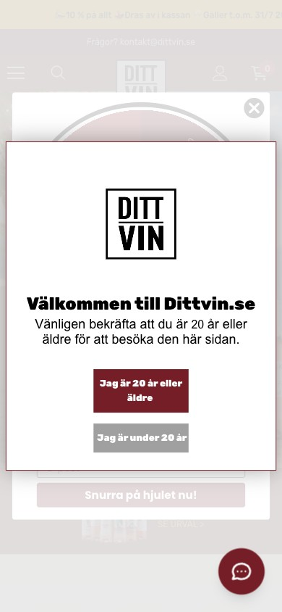
2026
Expert Review · Entry
Two Walls Before a Single Product
Cold Facebook visitors (41% of traffic) land and hit a legally required age check stacked on top of a spin the wheel email popup, before they see any wine.
Two popups in a row. The age check ("bekräfta att du är 20 år eller äldre") is legally needed, but a "Snurra på hjulet" spin the wheel popup stacks on top of it. People have to close two popups before they see a single wine.
Combine them into one step, and remember the choice with a cookie so repeat visitors are not asked again.
Turn the age gate into a trust moment. Right now it only blocks. Add one line: lawful Danish import, tax included. It is the perfect place to answer the legality question.
Emoji heavy promo bar. The top bar (party and clock emoji) clashes with a "kvalitetsviner" premium promise on a wine brand.
Chat and Klaviyo present. Support and capture tools are live. The issue is stacking and sequence, not absence.
Live mobile entry · captured 2026-07-23
ECOMHOUSE ©ALL RIGHTS RESERVED
26

Slide 28
2026
Expert Review · Homepage
Strong Bones, Two Real Cracks
Clear category nav and box carousels drive a 24.9% bounce. But blanket discounting and broken sections undercut the premium story.
Clear category circles. Rött, Vitt, Mousserande, Rosé, Gin, Vinlådor, Erbjudanden, Abonnemang, Alkoholfri 0%. Easy orientation, with Vivino badges on products.
Everything is on sale. Every product wears a red discount flag (-45%, -51%) plus "Spara X kr". Permanent discounting erodes urgency and reads as generic, not premium.
Reserve discounting for real offers. Merchandise awards and Vivino scores as the proof instead.
Sections render inconsistently. "Upplev både nya..." and "Kunskap och inspiration" loaded as empty bands on one capture and filled on the next, consistent with the 90+ website errors.
Flaky product presentation blocks. Fix the errors and confirm sections render reliably on mobile Safari.
Trust assets buried. The Danish operator line and Løvens Hule backing sit only in the footer, far from where doubt occurs.
Homepage · mobile capture
ECOMHOUSE ©ALL RIGHTS RESERVED
27

Slide 29
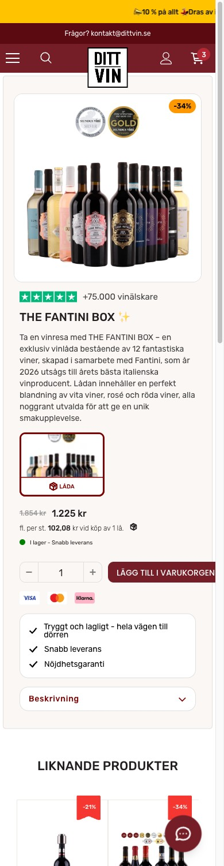
2026
Expert Review · Collection and Product Page
Good Product Page, Missing Reassurance
The product page has a sticky add to cart, social proof and a free shipping bar, but it never tells buyers the order is legal, says almost nothing about how each wine tastes, and leaks Danish text.
Solid fundamentals. Sticky add to cart, strikethrough price, "+75.000 vinälskare" social proof, Trustpilot and award badges, and a free shipping progress bar.
No legality block at the decision point. The exact place KRAN and Winefamly reassure, dittvin stays silent. This suppresses the 64% who view but never add.
You cannot tell how the wine tastes. A 12 bottle box shows only 3 photos and no taste notes for the wines inside: no grape, no sweetness or body, no food pairing, and no Vivino rating. People are asked to buy without knowing what they will actually drink.
Customers explicitly ask: "Jag saknar en beskrivning av respektive vin."
Danish leaks and shipping caveats. Page title reads "Kjøb hos Dittvin.se" (Danish), and free shipping is quietly limited to the Airmee carrier, which confuses buyers who then see a Bring fee.
Fantini box product page · mobile
ECOMHOUSE ©ALL RIGHTS RESERVED
28

Slide 30
2026
Expert Review · Balance
Strengths to Protect
This is a strong store. These assets should be preserved and amplified, not touched during optimization.
Box led assortment
4.7 Trustpilot on 5,985
Low homepage bounce
The wine box format is both the best converter (5.54%) and a genuine customer love ("hitta nya favoriter"). A rare product and data agreement.
A deep, credible review base. Underused on site, but a powerful proof asset for the legality and quality objections.
24.9% bounce on the homepage landing is excellent. The top of the experience works; the leaks are deeper in the funnel.
Sticky ATC and free ship bar
Real differentiators
Strong owned channels
Mobile buy box mechanics are already in place, including a cart progress bar toward free shipping.
Subscription plus boxes, alcohol free range, award medals, and a televised Løvens Hule backing that rivals lack.
Klaviyo email already drives 16% of orders at a 2.55% CVR. A ready lever to reduce paid dependency.
ECOMHOUSE ©ALL RIGHTS RESERVED
29

Slide 31
2026
05
Competitor Landscape
Five verified rivals plus the monopoly. Every competitor page was fetched before any claim. The pattern is clear: everyone reassures on legality except dittvin.
ECOMHOUSE ©ALL RIGHTS RESERVED
30

Slide 32
2026
Competitor · Verified Matrix
Where dittvin Sits
Scroll the table if needed. "Not shown" means the signal was absent from the fetched page, which is itself a finding. Den Sidste Flaske is dittvin's Danish market reference (same box and club model); it wins on free shipping with no minimum and a 100% satisfaction guarantee, both of which dittvin lacks.
CAPABILITY | DITTVIN | WINEFINDER | WINEFAMLY | KRAN | SUPERVIN | SYSTEMBOLAGET | SIDSTE FLASKE (DK)
Legality / tax messaging | None | Trygg mark | Tax stated | Skatteverket stated | CVR + Trygg | Is the channel | N/A, DK market
Trygg E-handel badge | No | Yes | Yes | No | Yes | N/A | N/A (DK), e-mark
Delivery cost / speed shown | Vague, Airmee only | Carriers named | Home delivery | Not stated | From 29 kr, 2-5 days | Multiple | Free, no minimum
Subscription | Yes | No | Boxes | Release club | No | No | Yes, Vinklub
Wine boxes / cases | Yes | Yes | Yes | Yes | Yes | No | Yes, Smagekasser
Reviews showcased | Vivino + medals | Critic + stars | Not shown | Press quotes | Trustpilot embed | None | Trustpilot 4,6 + Vivino
Alcohol free range | Yes | Not shown | Yes | Not shown | Yes | Yes | Yes
Filtering / search | Basic | Faceted + Vinprofil | Category | Minimal | Category | Food pairing | Category
ECOMHOUSE ©ALL RIGHTS RESERVED
31

Slide 33
2026
Competitor · Opportunity
Five Gaps, One Big Wedge
Close the gaps, then turn the biggest one into a differentiator no rival owns well.
1
2
3
Own the legality question
Add Trygg E-handel
Make delivery concrete
The category's top objection, and only KRAN answers it (buried in text). A friendly, visible "why this is legal" section would out reassure everyone.
Three of four direct rivals show the Swedish trust mark. dittvin leans on a Danish TV endorsement that carries less "safe Swedish shop" signal.
Supervin states "from 29 kr, free over 999, 2-5 days". dittvin says only "snabb" with a caveated 695 kr Airmee threshold. Concrete beats vague.
Biggest wedge
Quick win
Trust + clarity
4
5
+
Localize fully to Swedish
Merchandise proof, not just discounts
The retention moat rivals lack
Danish product types and page titles leak through ("Kjøb", "Smagekasser"). It reads un Swedish and hurts both trust and discovery.
dittvin holds award medals, Vivino scores and 4.7 Trustpilot but relies on a blanket 10% off. Own "curated wines at honest prices, with the proof".
dittvin already has subscription plus boxes. Winefinder and Supervin have no subscription at all. Own "the recurring discovery box for everyday Swedes".
Polish
Positioning
Defensible
ECOMHOUSE ©ALL RIGHTS RESERVED
32

Slide 34
2026
06
Technical Audit
Verified by live network capture, not an HTML scan. The tags are all present, but the configuration is noisy and partly wrong.
ECOMHOUSE ©ALL RIGHTS RESERVED
33

Slide 35
2026
Technical · Tracking
Clean the Data Before You Trust It
Everything fires (GTM, GA4, Meta Pixel, Google Ads, Klaviyo, Clarity, Cookiebot). The problem is redundancy and one clear misconfiguration.
High
High
Medium
Conversion fires on the homepage
Four GA4 properties at once
Dead and duplicate tags
A Google Ads conversion tag (AW-16748333837) fires "en=conversion, value 1.43 SEK" on homepage load. Every visit logs a conversion, polluting Ads data and misleading bidding.
G-2H577FR3BL, G-QVVPL3QFTK, G-ZHBPVPWFVY and G-ZPDXL42WNW all fire page_view in parallel. Fragmented, duplicated reporting. Consolidate to one source of truth.
Legacy Universal Analytics (UA-234356383-1) still sits in GTM (dead since 2023), and two Google Ads accounts fire. Prune to prevent double counting.
Low effort · High impact
Med effort · High impact
Low effort · Med impact
Medium
Asset
Medium
90+ console errors per load
Clarity is already installed
Recover the "(not set)" signal
Every page throws 90 to 190 JS errors. This is the likely cause of the blank homepage sections and a suspect in checkout drop off.
Microsoft Clarity (project v7fb9kby3w) is live and collecting session replays. You are sitting on behavioral data you are not using. Grant dashboard access.
Server side GTM plus Meta server side tracking and consent mode modeling would recover the 29% of sessions currently lost, and feed better data to the ad channel you depend on.
Med effort · Med impact
No effort · Insight
High effort · High impact
ECOMHOUSE ©ALL RIGHTS RESERVED
34

Slide 36
2026
Technical · Speed
Too Many Tags Slow the Store
The store loads a lot of third party tags and scripts on every page. On mobile, where 86% of buyers are, all that extra weight makes the page slower. The fix is smart tag management: remove what is not needed and combine the rest.
417
90+
4 + 2
Blocked
Things Load on the Homepage
Errors on Every Page
GA4 and Ads Tags
Speed Score
A heavy pile of third party scripts
Code errors to clear
Plus Meta, Rebuy, Klaviyo, chat
The speed test hit a daily limit; measure real speed in Clarity
The speed test was blocked by a daily limit, so there is no 0 to 100 score here. Shopify speed scores also read lower than real life, so treat speed as basic hygiene: cut the tag weight, clear the errors, then track real visitor speed in Clarity and Search Console.
ECOMHOUSE ©ALL RIGHTS RESERVED
35

Slide 37
2026
07
RPV: The Northstar
Revenue per visitor = conversion x order value, compounded by repeat. Before we grow it, we have to be able to see it. On Shopify numbers, here is where it stands and how to grow it.
ECOMHOUSE ©ALL RIGHTS RESERVED
36

Slide 38
2026
RPV · The Real Numbers
The Revenue Base (Shopify)
RPV = revenue per visitor. Here is the true 90 day base it multiplies from, straight from Shopify.
Shopify · 90 days · 25 April to 23 July 2026
METRIC (SHOPIFY, 90 DAYS) | VALUE | NOTE
Orders | 38,306 | 31,860 customers
Gross sales | 33.3M SEK | ex VAT, discounts, refunds
Total sales incl VAT + shipping | 41.5M SEK | money collected
Net sales | 31.7M SEK | recognised revenue
AOV | 864 SEK | gross / orders
Run rate: about 135M SEK/year gross, 165M incl VAT. GA4 would imply roughly a third of that, which is why measurement is lever one. RPV grows by lifting conversion (checkout), order value (box ladder) and repeat (subscription).
ECOMHOUSE ©ALL RIGHTS RESERVED
37

Slide 39
2026
RPV · The Equation
RPV = Conversion x Order Value
Four levers move the northstar: traffic quality, conversion, order value, and repeat. The real numbers, corrected against Shopify.
Shopify · 90 days · 25 April to 23 July 2026
868 SEK
99 SEK
38,306
66%
True AOV (Shopify)
RPV / session
Real Orders / 90d
Returning Buyers
GA4 overstated it at 1,017
33.3M / 336,855 sessions
3.3x the GA4 count
the repeat engine is on
RPV = Shopify gross 33.3M / Shopify sessions 336,855 = ~99 SEK per session, roughly 2.7x the Shopify benchmark. The levers with the most room are checkout conversion and subscription sign ups; measurement is what lets us steer them.
ECOMHOUSE ©ALL RIGHTS RESERVED
38

Slide 40
2026
GA4 Rates + Shopify Revenue · Directional
The New Customer Conversion Gap
New visitors are about twice the volume of returning ones, but they convert lower and bring only a quarter of revenue. Lifting new customer conversion toward the returning rate is the biggest immediate and lasting lift, and taste clarity is the lever.
GA4 · 90 days · 25 April to 23 July 2026 · directional
2.62%
3.42%
25%
+30%
New Visitor CVR
Returning Visitor CVR
New Customer Revenue
New Orders If Gap Closes
GA4, directional
~1.3x new (GA4)
Shopify: 10.9M of 43.7M
~+3,300 orders, +3.3M SEK (Est.)
GA4 tracks fewer purchases than Shopify (about 31% of orders), so read the counts as directional; we use the rates, not the absolutes, and the gap holds regardless of the undercount. Revenue split is Shopify (source of truth): new customers are 26% of orders and 25% of revenue. The lever to close the gap is removing the biggest new buyer hesitations: taste clarity first, then legality reassurance and a believable delivery promise. Every new customer converted compounds, because they become the returning base that already drives 75% of revenue.
ECOMHOUSE ©ALL RIGHTS RESERVED
39

Slide 41
2026
RPV · The AOV Engine
Boxes Are the Business
Tasting boxes are 76% of net sales at near full price. The realized blended discount is only 3.4%, so the on-site "-45%" flags are theatre, not margin loss.
Shopify · 90 days · 25 April to 23 July 2026
SEGMENT | UNITS 91D | SHARE OF NET SALES | AVG PRICE | REALIZED DISCOUNT
Tasting boxes (vinlådor) | 43,617 | 76.3% | 567 SEK | 1.2%
Single red bottles | 11,396 | 12% | ~400 SEK | 18.4%
Premium boxes (Grill, Guld, Deluxe) | 2,668 | 7% | 700 to 865 SEK | 2 to 5%
Subscription (3 tiers) | live | 101 orders / 90d | 749-849 SEK | 0%
Top 2 SKUs (THE FANTINI BOX, XL Introlåda) = 26.5% of net sales. Top 30 SKUs (6% of the catalog) = 80%. The AOV lever is a box ladder (move the 567 SEK buyer up to the 700 SEK+ premium tiers) plus growing the existing subscription sign ups, not more discounting.
ECOMHOUSE ©ALL RIGHTS RESERVED
40

Slide 42
2026
EcomHouse · Proven Winners
RPV Wins We Have Shipped
The same levers in this roadmap, run as A/B tests for other EU ecom brands. Client names under NDA, every one lifted revenue per visitor.
TEST (ON THE PRODUCT PAGE) | UPLIFT CVR | UPLIFT RPV
Trust section | n/a | +38.0%
Sticky add to cart | +25.3% | +21.1%
Volume discount display | +13.5% | +20.7%
Product trust tags | +13.2% | +10.8%
Quantity selector badge | +5.8% | +8.7%
Above the fold redesign | +6.9% | +5.2%
Six A/B tests EcomHouse ran for other EU ecommerce brands (client names under NDA), all on product pages and all run to statistical significance (86 to 96%). They map directly to this roadmap: trust, sticky add to cart, and volume or quantity offers. Every one lifted revenue per visitor, the same northstar we are optimising for dittvin.
ECOMHOUSE ©ALL RIGHTS RESERVED
41

Slide 43
2026
08
CRO & RPV Roadmap
Sequenced by impact and evidence. Fix trust and the cart leak first, then the product page and delivery experience, then the polish and the plumbing.
ECOMHOUSE ©ALL RIGHTS RESERVED
42

Slide 44
2026
Roadmap · The RPV Growth Plan
Five Levers, In Order
Sequenced by leverage on revenue per visitor. Measurement first because it multiplies every other lever and every paid krona.
# | LEVER | MOVE | WHY IT MOVES RPV | EFFORT
1 | Measurement | Server side GTM + Consent Mode modeling + Meta server side tracking; consolidate to one GA4 | Unlocks true RPV and feeds the ad algorithms 3x the conversion signal, lifting ROAS on the same spend | High
2 | Subscription | Grow the existing subscription (Wine, Gin, Champagne 749-849 SEK): showcase it, add sign up prompts at product page and checkout | Repeat is already strong (66%); a bigger subscription base turns it into predictable recurring RPV | Med
3 | AOV ladder | Anchor and upsell 567 SEK buyers to 700 SEK+ boxes; Rebuy cart add ons; tune free ship threshold | Boxes are 76% of revenue; moving box tier and sign ups rate lifts the AOV half of RPV without new traffic | Med
4 | Conversion | Taste profiles on every box + legality trust block + honest delivery promise + cart shipping clarity | Lifts the conversion half of RPV by closing the new customer gap (2.62% vs 3.42% returning), and new visitors are most of the traffic | Med
5 | Traffic mix | Grow organic search and balance the paid social mix (49% direct, 33% Meta today) | Diversified, cheaper traffic de risks the ~33% paid social dependence and steadies blended RPV | Strategic
Levers 1 and 2 are the RPV multipliers. Levers 3 and 4 are the CRO roadmap that follows. Lever 5 protects the whole system.
ECOMHOUSE ©ALL RIGHTS RESERVED
43

Slide 45
2026
Roadmap · Expected Uplift
What 90 Days of CRO Is Worth
The program lifts revenue per visitor by removing buyer hesitation (taste, legality, delivery) so more of today's visitors buy, and by nudging order value up. A 5 to 10% RPV lift in 90 days also builds the conversion foundation to capture the holiday traffic peak, when the same fixes pay back on far more traffic.
+5 to 10%
104 to 109 SEK
+1.7 to 3.3M SEK
+7 to 13M SEK
RPV Uplift (Est.)
Target RPV / session
Gross / 90 days (Est.)
Annualized (Est.)
90 day target
from 99 SEK today
on the current base
before holiday upside
LEVER | TODAY | TARGET | HOW
Checkout completion | 41% | 43 to 44% | Delivery clarity, legality reassurance, fewer website errors
Add to cart | 12.6% | 12.9 to 13.2% | Clearer taste and trust on product pages
Average order value | 868 SEK | 880 to 895 SEK | Box ladder, add-ons, subscription sign ups
Est. Modeled on the Shopify 90 day base, a conservative 5 to 10% RPV lift. The levers are the cheapest and highest intent ones: recover checkout, lift add to cart with clearer taste and trust, and nudge order value. The bigger prize is timing: a stronger conversion base before the holiday season means the store converts more of the seasonal spike, not just today's traffic.
ECOMHOUSE ©ALL RIGHTS RESERVED
44

Slide 46
2026
Roadmap · P0 · Do First
The Two Trust Levers
WHERE | TEST / FIX | HYPOTHESIS | EVIDENCE | EST. IMPACT
Global / product page / Cart | Add a plain language legality trust block (lawful Danish import, tax included, age verified, Trustpilot 4.7) | Neutralizing the monopoly doubt lifts first time buyer add to cart and checkout | Zero on-site legality copy; fraud language in reviews; KRAN and Winefamly reassure | High
Delivery promise | Replace "1-3 dagar" with an honest order specific ETA and proactive status updates | An accurate promise cuts the negative tail and protects repeat revenue | 86% of complaints, 31% cite the broken promise, repeat buyers churning | High
Cart to checkout | Surface shipping rule and free ship threshold in cart, add a clear continue step | Removing the shipping surprise recovers the largest abandonment pool | 60.2% cart abandonment, 32,859 users/90 days; free ship confusion in reviews | 1.5 to 1.8M SEK/qtr (Est.)
ECOMHOUSE ©ALL RIGHTS RESERVED
45

Slide 47
2026
Roadmap · P1 · Do Next
Conversion and Product Depth
WHERE | TEST / FIX | HYPOTHESIS | EVIDENCE | EST. IMPACT
Checkout | Diagnose and clear the website errors, verify payment path on mobile Safari | Removing checkout errors recovers the highest intent, cheapest audience | 46.9% checkout abandonment; 90+ JS errors per load | High
Box product page | Add per wine detail: grape, region, dry to sweet scale, Vivino score, more images | Turning a blind box into an informed pick lifts add to cart and cuts taste complaints | "Jag saknar en beskrivning av respektive vin"; 14% taste complaints; 3 images only | Med to High
Delivery UX | Let customers choose a delivery day/window, align carrier expectations | Solving the be home problem reduces cancellations and 1 to 3 star reviews | 23% cite the cancelled window / be home problem | Med
Collection | Box first layout, stronger faceted filtering (grape, sweetness, occasion) | Better discovery lifts the collection page from 2.6% toward box level CVR | Collection 2.6% vs boxes 4 to 5.5%; requests for a sortable list | Med
ECOMHOUSE ©ALL RIGHTS RESERVED
46

Slide 48
2026
Roadmap · P2 · Polish and Plumbing
Clean Up and De Risk
WHERE | TEST / FIX | HYPOTHESIS | EVIDENCE | EST. IMPACT
Entry | Merge age gate and spin wheel into one step, remember the choice | One clean gate reduces entry friction on cold paid traffic | Double popup verified on mobile; 41% cold Facebook traffic | Med
Tracking | Fix homepage conversion tag, consolidate to one GA4, remove dead UA | Clean data improves ad optimization and decision quality | Conversion on pageview; 4 GA4 + dead UA verified | High (data)
Trust marks | Add Trygg E-handel, surface Danish operator and Løvens Hule higher up | Recognized Swedish trust marks lift legitimacy for new buyers | 3 of 4 rivals show Trygg; assets buried in footer | Med
Localization | Remove Danish leaks ("Kjøb", "Smagekasser") and the stray .dk Trustpilot widget | Full Swedish polish removes trust dissonance | Danish page title + .dk widget shown to Swedes | Low
Owned channels | Grow email and search to balance the ~33% paid social share | Diversified demand de risks the whole business | Paid social ~33% of sessions; tagged email ~1% of sessions yet ~16% of orders, barely instrumented | Strategic
ECOMHOUSE ©ALL RIGHTS RESERVED
47

Slide 49
2026
Roadmap · The One Page Read
If You Do Only Three Things
These three sit at the intersection of biggest evidence and lowest effort. Start here.
1
2
3
Answer the legality question
Fix the delivery promise
Recover the cart leak
Trust wedge
Retention
1.5 to 1.8M
A visible "why this is legal" block on product page and cart, with the age check, Danish import model, tax included, and your 4.7 Trustpilot proof.
Replace "1-3 dagar" with an honest ETA and proactive updates. Protects the 40% of revenue that comes from repeat buyers.
Surface shipping rules in cart and add a clear continue step. 60.2% of carts never reach checkout today.
Lifts first time buyers
Kills 86% of complaints at the source
Est. SEK per quarter at current AOV
ECOMHOUSE ©ALL RIGHTS RESERVED
48

Slide 50
2026
09
SECTION 09
Recommended Tests
The first three tests to run, each with a hypothesis, primary metric, and a pre-agreed target. Built and QA'd by EcomHouse.
ECOMHOUSE ©ALL RIGHTS RESERVED
49

Slide 51
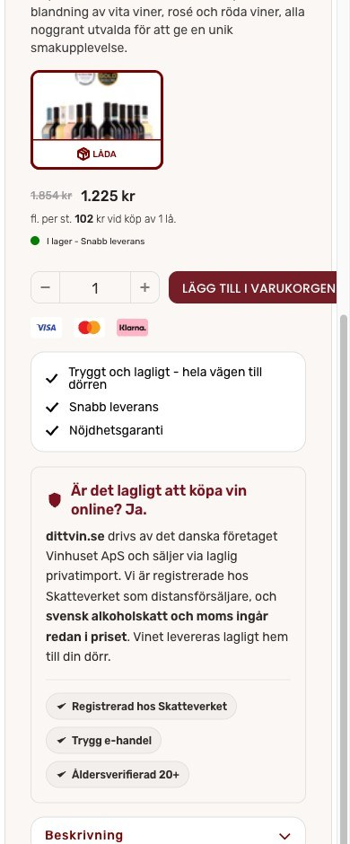
2026
TEST · DV-01
PDP legality & trust block
OBSERVATION
•
64% of product viewers never add to cart.
•
Zero on-site legality copy in a monopoly market.
•
80,8% of buyers are first time and new to private import.
HYPOTHESIS
Answering "is it legal?" at the buy box (Danish import, Skatteverket, tax included) removes the top objection and lifts add to cart for new buyers.
KEY METRICS
1.
View to add to cart (primary)
2.
PDP to purchase
3.
New visitor conversion rate
VARIANT · LEGALITY BLOCK
METRIC
CONFIDENCE
MIN ORDERS
DURATION
ATC rate
80%
300
2-4 wks
ECOMHOUSE ©ALL RIGHTS RESERVED
50

Slide 52
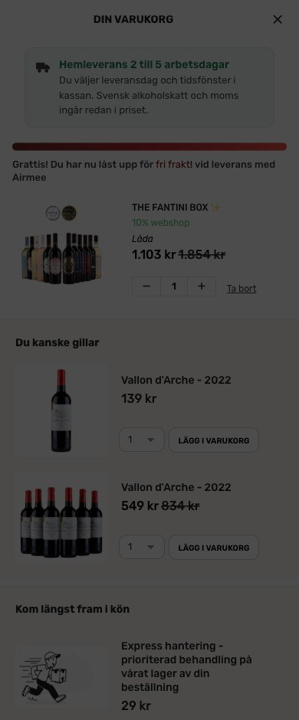
2026
TEST · DV-02
Cart drawer: delivery clarity
OBSERVATION
•
60,2% of add to carts never begin checkout.
•
Delivery estimate is buried; "1-3 dagar" promise is broken.
•
Free shipping is quietly Airmee-only, which confuses buyers.
HYPOTHESIS
Elevating an honest 2-5 day delivery block with a chooseable day, plus tax-included and payment trust at checkout, recovers the cart to checkout leak.
KEY METRICS
1.
Cart to begin checkout (primary)
2.
Checkout completion
3.
Revenue per session
VARIANT · CART CLARITY
METRIC
CONFIDENCE
MIN ORDERS
EST.
Cart→CO
80%
300
1,5-1,8M/qtr
ECOMHOUSE ©ALL RIGHTS RESERVED
51

Slide 53
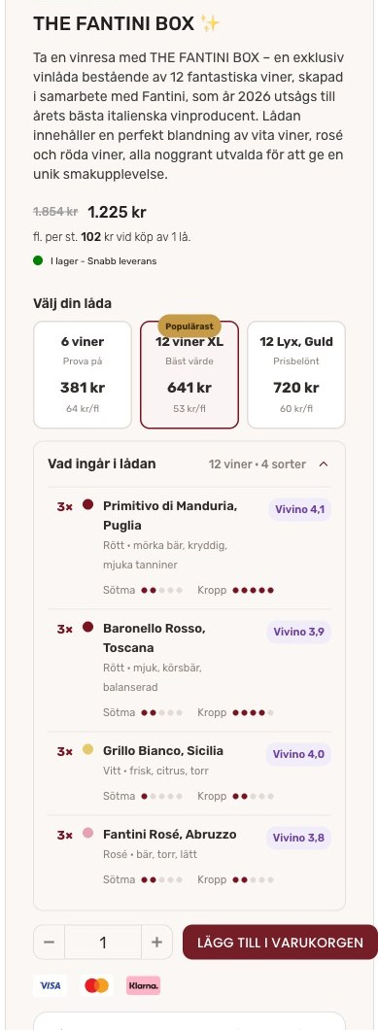
2026
TEST · DV-03
Box PDP: AOV ladder & taste detail
OBSERVATION
•
Boxes are 76% of revenue; avg box 567 SEK.
•
Premium 700 SEK+ tiers exist but sell in low volume.
•
Buyers cannot taste; 14% of complaints are about taste.
HYPOTHESIS
A tier ladder (6 / 12 XL / 12 Guld) with per bottle math and a per wine taste profile lifts order value and add to cart by removing the blind box risk.
KEY METRICS
1.
Revenue per session (primary)
2.
Average order value
3.
Add to cart rate
VARIANT · AOV LADDER
METRIC
CONFIDENCE
MIN ORDERS
DURATION
RPV / AOV
80%
300
2-4 wks
ECOMHOUSE ©ALL RIGHTS RESERVED
52

Slide 54
2026
10
SECTION 10
Working With EcomHouse
You approve, we execute. Research through rollout, priced on the wins. Recent results from other clients.
ECOMHOUSE ©ALL RIGHTS RESERVED
53

Slide 55
2026
THE ECOMHOUSE METHOD
Six steps, end to end
You approve. We execute. Every step is owned by us, including build, QA, and rollout. Client only approves the brief and rollout.
// 01
// 02
// 03
// 04
// 05
// 06
Research
Ideate
Pre-test brief
Build + QA
Run + monitor
Analyze + roll out
GA4, Shopify, heatmaps, recordings, reviews, support.
→
Hypothesis, variant concepts, copy, Figma prototype.
→
Written brief with metric, confidence, sample size.
→
Shopify or test tool variant, tracked, QA'd across devices.
→
Live test with guardrail watch, weekly progress updates.
→
Written verdict, fee invoiced on rollout to 100 % of traffic.
Zero-row service: the client is not expected to do production work. We handle everything from research through analysis. The client approves the pre-test brief and the rollout decision in writing.
ECOMHOUSE ©ALL RIGHTS RESERVED
54

Slide 56
2026
BRIEF + PROTOCOL
How every test launches and concludes
No test starts without a written, approved brief. Tests only conclude when all approved conditions are met.
PRE-TEST BRIEF
TESTING PROTOCOL
Every test launches with a written, approved brief
Guardrails on tooling, rigor, conclusion
// PART 1 Test setup
// PART 2 Statistical parameters
DEFAULT TOOL
CONFIDENCE
✓
Hypothesis and Control vs Variant difference
✓
Primary metric (RPV or funnel metric)
IntelliGEMS
80 % min
Or Convert, GrowthBook, Shopify-native with written approval.
Higher per test if you require it.
✓
Audience and traffic filters
✓
Statistical confidence (80 % default)
✓
Funnel stage and stage multiplier
✓
Minimum visitor and order count
CONCLUSION
REPORTING
✓
URL targeting
✓
Worked fee range at +5 / +10 / +15 %
All conditions met
Weekly Loom
✓
Frozen baselines from trailing 30 days
✓
Data sources named explicitly
Min visitors, orders, and confidence reached.
Plus a running test log you can access anytime.
ECOMHOUSE ©ALL RIGHTS RESERVED
55

Slide 57
2026
TRACK RECORD
Three winning EcomHouse tests
Real results from EcomHouse client engagements. Each test rolled out to 100 % of traffic after meeting the pre-approved confidence threshold. IntelliGEMS test tool.
Comforth · DK
PH Import · DK
PH Import · DK
Product tags on collection cards
PDP volume discount tiers
Homepage hero optimization
PROFIT / VISITOR
CONVERSION RATE
REVENUE / VISITOR
+11,42%
+11,08%
+20,87%
-11 % to +39 %
-3 % to +27 %
-12 % to +67 %
+106.550 kr / mo
+134.917 kr / mo (RPV)
+272.913 kr / mo
CR
+13,07%
2,09% → 2,37%
RPV
+17,10%
20,36 → 23,84 kr
CR
+7,72%
16,3% → 17,6%
RPV
+11,13%
26,88 → 29,87 kr
AOV
+5,42%
293,47 → 309,37 kr
AOV
+12,21%
401,87 → 450,94 kr
Orders / mo
+169
Orders / mo
+298
PDP view rate
+9,21%
56,6% → 61,8%
Added trust + benefit tags to collection product cards. Lift compounded across all three metrics.
Surfaced volume discount tiers directly on the PDP. CR was primary, RPV and AOV lifted simultaneously.
Reworked homepage hero with lighter background. Lifted the full funnel: more PDP views, higher AOV, more revenue.
Source: IntelliGEMS test reports. Confidence intervals shown reflect range of likely true effect. References available on request.
ECOMHOUSE ©ALL RIGHTS RESERVED
56

Slide 58
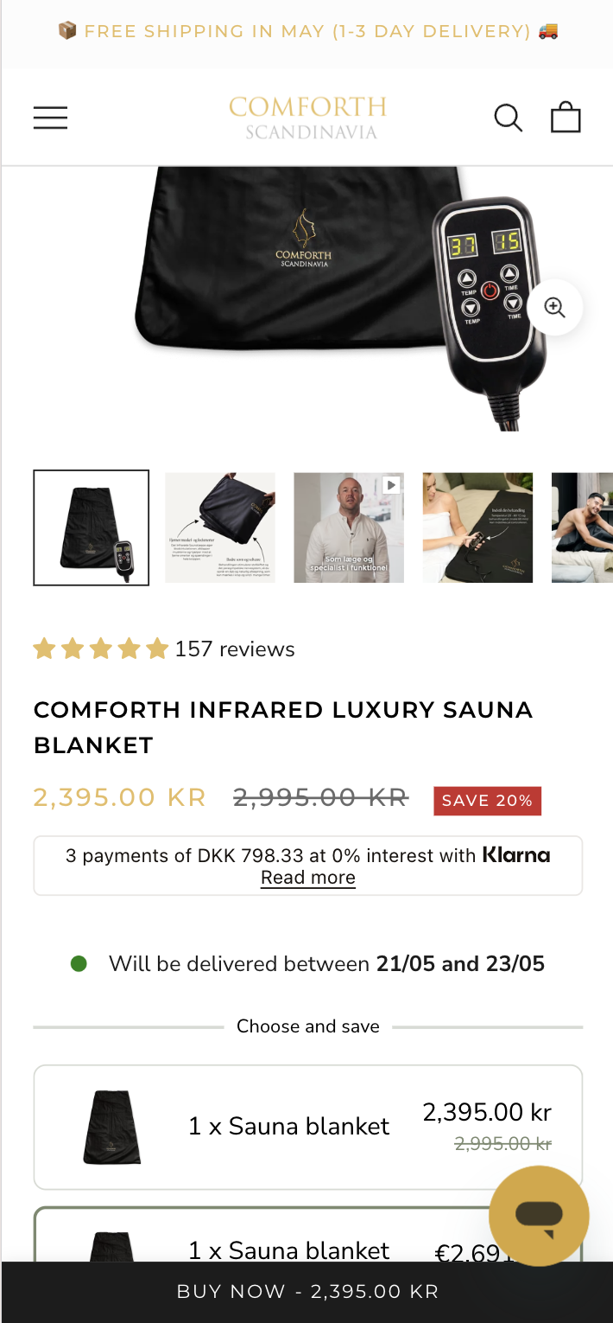
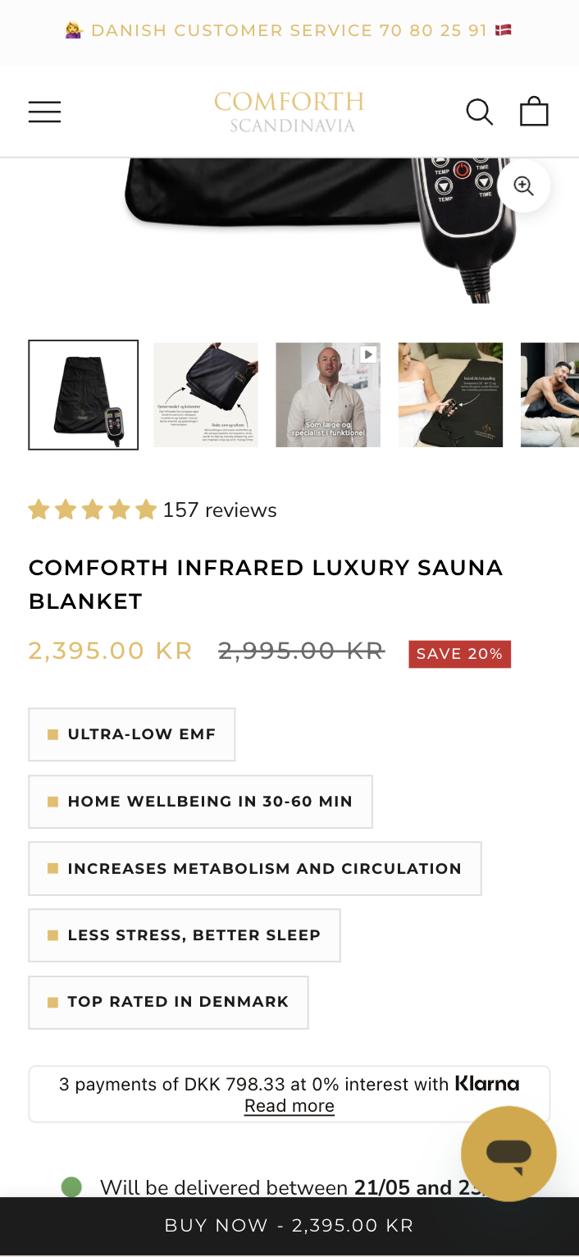
2026
CASE STUDY · 01
Comforth · Product tags on collection cards
Added benefit and trust tags directly to product cards on collection pages. Variant lifted all three commercial metrics with no degradation in any guardrail. IntelliGEMS, 100 % rollout.
PROFIT PER VISITOR (PRIMARY)
+11,42%
-11 % to +39 % CI
+106.550 kr / month projected
METRIC
CONTROL
VARIANT
Δ
Conversion rate
2,09 %
2,37 %
+13,07%
Revenue / visitor
26,88 kr
29,87 kr
+11,13%
Profit / visitor
15,07 kr
16,80 kr
+11,42%
CONTROL
VARIANT
Est. orders / mo
·
+169
ECOMHOUSE ©ALL RIGHTS RESERVED
57

Slide 59
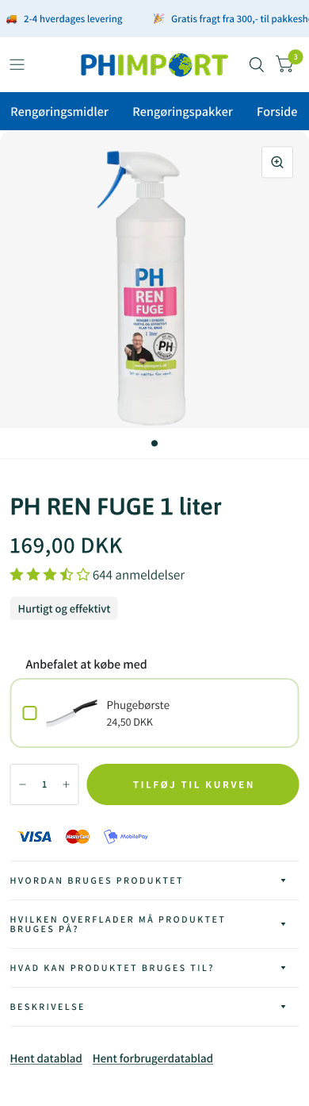
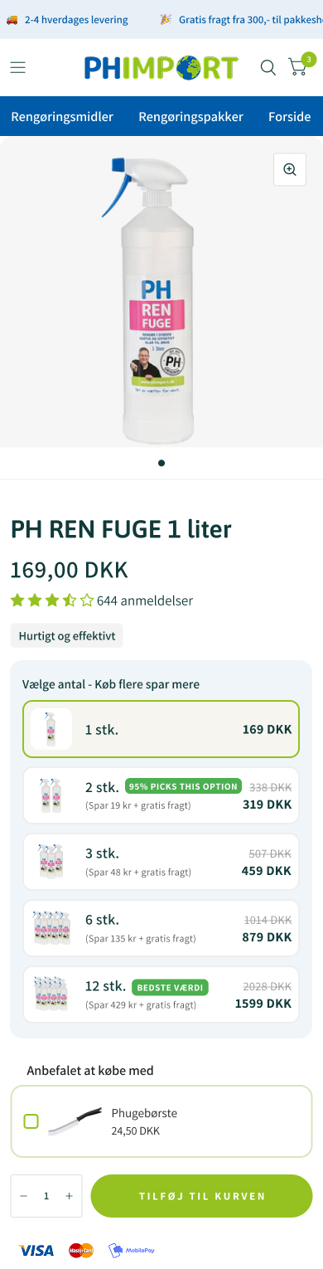
2026
CASE STUDY · 02
PH Import · PDP volume discount tiers
Surfaced volume discount tiers directly on the PDP. The variant lifted purchase rate, AOV, and downstream profit simultaneously. IntelliGEMS, 100 % rollout.
CONVERSION RATE (PRIMARY)
+11,08%
-3 % to +27 % CI
+298 orders / month · +134.917 kr / mo (RPV)
METRIC
CONTROL
VARIANT
Δ
Conversion rate
6,94 %
7,71 %
+11,08%
Revenue / visitor
20,36 kr
23,84 kr
+17,10%
Profit / visitor
10,49 kr
12,25 kr
+16,68%
CONTROL
VARIANT
Avg order value
293,47 kr
309,37 kr
+5,42%
ECOMHOUSE ©ALL RIGHTS RESERVED
58

Slide 60
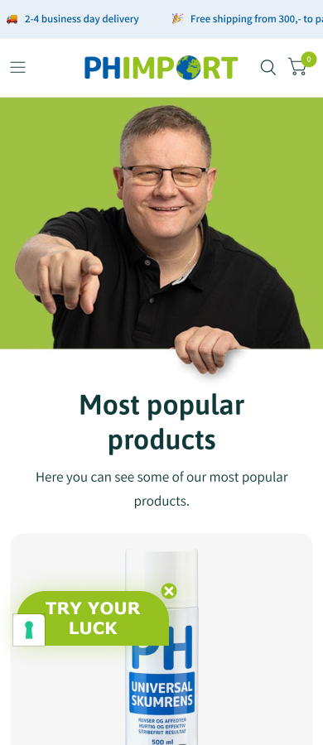
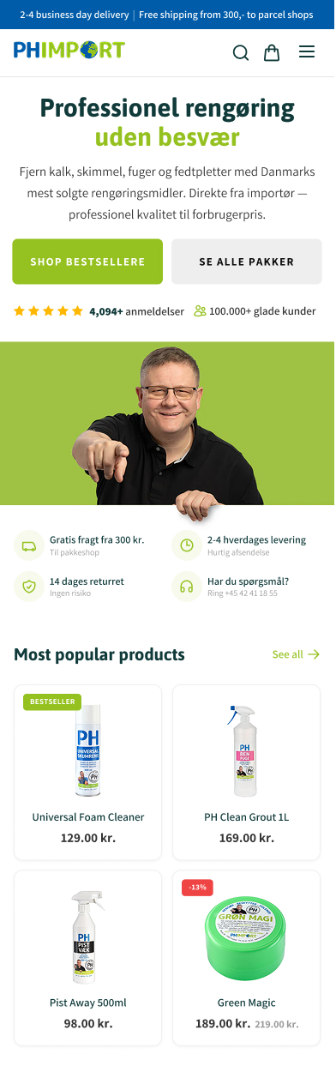
2026
CASE STUDY · 03
PH Import · Homepage hero optimization
Reworked homepage hero with a lighter background and a sharper category-led layout. Lift compounded through PDP views, AOV, and revenue. IntelliGEMS, 100 % rollout.
REVENUE PER VISITOR (PRIMARY)
+20,87%
-12 % to +67 % CI
+251 orders / month · +272.913 kr / mo
METRIC
CONTROL
VARIANT
Δ
Revenue / visitor
65,50 kr
79,17 kr
+20,87%
Profit / visitor
34,78 kr
42,35 kr
+21,78%
Avg order value
401,87 kr
450,94 kr
+12,21%
CONTROL
VARIANT
PDP view rate
56,6 %
61,8 %
+9,21%
ECOMHOUSE ©ALL RIGHTS RESERVED
59

Slide 61
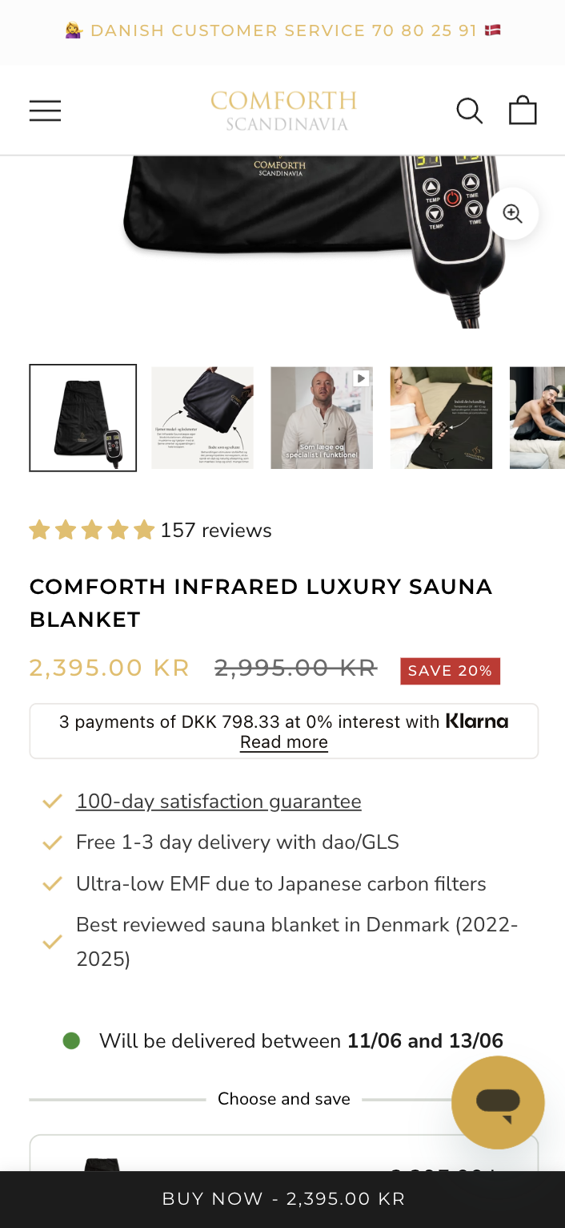
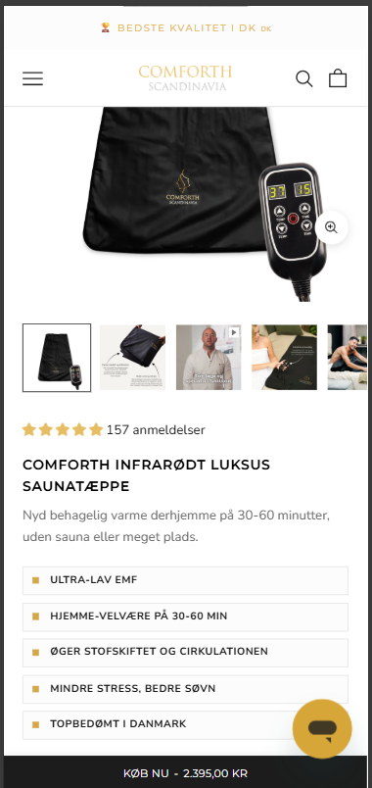
2026
CASE STUDY · COMFORTH DK
Comforth · Product tags on the PDP
REVENUE PER VISITOR (PRIMARY)
+10,83%
+183.515 kr / month projected
METRIC
CONTROL
VARIANT
Δ
Revenue / visitor
27,37 kr
30,34 kr
+10,83%
Verdict
Winner
CONTROL
VARIANT · WINNER
dittvin DV-03 does the same with taste and box detail above the fold.
ECOMHOUSE ©ALL RIGHTS RESERVED
60

Slide 62
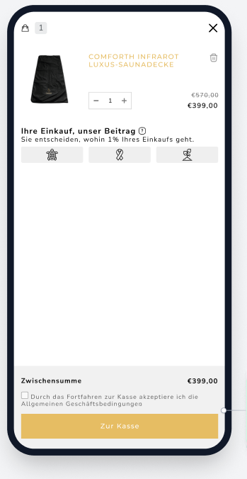
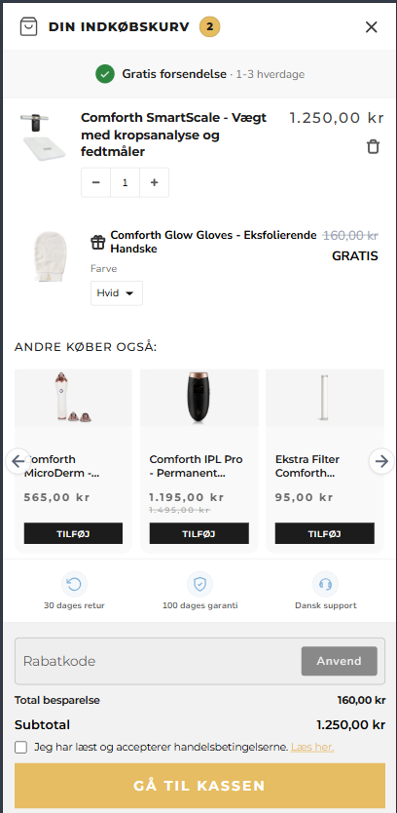
2026
CASE STUDY · COMFORTH DK
Comforth · Cart drawer redesign
REVENUE PER VISITOR (PRIMARY)
+15,52%
+171.285 kr / month projected
METRIC
CONTROL
VARIANT
Δ
Revenue / visitor
20,14 kr
23,26 kr
+15,52%
Verdict
Winner
CONTROL
VARIANT · WINNER
dittvin DV-02 targets the same cart to checkout leak.
ECOMHOUSE ©ALL RIGHTS RESERVED
61

Slide 63
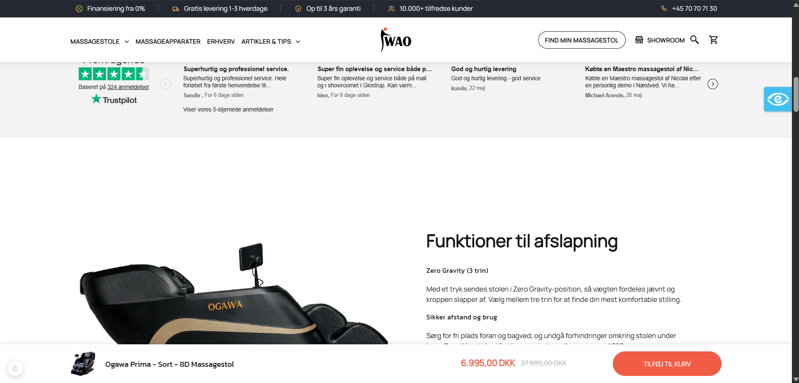
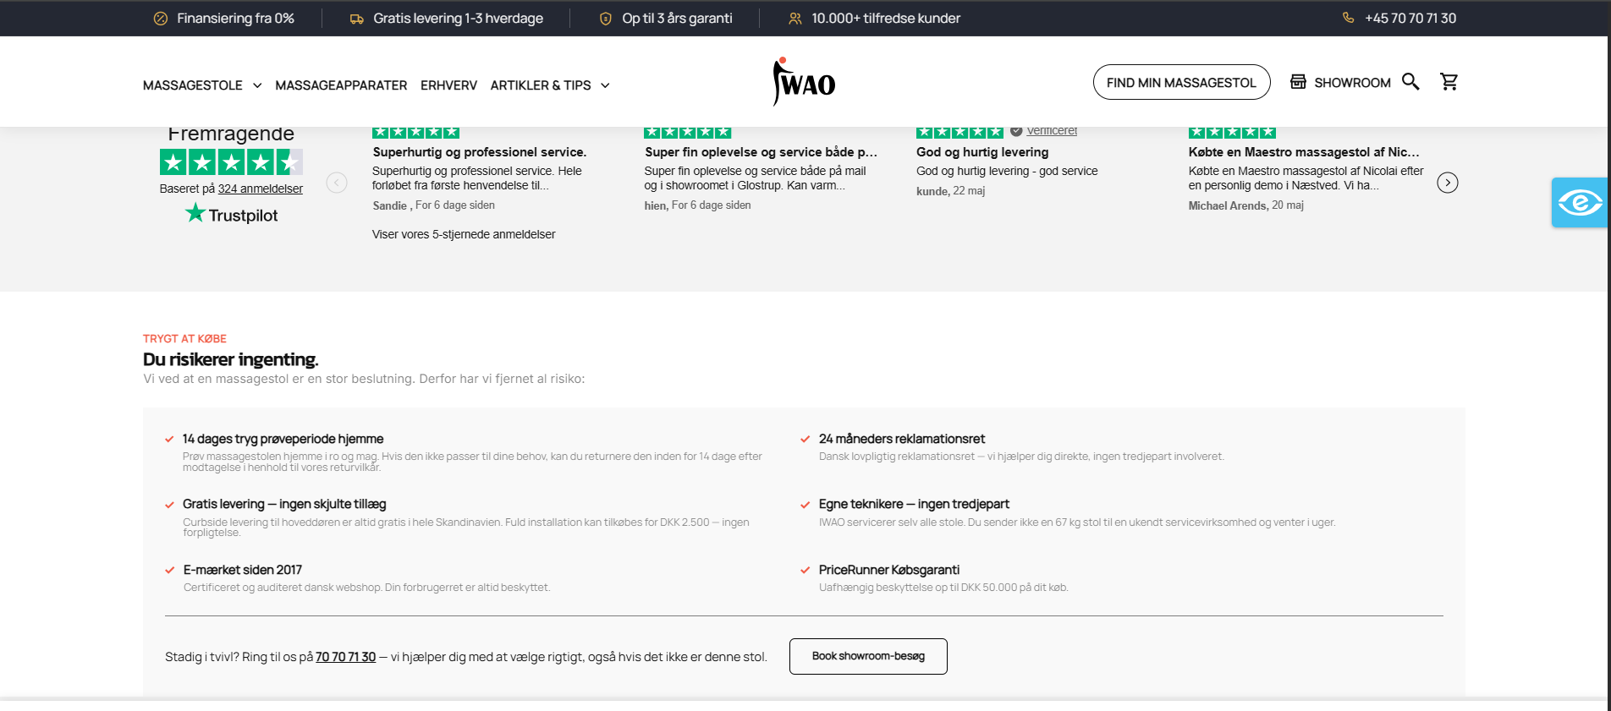
2026
CASE STUDY · IWAO
IWAO · Trust section on a high AOV PDP
ADD TO CART RATE (PRIMARY)
+38,03%
+27.931 kr / month projected
METRIC
CONTROL
VARIANT
Δ
Add to cart rate
11,36 %
15,68 %
+38,03%
Verdict
Winner
CONTROL
VARIANT · WINNER
IWAO sells DKK 8K to 125K. dittvin DV-01 legality and trust block is the same move for the monopoly market.
ECOMHOUSE ©ALL RIGHTS RESERVED
62

Slide 64
2026
COMPENSATION
We win when you win
Performance-based fee on every winning test rolled out to 100 % of traffic. One-time charge per test. No attribution window. No recurring tail.
// PERFORMANCE FEE
// OPTIONAL RETAINER
% of estimated monthly revenue uplift
Fixed monthly fee
Y %
X kr / month
Charged once per winning test on rollout. Calculated from the test's measured uplift and the client's own data, with the agreed stage multiplier applied.
Optional. Predictable monthly cost on top of (or instead of) the performance fee. Some clients prefer this for budgeting.
→
One time fee per winning test
→
Billed on the 1st, in advance
→
No recurring tail, no attribution window
→
Void if not agreed
→
Loser and inconclusive tests are free
→
Stackable with the performance fee
Billing: one invoice on the 1st covering the retainer (if any) plus the performance fee for every winning test rolled out last month. 8 day payment terms. Third-party costs (test tools, apps) paid by the client.
ECOMHOUSE ©ALL RIGHTS RESERVED
63

Slide 65
2026
DITT VIN
Thank You
Questions, and where we start
Recommended first sprint: legality trust block, delivery promise, cart shipping clarity
Prepared by Bhaskar Roy · CRO Audit for dittvin.se
ECOMHOUSE ©ALL RIGHTS RESERVED
64

