Slide 1


2026
sportgym.dk
5 changes that pay for themselves.
CRO Audit
A/B Test Roadmap
Performance-priced
Last 30 days (Shopify) · 9.510 sessions · 252 orders · 1.002.672 kr gross sales · 1,77 % site CR.
Prepared by EcomHouse for sportgym.dk · May 2026
ECOMHOUSE ©ALL RIGHTS RESERVED
00

Slide 2
2026
METHODOLOGY
How this report works
Every opportunity is GA4-backed, sized in DKK per month, and tagged by effort. Absolute GA4 numbers are directional, not exact. Step-to-step ratios drive prioritization.
// 01
// 02
// 03
Shopify analytics
DKK impact sizing
Effort tags
Re-baselined on Shopify last 30 days (Apr 21 to May 21, 2026). GA4 was found to underreport sessions by ~85 % and orders by ~90 % (Web Pixels Manager + iOS 17). Shopify is the source of truth for absolute counts.
Each opportunity is sized by estimated monthly DKK uplift. Math is conservative, uses Shopify baseline (9.510 sessions, 1.77 % CR, 3.813 kr AOV).
Every action carries a Low, Medium, or High effort tag so the work can be sequenced across three phases without forcing a replatform.
90 day revenue impact: at 50 % realization, this roadmap adds 127.000 to 235.000 kr per month on top of the current ~1.000.000 kr / month baseline. A 13 % to 23 % revenue increase within one quarter.
ECOMHOUSE ©ALL RIGHTS RESERVED
01

Slide 3
2026
BASELINE
Where sportgym.dk stands today
Shopify analytics · Last 30 days (Apr 21 to May 21, 2026). Re-baselined from Shopify after GA4 was found to underreport sessions by ~85 % and orders by ~90 %.
1.002.672 kr
252
3.813 kr
1,77 %
96 %
9.510
GROSS SALES · 30 DAYS
ORDERS · 30 DAYS
AVG ORDER VALUE
SITE CONVERSION RATE
SESSIONS TO ATC DROP
SESSIONS · 30 DAYS
MONTHLY UPLIFT OPPORTUNITY
253.000 to 469.000 kr / month · +25 % to +47 %
The leak is on the PDP. Over 30 days, 9.151 sessions hit the site and never added to cart (96 % drop). Three of the top five opportunities target that exact step.
ECOMHOUSE ©ALL RIGHTS RESERVED
02

Slide 4
2026
OVERVIEW
The opportunity landscape
Nine opportunities grouped into three priority buckets. Fix the PDP buy box, social proof, and financing first.
PHASE IMPACT
TOP 5 LEVERS
Critical · Week 1 to 2
1
PDP buy box rebuild · SG-02
65K to 120K
100.000 to 180.000 kr / month
2
Hero rebuild · category led · SG-01
28K to 55K
High value · Week 3 to 6
3
Accessories cross sell · SG-03
18K to 35K
123.000 to 232.000 kr / month
4
Klarna or ViaBill on PDP
55K to 100K
Optimize · Week 7 to 12
30.000 to 57.000 kr / month
5
Trustpilot 4,5 social proof
45K to 80K
PDP-level wins (buy box, financing, social proof) account for 165K to 300K kr per month, two thirds of the total opportunity. Every paid ad euro lands on a PDP today, so these fixes compound with the Facebook ad spend.
ECOMHOUSE ©ALL RIGHTS RESERVED
03

Slide 5
2026
00
RESEARCH FOUNDATION
What the data showed
Funnel decomposition, device behavior, traffic acquisition, and landing page performance pulled from Shopify (last 30 days) and GA4 (where ratios still hold). Every opportunity in the next sections is anchored in the data on these slides.
ECOMHOUSE ©ALL RIGHTS RESERVED
04

Slide 6
2026
FUNNEL DECOMPOSITION
Where visitors drop off
Shopify funnel · last 30 days. The 96 % collapse from session to add-to-cart is the single largest leak. Ratios match what GA4 reported, only the absolute counts changed.
1. Sessions
9.510
100 %
·
entry
2. Added to cart
359
3,77 % of sessions
- 9.151
no ATC
3. Reached checkout
246
68,5 % of ATC
- 113
ATC abandon
4. Completed checkout
169
68,7 % of checkout
- 77
checkout drop
5. All orders
252
+ Shop Pay etc.
+ 83
other channels
The single biggest leak is session to add to cart. 9.151 sessions (96 % of all visitors) never added a product to cart. Mobile drops ~97 %, desktop ~91 %. Same product page, very different mobile experience. Fix the PDP first, everything downstream is plumbing.
ECOMHOUSE ©ALL RIGHTS RESERVED
05

Slide 7
2026
DEVICE BEHAVIOR
Mobile carries traffic, desktop converts
Device split estimated from GA4 ratios applied to Shopify volume. Mobile is ~83 % of sessions but converts ~43 % worse than desktop. Mobile AOV is ~40 % lower.
Mobile
~83 % sessions
Desktop
~15 % sessions
SESSIONS · 30D
ORDERS
SESSIONS · 30D
ORDERS
~7.890
~150
~1.620
~80
CONVERSION RATE
AVG ORDER VALUE
CONVERSION RATE
AVG ORDER VALUE
~1,6 %
~3.500 kr
~2,8 %
~5.800 kr
MOBILE SESSION TO ATC
DESKTOP SESSION TO ATC
~3,0 %
~8,5 %
~97 % of mobile sessions never added to cart.
~91 % drop. Still high, but ~2,8x stronger than mobile.
ECOMHOUSE ©ALL RIGHTS RESERVED
06

Slide 8
2026
TRAFFIC ACQUISITION
Paid Facebook spends 46 % of GA4 sessions on zero tracked revenue
GA4 source/medium breakdown (90-day). GA4 only reports ~14 % of real sessions but the source mix is still directional. The Facebook gap is a tracking issue, not a creative one.
SOURCE / MEDIUM
SESSIONS
PURCHASES
REVENUE (KR)
NOTES
facebook / paid
1.797 (46 %)
0
0
Tracking gap or attribution loss
google / cpc
1.023
25
82.687
Healthy. 2,44 % CR
(direct) / (none)
379
21
126.715
Highest revenue. Likely absorbing FB
pricerunner / cpc
124
10
90.200
Premium intent. 9.020 kr AOV
partnerads / affiliate
228
4
8.175
Low ticket affiliate
google / organic
81
3
16.367
Thin presence. Opportunity
Tracking flag: 1.797 paid Facebook sessions with zero tracked revenue is a Conversions API or Pixel attribution issue, not a 'Facebook does not sell' issue. iOS 17 plus Shopify Web Pixels Manager regularly drop the source. Verify the Meta Pixel and CAPI before cutting Facebook spend.
ECOMHOUSE ©ALL RIGHTS RESERVED
07

Slide 9
2026
LANDING PAGES
Paid traffic lands on the page that breaks the funnel
Top landing pages over the last 90 days. Three of the top four are PDPs converting at 0,18 to 0,31 %. The homepage converts at 2,26 %.
LANDING PAGE
SESSIONS
BOUNCE
PURCHASES
CR
/products/the-virtufit-oval-isbad-500-liter-wood-look
569
68 %
1
0,18 %
/products/berg-sports-grand-champion-inground-520-grey
337
61 %
1
0,30 %
/products/virtufit-mini-bordtennisbord-tt160
324
80 %
1
0,31 %
/ (Homepage)
265
31 %
6
2,26 %
/products/flowfitness-ds100i-smart-home-gym
142
67 %
0
0,00 %
Every PDP fix in this audit compounds with the Facebook ad spend. If paid social keeps landing on PDPs, the buy box rebuild and the financing line are direct ad efficiency multipliers, not just on-site CRO.
ECOMHOUSE ©ALL RIGHTS RESERVED
08

Slide 10
2026
01
PHASE 1
Critical · fix this month
Three opportunities, 23.000 to 42.000 kr per month combined. Low to medium effort, all shippable inside 30 days. PDP-focused because the PDP is the leak.
ECOMHOUSE ©ALL RIGHTS RESERVED
09

Slide 11
2026
OPPORTUNITY 01 · CRITICAL
PDP buy box rebuild
ESTIMATED MONTHLY IMPACT
MEDIUM EFFORT
WEEK 3 TO 6
65.000 to 120.000 kr
EVIDENCE
ACTIONS
•
Session to ATC drops 96 % over 30 days (9.151 missed ATCs)
1
SHIP
Spec chip row under title: '3,0 HP · 18 km/t · 150 kg · Foldbart'
•
Mobile drop ~97 % vs desktop ~91 % on the same PDP
2
SHIP
Save badge above price: 'SPAR 4.000 kr · -22 %'
•
Above the fold: SKU, name, price, qty, CTA, two collapsed accordions. Built for a 200 kr product
3
SHIP
Trust badge row under CTA: 2 års garanti, Gratis fragt 499 kr, 365 dages retur, Showroom i Aarhus
•
'Relaterede produkter' cross sell shows competing treadmills, not accessories
4
TEST
Sticky add to cart on mobile, visible after gallery scroll
Recovering 1pp of mobile session-to-ATC (3,0 % to 4,0 %) on ~7.890 mobile sessions per month at the current 47 % ATC to purchase rate at 3.813 kr AOV adds about 140.000 kr per month. The full buy box rebuild targets ~1pp; the lower bound assumes 50 % realization.
5
TEST
Demo video as second gallery item (20 to 60 seconds)
6
SHIP
Replace cross sell with 'Komplet dit setup' (mat, lubricant, heart rate strap)
ECOMHOUSE ©ALL RIGHTS RESERVED
10

Slide 12
2026
OPPORTUNITY 04 · CRITICAL
Klarna or ViaBill financing on PDP
ESTIMATED MONTHLY IMPACT
LOW EFFORT
WEEK 1 TO 2
55.000 to 100.000 kr
EVIDENCE
ACTIONS
•
TR600i PDP shows 13.900 kr with no monthly equivalent. No Klarna, ViaBill, AnyDay, Sparxpres
1
SHIP
Install ViaBill or Klarna pay later via Shopify app
•
fitshop.dk shows both Klarna and ViaBill at PDP level and checkout
2
SHIP
Display monthly equivalent under price on every PDP above 1.500 kr
•
Average order value 3.813 kr. Top trampolines sit at 12.000 to 30.000 kr. Buyers finance major purchases
3
SHIP
Block under CTA: 'Op til 12 måneder rentefri delbetaling'
4
SHIP
Rotate 'Delbetaling tilgængelig' into top USP strip
•
Pay later is a default expectation in Denmark above 2.000 kr
Add financing logo to footer payment row + cart + checkout
5
SHIP
'Fra 1.158 kr / md med ViaBill' reframes the high price as a 12-month commitment. A 10 % relative lift on site CR (1,77 % to 1,95 %) on 9.510 monthly sessions at 3.813 kr AOV adds ~65.000 kr per month. Conservative half = ~55K.
ECOMHOUSE ©ALL RIGHTS RESERVED
11

Slide 13
2026
OPPORTUNITY 05 · CRITICAL
Promote the 4,5 Trustpilot stars you already have
ESTIMATED MONTHLY IMPACT
LOW EFFORT
WEEK 1 TO 3
45.000 to 80.000 kr
EVIDENCE
ACTIONS
•
SportGym ApS on Trustpilot: 4,5 / 5 across 15 anmeldelser ('Fremragende')
1
SHIP
Embed Trustpilot Trustbox under the homepage hero
•
Homepage shows no rating widget. Collection cards: zero stars. PDP: no review section
2
SHIP
Install Judge.me, Stamped, or Trustpilot Product Reviews. Stars on every collection card
•
fitshop.dk surfaces 4,84 / 41.278 reviews. Træningspartner shows 807 reviews
3
SHIP
Reviews block on every PDP: star average, count, verified buyer badge, 3 to 5 quotes
•
9.151 missed ATCs in 30 days. PDP has no social proof at the exact moment of decision
Klaviyo post-purchase flow: review request day 14, follow up day 30
4
SHIP
Social proof at PDP is the standard +5 % to +10 % CR lift in premium retail. On 252 monthly orders at 3.813 kr AOV, a 6 % lift compounds to ~58.000 kr per month. Conservative range 45-80K.
5
SHIP
Print one customer quote on order confirmation and unboxing card
ECOMHOUSE ©ALL RIGHTS RESERVED
12

Slide 14
2026
02
PHASE 2
High value · this quarter
Three opportunities, 18.000 to 34.000 kr per month combined. Mostly homepage and collection-level. Deliverable Week 3 to 8.
ECOMHOUSE ©ALL RIGHTS RESERVED
13

Slide 15
2026
OPPORTUNITY 02 · HIGH VALUE
Rebuild the hero around categories, not one Saturday
ESTIMATED MONTHLY IMPACT
MEDIUM EFFORT
WEEK 1 TO 2
28.000 to 55.000 kr
EVIDENCE
ACTIONS
•
Desktop hero left: dense 'KOM TIL EN SJOV DAG' event graphic. Right: event details (31. maj)
1
SHIP
Compress the event into a thin announcement strip under the existing fragt bar
•
Mobile first viewport is entire event banner. CTA 'Læg i indkøbskurv' never appears
2
SHIP
Category-led hero: lifestyle visual, brand promise, six tiles (Løbebånd, Romaskine, Smart Home Gym, Trampoliner, BERG, Tilbud)
•
Brand promise 'Alt til et aktivt liv, samlet ét sted' never appears above the fold
3
SHIP
Surface 4 trust USPs as a strip directly under the hero (fragt, retur, lager, showroom)
•
Homepage as landing converts at 2,26 %. Top three PDP landings convert at 0,18 to 0,31 %
4
TEST
Secondary CTA 'Find det rigtige løbebånd' leading to a guided buying flow
If rebuilt hero lifts homepage to PDP CTR by 10 % and downstream CR by 5 %, ~35.000 kr per month at the new baseline. Compounds with paid social redirected to homepage instead of PDPs.
ECOMHOUSE ©ALL RIGHTS RESERVED
14

Slide 16
2026
OPPORTUNITY 06 · HIGH VALUE
Structured filters and spec chips on collection pages
ESTIMATED MONTHLY IMPACT
HIGH EFFORT
WEEK 5 TO 8
18.000 to 35.000 kr
EVIDENCE
ACTIONS
•
/collections/lobebaend lists 13 treadmills from 3.495 to 39.900 kr. Filters: stock and price only
1
SHIP
Install Searchanise, Boost AI Search, or Smart Product Filter
•
No brand, motor power, max user weight, max speed, foldable, smart, or incline filter
2
SHIP
Løbebånd filters: Brand, Motor (HP), Max brugervægt, Maks hastighed, Hældning, Foldbart, Smart / App
•
Product cards show no specs, no ratings, no quick view, no compare
3
SHIP
Trampoliner filters: Størrelse, Form, Sikkerhedsnet, Aldersgruppe, Mærke
•
Collection / Isbad got 80 sessions, Trampoliner til nedgravning 81 sessions. Real category intent
3 to 5 spec chips on each card: '3 HP · 18 km/t · 150 kg · Foldbart'
4
SHIP
Filter UX improves collection to PDP rate by 10 % to 20 % in premium ecom. Estimated ~1.300 monthly collection sessions × 15 % lift × 3,77 % ATC × 47 % to purchase × 3.813 kr AOV adds ~25.000 kr per month.
5
TEST
'Find dit løbebånd' quiz at top of category
ECOMHOUSE ©ALL RIGHTS RESERVED
15

Slide 17
2026
OPPORTUNITY 03 · HIGH VALUE
Replace competing cross sells with accessories
ESTIMATED MONTHLY IMPACT
LOW EFFORT
WEEK 4 TO 6
18.000 to 35.000 kr
EVIDENCE
ACTIONS
•
Current 'Relaterede produkter' on TR600i PDP shows 4 other treadmills at 12.900, 4.995, 3.495, 7.495 kr
1
SHIP
Rename 'Relaterede produkter' to 'Komplet dit setup'
2
SHIP
Treadmill set: floor mat, lubricant, heart rate strap, water bottle, gulvmåtte
•
The cross sell competes with the current product. Sends the buyer sideways, not upward
•
Fitness Engros and Træningspartner ship accessory bundles. Best practice in fitness
3
SHIP
End the row with one upsell model for upgrade context
•
3.813 kr AOV. Floor mat (500 kr) and heart rate strap (600 kr) are obvious +10 % AOV adds
4
TEST
Cart drawer cross sell: 'Tilføj for kun 250 kr mere og få gratis fragt'
10 % AOV lift on 252 monthly orders at 3.813 kr = ~96.000 kr / month upside cap. Conservative 25 % capture = ~24.000 kr per month incremental.
ECOMHOUSE ©ALL RIGHTS RESERVED
16

Slide 18
2026
03
PHASE 3
Optimize · compound the wins
Three opportunities, 4.000 to 8.000 kr per month combined, plus a tracking quality fix that unblocks Meta ad efficiency. Mostly compounding, mostly long lever.
ECOMHOUSE ©ALL RIGHTS RESERVED
17

Slide 19
2026
OPPORTUNITY 07 · OPTIMIZE
Post purchase review flow (close the volume gap)
ESTIMATED MONTHLY IMPACT
LOW EFFORT
ONGOING
12.000 to 22.000 kr
EVIDENCE
ACTIONS
•
sportgym.dk: 15 Trustpilot reviews at 4,5 stars
1
SHIP
Klaviyo flow: review request 14 days after delivery, follow up at 30 days
•
træningspartner.dk: 807 reviews at 4,5 stars. Same score, 53x review volume
2
SHIP
Photo upload incentive: small thank you (next order discount or accessory)
•
berg.com: 4.000+ reviews. apuls.dk: 3.000+ reviews
3
SHIP
Print one customer quote on order confirmation and unboxing card
•
No automated review request flow in place. The asset is not growing
SMS follow up at 21 days for opted-in customers
4
TEST
A working flow at 252 orders / month at a 20 % response rate adds ~150 reviews / month. After 2 quarters the volume gap to peers halves and the PDP social proof opportunity compounds at a different scale.
ECOMHOUSE ©ALL RIGHTS RESERVED
18

Slide 20
2026
OPPORTUNITY 08 · OPTIMIZE
Buying guides plus 'Find dit løbebånd' quiz
ESTIMATED MONTHLY IMPACT
HIGH EFFORT
WEEK 8 TO 12
12.000 to 22.000 kr
EVIDENCE
ACTIONS
•
Organic search delivers 81 sessions at 16.367 kr revenue (4,1 % CR). Thin presence, high intent
1
SHIP
3 to 5 long form guides per major category (Løbebånd, Trampolin, Isbad, Smart Home Gym, Romaskine)
•
Fitness Engros runs an extensive blog plus athlete content. Træningspartner blogs but does not quiz
2
TEST
'Find dit løbebånd' quiz at top of /collections/lobebaend. 4 questions returning a shortlist of 2 to 3 SKUs
•
13 treadmills from 3.495 to 39.900 kr with no guided buying tool
3
SHIP
Link guides into the category page header and the PDP description block
•
No quiz flow today. Buyers compare 4 PDPs manually then leave
4
SHIP
Cross link from blog posts to specific PDPs
Buying guides drive organic compounding. Quiz delivers a 1,5x to 2x category to PDP conversion in premium retail. Steady state at 3 quarters: ~17.000 kr per month at the new baseline.
ECOMHOUSE ©ALL RIGHTS RESERVED
19

Slide 21
2026
OPPORTUNITY 09 · OPTIMIZE · TRACKING
Verify Meta Pixel and Conversions API before cutting FB spend
ESTIMATED MONTHLY IMPACT
LOW EFFORT
WEEK 1
Data quality unlock
EVIDENCE
ACTIONS
•
facebook / paid: 1.797 sessions, 0 tracked purchases, 0 kr revenue (46 % of all sessions)
1
SHIP
Audit Meta Pixel via Events Manager and Facebook Pixel Helper
•
(direct) / (none): 379 sessions, 21 purchases, 126.715 kr revenue (highest in the deck)
2
SHIP
Enable Shopify Conversions API integration in admin (server side fallback)
•
Direct is almost certainly absorbing the Facebook last click loss
3
SHIP
Run a 50 kr test purchase and confirm Purchase event fires once, not twice
•
iOS 17 plus Shopify Web Pixels Manager regularly drop the source on the new event API
Validate the event match quality score climbs above 7
4
SHIP
This is an ad efficiency unlock, not a CR opportunity. With proper attribution Meta's Advantage Plus campaigns can scale efficiently. Without it, every spend decision is blind. Fix this before any FB budget changes.
5
SHIP
Re-baseline attribution after 14 days of corrected data
ECOMHOUSE ©ALL RIGHTS RESERVED
20

Slide 22
2026
BENCHMARK
How three Danish competitors handle the same gaps
Fitshop is the scale player. Fitness Engros is the content brand. Træningspartner is the Trustpilot volume leader. Each solves at least three of the five blockers.
FEATURE
sportgym.dk
fitshop.dk
fitnessengros.dk
træningspartner.dk
Hero sells the category
No · event banner
Yes · categories
Yes · categories
Partial
Trustpilot widget on home
Not visible
Google 4,84 / 41k
Static stars
807 reviews
Reviews on PDP
None
Limited
None
Stars + count
Financing on PDP
None
Klarna + ViaBill
Not visible
Yes
Structured filters
Stock + price only
Some brand filters
Category subnav
Multi facet
Cross sell = accessories
Competing models
Mixed
Accessory bundles
Mixed
Showroom / pickup
Aarhus + PDP pickup
69 EU stores
Taastrup showroom
Limited
ECOMHOUSE ©ALL RIGHTS RESERVED
21

Slide 23
2026
CUSTOMER VOICE
'Fremragende'. 4,5 stars. And nobody is asking for more.
The Trustpilot profile for SportGym ApS shows a strong score on a thin sample. The fix is not to manufacture reviews. The fix is to show what you have and to ask after every purchase.
★ ★ ★ ★ ★
VOLUME GAP VS DANISH PEERS
sportgym.dk
15 reviews · 4,5 ★
4,5 / 5
træningspartner.dk
807 reviews · 4,5 ★
apuls.dk
3k reviews · 4,2 ★
SportGym ApS on Trustpilot · 'Fremragende'
berg.com
4k reviews · 4,5 ★
A 4,5 score is rare territory for fitness ecom. The cost of leaving it invisible compounds with every paid click. Every visitor who leaves to check Trustpilot on their own is a visitor you stopped trusting before they trusted you.
luksusleg.dk
15 reviews · 4,5 ★
Same score as Træningspartner. 1 / 53rd of their review volume. A post purchase email flow at scale closes that gap within two quarters.
ECOMHOUSE ©ALL RIGHTS RESERVED
22

Slide 24
2026
EXECUTION
90 day roadmap
Three phases. Compounding impact across the quarter. None require a replatform.
// PHASE 1
// PHASE 2
// PHASE 3
Quick wins
Core optimizations
Growth systems
Week 1 to 2
Week 3 to 6
Week 7 to 12
EXPECTED IMPACT
EXPECTED IMPACT
EXPECTED IMPACT
100K to 180K kr / mo
123K to 232K kr / mo
30K to 57K kr / mo
→
Embed Trustpilot Trustbox under hero
→
PDP buy box rebuild (chips, badges, financing, trust, sticky ATC, video)
→
Collection filters + spec chips
→
Install ViaBill or Klarna on PDP
→
Hero rebuild: category grid + brand promise
→
'Find dit løbebånd' quiz
→
Reviews app: stars on cards + PDP
→
Accessories cross sell ('Komplet dit setup')
→
Buying guides per category
→
Verify Meta Pixel + CAPI
→
Klaviyo post purchase review flow
→
PDP comparison table + FAQ block
→
Trust USP strip under hero
→
Re-baseline attribution post Meta fix
→
Compress event into thin strip
ECOMHOUSE ©ALL RIGHTS RESERVED
23

Slide 25
2026
SUMMARY
Opportunity scorecard
All 9 opportunities sized, prioritized, and tagged by effort and phase.
#
OPPORTUNITY
MONTHLY DKK
EFFORT
PHASE
01
PDP buy box rebuild · SG-02
65.000 to 120.000
Med
Phase 2
02
Hero rebuild · category led · SG-01
28.000 to 55.000
Med
Phase 2
03
Accessories cross sell · SG-03
18.000 to 35.000
Low
Phase 2
04
Klarna or ViaBill financing
55.000 to 100.000
Low
Phase 1
05
Trustpilot social proof
45.000 to 80.000
Low
Phase 1
06
Collection filters + chips
18.000 to 35.000
High
Phase 3
07
Post purchase review flow
12.000 to 22.000
Low
Phase 2
08
Buying guides + quiz
12.000 to 22.000
High
Phase 3
09
Meta Pixel + CAPI fix
Data quality unlock
Low
Phase 1
TOTAL ADDRESSABLE UPLIFT
253.000 to 469.000 kr per month · +25 % to +47 %
ECOMHOUSE ©ALL RIGHTS RESERVED
24

Slide 26
2026
04
SELECTED TEST PLANS
Three tests, three mockups
Three highest-impact opportunities, designed at the pixel level. Hypothesis and KPIs included on each card.
ECOMHOUSE ©ALL RIGHTS RESERVED
25

Slide 27
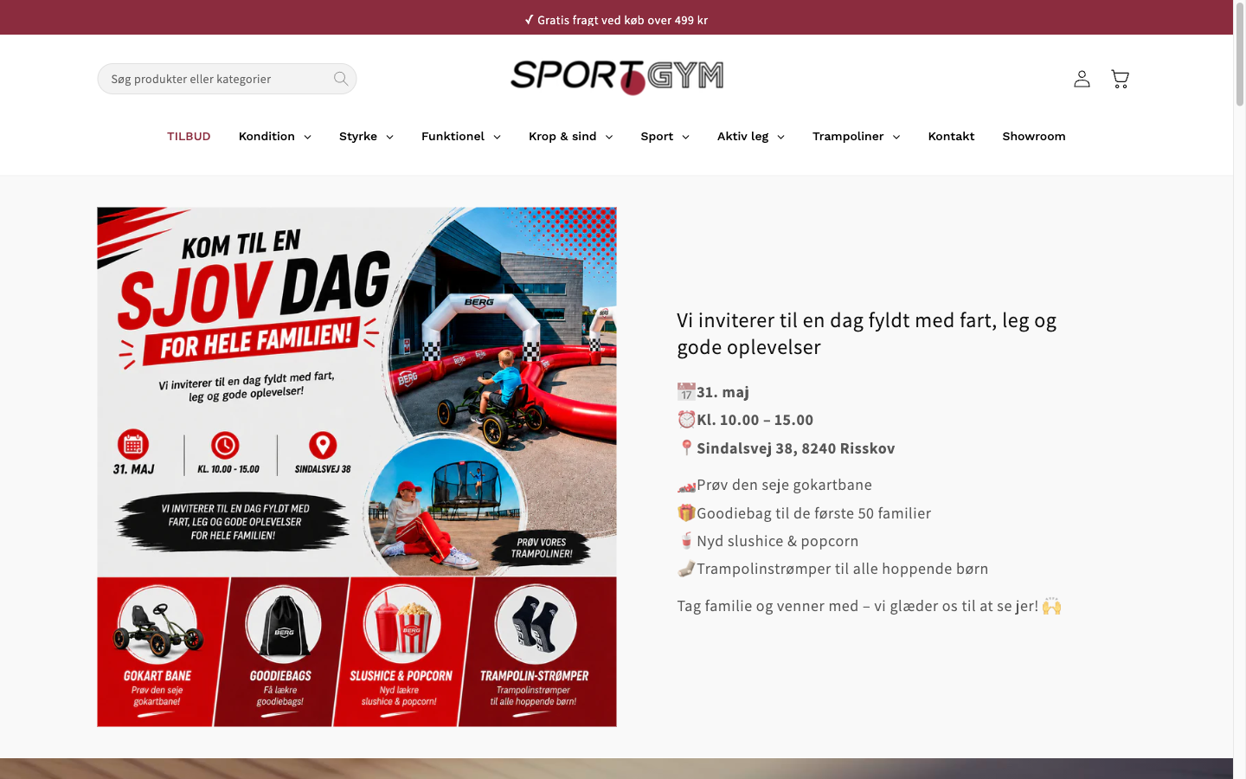
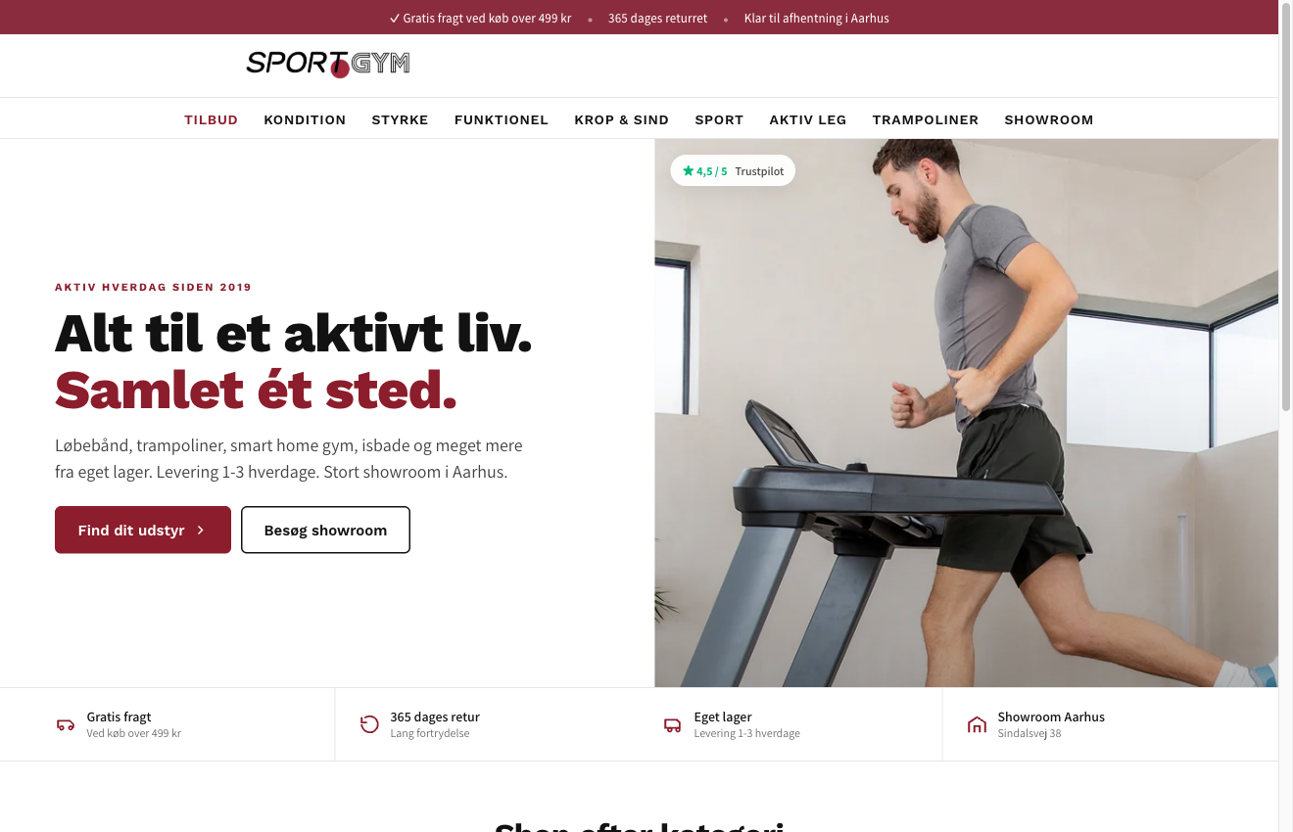
2026
SG-01 · HERO
Category led hero
Category led hero
Tool:
IntelliGEMS
Phase:
2 · W1-2
A/B TEST
OBSERVATION
•
Homepage hero is occupied by a one-day family event banner. New visitors get no signal this is a fitness equipment store.
•
Homepage as landing page converts at 2,26 % (6 / 265). Paid PDP landing pages convert at 0,18 to 0,31 %.
•
Brand promise and category nav never appear above the fold on mobile.
HYPOTHESIS
Replacing the event hero with a category-led layout (lifestyle visual, brand promise, six category tiles, four trust USPs) lifts homepage to PDP CTR and downstream site CR for paid social and direct traffic.
KEY METRICS
1.
Homepage to PDP CTR
2.
Bounce rate
3.
Site CR
CONTROL
VARIANT
DURATION
AUDIENCE
MULTIPLIER
URL
4 weeks
All visitors
25 %
/ (homepage)
ECOMHOUSE ©ALL RIGHTS RESERVED
26

Slide 28
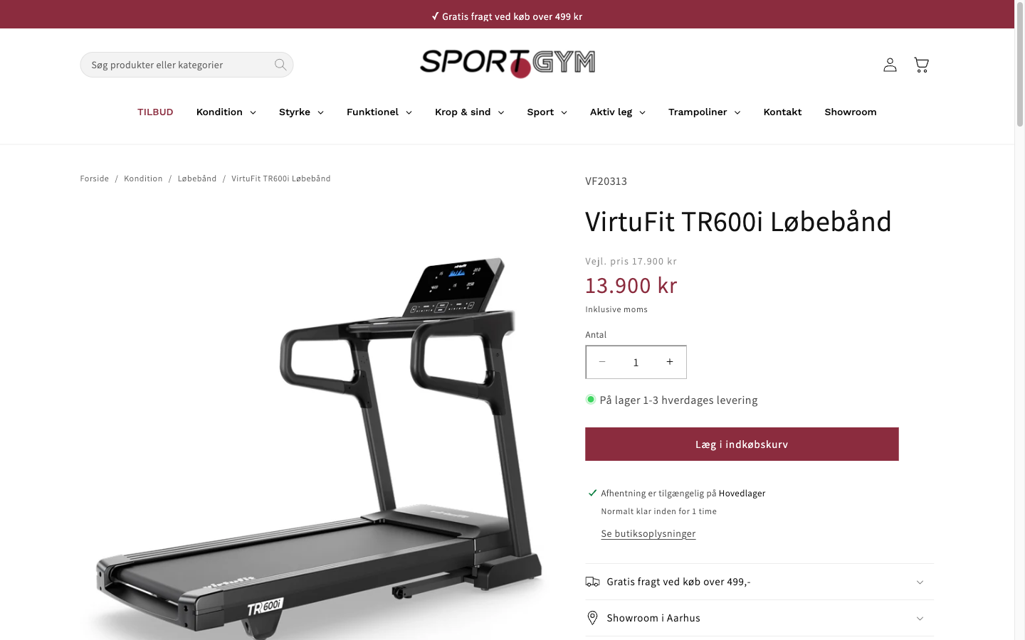
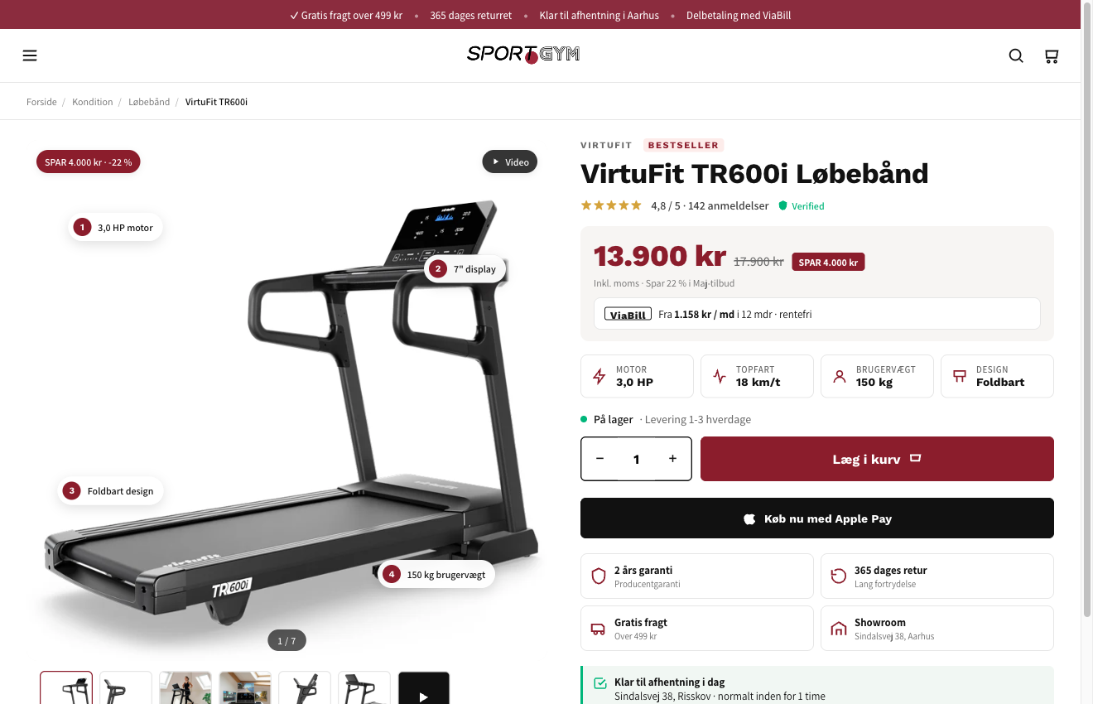
2026
SG-02 · PDP
PDP buy box rebuild
PDP buy box rebuild
Tool:
IntelliGEMS
Phase:
2 · W3-6
A/B TEST
OBSERVATION
•
95 % of PDP viewers never add to cart. 2.535 missed ATCs over 90 days. Mobile drops 96,2 %, desktop 86,1 %.
•
TR600i PDP at 13.900 kr shows no financing, no save badge, no spec chips, no trust badges, no demo video.
•
Cross sell module surfaces 4 competing treadmills instead of accessories.
HYPOTHESIS
Rebuilding the PDP fold with spec chips, a save badge, a financing line, four trust badges, and a sticky add-to-cart on mobile lifts PDP add-to-cart rate without changing price or product range.
KEY METRICS
1.
PDP to add-to-cart rate
2.
Revenue per visitor
3.
Average order value
CONTROL
VARIANT
DURATION
AUDIENCE
MULTIPLIER
URL
4-6 weeks
PDP visitors
75 %
/products/*
ECOMHOUSE ©ALL RIGHTS RESERVED
27

Slide 29
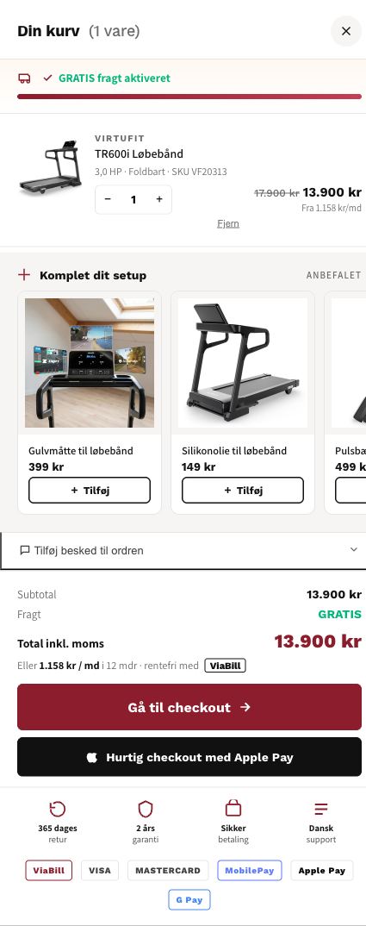
2026
SG-03 · CART
Cart drawer cross sell
Cart drawer cross sell
Tool:
IntelliGEMS
Phase:
2 · W4-6
A/B TEST
OBSERVATION
•
ATC to begin-checkout is 65 % (45 carts abandoned at the ATC step per quarter).
•
Current cart shows product, qty, total. No cross sell, no shipping progress, no financing reminder.
•
5.015 kr AOV. Floor mat, lubricant, heart rate strap are obvious accessory adds.
HYPOTHESIS
Upgrading the cart drawer with a 'Komplet dit setup' accessory module, free-shipping progress bar, financing reminder, and trust row lifts AOV and cart-to-checkout completion without slowing the primary purchase flow.
Cart drawer (current) Product · qty · subtotal · checkout No cross sell. No shipping progress. No trust row.
KEY METRICS
1.
Average order value
2.
Items per order
3.
Cart to checkout completion rate
CONTROL
VARIANT
DURATION
AUDIENCE
MULTIPLIER
URL
3 weeks
All ATC events
100 %
Cart drawer (global)
ECOMHOUSE ©ALL RIGHTS RESERVED
28

Slide 30
2026
AUDIT CLOSE
Ship Phase 1 this month.
Three Phase 1 wins (financing, social proof, Meta fix) are all Low effort and shippable inside two weeks. None require a replatform.
Expected impact within 30 days: 100.000 to 180.000 kr / month. Compounds into Phase 2 (PDP rebuild) at Week 3.
Powered by Shopify analytics (last 30 days) · live site capture 11. maj 2026 · Trustpilot · three Danish competitors · EcomHouse CRO team
ECOMHOUSE ©ALL RIGHTS RESERVED
29

Slide 31
2026
TRACK RECORD
Three winning EcomHouse tests
Real results from EcomHouse client engagements. Each test rolled out to 100 % of traffic after meeting the pre-approved confidence threshold. IntelliGEMS test tool.
Comforth · DK
PH Import · DK
PH Import · DK
Product tags on collection cards
PDP volume discount tiers
Homepage hero optimization
PROFIT / VISITOR
CONVERSION RATE
REVENUE / VISITOR
+11,42%
+11,08%
+20,87%
-11 % to +39 %
-3 % to +27 %
-12 % to +67 %
+106.550 kr / mo
+134.917 kr / mo (RPV)
+272.913 kr / mo
CR
+13,07%
2,09% → 2,37%
RPV
+17,10%
20,36 → 23,84 kr
CR
+7,72%
16,3% → 17,6%
RPV
+11,13%
26,88 → 29,87 kr
AOV
+5,42%
293,47 → 309,37 kr
AOV
+12,21%
401,87 → 450,94 kr
Orders / mo
+169
Orders / mo
+298
PDP view rate
+9,21%
56,6% → 61,8%
Added trust + benefit tags to collection product cards. Lift compounded across all three metrics.
Surfaced volume discount tiers directly on the PDP. CR was primary, RPV and AOV lifted simultaneously.
Reworked homepage hero with lighter background. Lifted the full funnel: more PDP views, higher AOV, more revenue.
Source: IntelliGEMS test reports. Confidence intervals shown reflect range of likely true effect. References available on request.
ECOMHOUSE ©ALL RIGHTS RESERVED
30

Slide 32
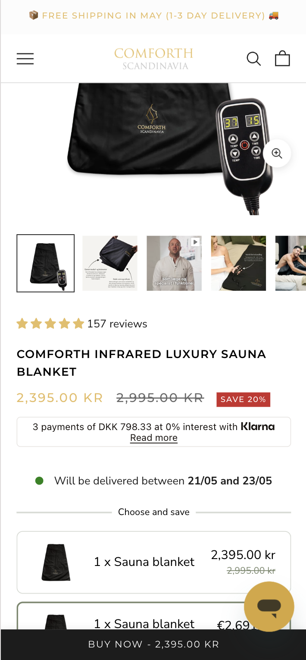
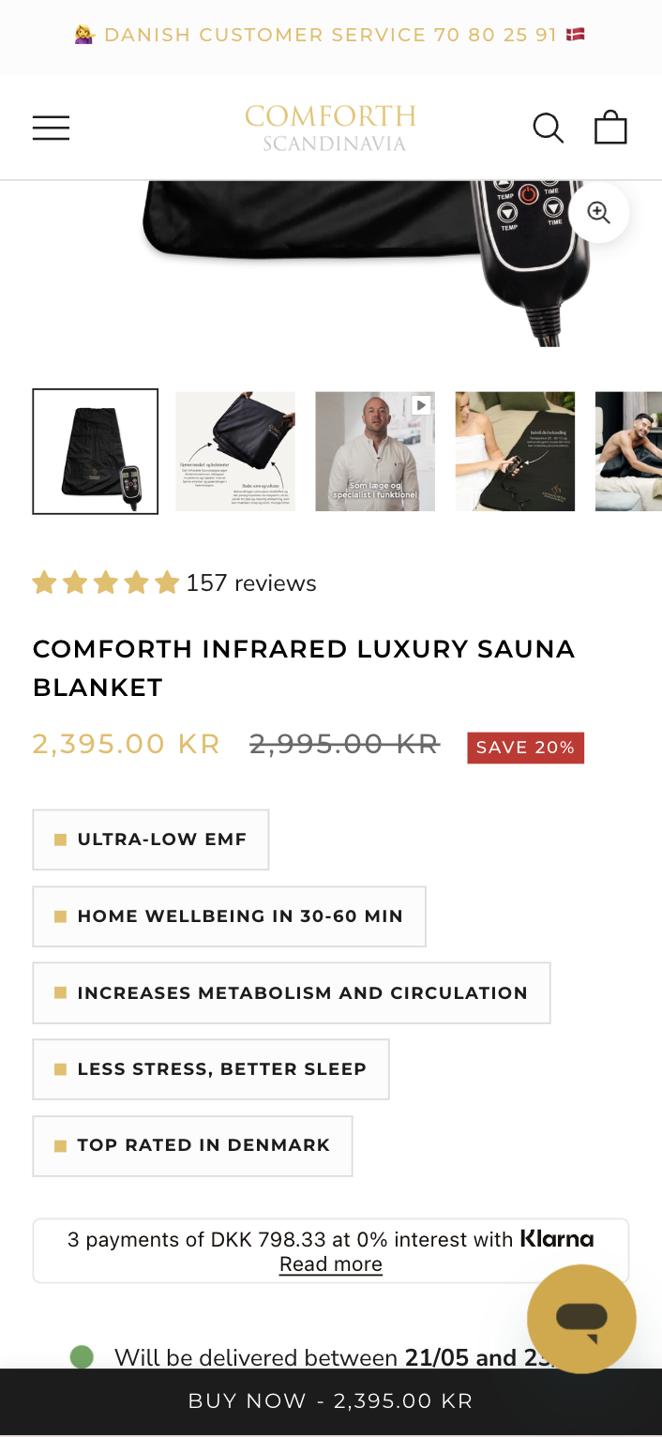
2026
CASE STUDY · 01
Comforth · Product tags on collection cards
Added benefit and trust tags directly to product cards on collection pages. Variant lifted all three commercial metrics with no degradation in any guardrail. IntelliGEMS, 100 % rollout.
PROFIT PER VISITOR (PRIMARY)
+11,42%
-11 % to +39 % CI
+106.550 kr / month projected
METRIC
CONTROL
VARIANT
Δ
Conversion rate
2,09 %
2,37 %
+13,07%
Revenue / visitor
26,88 kr
29,87 kr
+11,13%
Profit / visitor
15,07 kr
16,80 kr
+11,42%
CONTROL
VARIANT
Est. orders / mo
·
+169
ECOMHOUSE ©ALL RIGHTS RESERVED
31

Slide 33
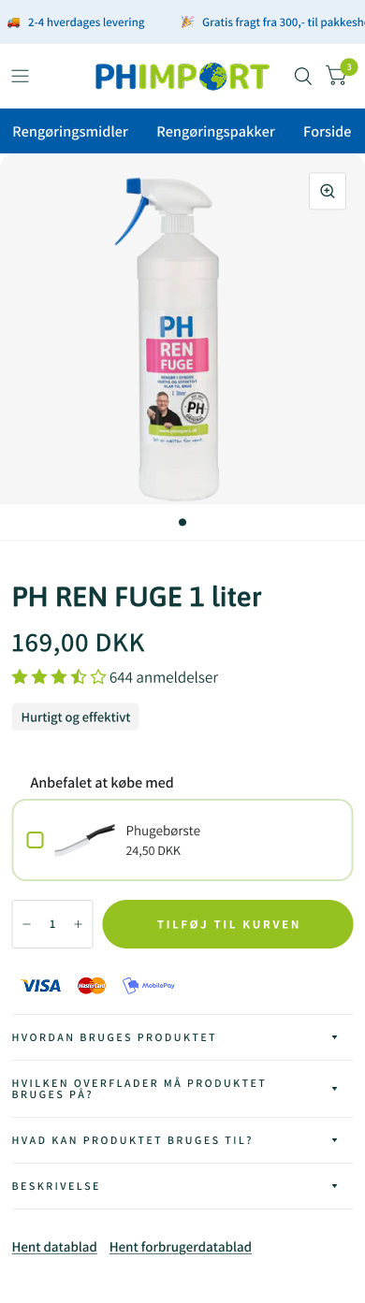
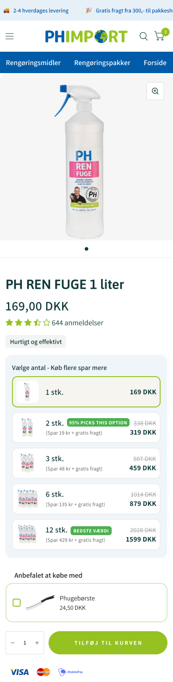
2026
CASE STUDY · 02
PH Import · PDP volume discount tiers
Surfaced volume discount tiers directly on the PDP. The variant lifted purchase rate, AOV, and downstream profit simultaneously. IntelliGEMS, 100 % rollout.
CONVERSION RATE (PRIMARY)
+11,08%
-3 % to +27 % CI
+298 orders / month · +134.917 kr / mo (RPV)
METRIC
CONTROL
VARIANT
Δ
Conversion rate
6,94 %
7,71 %
+11,08%
Revenue / visitor
20,36 kr
23,84 kr
+17,10%
Profit / visitor
10,49 kr
12,25 kr
+16,68%
CONTROL
VARIANT
Avg order value
293,47 kr
309,37 kr
+5,42%
ECOMHOUSE ©ALL RIGHTS RESERVED
32

Slide 34
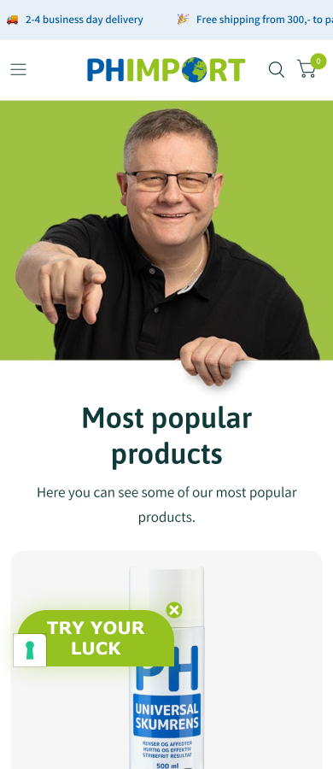
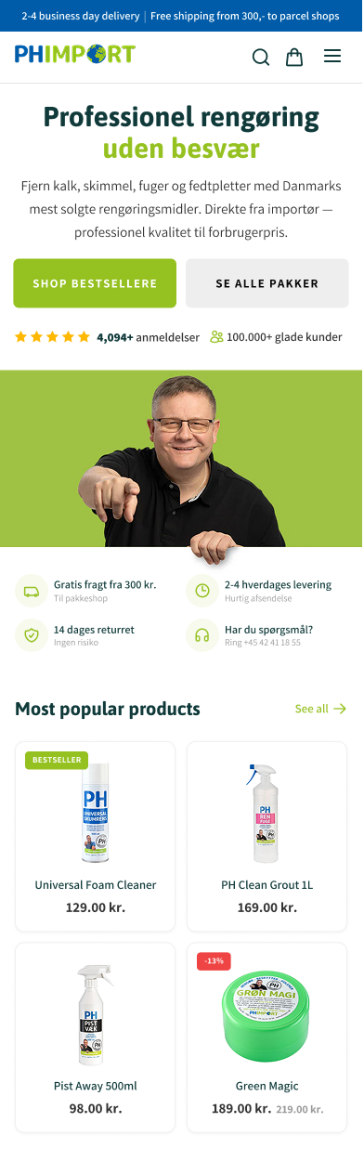
2026
CASE STUDY · 03
PH Import · Homepage hero optimization
Reworked homepage hero with a lighter background and a sharper category-led layout. Lift compounded through PDP views, AOV, and revenue. IntelliGEMS, 100 % rollout.
REVENUE PER VISITOR (PRIMARY)
+20,87%
-12 % to +67 % CI
+251 orders / month · +272.913 kr / mo
METRIC
CONTROL
VARIANT
Δ
Revenue / visitor
65,50 kr
79,17 kr
+20,87%
Profit / visitor
34,78 kr
42,35 kr
+21,78%
Avg order value
401,87 kr
450,94 kr
+12,21%
CONTROL
VARIANT
PDP view rate
56,6 %
61,8 %
+9,21%
ECOMHOUSE ©ALL RIGHTS RESERVED
33

Slide 35
2026
05
ECOMHOUSE METHOD
How we work, test, and charge
A zero-row CRO service: research, copy, design, build, QA, deploy, test, analyze, report. End to end, performance-priced.
ECOMHOUSE ©ALL RIGHTS RESERVED
34

Slide 36
2026
THE ECOMHOUSE METHOD
Six steps, end to end
You approve. We execute. Every step is owned by us, including build, QA, and rollout. Client only approves the brief and rollout.
// 01
// 02
// 03
// 04
// 05
// 06
Research
Ideate
Pre-test brief
Build + QA
Run + monitor
Analyze + roll out
GA4, Shopify, heatmaps, recordings, reviews, support.
→
Hypothesis, variant concepts, copy, Figma prototype.
→
Written brief with metric, confidence, sample size.
→
Shopify or test tool variant, tracked, QA'd across devices.
→
Live test with guardrail watch, weekly progress updates.
→
Written verdict, fee invoiced on rollout to 100 % of traffic.
Zero-row service: the client is not expected to do production work. We handle everything from research through analysis. The client approves the pre-test brief and the rollout decision in writing.
ECOMHOUSE ©ALL RIGHTS RESERVED
35

Slide 37
2026
PRE-TEST ANALYSIS
Every test launches with a written brief
No test starts without a documented, approved brief. This protects both sides: the client knows the rules, the agency knows the success criteria.
// PART 1
// PART 2
Test setup
Statistical parameters
✓
Hypothesis and the Control vs Variant difference
✓
Primary metric (RPV or relevant funnel-stage metric)
✓
Audience and traffic filters (mobile only, returning, country)
✓
Statistical confidence (80 % by default)
✓
Funnel stage and stage multiplier
✓
Minimum visitor and order count required before conclusion
✓
URL targeting (homepage, PDP, cart, checkout)
✓
Worked fee range at +5 %, +10 %, +15 % scenarios
✓
Frozen baselines for upper-funnel tests, pulled from trailing 30 days
✓
Data sources for every input figure, named explicitly
The test does not launch until the client approves the brief in writing. Approved conditions govern the test and the fee.
ECOMHOUSE ©ALL RIGHTS RESERVED
36

Slide 38
2026
TESTING PROTOCOL
How we run tests
Strict guardrails on tooling, statistical rigor, and conclusion. Tests only conclude when all approved conditions are met.
DEFAULT TOOL
CONFIDENCE
CONCLUSION
REPORTING
IntelliGEMS
80 % minimum
All conditions met
Weekly Loom
Or any other test tool you prefer (Convert, GrowthBook, Shopify-native), subject to written approval.
Statistical confidence threshold for declaring a winner. Higher thresholds set per test if you require it.
Tests only conclude when minimum visitors, orders, and confidence are reached. No early calls except for technical issues or clear-loser revenue protection.
Loom or written summary every week, plus a running test log with all hypotheses, results, and rollouts you can access anytime.
You have direct access to the testing software at all times. Live results, traffic splits, and historical tests visible to your team without going through us.
ECOMHOUSE ©ALL RIGHTS RESERVED
37

Slide 39
2026
COMPENSATION
We win when you win
Performance-based fee on every winning test rolled out to 100 % of traffic. One-time charge per test. No attribution window. No recurring tail.
// PERFORMANCE FEE
// OPTIONAL RETAINER
% of estimated monthly revenue uplift
Fixed monthly fee
Y %
X kr / month
Charged once per winning test on rollout. Calculated from the test's measured uplift and the client's own data, with the agreed stage multiplier applied.
Optional. Predictable monthly cost on top of (or instead of) the performance fee. Some clients prefer this for budgeting.
→
One time fee per winning test
→
Billed on the 1st, in advance
→
No recurring tail, no attribution window
→
Void if not agreed
→
Loser and inconclusive tests are free
→
Stackable with the performance fee
Billing: one invoice on the 1st covering the retainer (if any) plus the performance fee for every winning test rolled out last month. 8 day payment terms. Third-party costs (test tools, apps) paid by the client.
ECOMHOUSE ©ALL RIGHTS RESERVED
38

Slide 40
2026
SCHEDULE A · STAGE MULTIPLIERS
Tests further from purchase carry more projection risk
The stage multiplier discounts the performance fee for upper-funnel tests where revenue impact is estimated rather than directly measured. Approved in the pre-test brief, before the test runs.
100 %
RPV · AOV · Purchase CVR · Checkout CVR · Post-purchase
Revenue measured directly by the testing software. No projection needed.
75 %
Cart to checkout · PDP add to cart
One step from purchase. Light projection of downstream behavior.
50 %
Collection to PDP · PDP engagement
Two steps from purchase. Multiple downstream conversion rates to project.
25 %
Homepage to collection · Navigation · Site search
Three or more steps from purchase. Heaviest projection assumptions.
ECOMHOUSE ©ALL RIGHTS RESERVED
39

Slide 41
2026
WORKED EXAMPLE
Two tests, two fee calculations
How the same agency rate produces different fees depending on where the test sits in the funnel. Uses sportgym.dk's Shopify baseline (9.510 monthly sessions, 3.813 kr AOV, 1,77 % CR), 30 % performance rate.
Direct revenue test
Upper-funnel test
// 100 % multiplier · PDP buy box test
// 25 % multiplier · Homepage hero test
1
Monthly sessions
9.510
1
Monthly homepage sessions
~2.380
2
Baseline purchase CVR
1,77 %
2
Baseline HP to PDP rate
62 %
3
Test uplift (+15 % rel.)
+0,27pp → 2,04 %
3
Test uplift (+12 % rel.)
+176 visits
4
Extra purchases / mo
~26
4
× 4,7 % downstream CVR
~8 purchases
5
× 3.813 kr AOV
99.138 kr
5
× 3.813 kr AOV
30.504 kr
6
× 100 % stage multiplier
99.138 kr
6
× 25 % stage multiplier
7.626 kr
7
× 30 % agency rate
→
7
× 30 % agency rate
→
29.741 kr
2.288 kr
ONE TIME FEE
ONE TIME FEE
ECOMHOUSE ©ALL RIGHTS RESERVED
40

Slide 42
2026
NEXT STEP
Approve Phase 1 brief.
We ship in 14 days.
Three Phase 1 tests have a worked pre-brief ready: ViaBill on PDP (55-100K kr / mo), Trustpilot Trustbox under hero (45-80K kr / mo), Meta Pixel + CAPI fix (data quality unlock). Approve in writing, work begins next business day.
Performance-priced. No fee on losing or inconclusive tests. First invoice issues only after the first winning rollout.
Bhaskar Roy · bhaskar@ecomhouse.dk · ecomhouse.design
APPROVE PHASE 1
ECOMHOUSE ©ALL RIGHTS RESERVED
41

