Slide 1


2026
sportgym.dk
5 changes that pay for themselves.
CRO Audit
A/B Test Roadmap
Performance-priced
Last 30 days (Shopify) · 9.510 sessions · 252 orders · 1.002.672 kr gross sales · 1,77 % site CR.
Prepared by EcomHouse for sportgym.dk · May 2026
ECOMHOUSE ©ALL RIGHTS RESERVED
00

Slide 2
2026
BASELINE
Where sportgym.dk stands today
Shopify analytics · Last 30 days (Apr 21 to May 21, 2026). Re-baselined from Shopify after GA4 was found to underreport sessions by ~85 % and orders by ~90 %.
1.002.672 kr
252
3.813 kr
1,77 %
96 %
9.510
GROSS SALES · 30 DAYS
ORDERS · 30 DAYS
AVG ORDER VALUE
SITE CONVERSION RATE
SESSIONS TO ATC DROP
SESSIONS · 30 DAYS
MONTHLY UPLIFT OPPORTUNITY
253.000 to 469.000 kr / month · +25 % to +47 %
The leak is on the PDP. Over 30 days, 9.151 sessions hit the site and never added to cart (96 % drop). Three of the top five opportunities target that exact step.
ECOMHOUSE ©ALL RIGHTS RESERVED
01

Slide 3
2026
RESEARCH
What the data showed
Funnel decomposition, device split, traffic acquisition. Every step in the audit comes from these numbers.
// 01 FUNNEL
// 02 DEVICE
// 03 TRAFFIC
Sessions → ATC drops 96 %
Mobile carries traffic, desktop converts
Facebook spends 46 % on zero tracked revenue
1. Sessions
9.510
100 %
Mobile · ~83 %
Online store
9.510
1,18M kr
2. Added to cart
359
3,77 %
Conversion
AOV
facebook / paid (GA4)
1.797
0 kr ⚠
3. Reached checkout
246
68,5 %
~1,6 %
~3.500 kr
google / cpc (GA4)
1.023
82.687 kr
4. Completed checkout
169
68,7 %
(direct) / (none)
379
126.715 kr
Desktop · ~15 %
partnerads / affiliate
228
8.175 kr
5. All orders
252
incl. Shop Pay
Conversion
AOV
google / organic
81
16.367 kr
~2,8 %
~5.800 kr
ECOMHOUSE ©ALL RIGHTS RESERVED
02

Slide 4
2026
QUICK FIXES
Five conversion blockers
Ranked by leverage, not effort. None require a replatform. All five are sourced from the live site and the GA4 funnel.
01
02
03
04
05
HERO
REVIEWS
FINANCING
FILTERS
BUY BOX
Sells one Saturday, not a fitness store
4,5 / 5 Trustpilot. Invisible on the site
13.900 kr product, no Klarna or ViaBill
13 treadmills, 2 filters
Built for a 200 kr product
Homepage as a landing page converts at 2,26 %. Top three PDP landings at 0,18 to 0,31 %. The category navigation is hidden behind a hamburger on mobile.
15 reviews, 'Fremragende' on Trustpilot. Zero stars on collection cards. No PDP reviews block. The single biggest social-proof asset is unused.
Pay-later is a default expectation in Denmark above 2.000 kr. Fitshop shows both. sportgym shows neither, on or under the price.
Stock and price only. No brand, motor HP, max user weight, foldable, smart, or incline. 12x price range across the same category with no way to narrow.
SKU, name, price, qty, CTA, two collapsed accordions. No spec chips, no save badge, no trust badges, no financing line, no demo video. PDP view → ATC drops 95 %.
ECOMHOUSE ©ALL RIGHTS RESERVED
03

Slide 5
2026
TEST PIPELINE
Nine opportunities, ranked
Three phases. Sized in DKK / month, tagged by effort. All shippable on the existing Shopify theme.
#
OPPORTUNITY
MONTHLY DKK
EFFORT
PHASE
01
PDP buy box rebuild · SG-02
65.000 to 120.000
Med
Phase 2
02
Hero rebuild · category led · SG-01
28.000 to 55.000
Med
Phase 2
03
Accessories cross sell · SG-03
18.000 to 35.000
Low
Phase 2
04
Klarna or ViaBill financing
55.000 to 100.000
Low
Phase 1
05
Trustpilot social proof
45.000 to 80.000
Low
Phase 1
06
Collection filters + chips
18.000 to 35.000
High
Phase 3
07
Post purchase review flow
12.000 to 22.000
Low
Phase 2
08
Buying guides + quiz
12.000 to 22.000
High
Phase 3
09
Meta Pixel + CAPI fix
Data quality unlock
Low
Phase 1
TOTAL ADDRESSABLE UPLIFT
253.000 to 469.000 kr / month · +25 % to +47 %
ECOMHOUSE ©ALL RIGHTS RESERVED
04

Slide 6
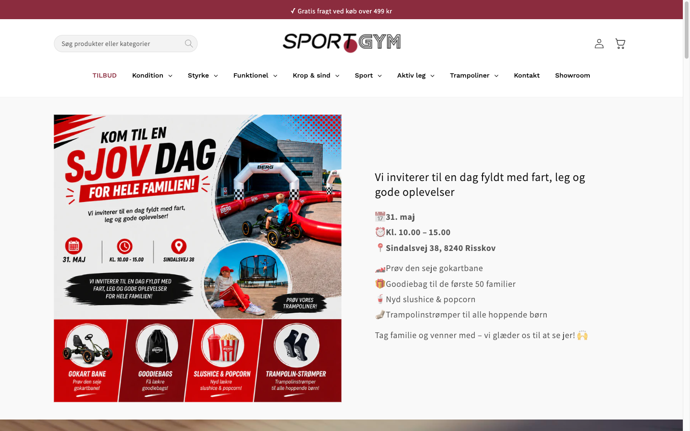
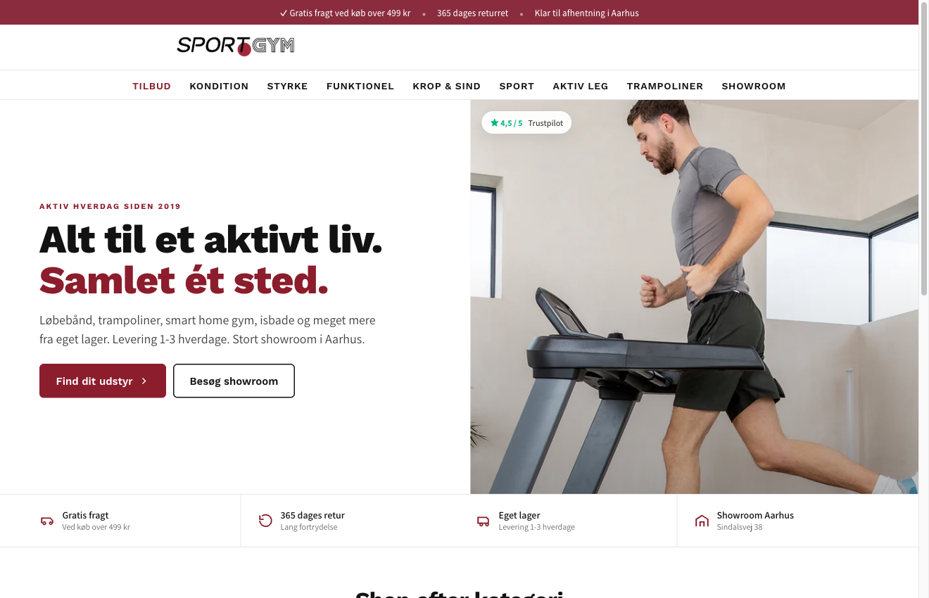
2026
SG-01 · HERO
Category led hero
Category led hero
Tool:
IntelliGEMS
Phase:
2 · W1-2
A/B TEST
OBSERVATION
•
Homepage hero is occupied by a one-day family event banner. New visitors get no signal this is a fitness equipment store.
•
Homepage as landing page converts at 2,26 % (6 / 265). Paid PDP landing pages convert at 0,18 to 0,31 %.
•
Brand promise and category nav never appear above the fold on mobile.
HYPOTHESIS
Replacing the event hero with a category-led layout (lifestyle visual, brand promise, six category tiles, four trust USPs) lifts homepage to PDP CTR and downstream site CR for paid social and direct traffic.
KEY METRICS
1.
Homepage to PDP CTR
2.
Bounce rate
3.
Site CR
CONTROL
VARIANT
DURATION
AUDIENCE
MULTIPLIER
URL
4 weeks
All visitors
25 %
/ (homepage)
ECOMHOUSE ©ALL RIGHTS RESERVED
05

Slide 7
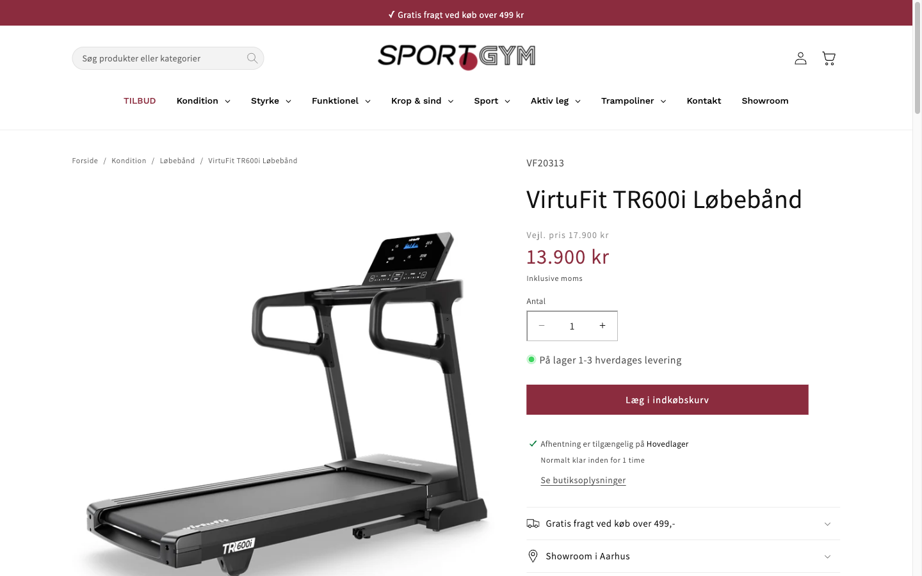
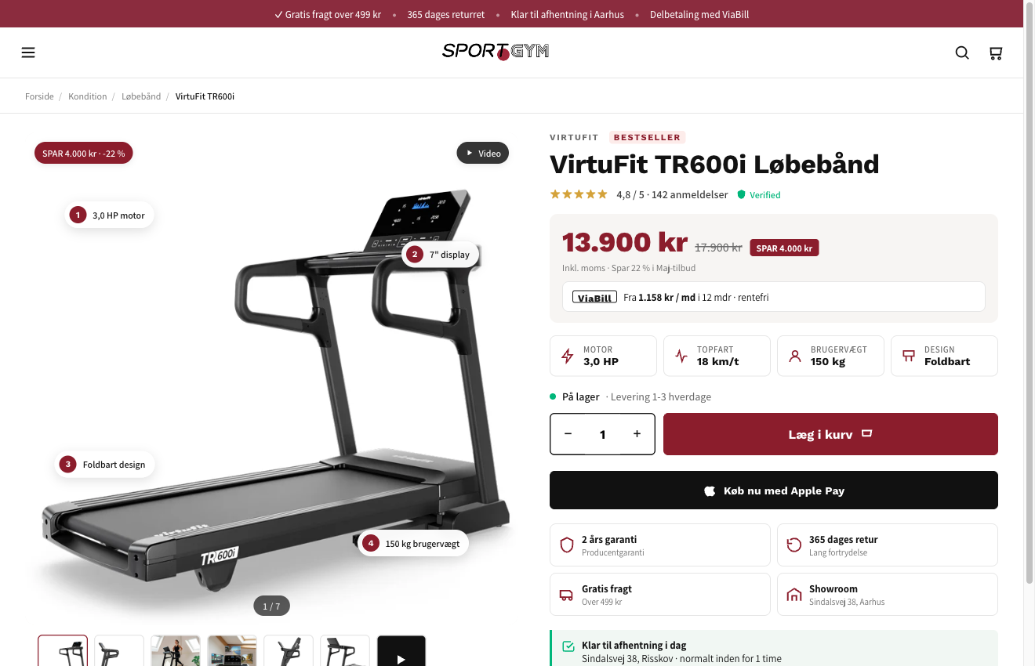
2026
SG-02 · PDP
PDP buy box rebuild
PDP buy box rebuild
Tool:
IntelliGEMS
Phase:
2 · W3-6
A/B TEST
OBSERVATION
•
95 % of PDP viewers never add to cart. 2.535 missed ATCs over 90 days. Mobile drops 96,2 %, desktop 86,1 %.
•
TR600i PDP at 13.900 kr shows no financing, no save badge, no spec chips, no trust badges, no demo video.
•
Cross sell module surfaces 4 competing treadmills instead of accessories.
HYPOTHESIS
Rebuilding the PDP fold with spec chips, a save badge, a financing line, four trust badges, and a sticky add-to-cart on mobile lifts PDP add-to-cart rate without changing price or product range.
KEY METRICS
1.
PDP to add-to-cart rate
2.
Revenue per visitor
3.
Average order value
CONTROL
VARIANT
DURATION
AUDIENCE
MULTIPLIER
URL
4-6 weeks
PDP visitors
75 %
/products/*
ECOMHOUSE ©ALL RIGHTS RESERVED
06

Slide 8
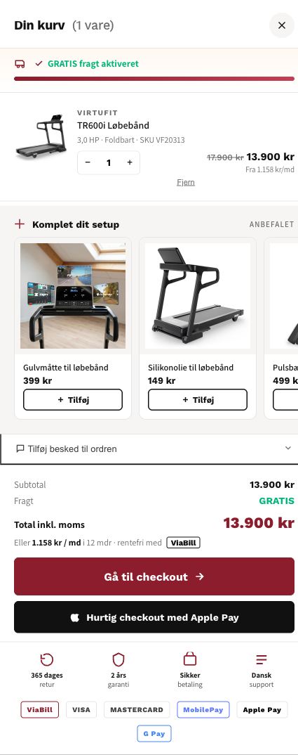
2026
SG-03 · CART
Cart drawer cross sell
Cart drawer cross sell
Tool:
IntelliGEMS
Phase:
2 · W4-6
A/B TEST
OBSERVATION
•
ATC to begin-checkout is 65 % (45 carts abandoned at the ATC step per quarter).
•
Current cart shows product, qty, total. No cross sell, no shipping progress, no financing reminder.
•
5.015 kr AOV. Floor mat, lubricant, heart rate strap are obvious accessory adds.
HYPOTHESIS
Upgrading the cart drawer with a 'Komplet dit setup' accessory module, free-shipping progress bar, financing reminder, and trust row lifts AOV and cart-to-checkout completion without slowing the primary purchase flow.
Cart drawer (current) Product · qty · subtotal · checkout No cross sell. No shipping progress. No trust row.
KEY METRICS
1.
Average order value
2.
Items per order
3.
Cart to checkout completion rate
CONTROL
VARIANT
DURATION
AUDIENCE
MULTIPLIER
URL
3 weeks
All ATC events
100 %
Cart drawer (global)
ECOMHOUSE ©ALL RIGHTS RESERVED
07

Slide 9
2026
BENCHMARK
How three Danish competitors handle the same gaps
Fitshop is the scale player. Fitness Engros is the content brand. Træningspartner is the Trustpilot volume leader. Each solves at least three of the five blockers.
FEATURE
sportgym.dk
fitshop.dk
fitnessengros.dk
træningspartner.dk
Hero sells the category
No · event banner
Yes · categories
Yes · categories
Partial
Trustpilot widget on home
Not visible
Google 4,84 / 41k
Static stars
807 reviews
Reviews on PDP
None
Limited
None
Stars + count
Financing on PDP
None
Klarna + ViaBill
Not visible
Yes
Structured filters
Stock + price only
Some brand filters
Category subnav
Multi facet
Cross sell = accessories
Competing models
Mixed
Accessory bundles
Mixed
Showroom / pickup
Aarhus + PDP pickup
69 EU stores
Taastrup showroom
Limited
ECOMHOUSE ©ALL RIGHTS RESERVED
08

Slide 10
2026
EXECUTION
90 day roadmap
Three phases. Compounding impact across the quarter. None require a replatform.
// PHASE 1
// PHASE 2
// PHASE 3
Quick wins
Core optimizations
Growth systems
Week 1 to 2
Week 3 to 6
Week 7 to 12
EXPECTED IMPACT
EXPECTED IMPACT
EXPECTED IMPACT
100K to 180K kr / mo
123K to 232K kr / mo
30K to 57K kr / mo
→
Embed Trustpilot Trustbox under hero
→
PDP buy box rebuild (chips, badges, financing, trust, sticky ATC, video)
→
Collection filters + spec chips
→
Install ViaBill or Klarna on PDP
→
Hero rebuild: category grid + brand promise
→
'Find dit løbebånd' quiz
→
Reviews app: stars on cards + PDP
→
Accessories cross sell ('Komplet dit setup')
→
Buying guides per category
→
Verify Meta Pixel + CAPI
→
Klaviyo post purchase review flow
→
PDP comparison table + FAQ block
→
Trust USP strip under hero
→
Re-baseline attribution post Meta fix
→
Compress event into thin strip
ECOMHOUSE ©ALL RIGHTS RESERVED
09

Slide 11
2026
TRACK RECORD
Three winning EcomHouse tests
Real results from EcomHouse client engagements. Each test rolled out to 100 % of traffic after meeting the pre-approved confidence threshold. IntelliGEMS test tool.
Comforth · DK
PH Import · DK
PH Import · DK
Product tags on collection cards
PDP volume discount tiers
Homepage hero optimization
PROFIT / VISITOR
CONVERSION RATE
REVENUE / VISITOR
+11,42%
+11,08%
+20,87%
-11 % to +39 %
-3 % to +27 %
-12 % to +67 %
+106.550 kr / mo
+134.917 kr / mo (RPV)
+272.913 kr / mo
CR
+13,07%
2,09% → 2,37%
RPV
+17,10%
20,36 → 23,84 kr
CR
+7,72%
16,3% → 17,6%
RPV
+11,13%
26,88 → 29,87 kr
AOV
+5,42%
293,47 → 309,37 kr
AOV
+12,21%
401,87 → 450,94 kr
Orders / mo
+169
Orders / mo
+298
PDP view rate
+9,21%
56,6% → 61,8%
Added trust + benefit tags to collection product cards. Lift compounded across all three metrics.
Surfaced volume discount tiers directly on the PDP. CR was primary, RPV and AOV lifted simultaneously.
Reworked homepage hero with lighter background. Lifted the full funnel: more PDP views, higher AOV, more revenue.
Source: IntelliGEMS test reports. Confidence intervals shown reflect range of likely true effect. References available on request.
ECOMHOUSE ©ALL RIGHTS RESERVED
10

Slide 12
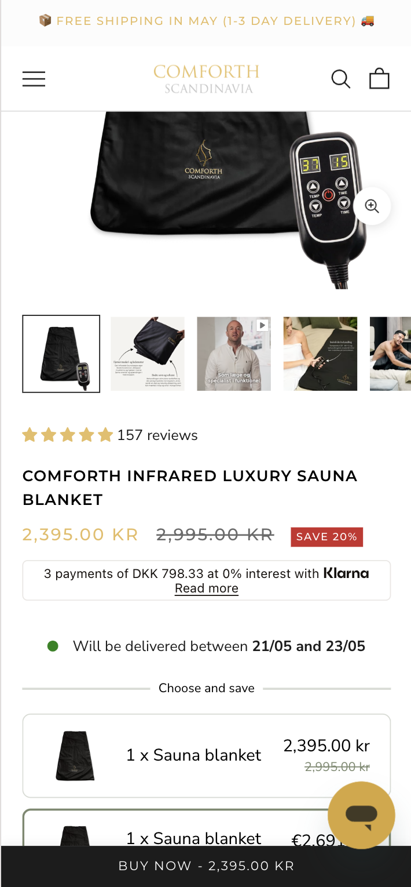
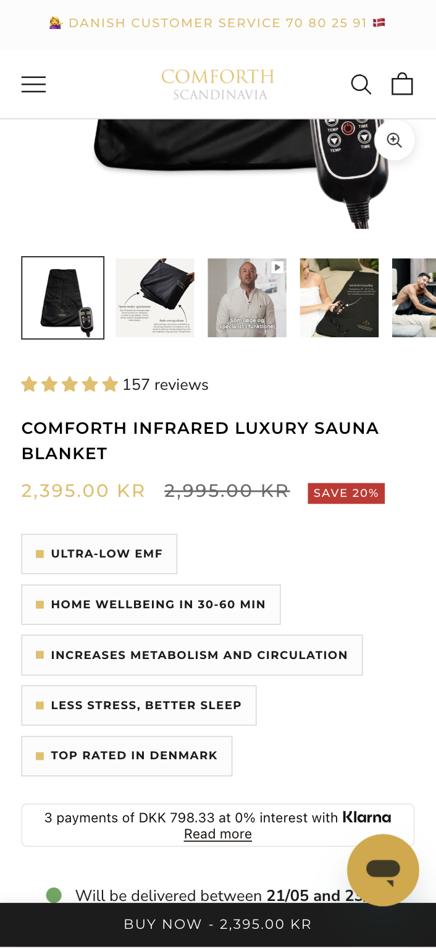
2026
CASE STUDY · 01
Comforth · Product tags on collection cards
Added benefit and trust tags directly to product cards on collection pages. Variant lifted all three commercial metrics with no degradation in any guardrail. IntelliGEMS, 100 % rollout.
PROFIT PER VISITOR (PRIMARY)
+11,42%
-11 % to +39 % CI
+106.550 kr / month projected
METRIC
CONTROL
VARIANT
Δ
Conversion rate
2,09 %
2,37 %
+13,07%
Revenue / visitor
26,88 kr
29,87 kr
+11,13%
Profit / visitor
15,07 kr
16,80 kr
+11,42%
CONTROL
VARIANT
Est. orders / mo
·
+169
ECOMHOUSE ©ALL RIGHTS RESERVED
11

Slide 13
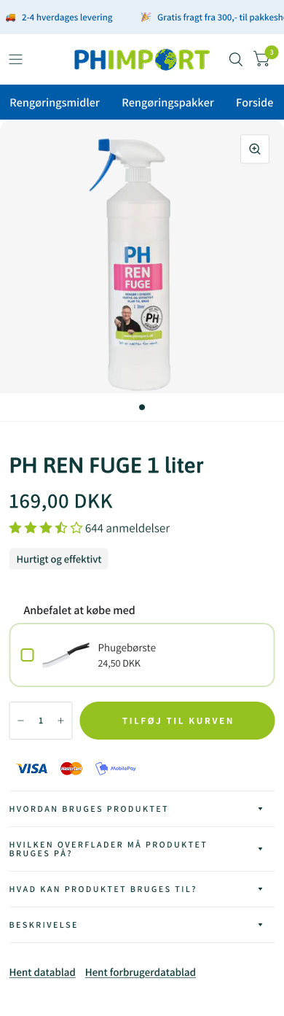
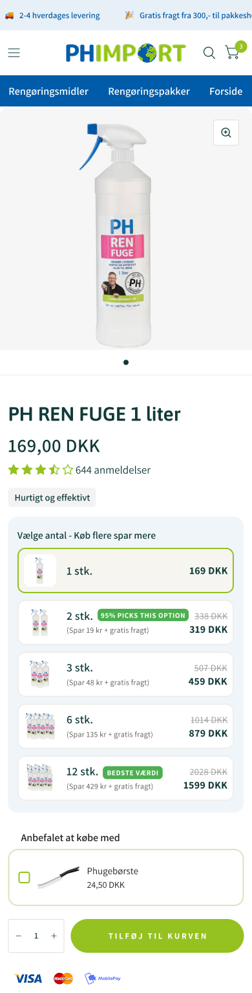
2026
CASE STUDY · 02
PH Import · PDP volume discount tiers
Surfaced volume discount tiers directly on the PDP. The variant lifted purchase rate, AOV, and downstream profit simultaneously. IntelliGEMS, 100 % rollout.
CONVERSION RATE (PRIMARY)
+11,08%
-3 % to +27 % CI
+298 orders / month · +134.917 kr / mo (RPV)
METRIC
CONTROL
VARIANT
Δ
Conversion rate
6,94 %
7,71 %
+11,08%
Revenue / visitor
20,36 kr
23,84 kr
+17,10%
Profit / visitor
10,49 kr
12,25 kr
+16,68%
CONTROL
VARIANT
Avg order value
293,47 kr
309,37 kr
+5,42%
ECOMHOUSE ©ALL RIGHTS RESERVED
12

Slide 14
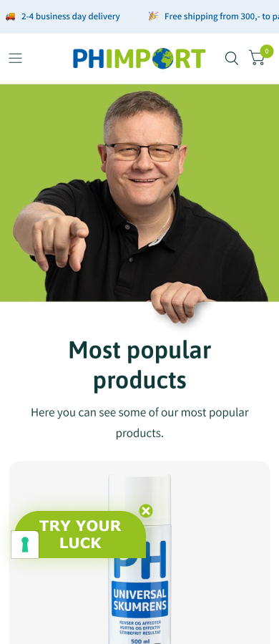
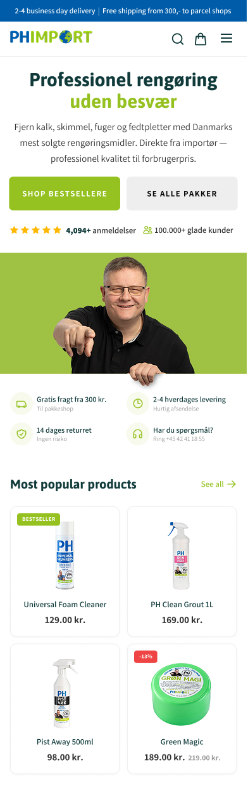
2026
CASE STUDY · 03
PH Import · Homepage hero optimization
Reworked homepage hero with a lighter background and a sharper category-led layout. Lift compounded through PDP views, AOV, and revenue. IntelliGEMS, 100 % rollout.
REVENUE PER VISITOR (PRIMARY)
+20,87%
-12 % to +67 % CI
+251 orders / month · +272.913 kr / mo
METRIC
CONTROL
VARIANT
Δ
Revenue / visitor
65,50 kr
79,17 kr
+20,87%
Profit / visitor
34,78 kr
42,35 kr
+21,78%
Avg order value
401,87 kr
450,94 kr
+12,21%
CONTROL
VARIANT
PDP view rate
56,6 %
61,8 %
+9,21%
ECOMHOUSE ©ALL RIGHTS RESERVED
13

Slide 15
2026
THE ECOMHOUSE METHOD
Six steps, end to end
You approve. We execute. Every step is owned by us, including build, QA, and rollout. Client only approves the brief and rollout.
// 01
// 02
// 03
// 04
// 05
// 06
Research
Ideate
Pre-test brief
Build + QA
Run + monitor
Analyze + roll out
GA4, Shopify, heatmaps, recordings, reviews, support.
→
Hypothesis, variant concepts, copy, Figma prototype.
→
Written brief with metric, confidence, sample size.
→
Shopify or test tool variant, tracked, QA'd across devices.
→
Live test with guardrail watch, weekly progress updates.
→
Written verdict, fee invoiced on rollout to 100 % of traffic.
Zero-row service: the client is not expected to do production work. We handle everything from research through analysis. The client approves the pre-test brief and the rollout decision in writing.
ECOMHOUSE ©ALL RIGHTS RESERVED
14

Slide 16
2026
BRIEF + PROTOCOL
How every test launches and concludes
No test starts without a written, approved brief. Tests only conclude when all approved conditions are met.
PRE-TEST BRIEF
TESTING PROTOCOL
Every test launches with a written, approved brief
Guardrails on tooling, rigor, conclusion
// PART 1 Test setup
// PART 2 Statistical parameters
DEFAULT TOOL
CONFIDENCE
✓
Hypothesis and Control vs Variant difference
✓
Primary metric (RPV or funnel metric)
IntelliGEMS
80 % min
Or Convert, GrowthBook, Shopify-native with written approval.
Higher per test if you require it.
✓
Audience and traffic filters
✓
Statistical confidence (80 % default)
✓
Funnel stage and stage multiplier
✓
Minimum visitor and order count
CONCLUSION
REPORTING
✓
URL targeting
✓
Worked fee range at +5 / +10 / +15 %
All conditions met
Weekly Loom
✓
Frozen baselines from trailing 30 days
✓
Data sources named explicitly
Min visitors, orders, and confidence reached.
Plus a running test log you can access anytime.
ECOMHOUSE ©ALL RIGHTS RESERVED
15

Slide 17
2026
COMPENSATION
We win when you win
Performance-based fee on every winning test rolled out to 100 % of traffic. One-time charge per test. No attribution window. No recurring tail.
// PERFORMANCE FEE
// OPTIONAL RETAINER
% of estimated monthly revenue uplift
Fixed monthly fee
Y %
X kr / month
Charged once per winning test on rollout. Calculated from the test's measured uplift and the client's own data, with the agreed stage multiplier applied.
Optional. Predictable monthly cost on top of (or instead of) the performance fee. Some clients prefer this for budgeting.
→
One time fee per winning test
→
Billed on the 1st, in advance
→
No recurring tail, no attribution window
→
Void if not agreed
→
Loser and inconclusive tests are free
→
Stackable with the performance fee
Billing: one invoice on the 1st covering the retainer (if any) plus the performance fee for every winning test rolled out last month. 8 day payment terms. Third-party costs (test tools, apps) paid by the client.
ECOMHOUSE ©ALL RIGHTS RESERVED
16

Slide 18
2026
SCHEDULE A · STAGE MULTIPLIERS + WORKED EXAMPLE
Tests further from purchase carry more projection risk
The multiplier discounts upper-funnel tests where revenue is estimated rather than directly measured. Approved in the pre-test brief, before the test runs.
STAGE MULTIPLIERS
WORKED EXAMPLES · 30 % AGENCY RATE
100 %
RPV · AOV · Purchase CVR · Checkout CVR
DIRECT TEST · PDP CVR · 100 % multiplier
Revenue measured directly. No projection.
1.
Monthly sessions
1.305
2.
Test uplift (+15 %)
+0,28pp → 2,14 %
3.
Extra orders × 5.015 kr AOV
18.054 kr
4.
× 100 % multiplier × 30 %
→
75 %
Cart to checkout · PDP add to cart
5.416 kr
ONE TIME FEE
One step from purchase.
UPPER FUNNEL · Homepage hero · 25 % multiplier
50 %
Collection to PDP · PDP engagement
1.
Monthly homepage sessions
88
Two steps from purchase.
2.
Uplift (+12 %)
+6 visits
3.
× downstream CVR × AOV
1.504 kr
4.
× 25 % multiplier × 30 %
→
25 %
Homepage to collection · Navigation
113 kr
ONE TIME FEE
Three or more steps from purchase.
ECOMHOUSE ©ALL RIGHTS RESERVED
17

Slide 19
2026
NEXT STEP
Approve Phase 1 brief.
We ship in 14 days.
Three Phase 1 tests have a worked pre-brief ready: ViaBill on PDP (55-100K kr / mo), Trustpilot Trustbox under hero (45-80K kr / mo), Meta Pixel + CAPI fix (data quality unlock). Approve in writing, work begins next business day.
Performance-priced. No fee on losing or inconclusive tests. First invoice issues only after the first winning rollout.
Bhaskar Roy · bhaskar@ecomhouse.dk · ecomhouse.design
APPROVE PHASE 1
ECOMHOUSE ©ALL RIGHTS RESERVED
18

