Slide 1

2026
DITT VIN
dittvin.se
The numbers say you are
bigger than you think.
CRO AUDIT
RPV NORTHSTAR
BENCHMARKED
A/B ROADMAP
Shopify 91 days: 38.310 orders, 33,2M SEK gross, 867 SEK AOV. GA4 property 461839723 captured only ~31%.
Prepared by EcomHouse for dittvin.se. July 2026.
ECOMHOUSE ©ALL RIGHTS RESERVED
00

Slide 2
2026
SCOPE
What we analyzed
Every number is traced to a source. Estimates are marked "Est."
// 01
// 02
// 03
GA4 Analytics
Voice of Customer
Competitor set
90 days, property 461839723. Sessions, funnel, channels, devices, landing pages.
5.985 Trustpilot reviews (4,7/5). 300 verbatim reviews mined via the widget API.
5 verified rivals: Winefinder, Winefamly, KRAN, Supervin, plus Systembolaget.
// 04
// 05
// 06
Heuristic review
Shopify sales data
Industry benchmarks
4 page types on mobile: entry, home, collection, PDP. Screenshot verified.
91 days of order, product and AOV exports. The source of truth for RPV.
Named sources: Littledata, Baymard, Sovos, SVB, Omnisend.
ECOMHOUSE ©ALL RIGHTS RESERVED
01

Slide 3
2026
EXECUTIVE SUMMARY
Six findings that move revenue
The store is healthy and box led. 11,88M SEK and 11.689 GA4 orders in 90 days. Wine boxes convert far above single bottles.
Wine boxes are the growth engine. Merchandise them harder.
Delivery is the number one trust wound. The site promises "1-3 dagar" but 31% of low star reviews report 7 to 16 days.
Fix the promise, not the wine. A retention leak, not just acquisition.
The legality question is unanswered. In a monopoly market, dittvin explains nothing while KRAN and Winefamly reassure directly.
80,8% of users are new. The trust block is missing where it converts.
The cart to checkout leak is the biggest recoverable pool. 60,2% of add to carts never begin checkout (32.859 users in 90 days).
Est. 1,5 to 1,8M SEK per quarter recoverable at current AOV.
Revenue rides on one channel. Facebook paid drives 41% of sessions and 43,6% of all orders.
Tracking is noisy and partly misconfigured. Four GA4 properties fire at once and 29% of sessions land as "(not set)".
ECOMHOUSE ©ALL RIGHTS RESERVED
02
Clean the data first. The store is better than the dashboard shows.

Slide 4
2026
01
SECTION 01
GA4 Analytics
90 days, 452.552 sessions. Where the traffic comes from, where it converts, and where it leaks.
ECOMHOUSE ©ALL RIGHTS RESERVED
03

Slide 5
2026
GA4 · 90 DAYS
Performance dashboard
452.552
11.689
11,88M
2,58%
80,8%
SESSIONS
PURCHASES
REVENUE (SEK)
SESSION CVR
NEW USERS
268.555 users · 95% Sweden
11.537 unique buyers
1.017 SEK AOV
~3,6% on clean traffic
Only ~19% return
GA4 attributed totals for the 90 day window. AOV is revenue / ecommerce purchases. Shopify shows the store is ~3x larger (see the RPV section).
ECOMHOUSE ©ALL RIGHTS RESERVED
04

Slide 6
2026
GA4 · 90 DAYS · UNIQUE USERS
The purchase funnel
Counted by unique users so it reconciles to real orders. Only 7,5% of viewers buy.
View product
153.509 100.0%
Add to cart
54.583 35.6%
64,4% do not add
Begin checkout
21.724 14.2%
60,2% abandon cart
Purchase
11.537 7.5%
46,9% abandon checkout
GA4 event totalUsers. The v1alpha sequential funnel corroborates the pattern (73,8% abandon before add to cart, 57,9% at cart, 58,1% at checkout).
ECOMHOUSE ©ALL RIGHTS RESERVED
05

Slide 7
2026
GA4 · 90 DAYS
The three biggest leaks
Ranked by how cheaply the revenue can be won back.
1
2
3
Add to cart to checkout
Checkout to purchase
View to add to cart
32.859 carts never reach checkout in 90 days. The largest recoverable pool. Shipping surprise (695 SEK, Airmee only) and no clear push to continue.
10.187 users start checkout and drop. Highest intent, lowest cost to recover. Delivery doubt and 90+ JS console errors are prime suspects.
98.926 product viewers never add. Lower intent, but PDP trust gaps (no legality block, thin box detail, 3 images) suppress action.
Est. 1,5-1,8M SEK/qtr
Cheapest win
PDP trust + detail
ECOMHOUSE ©ALL RIGHTS RESERVED
06

Slide 8
2026
GA4 · 90 DAYS
Mobile is the store
86% of sessions and 87% of orders are mobile, and mobile converts at least as well as desktop.
DEVICE | SESSIONS | SHARE | CVR | REVENUE (SEK) | BOUNCE
Mobile | 388.549 | 85,9% | 2,61% | 10,23M | 41,1%
Desktop | 47.604 | 10,5% | 2,25% | 1,21M | 39,4%
Tablet | 16.247 | 3,6% | 2,94% | 0,44M | 43,2%
Desktop converts slightly worse than mobile here, which is unusual and points to a desktop specific friction worth a follow up look.
ECOMHOUSE ©ALL RIGHTS RESERVED
07

Slide 9
2026
GA4 · 90 DAYS
Traffic and channel performance
Facebook paid carries the store. Email is a strong, cheaper second engine.
SOURCE / MEDIUM | SESSIONS | ORDERS | CVR | SHARE OF ORDERS | REVENUE (SEK)
facebook / paid | 187.519 | 5.092 | 2,72% | 43,6% | 4,73M
Klaviyo / email | 72.324 | 1.846 | 2,55% | 15,8% | 1,90M
google / cpc | 66.979 | 1.674 | 2,50% | 14,3% | 1,87M
(direct) | 50.060 | 1.252 | 2,50% | 10,7% | 1,41M
google / organic | 41.999 | 851 | 2,03% | 7,3% | 0,96M
Klaviyo / sms | 7.572 | 155 | 2,05% | 1,3% | 0,16M
Concentration risk: 43,6% of orders come from one paid channel. Email already returns a strong 2,55% CVR at lower cost.
ECOMHOUSE ©ALL RIGHTS RESERVED
08

Slide 10
2026
GA4 · 90 DAYS
Retention is underbuilt
Returning visitors convert 26% better, yet only about 1 in 5 users comes back.
2,66%
3,36%
40%
~19%
NEW USER CVR
RETURNING CVR
REV FROM RETURNING
USERS WHO RETURN
269.835 sessions
26% higher
4,81M SEK
80,8% are new
The subscription (Abonnement) plus Klaviyo flows are the levers to lift the return rate. Retention compounds on the 4,7 Trustpilot base.
ECOMHOUSE ©ALL RIGHTS RESERVED
09

Slide 11
2026
GA4 · 90 DAYS
Boxes outconvert everything
The intro wine box converts at more than double a single bottle page.
LANDING PAGE | SESSIONS | ORDERS | CVR | REVENUE
XL introlåda (box) | 25.583 | 1.418 | 5,54% | 1,34M
XL Smaken av Sydeuropa | 11.764 | 482 | 4,10% | 0,46M
The Fantini box | 21.018 | 816 | 3,88% | 0,78M
Homepage / | 62.611 | 2.105 | 3,36% | 2,38M
/collections/vinlador | 17.849 | 465 | 2,60% | 0,50M
PNK bubbles (single line) | 9.202 | 199 | 2,16% | 0,15M
ECOMHOUSE ©ALL RIGHTS RESERVED
10

Slide 12
2026
GA4 · DATA QUALITY
The store is better than the dashboard
Nearly a third of sessions land as "(not set)" and almost never convert.
129.913
10
~3,6%
CAPI
"(NOT SET)" SESSIONS
ORDERS FROM THEM
CVR ON CLEAN TRAFFIC
THE FIX
28,7% of all sessions
64% bounce, 37s dwell
vs 2,58% reported
Server side + consent
Most likely consent denied cookieless pings (Cookiebot) plus Facebook in app browser sessions where the landing page fails to resolve. Recovering this signal also feeds Meta and Google better conversion data, improving ad optimization on the channel the store depends on.
ECOMHOUSE ©ALL RIGHTS RESERVED
11

Slide 13
2026
02
SECTION 02
Voice of Customer
4,7 out of 5 on 5.985 Trustpilot reviews. We read 300 verbatim to find what drives the buy and what breaks the trust.
ECOMHOUSE ©ALL RIGHTS RESERVED
12

Slide 14
2026
TRUSTPILOT · VERIFIED
A loved brand with a sharp tail
94% of reviews sit at 4 or 5 stars. The negative tail is highly concentrated on one issue.
4,7
5.985
86%
14%
TRUSTSCORE
REVIEWS
COMPLAINTS RE DELIVERY
COMPLAINTS RE TASTE
"Utmärkt"
79,6% at 5 stars
sampled low star
"smakar som saft"
Buy drivers (sampled 200 high star): fast delivery 36%, easy to order 34%, price and value 28%, discovery boxes 21%, wine quality 20%.
ECOMHOUSE ©ALL RIGHTS RESERVED
13

Slide 15
2026
VOICE OF CUSTOMER
Why people buy, in their words
This copy already lives in your reviews. It is stronger than any marketing line.
"Smidigt, enkelt, prisvärt, bra viner mm! Dessutom inga begränsade öppettider att förhålla sig till."
"Är så skönt med färdiga bland lådor av viner, man har stor chans att hitta nya favoriter."
Smooth, easy, good value, and no restricted opening hours.
Ready made mixed boxes give a real chance to find new favourites.
kundnamn · 4 stjärnor
Ritva Nilsson · 5 stjärnor
"...trevligt att smaka viner från mindre kända vingårdar!"
"Mycket goda alkoholfria alternativ, såväl vitt vin som mousserande."
Nice to try wines from lesser known vineyards, at affordable prices.
Very good alcohol free options. A niche but loyal segment.
Martin Åström · 5 stjärnor
Sari Andersson · 5 stjärnor
ECOMHOUSE ©ALL RIGHTS RESERVED
14

Slide 16
2026
VOICE OF CUSTOMER · THE CORE PROBLEM
"1-3 dagar" is breaking trust
The homepage promises 1 to 3 day delivery. Customers report 7 to 16 days.
"1-3 dagars leverans står det. Just nu väntat i 11 dagar. Första och sista gången tyvärr."
"Vilseledande marknadsföring! Leverans som aldrig är 1-3 dagar som det står på sidan."
Says 1-3 days. Waited 11 days. First and last time.
Misleading marketing. Never the 1-3 days the site claims.
Sebastian Svahn · 1 stjärna
Elias Lindell · 1 stjärna
"Dittvin utlovar 1-3 dagars leverans men det är snarare 10-13. Trust me."
"Ska levereras mellan 17-22, sen 5 minuter innan så avbryts leveransen!"
Promises 1-3 days but it is more like 10-13.
Meant to arrive 17-22, then cancelled 5 minutes before. Alcohol needs someone home.
Mattias Bedding · 2 stjärnor
Elias Lindell · 1 stjärna
ECOMHOUSE ©ALL RIGHTS RESERVED
15

Slide 17
2026
VOICE OF CUSTOMER · SECONDARY FRICTIONS
Quality doubt and robot service
"Köpte 12 så kallade kvalitetsviner. Flertalet knappt drickbara och sämre än de billigare på systemet."
"Vinerna smakar som saft."
12 so called quality wines, several barely drinkable and worse than Systembolaget budget.
The wines taste like juice. 14% of complaints mention taste.
Consumer · 2 stjärnor
Harry Frank · 2 stjärnor
"Kundservice är ett automatiskt AI svar som 'beklagar och ska ta din feedback med oss'."
"En flaska var skadad, dom löste det snabbt och lätt. Mycket bra återkoppling på mejl."
Customer service is an automatic AI reply. 38% of complaints cite service.
Solved quickly. When service is fast, it becomes a 5 star reason.
Elias Lindell · 1 stjärna
Bengt Angséus · 5 stjärnor
ECOMHOUSE ©ALL RIGHTS RESERVED
16

Slide 18
2026
THE CATEGORY'S BIGGEST BARRIER
You cannot taste it before you buy
Online wine's one structural disadvantage: no tasting. Removing taste uncertainty lifts conversion and order value at once.
THE PROBLEM, IN YOUR OWN REVIEWS
THE FIX: A TASTE PROFILE ON EVERY WINE
Taste is a blind gamble
Show the flavor before the buy
14% of complaints are about taste, and buyers ask for the information outright. A box of 12 unknown wines is a leap of faith, so price and discount become the only decision cues.
Dry to sweet and light to full scales, plain language tasting notes, the Vivino score you already hold, and food pairing. Plus a short "hitta din smak" taste match quiz.
"Vinerna smakar som saft"
Torrt ————o———— Sött · Lätt ———————o— Fylligt
"Jag saknar en beskrivning av respektive vin."
Mörka bär · Kryddig · Vivino 4,1 · Passar grillat kött
The highest leverage content fix for a wine PDP: it turns a blind box into an informed pick, lifts add to cart, powers the AOV box ladder, and cuts the "smakar som saft" complaints.
ECOMHOUSE ©ALL RIGHTS RESERVED
17

Slide 19
2026
03
SECTION 03
The Trust Equation
Two levers decide the first purchase: is it legal, and will it arrive. dittvin is silent on the first and unreliable on the second.
ECOMHOUSE ©ALL RIGHTS RESERVED
18

Slide 20
2026
MARKET CONTEXT · HIGHEST LEVERAGE GAP
Nobody told the Swede it is legal
dittvin lawfully ships as a Danish cross border private importer. It never explains this, so doubt fills the gap.
WHAT DITTVIN DOES TODAY
WHAT THE BEST RIVAL DOES
Silence on legality
KRAN states it plainly
Zero mention of Systembolaget, private import, Swedish alcohol tax, or that VAT is included. The Danish operator identity is buried in the footer.
"Vi lyder under den svenska alkohollagstiftningen och regleras av svenska Skatteverket som distansförsäljare." Winefamly, Winefinder and Supervin also show Trygg E-handel.
"Tror detta r bedrägeri. VARNING" (I think this is fraud)
The fix: a plain "Is this legal? Yes" block on PDP and cart.
ECOMHOUSE ©ALL RIGHTS RESERVED
19

Slide 21
2026
VOICE OF CUSTOMER · STRATEGY
Three beliefs to destroy
1
2
3
"Buying wine privately might be illegal."
"They will not deliver on time."
"The 'quality wines' are cheap plonk."
Destroy it with a plain language legality block: Danish private import, Skatteverket distance seller, tax and VAT included, Trustpilot proof at hesitation.
Destroy it by fixing the promise, not the wine. Honest order specific ETA, proactive updates, and a chooseable delivery window.
Destroy it with real per wine specs: grape, region, a dry to sweet scale, and the Vivino score. A box should not be a blind gamble.
80,8% are new buyers
86% of complaints
14% cite taste
ECOMHOUSE ©ALL RIGHTS RESERVED
20

Slide 22
2026
04
SECTION 04
Heuristic Analysis
Entry, home and PDP, reviewed on the mobile experience that carries 86% of the store. Every claim is screenshot verified.
ECOMHOUSE ©ALL RIGHTS RESERVED
21

Slide 23
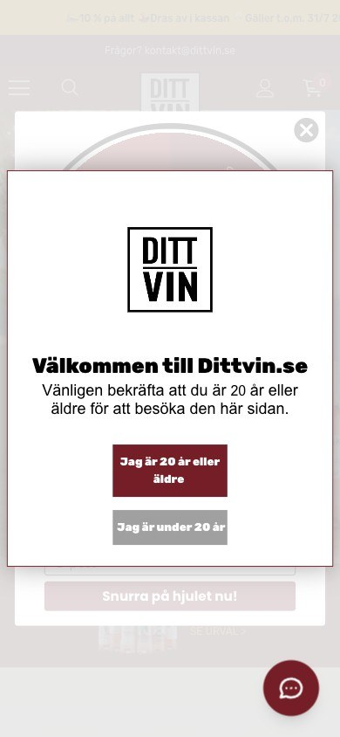
2026
HEURISTIC · ENTRY
Two walls before a single product
Double interstitial. A legally required age gate stacks on a spin the wheel popup. Two dismissals before the first product.
Turn the age gate into a trust moment. Add one line: lawful Danish import, tax included. The perfect place to answer legality.
Emoji heavy promo bar. Clashes with a "kvalitetsviner" premium promise on a wine brand.
Chat and Klaviyo present. Support and capture are live. The issue is stacking and sequence, not absence.
ENTRY · MOBILE
ECOMHOUSE ©ALL RIGHTS RESERVED
22

Slide 24
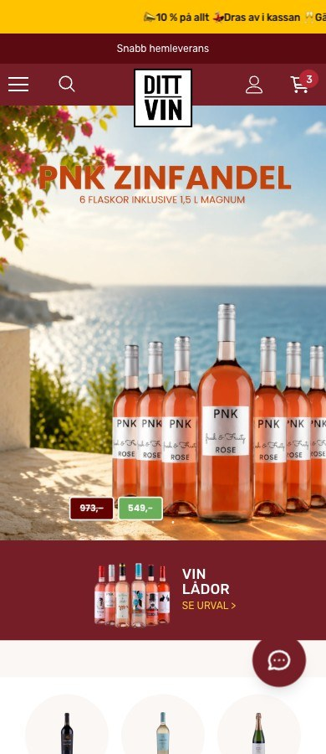
2026
HEURISTIC · HOMEPAGE
Strong bones, two real cracks
Clear category circles. Rött, Vitt, Mousserande, Rosé, Gin, Vinlådor, Erbjudanden, Abonnemang, Alkoholfri. Vivino badges on products.
Everything is on sale. Every product wears a red discount flag plus "Spara X kr". Permanent discounting reads as generic, not premium.
Reserve discounting for real offers.
Sections render inconsistently. "Upplev..." and "Kunskap..." load as empty bands on one capture and filled on the next.
Flaky, tied to 90+ JS errors.
Trust assets buried. The Danish operator line and Løvens Hule backing sit only in the footer.
HOMEPAGE · MOBILE
ECOMHOUSE ©ALL RIGHTS RESERVED
23

Slide 25
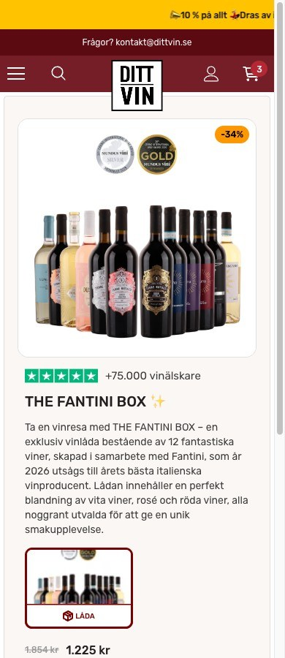
2026
HEURISTIC · COLLECTION & PDP
Good buy box, missing reassurance
Solid fundamentals. Sticky add to cart, strikethrough price, "+75.000 vinälskare", Trustpilot and award badges, free shipping bar.
No legality block at the decision point. The exact place KRAN and Winefamly reassure, dittvin stays silent. Suppresses the 64% who view but never add.
Thin box detail. Only 3 gallery images for a 12 bottle box, and no per wine grape, sweetness or Vivino.
Customers ask for it directly.
Danish leaks and shipping caveats. Title reads "Kjøb hos Dittvin.se", and free shipping is quietly limited to Airmee.
FANTINI BOX PDP · MOBILE
ECOMHOUSE ©ALL RIGHTS RESERVED
24

Slide 26
2026
HEURISTIC · BALANCE
Strengths to protect
Box led assortment
4,7 Trustpilot on 5.985
Low homepage bounce
The best converter (5,54%) and a genuine customer love. Product and data agree.
A deep, credible review base. A powerful proof asset for the legality and quality objections.
24,9% bounce is excellent. The top of the experience works. The leaks are deeper.
Sticky ATC + free ship bar
Real differentiators
Strong owned channels
Mobile buy box mechanics are already in place, including a cart progress bar.
Subscription plus boxes, alcohol free range, award medals, and Løvens Hule backing rivals lack.
Klaviyo email drives 16% of orders at 2,55% CVR. A ready lever to reduce paid dependence.
ECOMHOUSE ©ALL RIGHTS RESERVED
25

Slide 27
2026
05
SECTION 05
Competitor Landscape
Five verified rivals plus the monopoly. Everyone reassures on legality except dittvin.
ECOMHOUSE ©ALL RIGHTS RESERVED
26

Slide 28
2026
COMPETITOR · VERIFIED MATRIX
Where dittvin sits
CAPABILITY | DITTVIN | WINEFINDER | WINEFAMLY | KRAN | SUPERVIN | SYSTEM-BOLAGET
Legality messaging | None | Trygg | Tax stated | Skatteverket | CVR+Trygg | Is channel
Trygg E-handel | No | Yes | Yes | No | Yes | N/A
Delivery clarity | Vague | Carriers | Home | Not stated | 29 kr, 2-5d | Multiple
Subscription | Yes | No | Boxes | Club | No | No
Wine boxes | Yes | Yes | Yes | Yes | Yes | No
Reviews shown | Vivino | Critic+stars | Not shown | Press | Trustpilot | None
Filtering | Basic | Faceted | Category | Minimal | Category | Food pair
ECOMHOUSE ©ALL RIGHTS RESERVED
27

Slide 29
2026
COMPETITOR · OPPORTUNITY
Five gaps, one big wedge
1
2
3
Own the legality question
Add Trygg E-handel
Make delivery concrete
The top objection, and only KRAN answers it (buried in text). A visible "why this is legal" module out reassures everyone.
Three of four direct rivals show the Swedish trust mark. dittvin leans on a Danish TV endorsement.
Supervin states "from 29 kr, free over 999, 2-5 days". dittvin says only "snabb" with a caveated threshold.
Biggest wedge
Quick win
Trust + clarity
4
5
+
Localize fully to Swedish
Merchandise proof, not discounts
The retention moat rivals lack
Danish product types and titles leak through ("Kjøb", "Smagekasser"). It reads un Swedish.
dittvin holds medals, Vivino and 4,7 Trustpilot but relies on a blanket 10% off. Own "curated value with proof".
dittvin already has subscription plus boxes. Own "the recurring discovery box for everyday Swedes".
Polish
Positioning
Defensible
ECOMHOUSE ©ALL RIGHTS RESERVED
28

Slide 30
2026
06
SECTION 06
Technical Audit
Verified by live network capture, not an HTML scan. The tags are all present, but the configuration is noisy.
ECOMHOUSE ©ALL RIGHTS RESERVED
29

Slide 31
2026
TECHNICAL · TRACKING
Clean the data before you trust it
Everything fires (GTM, GA4, Meta Pixel, Google Ads, Klaviyo, Clarity, Cookiebot). The problem is redundancy and one clear misconfiguration.
Conversion fires on the homepage
Four GA4 properties at once
Dead and duplicate tags
A Google Ads conversion tag fires "en=conversion, value 1,43 SEK" on homepage load. Every visit logs a conversion, polluting Ads data.
G-2H577FR3BL, QVVPL3QFTK, ZHBPVPWFVY, ZPDXL42WNW all fire page_view in parallel. Fragmented, duplicated reporting.
Legacy Universal Analytics still sits in GTM (dead since 2023), and two Google Ads accounts fire.
HIGH · low effort
HIGH · med effort
MED · low effort
90+ console errors per load
Clarity is already installed
Recover the "(not set)" signal
Every page throws 90 to 190 JS errors. Likely cause of the blank homepage sections and a checkout suspect.
Microsoft Clarity (v7fb9kby3w) is live and collecting session replays you are not using. Grant dashboard access.
Server side GTM plus Meta CAPI and consent mode modeling recover the 29% of sessions currently lost.
MED
ASSET · no effort
HIGH · high effort
ECOMHOUSE ©ALL RIGHTS RESERVED
30

Slide 32
2026
07
SECTION 07
Industry Benchmarks
Every figure carries a named source. General ecommerce rows are the fair apples to apples comparison.
ECOMHOUSE ©ALL RIGHTS RESERVED
31

Slide 33
2026
BENCHMARKS · VERIFIED SOURCES
Where dittvin stands
Ahead where acquisition is measured, behind where revenue compounds.
METRIC | DITTVIN | BENCHMARK (SOURCE) | VERDICT
Session conversion rate | 2,58% | 1,4% Shopify avg (Littledata 2023) | Ahead
Average order value | 867 SEK | ~$85 Shopify avg (Littledata 2023) | On par
RPV per session | 26 / 73+ SEK | ~$1,19 Shopify Est. (AOV x CVR) | Ahead
Cart abandonment | 60% | 70,2% avg of 50 studies (Baymard 2025) | Ahead
Repeat customer rate | ~19% | under 20% is weak (OpenSend, MetricUno) | Behind
Email share of orders | 16% | ~20-30% of DTC revenue Est. (Omnisend) | Behind
Subscription / club share | 0,2% | wine clubs 39% of winery DtC (SVB 2025) | Behind
Mobile share of traffic | 86% | mobile converts ~37% below desktop (Littledata) | Upside
ECOMHOUSE ©ALL RIGHTS RESERVED
32

Slide 34
2026
BENCHMARKS · THE READ
Strong at the top, soft where it compounds
The funnel and order value are genuine strengths. The RPV upside is monetizing retention.
ALREADY AHEAD
THE RPV GAPS
Acquisition is a strength
Retention is underbuilt
Conversion ~1,8x the Shopify average, on 86% mobile. AOV above the Shopify line. RPV ~1,75x the derived Shopify benchmark. Cart abandonment 10 points better than Baymard.
Repeat rate ~19% sits under the "weak" 20% line, in the category that monetizes retention hardest. Email 16% of orders vs a 20-30% norm. Subscription 0,2% of revenue is the biggest single gap.
ECOMHOUSE ©ALL RIGHTS RESERVED
33

Slide 35
2026
08
SECTION 08
RPV: The Northstar
Revenue per visitor = conversion x order value, compounded by repeat. Before we grow it, we have to be able to see it.
ECOMHOUSE ©ALL RIGHTS RESERVED
34

Slide 36
2026
RPV · MEASUREMENT
You are measuring one third of the business
Shopify recorded three times the orders GA4 did over the same 91 days.
METRIC (SAME 91 DAYS) | SHOPIFY (TRUTH) | GA4 AUDIT PROPERTY | GA4 CAPTURES
Orders | 38.310 | 11.689 | 31%
Gross revenue | 33,2M SEK | 11,9M SEK | 36%
Total sales incl tax | 39,9M SEK | n/a
Net sales (ex tax, disc) | 31,9M SEK | n/a
Refund rate | 0,4% | n/a
Causes: Cookiebot consent denial, Facebook in app browser attribution loss on 41% of traffic, and 4 parallel GA4 properties. So the store is ~3x larger than the GA4 view, Facebook optimizes on 1/3 of the signal, and Shopify is the RPV source of truth until GA4 is rebuilt server side with Meta CAPI.
ECOMHOUSE ©ALL RIGHTS RESERVED
35

Slide 37
2026
RPV · THE EQUATION
RPV = conversion x order value
Four levers move the northstar. The real numbers, corrected against Shopify.
867 SEK
73+ SEK
38.310
0,2%
TRUE AOV (SHOPIFY)
TRUE RPV / SESSION
REAL ORDERS / 91D
ON SUBSCRIPTION
GA4 overstated it at 1.017
vs 26 SEK GA4 implied
3,3x the GA4 count
The repeat engine is off
RPV lower bound = Shopify gross 33,2M / GA4 sessions 452.552 = 73 SEK. The point is not the exact number: AOV and repeat are the levers with the most room, and measurement lets us steer them.
ECOMHOUSE ©ALL RIGHTS RESERVED
36

Slide 38
2026
RPV · THE AOV ENGINE
Boxes are the business
Tasting boxes are 76% of net sales at near full price. Realized blended discount is only 3,4%.
SEGMENT | UNITS 91D | SHARE OF NET SALES | AVG PRICE | REALIZED DISCOUNT
Tasting boxes (vinlådor) | 43.617 | 76,3% | 567 SEK | 1,2%
Single red bottles | 11.396 | 12% | ~400 SEK | 18,4%
Premium boxes (Grill, Guld) | 2.668 | 7% | 700-865 SEK | 2-5%
Subscription (Abonnement) | 108 | 0,2% | 611 SEK | 0%
Top 2 SKUs = 26,5% of net sales. Top 30 SKUs (6% of the catalog) = 80%. The AOV lever is a box ladder (567 SEK to the 700 SEK+ tiers) plus a real subscription, not more discounting.
ECOMHOUSE ©ALL RIGHTS RESERVED
37

Slide 39
2026
09
SECTION 09
CRO & RPV Roadmap
Sequenced by leverage on revenue per visitor. Measurement first because it multiplies every other lever.
ECOMHOUSE ©ALL RIGHTS RESERVED
38

Slide 40
2026
ROADMAP · THE RPV GROWTH PLAN
Five levers, in order
# | LEVER | MOVE | WHY IT MOVES RPV | EFFORT
1 | Measurement | Server side GTM + Consent Mode + Meta CAPI; one GA4 | Unlocks true RPV and feeds ad algorithms 3x the signal | High
2 | Subscription | Launch a real monthly discovery box club | Repeat is stuck at 19%; recurring RPV base | Med
3 | AOV ladder | Upsell 567 SEK buyers to 700 SEK+ boxes; Rebuy attach | Lifts the AOV half of RPV without new traffic | Med
4 | Conversion | Legality block + honest delivery + cart clarity | Lifts the conversion half of RPV, esp. first time buyers | Med
5 | Traffic mix | Grow email/owned and organic; cut Facebook reliance | Higher quality, cheaper traffic; de risks 43,6% concentration | Strategic
ECOMHOUSE ©ALL RIGHTS RESERVED
39

Slide 41
2026
ROADMAP · IF YOU DO ONLY THREE THINGS
Start here
1
2
3
Answer the legality question
Fix the delivery promise
Recover the cart leak
A visible "why this is legal" block on PDP and cart, with the age check, Danish import model, tax included, and your 4,7 Trustpilot proof.
Replace "1-3 dagar" with an honest ETA and proactive updates. Protects the 40% of revenue from repeat buyers.
Surface shipping rules in cart and add a clear continue step. 60,2% of carts never reach checkout today.
Lifts 80,8% new buyers
Kills 86% of complaints
Est. 1,5-1,8M SEK/qtr
ECOMHOUSE ©ALL RIGHTS RESERVED
40

Slide 42
2026
10
SECTION 10
Selected Test Plans
The first three tests to run, each with a hypothesis, primary metric, and a pre-agreed target. Built and QA'd by EcomHouse.
ECOMHOUSE ©ALL RIGHTS RESERVED
41

Slide 43
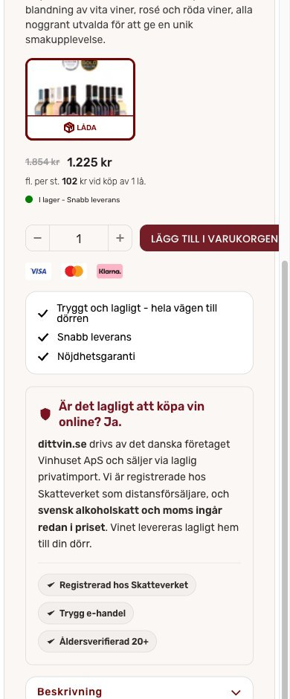
2026
TEST · DV-01
PDP legality & trust block
OBSERVATION
•
64% of product viewers never add to cart.
•
Zero on-site legality copy in a monopoly market.
•
80,8% of buyers are first time and new to private import.
HYPOTHESIS
Answering "is it legal?" at the buy box (Danish import, Skatteverket, tax included) removes the top objection and lifts add to cart for new buyers.
KEY METRICS
1.
View to add to cart (primary)
2.
PDP to purchase
3.
New visitor conversion rate
VARIANT · LEGALITY BLOCK
METRIC
CONFIDENCE
MIN ORDERS
DURATION
ATC rate
80%
300
2-4 wks
ECOMHOUSE ©ALL RIGHTS RESERVED
42

Slide 44
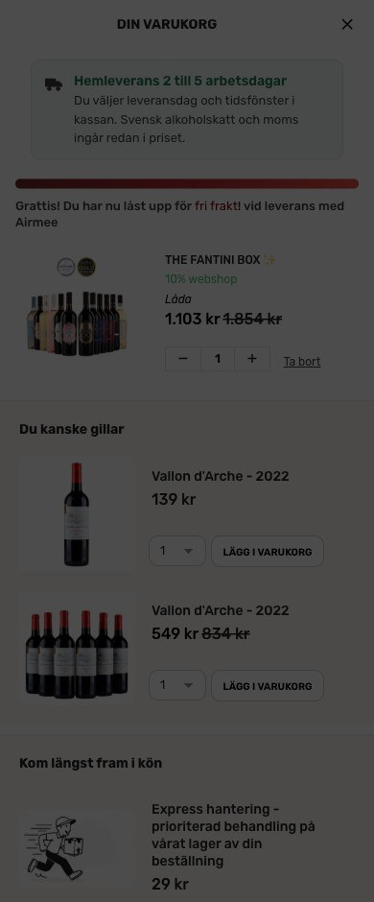
2026
TEST · DV-02
Cart drawer: delivery clarity
OBSERVATION
•
60,2% of add to carts never begin checkout.
•
Delivery estimate is buried; "1-3 dagar" promise is broken.
•
Free shipping is quietly Airmee-only, which confuses buyers.
HYPOTHESIS
Elevating an honest 2-5 day delivery block with a chooseable day, plus tax-included and payment trust at checkout, recovers the cart to checkout leak.
KEY METRICS
1.
Cart to begin checkout (primary)
2.
Checkout completion
3.
Revenue per session
VARIANT · CART CLARITY
METRIC
CONFIDENCE
MIN ORDERS
EST.
Cart→CO
80%
300
1,5-1,8M/qtr
ECOMHOUSE ©ALL RIGHTS RESERVED
43

Slide 45
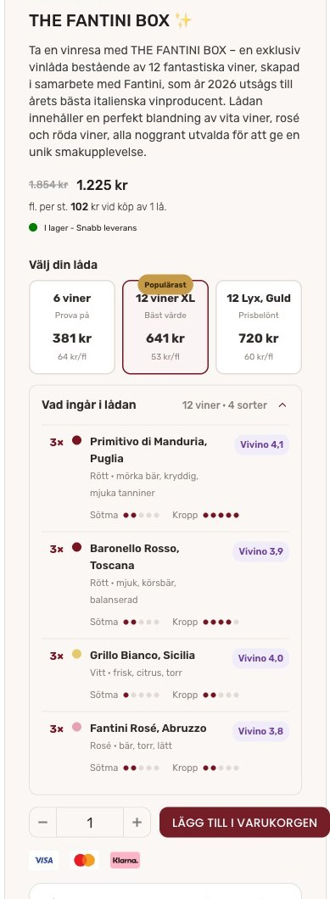
2026
TEST · DV-03
Box PDP: AOV ladder & taste detail
OBSERVATION
•
Boxes are 76% of revenue; avg box 567 SEK.
•
Premium 700 SEK+ tiers exist but sell in low volume.
•
Buyers cannot taste; 14% of complaints are about taste.
HYPOTHESIS
A tier ladder (6 / 12 XL / 12 Guld) with per bottle math and a per wine taste profile lifts order value and add to cart by removing the blind box risk.
KEY METRICS
1.
Revenue per session (primary)
2.
Average order value
3.
Add to cart rate
VARIANT · AOV LADDER
METRIC
CONFIDENCE
MIN ORDERS
DURATION
RPV / AOV
80%
300
2-4 wks
ECOMHOUSE ©ALL RIGHTS RESERVED
44

Slide 46
2026
11
SECTION 11
How EcomHouse Works
You approve, we execute. Research through rollout, priced on the wins. Recent results from other DK clients.
ECOMHOUSE ©ALL RIGHTS RESERVED
45

Slide 47
2026
THE ECOMHOUSE METHOD
Six steps, end to end
You approve. We execute. Every step is owned by us, including build, QA, and rollout. Client only approves the brief and rollout.
// 01
// 02
// 03
// 04
// 05
// 06
Research
Ideate
Pre-test brief
Build + QA
Run + monitor
Analyze + roll out
GA4, Shopify, heatmaps, recordings, reviews, support.
→
Hypothesis, variant concepts, copy, Figma prototype.
→
Written brief with metric, confidence, sample size.
→
Shopify or test tool variant, tracked, QA'd across devices.
→
Live test with guardrail watch, weekly progress updates.
→
Written verdict, fee invoiced on rollout to 100 % of traffic.
Zero-row service: the client is not expected to do production work. We handle everything from research through analysis. The client approves the pre-test brief and the rollout decision in writing.
ECOMHOUSE ©ALL RIGHTS RESERVED
46

Slide 48
2026
BRIEF + PROTOCOL
How every test launches and concludes
No test starts without a written, approved brief. Tests only conclude when all approved conditions are met.
PRE-TEST BRIEF
TESTING PROTOCOL
Every test launches with a written, approved brief
Guardrails on tooling, rigor, conclusion
// PART 1 Test setup
// PART 2 Statistical parameters
DEFAULT TOOL
CONFIDENCE
✓
Hypothesis and Control vs Variant difference
✓
Primary metric (RPV or funnel metric)
IntelliGEMS
80 % min
Or Convert, GrowthBook, Shopify-native with written approval.
Higher per test if you require it.
✓
Audience and traffic filters
✓
Statistical confidence (80 % default)
✓
Funnel stage and stage multiplier
✓
Minimum visitor and order count
CONCLUSION
REPORTING
✓
URL targeting
✓
Worked fee range at +5 / +10 / +15 %
All conditions met
Weekly Loom
✓
Frozen baselines from trailing 30 days
✓
Data sources named explicitly
Min visitors, orders, and confidence reached.
Plus a running test log you can access anytime.
ECOMHOUSE ©ALL RIGHTS RESERVED
47

Slide 49
2026
TRACK RECORD
Three winning EcomHouse tests
Real results from EcomHouse client engagements. Each test rolled out to 100 % of traffic after meeting the pre-approved confidence threshold. IntelliGEMS test tool.
Comforth · DK
PH Import · DK
PH Import · DK
Product tags on collection cards
PDP volume discount tiers
Homepage hero optimization
PROFIT / VISITOR
CONVERSION RATE
REVENUE / VISITOR
+11,42%
+11,08%
+20,87%
-11 % to +39 %
-3 % to +27 %
-12 % to +67 %
+106.550 kr / mo
+134.917 kr / mo (RPV)
+272.913 kr / mo
CR
+13,07%
2,09% → 2,37%
RPV
+17,10%
20,36 → 23,84 kr
CR
+7,72%
16,3% → 17,6%
RPV
+11,13%
26,88 → 29,87 kr
AOV
+5,42%
293,47 → 309,37 kr
AOV
+12,21%
401,87 → 450,94 kr
Orders / mo
+169
Orders / mo
+298
PDP view rate
+9,21%
56,6% → 61,8%
Added trust + benefit tags to collection product cards. Lift compounded across all three metrics.
Surfaced volume discount tiers directly on the PDP. CR was primary, RPV and AOV lifted simultaneously.
Reworked homepage hero with lighter background. Lifted the full funnel: more PDP views, higher AOV, more revenue.
Source: IntelliGEMS test reports. Confidence intervals shown reflect range of likely true effect. References available on request.
ECOMHOUSE ©ALL RIGHTS RESERVED
48

Slide 50
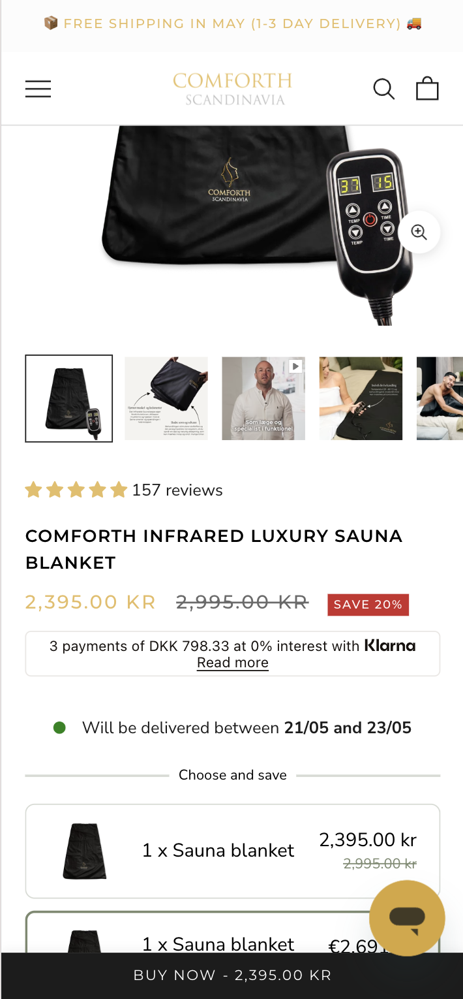
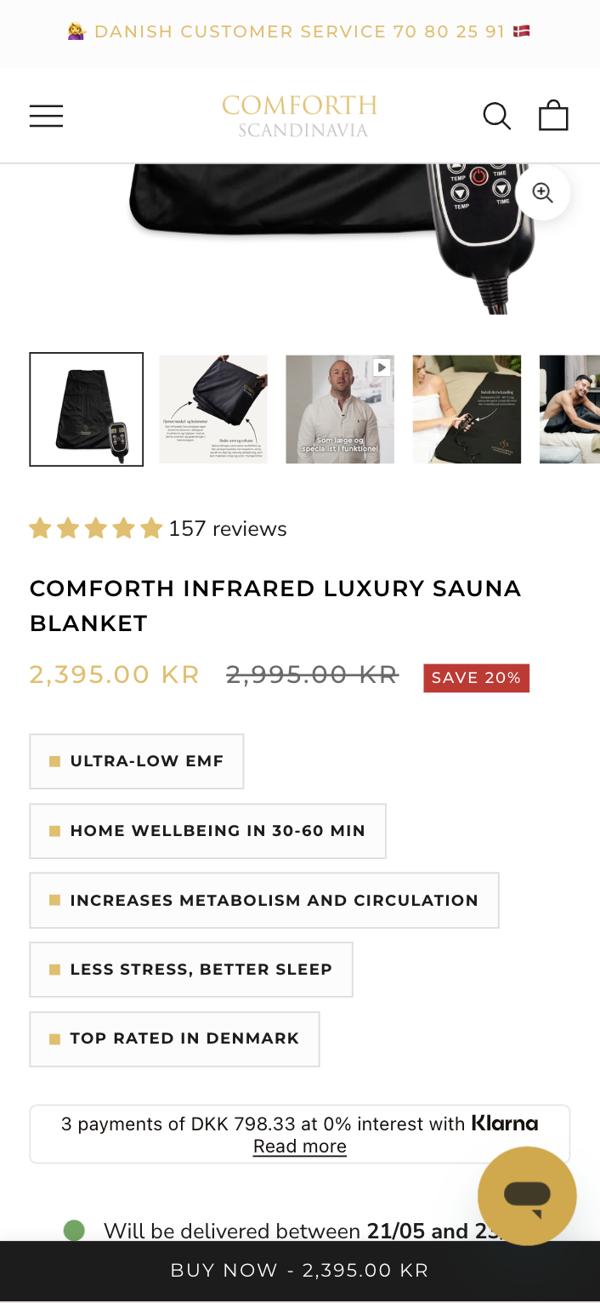
2026
CASE STUDY · 01
Comforth · Product tags on collection cards
Added benefit and trust tags directly to product cards on collection pages. Variant lifted all three commercial metrics with no degradation in any guardrail. IntelliGEMS, 100 % rollout.
PROFIT PER VISITOR (PRIMARY)
+11,42%
-11 % to +39 % CI
+106.550 kr / month projected
METRIC
CONTROL
VARIANT
Δ
Conversion rate
2,09 %
2,37 %
+13,07%
Revenue / visitor
26,88 kr
29,87 kr
+11,13%
Profit / visitor
15,07 kr
16,80 kr
+11,42%
CONTROL
VARIANT
Est. orders / mo
·
+169
ECOMHOUSE ©ALL RIGHTS RESERVED
49

Slide 51
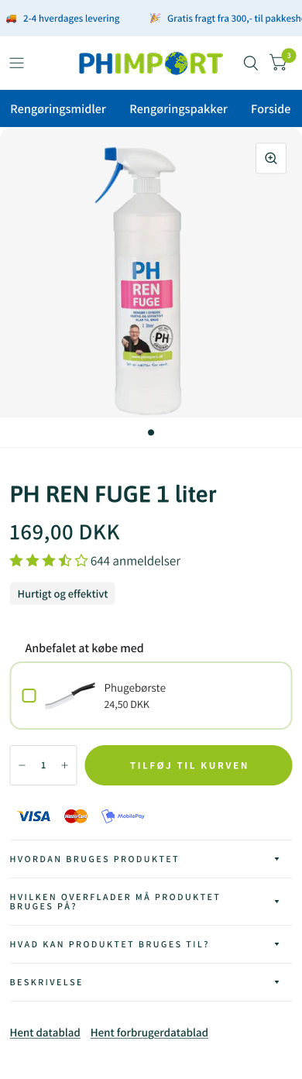
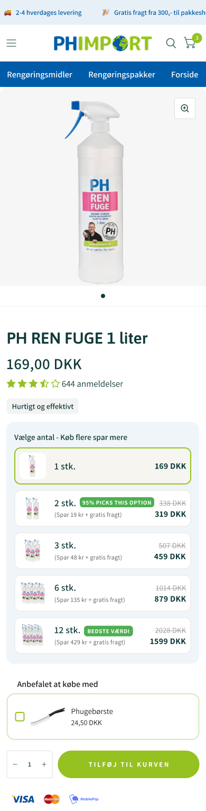
2026
CASE STUDY · 02
PH Import · PDP volume discount tiers
Surfaced volume discount tiers directly on the PDP. The variant lifted purchase rate, AOV, and downstream profit simultaneously. IntelliGEMS, 100 % rollout.
CONVERSION RATE (PRIMARY)
+11,08%
-3 % to +27 % CI
+298 orders / month · +134.917 kr / mo (RPV)
METRIC
CONTROL
VARIANT
Δ
Conversion rate
6,94 %
7,71 %
+11,08%
Revenue / visitor
20,36 kr
23,84 kr
+17,10%
Profit / visitor
10,49 kr
12,25 kr
+16,68%
CONTROL
VARIANT
Avg order value
293,47 kr
309,37 kr
+5,42%
ECOMHOUSE ©ALL RIGHTS RESERVED
50

Slide 52
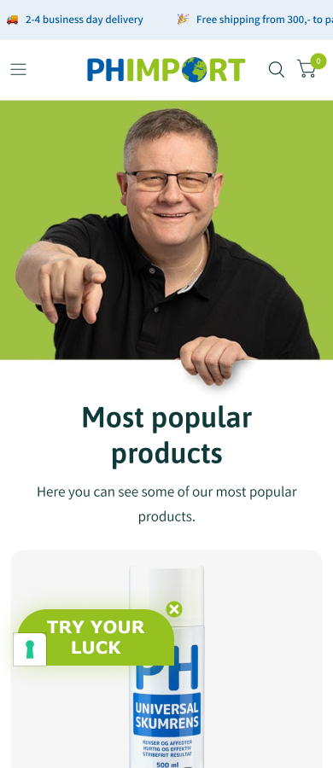
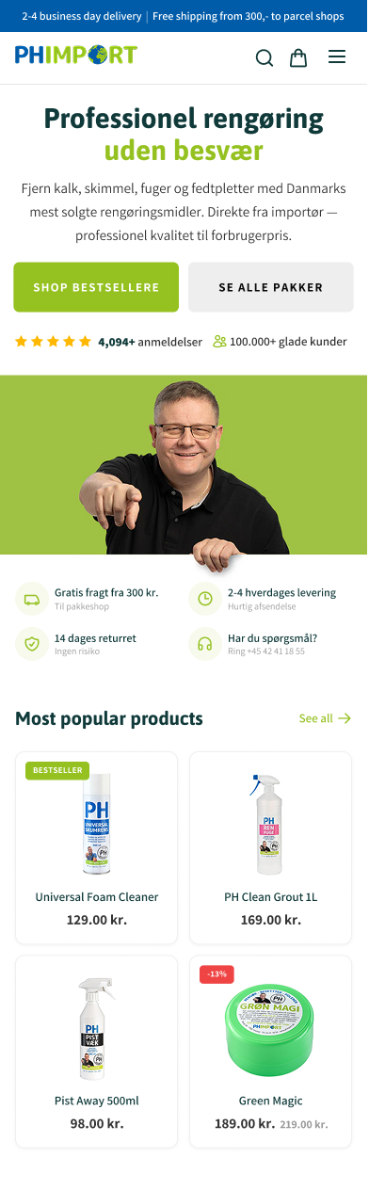
2026
CASE STUDY · 03
PH Import · Homepage hero optimization
Reworked homepage hero with a lighter background and a sharper category-led layout. Lift compounded through PDP views, AOV, and revenue. IntelliGEMS, 100 % rollout.
REVENUE PER VISITOR (PRIMARY)
+20,87%
-12 % to +67 % CI
+251 orders / month · +272.913 kr / mo
METRIC
CONTROL
VARIANT
Δ
Revenue / visitor
65,50 kr
79,17 kr
+20,87%
Profit / visitor
34,78 kr
42,35 kr
+21,78%
Avg order value
401,87 kr
450,94 kr
+12,21%
CONTROL
VARIANT
PDP view rate
56,6 %
61,8 %
+9,21%
ECOMHOUSE ©ALL RIGHTS RESERVED
51

Slide 53
2026
COMPENSATION
We win when you win
Performance-based fee on every winning test rolled out to 100 % of traffic. One-time charge per test. No attribution window. No recurring tail.
// PERFORMANCE FEE
// OPTIONAL RETAINER
% of estimated monthly revenue uplift
Fixed monthly fee
Y %
X kr / month
Charged once per winning test on rollout. Calculated from the test's measured uplift and the client's own data, with the agreed stage multiplier applied.
Optional. Predictable monthly cost on top of (or instead of) the performance fee. Some clients prefer this for budgeting.
→
One time fee per winning test
→
Billed on the 1st, in advance
→
No recurring tail, no attribution window
→
Void if not agreed
→
Loser and inconclusive tests are free
→
Stackable with the performance fee
Billing: one invoice on the 1st covering the retainer (if any) plus the performance fee for every winning test rolled out last month. 8 day payment terms. Third-party costs (test tools, apps) paid by the client.
ECOMHOUSE ©ALL RIGHTS RESERVED
52

Slide 54
2026
Thank you
Recommended first sprint: fix measurement, then the legality trust block, the delivery promise, and cart shipping clarity.
Prepared by EcomHouse for dittvin.se.
ECOMHOUSE ©ALL RIGHTS RESERVED
53

