Slide 1

2026
TJÅKKO
CRO Audit & Opportunity Report
GA4 Analysis
Funnel
Heuristic Audit
Voice of Customer
Competitors
tjakko.se · Barfotaskor & outdoor, Shopify, Sweden · Audit date 26 Jun 2026
GA4 property 461672304 (90-day pull + 28-day funnel), PageSpeed, Trustpilot VOC, 5 verified competitors.
Prepared by EcomHouse
ECOMHOUSE ©ALL RIGHTS RESERVED
00

Slide 2
2026
METHODOLOGY
How this audit was built
Every finding is grounded in GA4 data, live page behaviour, or the customer's own words. Absolute GA4 numbers are directional; the step to step drop-off ratios are unaffected and drive every priority.
// 01
// 02
// 03
GA4 evidence
Live page & speed
VOC + competitors
90-day pull + 28-day funnel from property 461672304: sessions, revenue, device split, traffic, sequential View to Purchase funnel.
Full walk of homepage, collection, PDP and cart on desktop and mobile, plus Google PageSpeed on all three page types.
41 verbatim Trustpilot reviews (4.3/5) theme coded, plus 5 verified barefoot retailers (freefoot, simplybarefoot, barfooties + 2 EU refs).
The one line version: 96% of product viewers never add to cart, the leak is concentrated on a mobile storefront that is 86% of traffic but converts at a third of desktop, and TJÅKKO already owns the proof and sizing help that would fix it but hides both at the decision point.
ECOMHOUSE ©ALL RIGHTS RESERVED
01

Slide 3
2026
EXECUTIVE SUMMARY
Where the money is leaking
90-day GA4: 47,312 sessions, 666 orders, 1.32M SEK revenue, 1.41% conversion. The funnel and the device split show exactly where to act first.
01
96% drop from View Product to Add to Cart
02
Mobile is 86% of traffic, converts 3x worse
GA4 funnel: 6,656 users view a product, only 262 add to cart. Checkout itself is healthy.
Mobile 1.06% CVR vs desktop 3.86% on 40,896 mobile sessions.
3.9% VIEW TO ATC
MOBILE CVR 1.06% VS 3.86%
03
42 reviews exist, 0 are shown
04
Sizing, the #1 objection, buried in the FAQ
4.3/5 on Trustpilot, yet the PDP renders "0 recensioner" and cards show no stars.
Sizing appears in 10 of 41 reviews. The measurement guide sits in the footer FAQ, not on the PDP.
SOCIAL PROOF HIDDEN
DRIVES VIEW TO ATC DROP
05
75% of sessions are paid, half underperforming
06
Cart drawer has no cross-sell
Facebook paid 20,013 sessions at 0.76% CVR vs Google CPC at 1.51%.
The drawer already has a free-shipping bar and free gift, but no cross-sell to reach them.
FB PAID 0.76% CVR
AOV LEVER HALF USED
ECOMHOUSE ©ALL RIGHTS RESERVED
02

Slide 4
2026
00
QUANTITATIVE ANALYSIS
The numbers
GA4 property 461672304. 90-day totals and a 28-day sequential funnel.
ECOMHOUSE ©ALL RIGHTS RESERVED
03

Slide 5
2026
BASELINE
Where TJÅKKO stands today
Last 90 days, GA4 property 461672304. Treat absolute numbers as directional anchors.
1.32M SEK
47,312
666
1.41%
~1,986 SEK
REVENUE (90D)
SESSIONS
ORDERS
CONVERSION RATE
AVG ORDER VALUE
28,249
37.6%
62%
2m 59s
86%
USERS
BOUNCE RATE
ENGAGEMENT RATE
AVG SESSION
TRAFFIC ON MOBILE
A healthy revenue base with strong engagement (62%, low 37.6% bounce). The problem is not getting people in or holding attention. It is converting the product view into a cart, especially on mobile.
ECOMHOUSE ©ALL RIGHTS RESERVED
04

Slide 6
2026
FUNNEL DECOMPOSITION
One step is eating the funnel
GA4 sequential funnel, last 28 days, unique users per step. The leak is the jump from viewing a product to adding it to the cart.
Session start
8,923
View product
6,656 · 74.6%
Add to cart
262 · 3.9%
Begin checkout
125 · 47.7%
Purchase
83 · 66.4%
96.1% of product viewers never add to cart. Checkout converts fine (66% of starts purchase). Every lever in this audit (reviews, sizing, mobile speed, PDP trust) targets this one step.
ECOMHOUSE ©ALL RIGHTS RESERVED
05

Slide 7
2026
DEVICE SPLIT
Mobile is the business, and it underperforms
90-day GA4. Mobile carries the traffic and most of the revenue, but converts at barely a quarter of desktop.
MOBILE (86% OF SESSIONS)
DESKTOP (12% OF SESSIONS)
1.06%
3.86%
vs
40,896 sessions · 435 orders 800,166 SEK · 86% of all sessions
5,779 sessions · 223 orders 511,806 SEK · 12% of sessions
Est. opportunity: lifting mobile from 1.06% to just 1.5% conversion is roughly 180 extra orders per quarter at ~1,839 SEK, about 330,000 SEK per quarter. The lever is the mobile buy-box experience (reviews, sizing, trust), not raw page speed.
ECOMHOUSE ©ALL RIGHTS RESERVED
06

Slide 8
2026
TRAFFIC & SPEND
Three quarters of sessions are paid
90-day GA4 by source / medium. Paid social brings the most sessions but converts worst, so the low-converting PDP is paid for twice.
Source / medium | Sessions | Share | Orders | CVR | Revenue
facebook / paid | 20,013 | 42% | 153 | 0.76% | 282,025 SEK
google / cpc | 15,425 | 33% | 233 | 1.51% | 444,841 SEK
direct | 4,338 | 9% | 67 | 1.54% | 123,463 SEK
google / organic | 2,676 | 6% | 38 | 1.42% | 70,564 SEK
shopify_email | 793 | 2% | 17 | 2.14% | 27,294 SEK
Facebook paid is 42% of sessions at 0.76% CVR, half of Google CPC's 1.51%. Email converts best (2.14%) on tiny volume, an underused owned channel. Fixing the PDP lifts the return on every paid krona.
ECOMHOUSE ©ALL RIGHTS RESERVED
07

Slide 9
2026
01
FOUNDATION
Site performance
A hygiene check, not the headline. Shopify stores routinely score low on synthetic mobile tests.
ECOMHOUSE ©ALL RIGHTS RESERVED
08

Slide 10
2026
CORE WEB VITALS
Mobile speed: worth a look, not the headline
Google PageSpeed lab scores, measured 26 Jun 2026. These are synthetic tests, and Shopify stores routinely score 30 to 50 on mobile. Confirm against real-user field data before investing.
Page | Perf (mob) | FCP mob | LCP mob | Perf (desk) | LCP desk | CLS desk
Homepage | 49 | 23.5s | 33.9s | 23 | 5.7s | 0.155
Collection | 33 | 23.7s | 31.0s | 28 | 4.6s | 0.155
PDP (Seacamp II) | 47 | 23.7s | 27.6s | 44 | 4.9s | 0.179
How to read this: these scores sit below average, but they are synthetic lab numbers (most Shopify stores land here) and not what real shoppers feel. The practical next step is small: audit the installed apps and third-party scripts, remove anything unused, then confirm any real gain in CrUX field data. It is a hygiene task, not the main conversion lever. The View to ATC fixes (reviews, sizing, trust) come first.
ECOMHOUSE ©ALL RIGHTS RESERVED
09

Slide 11
2026
02
PAGE BY PAGE
The conversion walk
Why 96% of viewers do not add to cart. Homepage to collection to PDP to cart.
ECOMHOUSE ©ALL RIGHTS RESERVED
10

Slide 12
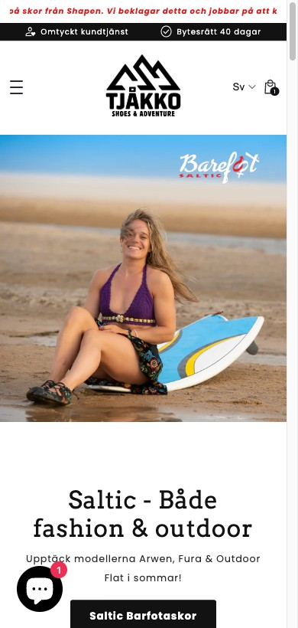
2026
HOMEPAGE
A strong story, led by the wrong slide
The homepage holds attention (16.9% bounce, 4m54s on site). The issue is what gets the spotlight.
What we observed
What to do
• Hero is a rotating SHAPEN supplier banner, not TJÅKKO's own promise.
• Bestseller tiles show prices but almost no star ratings.
• A large blank mid-page gap on cold load (ties to speed).
• Sizing answer buried in a footer FAQ accordion.
• A prominent Shapen delay notice is the first thing a visitor reads.
1. Lead with TJÅKKO's benefit hero ("frihet för fötterna").
2. Add star ratings to bestseller and collection cards.
3. Pull a "Hitta rätt storlek" entry point up near the hero.
4. Fix the render gap so the homepage paints top to bottom.
5. Scope the delay banner to affected products only.
LIVE, MOBILE
Customers describe the product as "att sätta fötterna fria". That line belongs in the hero. A supplier's summer promo does not.
ECOMHOUSE ©ALL RIGHTS RESERVED
11

Slide 13
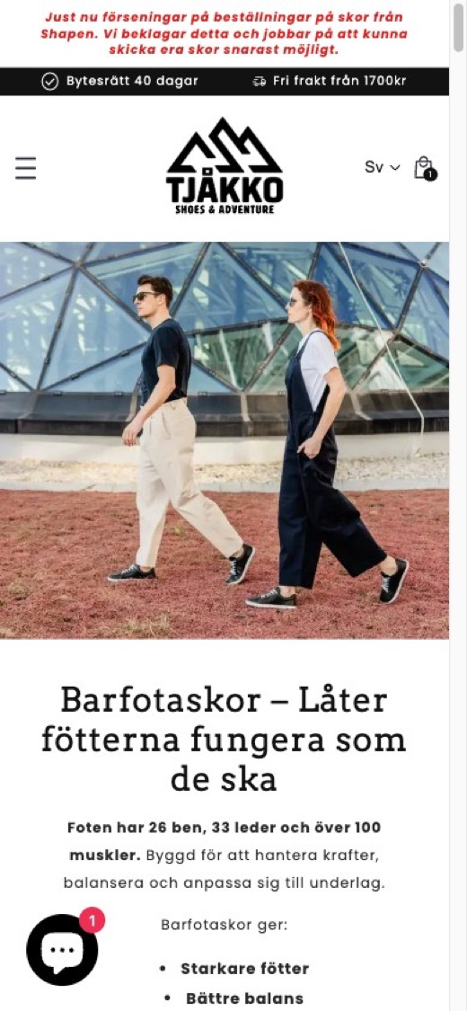
2026
COLLECTION / PLP
Products pushed below a wall of copy
/collections/barfotaskor. Filters exist (good), but a shopper works to reach a product.
What we observed
What to do
• Mobile opens with a full-screen lifestyle image + paragraphs of education before the first product.
• A left filter rail is present on desktop (a real strength).
• On cold capture the product grid rendered blank; images load late.
• No star ratings on any of the 64 product cards.
• No "for wide feet" or fit-based filter.
1. Compress the editorial intro on mobile, show products in the first scroll.
2. Lazy load product images with priority hints.
3. Seed and surface review stars on cards.
4. Add a width / fit filter (smal / normal / bred).
5. Keep the education, move it after the first product row.
LIVE, MOBILE
A collection page exists to show products. Right now a mobile visitor reads a brand essay first, then waits for images. Both are fixable.
ECOMHOUSE ©ALL RIGHTS RESERVED
12

Slide 14
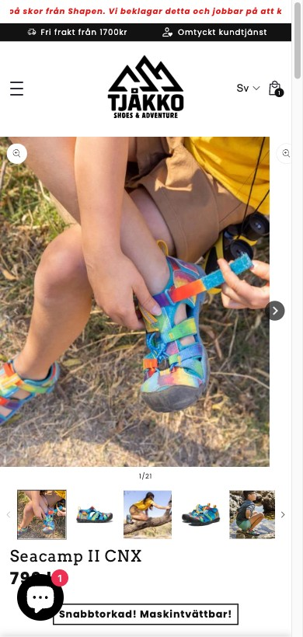
2026
PRODUCT PAGE
A rich PDP with an empty review box
This is where the 96% leak happens. The PDP is content rich, but two gaps undercut it.
What we observed
What to do
• Working well: a "BRED & RYMLIG" fit indicator with footprint diagram.
• Working well: trust badges (QR returns, secure delivery).
• Working well: a curated "Nöjda kunder" photo-review strip lower down.
• The Judge.me widget shows "0 recensioner" right above it.
• Sizing is a link to a separate table; smallest size pre-selected.
1. Import the 42 Trustpilot reviews, surface the aggregate on PDP + cards.
2. Move sizing inline: foot-measure guide + per-brand table + PDF.
3. Stop pre-selecting the smallest size.
4. Add a provenance / guarantee block to counter the "Temu" doubt.
LIVE, MOBILE
The highest impact fix in this audit: surface the 42 reviews the brand already owns. The proof exists, it is just not on the page.
ECOMHOUSE ©ALL RIGHTS RESERVED
13

Slide 15
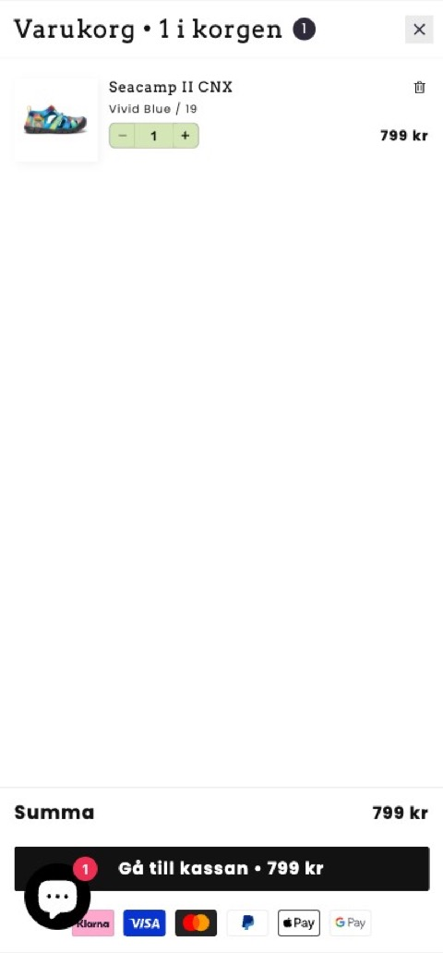
2026
CART DRAWER
The drawer already nudges. It needs a cross-sell.
Add-to-cart opens a drawer with a free-shipping bar and a free-gift tier. Checkout converts well (66%).
What we observed
What to do
• The drawer already shows a free-shipping bar and a free-gift tier. Both good.
• It goes straight to checkout and remembers an order note.
• The one gap: no curated cross-sell to reach the thresholds.
• The gift and shipping nudges have no "here is what to add" to act on.
1. Add a "Komplettera ditt köp" cross-sell of low-price accessories.
2. Match each add-on to the gap to the next threshold (fri frakt / gåva).
3. Keep the free-shipping bar, free gift and one-tap checkout as they are.
4. Optional: a 40-day / secure-payment reassurance line.
LIVE, MOBILE
The drawer is already doing the hard part. The missing piece is a concrete cross-sell so the nudge has somewhere to land.
ECOMHOUSE ©ALL RIGHTS RESERVED
14

Slide 16
2026
03
IN THEIR OWN WORDS
Voice of customer
41 verbatim Trustpilot reviews, theme coded.
ECOMHOUSE ©ALL RIGHTS RESERVED
15

Slide 17
2026
VOC · THEME COUNTS
What 41 reviews actually talk about
Trustpilot 4.3/5, 42 reviews. Roughly 85% are 4 to 5 stars.
Fast delivery
15 mentions
Customer service
12 mentions
Sizing / fit
10 mentions
Comfort
10 mentions
Returns / exchange
8 mentions
Barefoot "freedom"
6 mentions
Slow delivery (neg)
4 mentions
Hidden asset: 42 reviews at 4.3/5 with vivid Swedish comfort and service stories, and 0 appear on the product pages. Surfacing this is the cheapest attack on the 96% View to ATC drop.
ECOMHOUSE ©ALL RIGHTS RESERVED
16

Slide 18
2026
VOC · VERBATIM
The customer is writing your copy
All quotes are verbatim Trustpilot reviews for tjakko.se, captured 26 Jun 2026.
The barefoot payoff (5★)
Sizing then easy exchange (5★)
"Känns som att sätta fötterna fria"
Feels like setting my feet free.
→ This is your hero headline.
"1:a Storleken var för stor. Väldigt enkelt och snabb leverans för nästa sko som sitter perfekt"
First size too big. Very easy, fast exchange.
→ Inline size guide + promote easy exchange.
Kills "barefoot = cold" (5★)
The trust killer (1★)
"Barfota vinterskor håller mina fötter varma och det känns ändå som att jag har kontakt med jorden"
Warm and still connected to the ground.
→ Proof block on winter PDPs.
"Bildsöker deras skor och finner don på Temu, Aliexpress... Köp ej"
Found them on Temu / AliExpress.
→ Needs a provenance / "handgjord i Estland" block.
ECOMHOUSE ©ALL RIGHTS RESERVED
17

Slide 19
2026
04
THE FIELD
Competitor benchmark
Three Swedish barefoot retailers plus two EU references. Every URL verified.
ECOMHOUSE ©ALL RIGHTS RESERVED
18

Slide 20
2026
BENCHMARK MATRIX
Where TJÅKKO trails the field
Observed on live sites, 26 Jun 2026. The two columns that decide barefoot purchases are TJÅKKO's weakest.
Store | Sizing UX | Reviews on PDP | Free ship | Risk reversal | Education
TJÅKKO | cm table + link | 0 shown | 1700 kr (high) | 40-day (quiet) | benefit + Sámi
simplybarefoot.se | PDF + heel-to-wall | verified-buyer | 498 kr | free size exchange | Barfotaskolan
freefoot.se | per-brand guides | none on PDP | not stated | 30-day | selection guide
barfooties.se | +1.2 cm rule | 86 reviews shown | not stated | standard | measurement edu
wildling.shoes (ref) | Size Finder | none observed | 200 EUR | free returns | materials story
groundies.com (ref) | 3 fit profiles | none observed | not stated | 14-day guarantee | "Why barefoot" hub
Every Swedish rival has solved sizing more concretely than TJÅKKO, and barfooties proves shoppers expect review counts on the page. TJÅKKO has the raw assets to leapfrog both.
ECOMHOUSE ©ALL RIGHTS RESERVED
19

Slide 21
2026
STEAL THESE
Seven patterns worth adopting
Each one observed live on a named competitor, mapped to a TJÅKKO gap on the View to ATC step.
// 01
// 02
// 03
Downloadable PDF foot template
Per-brand size guides
Inline heel-to-wall method
simplybarefoot ships a printable true-scale template. TJÅKKO shows only a cm table.
freefoot links a brand-specific guide per PDP. TJÅKKO is multi-brand where lasts differ.
Put the measuring steps on the PDP, not buried on a separate page.
// 04
// 05
// 06
Plain-language buffer rule
Visible review proof
Risk reversal as a feature
barfooties' "+1.2 cm" rule answers "which size do I order?".
barfooties shows 86 reviews at 4.9/5 on the PDP. TJÅKKO surfaces none despite owning 42.
groundies' "14 day test guarantee". Elevate TJÅKKO's 40-day exchange near the ATC.
// 07 · Local trust + reachable thresholds: simplybarefoot's "SVENSK BUTIK" badge and Swish build Swedish-buyer confidence. TJÅKKO's drawer already shows the 1700 kr bar, so add a local-trust signal and a cross-sell to reach it.
ECOMHOUSE ©ALL RIGHTS RESERVED
20

Slide 22
2026
05
SEQUENCED FOR IMPACT
90-day roadmap
Ordered by impact over effort. Everything targets the View to ATC step.
ECOMHOUSE ©ALL RIGHTS RESERVED
21

Slide 23
2026
PRIORITIZED PLAN
90-day roadmap
Ordered by impact over effort. Everything targets the View to ATC step and the mobile conversion gap.
PHASE 1 · WEEKS 1-3
PHASE 2 · WEEKS 4-7
PHASE 3 · WEEKS 8-12
Foundation & free wins
Sizing & basket
Trust & depth
VIEW TO ATC
VIEW TO ATC + AOV
BUILDS THE MOAT
→ Import 42 Trustpilot reviews, show stars on PDP + cards
→ Cart drawer cross-sell ("Komplettera ditt köp")
→ Inline sizing guide on the PDP, stop pre-selecting a size
→ Lightweight image-loading pass (after a CrUX check)
→ Inline foot-measure guide + per-brand size tables
→ Stop pre-selecting the smallest size
→ Cart cross-sell to bridge to free shipping
→ Rebuild homepage hero around the benefit
→ Provenance / "handgjord i Estland" + guarantee block
→ Width / fit filter on collection pages
→ Per-brand lead times + proactive delay emails
→ Grow the email channel (best CVR, smallest volume)
Conservative target: lifting mobile conversion from 1.06% to 1.5% is roughly 330,000 SEK per quarter. The full View to ATC fix has materially more headroom.
ECOMHOUSE ©ALL RIGHTS RESERVED
22

Slide 24
2026
EXECUTION
Just ship vs A/B test
Some fixes are obviously correct with no downside. Others deserve a measured test against the 1.41% baseline.
JUST SHIP · no downside
A/B TEST · measure it
• Mobile speed / render fixes
• Import & show Trustpilot reviews
• Show 40-day exchange near the ATC
• Stop pre-selecting smallest size
• Inline sizing guide on PDP
1. Cart drawer cross-sell
2. Benefit hero vs supplier-promo hero
3. Lower / tier the 1700 kr threshold
4. Collection: products-first vs essay-first
5. Provenance / guarantee block on PDP
ECOMHOUSE ©ALL RIGHTS RESERVED
23

Slide 25
2026
SUMMARY SCORECARD
TJÅKKO at a glance
Where the storefront stands today, with the GA4 evidence behind each dimension.
Dimension | Today | Evidence | Priority
View to Add-to-Cart | Critical | 96.1% of viewers never add to cart (GA4 funnel) | P1
Mobile buy-box UX | Weak | 86% of traffic at 1.06% vs 3.86%; reviews/sizing on small screens | P1
Social proof on page | Missing | 42 reviews exist, 0 shown on PDP/cards | P1
Sizing guidance | Buried | #1 objection (10/41 reviews), help is in FAQ not PDP | P2
Cart drawer cross-sell | Missing | Drawer has bar + gift, but no cross-sell to reach them | P2
Mobile speed (lab) | Shopify-typical | Low synthetic scores like most Shopify; confirm via CrUX | P3
Checkout | Healthy | 66% of begin_checkout purchase; do not touch | keep
Engagement & trust | Solid | 37.6% bounce, 40-day exchange, broad payments, Sámi story | keep
Biggest single lever: Close the View to ATC leak: reviews + sizing + trust.
ECOMHOUSE ©ALL RIGHTS RESERVED
24

Slide 26
2026
06
READY TO RUN
A/B test plans
The top three ideas as test cards: observation, hypothesis, metrics, and a control vs variant view.
ECOMHOUSE ©ALL RIGHTS RESERVED
25

Slide 27
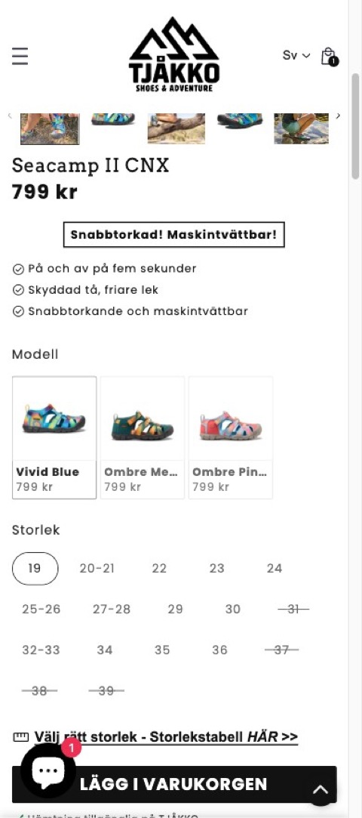
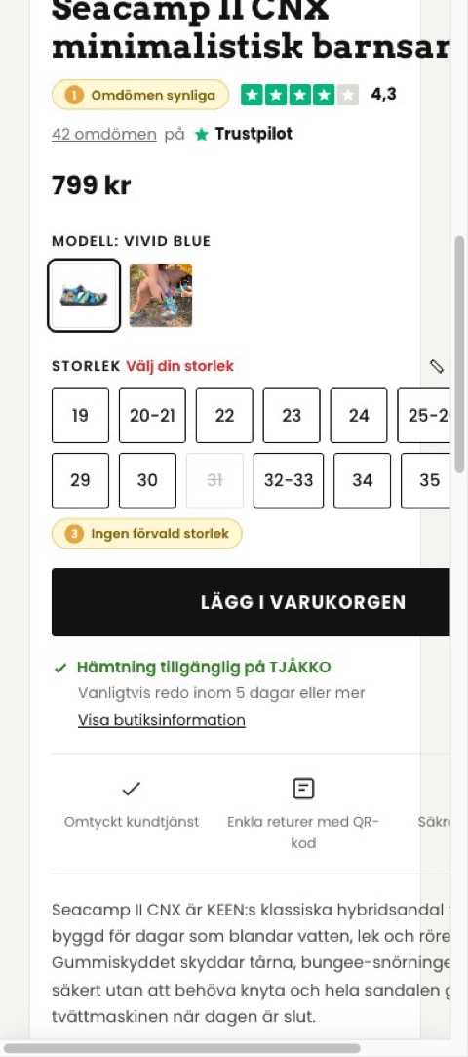
2026
Observation
T01 · PDP · Surface reviews + inline sizing
GA4 funnel: only 3.9% of product viewers add to cart (96% drop). The PDP renders "0 recensioner" despite 42 Trustpilot reviews at 4.3/5, and the smallest size is pre-selected.
Test ID: TJ-T01 Status: In planning
A/B TEST
Hypothesis
If we surface the 42 reviews and move sizing guidance inline on the PDP, then View to Add-to-Cart will rise, because the two biggest objections (trust and sizing) get answered at the decision point.
What we are testing
• Aggregate rating by the title + a populated review block
• Inline foot-measure guide, per-brand size table, PDF
• Remove the pre-selected smallest size
Key metrics
1. Add-to-Cart rate
2. PDP conversion rate
3. Exchange / return rate (guardrail)
Duration
Device
3 to 4 weeks
All devices
CONTROL
VARIANT
Expected impact
URL
High
Product page (PDP)
ECOMHOUSE ©ALL RIGHTS RESERVED
26

Slide 28
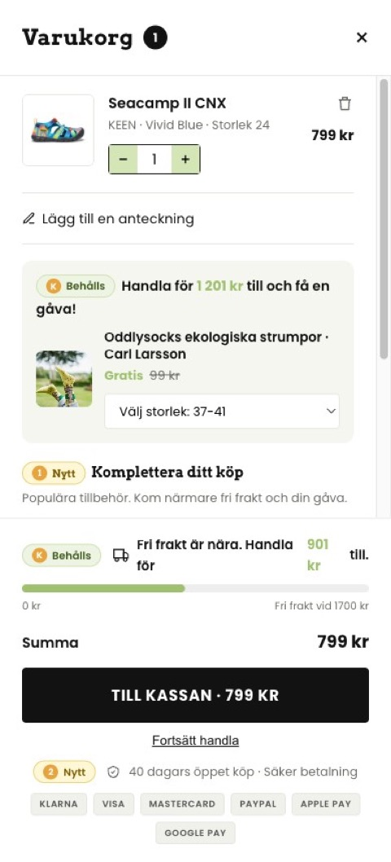
2026
Observation
T02 · Cart drawer · Cross-sell to lift AOV
AOV is ~1,986 SEK. The cart drawer already nudges with a free-shipping bar and a free-gift tier, but there is no curated cross-sell, so shoppers see the thresholds with no easy way to reach them.
Test ID: TJ-T02 Status: In planning
A/B TEST
Hypothesis
If we add a "Komplettera ditt köp" cross-sell of low-price accessories in the drawer, then AOV and revenue per session will rise, because shoppers get one-tap add-ons to cross the thresholds they are already shown.
What we are testing
• Cross-sell row of low-price accessories (tåspridare, innersulor, skovax)
• Match each add-on to the gap to the next threshold
• Keep the free-shipping bar, free gift and one-tap checkout
Key metrics
1. Average order value
2. Revenue per session
3. Cross-sell attach rate
Duration
Device
3 weeks
All devices
CONTROL
VARIANT
Expected impact
URL
Medium to high
Cart
ECOMHOUSE ©ALL RIGHTS RESERVED
27

Slide 29
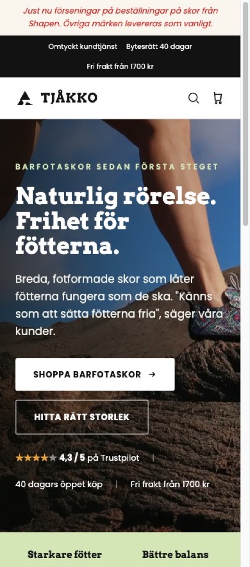
2026
Observation
T03 · Homepage · Benefit-led hero
The homepage holds attention (16.9% bounce) but leads with a rotating SHAPEN supplier banner, not TJÅKKO's own benefit. Bestseller tiles show no star ratings.
Test ID: TJ-T03 Status: In planning
A/B TEST
Hypothesis
If we lead with TJÅKKO's own promise ("Frihet för fötterna") plus a Trustpilot trust row and rated tiles, then homepage to PDP click-through and CVR will rise.
What we are testing
• Benefit hero with two clear CTAs
• Trust row (4,3/5 Trustpilot, 40-day returns, free shipping)
• Star ratings on tiles, supplier promo demoted below
Key metrics
1. Homepage to PDP click-through
2. Site-wide conversion rate
3. Bounce rate (guardrail)
Duration
Device
3 to 4 weeks
All devices
CONTROL
VARIANT
Expected impact
URL
Medium
Homepage
ECOMHOUSE ©ALL RIGHTS RESERVED
28

Slide 30
2026
07
WHO RUNS THIS
How EcomHouse works
A zero-row CRO service: research, design, build, QA, deploy, test, analysis end to end. The method, and what it has delivered.
ECOMHOUSE ©ALL RIGHTS RESERVED
29

Slide 31
2026
THE ECOMHOUSE METHOD
Six steps, end to end
You approve. We execute. Every step is owned by us, including build, QA, and rollout. Client only approves the brief and rollout.
// 01
// 02
// 03
// 04
// 05
// 06
Research
Ideate
Pre-test brief
Build + QA
Run + monitor
Analyze + roll out
GA4, Shopify, heatmaps, recordings, reviews, support.
→
Hypothesis, variant concepts, copy, Figma prototype.
→
Written brief with metric, confidence, sample size.
→
Shopify or test tool variant, tracked, QA'd across devices.
→
Live test with guardrail watch, weekly progress updates.
→
Written verdict, fee invoiced on rollout to 100 % of traffic.
Zero-row service: the client is not expected to do production work. We handle everything from research through analysis. The client approves the pre-test brief and the rollout decision in writing.
ECOMHOUSE ©ALL RIGHTS RESERVED
30

Slide 32
2026
BRIEF + PROTOCOL
How every test launches and concludes
No test starts without a written, approved brief. Tests only conclude when all approved conditions are met.
PRE-TEST BRIEF
TESTING PROTOCOL
Every test launches with a written, approved brief
Guardrails on tooling, rigor, conclusion
// PART 1 Test setup
// PART 2 Statistical parameters
DEFAULT TOOL
CONFIDENCE
✓
Hypothesis and Control vs Variant difference
✓
Primary metric (RPV or funnel metric)
IntelliGEMS
80 % min
Or Convert, GrowthBook, Shopify-native with written approval.
Higher per test if you require it.
✓
Audience and traffic filters
✓
Statistical confidence (80 % default)
✓
Funnel stage and stage multiplier
✓
Minimum visitor and order count
CONCLUSION
REPORTING
✓
URL targeting
✓
Worked fee range at +5 / +10 / +15 %
All conditions met
Weekly Loom
✓
Frozen baselines from trailing 30 days
✓
Data sources named explicitly
Min visitors, orders, and confidence reached.
Plus a running test log you can access anytime.
ECOMHOUSE ©ALL RIGHTS RESERVED
31

Slide 33
2026
COMPENSATION
We win when you win
Performance-based fee on every winning test rolled out to 100 % of traffic. One-time charge per test. No attribution window. No recurring tail.
// PERFORMANCE FEE
// OPTIONAL RETAINER
% of estimated monthly revenue uplift
Fixed monthly fee
Y %
X kr / month
Charged once per winning test on rollout. Calculated from the test's measured uplift and the client's own data, with the agreed stage multiplier applied.
Optional. Predictable monthly cost on top of (or instead of) the performance fee. Some clients prefer this for budgeting.
→
One time fee per winning test
→
Billed on the 1st, in advance
→
No recurring tail, no attribution window
→
Void if not agreed
→
Loser and inconclusive tests are free
→
Stackable with the performance fee
Billing: one invoice on the 1st covering the retainer (if any) plus the performance fee for every winning test rolled out last month. 8 day payment terms. Third-party costs (test tools, apps) paid by the client.
ECOMHOUSE ©ALL RIGHTS RESERVED
32

Slide 34
2026
SCHEDULE A · STAGE MULTIPLIERS
Tests further from purchase carry more projection risk
The stage multiplier discounts the performance fee for upper-funnel tests where impact is estimated rather than measured.
100 %
RPV · AOV · Purchase CVR · Checkout CVR
Revenue measured directly by the testing software.
75 %
Cart to checkout · PDP add to cart
One step from purchase. Light projection of downstream behavior.
50 %
Collection to PDP · PDP engagement
Two steps from purchase. Multiple downstream rates to project.
25 %
Homepage to collection · Navigation · Search
Three or more steps from purchase. Heaviest projection assumptions.
Only your own data goes into the estimate. No industry benchmarks. Visitors, baseline CVRs and AOV are pulled from the trailing 30 days of GA4 and Shopify, frozen pre-test, and approved by you.
ECOMHOUSE ©ALL RIGHTS RESERVED
33

Slide 35
2026
PROVEN RESULTS
Recent A/B tests we shipped
Live winners on PH Import (Danish Shopify), measured in Intelligems. The same levers we recommend for TJÅKKO.
CASE · PH IMPORT
CASE · PH IMPORT
Assurance icons below Add to Cart
Lighter homepage hero
Trust icons under the ATC to close hesitation. Same idea as surfacing your reviews.
Light homepage with a clear headline, CTA and USP row. Same as your benefit hero test.
+19.1%
+17.5%
+776K
+15.7%
+231K
CVR
REV/VISITOR
DKK/MO
REV/VISITOR
DKK/MO
CASE · PH IMPORT
CASE · PH IMPORT
Pack selector + social-proof badge
Tiered volume discounts
Preselected the higher pack with a "95% pick this" badge.
Bulk discounting on high-volume consumables. Same AOV lever as your cross-sell.
+8.7%
+2.0%
+483K
+13.5%
+151K
REV/VISITOR
AOV
DKK/MO
CVR
DKK/MO
Every result above is a live, rolled-out A/B winner, not a projection. The recommendations in this deck target the same levers that produced them.
ECOMHOUSE ©ALL RIGHTS RESERVED
34

Slide 36
2026
NEXT STEP
Win the cart-add.
Surface the proof. Nail the sizing.
96% of product viewers leave before adding to cart. Phase 1 (reviews + sizing + cart cross-sell) carries no downside and can ship in three weeks.
Conservative target: ~330,000 SEK per quarter from mobile conversion alone.
Prepared by EcomHouse
ECOMHOUSE ©ALL RIGHTS RESERVED
35

