Slide 1
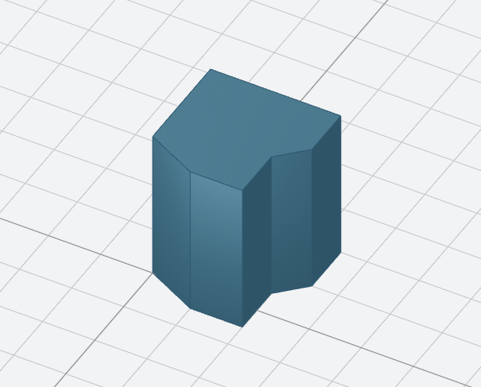
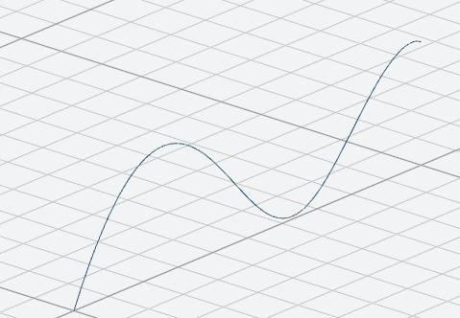
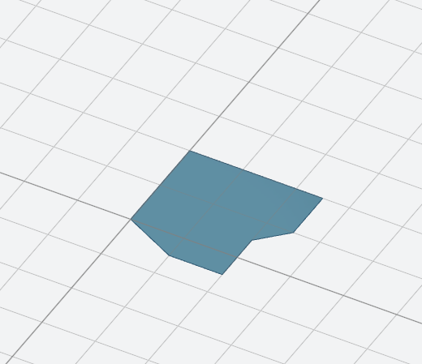
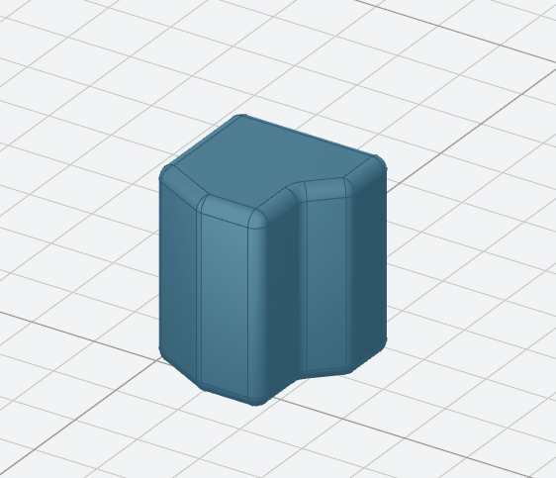
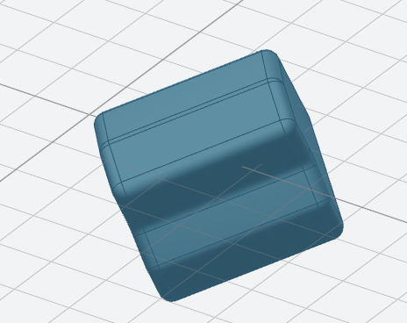
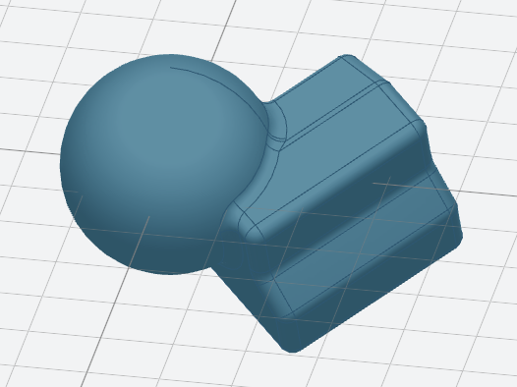
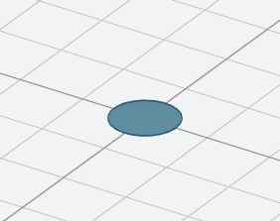
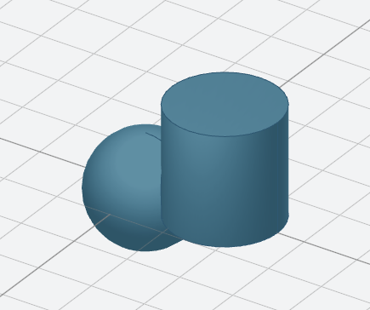
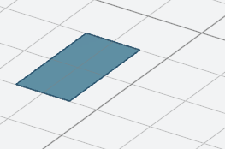
Create 3d wire/face
Find features
Sketch
Create shapes
Modify shapes
Transform shapes
Combine shapes
Pre-baked sketches
Pre-baked shapes

Slide 2
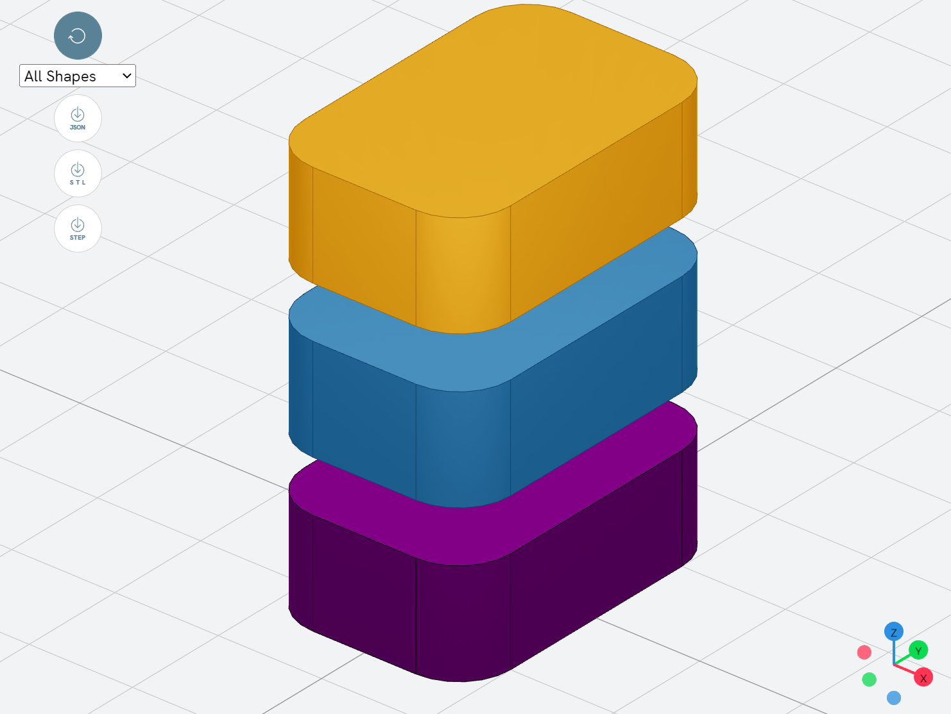
Select input file
Choose displayed
shapes
JSON
Export
STL
STEP
Rotate
Zoom
Pan
Choose view direction

Slide 3
Select input file
Choose displayed
shapes
JSON
Export
STL
STEP
Rotate
Zoom
Pan
Choose view direction

Slide 4
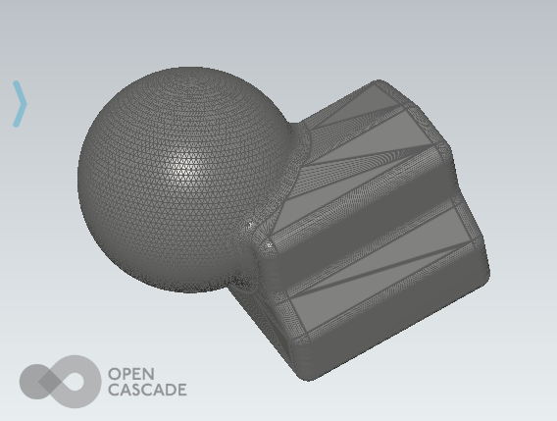
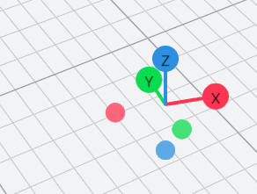
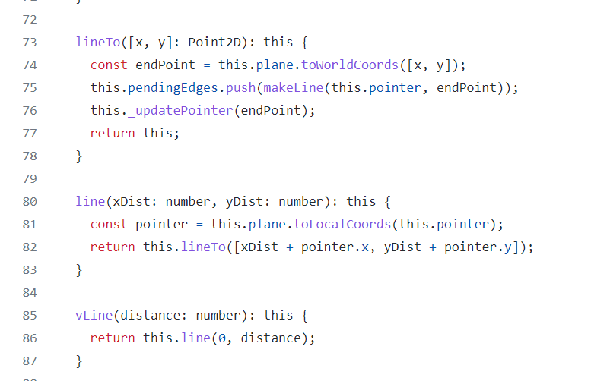

Pre-baked sketches
Pre-baked shapes
Export
Sketch
Create shapes
Modify shapes
Transform shapes
Combine shapes
Determine planes
Create 3d wire/face
Find edges/faces
Create functions

Slide 5
line(dx,dy)
polarLine(dr,angle)
hLine(dx)
vLine(dy)
tangentLine(dr)
movePointerTo(x,y)
lineTo(x,y)
polarLineTo(r,theta)
hLineTo(x)
vLineTo(y)

Slide 6
1
1
2
threePointsArcTo
tangentArcTo
ellipseTo
halfEllipseTo
sagittaArcTo
vSagittaArcTo
hSagittaArcTo

Slide 7
2
3
2
3
1
b
1
2
1
1
n
a
.quadraticBezierCurveTo
.cubicBezierCurveTo
.bezierCurveTo
.smoothSplineTo

Slide 8
sketchRectangle(l,w)
sketchRoundedRectangle(l,w,r)
sketchCircle(r)
sketchFaceOffset(f,t)

Slide 9
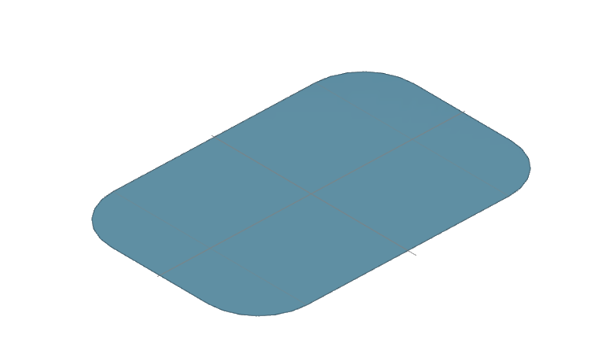
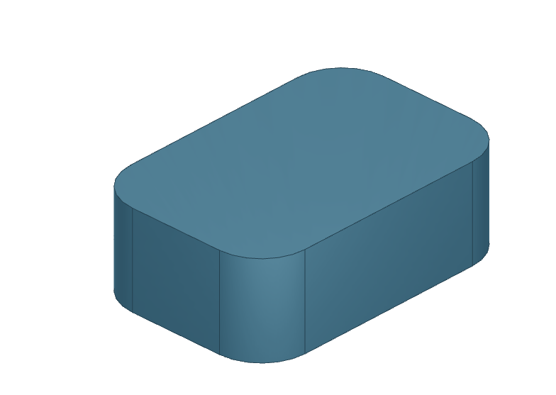
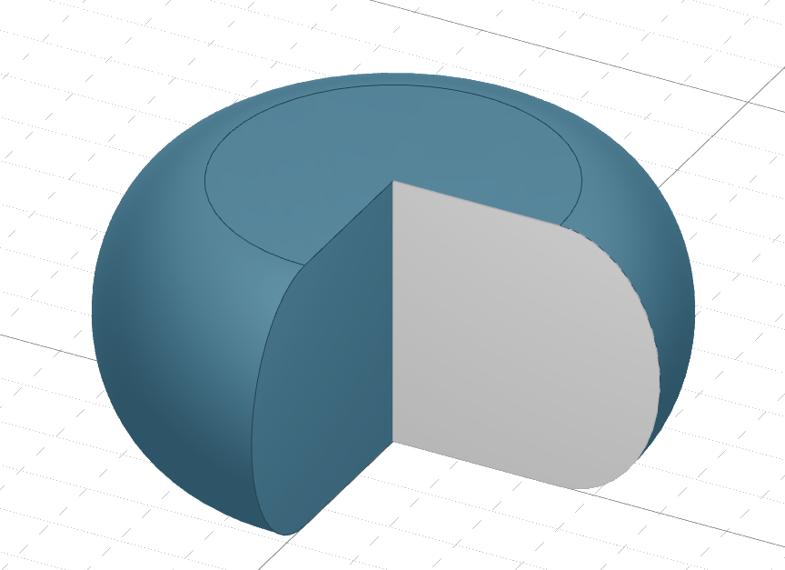
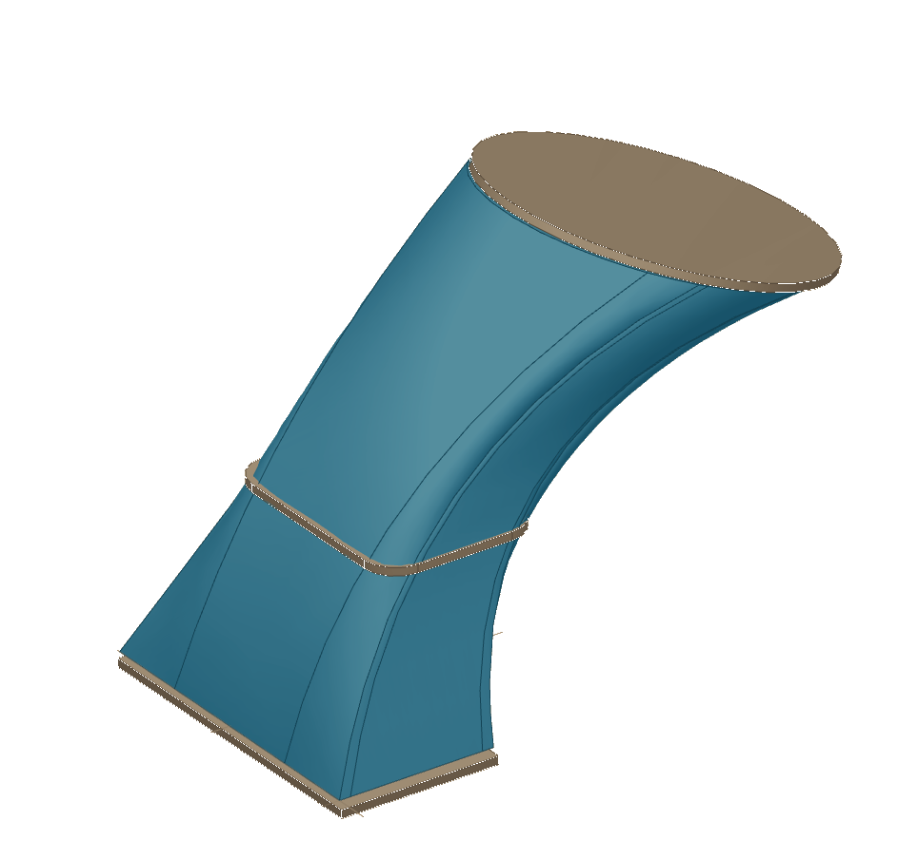
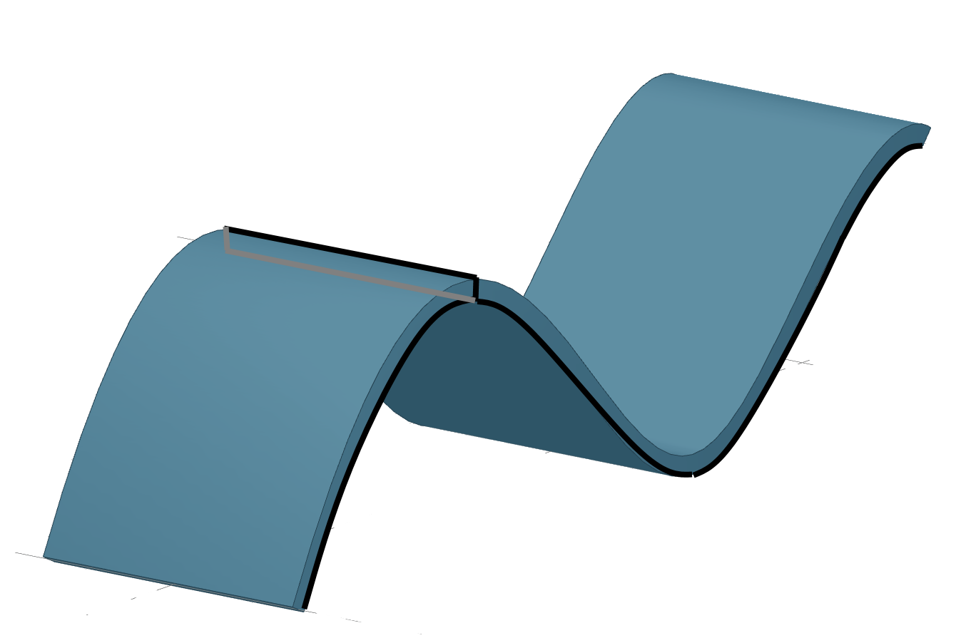
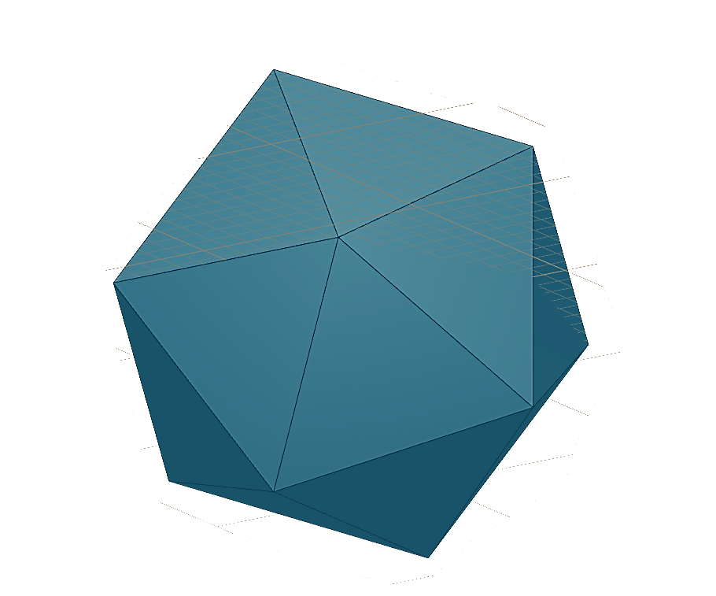
b
a
.face()
.extrude(d)
.revolve(axis)
.loftWith([a,b])
.sweepSketch()
makeSolid()
a
b
.extrude(d)

Slide 10
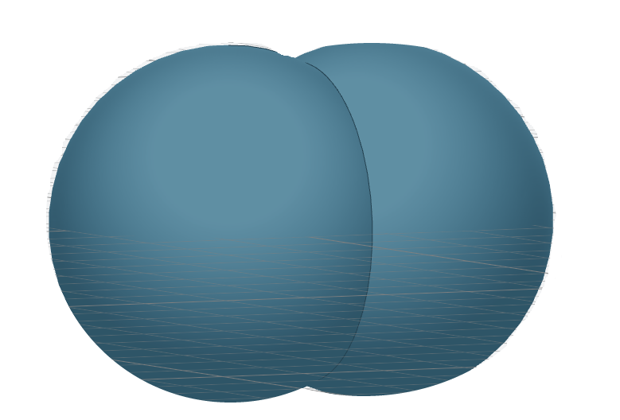
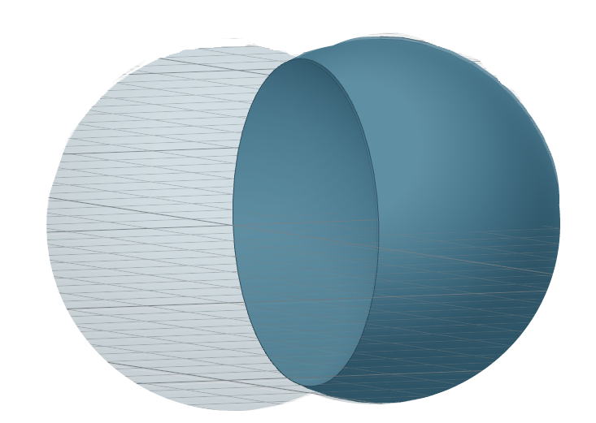
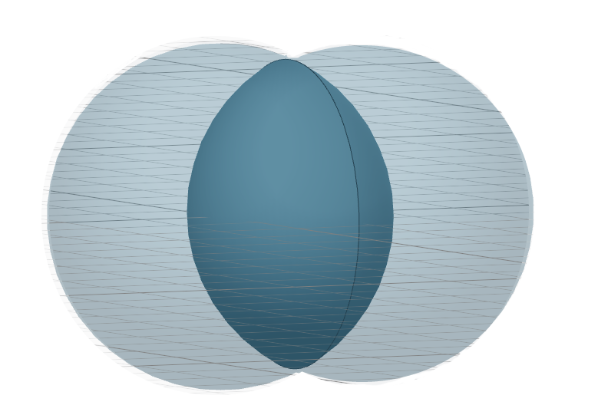
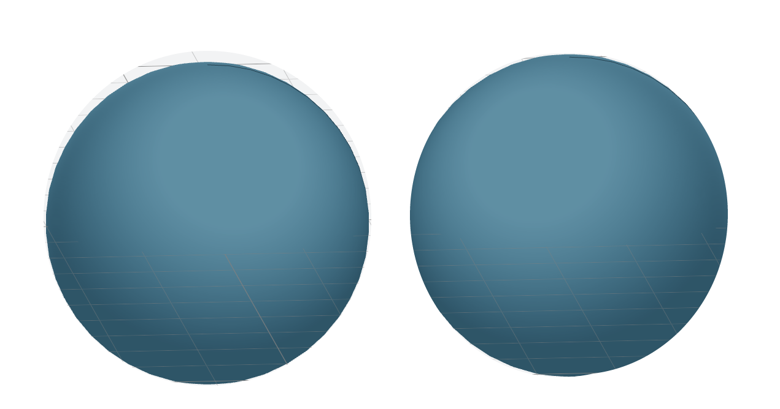
.fuse()
.cut()
.intersect()
makeCompound()

