Slide 1

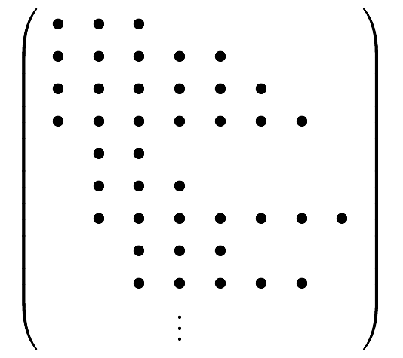

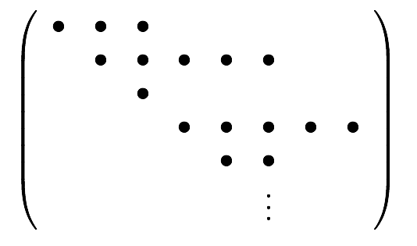
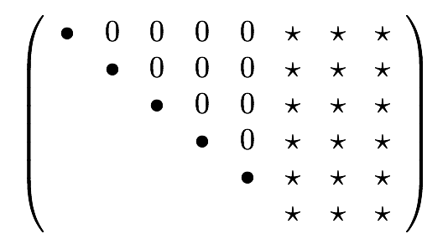

Integrand Reduction Reloaded;
Integration By Parts technique
Ray D. Sameshima
Department of Physics – New York City College of Technology
Graduate School and University Center, City University of New York
15th Annual City Tech Poster Session
More detail is on my poster !!

