Slide 1
Tips for Faster Web Site
Rayed Alrashed
rayed.com

Slide 2
Contents
Front End tips
Application & DB tips
Web Server tips
Miscellaneous tips

Slide 3
Contents
Front End tips
Application & DB tips
Web Server tips
Miscellaneous tips

Slide 4
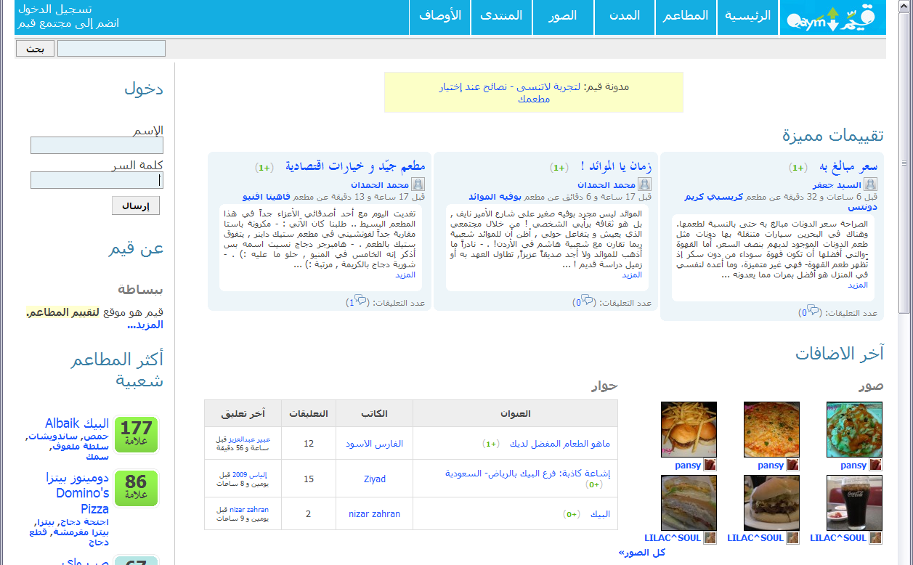
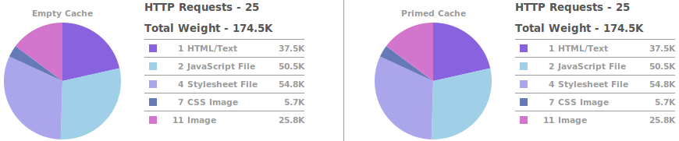
Front End: Test Case
Qaym.com

Slide 5
Front End: Fewer HTTP Requests
Why
  HTTP Request are slow
  Fewer requests = Faster Loading
  40-60% of daily visitors come in with an empty cache
  Making your page fast for first time visitors is key to a better user experience
How
  Combine Files:
    All JavaScripts files in one file
    All CSS files in one file
  CSS Sprites
    Combine your background images into a single image
    CSS background-image and background-position
  Image maps

Slide 6
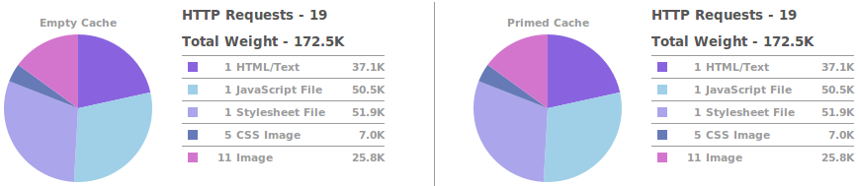
Front End: Fewer HTTP Requests
25 requests became 19 requests

Slide 7
Front End: Expires Header
First Request
GET /image.png HTTP/1.0
Host: rayed.com
HTTP/1.1 200 OK
Content-Length: 290
Content-Type: image/png
:
image file
:
Second Request
GET /image.png HTTP/1.0
Host: rayed.com
If-Modified-Since: Sun, 11 Jun 2006 09:41:33 GMT
HTTP/1.1 304 Not Modified
Content-Type: image/png

Slide 8
Front End: Expires Header
First Request
GET /image.png HTTP/1.0
Host: rayed.com
HTTP/1.1 200 OK
Content-Length: 290
Content-Type: image/png
Expires: Mon, 28 Jul 2014 23:30:00 GMT
:
image file
:
Second Request
NO REQUEST

Slide 9
Front End: Expires Header
Static component never expires
  Images
  JavaScript
  CSS
  Flash
Benefit returning visitor
What if I change it?
  Use versioning: jquery-1.3.2.min.js

Slide 10
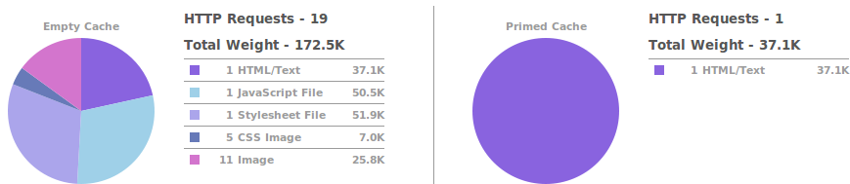
Front End: Expires Header
19 requests became 1 request
172KB became 37KB
Static Files Cached

Slide 11
Front End: Gzip Components
Why
  Smaller files are fast to transfer
  Compress all components
  90% of browsers support compressed content
  Compressed Text = 15% of original
Dynamic content
  php.ini
  zlib.output_compression = On
  <?php
  ob_start("ob_gzhandler");
JavaScript & CSS
  Apache mod_deflate

Slide 12
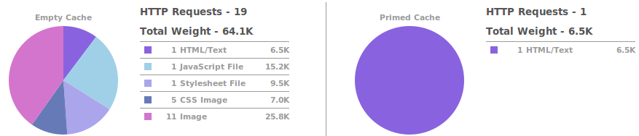
Front End: Gzip Components
172KB became 64K
37KB became 6.5K

Slide 13
Front End: Gzip Components
What about Images?
  Already compressed
  Smush.it: could compress further
Try different format:
  Sometimes PNG is smaller than GIF
Don't Scale Images in HTML

Slide 14
Front End: Conclusion
From 25 requests to 19
From 174K to 64K
270% Faster
From 25 requests to 1
From 174K to 6.5K
2700% Faster

Slide 15
Front End: Best Practices for Speeding Up Your Web Site
Developed by Yahoo!'s Exceptional Performance team
34 best practices divided into 7 categories:
  Content
  Server
  Cookie
  CSS
  Javascript
  Images
  Mobile
http://developer.yahoo.com/performance/rules.html

Slide 16

Front End: YSlow!
Firefox > Firebug > YSlow!
Analyzes web pages and suggests ways to improve their performance
http://developer.yahoo.com/yslow/

Slide 17
Contents
Front End tips
Application & DB tips
Web Server tips
Miscellaneous tips

Slide 18
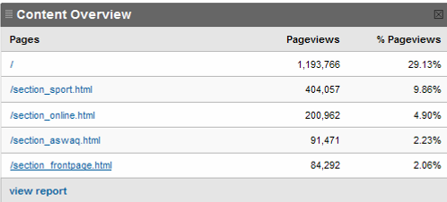
Application & DB: First page
Front page count for 30% of visits
Store it in a file
  wget –O index.html http://mysite.com/index.php
  Refresh every minute!
Cheap trick!
Use in
emergency
Full page
cache!

Slide 19
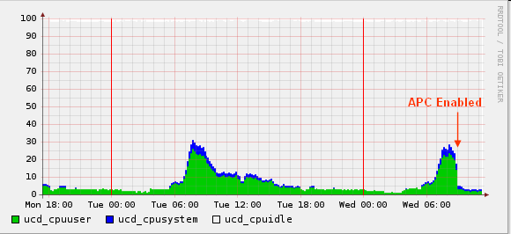
Application & DB: PHP Accelerators
Caching PHP compiled bytecode
Reduces server load
Increases the speed from 2-10 times

Slide 20
Application & DB: Optimize Queries
Use “Explain” to optimize complex queries
Slow query log
  long_query_time = 1
  log-queries-not-using-indexes

Slide 21
Application & DB: Optimize Queries
EXPLAIN SELECT *
FROM `test_posts`
WHERE user_id=1
ORDER BY timestamp
ALTER TABLE `test_posts` ADD INDEX ( `user_id` )
ALTER TABLE `test_posts` ADD INDEX (`user_id` ,`timestamp` ) ;

Slide 22
Application & DB: Cache
Query is optimized but still slow!!
  Normal
  Large data need long time to process
Solution: Caching!!
  Store the result in cache
  Ask cache first, when not found ask DB
Cache invalidation:
  Expiry
  Application invalidation

Slide 23
Application & DB: Cache
What is cache?
  fast storage
Where to store?
  File
  Database (cache slow result in simple table)
  Memory local: APC
  Memory remote: Memcached
Cache Performance Comparison
  http://www.mysqlperformanceblog.com/2006/08/09/cache-performance-comparison/

Slide 24
Application & DB: Cache
What is Memcached?
Network server
Store in memory
Key->Value
Distributed
Very fast

Slide 25
Application & DB: Cache
function get_post_by_cat($blog_id, $cat_id)
{
// Check Cache first
$cache_id = “post_by_cat_{$blog_id}_{$cat_id}";
$cache = $this->memcached->get($cache_id);
if ($cache!==false) return $cache;
// Very long and time consuming query
:
:
$posts = $data;
// Set cache
$this->memcached->set($cache_id, $posts);
return $posts;
}
Execution 30ms
Execution 1000ms

Slide 26
Application & DB: Do it offline
Do don’t do everything at once
Do the minimum to respond to the user
Delay other tasks for later
Don’t make the user wait
Flickr Engineers Do It Offline
  http://code.flickr.com/blog/2008/09/26/flickr-engineers-do-it-offline/
Queue everything and delight everyone
  http://decafbad.com/blog/2008/07/04/queue-everything-and-delight-everyone

Slide 27
Application & DB: Do it offline
Do everything at once
Post Picture Page
Client
Add to database 50ms
Total time 1000 ms!!!
Create thumbnail 300ms
Add to search engine 300ms
Email notifications 350ms

Slide 28
Application & DB: Do it offline
Move what you can to offline
Post Picture Page
Client
Add to database 50ms
Total time 100 ms!!!
Add to Message Queue 50ms
Message
Queue
Offline process
Create thumbnail 300ms
Add to search engine 300ms
Email notifications 350ms

Slide 29
Application & DB: Do it offline
What is message queue?!!
  Database table
  Message Queue Server
Messages
  Asynchronous: do don’t wait for an answer (synchronous: will wait)
KISS!

Slide 30
Application & DB: Denormalize
Break the rules for speed
Add redundant data to avoid joins and improve query execution
  Extend tables vs New tables
How to keep consistent?
  Triggers
  Application
Pros: Faster
Cons: Larger, Complicated

Slide 31
Application & DB: Scalability and Replication
MySQL Replication:
  One master -> Many Slaves
Application can read from any slave
… But write to one master

Slide 32
Contents
Front End tips
Application & DB tips
Web Server tips
Miscellaneous tips

Slide 33
Web Server: Architectures
Forking / Threading
Create Process (or thread) for each client
Web Server
Process
Client
Process
Client
Process
Client
Problem: New process takes long time
Examples: Email Servers

Slide 34
Web Server: Architectures
Preforking / Prethreading
Create X Process (or thread) for potential clients
Web Server
Process
Client
Process
Client
Process
Client
Problem: X+1 clients
Examples: Apache, IIS

Slide 35
Web Server: Architectures
Event based (select, poll)
One process handles all clients
Web Server
Process
Client
Client
Client
Problem: Maturity, Flexibly
Example: Nginx, Lighttpd, Cherokee

Slide 36
Web Server: Architectures
Event based (select, poll)
Very High Performance & Scalability for static files
  (html, images, JS, CSS, Flash)
Same as preforking on dynamic content
PHP Process
Web Server
PHP Process
Process
Client
PHP Process
Client
Client
Other Server
Disk

Slide 37
Web Server: Deployment Options
Apache only:
  Couldn’t scale
  Poor performance on high load
  blocked.igw.net.sa + alriyadh.com
Lighttpd only:
  Maturity & Support Issues
  Configuration inflexibility
Mix and Match?!

Slide 38
Web Server: Deployment Options
Apache for dynamic, Lighttpd for static:
  www.alriyadh.com => Apache
  img.alriyadh.com => lighttpd
Apache
Process
Dynamic content
Process
Client
Process
Lighttpd
Static content (images,js,css,html,pdf)
Process

Slide 39
Web Server: Deployment Options
Lighttpd serve static, and proxy dynamic to Apache
Apache
Process
Lighttpd
Process
Process
Client
Process
Disk

Slide 40
Web Server: Deployment Options
Squid cache and proxy to Apache
  Squid only cache, doesn’t have original data
  Squid in reverse proxy setup
  Varnish (http://varnish.projects.linpro.no/)
Apache
Process
Squid
Process
Process
Client
Process
Disk
Disk

Slide 41
Contents
Front End tips
Application & DB tips
Web Server tips
Miscellaneous tips

Slide 42

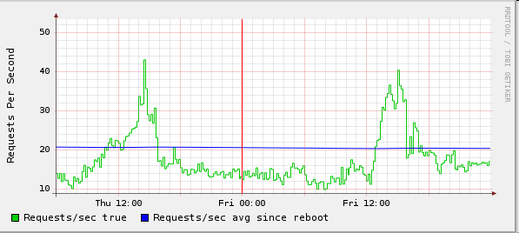
Misc: Measuring
I use Cricket
Does your change really work

Slide 43
Misc:
If it works, don’t fix it!
KISS: Keep It Simple, Stupid
  design simplicity should be a key goal and that unnecessary complexity should be avoided
http://highscalability.com/

Slide 44
Thank you

