Slide 1
LogicPuzzleX
One constraint engine. Many puzzles. Watch it think.
Same puzzle, same Python. One algorithm gives up on 1 puzzle in 3. Another answers in 24 ms.
Md Shihabul Alam Shihab
Rayed Riasat Rabbi
Rifat Imtiaze Ruddro
Sayma Akhter Snigdha
CSP engine and search
Puzzle modeling, propagation, generator
Logic track, explanations, experiments
Web app, demo video, integration
CSE 440 · Section 1 · North South University
Notes:
SHIHAB (0:00 to 0:15). We are Group 2. I am Md Shihabul Alam Shihab, and with me are Rayed Riasat Rabbi, Rifat Imtiaze Ruddro and Sayma Akhter Snigdha. Here is the question behind our project. On the same puzzle, in the same language, one algorithm gives up on one puzzle in three, and another answers in 24 milliseconds. What makes the difference?
Giving up means hitting our 10 second limit: bt timed out on 32.9% of 1000 rated puzzles. 24 ms is the median for mac+.

Slide 2
Every Sudoku is a factor graph
8
weight(x) = f₁(x) · f₂(x) ··· f_{m}(x) = 1
3
6
A board is solved only when every factor says yes.
7
9
2
81
variables, one per cell
5
7
X
4
5
7
810
binary ≠ factors
1
3
1
6
8
20
peers of cell X: its Markov blanket
8
5
1
9
4
Course link: factor graphs, conditioning, Markov blanket (Vol. 3)
Notes:
SHIHAB (0:15 to 1:00). We model every puzzle as a factor graph, the way we learned in class. Each cell is a variable. Each rule is a factor that returns zero or one, and a board solves the puzzle only when the product of all factors is one. A 9 by 9 Sudoku has 81 variables and 810 not-equal factors.
Look at cell X. The highlighted cells are its 20 peers: its row, column and box. They are its Markov blanket, so if we know those cells, nothing else on the board can affect X. Givens are fixed by conditioning. Rayed will show how we search this graph.

Slide 3
One search, and each rung adds one idea
dpll
The logic track: the same puzzle in CNF
729 symbols, 11,745 clauses.
s is unique when KB ∪ {¬s} is unsatisfiable, so KB ⊨ s.
mac+
Course link: propositional logic, entailment (Vol. 4)
mac
+ hidden singles
lcv
+ AC-3 after every move
mrv
+ least constraining value
fc
+ tightest cell first
bt
+ forward checking
Plain backtracking
Course link: backtracking, DFS (Vol. 1) and CSP propagation (Vol. 3)
Notes:
RAYED (1:00 to 2:00). One recursive search runs the whole ladder. Each rung changes one thing only: the order of variables, the order of values, or what we infer after a move.
bt is plain backtracking. fc removes values from neighbors after each move. mrv picks the tightest cell first, so failures come early. lcv tries the value that hurts neighbors least. mac runs AC-3 after every move. mac+ adds hidden singles: a digit with only one place left in a unit.
On the side is the logic track. dpll solves the same puzzle as a propositional formula, and it proves there is exactly one solution: if the knowledge base plus not-s is unsatisfiable, the knowledge base entails s. Same engine, same trace, so every algorithm can be replayed and compared. Rifat will show what this looks like running.

Slide 4
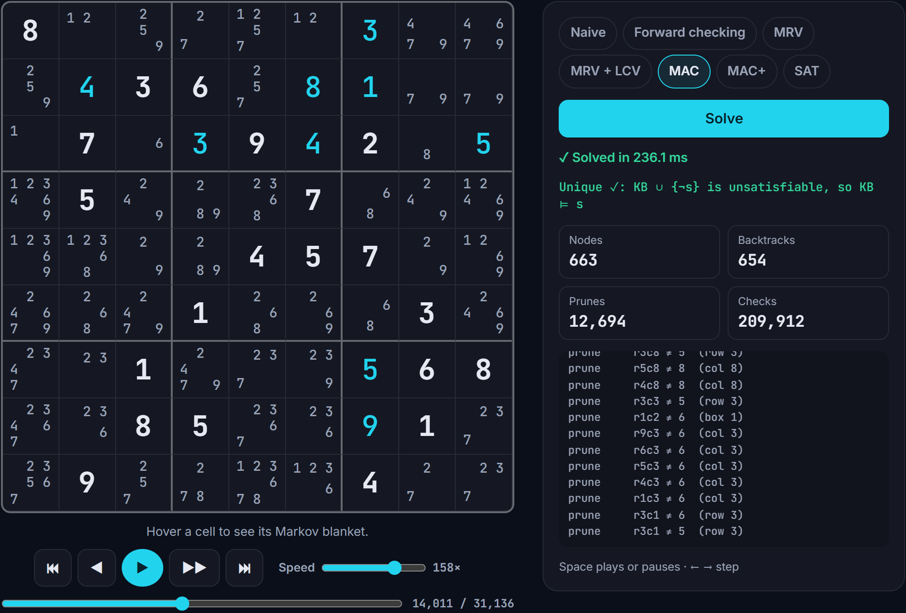
Sudoku already works end to end
✓
4×4 to 16×16 grids
✓
7 algorithms
✓
Play, replay, race, explain
✓
Graded puzzle generator
✓
Uniqueness proved by SAT
✓
166 automated tests
Kakuro comes next
Notes:
RIFAT (2:00 to 2:25). All of Sudoku already works, from the solver to the browser. This is Watch it think: the replay of MAC on Inkala's 2012 puzzle. Candidates vanish as constraints propagate. On the right are live statistics and the SAT proof that this puzzle has one solution.
You can also play yourself with live checks, race four algorithms, read plain-English explanations and generate graded puzzles. Kakuro is the main work left.

Slide 5
MRV is the biggest jump: 23× fewer nodes
100%
of easy puzzles: mac+ never backtracks
208 ms
at 16×16, where only mac+ finishes
Surprise: LCV adds nothing, and MAC runs slower than MRV.
23× is the median per-puzzle ratio. bt and fc are lower bounds: a run at the 10 s limit counts only the nodes it reached.
Notes:
RIFAT (2:25 to 3:00). We ran every algorithm on 1000 rated puzzles with a 10 second limit, and these are real results. The biggest single jump is MRV: 23 times fewer nodes than forward checking. Two things surprised us. LCV adds nothing here, and MAC roughly halves the nodes yet runs slower than MRV, 44 against 27 milliseconds. Hidden singles are what pay off. mac+ never backtracks on an easy puzzle, and at 16 by 16 it is the only one that finishes, in 208 milliseconds. The other six hit the limit on all 8 puzzles.
If asked: the 23 times figure is the paired median. The dataset rating comes from an automated solver, not people, and rating versus nodes peaks at Spearman 0.475 for mac+.

Slide 6
Next: Kakuro on the same engine
3 to 16 Nov
17 to 30 Nov
December
Core
Polish
Ship
Kakuro: sum factors, propagation and a board in the app
Kakuro in the scaling experiment, README GIF, feature freeze
8-page report, final slides, one-minute video
Now on GitHub: README → commits → code
github.com/rayedriasat/logic-puzzle-x
Notes:
SAYMA (3:00 to 3:15). Next is Kakuro, on the same engine with new sum factors. It lets us answer our last question: can one engine scale beyond Sudoku without puzzle-specific search code? Then polish and feature freeze, then the final report, slides and video.
SAYMA, GITHUB (3:15 to 4:00, about 45 seconds). Open the repository in the browser. Show the README: the pitch, the results and the code tour. Scroll the commit history. Open support/solver.py and show the ALGORITHMS table: that is the whole ladder in six lines.

