Slide 1

INFO 523 – Final Presentation
By Ray Elliott

Slide 2
Project agenda
Discuss dataset and data construction
Discuss steps went into wrangling the data.
Taking the dataset apart and analyzing general patterns
Discuss the models used in training the data
Design a model to predict the probability of passenger survival on Titanic
Conclusion and limitations of the dataset

Slide 3
Dataset & Data wrangling

Slide 4
Dataset & Data wrangling
Titanic dataset: https://www.kaggle.com/datasets/vinicius150987/titanic3?select=titanic3.xls
Titanic dataset is one of the most popular datasets out there and it’s widely known as a good dataset to conduct preliminary predictions on.
Real life datasets are often, huge, messy and a lot more complicated.
Titanic data was used because of its availability and popular common understanding of the variables.

Slide 5

Dataset & Data wrangling – issue
One of the biggest issues with this data is missing values for the “Age” variable.
Omitting rows that contain missing value for age might be a good idea at first, but by omitting these rows, we are also removing valuable information from our dataset. Therefore ,the missing age issue must be corrected in logical way.
Missing data for age is 264 which is over 20% of our dataset. Here is how this number is calculated:

Slide 6
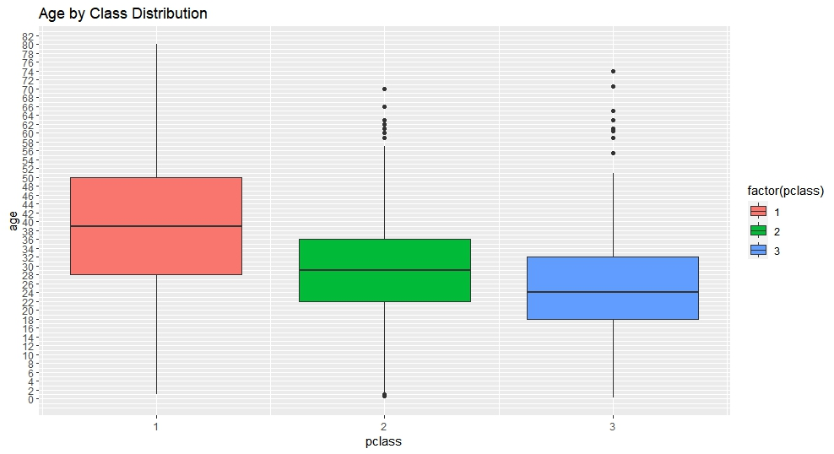
Dataset & Data wrangling – solution
Knowing the average age of the passengers that were in classes 1 to 3 is useful.
We can average the passenger age in these classes and assign the average age to missing values.
A boxplot view of age and class will provide a better insight to this issue.
Based on the findings of this plot, we can argue that the average age of most passengers in 1st class was 40, 2nd class was 30 and 3rd class was 25.

Slide 7
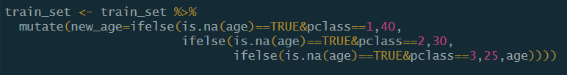
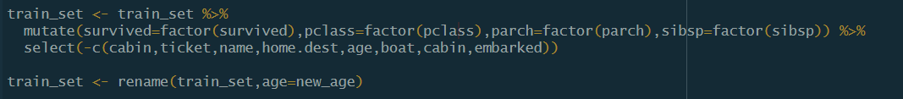
Dataset & Data wrangling – solution – cont’d
I added a column to the database that redefined the age variable, based on the findings of the boxplot.
The dataset was then cleaned and got ready for the next step of the analysis.

Slide 8
Data visualization and general patterns

Slide 9
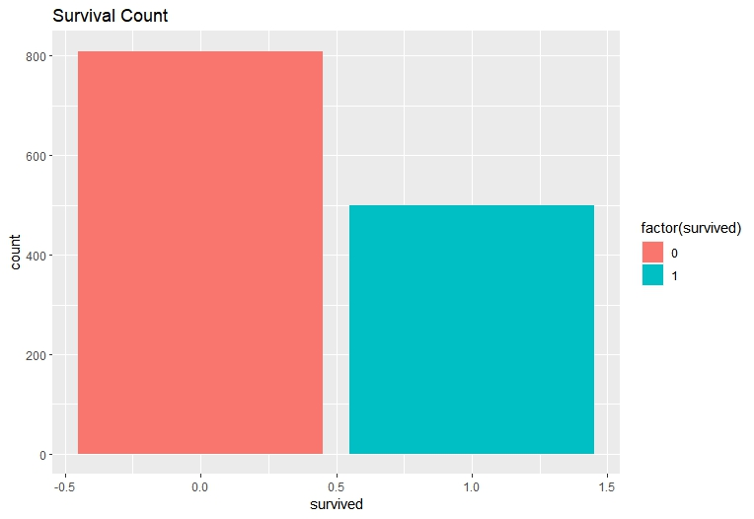
Data visualization – survival count
In order to understand the general flow of the dataset, I used the ggplot function to make some visualizations that would help understand the data better.
The chart on the left shows the survival count of the passengers on Titanic. 0 indicates that passengers were diseased and 1 is an indication that passengers survived.

Slide 10
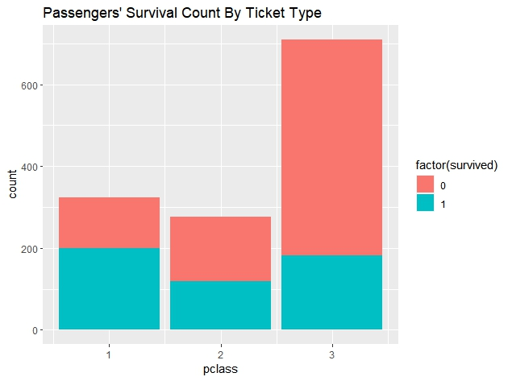
Data visualization – survival count by ticket
The chart to the left explains the survival count based on ticket class of passengers.
It appears that the passengers on the 1st class were more likely to survive.

Slide 11
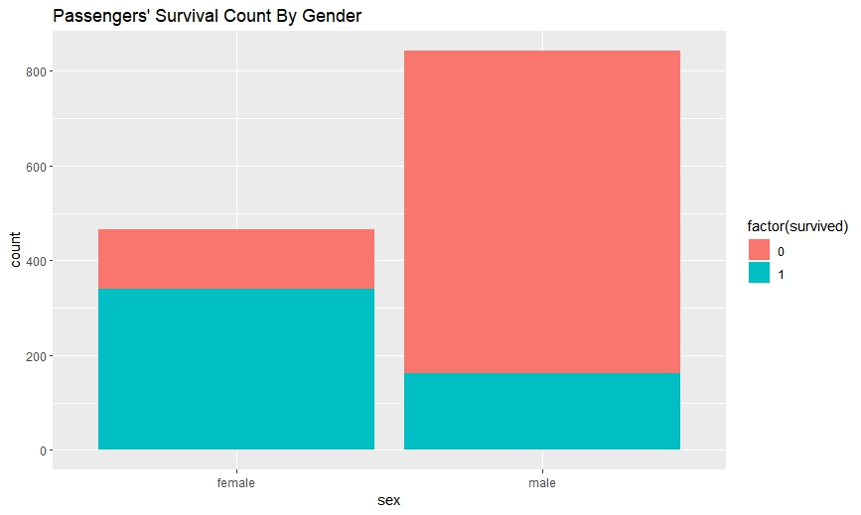
Data visualization – survival count by sex
This chart illustrates the survival count by gender of the passengers on Titanic.
It appears that females were more likely to survive, but this view will be dissected later through the analysis.

Slide 12
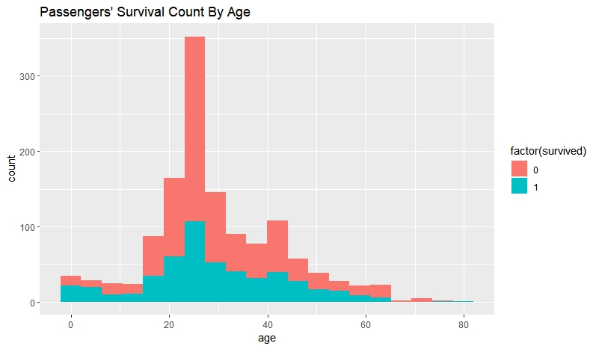
Data visualization – survival count by age
This chart shows the survival count of passengers based on their age.
It appears that passengers between the age of 23 and 45 were more likely to survive.

Slide 13
Models used in analysis

Slide 14
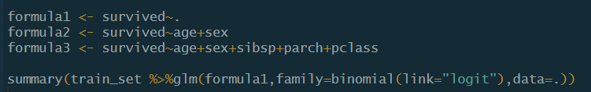
Models used in analysis
The models used in this analysis are logistic regression and classification.
I will use decision tree and random forest to depict the outcome of the analysis.
Before training the dataset, I went ahead and input the dataset in a regression model.

Slide 15
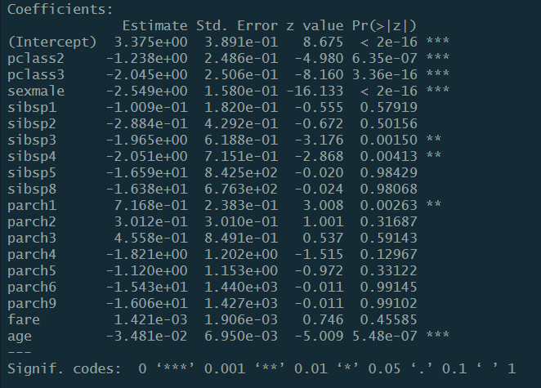
Models used in analysis – models: regression
The output suggests that ticket classes 2&3, passengers with 3 or 4 siblings along with either one parent or child were more likely to influence the survival chances. Age along with sex (especially male) was also a significant factor to the beforementioned statement.

Slide 16
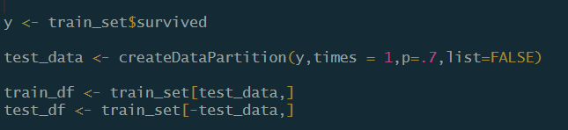
Models used in analysis – creating partitions for the model
In order to divide the data to training and test sets, I will use the below approach:
The “y” variable is the measure we want to test

Slide 17
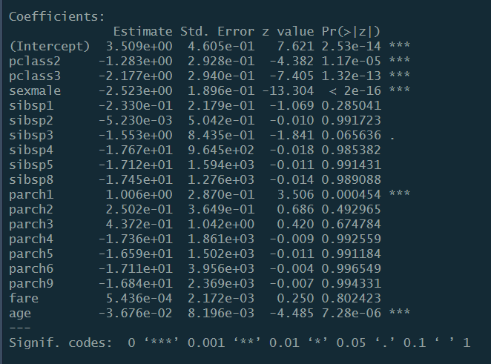
Models used in analysis – findings of the training set
The summary() function reveals the details of our model as shown.
The findings are close to the previous findings of the logistic model. The significant variables have been repeated here.

Slide 18
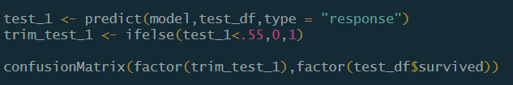
Models used in analysis – findings of the regression model
Now that my data is trained, I go ahead and use the predict function.
In addition, I created a trim_test_1 variable that streamlines the probability output of the prediction function, so that we can compare it to the test set.

Slide 19
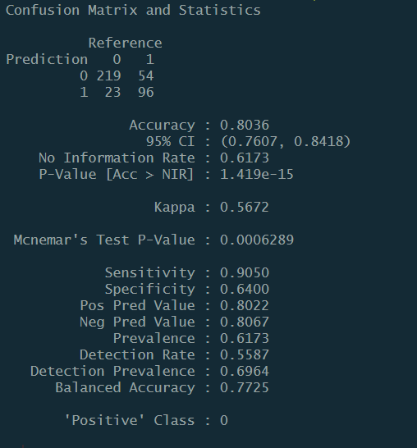
Models used in analysis – findings of the regression model – cont’d
Here are the findings of the confusion matrix table

Slide 20

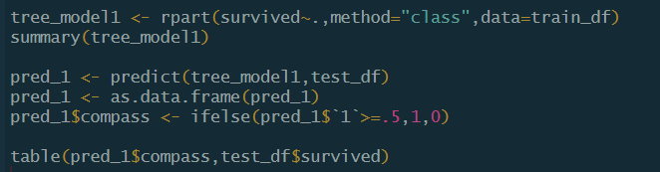
Models used in analysis – decision tree and Random forest
I used rpart function to create a decision tree, train and test the data.

Slide 21
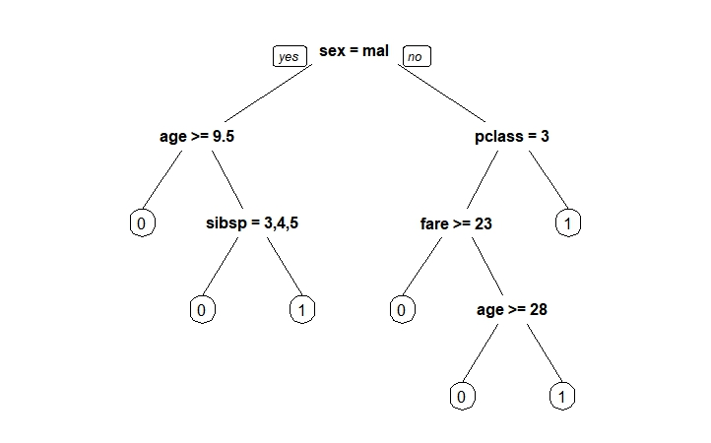
Models used in analysis – decision tree and Random forest cont’d
The node root is cut off at sex and implies that male gender is statistically more significant.

Slide 22

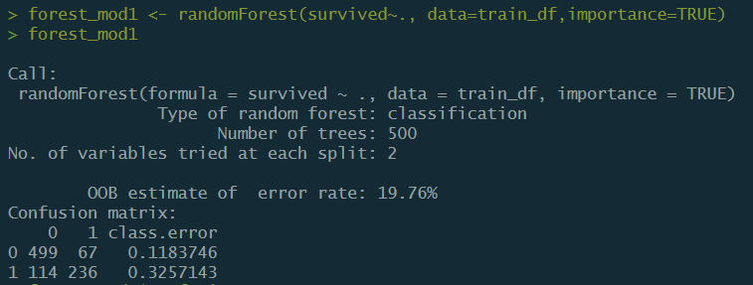
Models used in analysis – decision tree and Random forest cont’d
The random forest error rate is about 20%

Slide 23
Conclusion and limitations
Conclusion:
Age, gender and ticket class were among the factors that were more likely to influence the chance of survival on Titanic.
It is more likely that children under the age of 9 were not able to survive.
Missing data for the “Age” variable was filled based on the average age of passengers in that class. However, passengers’ gender was not taken to account which could potentially impact the accuracy of the findings.
The significant variables were not a good measure of all the contributing factors that led to the sinking of Titanic. More data is needed in order to support the existing findings.

