Slide 1
🚀
Analysis of the Physiological
Effects of Spaceflight
Open Data Analysis & Interactive Dashboard Development
Internship Project — TUNSA (Tunisian Space Association)
[Your Full Name] · 2nd-Year Preparatory Engineering Student · August 2026

Slide 2
Agenda
🎯
Context & Objectives
📊
Key Findings — Bone, Muscle, Cardiovascular, Sleep
🔍
The Data Challenge — What Was Actually Available
🩸
Flagship Finding — Recovery Case Study
🗂️
Datasets & Coverage Verification
🖥️
Interactive Dashboard
⚙️
Pipeline & Methodology
⚠️
Limitations & Honest Scope
2

Slide 3
Why This Matters
Spaceflight exposes the human body to stressors with no equivalent on Earth: sustained microgravity, radiation, and disrupted circadian rhythm.
570
Real astronauts analyzed
As missions grow longer — toward Mars-length transits — understanding adaptation and recovery becomes critical for mission planning and astronaut health.
38
Literature-sourced findings
4
Systems: Bone, Muscle,
Cardiovascular, Sleep
3

Slide 4
Project Objectives
1
Quantify physiological change across bone, muscle, cardiovascular, and sleep systems
2
Compare impact across mission durations — short vs. long-duration flights
3
Enable exploration and comparison across real astronauts and missions
4
Deliver an interactive, filterable dashboard for non-technical exploration
5
Practice a complete, professional data science workflow end to end
4

Slide 5
The Data Challenge — What We Assumed vs. What We Found
❌ Original Plan
✅ What We Actually Used
NASA LSDA individual astronaut records
→ Requires IRB approval, months-long process
NASA OSDR / GeneLab open data
→ Dominated by 'omics data from mice, plants — not human tabular data
570-astronaut Kaggle metadata dataset
38 literature-compiled findings across 4 systems
Real Inspiration4 blood-panel data (OSDR)
Verified column-by-column before writing any code
5

Slide 6
Three Complementary Datasets
🧑‍🚀
📚
🩸
Astronaut Metadata
Literature Findings
Inspiration4 Blood Panel
Kaggle
Peer-reviewed studies
NASA OSDR (OSD-569)
570 astronauts, 42 countries — career flight time, missions, comparison
38 findings across Bone, Muscle, Cardiovascular, Sleep — cross-study aggregates
4 astronauts, 23 analytes, 7 timepoints — the only true longitudinal data
6

Slide 7
Coverage Verification — Before Writing Any Code
Every originally-desired parameter was checked against real columns and values — not assumed from a dataset's general topic.
✅
⚠️
❌
Fully Covered
Partial / Proxy
Missing
BMD by site, orthostatic
intolerance, sleep duration,
astronaut ID/sex/flights
Muscle mass & strength,
bone evolution, sleep
disturbance, mission metadata
Resting HR, blood pressure,
HRV, bone turnover markers,
age, countermeasure adherence
7

Slide 8
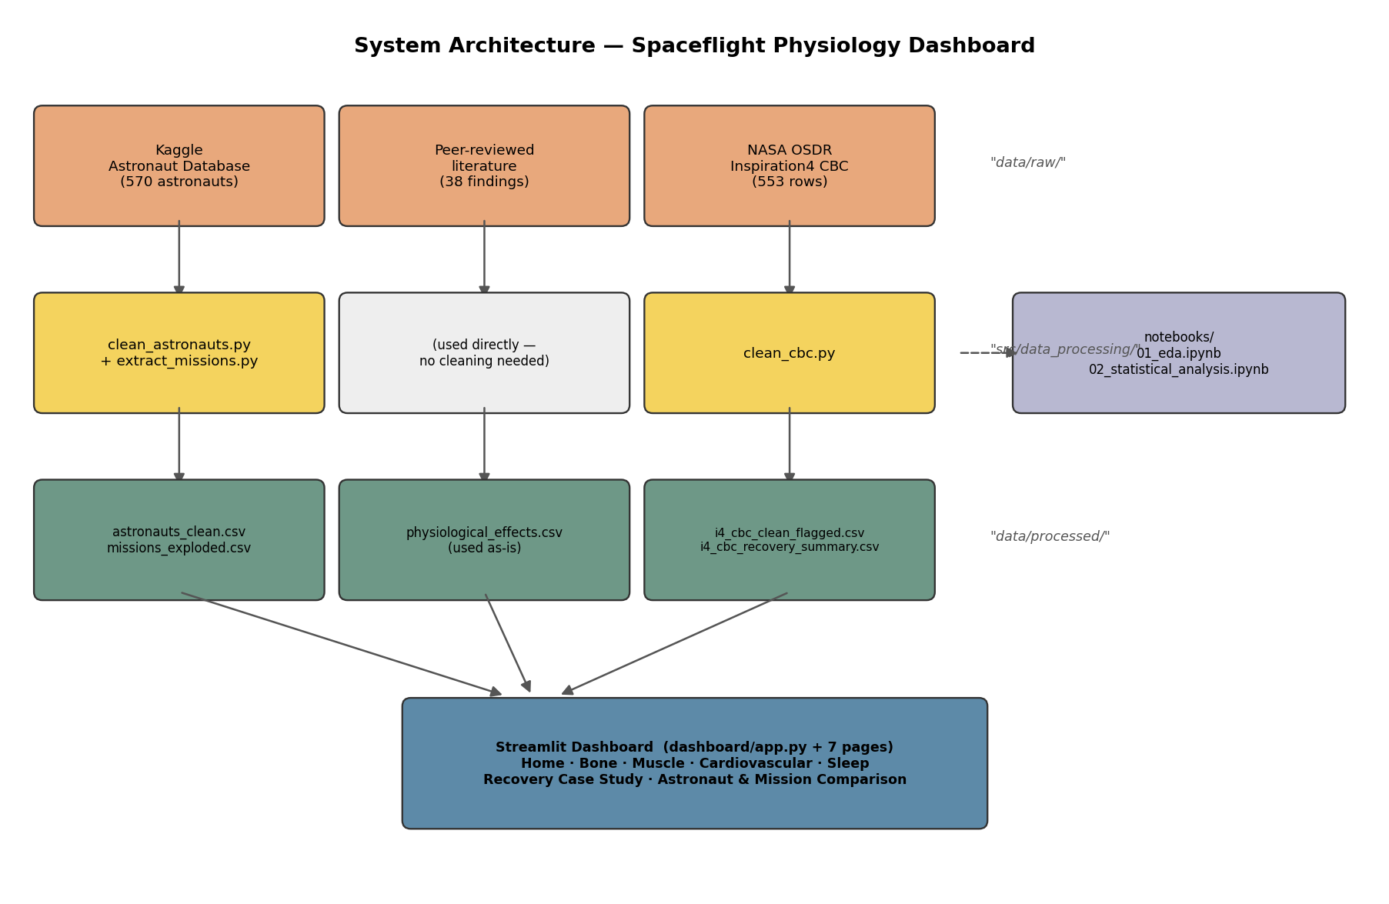
Data Pipeline & Methodology
8

Slide 9
Finding — Bone Density Loss Is Site-Specific
Weight-bearing regions (spine, pelvis, legs) lose the most bone density.
The skull actually gains density — consistent with mechanical-loading theory of bone remodeling.
At 1 year post-flight: only 34% recovered hip BMD, 47% recovered spine BMD.
Source: literature-compiled findings, see docs/data_sources.md
9

Slide 10
Finding — Muscle Loss Scales with Mission Duration
For matching muscle groups, long-duration losses are consistently larger.
Calf muscle: -6% after 8 days vs. -27.5% force loss after 6 months.
Only 1 strength data point exists (calf, long-duration) — a real coverage gap.
Source: literature-compiled findings, see docs/data_sources.md
10

Slide 11
Finding — Orthostatic Intolerance Rises Sharply with Duration
One of the strongest duration effects found in this project.
Dizziness/fainting risk upon standing after return jumps from ~25% (short) to 83% (long).
Resting HR, blood pressure, and HRV were not available in any dataset — a genuine open-data gap.
Source: literature-compiled findings, see docs/data_sources.md
11

Slide 12
Finding — Sleep Deficit Is Duration-Independent
Astronauts sleep ~2-3 hours less than NASA's own 8.5h schedule.
The deficit is nearly identical for short and long missions — suggesting an operational/environmental cause, not a physiological adaptation.
No validated sleep quality or efficiency score was available.
Source: literature-compiled findings, see docs/data_sources.md
12

Slide 13
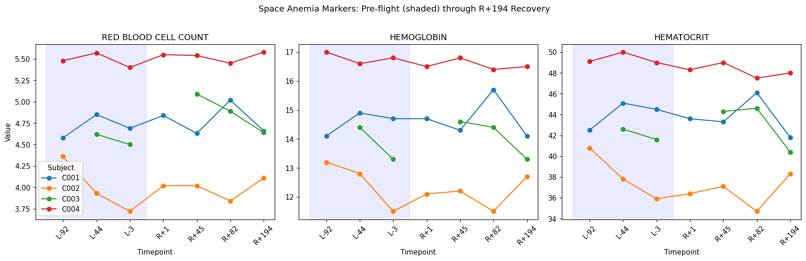
Flagship Finding — Recovery Case Study (Inspiration4)
4
real astronauts
tracked
194
days of post-flight
recovery tracked
Figure — RBC, hemoglobin, hematocrit for all 4 crew members, pre-flight through R+194
The textbook "spaceflight anemia" dip was NOT clearly present here — we checked, and corrected our own draft finding.
Likely explanation: Inspiration4 (~3 days) was too short to trigger the effect seen in much longer ISS missions — itself a genuine, duration-dependent finding.
1
data anomaly found
& transparently flagged
Source: NASA OSDR, OSD-569 / LSDS-7
13

Slide 14
Interactive Dashboard — 8 Pages
🏠
🦴
💪
❤️
Home
Bone Health
Muscle Health
Cardiovascular
😴
🩸
🧑‍🚀
🛰️
Sleep
Recovery Case Study
Astronaut Comparison
Mission Comparison
Verified with Streamlit's AppTest framework — every page executed against real data with zero exceptions.
14

Slide 15
Limitations & Honest Scope
What we deliberately did NOT claim:
❌
No in-flight / during-mission measurement exists in ANY dataset used, for ANY physiological system
❌
No bone turnover markers, muscle fiber-type data, resting heart rate, blood pressure, or HRV
❌
No astronaut age or countermeasure (exercise protocol) adherence data
❌
Literature findings are cross-study aggregates, not individual longitudinal measurements
❌
Mission duration/dates are only approximately recoverable via text parsing, not clean structured fields
Why this matters: naming what's missing is what makes everything else credible.
15

Slide 16
Conclusion
A rigorous, honest data science workflow is achievable even under real data-access constraints — provided those constraints are identified early and the scope adapts accordingly, rather than being assumed away.
Verified data coverage before writing analysis code
Caught and excluded a real data-entry anomaly
Corrected an overstated finding after checking the raw numbers
Delivered a working, tested 8-page dashboard
Thank you — Questions?
16

