Slide 1





END-OF-STUDIES INTERNSHIP DEFENSE
CST LePoint
Fleet Tracking & Workforce Attendance
Management Platform
Presented by:
Rayen
Host Company:
Canadian System Technology (CST)
Academic Year:
2025 – 2026

Slide 2
Agenda
Overview of today's defense
01
02
03
Project Overview
Study of Existing Solutions
Requirements Specification
Host company · Problem statement · Scope
Market analysis · Limitations · Financial impact
Functional · Non-functional · Use cases
04
05
06
Proposed Solution
Implementation & Testing
Conclusion & Perspectives
Architecture · DDD · Clean Architecture · CQRS
Tech stack · Sprints · Screens · Testing
Contributions · Lessons learned · Future work

Slide 3
01
Chapter 01
Project Overview
Host company · Problem statement · Scope & objectives

Slide 4
Project Overview
Host company & operational context
Canadian System Technology (CST)
Problem Statement
Founded 1989 · Montréal · Tunisia subsidiary since 1997
🔴 No real-time GPS tracking of buses
GIC
Le Point ERP Suite (GPAO, GRH, FICO…)
🔴 Manual paper-based attendance rosters
GIC-Distribution
Cybersecurity & infrastructure integration
🔴 No route compliance or geofence auditing
Bs4m
Mobile field services & fleet telemetry
🔴 Desktop-only legacy fat-client access
CST Canada
Custom software & management consulting
🔴 No predictive ETA or absenteeism analytics
🔴 Manual invoice auditing (error-prone)
💡 Target: A unified web-based platform with IoT telemetry,
RFID attendance, ML forecasting, and BI dashboards.

Slide 5
02
Chapter 02
Study of Existing Solutions
Market critique · Operational failures · Financial impact

Slide 6
Study of Existing Solutions
Market analysis and operational limitations
Wialon / GPSGate
(Fleet GPS Platforms)
ZKTime / Biometric Gates
(Attendance Terminals)
Manual Logbooks & WhatsApp
(SME Standard)
STRENGTHS
STRENGTHS
STRENGTHS
✔ Mature cartographic engine
✔ Geofenced alerts & traces
✔ High accuracy, anti-buddy-punch
✔ Payroll integration
✔ Zero cost, instant setup
LIMITATIONS
LIMITATIONS
LIMITATIONS
✘ No HR / employee data link
✘ Cannot verify who's onboard
✘ Gate-only — blind to transit
✘ Absent = late with no context
✘ No scale — safety risk
✘ Falsifiable, invoice errors
📉 Financial Impact — Concrete Calculation:
A bus breakdown delays 40 operators for 1.5 h → Loss = 15,000 TND/h × 1.5 + 2,500 TND overtime = 25,000 TND per incident

Slide 7
03
Chapter 03
Requirements Specification
21 functional requirements · 6 use cases · NFRs

Slide 8
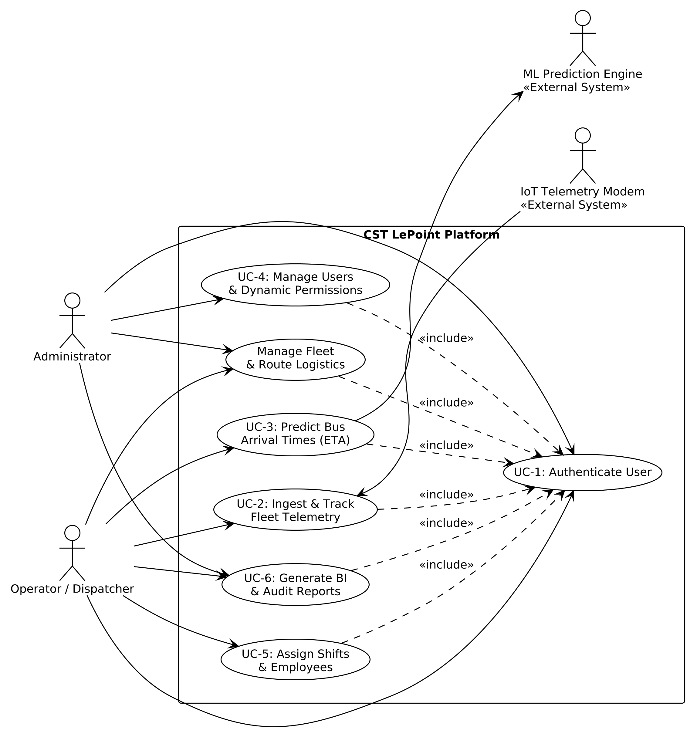
Requirements Specification
Functional requirements, use cases & non-functional constraints
Key Functional Requirements
Non-Functional Requirements
FR-01–04
Authentication & RBAC
⚡ Telemetry ingestion < 200 ms response time
Multi-tenant JWT, BCrypt, granular permissions
🔒 JWT + BCrypt + action-level RBAC security
FR-05–07
Fleet Management
🏗 Clean Architecture — inward dependencies only
Bus, driver, IoT modem catalogs
🐳 Containerized: Docker Compose multi-service
FR-08–09
Pickup Planning
♻ Fault-tolerant: ML fallback to heuristics
GPS circuits, ordered stop sequences
FR-10–12
Workforce Scheduling
Employee RFID, shifts, work orders
Actors & Use Cases
FR-13–15
IoT Telemetry Ingestion
👤 Administrator
Tenant config, RBAC, device registry
Real-time GPS, replay protection, geofencing
👤 Operator / Dispatcher
Live map, circuit planning, BI reports
FR-16–17
Live Cartographic Tracking
Leaflet map, WebSocket telemetry timeline
📡 IoT Modem
GPS & RFID telemetry streaming
FR-18–19
ML ETA Forecasting
🤖 ML Engine
FastAPI ETA predictions
FastAPI predictions, parallel async calls
FR-20–21
BI Reporting
Custom layouts, export, multi-level grouping

Slide 9
04
Chapter 04
Proposed Solution
Clean Architecture · DDD · CQRS · Containerized deployment

Slide 10
Proposed Solution — Architecture
Clean Architecture · DDD · CQRS · Multi-tier ecosystem
① Field & IoT Tier
Architectural Principles Applied
GPS modems + RFID scanners on vehicles
◆ Clean Architecture
Dependencies point inward only. Domain & Application layers are pure — zero framework dependencies.
② User Portal (SPA)
◆ Domain-Driven Design (DDD)
Angular 19 · Leaflet map · DevExtreme BI
Private setters, factory constructors, strongly-typed ULIDs as aggregate IDs for lexicographic clustering.
◆ CQRS with MediatR
③ Business Core (.NET)
Write commands separated from read queries. Pipeline behaviors handle Unit-of-Work & FluentValidation.
CQRS · MediatR · Clean Arch · Carter APIs
◆ Multi-Tenant Security
Global EF Core query filters enforce SocieteId isolation. JWT carries tenant + permission matrix claims.
④ Data & AI Tier
SQL Server 2019 + FastAPI ML microservice
◆ Containerized Deployment
Docker Compose: Angular/Nginx · .NET API · SQL Server · Python FastAPI — isolated bridge network.

Slide 11
05
Chapter 05
Implementation & Realization
Tech stack · Agile sprints · UI screens · ML microservice

Slide 12
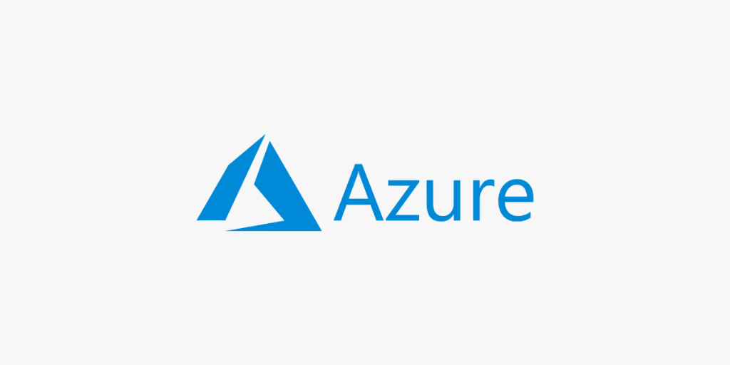
Implementation — Tech Stack & Sprints
Agile Scrum development across 5 sprints
.NET 8 C#
Angular 19
Python 3.11
SQL Server 2019
Docker Compose
Azure
Scrum Sprint Timeline
Sprint 1
Sprint 2
Sprint 3
Sprint 4
Sprint 5
Auth & Security
Master Data & Logistics
Live Tracking & Map
IoT Ingestion & ML
BI & Testing
JWT, BCrypt, RBAC, navigation guards
Fleet, circuits, employees, shifts
Leaflet, WebSocket, telemetry dashboard
GPS ingest, geofencing, FastAPI ETA
Reports, custom layouts, xUnit tests

Slide 13
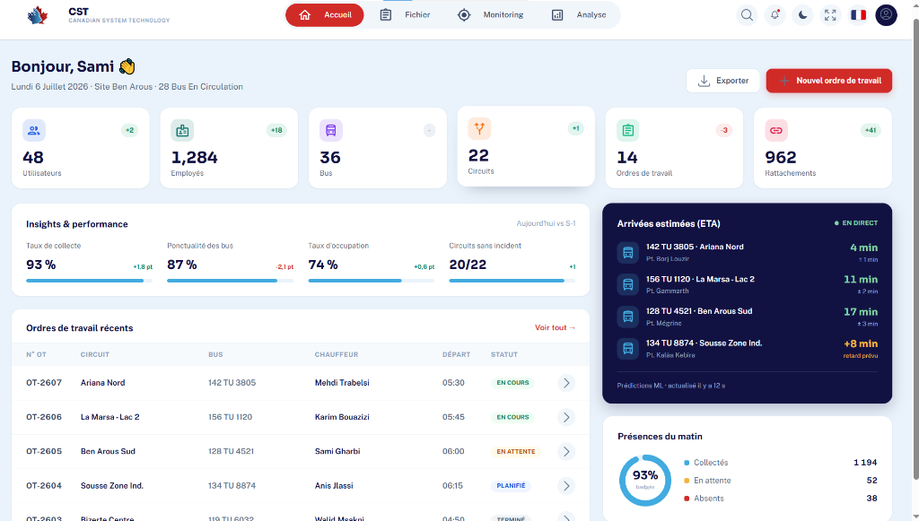
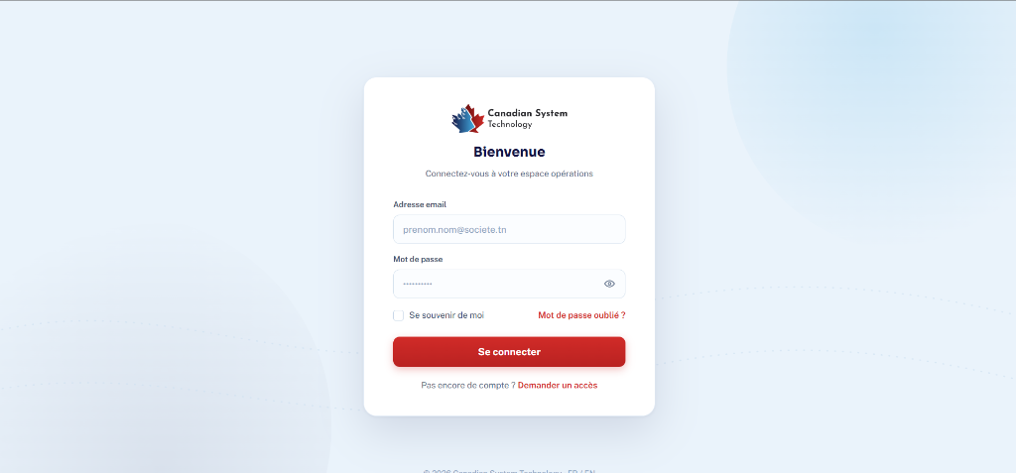
Dashboard & Authentication
Central operations cockpit · KPI cards · Live ETA ticker · Attendance donut
Central Operations Dashboard
Multi-Tenant Authentication Screen

Slide 14
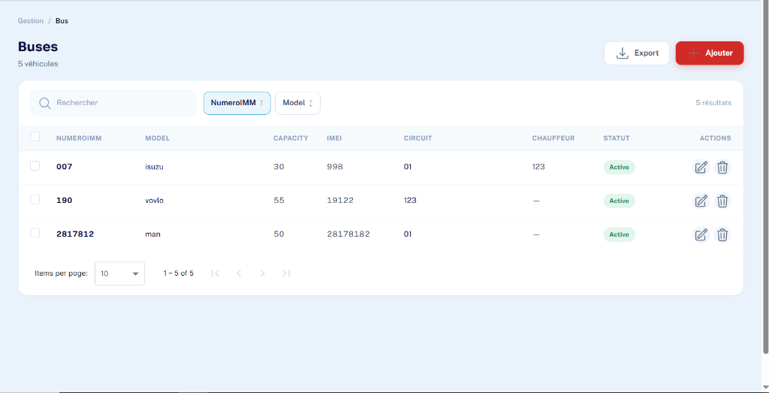
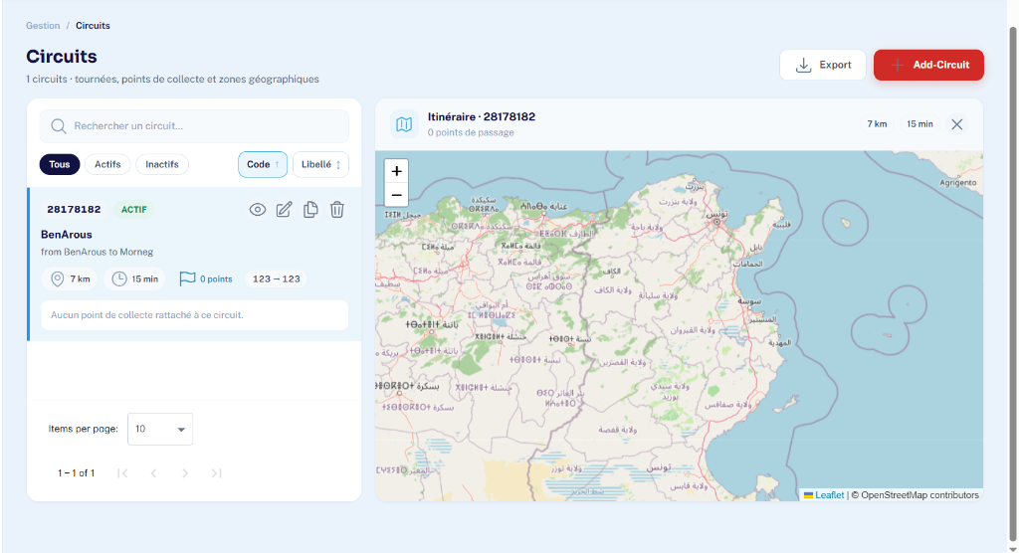
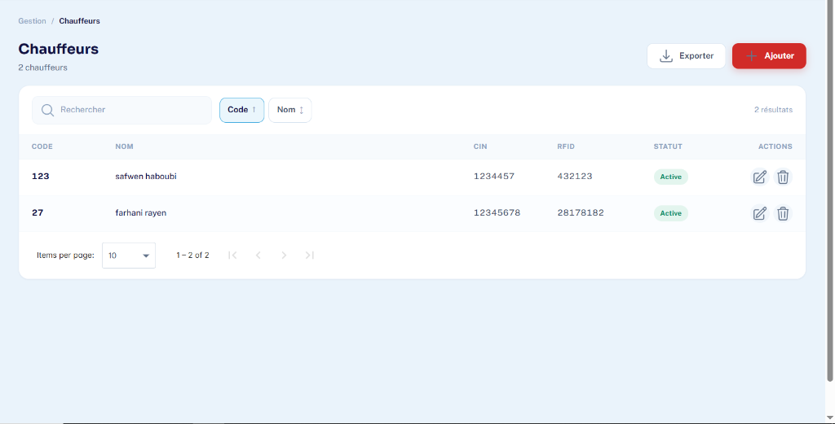
Fleet & Route Management
Bus catalog · Driver assignments · Circuit definitions · Pickup stops
Fleet Vehicle Catalog & IMEI Pairing
Transit Circuit Definitions
Driver Management

Slide 15
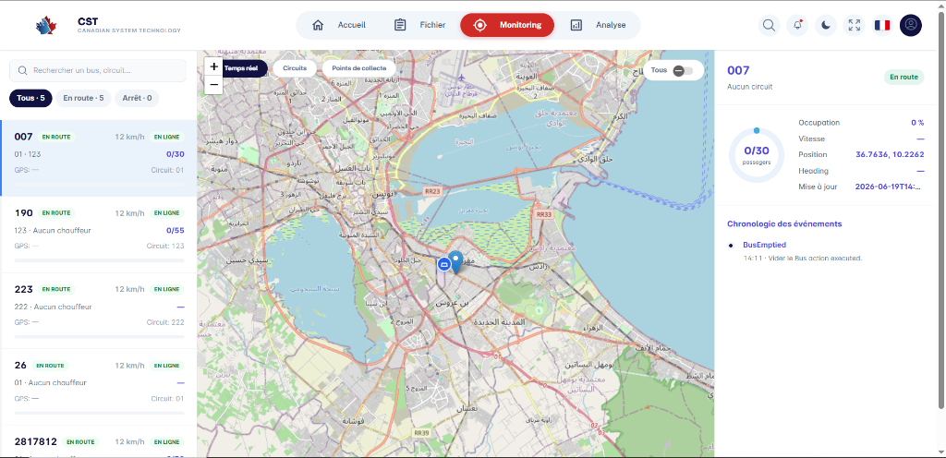
Live Cartographic Tracking
Real-time bus positions · Geofenced deviation alerts · WebSocket streaming
Live Fleet Tracking Map — Leaflet.js

Slide 16
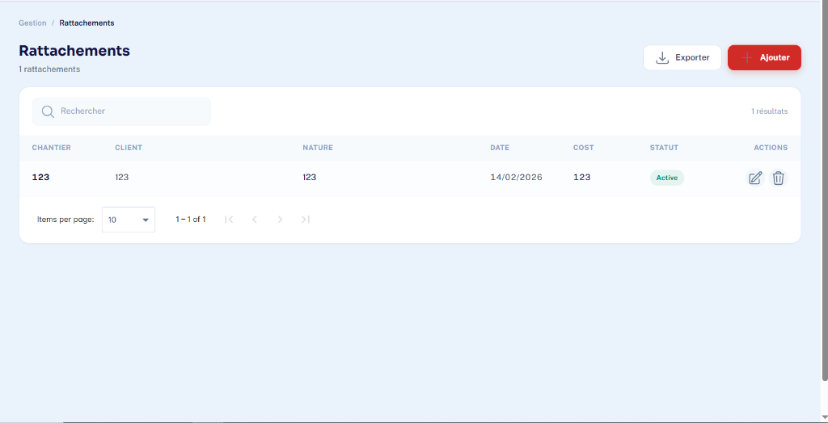
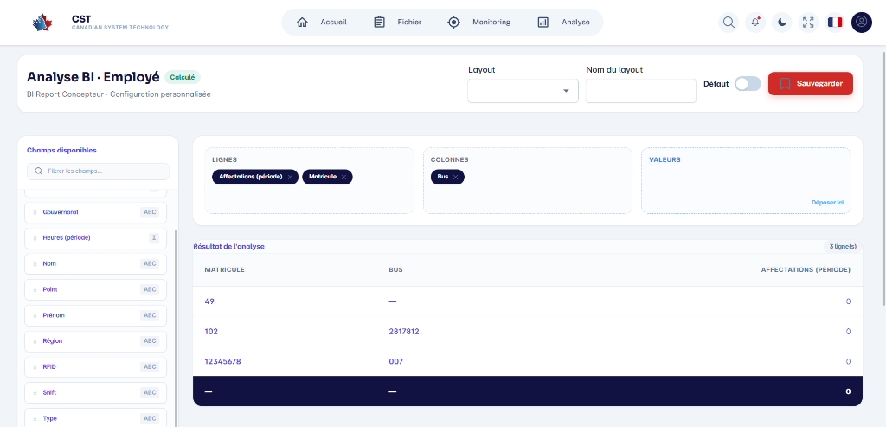
Workforce & BI Analytics
Employee pickup assignments · Shift schedules · Custom BI layouts
Employee Pickup Assignment Map
Business Intelligence & Custom Reports

Slide 17
Predictive Intelligence — ML Microservice
FastAPI · Scikit-Learn · LightGBM · ETA Forecasting
Machine Learning Service
UC-3: Predict Bus ETA
▸ ETA Forecasting
1. Operator clicks active bus on live map
Scikit-Learn + LightGBM regression trained on historical
transit trajectories. Input: speed, occupancy, circuit ID, distance.
2. Angular → POST /cm/bus/eta to .NET API
3. Backend aggregates telemetry: speed, coords,
occupancy, capacity, circuit
▸ Absence Risk Assessment
Evaluates employee boarding patterns to flag
high-risk absenteeism before shifts begin.
4. .NET → POST http://ml-service:8001/predict/eta
5. FastAPI loads model → inference → ETA (minutes)
▸ FastAPI Async Endpoint
POST /predict/eta — asynchronous inference.
Backend calls in parallel for all active buses.
6. API returns prediction to frontend panel
7. Fallback: if ML down → heuristic distance/speed
▸ Fault-Tolerant Fallback
If ML container is unreachable, system falls back to
deterministic distance ÷ speed heuristics automatically.

Slide 18
Testing & Quality Assurance
xUnit integration tests · Ingestion latency · Traceability
< 200 ms
< 500 ms
50+
100%
9 / 9
Telemetry ingestion
response time
BI grid load
(virtual scroll)
Concurrent IoT
modem support
FR traceability
coverage
Requirements
traced & verified
Testing Strategies
Requirements Traceability Matrix
◆ xUnit Unit Tests
Business logic, validators, domain invariants
REQ-01
Auth / BCrypt / JWT
UC-1 ✔
◆ Integration Tests
EF Core in-memory, telemetry ingestion pipeline
REQ-04
Telemetry Ingestion
UC-2 ✔
◆ Serilog JSON Logs
Daily rolling structured log files for auditing
REQ-05
Live Geofencing
UC-2 ✔
REQ-06
Cartographic Map
UC-2 ✔
◆ Rin Request Inspector
Real-time HTTP timeline & DB query profiling
REQ-07
ML ETA
UC-3 ✔
◆ FluentValidation
Fail-fast input guards at command boundary
REQ-08
Custom BI Layouts
UC-6 ✔
◆ Swagger / OpenAPI
Interactive API contract documentation & testing
REQ-09
Pickup Assignment
UC-5 ✔

Slide 19
06
Chapter 06
Conclusion & Perspectives
Contributions · Insights · Future extensions

Slide 20
Conclusion & Perspectives
Contributions · Technical insights · Future extensions
Project Contributions
Future Perspectives
✅
Clean Architecture .NET 8 Backend
🔍 GPS Anomaly Detection
CQRS/MediatR, inward-only dependencies
ML models to flag GPS spoofing, unauthorized
detours, and fraudulent RFID badge scans.
✅
Encapsulated DDD Domain Model
Private setters, ULID factory constructors
🗺 Dynamic Route Optimization
✅
Real-Time Telemetry & Geofencing
VRP algorithms computing optimal paths from
employee home coordinates to minimize mileage.
Haversine-based route deviation alerts
✅
Angular 19 SPA
🔧 Predictive Fleet Maintenance
Leaflet map, DevExtreme grids, Transloco i18n
Telemetry diagnostics (voltage, speed profiles)
to forecast engine failures before breakdowns.
✅
ML FastAPI Microservice
ETA forecasting + absence risk assessment
📊 Demand-Driven Fleet Sizing
✅
Containerized Docker Deployment
Historical occupancy analysis to dynamically
allocate bus sizes per pickup point per shift.
Nginx · .NET · SQL Server · FastAPI isolated

Slide 21
Thank You
Questions & Discussion
CST LePoint · Fleet Tracking & Workforce Attendance Platform
Canadian System Technology (CST) · Academic Year 2025–2026

