Slide 1

Predicting the Traffic Impact of US Road Accidents
Data preparation, exploration & feature engineering
Omar Tentouch · Tamjid Trabelsi · Youssef Ouenniche · Rayen Chanchah · Mohamed Yamoun
Data Science Midterm Project · October 2026
Notes:
Hi, we are presenting our midterm project on the US Accidents dataset. Our goal is to predict how much an accident will slow down traffic, using only what is known when it is first reported. We follow the six CRISP-DM phases: business understanding, data understanding, preprocessing, exploratory analysis, feature engineering, and conclusions and next steps. We did not train models yet; that is the next phase.

Slide 2





Which accidents will block traffic for hours?
Research questions
Problem statement
Predict the Severity of an accident (1 = short delay, 4 = long delay) using only information known when it is first reported.
RQ1 · Time
When do high-impact accidents happen?
RQ2 · Weather
Severity = impact on traffic, not injuries.
Does weather change severity?
RQ3 · Road
How we will judge a future model
Do highways, signals and junctions matter?
> 0.22
> 0
RQ4 · Consistency
Is the label the same across providers and years?
Macro F1
Recall of Severity 4
RQ5 · Features
score of always guessing "Severity 2"
it must find some of the worst accidents
Which report-time information matters most?
US Accidents Severity · Data Science Midterm
2
Notes:
Traffic centres and navigation apps must decide right after a report how many responders to send and whether to reroute drivers. So our question is: from the first report, can we predict the delay level? Severity here is traffic delay, not injuries. We wrote five research questions about time, weather, road, label consistency and features. Success criteria: accuracy is misleading because 80% of accidents are Severity 2; always guessing 2 gives 80% accuracy but only 0.22 macro F1. So we will use macro F1 and the recall of Severity 4. For this midterm our criteria were: no leakage, documented cleaning, evidence for every question, justified features, and one-command reproducibility.

Slide 3
500,000 accidents, and 4 out of 5 are Severity 2
500K
46
accidents (sample of 7.7M)
columns: time, place, weather, road
2016–23
3
February 2016 to March 2023
data providers, 49 states
Quality issues found: missing values (up to 44%), leaking columns, impossible values (207 °F, 822 mph), 24 spellings of wind direction, 2,884 duplicates.
Source: US Accidents (Moosavi et al., 2019), Kaggle. The sample keeps the full dataset's class shares (±0.1 pt).
US Accidents Severity · Data Science Midterm
3
Notes:
We used the US Accidents dataset by Moosavi and colleagues, from Kaggle, licence CC BY-NC-SA. The full dataset has 7.7 million accidents; we used the 500,000-row random sample, which keeps the same class shares. There are 46 columns: time, location, address, weather from the nearest airport station, 13 road features from OpenStreetMap, and day/night columns. The target is very unbalanced: 80% Severity 2, under 1% Severity 1 and 2.6% Severity 4. We also listed the quality problems we found first. Every column is defined in Appendix A of the report.

Slide 4



We removed 11 columns that would give away the answer
Our rule: keep a column only if it is known when the accident is first reported.
Leakage (5)
End_Time, End_Lat, End_Lng, Distance(mi), Description: only known after the accident
No information (3)
ID, Country (always US), Turning_Loop (always False)
Repeated (3)
Weather_Timestamp, Timezone, Airport_Code: same as time and place
Anything that learns from data (filling, encoding, scaling, selection) is fitted on the training split only.
US Accidents Severity · Data Science Midterm
4
Notes:
Data leakage was our biggest risk. Some columns are only known after the accident: when it ended, the length of road affected, and the description. The chart shows why this matters: 88.5% of Severity 4 descriptions say 'closed', against about 5% for the others. A model using them would look perfect in testing and fail in real life. So our rule: keep a column only if it is known at report time. We also removed constant and repeated columns. We kept Source: it is known at report time, but suspicious, so we will test models with and without it. Leakage also happens in transformations, so every step that learns from data is fitted on the training split only.

Slide 5




Cleaning kept 99.1% of the rows
1
Drop columns
2
Duplicates
3
Missing values
4
Outliers & categories
11 leaking or useless columns removed
2,884 exact copies removed
A fix chosen per column (table below)
13 impossible values set empty; categories merged
500,000 × 35
497,116 rows
495,532 rows
495,532 × 36
Missing values: one fix per case
Outliers and messy categories
Column | What we did and why
Wind_Chill (26% empty) | Dropped: almost a copy of Temperature (r = 0.994)
Precipitation (29% empty) | Filled with 0 + flag precip_missing (empty mostly means no rain)
City, Zipcode, light (0.3%) | Dropped 1,584 rows: too few to be worth guessing
Weather text, wind direction | New "Unknown" category: keeps the rows
Temperature, humidity, … | Training median, filled later: avoids test-data leakage
Physical limits: temperature −50 to 130 °F, wind ≤ 200 mph, visibility ≤ 100 mi, pressure 15–32 inHg
Wind direction: 24 spellings → 16 compass points + CALM + VAR
Weather: 108 labels → 8 groups (the most dangerous rule wins)
US Accidents Severity · Data Science Midterm
5
Notes:
Cleaning in four steps, each logged in cleaning_log.md with rows and columns before and after. We dropped 11 columns, then 2,884 duplicate rows. For missing values we chose a fix per column: Wind_Chill was dropped because it is 99.4% correlated with temperature; empty precipitation mostly means no rain, so we filled 0 and kept a flag; for the five numeric weather columns we use the training median later, because filling now would use test data, and the median because these columns are skewed. Impossible values like 207 °F or 822 mph were set to empty using physical limits; extreme-but-possible values were kept. Then we merged messy categories. In total we only lost 0.9% of the rows.

Slide 6
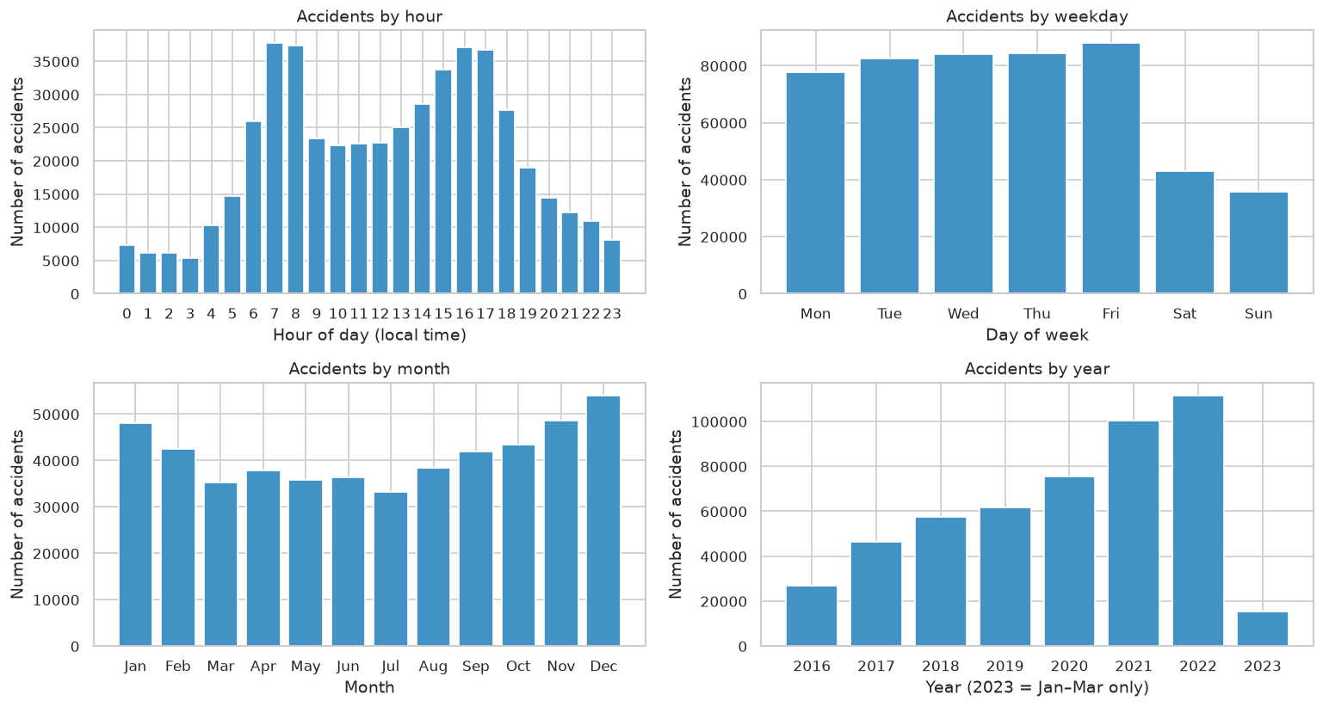
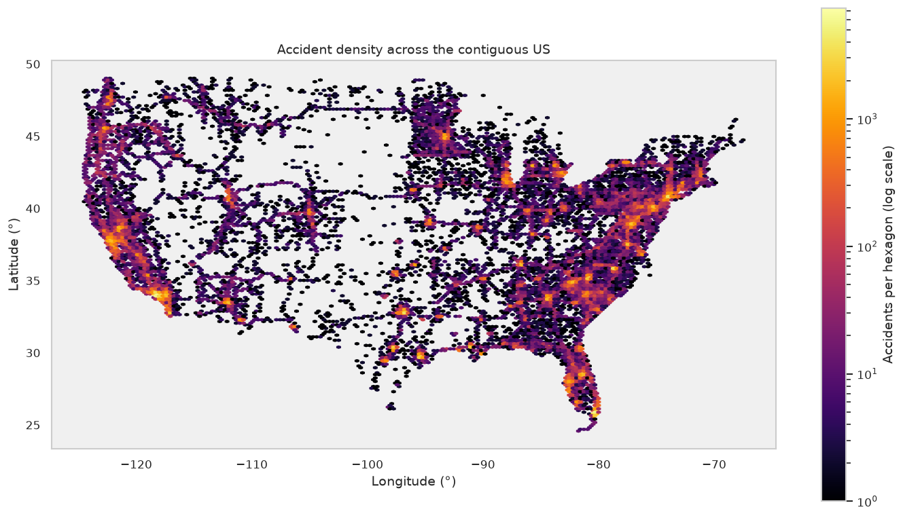



Accidents follow commuting, big cities and highways
Two daily peaks at 7–8 h and 15–17 h; half as many on weekends
California 23%, Florida 11%, Texas 7.5% of accidents
Yearly count grows 4× (2016 → 2022): better data collection, not more accidents
Figures 3 and 5 of the report (reports/figures).
US Accidents Severity · Data Science Midterm
6
Notes:
Before looking at severity, we looked at when and where accidents happen. Left: accidents follow commuting, with peaks in the morning and afternoon and fewer on weekends; December and January are the busiest months. Right: the map follows highways and big cities; California alone has 23%. One warning: the number per year grows from 26,700 to 113,700, mostly because the providers collected more data. So the data changes over time, which leads to RQ4.

Slide 7


RQ1–RQ2: night and bad weather matter, but only a little
Effect size (Cramér's V)
0.05
day / night
0.04
weather group
below 0.1 = very small
Time (RQ1)
Weather (RQ2)
Rush hour has the most accidents, not the worst. Severity 4 peaks around midnight (5–6% vs 1.6% at 7–8 h).
Snow / ice raises Severity 4 (3.4% vs 2.6%). Visibility is the same for every level (median 10 mi).
US Accidents Severity · Data Science Midterm
7
Notes:
RQ1: rush hours have the most accidents but not the worst ones. Severity 4 is 1.6 times more common at night: 3.5% against 2.2%. Possible reasons: faster driving on empty roads, darkness and slower response. RQ2: rain and storms raise the high-impact share from 17% to 22%, and snow raises Severity 4. But look at the effect sizes on the right: Cramér's V is 0.05 and 0.04. They are statistically significant because we have 500,000 rows, but the effect is very small. So weather and time help a little, but cannot predict severity alone.

Slide 8
RQ3–RQ4: road type and data provider matter most
Near traffic signals, crossings or stop signs only 6–10% are high-impact: slow city streets.
Part of the label is who recorded it. Severity 3 fell from 32% (2017–18) to 4.5% (2022) as Source1 replaced Source2.
US Accidents Severity · Data Science Midterm
8
Notes:
RQ3: road type gives the clearest signal. Highway accidents are 28% high-impact against 11% on other roads; we built the is_highway feature from the street name. Accidents near traffic signals or stop signs are rarely severe because those are slow city streets. RQ4 is our most important finding: the label is not consistent. Source2 labels 34% of its accidents Severity 3, Source1 only 4%. Over the years Source1 replaced Source2, so Severity 3 drops from 32% to 4.5%. A model could learn the provider instead of the accident. That is why we will train with and without Source and use a time-based test.

Slide 9


Hypothesis tests: all significant, few are strong
Chi-square test
For categorical variables. H0: the variable and Severity are independent. Needs expected counts ≥ 5, so 203 "Other" weather rows were left out.
Kruskal-Wallis test
For temperature across 4 levels, instead of ANOVA: not normal (p ≈ 10⁻⁴¹) and unequal variances (p ≈ 10⁻¹⁹⁴).
Why effect sizes
With 500,000 rows every p ≈ 0. Effect size shows how strong the link is; we also re-ran each test on 5,000 rows.
0.1 = small · 0.3 = medium · 0.5 = large
α = 0.05 · temperature: H = 1,818, ε² = 0.004 (very small) · junction not significant on 5,000 rows
US Accidents Severity · Data Science Midterm
9
Notes:
We tested the main patterns at significance level 0.05. For two categorical variables we used the chi-square test of independence; its assumption is expected counts of at least 5, so we left out the 203 rows of 'Other' weather. For temperature across four groups we used Kruskal-Wallis instead of ANOVA, because the D'Agostino test showed it is not normal and Levene showed unequal variances. The key point: with 500,000 rows every p-value is almost zero, so p-values alone are not useful. That is why we report effect sizes and repeat each test on a 5,000-row sample. We reject every H0, but only the provider (0.29) and traffic signals (0.12) have more than a negligible effect. No single variable explains severity.

Slide 10




From 41 candidates to 36 leakage-safe inputs
Create
Split first
Select
Encode & scale
• hour, weekday, season
• is_weekend, is_rush_hour
• civil / astro night
• bad_weather, precip_missing
• road_feature_count
• is_highway (28% vs 11%)
• 80% train / 20% test
• stratified by Severity
• seed 42
• test set stays unseen
• drop 3 near-constant (< 0.1%)
• drop 2 repeated (|r| > 0.85)
• rank by mutual information
• median filling
• one-hot: State, Source, …
• frequency: City, County
• 50 K-means location regions
• standard scaling
36
165
0
399
final inputs
model columns after encoding
missing values left
unseen test cities → frequency 0
US Accidents Severity · Data Science Midterm
10
Notes:
Feature engineering has two parts. Features built from one row, like hour, season, night flags, bad_weather, road_feature_count and is_highway, are safe at any time; is_highway is the strongest new feature. Then, before anything that learns from data, we split 80/20 stratified. Selection: we removed three near-constant road columns and two repeated night columns, and ranked features with mutual information, which also catches non-linear links. Encoding: one-hot for columns with few values, frequency encoding for City and County because one-hot would make about 10,000 columns, and K-means regions for coordinates. Scaling only matters for linear models. Check: test cities never seen in training get frequency 0, which proves nothing was learned from the test data.

Slide 11
Answers to our research questions
RQ1 · Time
WEAK
Worst accidents at night: Severity 4 3.5% vs 2.2% by day (V = 0.05)
RQ2 · Weather
WEAK
Rain and storms: 22% high-impact vs 17% in clear weather (V = 0.04)
RQ3 · Road
CLEAR
Highway 28% high-impact vs 11% elsewhere; signals only 6–10% (V = 0.12)
RQ4 · Consistency
NO
Providers label very differently (V = 0.29, the strongest link)
RQ5 · Features
FOUND
Location, provider, year and highway tell us the most; 36 inputs kept
Main message: severity depends more on where and who reported it than on weather or time. The signal is weak and non-linear, so tree-based models should work best.
US Accidents Severity · Data Science Midterm
11
Notes:
Here are our answers. Time and weather: real but weak effects. Road: a clear effect; highways are the strongest signal. Consistency: no, the provider has the strongest link with severity, so part of the label reflects who recorded it. Features: location, provider, year and highway are the most informative. Overall: no single variable explains severity, the relationships are weak and non-linear, so a model will have to combine many weak signals, and tree-based models like Random Forest or LightGBM should do better than linear ones.

Slide 12

Limitations and next steps
Limitations
Next: modelling (not part of the midterm)
Severity = delay as each provider records it, not injuries
1
Splits: train / validation / test 70/15/15 + time check (2016–21 → 2022–23)
6.5% sample; data ends March 2023; coverage varies by state
2
Imbalance: class weights vs. undersampling Severity 2
3
Models: baseline → Logistic Regression → Decision Tree → Random Forest → LightGBM / XGBoost
Weather comes from the nearest airport, not the exact place
4
Evaluation: macro F1, Severity 4 recall, confusion matrix
Some rules of thumb: outlier limits, highway name rule, thresholds
5
Provider test: best model with and without Source
Tests show association, not cause
6
Explain: feature importance and SHAP
US Accidents Severity · Data Science Midterm
12
Notes:
Limitations: Severity is recorded differently by each provider, which is our main concern. We used a 6.5% sample, the weather is from the nearest airport, and some thresholds are rules of thumb we chose. Tests show association, not cause. Next steps for the final project: a validation split plus a time-based test, handle the imbalance with class weights or undersampling, start from a trivial baseline and move to tree-based models, evaluate with macro F1 and Severity 4 recall, test the model with and without Source, and explain it with SHAP.

Slide 13

Thank you. Questions?
US Accidents Severity · Data Science Midterm
13
Notes:
Thank you. Everything is in the GitHub repository and can be rebuilt with one command. Likely questions: Why remove Description? It is written after the accident and says 'closed' for 88.5% of Severity 4. Why median and not mean? The columns are skewed. Why Kruskal-Wallis? Temperature is not normal. Why keep Source? It is known at report time; we will measure its effect. Why frequency encoding? One-hot would create about 10,000 columns.

