Slide 1

Prompt Analysis in Zero Shot Learning
BLM6114 Computational Semantics
Rayene Bech
24.04.2023

Slide 2
Content
Text Classification with Zero Shot Prompting
Models
BERT base model
MPNET sentence model
T5 base sentence model
Experiments
Topic Classification dataset
Sentiment Analysis dataset

Slide 3
Text Classification with Zero Shot Prompting
Zero-shot text classification is a task where a pretrained model is used to classify examples from previously unseen classes.
In this work, the semantic similarity between the prompt and the text is used to classify the text.
Prompts are built using the semantics of the labels, without any prior knowledge of the tain/test data.
A similarity score is computed between the text and each prompt. The text is assigned to the highest score.

Slide 4
Text Classification with Zero Shot Prompting
Cosine Similarity Score
Text Embeddings
Prompt Embeddings
NN Model
NN Model
Text
Prompt

Slide 5
Models
BERT base model*
Pretrained BERT’s raw embeddings
No finetuning.
MPNET sentence model**
Microsoft's mpnet-base model
T5 base sentence model***
Google’s t5-base model
Finetuned for sentence similarity tasks.
2B question-answer pairs from diverse online communities.
Finetuned the model using a contrastive objective.
Over 1 billion sentences

Slide 6

Experiments

Slide 7
Topic Classification dataset
Dataset taken from: “Benchmarking Zero-shot Text Classification: Datasets, Evaluation and Entailment Approach” Yin et al. (2019)
Originally from Yahoo dataset released by Zhang et al. (2015).
The dataset contains 10 classes:
Society & Culture
Science & Mathematics
Health
Education & Reference
Computers & Internet
Sports
Business & Finance
Entertainment & Music
Family & Relationships
Politics & Government
Sampled 100 examples from each class.

Slide 8
Topic Classification Dataset Samples
'Computers & Internet’ : "what is RSS ? RSS is a format for syndicating news and the content of news-like sites , including major news sites like Wired , news-oriented community sites like Slashdot , and personal weblogs . But it 's not just for news . Pretty much anything that can be broken down into discrete items can be syndicated via RSS : the `` recent changes '' page of a wiki , a changelog of CVS checkins , even the revision history of a book . Once information about each item is in RSS format , an RSS-aware program can check the feed for changes and react to the changes in an appropriate way .”
'Society & Culture’: 'Prostitution and class c drugs . Should governments be that strict ? Class C drugs like marijuana and one of the oldest proffessions in human history , prostitution . Is tourism really worth it without the two ? Victimless crimes should not be prosecuted by the government .’
'Science & Mathematics’ : 'whats the weight in kilograms if the pounds is 127 ? you have to divide 127 by 2.2. so 127 lbs would be 57.73 kilos’
'Sports’ : "what midfield players are manutd planing to buy ? is obi mikel coming to utd ? news ? i want you to avail me with every manutd news i don ; t think mikel obi is gon na come to Man Utd.. in fact , i dont think it is worthwhile for sir alex to battle for mikel , such arrogance at a young age.. he don ; t have the heart to play for manchester united.. he don ; t even have what it takes to play in united , only good enough for second class clubs like chelsea = ) anyhow , manchester united has recently signed nemanja vidic ( from spartak moscow if i ; m not mistaken ) .. he is a defender , one of the serbia and montenegro 's 'famous 4 ' defence . they only let in 1 goal throughout the whole world cup qualifier campaign.besides that , united has nearly closed the deal to bring in patrick evra from monaco.. he is quite a good player , one of those who played in the champions league final 2 year ago between monaco and porto ( which porto won ) . he aims to become the next eric cantona , his french compatriot.HAIL MANCHESTER UNITED ! *******************it was said that manchester united has put up a 3.8mil pound bid for thomas gravesen of real madrid ... natural replacement for roy keane , i assume.."

Slide 9
Topic Classification Prompts
Prompt name | Template | Example
CLASS_NAME | {class_name} | society and culture
TEXT_IS_ABOUT | "This sentence is about {class_name}" | This sentence is about society and culture
TOPIC_DEFINITION | TOPIC_DEFINITION["society and culture"] | Society is a large group of people who live together in an organized way, making decisions about how to do things and sharing the work that needs to be done. All the people in a country, or in several similar countries, can be referred to as a society. Culture is the way of life, especially the general customs and beliefs, of a particular group of people at a particular time.
KEYWORDS | This sentence is about {CLASS_KEYWORDS[class_name]} | This sentence is about culture, society, civilisation, club, tribal society, letters, beliefs, design, dialect, diffusion, ethic, heritage, mores
NEWS_ABOUT | News article about {CLASS_KEYWORDS[class_name]} | News article about culture, society, civilisation, club, tribal society, letters, beliefs, design, dialect, diffusion, ethic, heritage, mores

Slide 10
Notes
For TOPIC_DEFINITION, the exact definitions from dictionary.cambridge.org were used.
To extract KEYWORDS from categories, the API “wordsapiv1” was used with different endpoints. Then top keywords were kept.

Slide 11
Topic Classification dataset results
Model / Prompt | CLASS_NAME | TEXT_IS_ABOUT | TOPIC_DEFINITION | KEYWORDS | NEWS_ABOUT
BERT base model | 10.96% | 28.86% | 34.18% | 43.43% | 41.04%
MPNET sentence model | 50.05% | 56.10% | 41.02% | 46.31% | 40.07%
T5 base sentence model | 54.08% | 59.40% | 49.13% | 47.81% | 49.62%
Table 01. F1 score results for Topic Classification

Slide 12
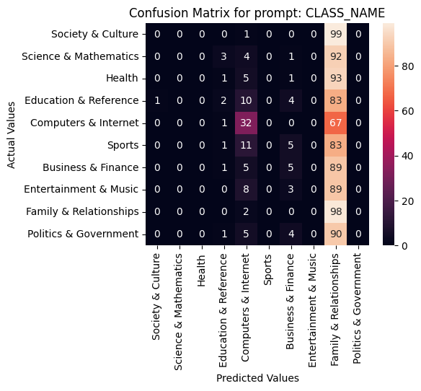
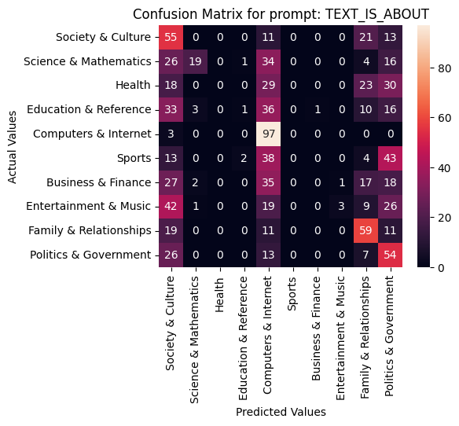
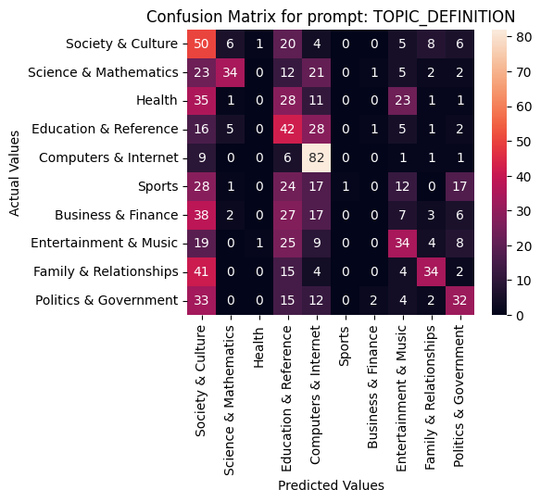
Topic Classification Confusion Matrices BERT Model
# 5
# 4
# 3

Slide 13
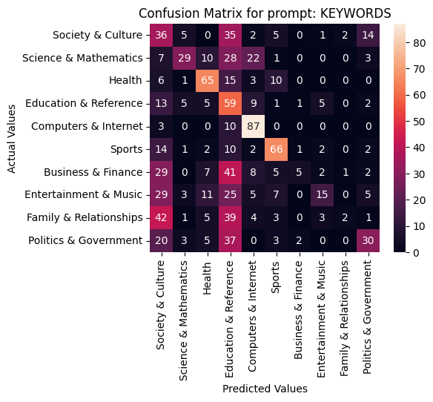
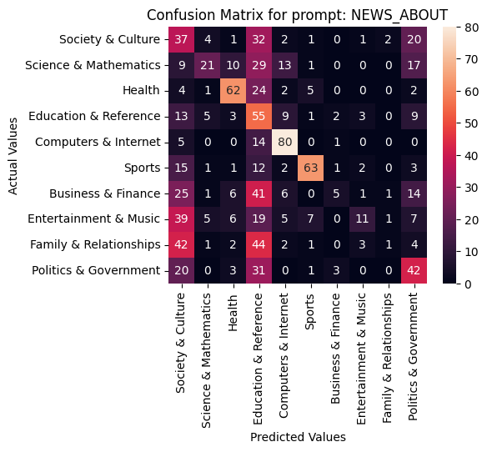
Topic Classification Confusion Matrices BERT Model
# 1
# 2

Slide 14
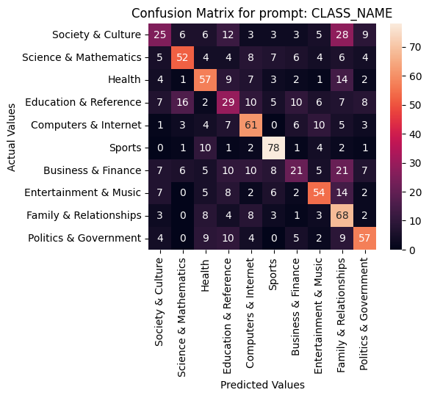
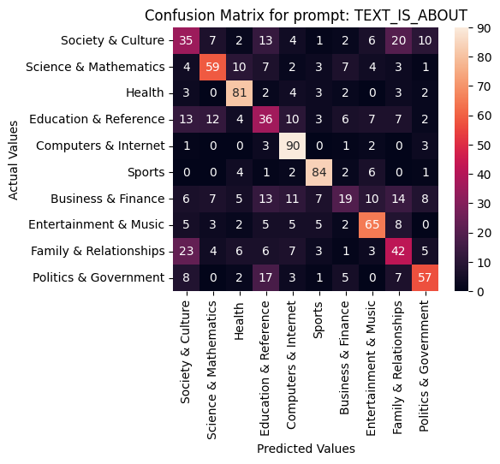
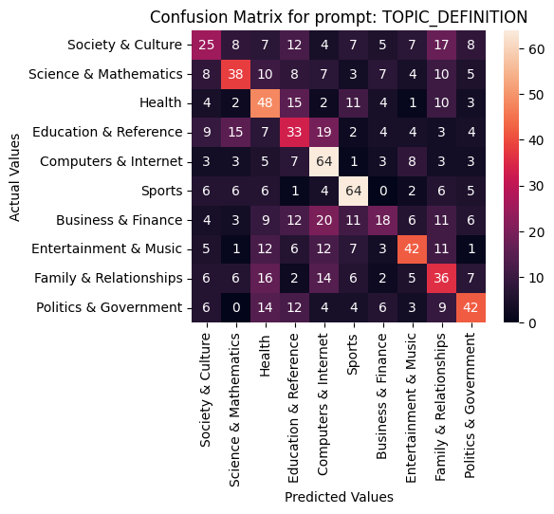
Topic Classification Confusion Matrices MPNET Sentence Model
# 2
# 1
# 4

Slide 15
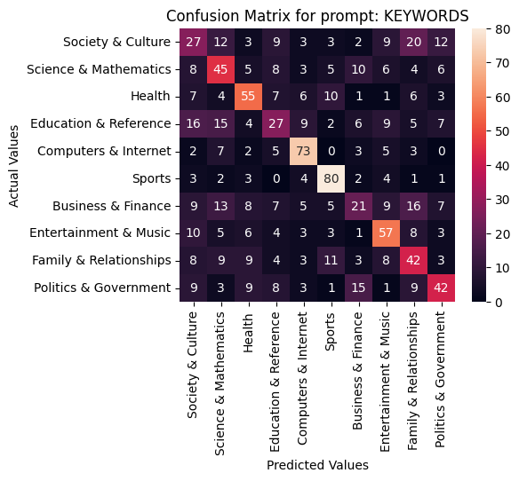
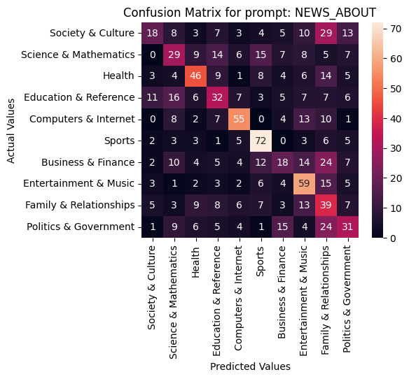
Topic Classification Confusion Matrices MPNET Sentence Model
# 3
# 5

Slide 16
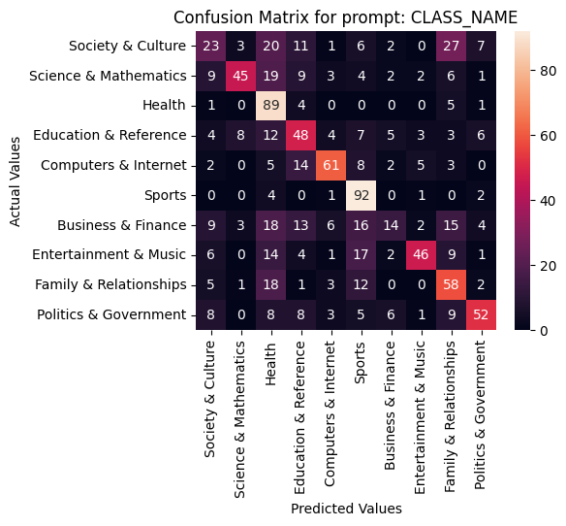
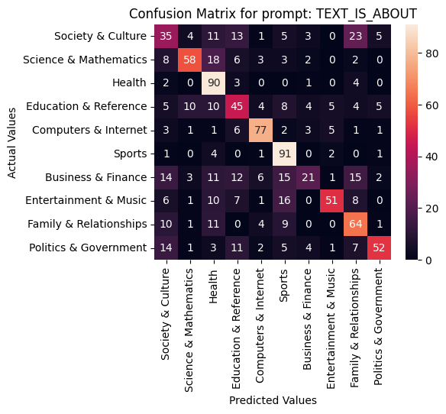
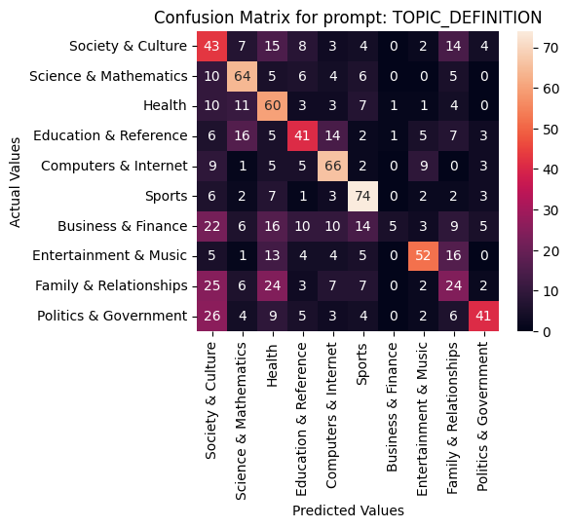
Topic Classification Confusion Matrices T5-base Sentence Model
# 2
# 1
# 4

Slide 17
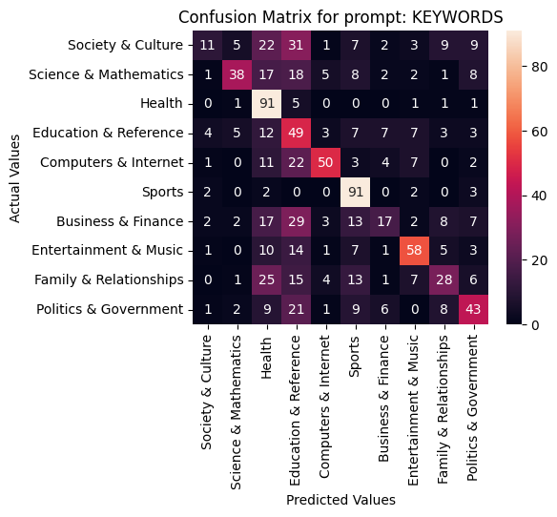
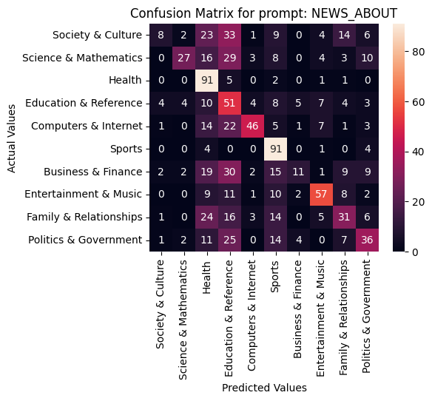
Topic Classification Confusion Matrices T5-base Sentence Model
# 5
# 3

Slide 18
Conclusion about Topic Classification
The sentence models that were fine-tuned on sentence similarity tasks gave better embeddings and outperformed the pretrained BERT model.
Adding the prefix (“Text is about”) to the class name increased dramatically the performance for all models.
The use of keywords and topic definitions enhanced the performance of the pretrained model BERT. However, it hurt the performance of the sentence models.

Slide 19
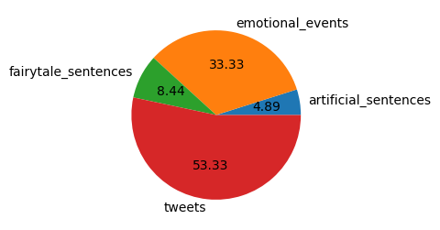
Sentiment Analysis dataset
Dataset taken from: “Benchmarking Zero-shot Text Classification: Datasets, Evaluation and Entailment Approach” Yin et al. (2019)
Originally from a dataset released by Bostan and Klinger (2018)
The dataset contains 9 classes:
Sadness
Joy
Anger
Disgust
Fear
Surprise
Shame
Guilt
Love
Sampled 100 examples from each class.
Fig 01: Data sources

Slide 20
Sentiment Analysis Dataset Samples
’Anger’: ‘time for tv in bed.Then spending all day catching up on studying i hate online summer classes’.
’Joy’: 'staring at the sunshine through my office window!’,
‘Shame’: 'When I was a child: I had told my mother a lie and she found it out.',
‘Fear’: 'The innocent little bird which had caused all the mischief, flew away in a fright!’,
‘Disgust’: "You see, that's their life; they exist only for the eye and the nose.",

Slide 21
Sentiment Analysis Prompts
Prompt name | Template | Example
CLASS_NAME | {class_name} | sadness
TEXT_IS_ABOUT | This sentence is about {class_name} | This sentence is about sadness
THIS_IS_I_FEEL | This is {bad/good}. I am feeling {class_name_adj} | This is bad! I am feeling sad
I_FEEL | I am feeling {class_name_adj} | 'I am feeling sad'
KEYWORDS | This sentence is about {CLASS_KEYWORDS[class_name]} | This sentence is about sadness, heavy, sorrow, regret, misery, lonely, poignancy, bereavement, desolation, dejectedness, mourning, ruefulness, depression, weepiness, tearfulness, lowness

Slide 22
Sentiment Analysis dataset results
Model / Prompt | CLASS_NAME | TEXT_IS_ABOUT | THIS_IS_I_FEEL | I_FEEL | KEYWORDS
BERT base model | 17.10% | 16.40% | 19.62% | 18.49% | 18.87%
MPNET sentence model | 27.28% | 34.44% | 36.69% | 35.52% | 27.66%
T5 base sentence model | 29.84% | 33.99% | 35.49% | 37.42% | 30.94%
Table 02. F1 score results for Sentiment Analysis

Slide 23
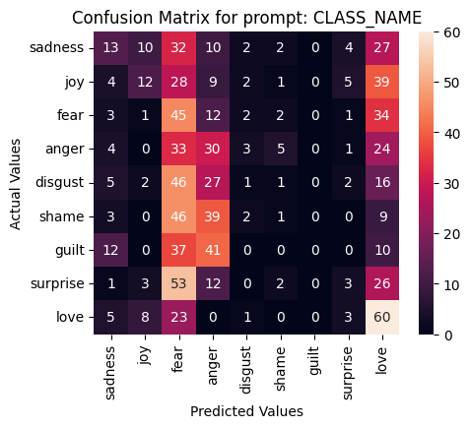
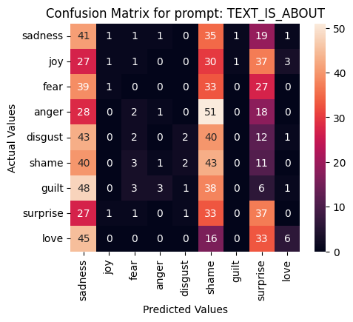
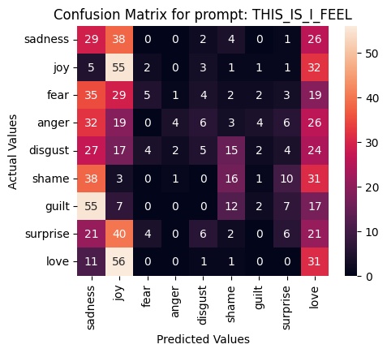
Sentiment Analysis Confusion Matrices BERT Model
# 4
# 5
# 1

Slide 24
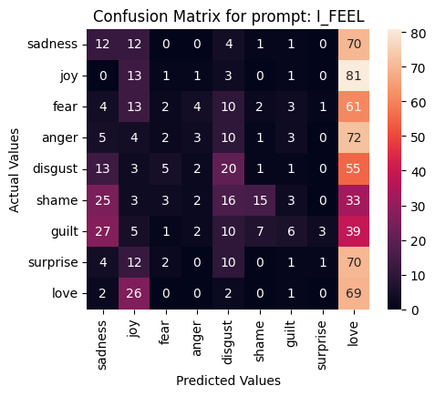
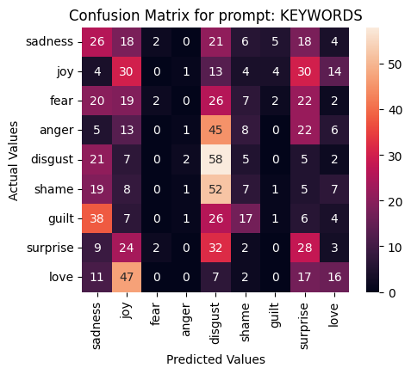
Sentiment Analysis Confusion Matrices BERT Model
# 3
# 2

Slide 25
Sentiment Analysis Confusion Matrices MPNET Sentence Model
# 5
# 3
# 1

Slide 26
Sentiment Analysis Confusion Matrices MPNET Sentence Model
# 2
# 4

Slide 27
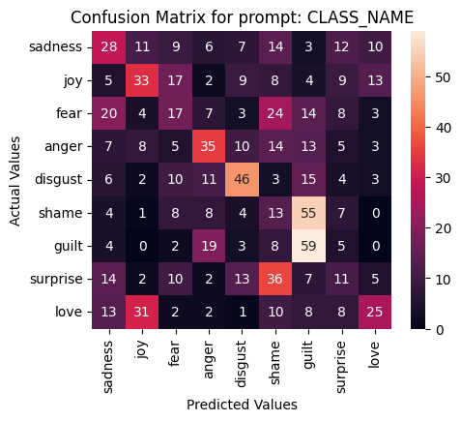
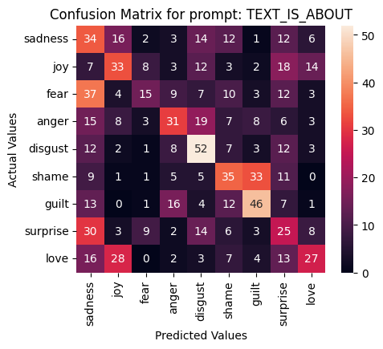
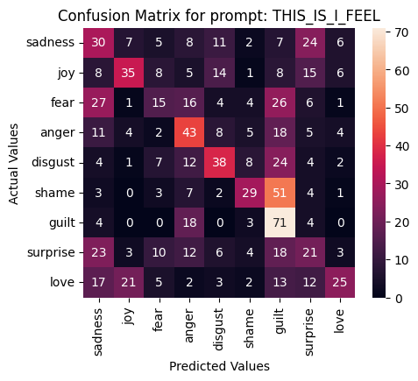
Sentiment Analysis Confusion Matrices T5-base Sentence Model
# 5
# 3
# 2

Slide 28
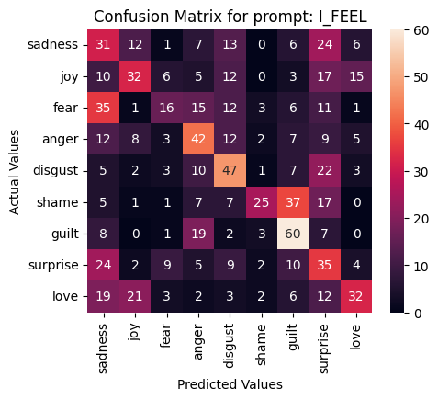
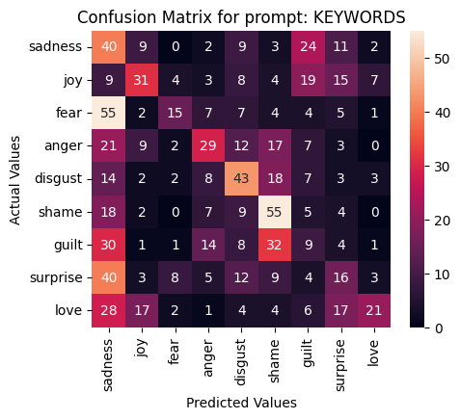
Sentiment Analysis Confusion Matrices T5-base Sentence Model
# 1
# 4

Slide 29
Conclusion about Sentiment Analysis
The sentence models that were fine-tuned on sentence similarity tasks gave better embeddings and outperformed the pretrained BERT model.
Unlike in topic classification, adding the prefix (“Text is about”) to the class name decreased the performance for the BERT model. Whereas it enhanced theperformance of the sentence models. by a significant margin.
Desiging the prompt as a personal feeling (I feel …) performed the best for all models. This emphasizes the role of the pronoun in constructing the sentence embeddings.

Slide 30

Thank you
Questions?

