Slide 1




MEDX HEALTH PLATFORM
Technical Solution Design
Consult
Records
Telehealth consultations · Patient records · Prescription tracking
High-level architecture · component design · data & storage · scalability & performance · security & compliance
Prescribe
Protect
Mini-project 5DESI · Architecture proposal · 2026
Notes:
Opening (30 s).
Good morning. We were asked to design the technical solution for MedX: a platform for teleconsultations, patient records and prescription tracking.
In the next 15 minutes I will show the architecture, how each component works, how data is stored, how the platform scales, and how it protects health data.
One idea guides every choice: MedX's own priorities. Data protection and emergency access come first; everything else is built on top of them.

Slide 2



DESIGN DRIVERS
What MedX needs — and what comes first
MEDX MISSION
H
HIGH
Non-negotiable foundations
Telehealth consultations
Encryption at rest & in transit
Patient records management
Emergency access
Authentication & authorization
Integrity & secure files
Book, meet a doctor by video, chat and share documents
M
MEDIUM
Care workflows
Patient records
A lifelong, trustworthy record — available in emergencies
Scheduling
Video · chat · files
Prescriptions
Masking & redaction
External calendars
Prescription tracking
L
LOW
Designed now, delivered last
From the doctor's signature to the pharmacy counter
Pharmacy interface
Preferences
Notification tracking
Anonymization
Payments
Refunds
High priorities become architecture principles · Medium features are built on them · Low features are designed now, delivered last
MedX · Technical Solution Design
Notes:
Design drivers (1 min).
MedX has three pillars: teleconsultation, a lifelong patient record, and prescription tracking up to the pharmacy.
The brief ranks requirements. The five HIGH priorities — encryption, records, emergency access, authentication and integrity — are not features we add at the end: they are the foundations and the non-negotiable principles of the architecture.
The MEDIUM priorities are the care workflows built on that foundation, and the LOW priorities are fully designed now but delivered last, mostly with partners such as a payment provider.

Slide 3








DESIGN TARGETS & PRINCIPLES
Sized for 10× growth, guided by eight principles
10 M
200 k
10 k
99.99 %
< 300 ms
registered patients (Year 3)
teleconsultations per day
concurrent video calls at peak
availability of emergency access
to serve a critical summary
P1
P2
P3
P4
Privacy by design
Patient safety first
Integrity first
Standards over custom
Encrypt everything, minimise, deny by default
The emergency path works when all else fails
Clinical history is never rewritten
FHIR · OpenID Connect · WebRTC · OpenAPI
P5
P6
P7
P8
Loose coupling
Reuse, then build
Scale out & automate
Observable & auditable
Domain events, one database per service
Reuse IdP, PSP, SFU — build care logic
Stateless, autoscaled, infrastructure as code
Every request traced, every access audited
MedX · Technical Solution Design
Notes:
Targets and principles (1 min).
We sized the platform for year 3: 10 million patients, 200 thousand teleconsultations a day, up to 10 thousand simultaneous video calls — and we keep a 2x headroom on top of that.
Two numbers matter most because they come from the HIGH priorities: emergency access must be available 99.99% of the time and return the critical summary in under 300 milliseconds.
The eight principles below turn the priorities into rules every team follows — for example "integrity first": clinical history is never overwritten.

Slide 4





HIGH-LEVEL ARCHITECTURE
Architecture at a glance
USERS
EDGE · PUBLIC
IDENTITY & ACCESS
EXTERNAL SYSTEMS
Patients & proxies
CDN · WAF · DDoS
① User Management + IdP
H
Policy engine (OPA)
H
Identity federation
TLS 1.3
OIDC · MFA · passkeys · roles · preferences
RBAC + ABAC · consent · masking obligations
used by ①
Doctors
CLINICAL ZONE · HEALTH DATA
External calendars
API Gateway
② Scheduling
M
③ Consultation
M
⑤ Prescription
M
JWT · rate limits
used by ②
Emergency clinicians
Booking · waitlist · urgent · calendars
Rooms · video · chat · files
E-signature · checks · tracking
Drug database
Real-time Gateway
④ Patient Records
H
Emergency Access
H
⑥ Pharmacy Interface
L
used by ⑤
Pharmacies
WebSocket
FHIR · versioned · hash-chained
Break-glass · Tier 0 · 2 regions
Inbox · status · inventory
National e-health
Media plane
used by ④ ⑤
MedX operations
SFU · TURN
⑦ Notification
L
⑧ Billing & Payment
L
SMS · e-mail · push · in-app — no health data
PSP tokens only (PCI SAQ A) · ledger
Pharmacy systems
used by ⑥
EVENT BUS · Kafka — domain events via transactional outbox · schema registry
SMS · e-mail · push
Audit trail (WORM)
Document store
Keys & secrets (HSM)
Observability & SIEM
De-identified data
used by ⑦
Payment provider
PostgreSQL ×8
Redis
Cassandra
Object storage
OpenSearch
Backups · DR
used by ⑧
MedX · Technical Solution Design
Notes:
Architecture at a glance (2 min) — the key slide.
Read it from left to right. Users reach MedX only through the edge: CDN and firewall, the API gateway, a real-time gateway for chat and live statuses, and the media plane for video.
Behind it, the eight components of the brief are microservices grouped in security zones. The identity zone decides who you are and what you may do. The clinical zone holds all health data and has the strictest controls. Notification never stores health data, and billing sits in its own payment zone.
Services talk through a Kafka event bus; shared platform services provide audit, secure documents and key management; each service owns its database.
Emergency access — in red — is deployed separately so nothing else can slow it down.

Slide 5




ARCHITECTURE LOGIC
One care journey across the services
1
2
3
4
5
Book
Consult
Document
Prescribe
Dispense & pay
② Scheduling · ⑧ Billing
③ Consultation
④ Patient Records
⑤ Prescription
⑥ Pharmacy · ⑧ Billing · ⑦
10-min slot hold + database exclusion constraint · fee pre-authorised
Waiting room · WebRTC SFU · end-to-end encryption · chat & files
FHIR note, signed · versioned · hash-chained · audited
Allergy & interaction checks · e-signature in HSM · QR verification
Pharmacy statuses · payment captured · invoice · patient notified
Kafka events: AppointmentBooked → ConsultationCompleted → RecordUpdated → PrescriptionIssued → FulfilmentStatusUpdated · PaymentCaptured
Synchronous only when a user waits
Events carry IDs, never clinical data
Transactional outbox
At most 2 hops, timeouts and circuit breakers everywhere
Consumers fetch details under their own authorization
No lost or phantom events · idempotent consumers
MedX · Technical Solution Design
Notes:
How the pieces work together (1.5 min).
Here is one care journey. The patient books: Scheduling holds the slot for 10 minutes, a database constraint makes double booking impossible, and Billing pre-authorises the fee.
They meet by video in the Consultation service; the doctor documents in the Records service, then signs a prescription, which the pharmacy receives within seconds; finally the payment is captured.
Below, the event bus: each step publishes an event. Three rules keep this robust: synchronous calls only when a user is waiting, events never carry clinical content, and the outbox pattern guarantees we never lose or invent an event.

Slide 6



HIGH PRIORITY · H4
Strong identity, fine-grained authorization
KEYCLOAK — 3 REALMS, 3 RISK PROFILES
EVERY REQUEST ON HEALTH DATA
Patients
App
API Gateway
Service (PEP)
Data
Passkey or password · risk-based MFA · biometric unlock on mobile · DPoP-bound 10-min tokens
access token
(DPoP-bound)
signature, expiry,
audience, rate limit
looks up care grant,
consent, labels
decrypt +
mask
Professionals
permit / deny
+ masking obligations
OPA sidecar
< 1 ms, no network hop
Phishing-resistant MFA always (passkey, e-CPS smart card) · step-up before signing or break-glass · 15-min idle timeout
RBAC + ABAC decision
MedX workforce
Role
doctor
+
Relationship
care grant
+
Purpose
treatment
+
Consent
labels
+
Assurance
MFA level
Corporate SSO + hardware keys · just-in-time admin, recorded · no access to health data
Policies as code: Git → unit tests → signed bundles → sidecars. Deny by default.
MedX · Technical Solution Design
Notes:
HIGH priority H4 — authentication and authorization (1.5 min).
We do not build authentication ourselves: Keycloak, a proven identity provider, handles OpenID Connect, MFA and passkeys, with three separate realms. Patients get a smooth experience; professionals always use phishing-resistant MFA and must re-authenticate before signing a prescription or breaking the glass; MedX staff never see health data.
Authorization is two layers: roles for the coarse rules, and attribute-based policies for the fine ones — is this doctor treating this patient, for which purpose, with which consent. OPA evaluates them next to every service in under a millisecond, and returns masking obligations with the decision.

Slide 7


HIGH PRIORITY · H2 · H5
Patient records: complete, correct, tamper-evident
EVERY REQUEST CROSSES THE SAME CHAIN
FHIR R4 + International Patient Summary
History is never rewritten
1
Authorization (PEP → OPA)
Standard model with validation, versioning and search — ready for national services and hospitals.
Append-only versions · signed notes, then addenda · "entered-in-error" instead of delete.
2
Validation (FHIR profiles)
3
Provenance (who, why)
Tamper-evident
Right person, right reason
4
Encryption (patient key)
Hash chain
Per-patient hash chain · daily Merkle root signed in HSM, timestamped, stored write-once.
Self · proxy · care grant (30 days) · patient share · break-glass. Pharmacists and staff: no access.
5
6
Audit (same transaction)
MASKING & REDACTION (M4)
7
Masking (obligations)
Support agent: +33 6 •• •• •• 42 · Pharmacist: no diagnosis · Break-glass: psychotherapy notes excluded · Patient: results released after review · Logs: never any PHI
MedX · Technical Solution Design
Notes:
HIGH priorities H2 and H5 — patient records (1.5 min).
Records are stored in HL7 FHIR, the healthcare standard, so validation, versioning and future integration with national services come for free.
Every request goes through the same seven-step chain on the left, so no endpoint can forget a control.
Integrity is provable: history is append-only, each version is chained by a hash, and every night the chain heads are signed in a hardware security module and stored in write-once storage — even an administrator cannot rewrite history unnoticed.
Access is explicit: the patient, a proxy, a treating doctor with a time-limited care grant, a doctor the patient shared with, or break-glass. Pharmacists and MedX staff have no access to the record.

Slide 8

HIGH PRIORITY · H3
Emergency access in seconds — accountable afterwards
1
Identify
2
Declare
3
Step-up MFA
4
Time-boxed grant
5
Summary < 1 s
Exact match only: national ID, or name + birth date + sex
Reason code + free-text justification
Passkey or smart card · entitlement & opt-out checked
4 hours · read-only · this patient only
Allergies, problems, medications, blood group, directives
≈ 30 s for the clinician · p95 < 300 ms per API call · 99.99 % availability · active in two regions
Guardrails — accountable afterwards
Tier 0 — survives failures
Audit event written in the same transaction as the grant
Real-time alert to the privacy office (SIEM)
Patient informed within 24 h: who, when, what
Mandatory review within 72 h; misuse → suspension
Patients may opt out where the law allows it
Separate deployment with reserved capacity (bulkhead)
Pre-computed summary read from local replicas
Active in the DR region with its own grant database
Token and policy checks are local (cached keys, OPA)
Audit buffered in an outbox if the pipeline is down
MedX · Technical Solution Design
Notes:
HIGH priority H3 — emergency access (2 min).
In an emergency, minutes matter, so access is never blocked by a workflow: it is narrow, time-boxed and answered for afterwards.
The clinician identifies the patient by exact match only, declares the emergency with a reason, re-authenticates with a passkey or smart card, and immediately gets a four-hour read-only grant. The International Patient Summary — allergies, problems, medications, blood group, directives — comes back in under 300 milliseconds.
Accountability: the audit record is written in the same transaction, the privacy office is alerted in real time, the patient is informed within 24 hours, and every case is reviewed within 72 hours.
And it survives failures: separate deployment, pre-computed summaries on replicas, active in two regions.

Slide 9




HIGH PRIORITY · H1 · H5
Encrypted everywhere, integrity you can prove
In transit
At rest — envelope encryption
Integrity
Apps ↔ edge
HSM root keys
ACID transactions, constraints, optimistic concurrency
TLS 1.3 · HSTS · pinning · hybrid post-quantum
FIPS 140-3 level 3 · never exported
Service ↔ service
Append-only history + per-patient hash chains
mTLS in the mesh, STRICT mode
KEK per service · env · class
in KMS · rotated yearly · every use logged
Service ↔ data
Daily signed anchors in write-once storage
TLS verify-full, short-lived credentials
Data key per patient / file / chat
Video & audio
AES-256-GCM · cached ≤ 5 min in memory
SHA-256 on every file · scanned uploads
DTLS-SRTP + end-to-end (SFrame)
Ciphertext + storage encryption
Partners
Immutable cross-account backups · weekly restore tests
two independent layers
mTLS + OAuth 2.0 · signed webhooks
Crypto-shredding: destroy a patient's keys at end of retention → every copy unreadable
MedX · Technical Solution Design
Notes:
HIGH priorities H1 and H5 — encryption and integrity (1.5 min).
In transit, there is no plaintext hop: TLS 1.3 at the edge, mutual TLS between services, verified TLS to every database, and end-to-end encryption for video. Because health data must stay secret for decades, we enable hybrid post-quantum key exchange where supported.
At rest we have two independent layers: storage encryption everywhere, plus application-level encryption with one key per patient, wrapped by keys that never leave hardware security modules. A stolen backup is useless, and destroying a patient's keys at the end of retention makes every copy unreadable.
Integrity is enforced by constraints and append-only history, and proven by hash chains, checksums and immutable backups that we restore every week.

Slide 10



MEDIUM PRIORITY · M1 – M5
Care workflows built on the secure core
Scheduling & calendars
Consultation
Prescription & masking
M1 · M5
M2
M3 · M4
10-min slot hold + database exclusion constraint → no double booking
Waitlist offers and an urgent queue for on-call doctors; red flags → call 15 / 112
Doctors notified live (WebSocket + push)
Google · Microsoft · CalDAV: free/busy only, no patient data written
Waiting room, short-lived room tokens
Self-hosted WebRTC SFU in the EU + TURN on port 443
Simulcast, audio-only fallback, auto-reconnect
End-to-end encryption for 1-to-1 · no recording
Chat with receipts · files scanned & encrypted
Allergy & interaction checks at signing
E-signature in HSM · QR code for pharmacy verification
Modify = new signed version; revoke = critical alert to the pharmacy
Pharmacists see only what dispensing requires
KEY MECHANISM
KEY MECHANISM
KEY MECHANISM
A PostgreSQL exclusion constraint on (doctor, time range) makes overlapping bookings physically impossible.
Control plane (rooms, tokens) is separated from the media plane (SFU): media never touches business services.
Two state machines — legal status (prescriber) and fulfilment (pharmacy): never "ready" on a revoked prescription.
MedX · Technical Solution Design
Notes:
MEDIUM priorities — the care workflows (1.5 min).
Scheduling: a short hold plus a database constraint make double booking impossible; waitlists and an urgent queue serve priority cases, and red-flag symptoms redirect to emergency services. External calendars are read as free/busy only — no patient data ever leaves MedX.
Consultation: a self-hosted WebRTC media server in the EU, with adaptive quality, audio-only fallback and end-to-end encryption for one-to-one calls; chat and file sharing are persisted securely.
Prescription: safety checks against the patient's allergies at signing, a signature in a hardware module, and a revocation that reaches the pharmacy as a critical alert. Masking guarantees pharmacists see only what dispensing requires.

Slide 11




LOW PRIORITY · L1 – L6
Ecosystem services — designed now, delivered last
Pharmacy interface
Notifications
L1
L2 · L3
Portal for every pharmacy + partner API with signed webhooks
Statuses: received → ready → dispensed
Inventory adapters, nearby availability
SMS · e-mail · push · in-app, with priority lanes
Preferences, quiet hours, frequency caps
Delivery & read tracking — no health data in messages
Until then: printable prescription with a verifiable QR code, usable in any pharmacy
A thin transactional version (confirmations, reminders) ships with the Medium features
Billing & refunds
Anonymization
L5 · L6
L4
PSP hosted fields → PCI DSS SAQ A
Pre-authorise at booking, capture after
Ledger, invoices, credit notes, 4-eyes refunds
Synthetic patients for dev, staging, demo
Anonymisation pipeline with k-anonymity
DPO approval · production keys unusable elsewhere
Bought, not built: the payment provider carries card data and fraud checks
Rule from day one: production health data never leaves production
MedX · Technical Solution Design
Notes:
LOW priorities — designed now, delivered last (1 min).
These services complete the platform. The pharmacy interface offers a web portal to every pharmacy on day one and an API with signed webhooks for integrated systems.
Notifications have priority lanes so a revocation alert is never stuck behind reminders, and they never contain health data.
Billing uses the payment provider's hosted fields, so card numbers never touch MedX, which keeps us in the lightest PCI scope.
And non-production environments only ever see synthetic or anonymised data.

Slide 12
DATA MODEL & STORAGE
PostgreSQL by default, specialised stores only when justified
Component | System of record | Also uses | Why
① User Management | PostgreSQL | Redis (sessions) | Identities; e-mail encrypted with blind index
② Scheduling | PostgreSQL | Redis · OpenSearch | Exclusion constraint: no double booking
③ Consultation | PostgreSQL | Cassandra (chat, 30 d) | Append-heavy chat with expiry
④ Patient Records | PostgreSQL (FHIR JSONB) | Replicas ×3 + DR | ACID, versions, hash chain · ~10 TB
⑤ Prescription | PostgreSQL | OpenSearch (drugs) | Signed, immutable versions
⑥ Pharmacy | PostgreSQL + PostGIS | Redis (availability) | Geo search, status events
⑦ Notification | Cassandra | PostgreSQL · Redis | Write-heavy log, 13-month TTL
⑧ Billing | PostgreSQL | Object storage (PDF) | Double-entry, append-only ledger
Documents | Object storage | PostgreSQL (metadata) | ~150 TB · versioning · Object Lock
Audit trail | Object storage (WORM) | OpenSearch · SIEM | Tamper-evident archive
PRINCIPLES
One database per service; references by ID only
Classify first: C0 public → C4 sensitive health data
Clinical, legal and financial data are append-only
Caches and indexes are rebuildable, never the only copy
Record kept 20 years, then crypto-shredded
Everything encrypted, private, backed up, monitored
MedX · Technical Solution Design
Notes:
Data model and storage (1.5 min).
Each service owns its database. PostgreSQL is our default because transactions and constraints protect integrity — for example the exclusion constraint that forbids double booking, or the balanced double-entry ledger.
We add a specialised store only when PostgreSQL is a poor fit: Cassandra for append-heavy logs with expiry, object storage for 150 terabytes of documents with write-once retention, Redis and OpenSearch for derived data that can always be rebuilt.
Clinical data is modelled in FHIR and kept 20 years; at the end, crypto-shredding makes it unrecoverable.

Slide 13




SCALABILITY & PERFORMANCE
Built for 10× growth, tested at 2× peak
5 k → 10 k
10 k
24 Gbit/s
150 TB
API req/s at peak → design capacity
concurrent video calls ≈ 100 SFU nodes
media egress at Year-3 peak
documents in object storage
Autoscale on the real bottleneck
Pre-compute the hot paths
Absorb peaks with Kafka
RPS, connections, queue lag, participants
Availability, emergency summaries
Priority lanes for notifications
Replicas → partitions → shards
Adaptive video
Regional cells
Records sharded by patient when triggered
Simulcast, audio-first, drain on scale-in
Isolated copies per country / population
EMERGENCY PATH LATENCY BUDGET (server side)
≈ 40–70 ms typical
300 ms objective (p95)
Gateway 5 ms · policy < 1 ms · grant + audit 15 ms · summary read 10 ms · key + decrypt 6 ms — large margin for network jitter and failover
Load, soak, chaos and WebRTC tests at 2× forecast peak before every major release · SLOs with error budgets
MedX · Technical Solution Design
Notes:
Scalability and performance (1.5 min).
At year 3 we expect about 5 thousand requests per second at peak, and we design for 10 thousand; 10 thousand simultaneous calls means about 24 gigabits per second through roughly 100 media servers.
The levers: stateless services autoscaled on their real bottleneck, pre-computed availability and summaries, Kafka to absorb peaks, and a clear database path — replicas, partitions, then sharding by patient, and finally regional cells.
The latency budget of the emergency path shows the design leaves a wide margin: about 40 to 70 milliseconds typical against a 300 millisecond objective. Everything is load-tested at twice the forecast peak before each major release.

Slide 14
RESILIENCE & DISASTER RECOVERY
Resilient by tier — emergency access survives a region loss
Tier | Scope | Availability | RPO | RTO (region loss)
Tier 0 | Emergency access, sign-in, record reads | 99.99 % | 0 in-region · ≤ 1 min | ≤ 15 min · active in both regions
Tier 1 | Records writes, consultation, scheduling, prescription | 99.95 % | 0 in-region · ≤ 1 min | ≤ 1 h
Tier 2 | Pharmacy, notification, billing, analytics | 99.9 % | ≤ 5 min | ≤ 4 h
PRIMARY · PARIS
DR · FRANKFURT
3 availability zones
Emergency Access ACTIVE
All services
Identity provider ACTIVE
DB primary + sync standby
DB replicas (lag < 1 s)
Kafka × 3 brokers
Services scaled down
async replication · encrypted
LOAD-SHEDDING ORDER UNDER EXTREME LOAD (protected first → shed first)
Emergency access
Ongoing consultations
Clinical writes
Booking
Notifications
Analytics
1
2
3
4
5
6
MedX · Technical Solution Design
Notes:
Resilience and disaster recovery (1.5 min).
Services are grouped in three criticality tiers. Tier 0 — emergency access and sign-in — targets 99.99% and keeps working even if the whole primary region is lost, because it is active in both regions.
Inside a region, every tier is replicated across three availability zones with a synchronous database standby, so losing a zone loses no data. Across regions, a warm standby receives asynchronous replication with less than a minute of potential loss; care services are back within an hour.
Under extreme load we shed in a fixed order: emergency access and ongoing consultations are protected first; analytics are sacrificed first.

Slide 15
SECURITY & COMPLIANCE
Compliance by design, not by audit
GDPR
HDS
Privacy by design
Health data (art. 9) · DPIA · DPO · 72-h breach notice
Certified hosting · data stays in the EEA
No health data in SMS, e-mail, push, calendars, events or logs
Production data never leaves production — synthetic data elsewhere
20-year retention, then crypto-shredding
Patients see who accessed their record
STRIDE threat model: 15 top threats mitigated
Pentest before launch, then yearly; ISO 27001 in year 1–2
Telemedicine rules
NIS2
Identified patient, consent, report in the record
Risk measures · incident reports 24 h / 72 h
eIDAS
PCI DSS
Prescription signatures · qualified timestamps
SAQ A: card data only at the PSP
EHDS
HIPAA-ready
Patient access & exchange · access logging
Separate US cell, same controls, BAAs
MedX · Technical Solution Design
Notes:
Security and compliance (1.5 min).
Health data puts MedX under GDPR article 9: we need a DPIA before launch, a DPO, and 72-hour breach notification. In France, hosting requires HDS certification, so we only use HDS-certified regions in the European Economic Area. Telemedicine rules, NIS2, eIDAS for signatures, PCI DSS for payments and the European Health Data Space are covered by design, and a separate US cell would make MedX HIPAA-ready.
Privacy by design is visible in concrete rules: no health data in SMS, e-mails, calendars or logs; production data never leaves production; records are crypto-shredded at the end of retention; and patients can see who accessed their record.

Slide 16
DECISIONS & TRADE-OFFS
What we chose — and what we accepted to give up
We chose | Instead of | Because | Cost we accept
Microservices in security zones | Modular monolith | H1 · H3 | Operational complexity
Break-glass + post-hoc review | Supervisor pre-approval | H3 | Possible misuse — detected & sanctioned
Per-patient envelope encryption | Disk encryption only | H1 | Key management, ~1 ms per request
Append-only history + hash chains | In-place updates | H2 · H5 | ~30 % more storage
Self-hosted SFU + end-to-end encryption | Video CPaaS | H1 · M2 | Media operations, no recording
Active-active for Tier 0 only | Full active-active | H3 | Tier 1–2 recover in 1–4 h
PSP hosted payment fields | Handling card data | L5 | Less control over payment UI
Full decision records (14 ADRs) with context, alternatives and consequences: docs/06-architecture-decisions.md
MedX · Technical Solution Design
Notes:
Key decisions and trade-offs (1.5 min).
Every decision has a cost, and we chose the cost that MedX's priorities make acceptable.
Microservices in security zones cost operational complexity, but isolate health data and the emergency path. Break-glass without pre-approval accepts that misuse is possible — it is detected, reviewed and sanctioned — because a pre-approval would be too slow at 3 am in an emergency room. Per-patient encryption adds key management; append-only history costs about 30% more storage; a self-hosted video server means operating media infrastructure and no recording; and we keep full active-active only for Tier 0 to control cost.

Slide 17
ROADMAP
Delivered in the order of MedX priorities
Phase 0
Phase 1
Phase 2
Phase 3
Phase 4
Foundations
Secure clinical core
Care workflows
Ecosystem
Scale & expand
≈ 2 months
HIGH · ≈ 4 months
MEDIUM · ≈ 4 months
LOW · ≈ 4 months
continuous
Landing zone, Kubernetes, mesh
KMS/HSM, Vault, audit, Kafka
CI/CD with signed images
Identity, OPA policies
Records, integrity, encryption
Emergency access + DR region
Scheduling + calendars
Video, chat, files
Prescriptions + masking
Pharmacy interface
Notifications, preferences
Billing, refunds, anonymisation
National e-health services
Sharding, regional cells
ISO 27001, US cell
Exit: all built from code, 100 % of stores encrypted
Exit: authz tests green, break-glass < 300 ms, DR drill
Exit: load test at 2× peak, video quality KPIs met
Exit: PCI SAQ A attested, ledger reconciled
Triggered by measured growth and new markets
Gate: DPIA · pentest · DR drill
Pilot with partner clinics
Public launch
MedX · Technical Solution Design
Notes:
Roadmap (1 min).
We deliver in the order of MedX's priorities. Phase 0 builds the platform foundations. Phase 1 delivers the secure clinical core — identity, records, integrity, emergency access and the DR region — and ends with a security gate: DPIA, penetration test and DR drill.
Phase 2 adds the care workflows and ends with a pilot with partner clinics. Phase 3 brings pharmacies, notifications tracking, billing and anonymisation, then the public launch. Each phase has measured exit criteria, not declared ones.

Slide 18


IN SUMMARY
A zero-trust, event-driven platform where health data is encrypted twice, history cannot be rewritten, and emergency access works in seconds.
Security is the foundation
Emergency access in seconds
Scales by design
TLS 1.3 / mTLS everywhere · per-patient keys in HSM · RBAC + ABAC · immutable audit
Break-glass on an isolated Tier-0 path, active in two regions, reviewed within 72 h
Events, autoscaling, replicas → shards → cells · tested at 2× peak
Questions?
Full design package: docs/ · diagrams/ · presentation/
Notes:
Conclusion (30 s).
To summarise: security is the foundation — health data is encrypted twice, every access is authorised and audited, and history cannot be rewritten. Emergency access works in seconds, even during a regional outage, and remains accountable. And the platform scales by design, from launch to ten times the load, through events, autoscaling, sharding and regional cells.
All the details — component designs, data models, capacity math, security controls and decision records — are in the repository. Thank you; I'm happy to take your questions.

Slide 19
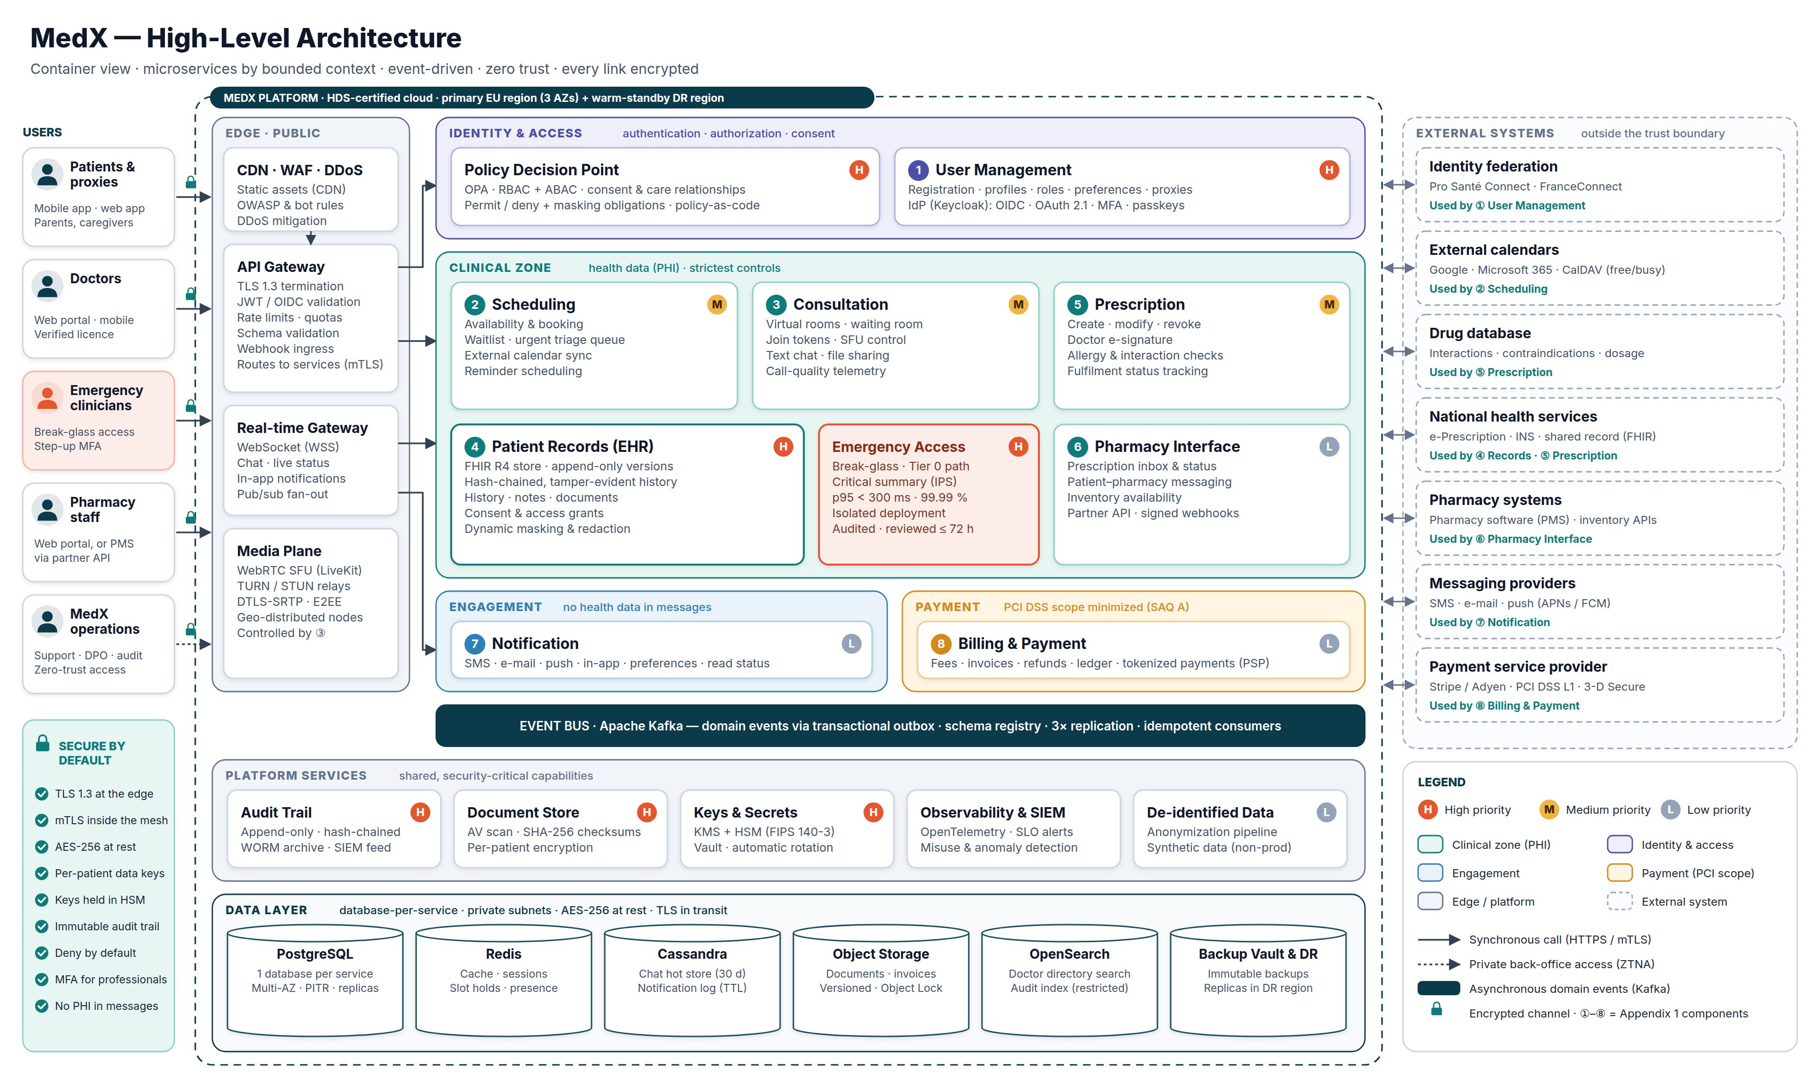
APPENDIX A1
Detailed high-level architecture
MedX · Technical Solution Design
Notes:
Detailed container view with every component, zone, platform service, datastore and external system. Use it to answer detailed questions; zoom in PowerPoint (the image is high resolution).

Slide 20
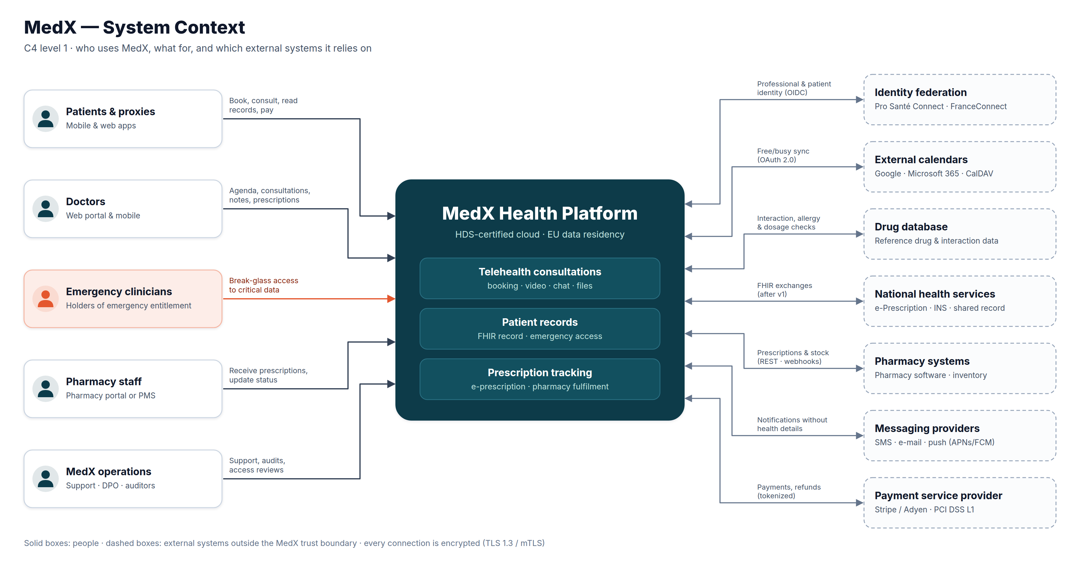
APPENDIX A2
System context (C4 level 1)
MedX · Technical Solution Design
Notes:
Who uses MedX and which external systems it depends on.

Slide 21
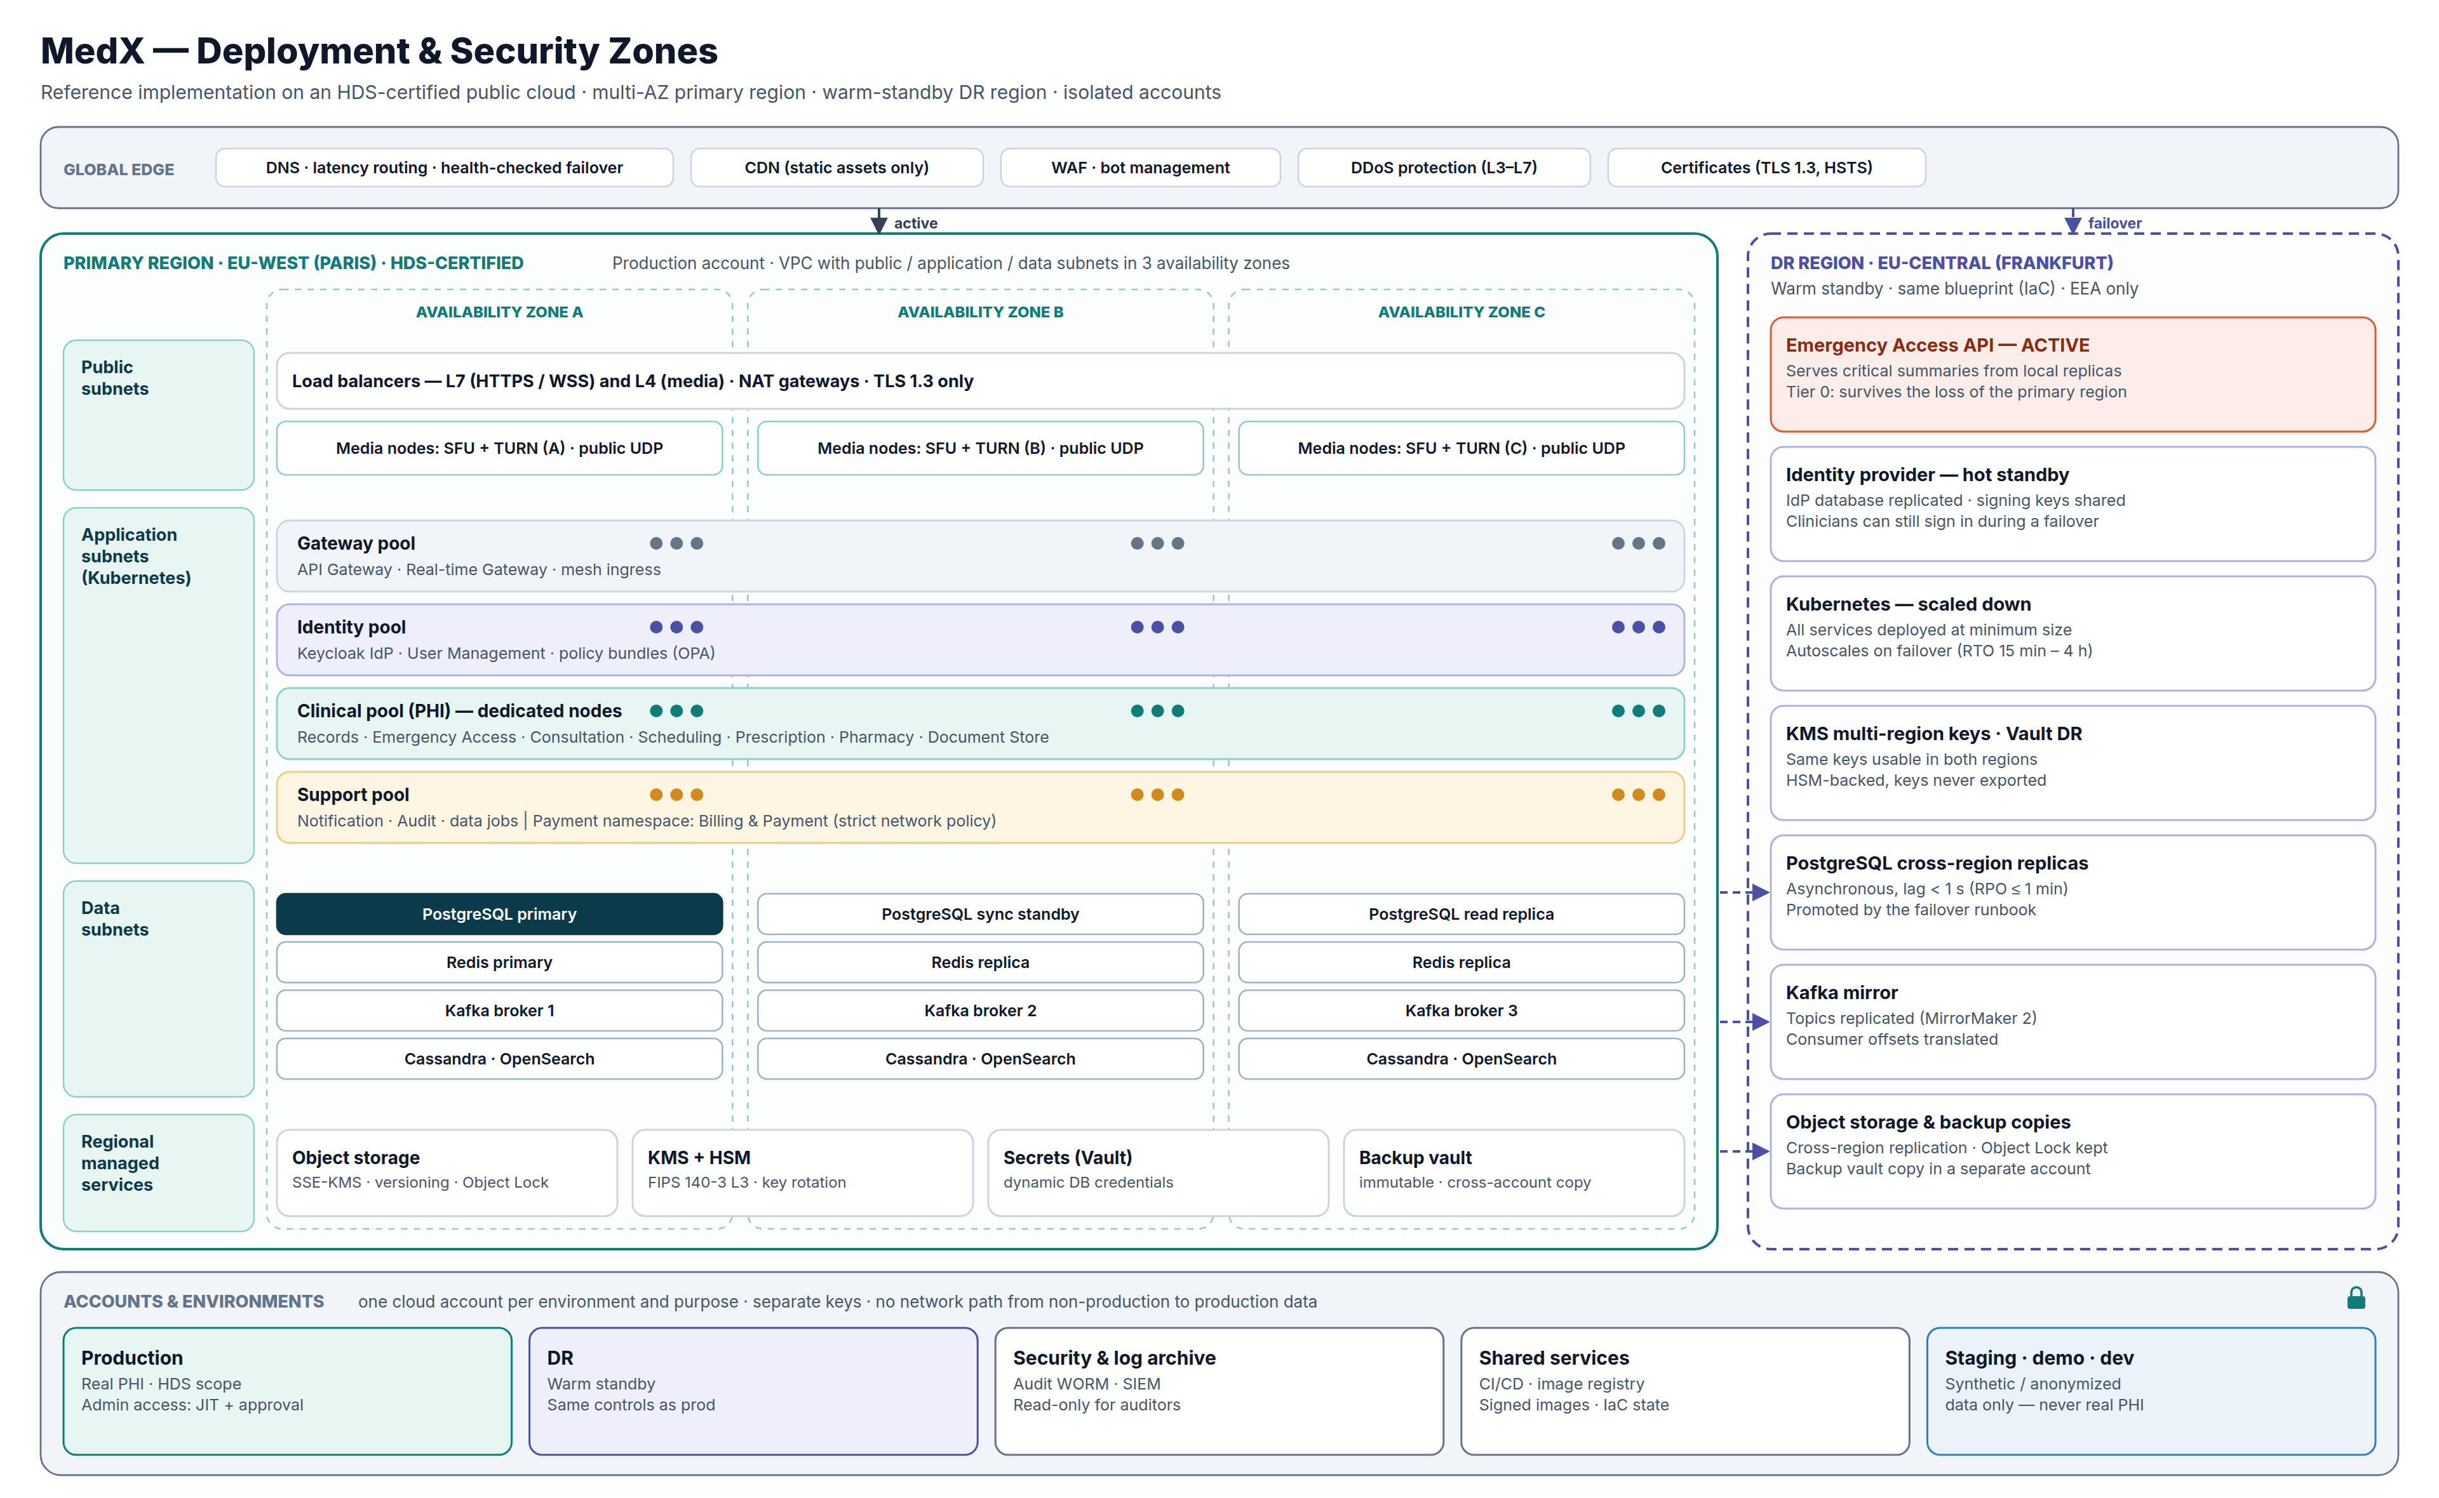
APPENDIX A3
Deployment & security zones
MedX · Technical Solution Design
Notes:
Primary region with three availability zones, warm-standby DR region, node pools per security zone, and one cloud account per environment.

Slide 22
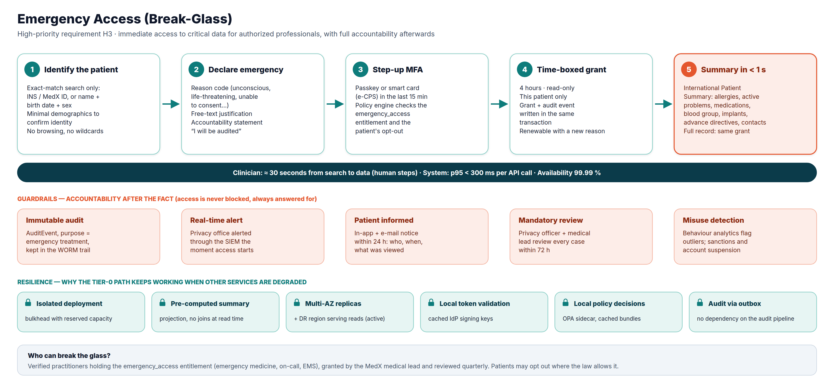
APPENDIX A4
Emergency access — detailed flow
MedX · Technical Solution Design
Notes:
Five steps, guardrails and resilience mechanisms of the break-glass capability.

Slide 23
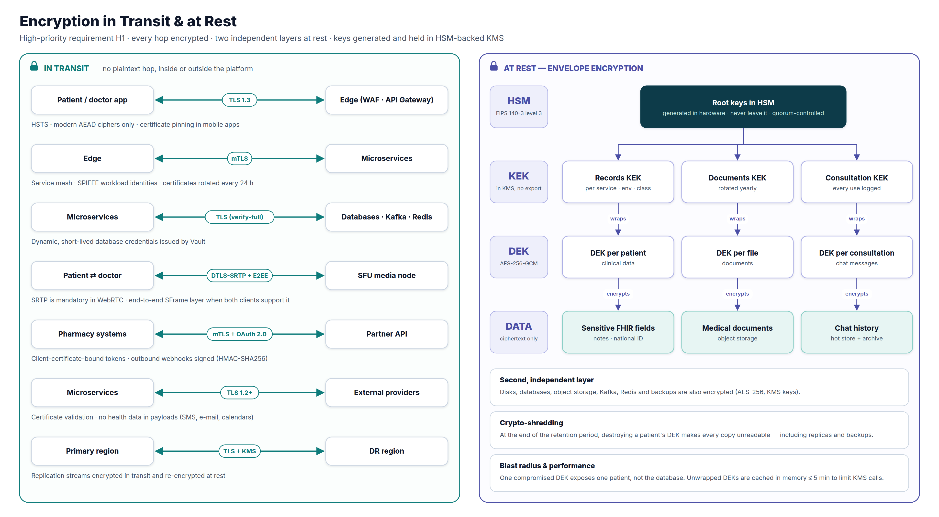
APPENDIX A5
Encryption in transit & at rest
MedX · Technical Solution Design
Notes:
Every encrypted channel and the envelope-encryption key hierarchy.

