Slide 1
Servo
Robotics Multi-Agent Assistant: a supervised team of AI specialists that takes a robotics idea from question to wiring plan to working code to a purchasable parts list.
LangGraph · FastAPI · React · MCP + Qdrant · AP2 · DigiKey · Lithic
Robotics Multi-Agent Assistant
1

Slide 2
Purpose:
“I wanted to reduce the distance between an idea… and a working robot.”
LangGraph · FastAPI · React · MCP + Qdrant · AP2 · DigiKey · Lithic
Robotics Multi-Agent Assistant
1

Slide 3
THE IDEA
One conversation, routed to the right expert automatically
A LangGraph supervisor reads the request and hands it to the specialist built for that job and lets specialists hand off to each other inside the same thread.
RAG Agent
Grounded Arduino & robotics knowledge, MCP + Qdrant
Wiring Agent
Deterministic pin planning and validation
Coding Agent
Generates & validates Arduino / Python sketches
Visualization Agent
OpenSCAD robot models + rendered previews
Component Manager
DigiKey sourcing, proposals & purchasing
Every specialist keeps its own narrow toolset; the supervisor keeps the plan coherent, and a human approves anything that writes files, renders, or spends money.
Pitch
3

Slide 4
WHO IT’S FOR
Built for people who learn robotics by building it
1
2
3
Hobbyist makers & students
Robotics course instructors
Hardware prototyping teams
Turning an Arduino/Raspberry Pi idea into a working build without juggling five reference tabs and a shopping cart.
Bootcamps and STEM programs that want students focused on concepts, not fighting toolchains.
Fast iteration from concept to a bill of materials that can actually be ordered, with an audit trail on every purchase.
Pitch
4

Slide 5
IN ACTION
One prompt → four specialists → a purchasable result
“Build me a two-wheel obstacle-avoiding robot with an ultrasonic sensor.”
1
Wiring Agent
Plans HC-SR04 + motor driver pinout, validates against the board.
2
Coding Agent
Generates the Arduino sketch (approval required before saving).
3
Visualization Agent
Builds & renders an OpenSCAD chassis preview (approval required).
4
Component Manager
Finds the sensor on DigiKey, proposes a purchase; user approves the AP2 mandate before Lithic pays.
Same chat thread, start to finish — with a human confirming every step that writes, renders or spends.
Pitch
5

Slide 6
PART TWO
Technical Stack
How the multi-agent system is actually built, orchestrated and kept safe.
Technical Stack
6

Slide 7
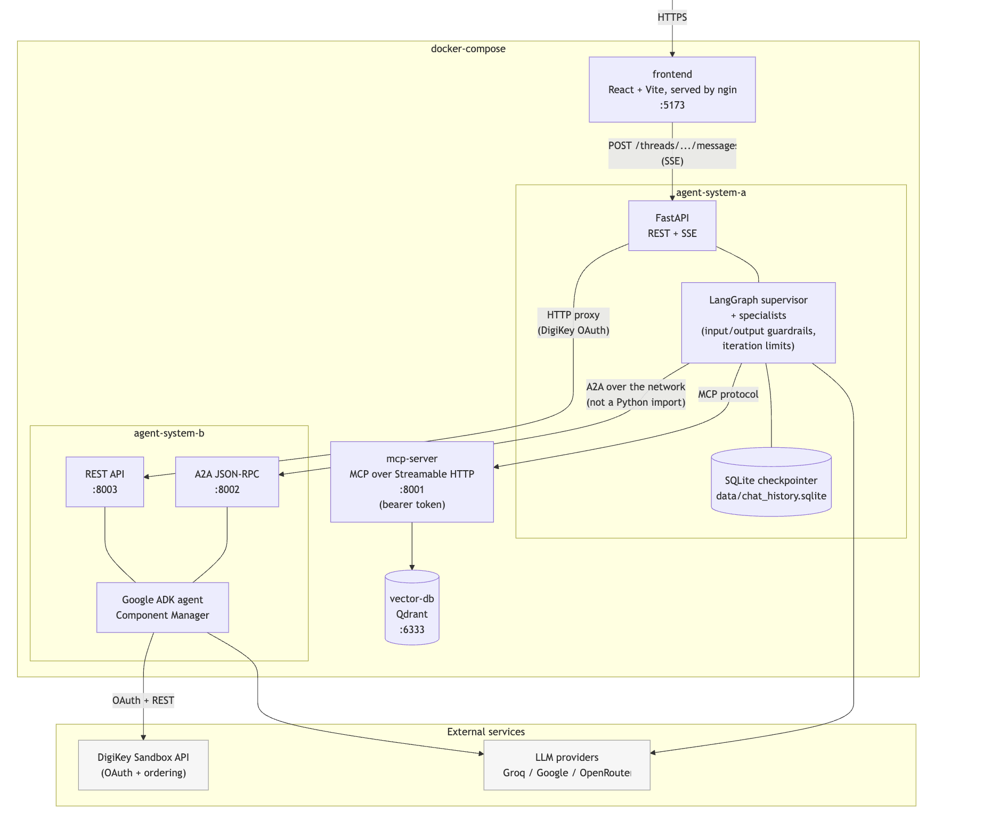
ARCHITECTURE
Four independently deployable services
Why split it up
Agent A owns conversation state, routing, approvals and payments.
Agent B owns DigiKey OAuth and sandbox ordering — reached over A2A, never imported.
The MCP service owns the embedded robotics RAG runtime and corpus.
The browser only ever talks to Agent A’s public API.
Component Manager
Agent System B
A2A + REST • :8002/:8003
DigiKey + Lithic
sandbox sourcing & payment
Technical Stack
7

Slide 8
THE AGENT ROSTER
Each specialist has a narrow job and a matched model
Component | Responsibility | Model / Mechanism
Supervisor | Selects the next specialist or finishes | Groq openai/gpt-oss-120b, structured JSON
RAG Agent | Grounded Arduino & robotics Q&A | Gemini gemini-3.1-flash-lite + MCP tools
Wiring Agent | Deterministic pin planning & validation | Groq qwen/qwen3.6-27b
Coding Agent | Generates, saves & validates code | Groq qwen/qwen3.6-27b
Visualization Agent | OpenSCAD model generation & render | Gemini gemini-3.1-flash-lite
Component Manager | DigiKey search, sourcing, purchase proposals | Google ADK agent (System B), via A2A
Guardrails / Judge | Input & output safety self-check, eval grading | Groq openai/gpt-oss-safeguard-20b
Technical Stack
8

Slide 9
TRUST & SAFETY
Nothing writes, renders, or spends without a human in the loop
Guardrails as graph nodes
Human-in-the-loop approval
Regex PII masking (emails, phones, cards, SSNs, IPs) runs before an LLM self-check on both input and output — compiled into the LangGraph itself, not bolted on.
A dedicated node calls interrupt() before any side-effecting specialist (code write, render, purchase). Approve or reject resumes the exact paused graph state via Command(resume=...).
AP2 payment mandates
Isolated payment vault
Every purchase needs an explicit user-approved mandate validating user, merchant, amount, items, expiry, nonce and single-use — before PaymentService ever runs.
The model only ever sees a payment_method_id and a display string. PANs, CVVs and Lithic API keys never enter LangGraph state, logs, or model context.
Technical Stack
9

Slide 10
FULL STACK
By layer
Layer | Technologies
Frontend | React 19, TypeScript, Vite, TanStack Query, react-markdown
Orchestration | LangGraph (supervisor graph + checkpointing), FastAPI
Models | Groq (gpt-oss-120b, qwen3.6-27b, gpt-oss-safeguard-20b), Google Gemini (gemini-3.1-flash-lite)
RAG / Retrieval | FastMCP Streamable HTTP server, Qdrant vector DB, sentence-transformers, rank-bm25 hybrid search
Commerce | Google AP2 protocol, A2A SDK, DigiKey Product Information API, Lithic Sandbox virtual cards
Voice | faster-whisper (local transcription)
Persistence | SQLite (aiosqlite) + langgraph-checkpoint-sqlite, per-service data volumes
Infra | Docker Compose — 5 services (frontend, Agent A, Agent B, MCP server, Qdrant)
Technical Stack
10

Slide 11
PART THREE
Evaluation
From 51.7% case-pass to a clean 100% — measured, not assumed.
Evaluation
11

Slide 12
METHODOLOGY
Two golden datasets, two evaluation families
Two golden datasets, graded separately
A 28-case agent dataset (routing, tools, guardrails, approvals) and a 50-question Arduino RAG dataset (retrieval ranking + RAGAS generation quality) — never blended into one score.
Independent metrics, never conflated
Route, tool selection, tool order, guardrails, approvals and project state are checked separately — case_pass is their conjunction, not a proxy.
LLM-judged task completion
For cases with a stated goal, evaluation/judge.py grades whether the final answer actually accomplished it — not a string match.
Cost & efficiency tracked per case
Every graph run is wrapped with a token-usage collector, priced against live provider rates; step_efficiency_ratio flags wasted iterations.
Metric | What it checks
route_correct | Exact specialist routing sequence
tool_selection_correct | Right tools called
tool_order_correct | Tools called in the right order
guardrail_correct | Input/output safety behavior
approval_correct | Human-in-the-loop checkpoint behavior
task_completion_correct | LLM judge: did it actually solve it
Evaluation
12

Slide 13
RAG EVALUATION — RETRIEVAL RANKING
Cross-encoder reranking, pre vs. post — K=5, 50 questions
Metric | Pre-reranker | Post-reranker | Δ
Precision@5 | 0.660 | 0.696 | +0.036
Recall@5 | 0.903 | 0.903 | +0.000
MRR | 0.852 | 0.877 | +0.026
NDCG@5 | 0.734 | 0.760 | +0.026
Precision & ranking improve
Reranking pulls the truly relevant chunk to the top more often — MRR +0.026, NDCG@5 +0.026.
Zero recall cost
Recall@5 is unchanged (+0.000) — reranking reorders the same candidate set, it doesn’t discard evidence.
Kept in the final architecture
This is configuration comparison #1: reranking on beats reranking off on every axis that moved, at no measured downside.
arduino_rag_gold_dataset_final.jsonl · dense (Qdrant) retrieval + local cross-encoder reranker
Evaluation
13

Slide 14
RAG EVALUATION — GENERATION QUALITY (RAGAS)
Three retrieval configurations, 15 questions each
Metric | Dense baseline | Hybrid (BM25+RRF+rerank) | Detailed-caption pilot
Faithfulness | 0.904 | 0.859 | 0.944
Answer relevancy | 0.878 | 0.805 | 0.875
Context precision | 0.605 | 0.702 | 0.790
Context recall | 0.967 | 0.833 | 0.967
Detailed image captioning (wiring-diagram content made retrievable as text) won on every axis with no recall tradeoff — it became the final architecture.
0.967
0.910
0.779
0.922
Faithfulness
Answer relevancy
Context precision
Context recall
Final architecture, full 30-question set — 28/30 answers scored perfect faithfulness.
Evaluation
14

Slide 15
AGENT EVALUATION — ROUTING & TOOL SELECTION
Three saved runs across three days of iteration
Run | Date | Cases | Case Pass | Route Acc. | Tool Selection Acc. | Guardrail Acc.
First_eval | Aug 18 | 29 | 51.7% | 69.0% | 75.9% | 93.1%
baseline | Aug 20 | 28 | 71.4% | 100% | 82.1% | 100%
final_submission | Aug 21 | 28 | 100% | 100% | 100% | 100%
+48.3 pp
+31.0 pp
+24.1 pp
$0.0056
case-pass rate, First_eval → final
route accuracy, First_eval → final
tool selection accuracy, First_eval → final
avg. cost per case, held flat under tighter checks
Observed: the polished 28-case set climbed to a clean 100% after iterative fixes across three saved runs — but every fix was verified by re-running those same 28 cases.
Improved: a separate 41-case held-out set (components/boards never touched while debugging) caught two real bugs this set never exercised — see the held-out slide.
Result: 100% on the polished set is real for what it tests; the held-out set's 95.1% is the more honest number for this system's actual reliability.
Evaluation
15

Slide 16
AGENT EVALUATION — CORRECTNESS
Beyond “used the right tool” — did it actually deliver?
Correctness dimension | Passed / Total | Rate
Task completion (LLM judge) | 14 / 15 | 93.3%
Approval correct | 10 / 10 | 100%
Project-state correct | 16 / 16 | 100%
Cross-artifact checks | 2 / 2 | 100%
Recovery correct | 1 / 1 | 100%
Required-tool recall | 50 / 50 | 100%
60.0% → 93.3%
Task completion rose after two fixes: the coding prompt now requires the full code in the answer text, and the judge got an evidence block crediting artifacts delivered outside the answer (images, saved files) instead of penalizing silence about them.
Remaining gap — rag_servo_pwm
Answer states a 0.5–2.5ms pulse-width range; the golden goal expects the ~1–2ms “typical hobby servo” range — a genuine, narrow factual-precision miss, left as a real signal rather than loosened.
Evaluation
16

Slide 17
AGENT EVALUATION — HELD-OUT VALIDATION
Is the 100% real, or fit to the 28 cases we iterated against?
Dataset (cases) | Case Pass | Route Acc.
Main set — iterated against (28) | 100% | 100%
Held-out set — new components/boards (41) | 95.1% | 97.6%
Observed
17 wiring cases used components/boards never touched this session (MPU6050, L298N, stepper, keypad, RFID, relay...), ground-truthed by calling the real allocator directly, not hand-predicted.
Improved
found 2 real bugs the main set never caught: wiring_agent was writing firmware code inline (bypassing coding_agent's approval gate), and intermittently skipping its own required tool call. Both fixed by scoping the prompt.
Result
39/41 (95.1%) after the fix, with both remaining failures fully characterized (one MCP transport flake, one test-authoring gap) — not mysterious, not hidden.
Evaluation
17

Slide 18
COST & EFFICIENCY
What does it cost?
$0.0056
Model | Role | $ / M input | $ / M output
gpt-oss-120b | Supervisor | 0.15 | 0.60
gpt-oss-safeguard-20b | Guardrails, judge | 0.075 | 0.30
qwen3.6-27b | Coding, wiring | 0.60 | 3.00
gemini-3.1-flash-lite | RAG, visualization | 0.25 | 1.50
Avg. cost per case
~10,143
Avg. tokens per case
Observed
cost is tracked per case via a LangChain usage callback, priced at live provider rates — a model missing from the pricing table reports null, never a silent $0.
Held flat under tighter checks
mean cost/case ($0.0056) and step-efficiency (1.00, no wasted iterations) stayed stable even as routing/tool accuracy rose to 100%.
1.00
$0.158
Mean step-efficiency ratio
Total suite cost
Evaluation
18

Slide 19
WHAT’S NEXT
Where the eval and the system still have room to grow
Specialist-level datasets
Grounded factual accuracy for RAG, compile/behavioral checks for coding, geometric + render checks for visualization — separating orchestration quality from answer quality.
Cross-framework comparison
Benchmark LangGraph against alternatives on routing clarity, HITL support, observability and recovery, not a feature checklist.
Shared cross-service state
System A and System B each keep their own SQLite file today, joined only by hand-carried IDs — a shared store would enable real cross-service queries.
Multimodal answer normalization
Flatten Gemini content blocks to plain text everywhere before they reach storage or the final response.
Evaluation
19

Slide 20
From a question to a working, ordered robot —
one conversation, fully audited.
Measured at 100% routing and guardrail accuracy, 93.3% task completion, and a fraction of a cent per request — with a human approving every write, render and purchase.
Robotics Multi-Agent Assistant
20

