Slide 1

When Satellite and Street Views Disagree:
Cross-View Complementarity in Disaster Damage Assessment
Yifan Yang, Ph.D. Student
Advisor: Dr. Lei Zou (lzou@tamu.edu)
Department of Geography, Texas A&M University
GEAR Lab Website: https://www.geoearlab.com
Notes:
Good afternoon. I am Yifan Yang from the Department of Geography at Texas A&M, and this is joint work with my advisor Lei Zou.
The title is a question we kept running into while building damage-assessment pipelines: what should we do when the satellite view and the street view disagree about the same building? This talk argues that those disagreements are not noise to average away. They are the most informative records we have.

Slide 2

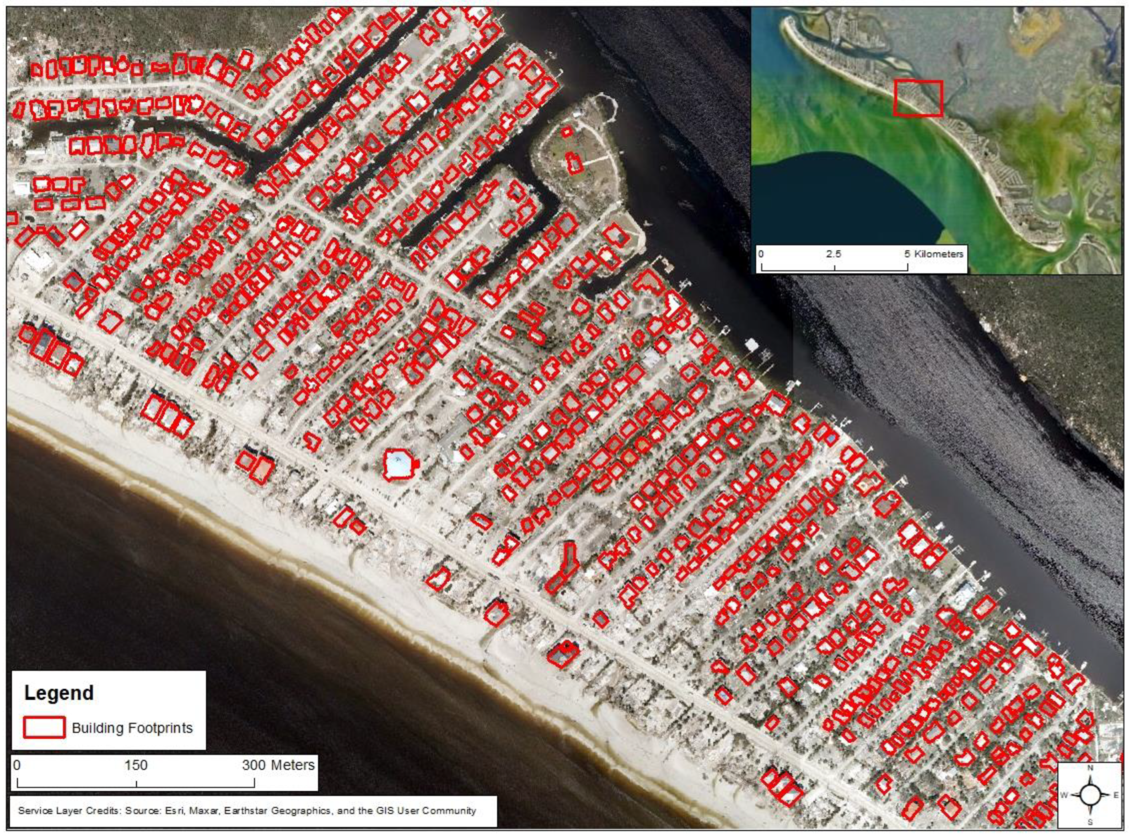
Background
Satellite imagery: rapid, large-scale observation within hours, but it mainly shows roofs
Notes:
After a disaster, satellite imagery is the first thing we get. It covers a whole region within hours, and it is the basis of standardized damage mapping such as xBD.
But from above you mostly see roofs. A roof that looks intact does not tell you what happened to the walls underneath.

Slide 3
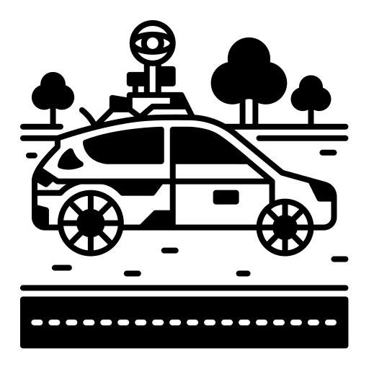
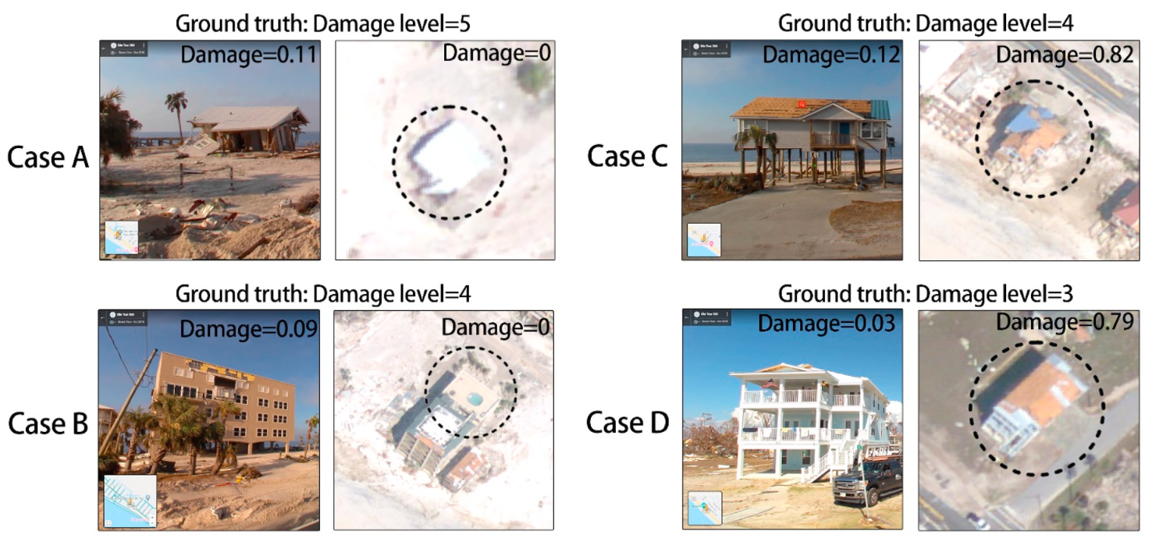
Background
Street-view imagery: facades and debris that overhead sensors cannot fully detect
Notes:
Ground-level imagery, whether crowdsourced street-view panoramas or official inspection photographs, shows the facades and the debris that overhead sensors cannot fully detect.
These four cases from our earlier hurricane work make the point: for the same structure, the street-view model and the satellite model give very different damage scores. Case A is level-5 damage from the ground and reads as zero from above. The views are complementary, and sometimes only one of them sees the damage.

Slide 4
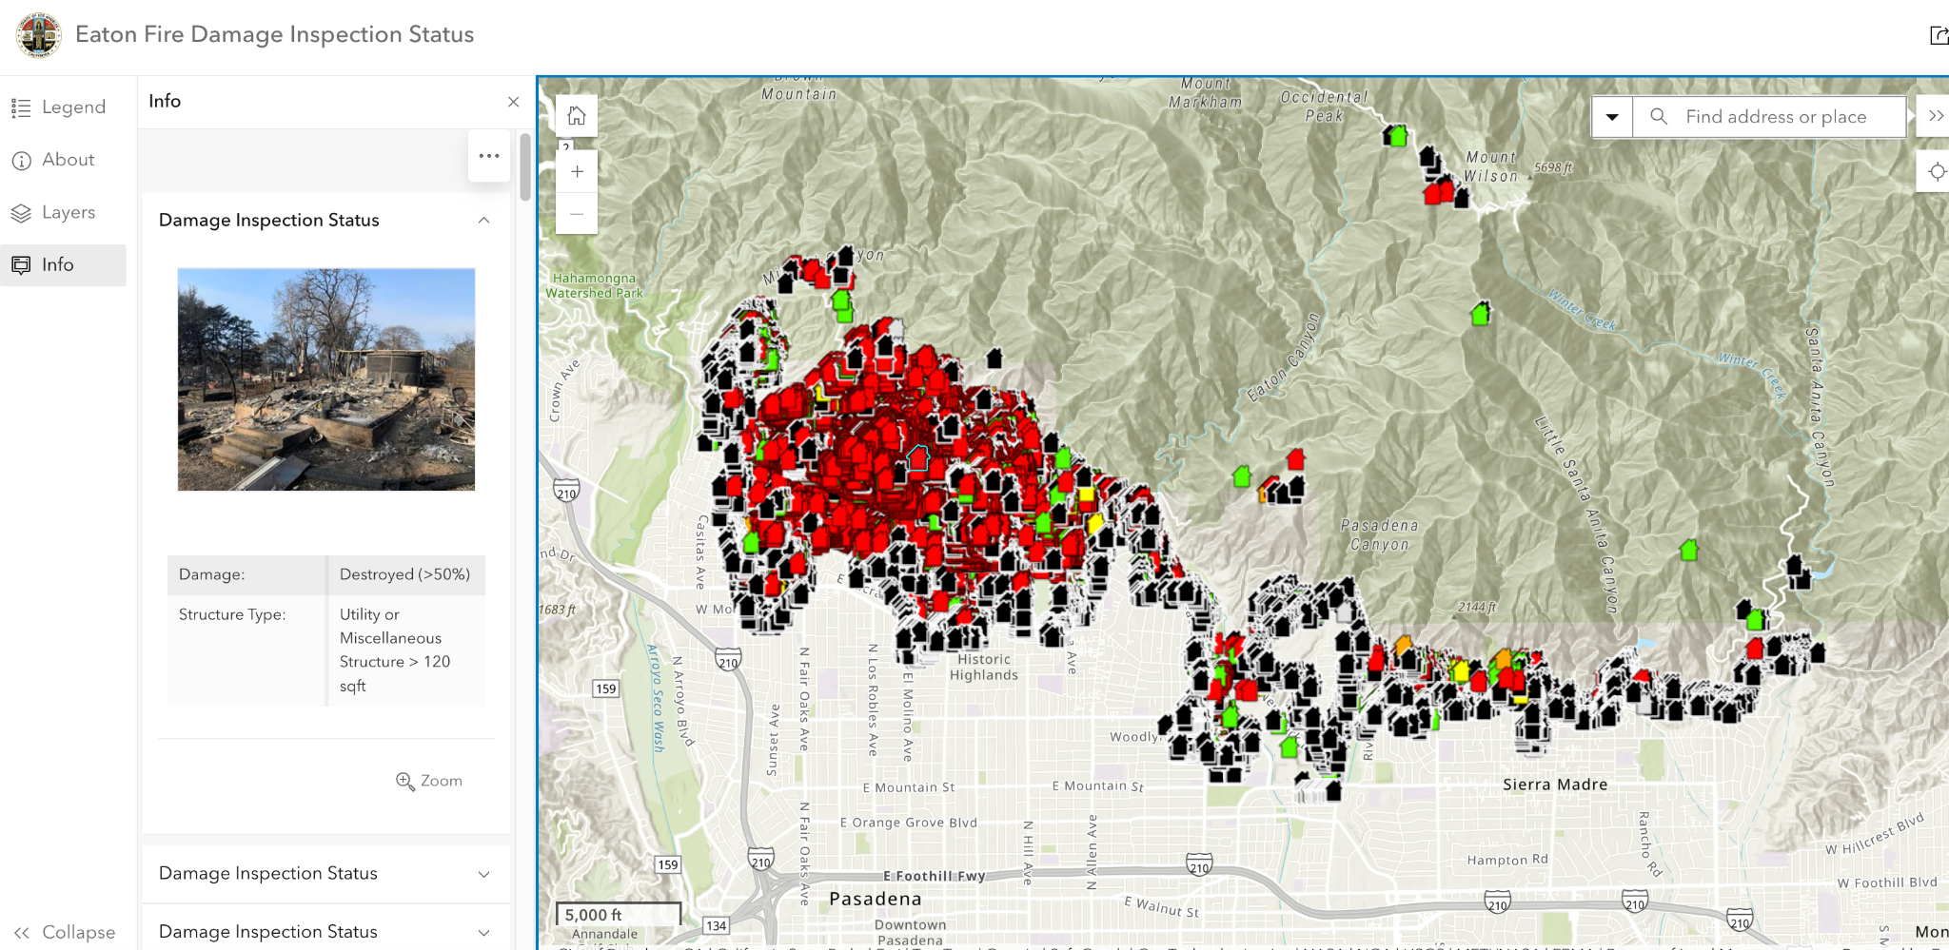
Background
Eaton wildfire, Altadena CA (Jan 2025): CAL FIRE DINS building-level damage inspections · https://lacounty.maps.arcgis.com/apps/instant/sidebar/index.html?appid=2209ecd140d8456291aeba7adbdfd69b
Notes:
One of our settings is the January 2025 Eaton fire in Altadena, California. CAL FIRE's Damage Inspection program visited every structure, photographed it, and assigned a six-level damage label.
That gives us something rare: a ground photograph that is deliberately aimed at one building, paired with a post-event satellite tile of the same parcel. Keep that word, "aimed", in mind; it becomes the key variable later.

Slide 5
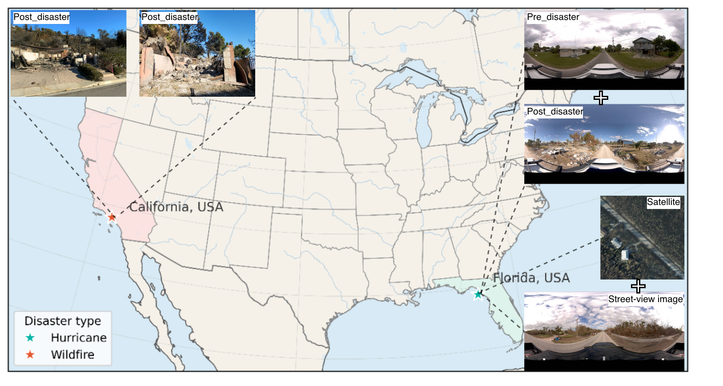

The Problem and Research Questions
Fusion papers report that combining views raises average accuracy. But for most buildings the two views agree, so the average hides whether complementary evidence is used.
We mine the conflict cases (independently trained single-view models disagree) and ask:
RQ1 How much complementary headroom do fusion methods leave on conflicts?
RQ2 Can a simple, readable gate recover part of it?
RQ3 Does aiming the ground view at the building change the value of fusion?
RQ4 Does the spatial density of conflicts track damage, without labels?
Notes:
Here is the problem. Fusion papers usually report that combining the two views raises average accuracy. That is true, but it says little about whether the complementary evidence is actually used, because for most buildings the two views simply agree.
So we focus on the conflict cases: the test samples on which two independently trained single-view models disagree. On a conflict, at least one view carries evidence the other lacks, whether damage is visible from only one side, vegetation hides the building, or the views are misaligned.
We ask four questions. One, how much complementary headroom do fusion methods leave on conflicts? Two, can a simple, readable gate recover part of it? Three, does aiming the ground view at the building change the value of fusion? And four, does the spatial density of conflicts track damage, with no labels at all?

Slide 6
Data: Three Paired Cross-View Collections
 | Eaton wildfire (Altadena, CA) | Hurricane Ian (Sanibel Island, FL) | Hurricane Milton (Florida)
Event | January 2025 wildfire | September 2022 hurricane | October 2024 hurricane
Ground view | CAL FIRE DINS inspection photos, property-centric (aimed at a building) | Mapillary 360° panoramas (CVIAN pairing, CVDisaster) | 360° street-view panoramas, built the same way
Overhead view | Post-event VHR tiles | 27 cm post-event satellite imagery | Post-event satellite imagery
Labels | Six-level DINS scale → 3 ordinal classes (no/trace, damaged–repairable, destroyed) | Three-level damage perception | Three-level damage perception
Train / val / test pairs | 6.5k / 1,966 / 1,984 | 3,248 / 573 / 300 | 1,740 / 307 / 254
Conflict rate (test) | 9.6% | 33.2% | 25.7%
Two hazards × two ground-view regimes: photographs aimed at a building vs. panoramas that are not. Eaton is split by property and tile, so all photographs of one structure fall in one partition.
Notes:
We use three paired street and overhead collections. They span two hazards and, more importantly, two ground-view regimes.
Eaton is property-centric: the DINS photographs are aimed at a building. Hurricane Ian on Sanibel Island and Hurricane Milton in Florida use 360-degree panoramas from a vehicle, which are not aimed at anything in particular.
Conflict rates on the test sets are 9.6 percent on Eaton, 33 percent on Ian and 26 percent on Milton. So conflicts are a minority, but a large one on the panoramic data.
One caveat for the record: the released Ian split has sequence overlap between train and test. A spatially blocked protocol lowers macro-F1 for every model by 5 to 10 points, so the Ian numbers should be read as in-distribution results.

Slide 7
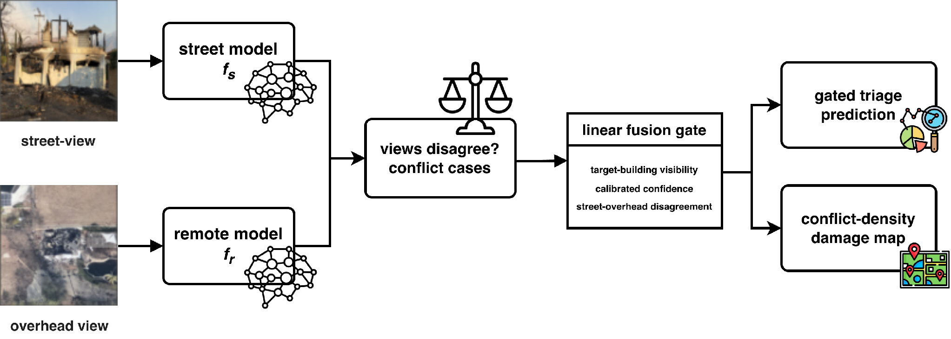
Method
Single-view models (street, remote) define the conflict cases
Oracle picks the correct single view per conflict → headroom
Linear fusion gate over 11 visibility, confidence and disagreement features
Field-of-view intervention: building-centered vs. random 90° crops
Conflict density per tile as a label-free damage map
Figure 1 of the paper. The implemented gate also mixes in the end-to-end fusion model (omitted in the diagram).
Notes:
The pipeline has four parts. Independently trained street and remote models define the conflict cases. An oracle that always picks the correct single view tells us the headroom. A linear fusion gate decides, per sample, how much weight each view gets, from building-visibility, confidence and disagreement features. And aggregating conflicts over space gives a conflict-density map that we test as a damage indicator.

Slide 8
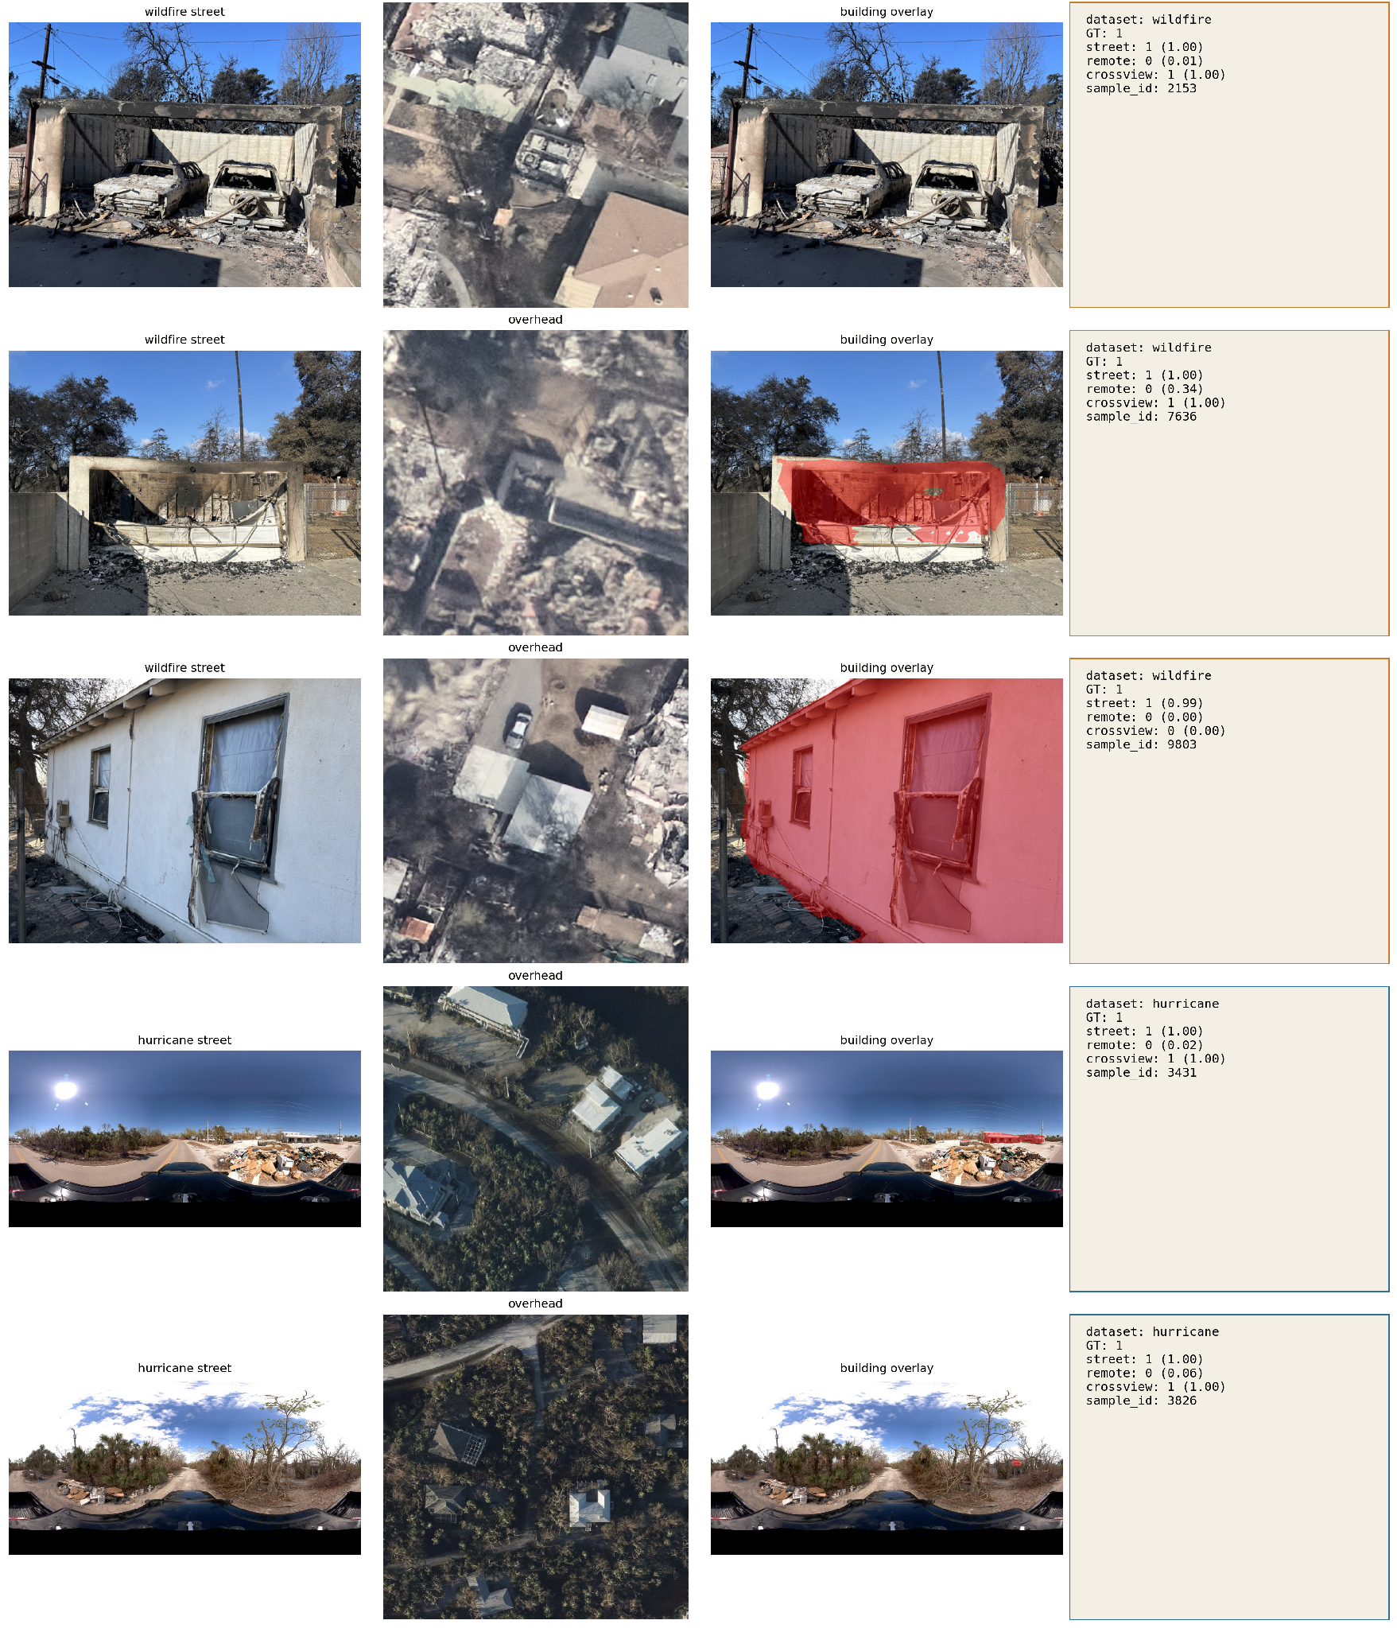
Method: Conflict Cases and the Oracle Gap
Base models, one protocol, five seeds: street_only and remote_only (ResNet-18 + linear head), concat (both encoders + MLP), crossview (learned interaction head = end-to-end fusion reference). Class-balanced CE, 224 px, AdamW, early stopping on val macro-F1.
Conflict subset: C = { x : s(x) ≠ r(x) }, the test samples where the two single-view argmax predictions differ.
Oracle single view: a conflict counts as correct if either view is correct. It measures the headroom of hard view selection between two fixed models; probability mixtures can in principle exceed it.
Oracle-gap closure: closure(m) = [acc_C(m) − acc_C(best single)] / [acc_C(oracle) − acc_C(best single)]
Calibration: one temperature per view on validation predictions; every training-free fusion baseline runs on calibrated probabilities (argmax and conflict subset unchanged).
Conflict cases: street view vs. overhead with per-model predictions (GT, street, remote, crossview).
Notes:
Some definitions, quickly. For each dataset we train four models under one protocol and five seeds: street-only and remote-only ResNet-18s, a concatenation model, and a cross-view model with a learned interaction head, which is our end-to-end fusion reference.
The conflict subset is simply the samples where the two single-view predictions differ.
The oracle counts a conflict as correct if either single view is correct. It measures how much you would gain from perfect hard selection between two fixed models. We report each method's conflict accuracy and its closure of that oracle gap, from zero at the best single view to one at the oracle.
All training-free fusion baselines run on temperature-calibrated probabilities, so miscalibration does not distort the averaging comparisons.

Slide 9
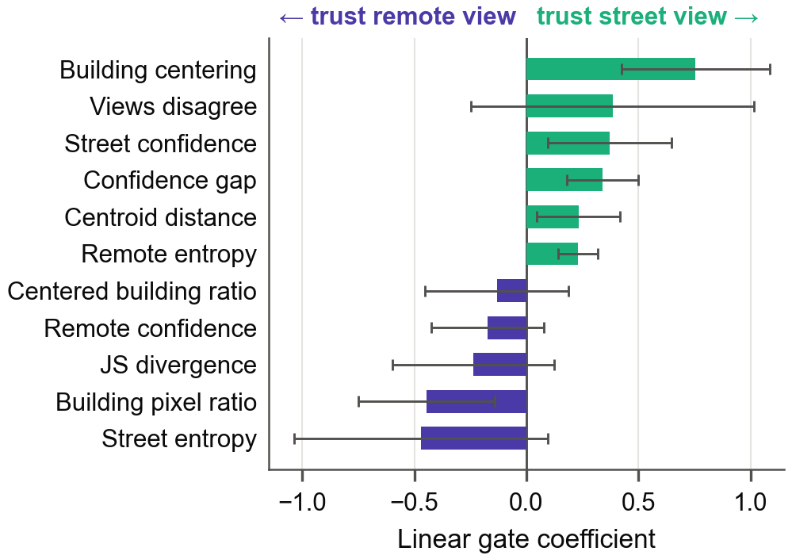
Method: Visibility-Conditioned Fusion Gate
Eleven z-scored features per sample
Building visibility (frozen SegFormer-B0, ADE20K): building pixel ratio, ratio inside a centered half-size crop, their difference (centering), normalized centroid distance from image center
Prediction cues: calibrated confidence and entropy per view, confidence gap, Jensen–Shannon divergence, disagreement flag
Mixture of experts with linear logits
p(y | x) = Σk wk(z) pk(y | x), w(z) = softmax(Wz + b), k ∈ {street, remote, crossview}
Fit on the validation split by minimizing mixture NLL. One frozen segmentation pass plus a linear fit: cheap and auditable.
Two-expert variant (street vs. remote) has a single logit, so each coefficient reads as a shift of weight toward one view (figure). A small MLP in place of the linear logits did not help on Eaton.
Two-expert gate coefficients on Eaton (mean ± std, five seeds). Positive = weight toward the street view.
Notes:
The gate uses eleven features per sample. Four describe building visibility in the street image, from a frozen SegFormer: the building pixel ratio, the ratio inside a centered crop, their difference as a centering signal, and the distance of the building centroid from the image center. Seven describe the predictions: calibrated confidence and entropy per view, the confidence gap, the Jensen-Shannon divergence, and a disagreement flag.
The gate itself is a mixture of experts with linear logits, fit on the validation split. In the two-expert version there is a single logit, so each coefficient reads directly as "shift weight toward the street view" or "toward the overhead view". A small MLP in place of the linear logits did not help, so we kept the readable version.

Slide 10
Results: Accuracy, Conflict Accuracy, Closure
Test set, five-seed means (accuracy std ≤ 0.03). Conflict accuracy on each seed’s conflict subset. Best non-oracle value per column in bold.
 | Eaton wildfire (conflict rate 9.6%) | Hurricane Ian (33.2%) | Hurricane Milton (25.7%)
Method | Acc. | Conflict acc. | Closure | Acc. | Conflict acc. | Closure | Acc. | Conflict acc. | Closure
street_only | 0.931 | 0.486 | — | 0.703 | 0.529 | — | 0.759 | 0.557 | —
remote_only | 0.929 | 0.475 | — | 0.648 | 0.367 | — | 0.721 | 0.407 | —
concat | 0.930 | 0.674 | 0.40 | 0.709 | 0.588 | 0.16 | 0.766 | 0.622 | 0.16
crossview (end-to-end fusion) | 0.940 | 0.699 | 0.45 | 0.735 | 0.624 | 0.26 | 0.776 | 0.649 | 0.23
calibrated probability averaging | 0.954 | 0.732 | 0.52 | 0.731 | 0.617 | 0.24 | 0.776 | 0.626 | 0.17
fusion gate (linear) | 0.959 | 0.768 | 0.59 | 0.731 | 0.618 | 0.24 | 0.777 | 0.631 | 0.18
oracle single view | — | 0.961 | 1.00 | — | 0.896 | 1.00 | — | 0.964 | 1.00
Fusion beats the street model on conflicts everywhere (Eaton +0.246, p < 10⁻⁴; Ian +0.078, p = 0.013; Milton +0.141, p = 0.006). Calibrated averaging is a strong baseline once single-view models are converged (Eaton 0.954 vs. 0.940 overall). The oracle dwarfs both: +0.475 / 0.367 / 0.407 over the better single view and still +0.193 / 0.272 / 0.315 over the best fusion method.
Notes:
This is the main table. Three things to read off it.
First, end-to-end fusion beats the street model on conflicts on every dataset, and the gains are significant.
Second, once the single-view models are converged and calibrated, plain probability averaging is a strong baseline. On Eaton it beats end-to-end fusion on both overall and conflict accuracy.
Third, and this is the point of the paper: the oracle dwarfs all of these differences. Picking the right single view per conflict would add 0.37 to 0.48 over the better single view, and still 0.19 to 0.32 over the best fusion method we evaluated.

Slide 11
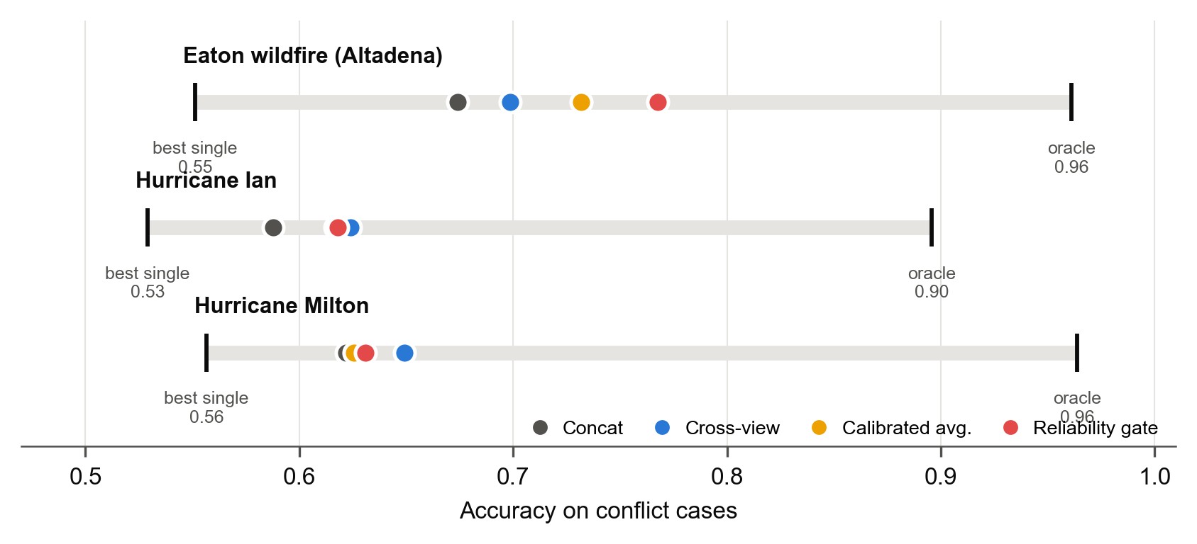
RQ1 · The Oracle Gap Dwarfs Every Fusion Gain
Each bar spans best single view → oracle on conflict cases; dots place each method. Picking the right single view per conflict would add 0.37–0.48 over the better single view; current fusion leaves most view-specific evidence unused.
Notes:
The same result as a picture. Each grey bar spans from the best single view to the oracle on conflict cases, and the dots place each method. On all three datasets the dots sit in the left third of the bar. Current fusion, including the learned one, leaves most of the view-specific evidence unused.

Slide 12
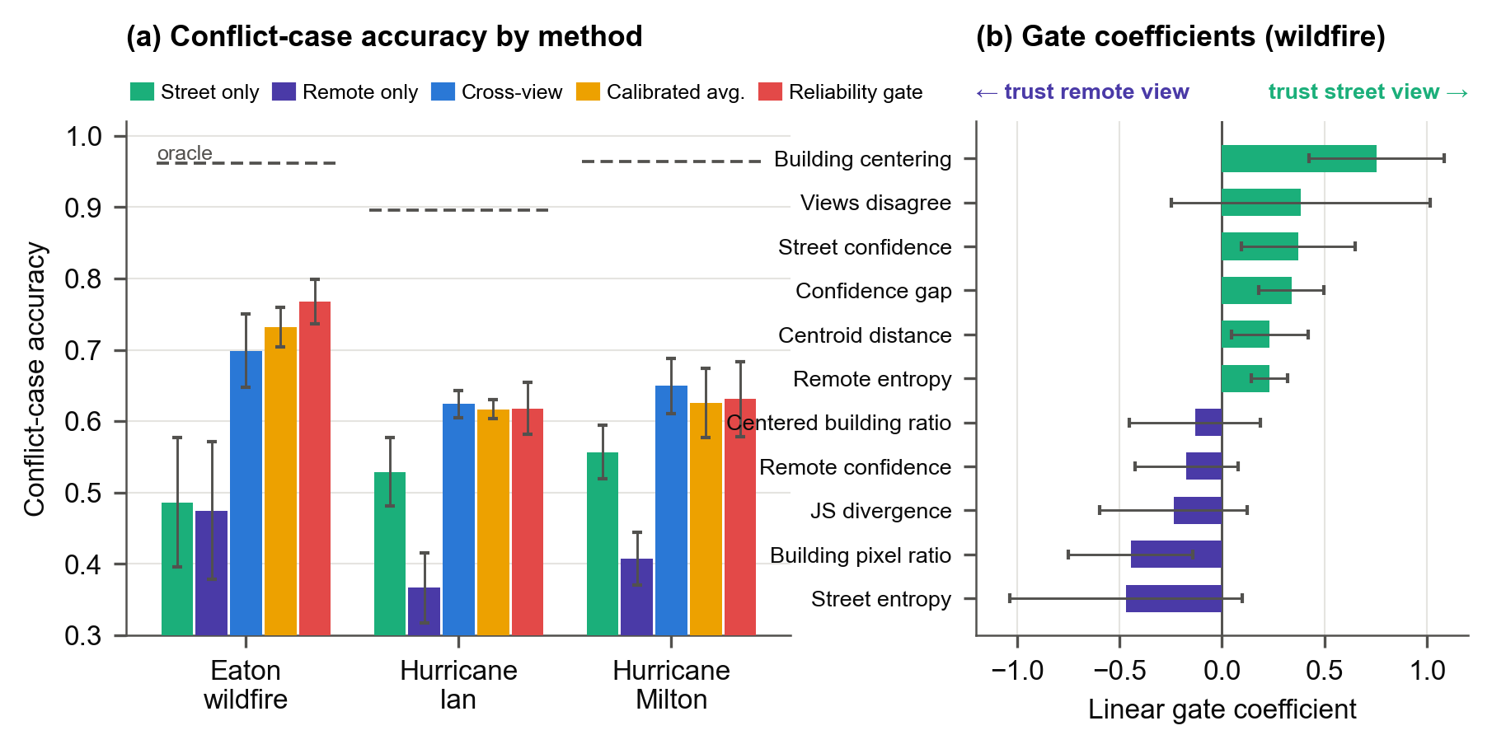
RQ2 · The Gate Helps on Building-Aimed Photos
Eaton (property-centric)
+0.072 conflict acc. vs. end-to-end fusion (p < 10⁻⁴); +0.018 on the full test set
+0.051 vs. calibrated averaging (95% CI [+0.026, +0.077], p = 0.0001)
Closure 0.59, highest in Table 1
Ian / Milton (panoramic)
Indistinguishable from end-to-end fusion (+0.005, p = 0.70; −0.015, p = 0.57)
Buildings rarely prominent: mean building pixel ratio 0.027 vs. 0.119 on Eaton
Two-expert gate alone (reweight street vs. remote only) reaches 0.734, on par with calibrated averaging and above end-to-end fusion (+0.034, p = 0.047); adding crossview as a third expert lifts it to 0.768. Largest coefficient: building centering (+0.75 ± 0.33); raw building pixel ratio is negative (−0.45 ± 0.31).
Notes:
Can a simple gate recover part of that? On Eaton, where photographs are aimed at buildings, yes. The gate gains 7 points of conflict accuracy over end-to-end fusion and 5 points over calibrated averaging, both highly significant, with a closure of 0.59, the highest in the table.
On the panoramic hurricane data the gate is statistically indistinguishable from end-to-end fusion. The reason is on the right: the building is rarely prominent in a panorama, with a mean building pixel ratio of under 3 percent versus 12 percent on Eaton, so the visibility features carry little signal.
The two-expert coefficients are the interpretable part. The largest weight is building centering, followed by the confidence gap and street confidence, while the raw building pixel ratio is negative. In words: trust the street view when it is confident and the building sits in the middle of the frame, not merely when the image is full of built-up area.

Slide 13
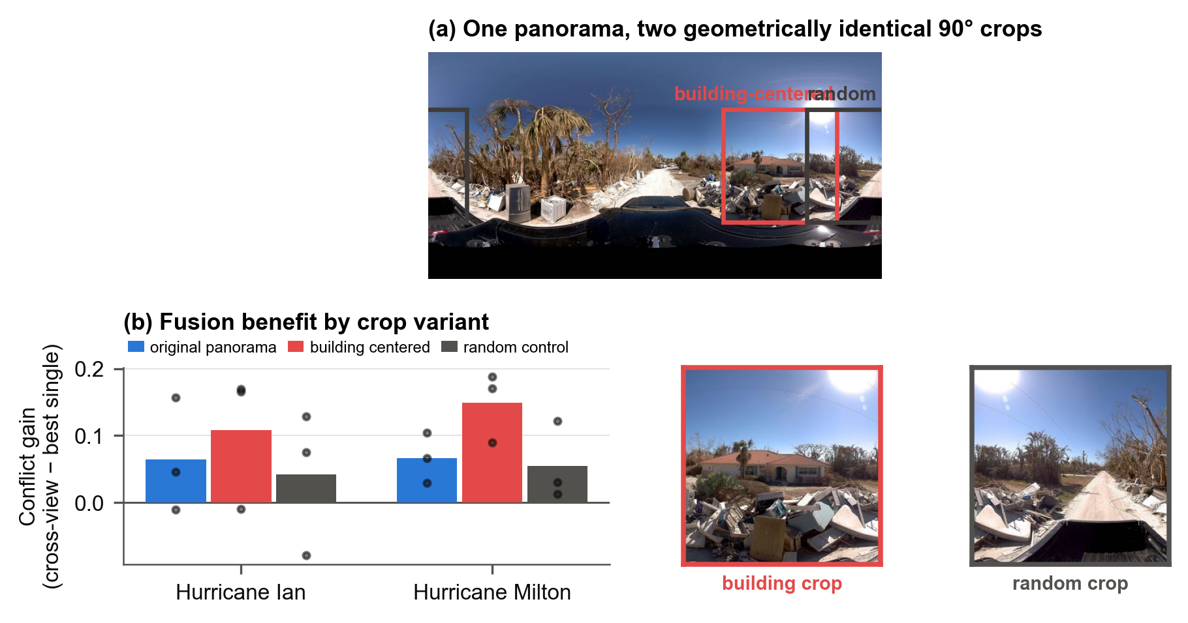
RQ3 · Aiming the Ground View at the Building Raises the Value of Fusion
Intervention
Each 1024 × 512 panorama → one 256 × 256 window with a 90° field of view, aimed at the SegFormer building azimuth or at a reproducible random azimuth. Same geometry, different pointing.
Conflict gain (crossview − best single)
Ian: 0.064 → 0.109 (random 0.042)
Milton: 0.067 → 0.149 (random 0.055)
Building − random positive in 6 / 6 dataset–seed pairs
Cropping lowers street-only accuracy yet raises the benefit of fusion, so the gain is not a stronger street model; the random control argues against a cropping artifact.
Three seeds, three-epoch schedule; remote models unchanged. A fixed-sample test with target-building annotations would be stronger evidence.
Notes:
If framing matters, we should be able to change it. We take each hurricane panorama and cut one 90-degree window: either aimed at the building azimuth from the segmenter, or at a reproducible random azimuth. Same geometry, different pointing. Then we retrain the street and fusion models.
Building-centered cropping raises the conflict gain of fusion on both hurricanes: from 0.06 to 0.11 on Ian and from 0.07 to 0.15 on Milton. Random crops of identical size do not, and the building-minus-random contrast is positive in all six dataset-seed pairs.
Note that cropping actually lowers street-only accuracy. So the gain is not a stronger street model; it is that the street view now carries evidence the overhead view lacks. Building-oriented framing is a driver of which view carries the evidence.

Slide 14
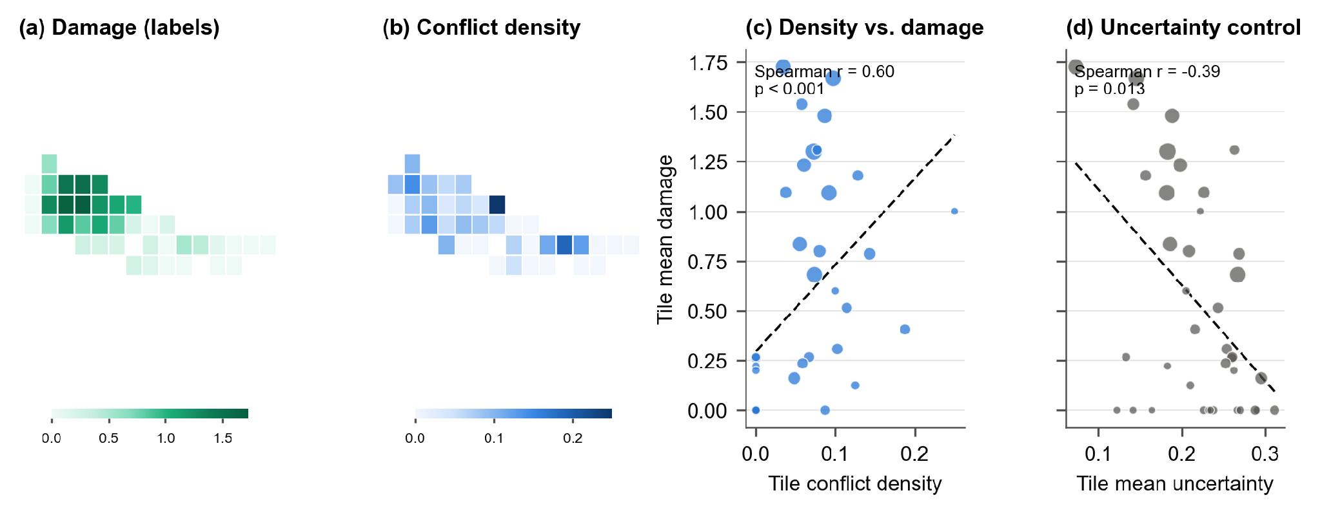
RQ4 · Conflict Density Tracks Damage, No Labels
Eaton wildfire, 0.01° grid: tile conflict density (fraction of samples where the two argmax predictions disagree) tracks labeled damage, Spearman r = 0.615 (p = 0.001, 25 tiles), with no labels needed once the models are trained. The uncertainty control anti-correlates (r = −0.37 to −0.52): parcels burned to the ground are easy, confident classifications.
Caveats: damage is spatially autocorrelated (Moran’s I = 0.27), so nominal p-values overstate the evidence; on Milton the signal is weaker and not significant (r = 0.289, p = 0.14) because better single-view models disagree less.
Notes:
Finally, a use for conflicts that needs no labels once the models are trained. We aggregate predictions to 0.01-degree tiles over the Eaton fire and compute the fraction of samples on which the two views disagree.
Panel (a) is labeled damage, panel (b) is conflict density, and they track each other with a Spearman correlation of 0.6 over 25 tiles. The control in panel (d) is single-view uncertainty, and it anti-correlates with damage, because parcels burned to the ground are easy, confident classifications. Disagreement between views is a different signal from uncertainty within a view.
Two caveats: damage is spatially autocorrelated, so the nominal p-value overstates the evidence, and on Milton the signal is weaker and not significant, because better single-view models disagree less.

Slide 15
What Conflict Cases Look Like
Wildfire, property-centric (rows 1–3)
A gutted garage or facade under a roof that still reads intact from above: the street view carries the evidence while the remote model says “no damage” with high confidence (0.01, 0.34, 0.00).
Row 3: street 1 (0.99), remote 0 (0.00), crossview 0 (0.00). End-to-end fusion followed the overhead view and missed. This is the headroom the oracle measures.
Hurricane, panoramic (rows 4–5)
The building is a small patch of the panorama; debris piles along the road drive the street prediction. Visibility cues carry little signal here, which is why the gate cannot beat end-to-end fusion on Ian and Milton.
What a conflict is and is not
We measure prediction complementarity, not which component was damaged. Conflicts may also stem from occlusion, misalignment, or label ambiguity.
Notes:
A few actual conflicts. In the wildfire rows a garage or facade is gutted while the roof still reads intact from above, so the remote model says "no damage" with near-certainty. In row three, end-to-end fusion followed the overhead view and missed as well. That is exactly the headroom the oracle measures.
In the hurricane rows the building is a small patch of the panorama and debris along the road drives the street prediction. There is little for a visibility feature to work with.
One honest note: we measure prediction complementarity, not which component was damaged. Some conflicts come from occlusion, misalignment or label ambiguity rather than from genuinely view-specific damage.

Slide 16
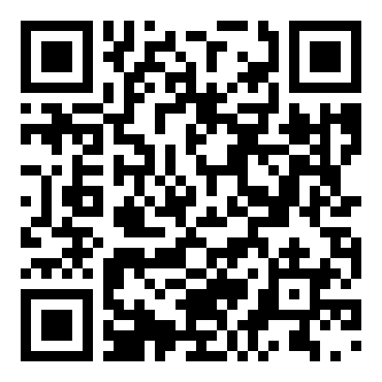
Takeaways
Conflict cases make complementarity measurable. The oracle headroom, a restricted choice between two existing models, exceeds every fusion gain we observed: current fusion leaves most view-specific evidence unused.
Which view carries the evidence depends on hazard and capture setting. On building-aimed wildfire photographs a cheap, auditable gate helps: weight the street view when it is confident and the building is centered. On hurricane panoramas calibrated averaging or end-to-end fusion suffices, and framing photographs on structures raises the value of fusion.
Spatially aggregated disagreement is a label-free damage indicator (Eaton r = 0.615), and once single-view models are converged and calibrated, probability averaging is as strong as end-to-end fusion.
Mining conflicts turns “does fusion help?” into “which view carries the evidence, where, and why?”
Code · data · paper
Yifan Yang and Lei Zou. 2026. When Satellite and Street Views Disagree: Cross-View Complementarity in Disaster Damage Assessment. In The 5th ACM SIGSPATIAL International Workshop on Searching and Mining Large Collections of Geospatial Data (GeoSearch ’26), November 03–06, 2026, Riverside, CA, USA. ACM, New York, NY, USA, 4 pages. https://doi.org/10.1145/3849732.3857333
Code, protocols and results: https://github.com/rayford295/CrossViewGate · arXiv:2610.04327
Notes:
Three takeaways. Conflict cases make the value of complementary views measurable, and by that measure current fusion leaves most view-specific evidence unused.
Which view carries the evidence depends on hazard and capture setting. On building-aimed photographs a cheap, auditable gate helps: one frozen segmentation pass and a linear fit. On panoramas, calibrated averaging or end-to-end fusion is enough, and pointing the camera at the structure raises the value of fusion.
And spatially aggregated disagreement is a label-free damage indicator.
So mining conflicts turns the question "does fusion help?" into "which view carries the evidence, where, and why?" Code, protocols and the full result tables are in the repository behind the QR code.

Slide 17
Q&A
Welcome any comments/questions
yyang295@tamu.edu
github.com/rayford295/CrossViewGate
Notes:
Thank you. I am happy to take questions, and the QR code goes to the GitHub repository with code, data pointers and the paper.

