Slide 1

RAPID: A Reproducible Multi-Agent Pipeline for Interpretable Disaster Damage Assessment from Satellite and Street-View Imagery
Yifan Yang, Ph.D. Student
Advisor: Dr. Lei Zou (lzou@tamu.edu)
Department of Geography, Texas A&M University
GEAR Lab Website: https://www.geoearlab.com

Slide 2

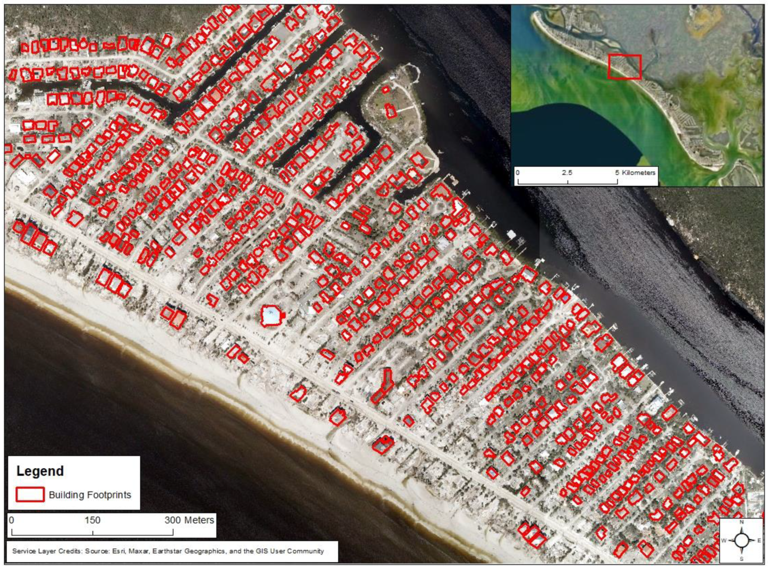
Background
Satellite Imagery--Rapid, large-scale observation immediately after disasters

Slide 3
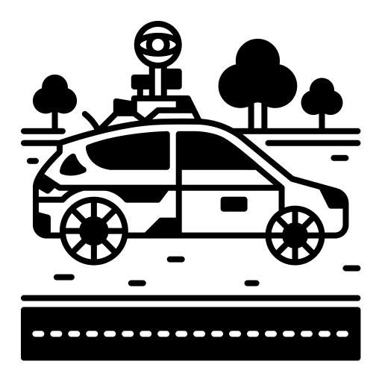
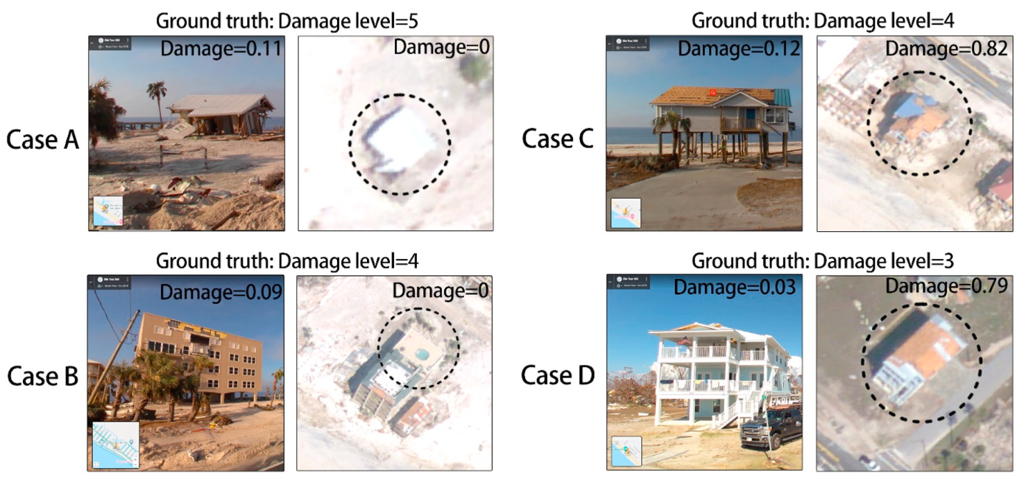
Background
Street-View Imagery-- Human-scale context, essential for structural damage assessment

Slide 4
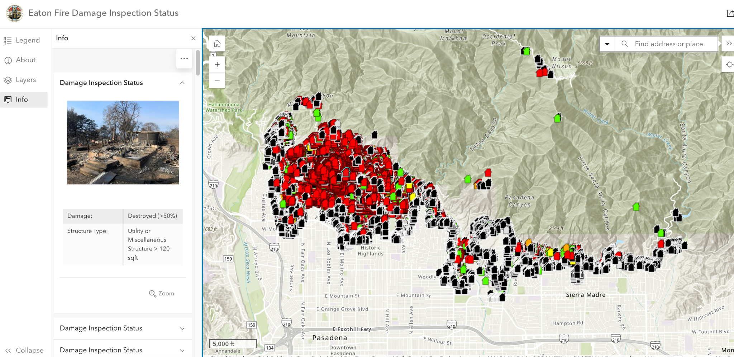
Background
https://lacounty.maps.arcgis.com/apps/instant/sidebar/index.html?appid=2209ecd140d8456291aeba7adbdfd69b

Slide 5

Background
Two Families of AI — (Discriminative vs. Generative)
Discriminative AI
Generative AI
Designed for closed-ended questions with labeled answers (such as "what is it" or "to what extent"):
"Is this building damaged?"
"What is the extent of the damage—none/minor/severe/total destruction?"
Open-ended/Constructive Questions ("What is missing? / What if...? / How should it be presented, and why?")
"Why was this location assessed as severely damaged? What actions should rescue personnel take here?"
Notes:
Discriminative AI is designed for closed-ended questions with labeled answers. For example: is this building damaged? Is the damage mild, moderate, or severe? These models are useful when we have defined classes and training data.
Generative AI addresses a different set of questions. It can describe a scene, explain what evidence supports an assessment, reason about missing information, and produce reports for human users. For example, it can answer why a location appears severely damaged and what response actions may be relevant.
The dissertation does not treat these two families as competitors. Instead, I use them as complementary components in a broader geospatial intelligence workflow.

Slide 6
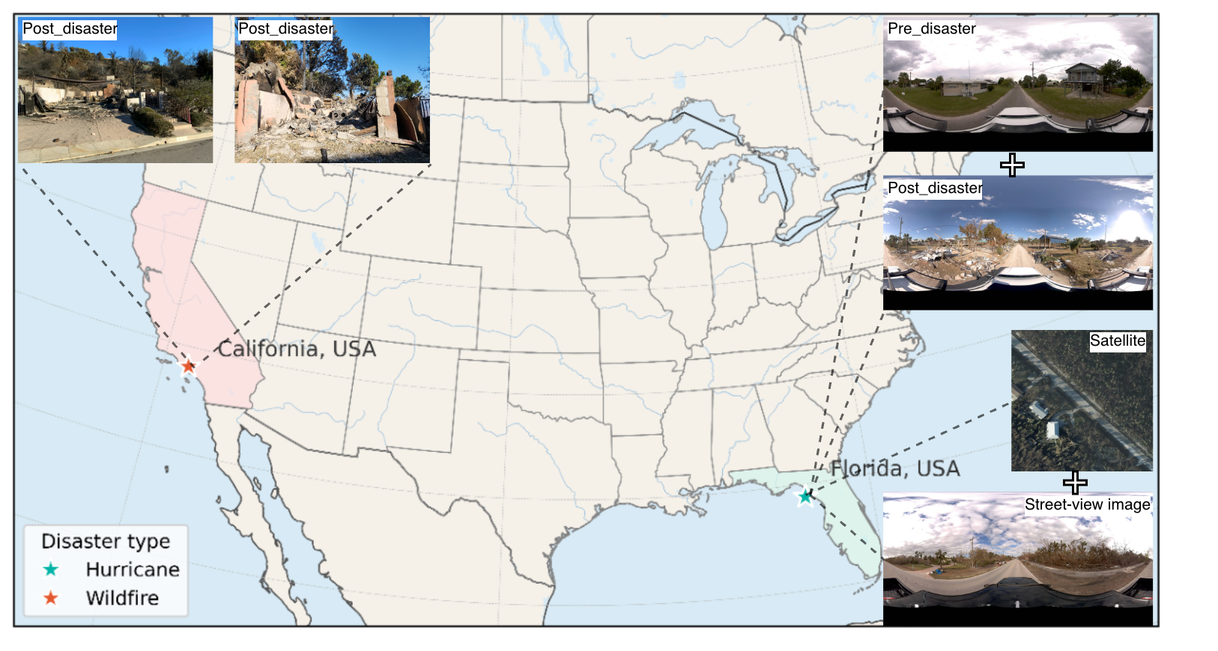
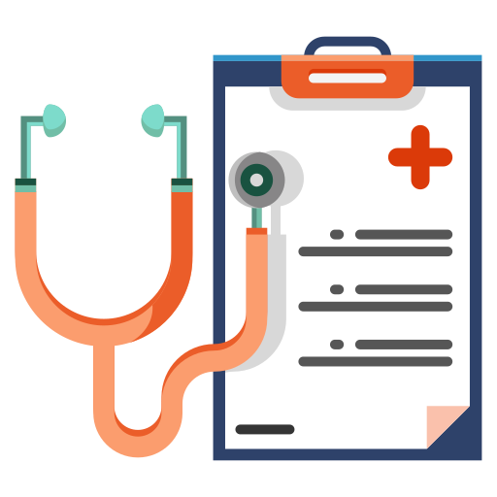
Research Question
Research Question
Can RAPIDmap support:
• Cross-view assessment?
• Different regions and hazards?
• Rapid zero-shot reasoning?
• Interpretable damage reports?

Slide 7
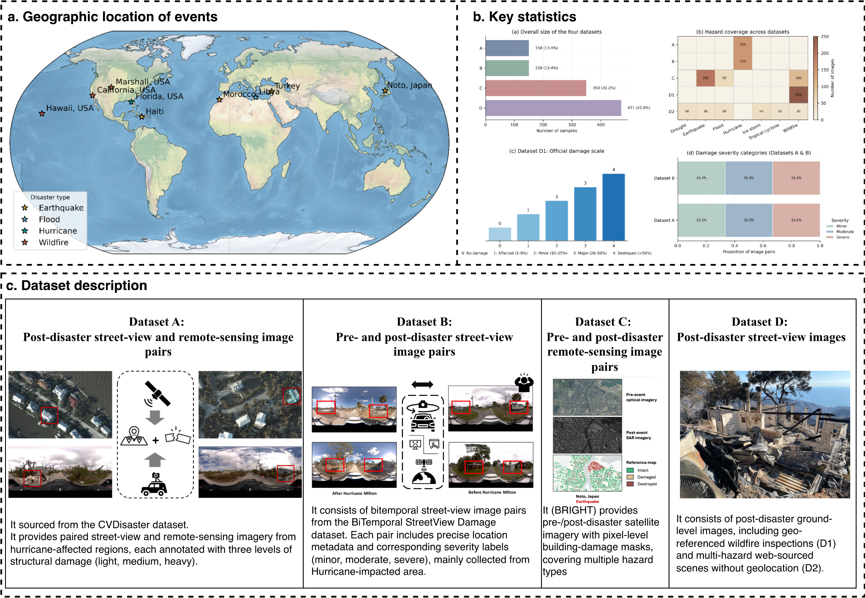
Dataset
Notes:
The objectives are:
(1) to assess the performance gains of incorporating pre-disaster street-view images as a no-damage category
(2) to design and evaluate a dual-channel algorithm that reads pair-wise pre- and post-disaster street-view images for hyperlocal damage assessment.

Slide 8
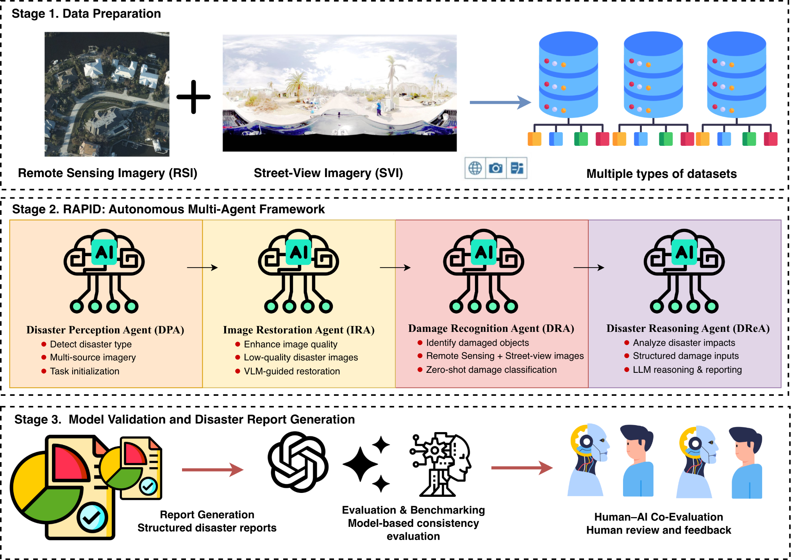
Method
• Cross-view imagery input
• Zero-shot multi-agent assessment
• Structured report generation

Slide 9
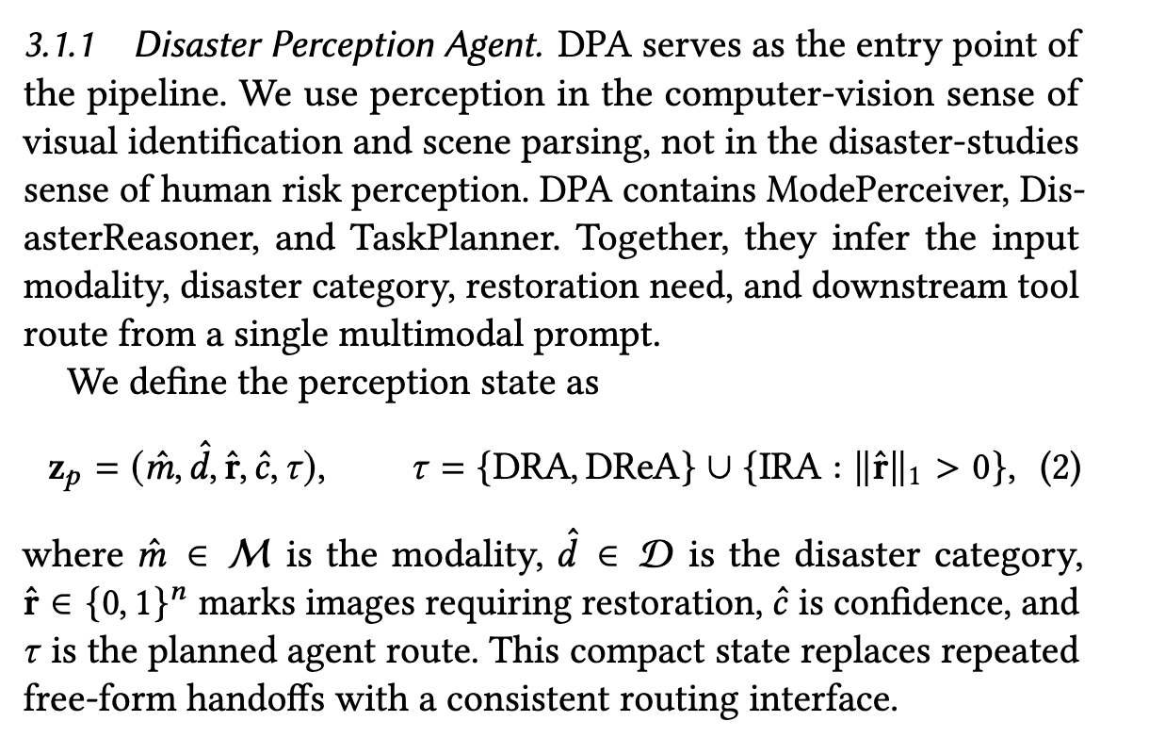
Components of the Multi-Agent Framework: Disaster Perception Agent

Slide 10
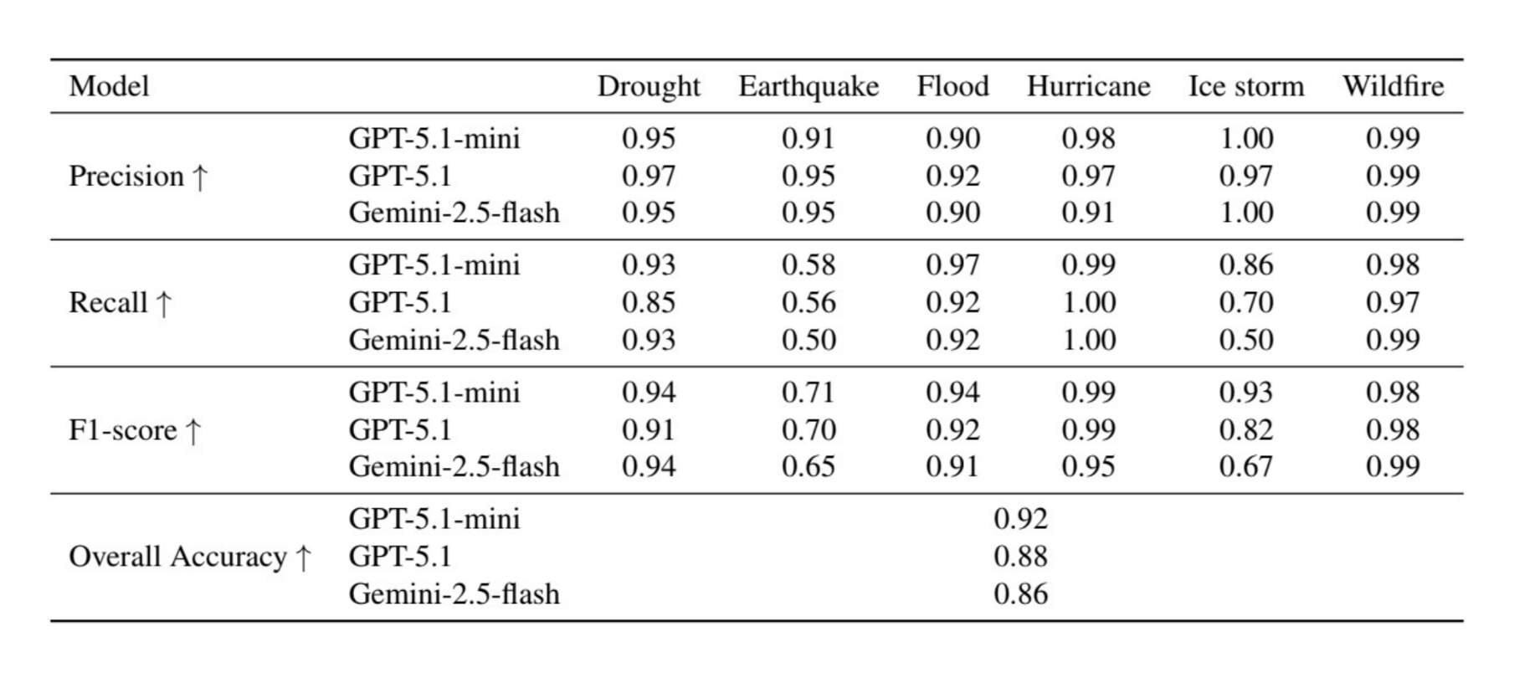
Components of the Multi-Agent Framework: Disaster Perception Agent

Slide 11
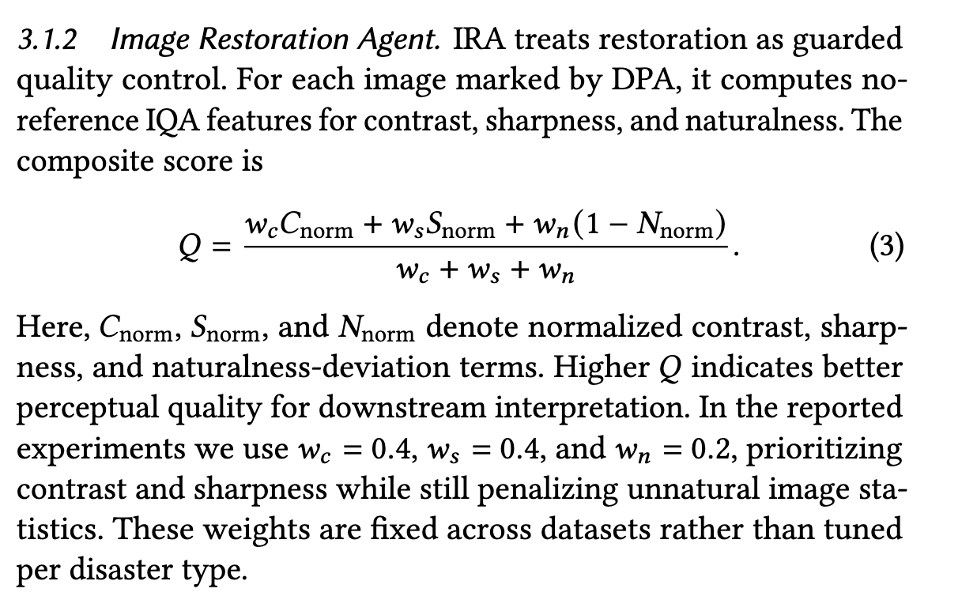
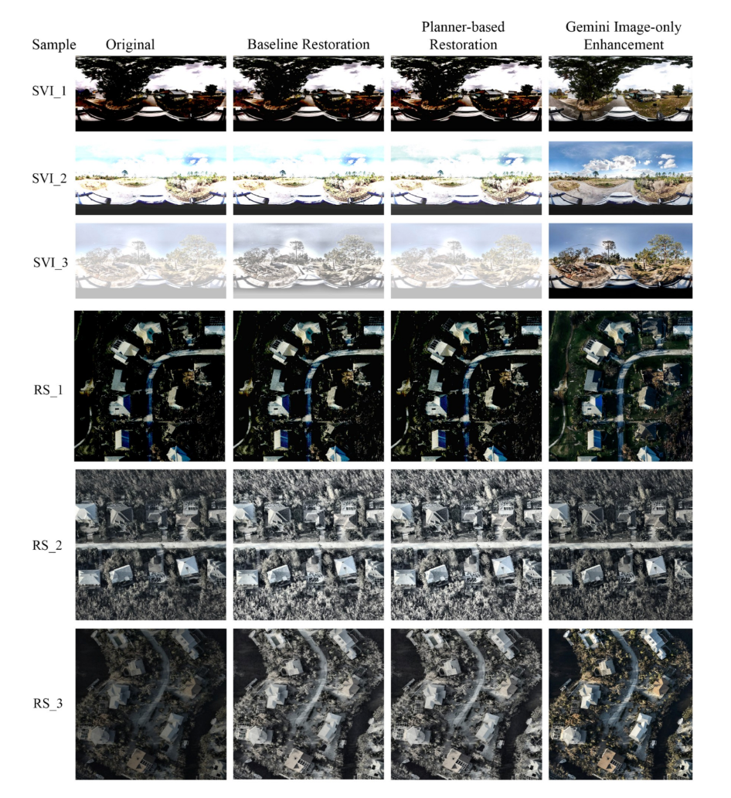

Components of the Multi-Agent Framework: Image Restoration Agent

Slide 12
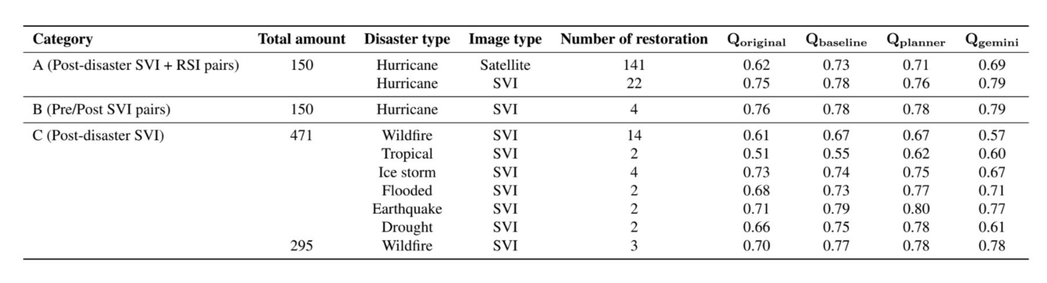
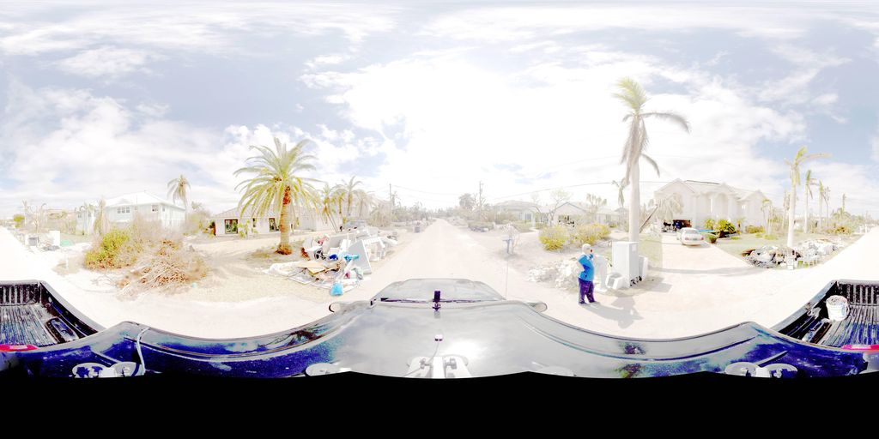
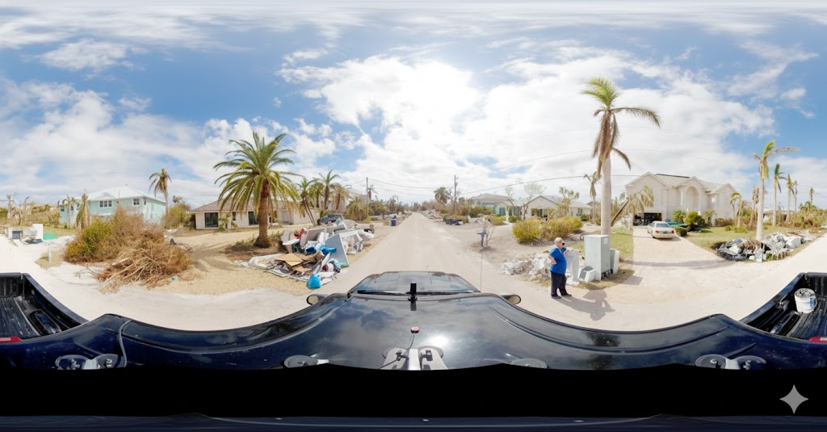
Components of the Multi-Agent Framework: Image Restoration Agent

Slide 13
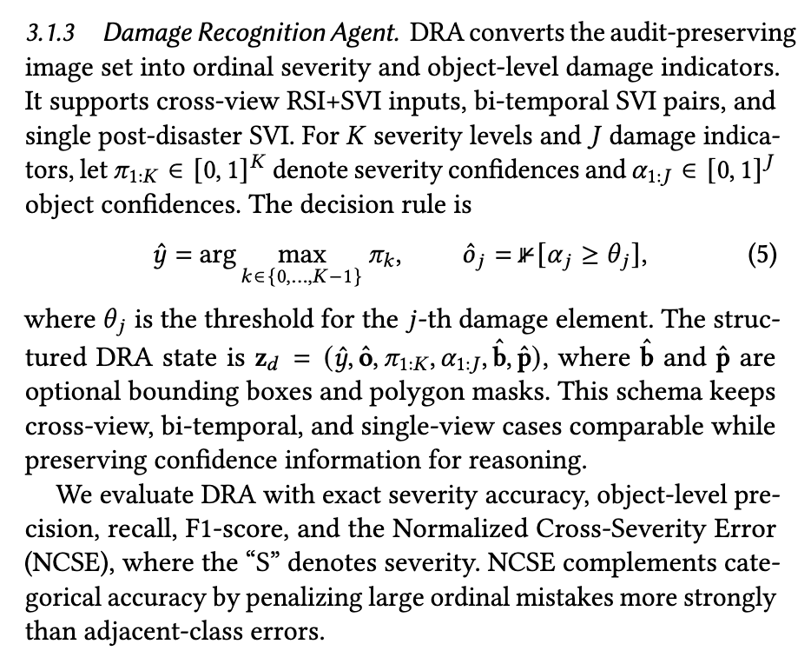
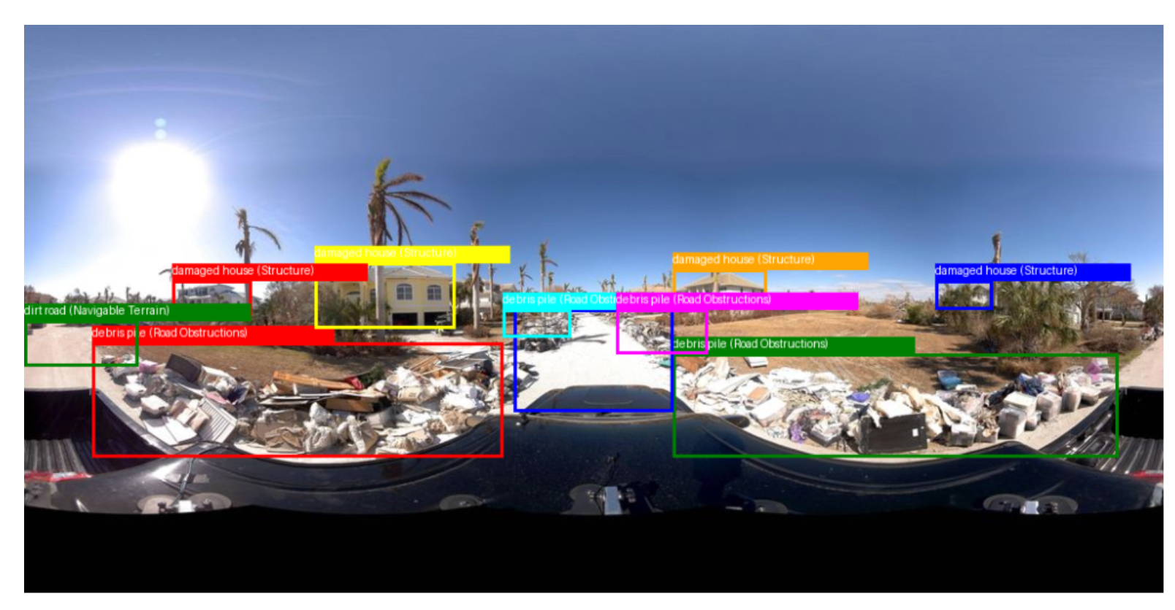

Components of the Multi-Agent Framework: Damage Recognition Agent

Slide 14
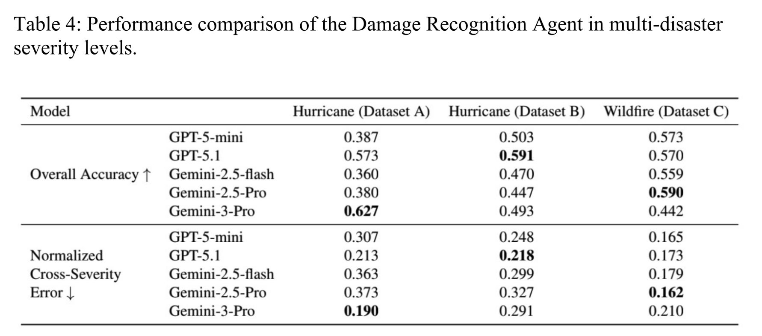
Components of the Multi-Agent Framework: Damage Recognition Agent

Slide 15
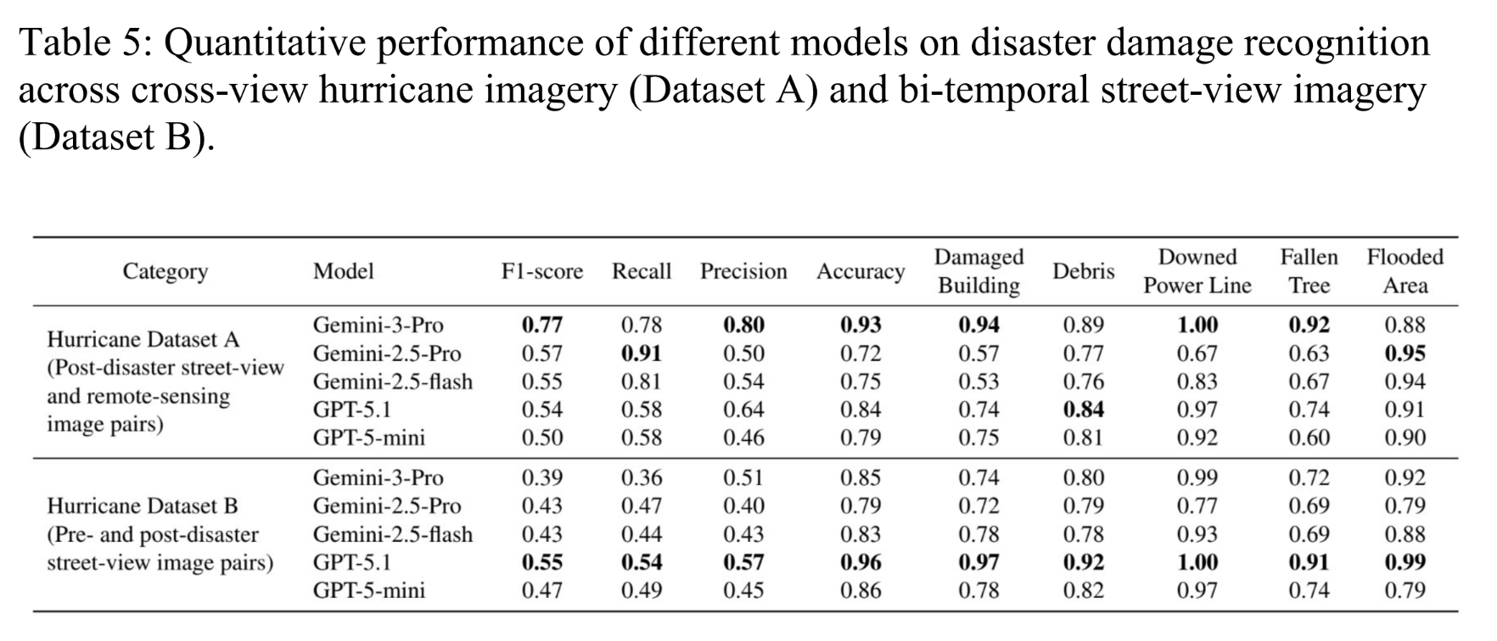
Components of the Multi-Agent Framework: Damage Recognition Agent

Slide 16
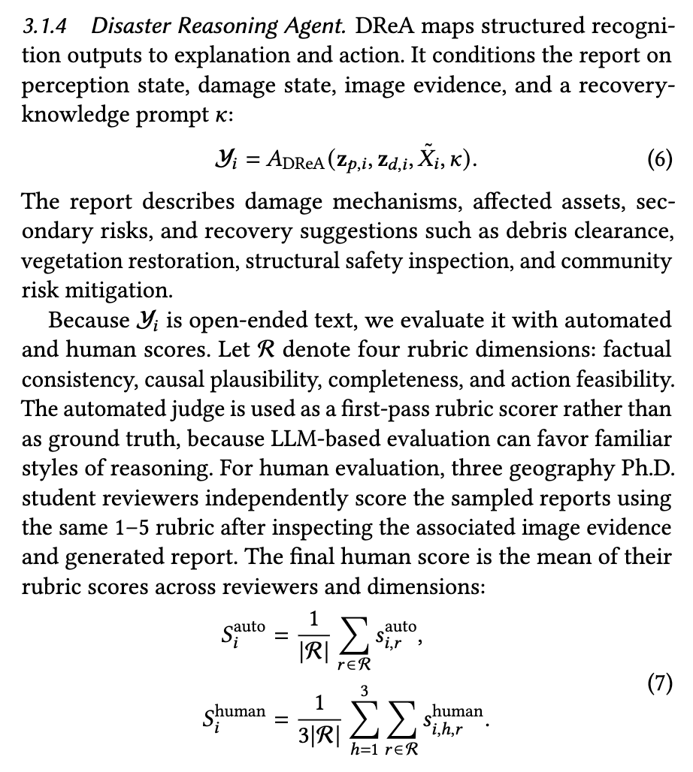

Components of the Multi-Agent Framework: Disaster Reasoning Agent

Slide 17
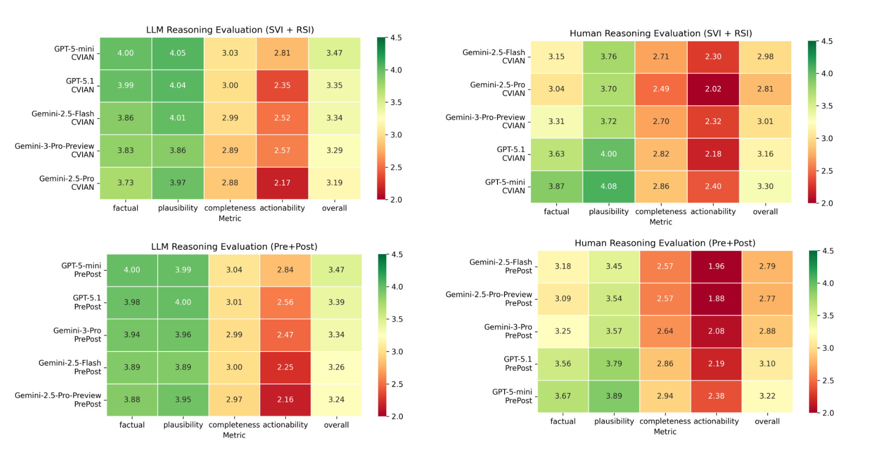
Components of the Multi-Agent Framework: Disaster Reasoning Agent

Slide 18
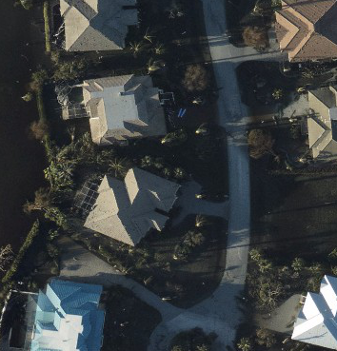
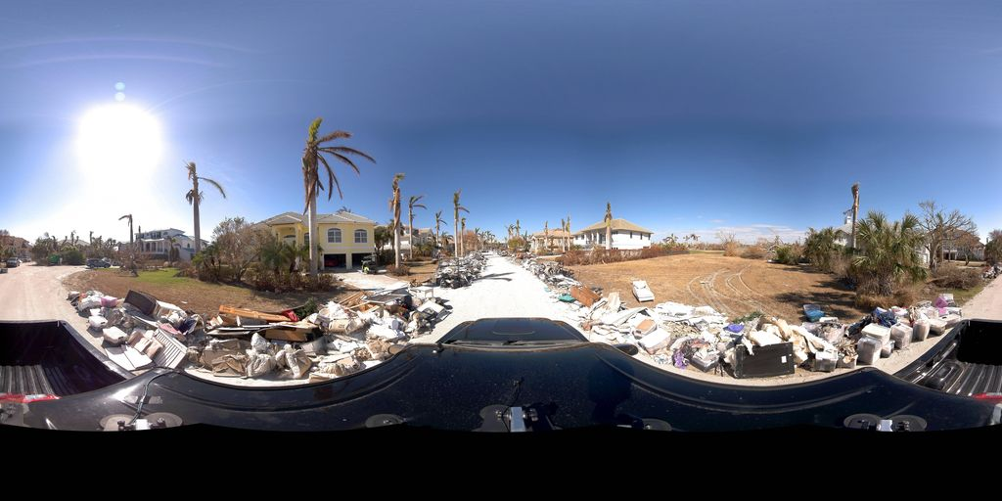
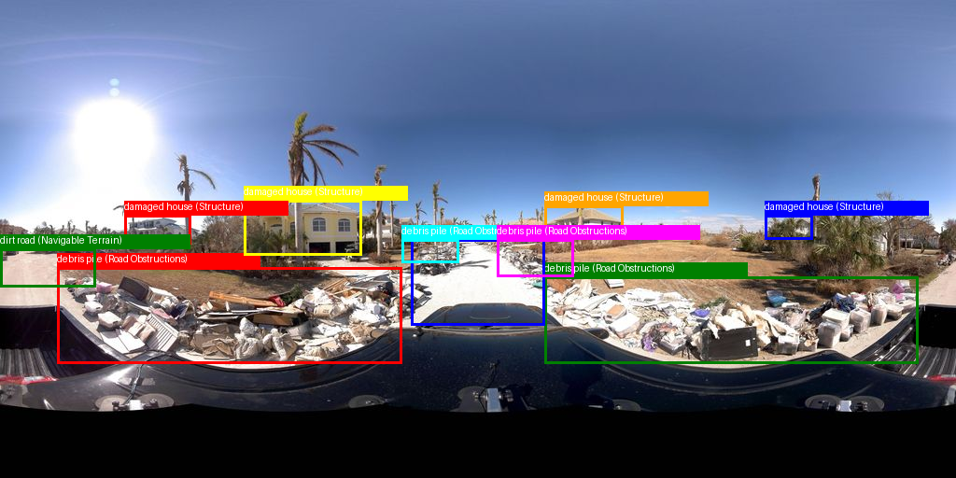
Final output from the disaster-reasoning agent
Input Images | Model Responses | Gemini-3-Pro | Gemini-2.5-Pro | ChatGPT-5.1
 | Type of disaster | hurricane | hurricane | hurricane
 | Image restoration | No | No | No
 | Disaster severity classification | Severe | Severe | severe
 | Voted candidate | SVI and RSI | SVI and RSI | SVI and RSI
 | Confidence | 0.85 | 0.95 | 0.96
 | Object recognition | Debris, Fallen Tree | Debris, Fallen Tree, Damaged Building | Debris, Fallen Tree, Damaged Building
Using Gemini-3-Pro for object recognition | The Street View Image reveals massive piles of debris (furniture, appliances, drywall) lining the road, indicating that the adjacent homes were gutted by storm surge, which constitutes 'significant building debris' and major economic destruction. While the roads are not currently 'fully flooded' (they are covered in surge sand) and trees are mostly standing (though stripped), the sheer volume of property loss and the saturated ground visible in the Remote Sensing image align the overall impact with the 'Severe' classification. Reasoning for Gemini-3-Pro-Disaster Assessment
 | Recovery efforts must prioritize the rapid removal of the substantial debris (furniture, appliances, drywall) currently lining the streets to fully restore logistical access. Given that homes were 'gutted' by storm surge, reconstruction requires rigorous structural inspections and professional mold remediation before habitation is permitted. Infrastructure teams should focus on clearing surge sand from roadways and assessing subsurface utility stability due to the 'saturated ground.' Long-term planning should enforce elevated construction standards to mitigate future surge risks. Reasoning for Gemini-3-Pro-Disaster Recovery / Reconstruction Suggestion

Slide 19
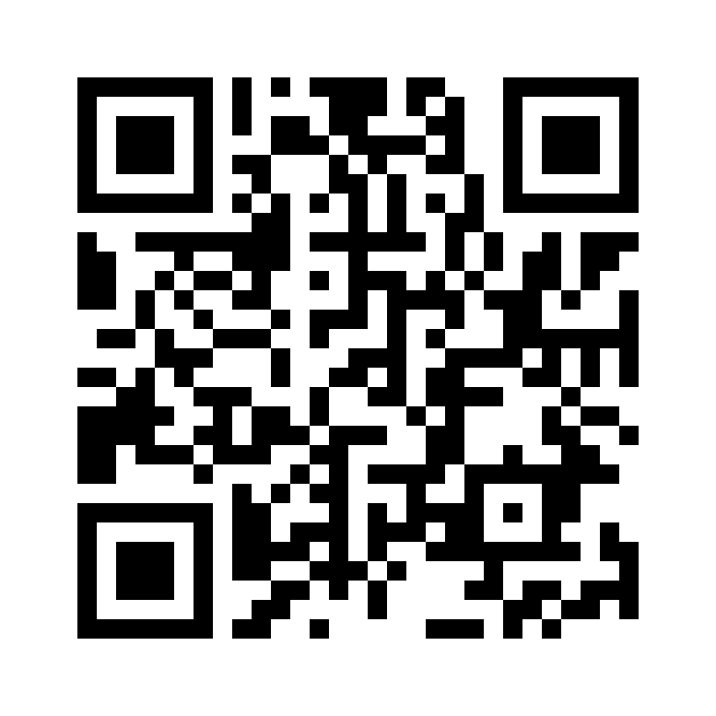

Takeaways
- A zero-shot multi-agent pipeline capable of transforming satellite and street-view imagery into traceable attribute information ready for mapping, while also providing corresponding textual descriptions for each location.
- Severity and confidence are not yet map-grade: severity accuracy stays at 0.38–0.63, self-reported confidences are uncalibrated, and LLM judges rate reports higher than human reviewers do.
- Disaster mapping with agents should be interactive, not one-shot. The agent proposes, explains, and revises; the cartographer questions, corrects, and decides what reaches the map.
Yifan Yang, Wenjing Gong, Kaili Zhang, Lei Zou, Zhengzhong Tu, Hao Li, Zongrong Li, and Xinyue Ye. 2026. RAPID: A Reproducible Multi-Agent Pipeline for Interpretable Disaster Damage Assessment from Satellite and Street-View Imagery. In The 34th ACM International Conference on Advances in Geographic Information Systems (SIGSPATIAL ’26), November 03–06, 2026, Riverside, CA, USA. ACM, New York, NY, USA, 12 pages. https://doi.org/10.1145/3841645.3843346

Slide 20
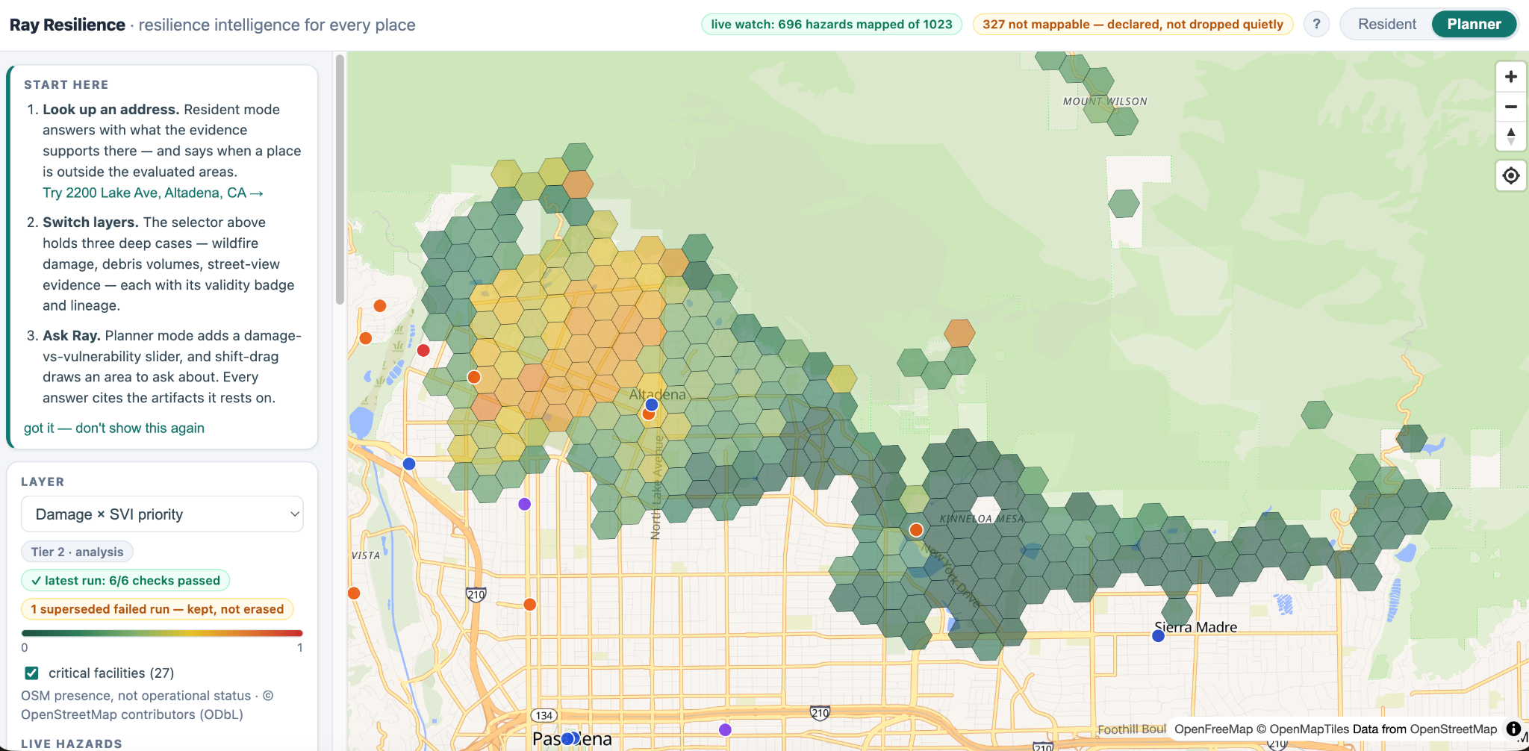
Future Directions

Slide 21
Q&A
Welcome any comments/questions
yyang295@tamu.edu

