Slide 1
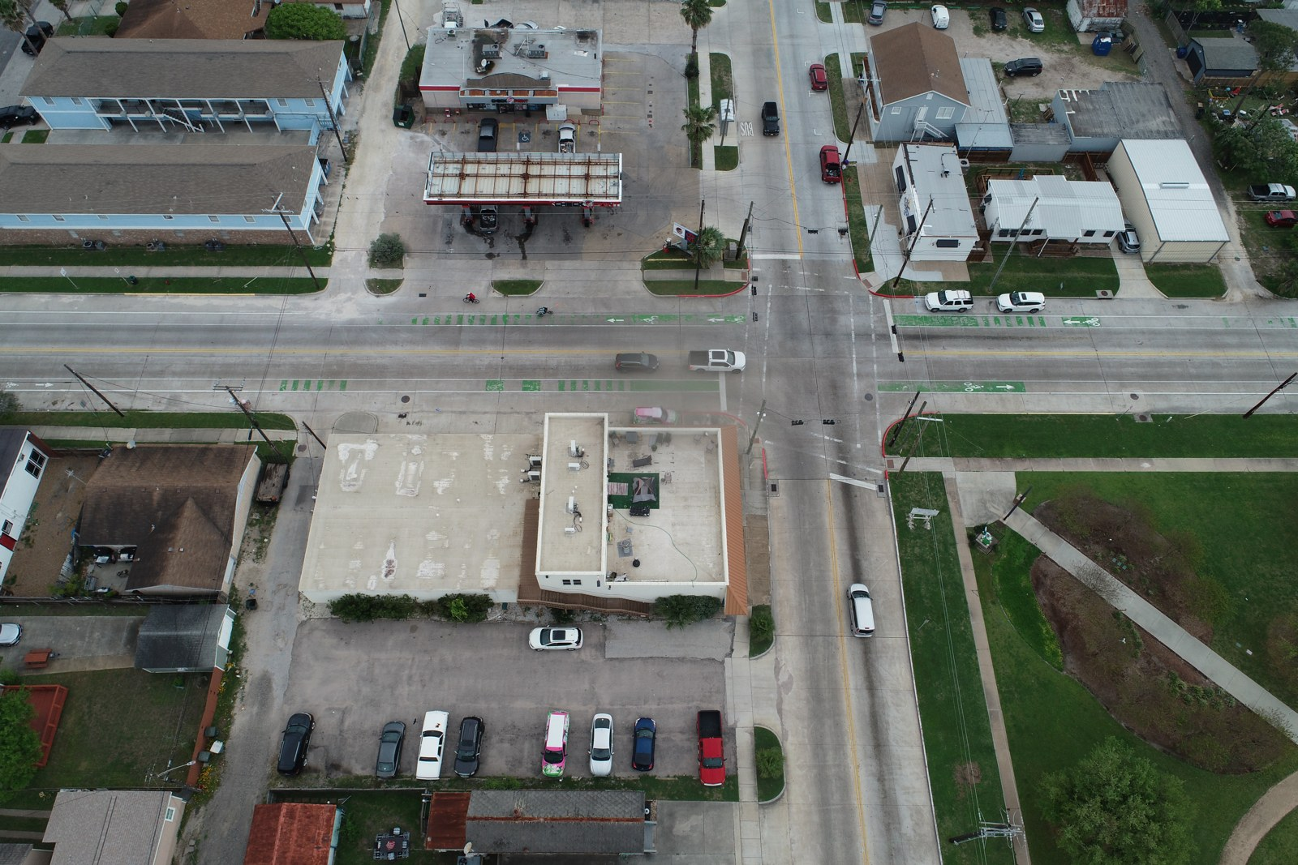
SC26 CDC
DeltaAI GH200
Compression Experiment Response Is Complete
CDC conditional-diffusion lossy compression and reconstruction of high-resolution drone imagery on DeltaAI. All June 2 workflows — compression, reconstruction, the tradeoff matrix, detection, and SAM — are done.
Compression
GPU peak
Workflows
79.98×
≈1.6 GB
6 / 6
balanced · 256 tile
from ~52 GB full-image
complete (2 as pilots)
Prepared by Yifan Yang · Updated June 7, 2026 · rayford295/sc26-cdc-deltaai @ d87a8a9
Galveston, TX — 100 RGB drone images, ≈5472×3648 px, ≈8.34 MB each, ~47 m altitude.

Slide 2
The Systems Question Behind the Poster
Can a CDC compression and reconstruction workflow cut HPC storage and transfer pressure while preserving enough quality for inspection and downstream computer vision?
Data
Baseline
100 images
fp32 · 65 steps
≈5472×3648 px · ≈8.34 MB · ~47 m
native full-res · batch size 1
Platform
Metrics
GH200
11 families
DeltaAI main · H200 compare
time · GPU · BPP · PSNR/SSIM/LPIPS · CV
Controlled settings: checkpoint, tile size, tile batch, denoising steps, precision, resolution, and storage placement.
Representative drone survey scene: vehicles, roads, and buildings drive the downstream-CV tests.
Source: poster storyline and run setup in README + experiment-response document.
SC26 CDC · DeltaAI experiment response · June 7, 2026

Slide 3
Every Requested Workflow Is Complete
Implementation and the main DeltaAI runs are done; the only open items are quality upgrades before paper-grade detection claims.
Item | Question | Status | Evidence
Experiment 1 | Compression optimization | Complete | Checkpoint-controlled settings selected; b00064 balanced, b00128 stress test.
Experiment 2 | Reconstruction optimization | Complete | 256 and 512 tiling validated; 256 fastest/lowest memory, 512 quality backup.
Experiment 3 | Compression × tile-size tradeoff | Complete | N50 LPIPS matrix finished all 9 rows on GH200 (Slurm 2422336).
Experiment 4 | Object-detection impact | Complete (pilot) | N50 COCO YOLOv8x vehicle workflow finished (2426722); labels are draft.
Add-on | SAM zero-shot mask stability | Complete (pilot) | SAM ViT-H on 50 images, 829 prompts (2426827); 0 failed prompts.
Add-on | GH200 vs H200 comparison | Complete | H200 runs the workflow and is ~3.6% faster at matched step counts.
Source: experiment-response completion table; Slurm job IDs as cited.
SC26 CDC · DeltaAI experiment response · June 7, 2026

Slide 4
Recommended Setting: Balanced b00064 + 256 Tile
Best speed and memory profile in the formal N50 tradeoff run, with a quality-safe backup and a stress-test ceiling.
Primary (deploy)
Quality-safe backup
Stress test only
b00064 · 256
b00064 · 512
b00128 · 256
79.34 s/img · 1.57 GB · 79.98×
86.0 s/img · 2.90 GB · 78.48×
139.89× · PSNR 30.89
Why 256 tiling wins operationally
Peak GPU memory: ~52 GB → ~1.6 GB.
256 tiling makes full-resolution reconstruction practical on shared GPUs.
Quality at 256: PSNR 33.14 · SSIM 0.877 · LPIPS 0.00183.
Only marginally below 512; 512 is slightly better on PSNR/SSIM/LPIPS and seams.
Runtime: ~143 s → ~79 s per image.
Fastest and lowest-memory setting in the N50 matrix.
b00128 saves the most storage (139.9×).
But shows the largest quality and detection drop — keep as a ceiling only.
Source: results/2026-06-05-tradeoff-n50-lpips/ (combined_summary).
SC26 CDC · DeltaAI experiment response · June 7, 2026

Slide 5
Experiment 1 — Compression Is Controlled by Checkpoint
The x-parameterization CDC path has no continuous runtime ratio knob; compression is set by checkpoint and reported via measured BPP and ratio.
Role | Ckpt | Sec/img | GPU GB | BPP | Ratio | PSNR | SSIM
High quality | b00512 | 143.73 | 50.8 | 0.7345 | 32.67× | 34.84 | 0.9423
Balanced | b00064 | 143.66 | 50.7 | 0.2578 | 93.11× | 33.73 | 0.8803
High compression | b00128 | 143.70 | 50.7 | 0.1448 | 165.73× | 31.52 | 0.8281
Baseline | b02048 | 143.70 | 50.8 | 0.3371 | 71.20× | 29.45 | 0.8727
Main candidate
b00064
93.11× · PSNR 33.73
Ratio ceiling
165.7×
b00128 stress test
Fidelity ref.
N=20 checkpoint sweep (full-image). These settings feed the formal N50 tradeoff run.
34.84 dB
b00512 high quality
Source: results/2026-05-22-jacob-compression-n20/.
SC26 CDC · DeltaAI experiment response · June 7, 2026

Slide 6
Experiments 2 & 3 — Reconstruction × Tile-Size Tradeoff
Formal N50 run (LPIPS on) across checkpoint roles and tile sizes. Rows most relevant to the recommendation and downstream tests.
Configuration | Setting | Sec/img | GPU GB | Ratio | Storage saved | PSNR | SSIM | LPIPS
High quality 512 | b00512 + 512 | 88.51 | 2.96 | 29.73× | 96.64% | 34.19 | 0.9376 | 0.002591
Balanced 256 ◀ recommended | b00064 + 256 | 79.34 | 1.57 | 79.98× | 98.75% | 33.14 | 0.8768 | 0.001826
Balanced 512 (backup) | b00064 + 512 | 86.00 | 2.90 | 78.48× | 98.73% | 33.23 | 0.8782 | 0.001792
Max compression 256 | b00128 + 256 | 78.91 | 1.57 | 139.89× | 99.29% | 30.89 | 0.8193 | 0.005676
System readout: 256 tiling cuts peak GPU memory from ~52 GB (full-image) to ~1.6 GB and runtime from ~143 s to ~79 s per image. 512 is slower and heavier, but slightly safer on image-quality metrics.
Source: results/2026-06-05-tradeoff-n50-lpips/. Storage saved vs native full-resolution.
SC26 CDC · DeltaAI experiment response · June 7, 2026

Slide 7
Why 256 — Early Tile-Size Screening (512 / 1024 / 2048)
Before the N50 matrix, a baseline_b02048 pilot on 8 full-resolution images explained why larger tiles were dropped.
Tile | Time/img | GPU memory | PSNR | SSIM | Conclusion
No tiling | 143.55 s | 52.0 GB | 29.88 | 0.8847 | Reference; too slow & memory-heavy
512 × 512 | 86.01 s | 3.0 GB | 29.73 | 0.8822 | Best speed/memory at that stage
1024 × 1024 | 88.35 s | 11.2 GB | 29.82 | 0.8835 | Slightly better quality, far more memory
2048 × 2048 | 95.39 s | 43.8 GB | 29.90 | 0.8841 | Near no-tiling; loses tiling benefit
Takeaway
512 was best at the screening stage. Larger tiles kept quality marginally closer to no-tiling but cost far more memory. Once 256 was added it beat 512 on speed and memory, so the formal matrix focused on 256 and 512.
Source: baseline_b02048 tile-size pilot (8 full-resolution images).
SC26 CDC · DeltaAI experiment response · June 7, 2026

Slide 8
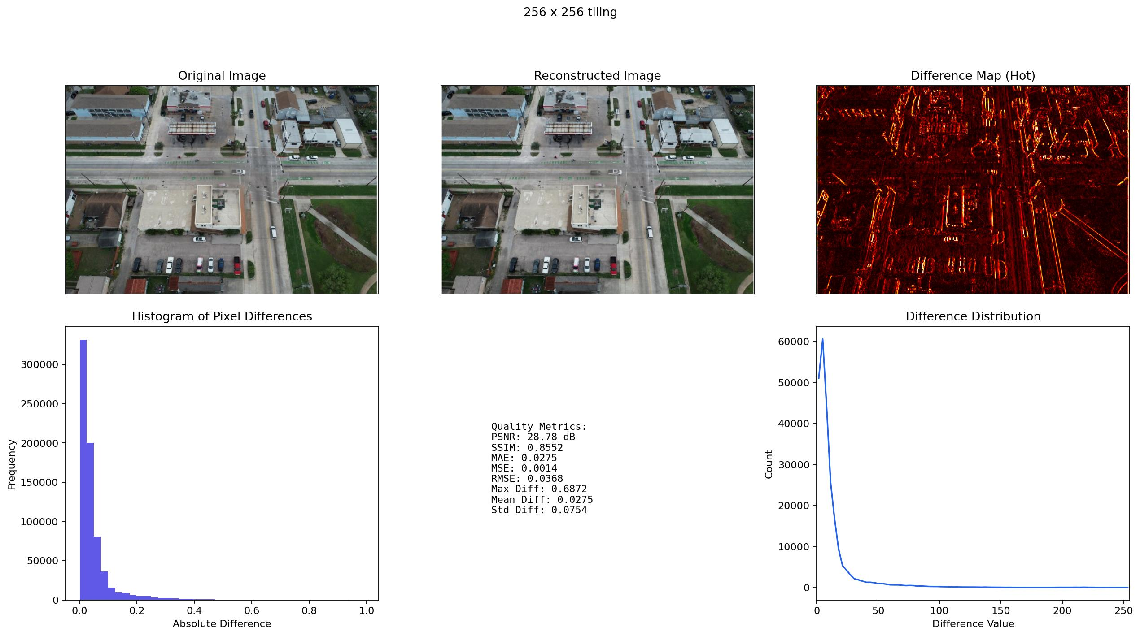
Reconstruction Quality Is Visually Inspectable
Difference maps put small reconstruction errors next to scalar metrics — the poster's quality-evidence visual for the 256 setting.
PSNR
28.78 dB
256 tile, this scene
SSIM
0.8552
structural similarity
Mean diff
0.0275
max diff 0.687
Errors concentrate on edges.
Hot map highlights roof lines, road markings, and vehicles.
Source: results/2026-05-22-yifan-poster-visual-qa/ (256 tiling poster panel).
SC26 CDC · DeltaAI experiment response · June 7, 2026

Slide 9
Experiment 4 — Object-Detection Impact (Pilot)
Fixed COCO YOLOv8x detector; COCO car/bus/truck → one pilot vehicle class; compared on 50 draft-labeled images (829 boxes).
Configuration | mAP@.5 | mAP@.5:.95 | Precision | Recall | F1 | Pred
Original | 0.6902 | 0.5711 | 0.0635 | 0.8432 | 0.1182 | 11002
High quality 512 | 0.6329 | 0.2706 | 0.0625 | 0.8094 | 0.1160 | 10742
Balanced 256 | 0.6280 | 0.2712 | 0.0601 | 0.8070 | 0.1118 | 11137
Balanced 512 | 0.6225 | 0.2703 | 0.0592 | 0.8070 | 0.1102 | 11310
Max compression 256 | 0.5889 | 0.2603 | 0.0568 | 0.7720 | 0.1059 | 11260
Balanced stays close to original.
mAP@.5 0.690 → 0.628; max-compression drops to 0.589.
Low precision is intentional.
conf=0.001 keeps many low-confidence boxes for AP/recall.
Pilot, not a benchmark.
Draft labels → sensitivity evidence; review labels before paper claims.
Source: results/2026-06-06-detection-coco-vehicle-n50/. Labels are draft.
SC26 CDC · DeltaAI experiment response · June 7, 2026

Slide 10
Add-On — SAM Zero-Shot Mask Stability (Pilot)
Promptable SAM ViT-H masks from reconstructed vs original images, same box prompts — a class-agnostic boundary-stability check.
Configuration | Mask IoU | Dice | Area ratio | Centroid shift | Failed
Original | 1.0000 | 1.0000 | 1.0000 | 0.00 px | 0%
Balanced 256 | 0.7056 | 0.8110 | 1.0193 | 16.76 px | 0%
Balanced 512 | 0.7061 | 0.8116 | 1.0133 | 16.81 px | 0%
Max compression 256 | 0.7048 | 0.8107 | 1.0229 | 16.67 px | 0%
Prompts
829 / 829
all returned usable masks
Failed rate
0.0%
every configuration
Balanced 512 slightly best.
On IoU, Dice, and area stability; 256 nearly tied → stays the pick.
Source: results/2026-06-06-sam-mask-impact-n50/ (50 images, 829 prompts).
SC26 CDC · DeltaAI experiment response · June 7, 2026

Slide 11
Hardware Check and Evidence Package
H200 runs the same workflow and is modestly faster; all results are committed as GitHub-safe summaries.
GH200 vs H200 (fp32, matched steps)
Evidence package (committed)
Steps | GH200 s/img | H200 s/img | Speedup
5 | 11.27 | 10.87 | 3.6%
20 | 44.37 | 42.74 | 3.7%
65 | 143.67 | 138.48 | 3.6%
Evidence | Repository folder
Compression × tile matrix | results/2026-06-05-tradeoff-n50-lpips/
Detection impact, N50 | results/2026-06-06-detection-coco-vehicle-n50/
SAM mask stability, N50 | results/2026-06-06-sam-mask-impact-n50/
Experiment code | experiments/compression/
Modest gain — base experiment selection on checkpoint and tile behavior before broad H200 reruns.
Publication boundary: GitHub stores lightweight tables, summaries, manifests, and docs. Full-resolution images, logs, weights, and raw outputs stay on /projects/bfod/$USER/cdc-deltaai/.
Source: results/2026-04-28-h200-reconstruction/ and committed evidence folders.
SC26 CDC · DeltaAI experiment response · June 7, 2026

Slide 12
Final answer
All Requested Workflows Are Done
Recommended setting: balanced_checkpoint_b00064 with 256 × 256 tiling, and b00064 + 512 × 512 as the quality-safe backup when fidelity is prioritized.
Deploy
Backup
Ceiling
b00064 · 256
b00064 · 512
b00128 · 256
79.98× · 1.6 GB · 79 s
quality-safe
stress test only
Remaining non-blocking quality steps
Review and correct the N50 draft labels. First gate before stronger detection claims.
Rerun Experiment 4 with a project-specific detector. When one becomes available.
Expand the reviewed label set if time allows. Improves benchmark credibility.
Then promote pilots to paper-grade benchmarks. Detection + SAM are workflow-complete today.
rayford295/sc26-cdc-deltaai @ d87a8a9 · Prepared by Yifan Yang · June 7, 2026

