Slide 1
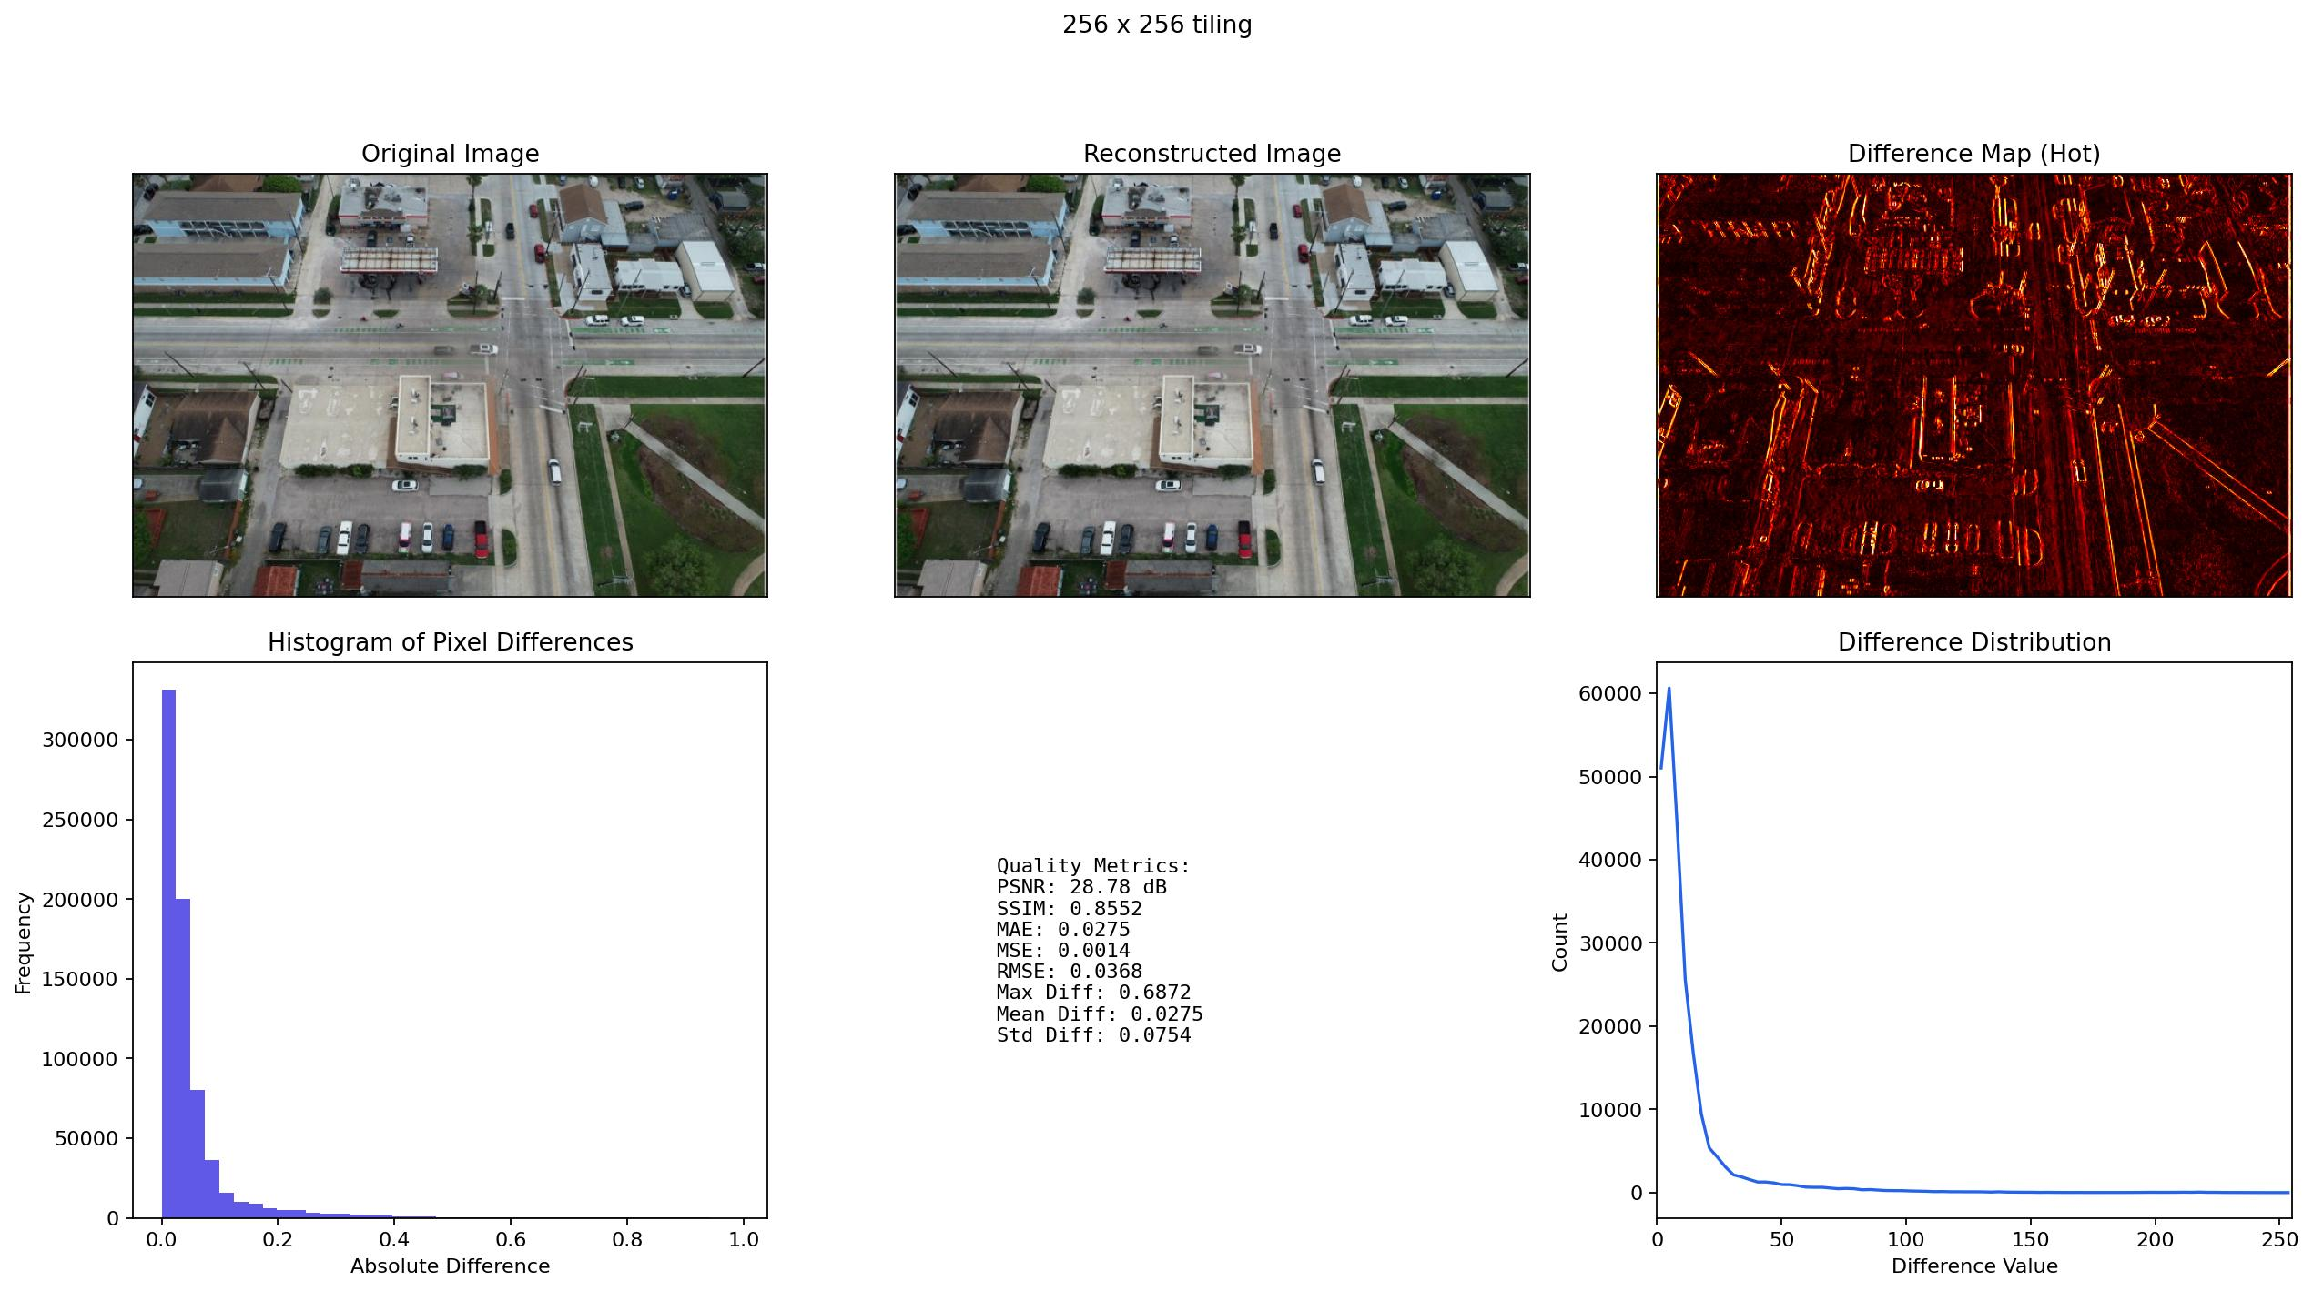
SC26 CDC
DeltaAI results
Compression Results Are Ready for the Poster Story
Three linked deliverables now support the update: 256 tiling, Jacob's compression-side experiment, and poster-ready difference-map panels.
Tiling
Compression
Poster
256 wins
N=20
3 panels
79.84s and 1.66 GB
checkpoint sweep complete
difference maps ready
Poster visual QA: original, reconstructed, hot difference map, histogram, metrics, and distribution.

Slide 2
Three Pieces Are Complete
The update can now move from experiment setup to poster assembly.
1
2
3
Yifan tiling
Jacob compression
Poster visuals
Selected `256 x 256` against no tiling and `512 x 512` on 50 full-resolution images.
Baseline, resolution, batch, checkpoint, scaling, and storage tests on 20 images.
Difference-map panels now match the visual format requested in chat.
Result
Result
Result
256 x 256
N=20
3 panels
speed and memory candidate
table is on GitHub
no tiling / 256 / 512
Source: committed result folders under results/2026-05-15, results/2026-05-22.
SC26 CDC update | May 22, 2026

Slide 3
256 x 256 Is the New Speed and Memory Candidate
The larger N=50 selected run confirms smaller tiles cut memory below 2 GB and improve wall time compared with 512 tiles.
Selected N=50 Tiling Results
Decision Point
Setup
Time
Memory
Ratio
PSNR
SSIM
p99
Runtime gain
No tiling
144.35s
52.01 GB
70.11x
28.96
0.8616
0.118
256 tile
79.84s
1.66 GB
68.24x
28.78
0.8552
0.120
44.7%
512 tile
87.71s
3.02 GB
66.31x
28.86
0.8583
0.119
144.35s to 79.84s
Memory gain
31.3x
52.01 GB to 1.66 GB
Use 256 x 256 as the speed/memory recommendation.
Quality is slightly lower than 512, but the operational savings are large.
Keep 512 x 512 as the quality-safe backup.
It has slightly better PSNR, SSIM, MAE, and high-percentile error.
Source: results/2026-05-15-yifan-selected-256-512-n50/.
SC26 CDC update | May 22, 2026

Slide 4
Jacob Compression-Side Experiment Is Now a Usable Table
N=20 results cover the requested baseline, batch, resolution, checkpoint, scaling, and storage questions.
Operational Baseline
Checkpoint Roles
Native batch 1
Role
Checkpoint
Ratio
PSNR
SSIM
144.32s
High quality
b00512
32.67x
34.84
0.942
Balanced
b00064
93.11x
33.73
0.880
per full-resolution image
High compression
b00128
165.73x
31.52
0.828
Peak memory
Storage staging did not help.
52.0 GB
Shared: 143.86s/image; local: 143.89s/image.
Recommended default remains batch size 1.
native full-resolution
It is the safest setting for shared CDC workflows.
Compression
71.20x
baseline_b02048
Batching is not helpful at 2K.
Batch 1 is 7.35s/image; batch 2 and 4 are slower and use more memory.
Source: results/2026-05-22-jacob-compression-n20/.
SC26 CDC update | May 22, 2026

Slide 5

Poster Visuals Now Show the Difference Map Directly
The visual package follows the requested layout: original, reconstructed, hot difference map, histogram, metrics, and distribution.
256 x 256 tiling panel
512 x 512 tiling panel
Visual format
Cases
Next
Ready
3
Regenerate raw
matches group-chat example
no tiling, 256, 512
for print-quality panels
Source: results/2026-05-22-yifan-poster-visual-qa/.
SC26 CDC update | May 22, 2026

Slide 6
Recommended Poster Story
The message is now coherent: tiling makes reconstruction practical, checkpoint choice controls compression trade-off, and difference maps make quality inspectable.
Use in poster
Write-up angle
Main reconstruction setting: 256 x 256 tiling.
Report speed, memory, and ratio together.
Fastest selected run and lowest memory among tested cases.
Avoid making compression ratio the only success metric.
Quality-safe backup: 512 x 512 tiling.
Show difference maps next to scalar metrics.
Use if visual artifacts appear in broader raw-panel review.
This makes small reconstruction differences visible to the poster audience.
Compression setting language: checkpoint-based.
Do not overclaim storage staging.
The x-param path has no direct runtime compression-level knob.
N=20 shows no meaningful local-storage speed gain.
Poster table
Visual evidence
Remaining work
Ready
Ready
Layout
N=50 tiling + N=20 compression
3 difference-map panels
place tables and panels on poster
Source: committed GitHub result folders and runbooks.
SC26 CDC update | May 22, 2026

Slide 7
Next Step Is Poster Assembly, Not More Setup
All requested experiment lanes have a committed artifact. Further experiments should be targeted only if the poster needs one missing comparison.
1
2
3
Poster table
Poster figures
Group update
Use 256 vs 512 vs no tiling.
Place one poster panel.
Say what is done.
Pull the N=50 tiling table directly from GitHub.
Use 256 panel as primary visual evidence.
Tiling, compression, and visual QA are all committed.
Add checkpoint roles.
Regenerate from raw if needed.
Ask for poster placement feedback.
High quality, balanced, high compression.
Use `make_poster_panels.py` on DeltaAI.
The next choice is layout emphasis.
Source: GitHub main branch after commits 47f85fb and 5fd6756.
SC26 CDC update | May 22, 2026

