Slide 1
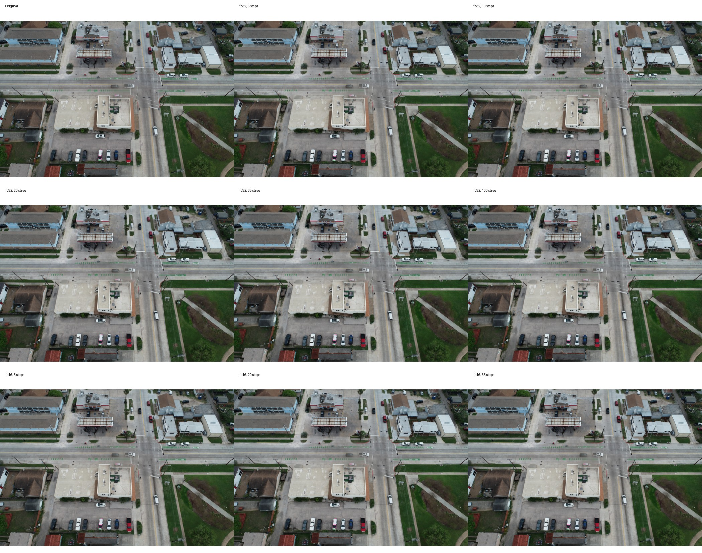
SC26 CDC
Reconstruction
CDC Reconstruction Weekly Progress
DeltaAI GH200 baseline completed; Delta H200 comparison validated.
Realistic batch
Step sweep
Compare
1
5-100
2 systems
Full-resolution reconstruction
GH200 full sweep
GH200 vs H200
Prepared for the week ending Apr 30, 2026
Visual check example: reconstructed drone imagery across denoising settings

Slide 2
Experiment Structure Is Now Set
The reconstruction task answers one question: how fast can we use the compressed data again?
1
2
3
Single-image sanity test
Realistic batch-size pilot
Repeated parameter sweeps
Run one full-resolution image first to verify model loading, inference, metrics, and output paths.
Test batch size under full-image memory pressure before longer sweeps. Current decision: batch size 1.
Repeat runs and average time, throughput, memory, PSNR, SSIM, and BPP for each setting.
Primary time metric
Throughput
Resource pressure
Quality
sec/image
img/hr
GPU memory
PSNR / SSIM
Inference time and total time
Same format for Jacob
Peak memory per config
BPP from fp32 rows
Source: SC26 experiment design notes and committed reconstruction workflow.
CDC reconstruction weekly progress | Apr 30, 2026

Slide 3
Compute Baseline Covers Both Systems
We should describe the current baseline as DeltaAI GH200, then use Delta H200 for hardware comparison.
Confirmed Access
Important hardware distinction
System
GPU
Account
Current role
DeltaAI uses GH200.
The 2026-04-26 reconstruction sweep belongs to this baseline.
DeltaAI
GH200
bfod-dtai-gh
Completed full reconstruction sweep
Delta has H200 partitions.
Delta
H200
bfod-delta-gpu
Validated quick comparison sweep
`gpuH200x8` and `gpuH200x8-interactive` were visible on Apr 28.
H100 is not confirmed.
No H100 partition appeared in the checked Delta `sinfo` output.
Delta H200 nodes
H200 GPU memory
Delta balance
Runtime check
gpue[01-08]
143.8 GB
1076 / 2037
PyTorch 2.8
Observed in `sinfo`
NVIDIA H200 node check
GPU hours on Apr 28
CUDA available on H200
Source: repository README, Delta login/resource checks, and NCSA Delta documentation.
CDC reconstruction weekly progress | Apr 30, 2026

Slide 4
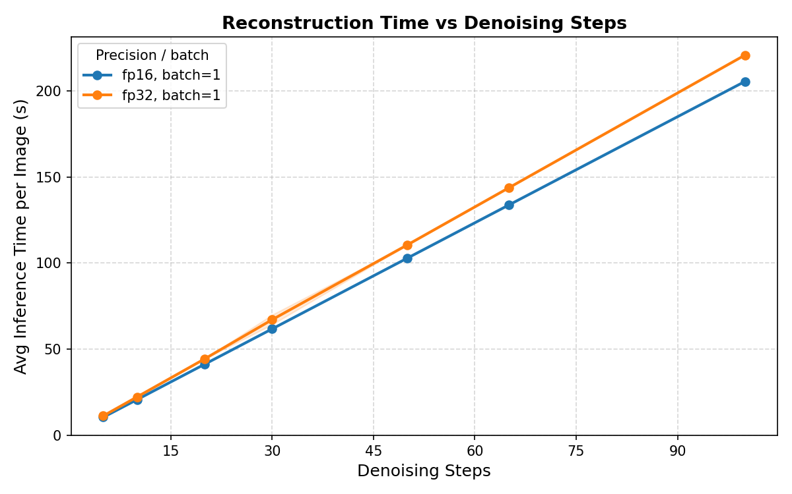
DeltaAI GH200 Baseline Is Complete
The full sweep shows diffusion inference dominates reconstruction time.
Key GH200 Findings
Batch size is fixed at 1.
Batch size 2 caused CUDA OOM for full-image reconstruction.
65-step fp32 profile takes 151.18 s/image.
Inference alone is 143.80 s/image, or 95.1% of runtime.
Reducing steps is the strongest speed lever.
5-step fp32 is 11.27 s/image; 20-step fp32 is 44.37 s/image.
fp16 cuts memory pressure.
Peak memory drops from about 52.2 GB to 34.2 GB.
Source: results/2026-04-26-reconstruction.
CDC reconstruction weekly progress | Apr 30, 2026

Slide 5
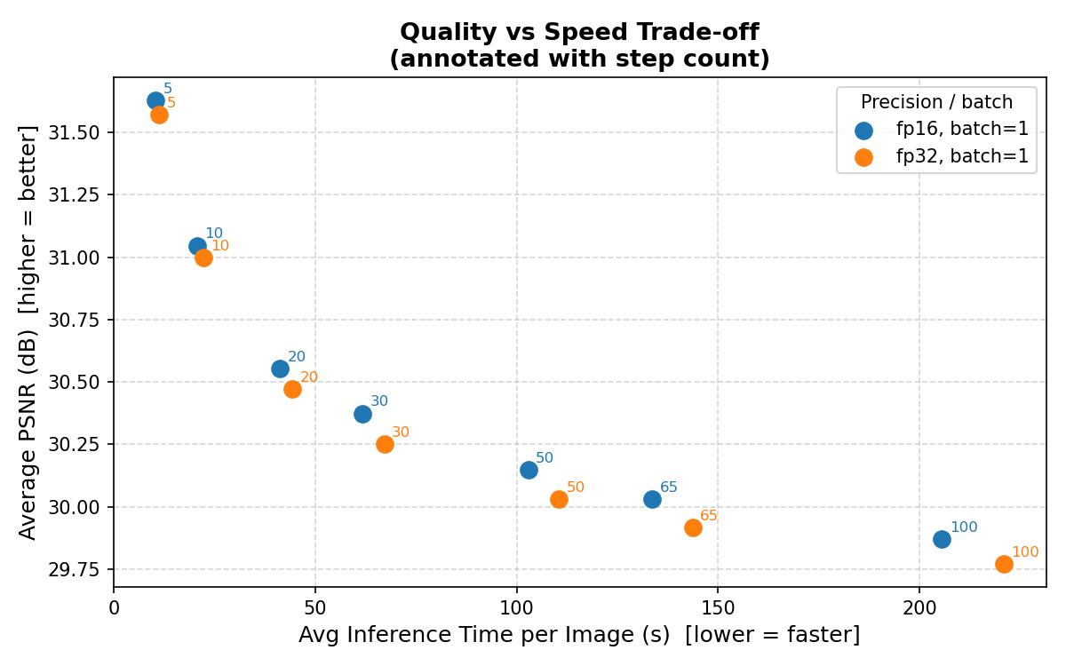
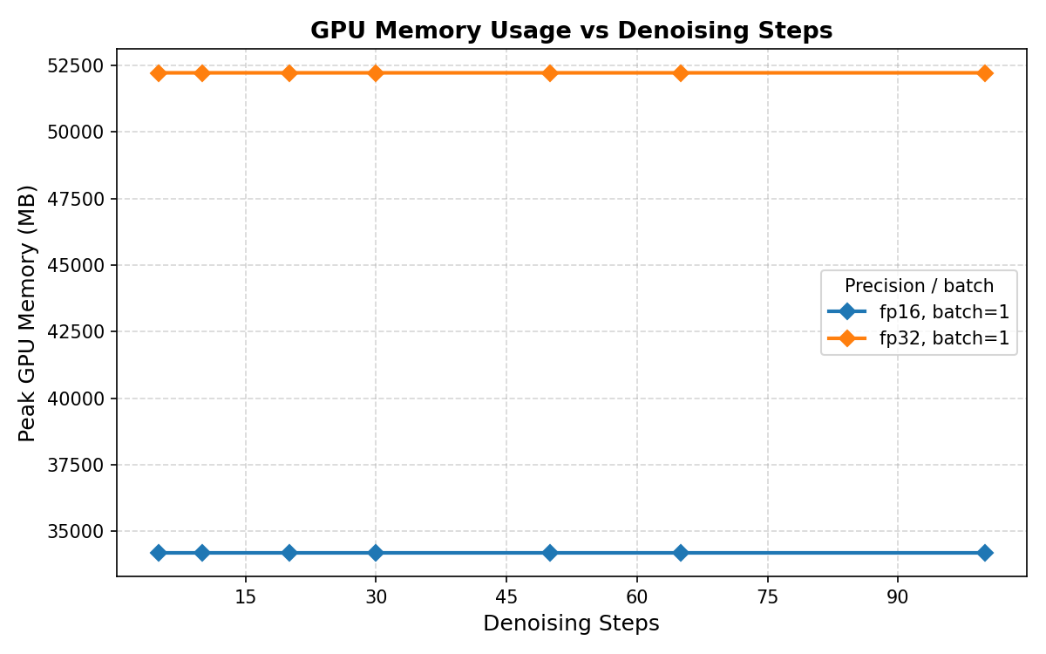
Speed Gains Come Mostly From Fewer Steps
Quality falls gradually as step count increases, while runtime grows almost linearly.
Fastest GH200 setting
Report BPP with
Memory drop with fp16
5 steps fp16
fp32
34.5%
10.47 s/image, 343.8 img/hr
fp16 BPP is invalid in current output
52.2 GB to 34.2 GB
Source: DeltaAI GH200 step sweep, batch size 1, N=15 per configuration.
CDC reconstruction weekly progress | Apr 30, 2026

Slide 6
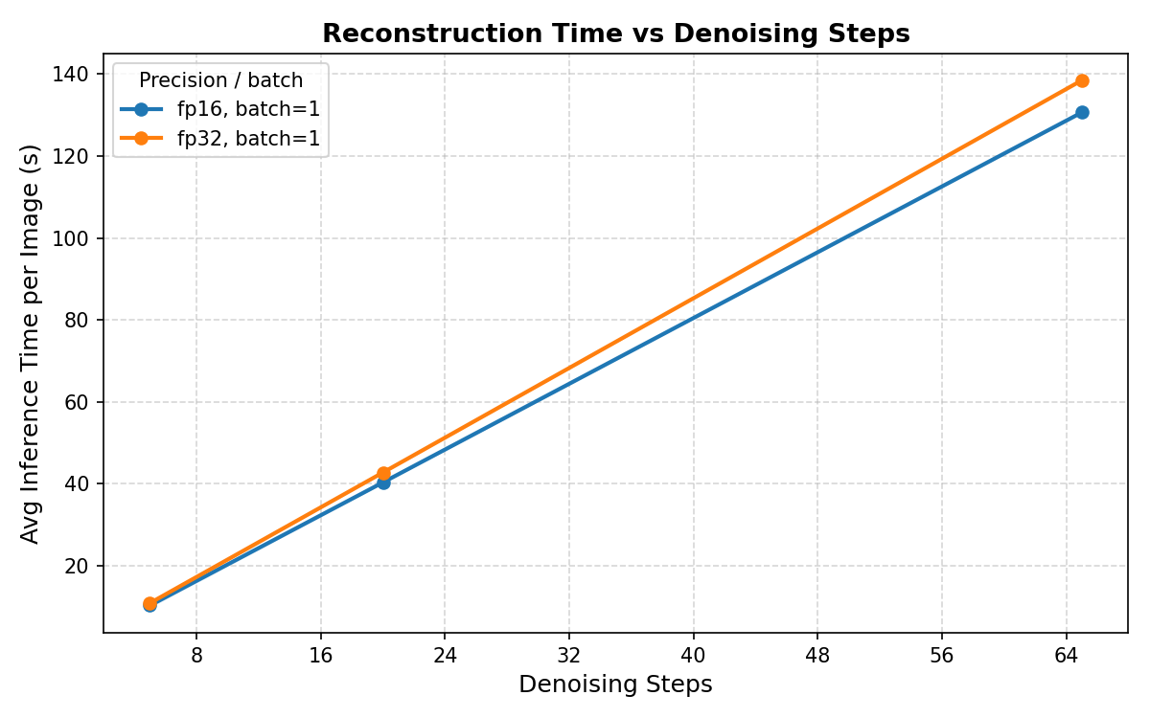
Delta H200 Is Runnable and Slightly Faster
A quick H200 sweep confirms the same workflow works on Delta and keeps batch size 1 as the best setting.
H200 Quick Results
20-step fp32: 42.74 s/image.
Throughput is 84.2 img/hr with 52.2 GB peak memory.
65-step fp32: 138.48 s/image.
Slightly faster than the GH200 65-step fp32 result.
Batch size 2 fits but slows down.
Pilot: batch 1 42.55 s/image; batch 2 53.14 s/image.
Decision remains batch size 1.
This is the realistic setting to share with Jacob for matched experiment design.
Source: results/2026-04-28-h200-reconstruction.
CDC reconstruction weekly progress | Apr 30, 2026

Slide 7
Matched GH200 vs H200 Comparison
At the shared step counts, H200 improves timing modestly; it does not change the main bottleneck story.
What Changed on H200?
Steps
GH200 fp32
H200 fp32
H200 faster
5
11.27s
10.87s
3.6%
20
44.37s
42.74s
3.7%
65
143.67s
138.48s
3.6%
Average fp32 gain
Average fp16 gain
3.6%
2.1%
H200 over GH200
H200 over GH200
Interpretation: hardware helps a little, but the number of denoising steps remains the dominant runtime lever.
Source: GH200 and H200 sweep summary CSVs; matched steps 5, 20, and 65.
CDC reconstruction weekly progress | Apr 30, 2026

Slide 8
Visual Check Supports the Fast Settings
The first GitHub-sized visual inspection did not show a clear failure at low step counts for this example.
Current Reading
5-step output passed a first visual check.
This is not a final perceptual study, but it supports testing fewer steps seriously.
Metrics stay close across practical settings.
PSNR and SSIM decline slowly as runtime increases with more steps.
Use the same figure style going forward.
This gives Jacob a matching format for compression plots.
Source: visual_examples_small/comparison_100_0005_0001.jpg.
CDC reconstruction weekly progress | Apr 30, 2026

Slide 9
This Week's Bottom Line
The reconstruction pipeline is now measured well enough to report, compare, and extend.
Completed
Next
DeltaAI GH200 full reconstruction sweep.
Run a full H200 sweep if the group wants a final hardware table.
Single-image test, batch pilot, repeated step sweep, fp32/fp16 plots, reports, and visual examples.
The quick sweep is enough for direction; a full sweep would match all GH200 step counts.
Delta H200 quick comparison sweep.
Fix or explain fp16 BPP.
H200 access, runtime, dependencies, batch pilot, and matched 5/20/65 step sweep are documented.
Use fp32 for compression-ratio reporting until the invalid fp16 BPP is resolved.
Test reconstruction optimizations.
GitHub organization by phase.
Candidate next knobs: fewer steps, tiled reconstruction, reuse loaded model, and multi-GPU inference.
Results are stored by date and hardware target for meeting traceability.
Recommended batch
Best speed lever
Comparison target
1
steps
GH200 vs H200
Full-resolution workload
5-step setting is fastest so far
H100 not confirmed
Source: committed repository results through Apr 30, 2026.
CDC reconstruction weekly progress | Apr 30, 2026

