Slide 1
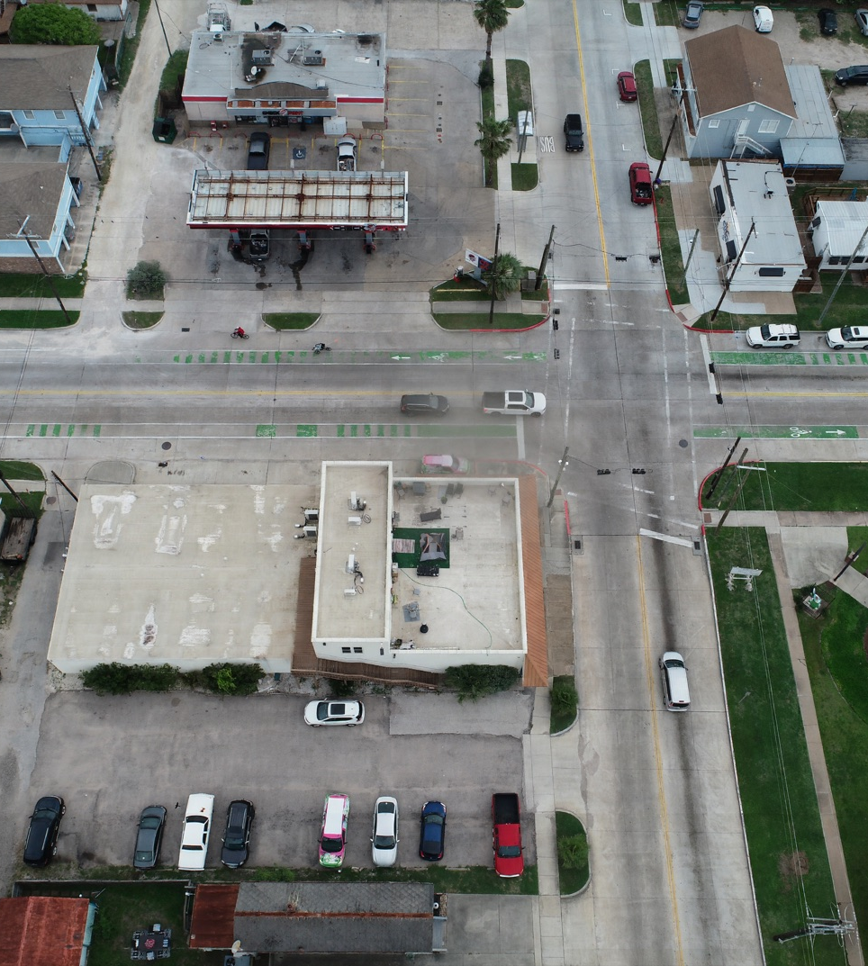
SC26 CDC
Yifan tiling
Tiling Makes Full-Resolution Compression Practical
DeltaAI GH200 pilot shows 512 x 512 tiles cut runtime and memory without obvious stitching artifacts in the checked sample.
Runtime
Memory
Artifacts
86.01s
3.0 GB
No obvious seams
per image with 512 tiles
17.2x lower than no tiling
checked visual sample
Prepared for the week ending May 12, 2026
Visual evidence: stitched 512 x 512 tiled output, image 100_0005_0001

Slide 2
This Week's Task Was Narrow and Testable
We focused only on Yifan's tiling path: split, compress independently, stitch, then check speed, memory, quality, and seams.
1
2
3
4
Split
Compress
Stitch
Measure
Full-resolution images are cropped to 5440 x 3648, then split into 512, 1024, or 2048 patches.
Each tile runs through the pretrained baseline_b02048 checkpoint with 65 denoising steps.
Tiles are assembled back into one image and saved with visual examples for inspection.
Summary records runtime, peak GPU memory, compression ratio, PSNR, SSIM, and seam metrics.
Pilot size
GPU target
Reference
Tile sizes
8 images
GH200
No tiling
512 / 1024 / 2048
after one-image smoke test
DeltaAI ghx4 partition
full-image baseline
all completed
Source: experiments/compression/slurm/03_tiling_sweep.sbatch and run stamp 20260512_yifan_tiling_pilot.
CDC tiling weekly progress | May 12, 2026

Slide 3
512 x 512 Is the Current Speed and Memory Winner
Across the eight-image pilot, smaller tiles gave the fastest runtime and the largest memory reduction.
Pilot Summary
What the Numbers Say
Setup
Time
Memory
Ratio
PSNR
SSIM
No tiling runtime
144s
No tiling
143.55s
52.0 GB
72.74x
29.88
0.8847
Full-image reference
512 tile
86.01s
3.0 GB
68.79x
29.73
0.8822
86.0s
512 tile runtime
1024 tile
88.35s
11.2 GB
66.11x
29.82
0.8835
2048 tile
95.39s
43.8 GB
66.04x
29.90
0.8841
40.1% lower wall time
No tiling memory
52.0 GB
Full-image reference
512 tile memory
3.0 GB
17.2x lower peak GPU memory
Trade-off: compression ratio decreases from 72.74x to 68.79x, while PSNR and SSIM remain close to no tiling.
Source: results/2026-05-12-yifan-tiling-pilot/tables/combined_summary.csv.
CDC tiling weekly progress | May 12, 2026

Slide 4
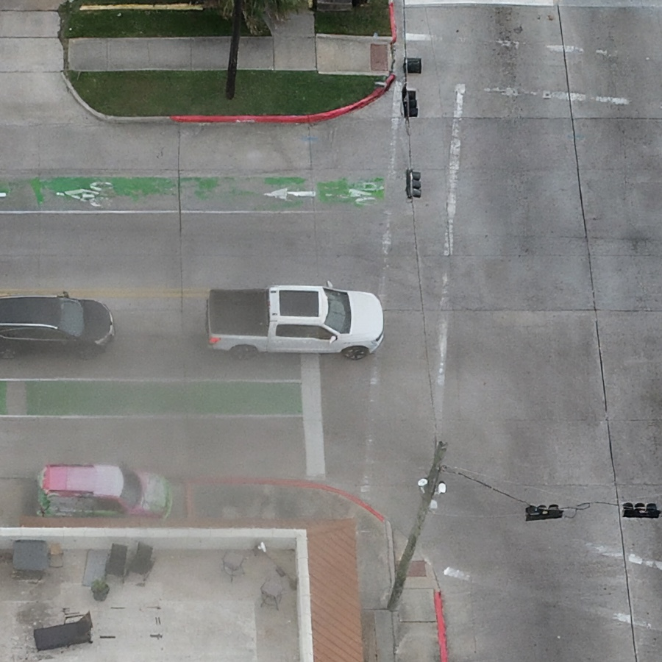
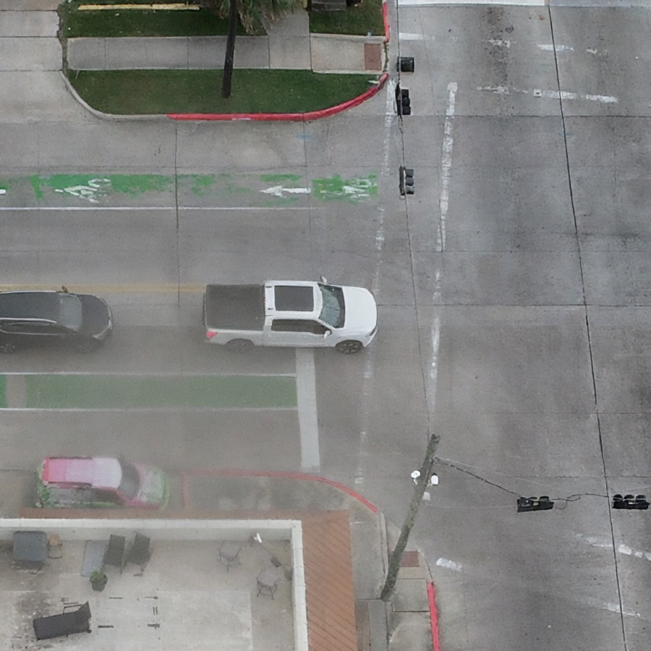
Visual Check Did Not Show New Grid-Like Seams
The seam-region crop compares the same road/intersection area across no tiling and the recommended 512-tile output.
No tiling reference
512 tile stitched output
Seam metric
Visual finding
Remaining caution
0.0278
Pass
Sample check
512-tile average
no obvious grid pattern
larger visual review still useful
Source: visual examples in results/2026-05-12-yifan-tiling-pilot/visual_examples_small/.
CDC tiling weekly progress | May 12, 2026

Slide 5
Decision: Use 512 x 512 as the Default Tiling Setup
The current evidence favors 512 x 512 for speed and memory, with 1024 x 1024 as a backup if larger visual checks reveal artifacts.
Recommended
Next
Default setup: 512 x 512 tiles.
Fastest runtime and largest memory drop in the eight-image pilot.
Run larger selected setup.
Use this result in the weekly update.
Suggested run: N_IMAGES=50, primarily 512 x 512.
86.01s/image, 3.0 GB, compression ratio 68.79x, PSNR 29.73, SSIM 0.8822.
Keep 1024 x 1024 as backup.
Mention artifact check honestly.
It is slightly slower and uses more memory, but quality metrics are close to no tiling.
Checked examples show no obvious grid-like seams; larger-sample review remains a final-poster step.
Prepare poster table.
Report time, memory, compression ratio, PSNR, SSIM, and artifact status.
Runtime reduction
Memory reduction
Current answer
40.1%
17.2x
Tiling helps
143.55s to 86.01s
52.0 GB to 3.0 GB
fast and storage-aware path
Source: committed pilot tables, visual examples, and weekly progress note.
CDC tiling weekly progress | May 12, 2026

